Slide 1

GMDSS in Polar regions
JCOMM Expert Team on Sea Ice 6th session – Expert Team on Maritime Safety Services 5th session
Helsinki, 28 February to 3 March 2017

Slide 2
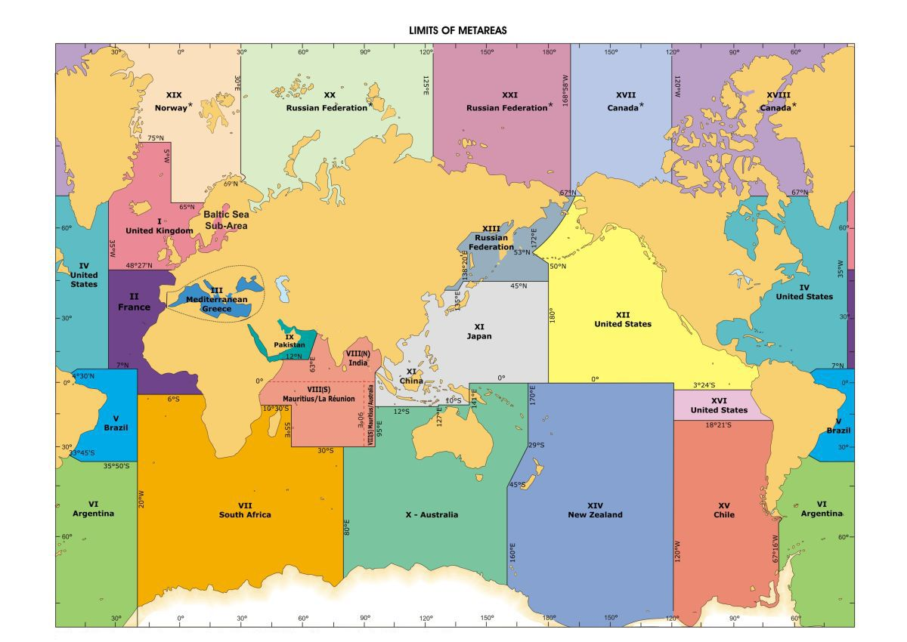
Polar (10) or METAREAs with floating ice occurrence (17) ?

Slide 3
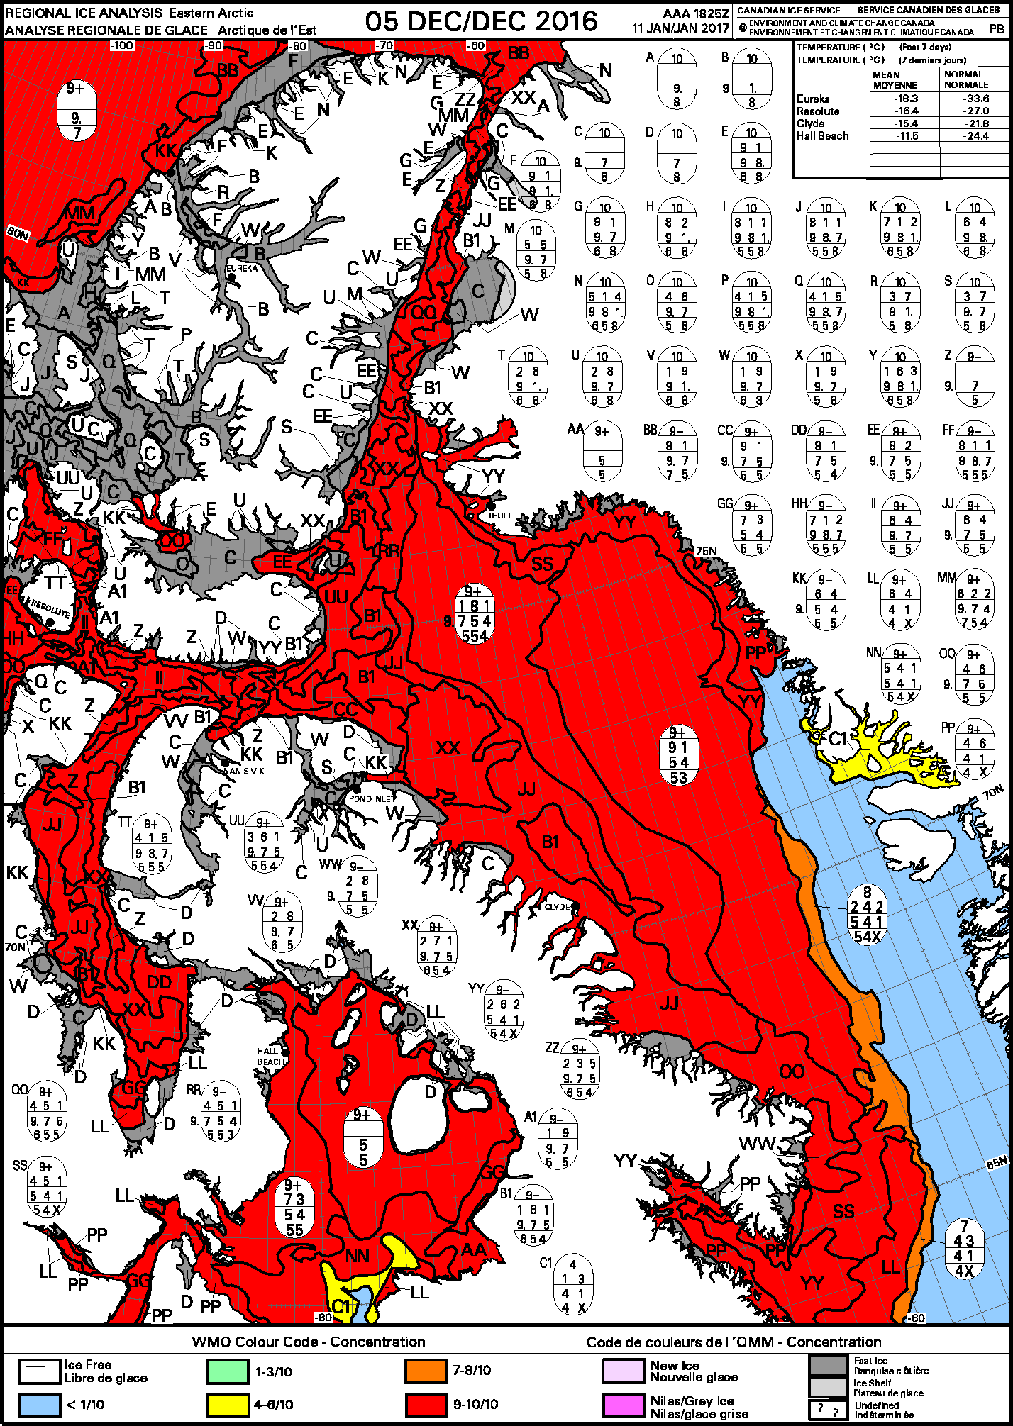
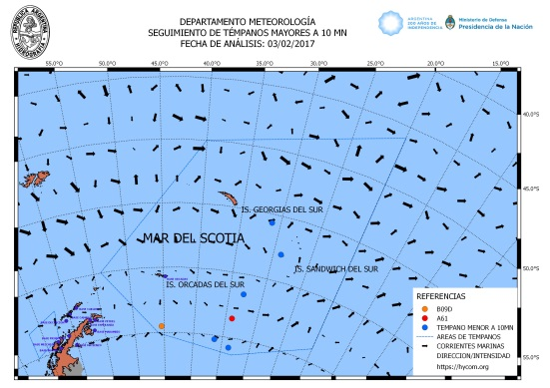
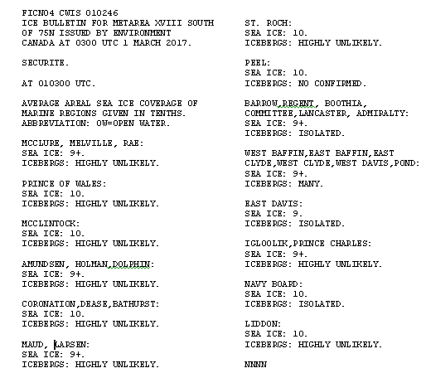
METAREAs covered by floating ice information in GMDSS bulletins
Arctic Ocean
  METAREA XVII, XVIII (Canada) - ⊕
  METAREA XIX (Norway) - ⊕
  METAREA XX, XXI (Russia) - ⊕
North Atlantic
    METAREA I Greenland Sea (Denmark, Norway) - ⊕
    METAREA I Baltic Sea (Baltic sea ice services) - ⊕
    METAREA III Black and Azov Seas (Russia)
    METAREA IV (Canada, USA) ⊕
  North Pacific
    METAREA XI (Japan, China)
    METAREA XIII (Russia)
    METAREA XII (USA) ⊕
Southern Ocean
  METAREA VI (Argentina) - ⊕
  METAREA VII, X, XIV, XV

