Slide 1

Implementing the New
JCOMM Marine Climate Data System (MCDS)
Lydia Gates, Vice-Chair Expert Team on Marine Climatology (ETMC),
Eric Freeman, Chair ETMC, Etienne Charpentier and Long Jiang, WMO Secretariat

Slide 2
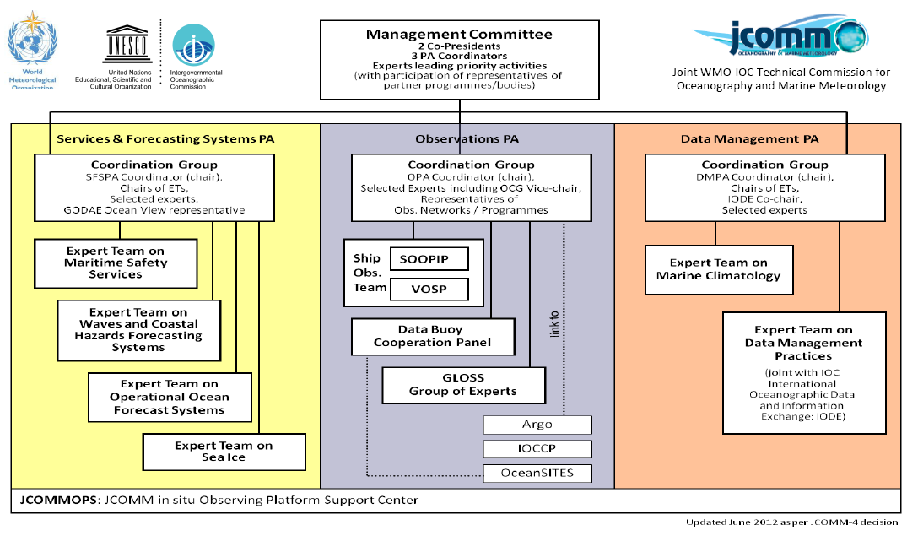
Structure of the Joint WMO-IOC Technical Commission for Oceanography and Marine Meteorology (JCOMM)

Slide 3
JCOMM Intersessional Priorities (2012-2017)
Weather and Ocean Forecasting;
Disaster and Risk Reduction (DRR);
Global Framework for Climate Services (GFCS) implementation;
WMO Integrated Global Observing System (WIGOS) and WMO Information System (WIS) implementation;
Capacity Development (CD).

Slide 4
Existing JCOMM Climate Data Management System
Non-standardised
High complexity
Not well documented
Not well understood
Not well linked

Slide 5
MCDS Vision and Goals
Standardised data management structure across JCOMM
Well documented and well defined processes (formats, standards, procedures, etc)
Reduced complexity
Improved timescales for data availability
Standardized high quality control (HQCS)
Capitalising on synergies among existing systems

Slide 6
MCDS Vision and Goals
Improved JCOMM Data Management linkages
Enhanced integration of WMO-IOC data, metadata and products
Improved availability of climate data and products (GFCS)
Interoperable with WIS and ODP
‘Internationalised’ data storage
International mirroring for improved access and security

Slide 7
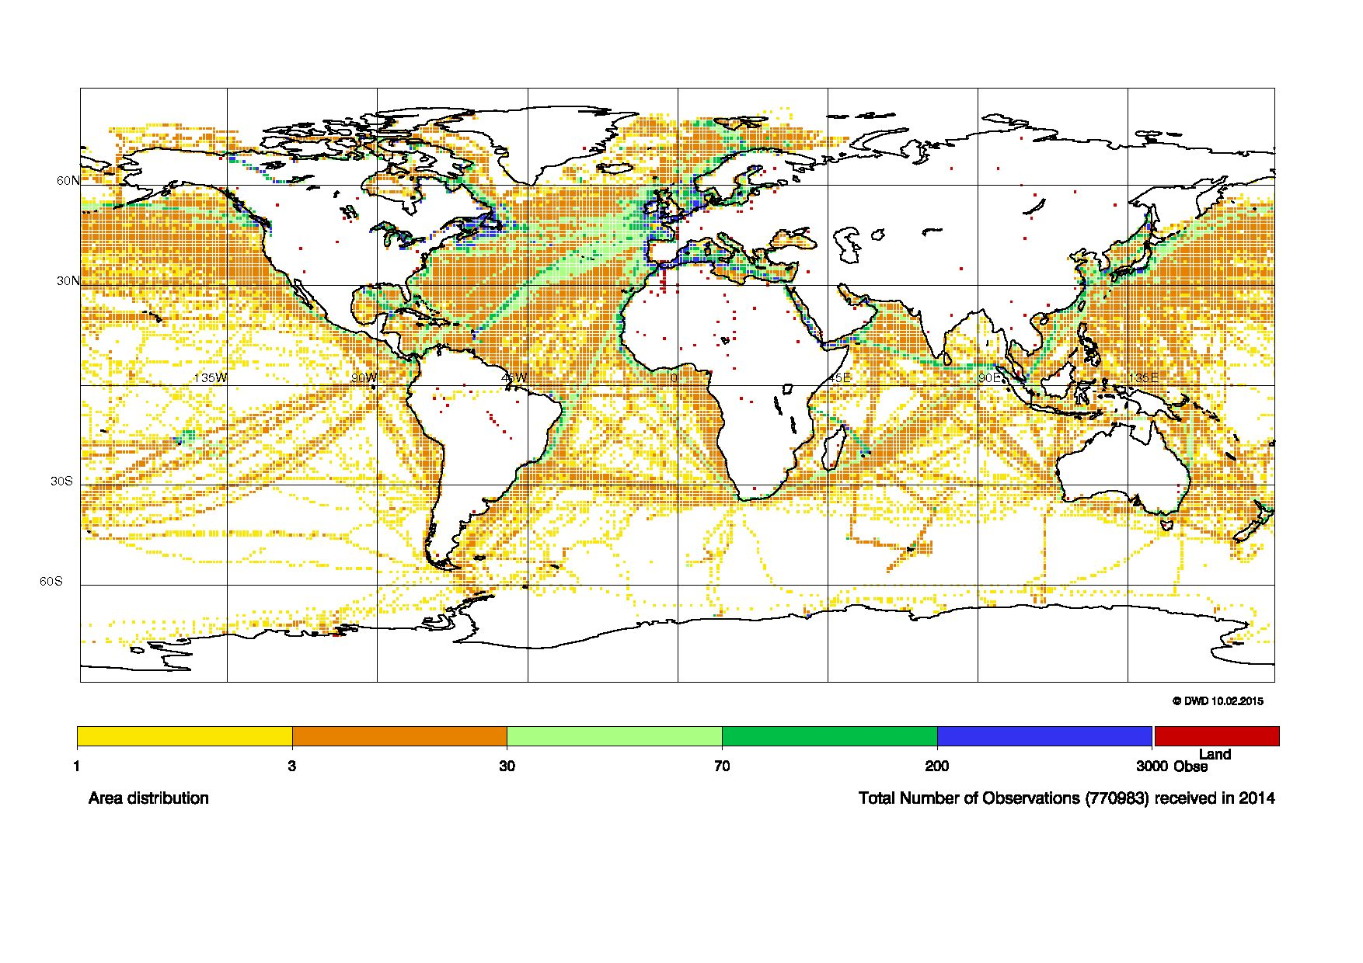
Distribution of Observations 2014

Slide 8
MCDS Data Flow
MCSS Data Flow
Data Sources
RT DM
RT-DAC(s)
DM-DAC(s)
GDAC(s)
Two GCCs
CMOC-China
CMOC a
CMOC b
CMOC c
JCOMM User Interface
Data stream
QC feedback
Notes:
Contributing member, responsible member

Slide 9
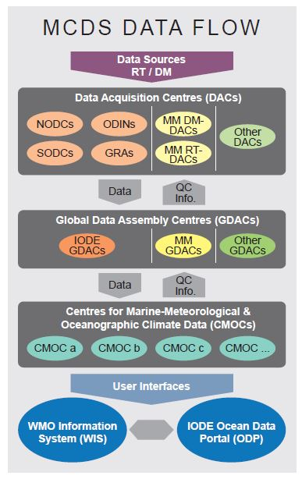

Slide 10
DACs
Data Acquisition Centres
Receive data/metadata from single platform type (e.g. buoy, ship)
Both in near real-time and delayed mode
Apply Minimum Quality Control (MQC)
Forward data to the GDACs in agreed formats

Slide 11
GDACs
Global Data Assembly Centres
Combine all data streams
Establish a unique complete dataset
Perform agreed quality checks including High Quality Control (HQC)
Forward the original and quality controlled data and metadata with flags to the CMOCs
Ensure that delayed-mode and real-time data streams are compared and linked
Feedback to DACs

Slide 12
CMOCs
WMO-IOC Centres for Marine-Meteorological and
Oceanographic Climate Data
Scope: many observational platforms
Act as a network of data centres
Collect data and metadata from GDACs and other sources
Undertake data/metadata rescue
Common formatting (e.g. netcdf), bias adj.
Make integrated climate datasets and products available to the user interface
Ensure storage of data and metadata with defined standards

Slide 13
CMOC-China
WMO-IOC Centre for Marine-Meteorological and
Oceanographic Climate Data
CMOC in Tianjin, China
was successfully evaluated against the CMOC evaluation criteria proposed by the ETMC and Data Management Coordination Group (DMCG); a resolution establishing CMOC/China was adopted by WMO and IOC
2014-2016: the integration of global drifting buoy observations and metadata, in cooperation with NOAA/AOML and GDACs, etc.
will also have a focus on historical metadata and data rescue in the Asian-Pacific region
capacity building activities

Slide 14
HQCS
High Quality Control Standard
Developed by DWD
Integrated land-sea-mask, accuracy of 0,01°
Climatology check based on background fields using the ERA-Interim-Reanalysis 1981-2010
Time-Sequence check, inconsistency check
Spatial check
Implementation of all MQC rules, capability to run as an MQC-only version
Handling of data with high temporal resolution
Documention of the code

Slide 15
Impacts
MCSS to be discontinued
Changes to role names and some tasks/responsibilities
CMs migrate to DACs
GCCs and VOSClim DAC migrate to GDACs
RMs – possible other roles within MCDS

Slide 16
Data Management Programme Area (DMPA) activities
Marine Climatological Summaries Scheme (MCSS) and development of the Marine Climate Data System (MCDS) contributing to GFCS
Congress approved the first WMO-IOC Centre for Marine Meteorological and Oceanographic Climate (CMOC) data in Tianjin, China.
CMOCs are key for integration of ocean climate data from various sources, higher level quality control, bias correction, and with regard to data rescue
Collaboration with the International Oceanographic Data and Information Exchange of the IOC of UNESCO on the Ocean Data Portal (ODP) and Ocean Data Standards and Best Practices (ODSBP)

Slide 17
Implementing the MCDS Vision
Begin implementation phase of the new JCOMM MCDS
Formalise and coordinate the activities of existing data management systems within JCOMM, and address gaps
Send invitations to candidate centres
Submit proposals for CMOC-ICOADS and CMOC-WOD
Rewrite relevant sections of WMO Publ. No. 471 and 558
Prepare adoption of the new MCDS at JCOMM-V in 2017
2020: Dedicated WMO-IOC Marine Climate Data System operational

Slide 18
Thank you!

