Slide 1


Blended sea ice climatologies based on national ice charting products for the Arctic and Antarctic – content and possible applications
Dr Vasily Smolyanitsky
Head of laboratory
Arctic and Antarctic Research Institute (AARI), St.Petersburg, Russia
Fourth International Workshop on the Advances in the Use of Historical
Marine Climate Data (MARCDAT-IV)
18 – 22 July 2016, National Oceanography Centre, Southampton, UK

Slide 2
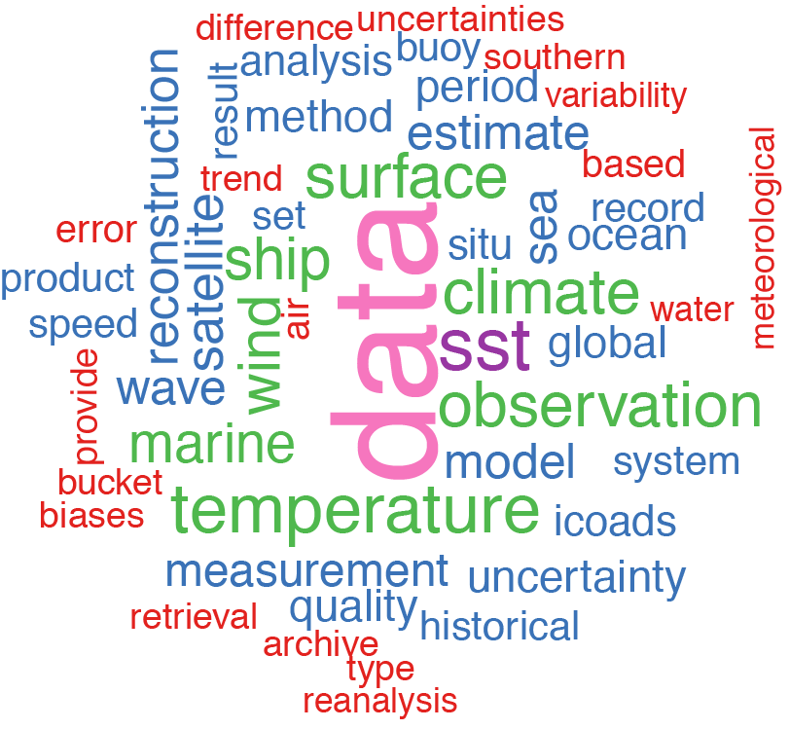
Marine climate data
Marine climate data should
Be global – include polar regions
Contain all marine meteorological parameters – include sea ice
Based on processing all historical archives – including ice charting
Contain uncertainties and scales – e.g. trends extremes for sea ice extent

Slide 3
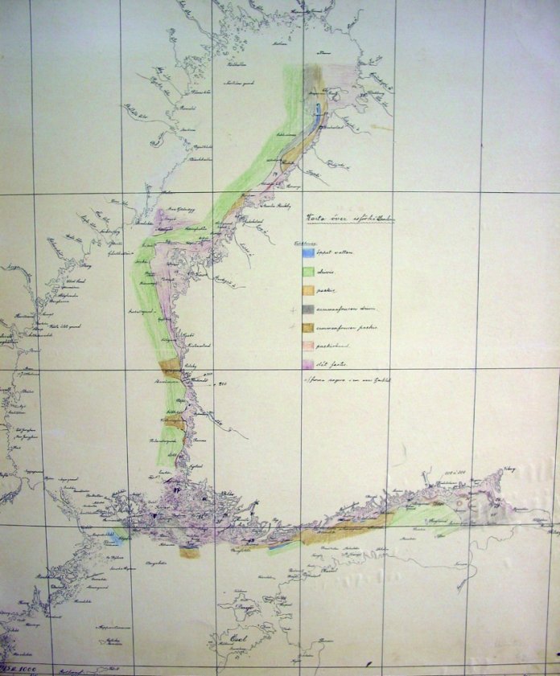
Reasons and background
Ice charting or an expert ice analysis of comprehensive material – satellite imagery, ice air reconnaissance, coastal and ship-borne observations, presented as the ice charts is still the source of the most adequate information on a number of sea ice parameters – concentration, stages of development, fast ice, forms of ice
Based on a single universal international standard – the WMO Sea Ice Nomenclature, the ice charting material contains a number of multidecadal or centennial long time series (North Atlantic, Baltic Sea)
First blending of ice analysis and satellite material was implemented by John Walsh and John Walsh and Chapman in 1980-1990 and further for a ~1° grid
Our approach is based entirely on ice charting material available through the WMO “Global Digital Sea Ice Data Bank” project, supervised by JCOMM ETSI
First blended versions were constructed in 2002 and 2007 within collaboration with UK Metoffice and repeated in 2011-2013 within IARC grant
12/03/1915

Slide 4
Reason for using the ice charting material is clearly visible if we compare, for example statistics for total concentration, based on a ice charting and widely used passive microwave ASI-algorithm data (using the Kara Sea as a sample area)
?
?
X
X
Total concentration (CT) median monthly values based on ice charting material for 2000-2012
X
X
X
X
X
X
X
X
CT median pentad values for 16 June – 15 August based on ASI-algorithm data, 2000 – 2012

Slide 5
Gaps in Walsh and Chapman NH Sea Ice
Rather coarse ~1° resolution grid
Single sea ice parameter – CT, no indicator for fast ice
Single statistic, no information for observed extremes
A number of regional multi-decadal datasets are still missing, e.g. most of the AARI data for Eurasian Arctic, mid-20th century met.no, DMI series for Barents Sea and Greenland waters

Slide 6
Chronology of digital sea ice charting within the GDSIDB archive
SIGRID
SIGRID-3
1880s 1900 1920 1940 1960 1980 2000 2010
Arctic
DMI
Greenland waters, ice edge
Greenland waters
Met.no
Greenland and Barents Seas, ice edge
Greenland and Barents Seas
AARI
Ice extent, NSR Seas
1933-: NSR Seas, Arctic Basin
CIS
1959-: Canadian Arctic
NIC
Kelly grid
1972-: NH
BSIM
Baltic ice code
1961-: Baltic Sea
HMC Russia
2000-: Аzov, Caspian
Antarctic
AARI
1956: irr.
1971-1991
2006: SO
NIC
1973-: SO
EMSR-SSMR-SSM/I-SSMIS, AMSR
EMSR
1978: SSMR-SSM/I-SSMIS
2003-: AMSR,2

Slide 7
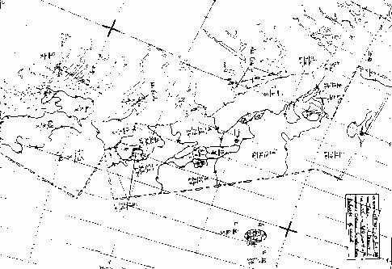
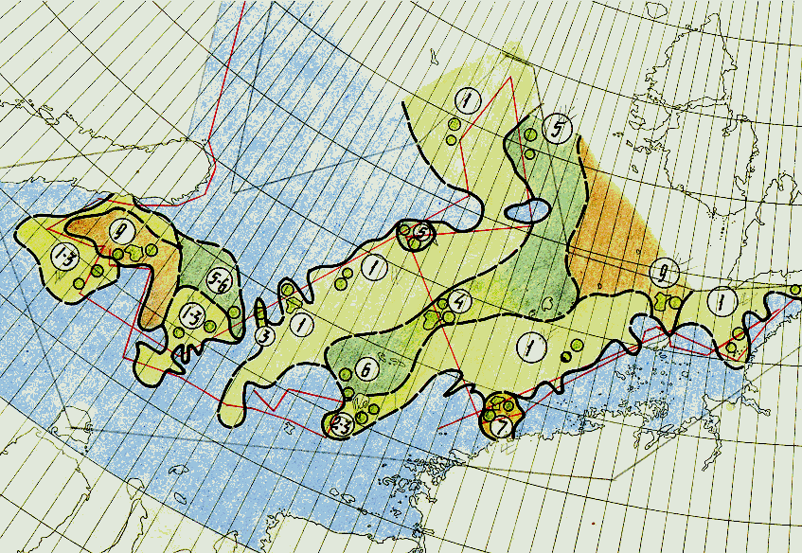
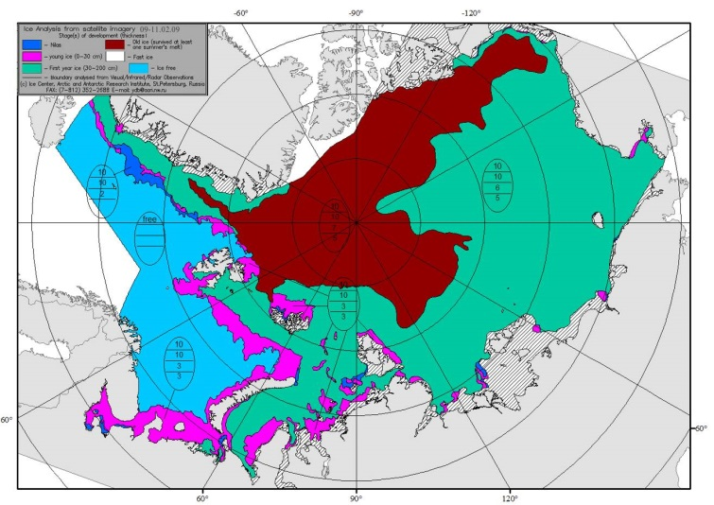
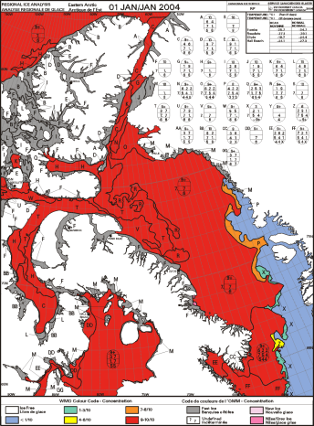
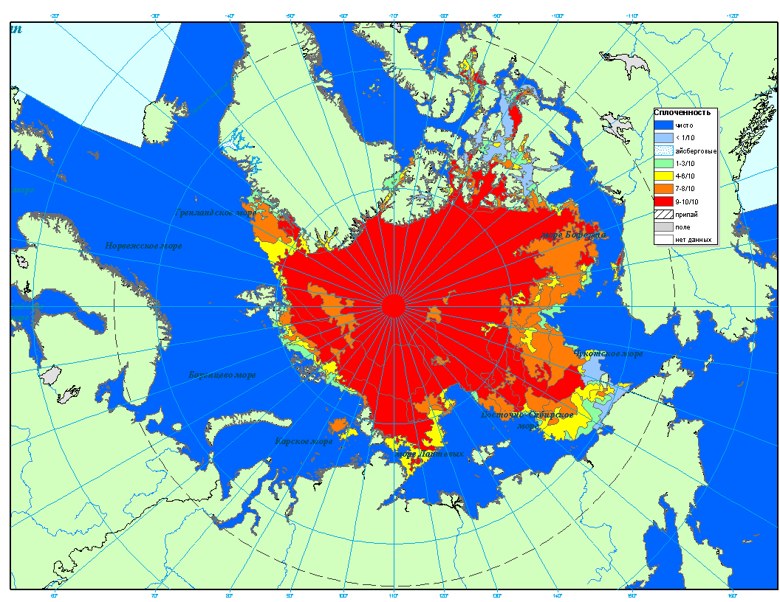
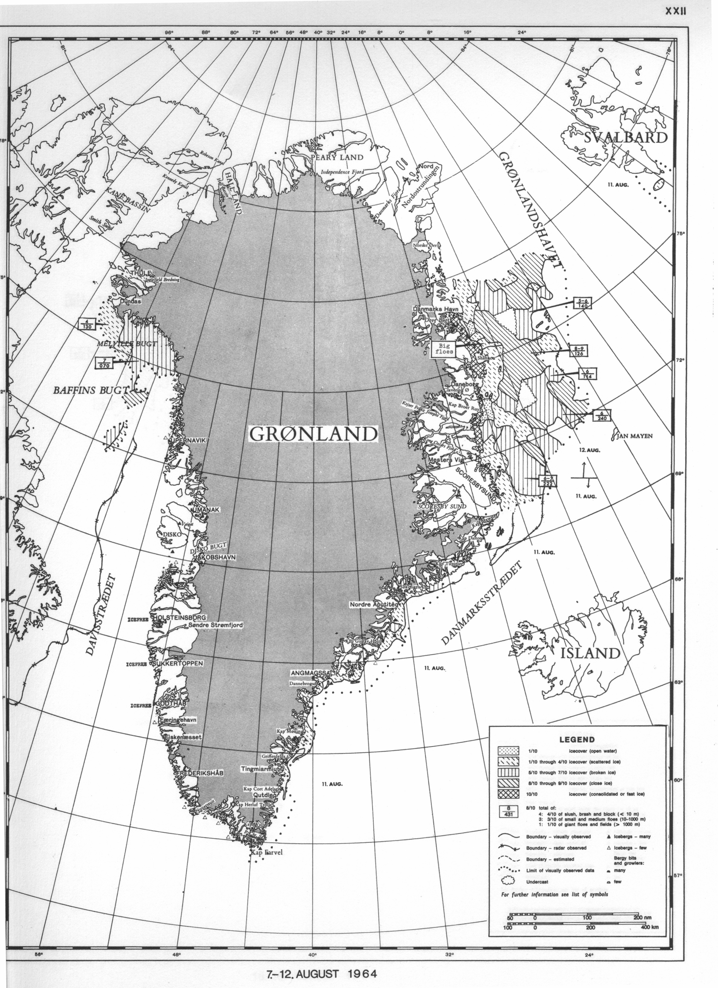
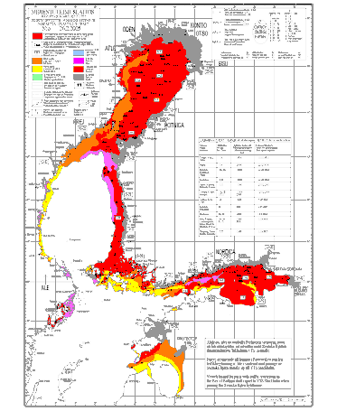
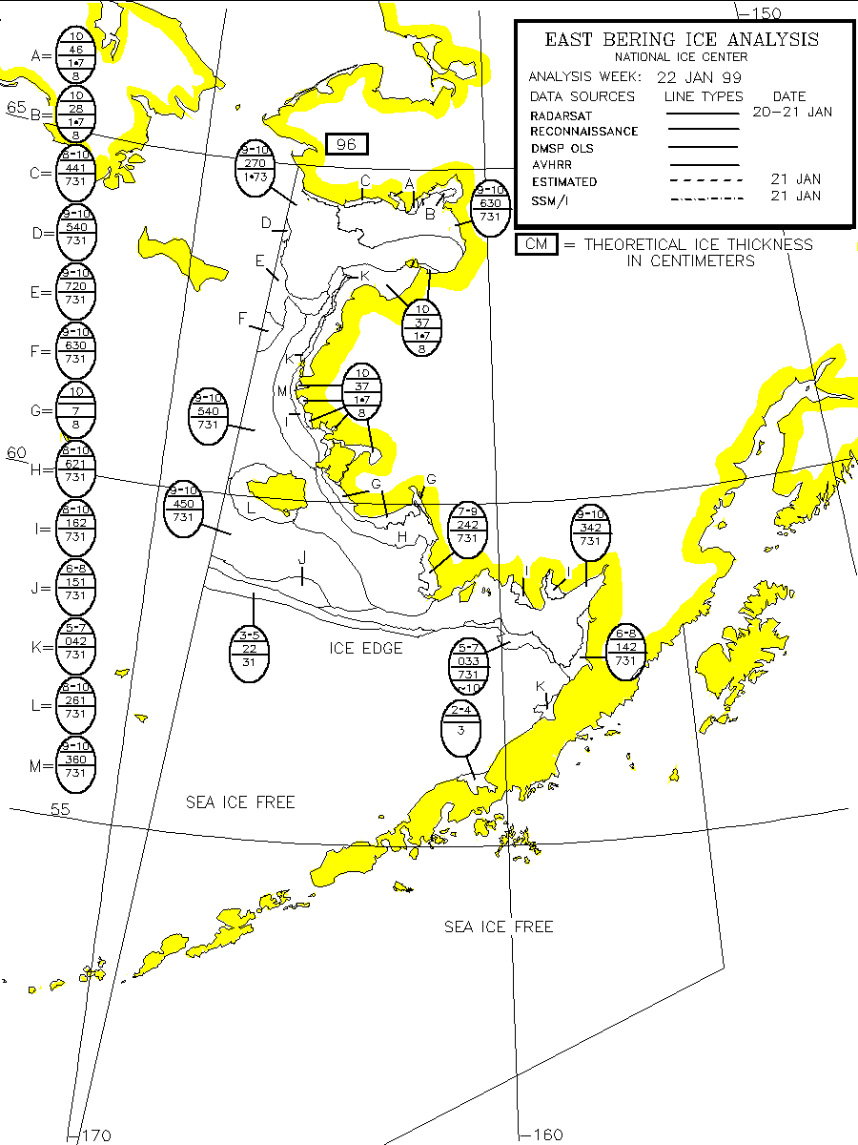
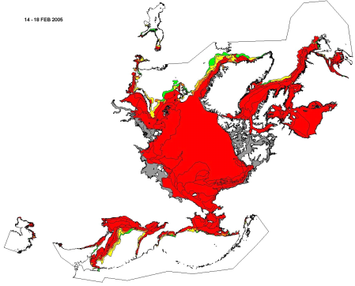
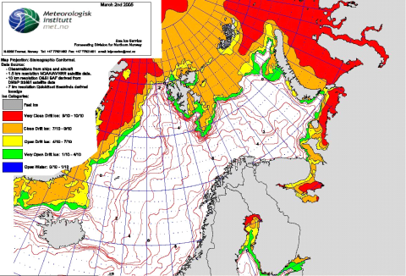
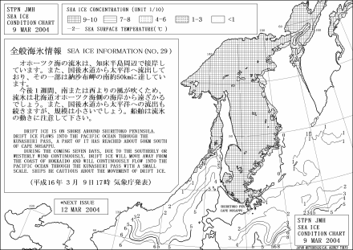
Sample ice charts for the Northern Hemisphere
Russia (AARI)
Canada (CIS)
Denmark (DMI)
BSIM (FMI
USA(NIC)
Norway (met.no)
Japan (JMA)

Slide 8
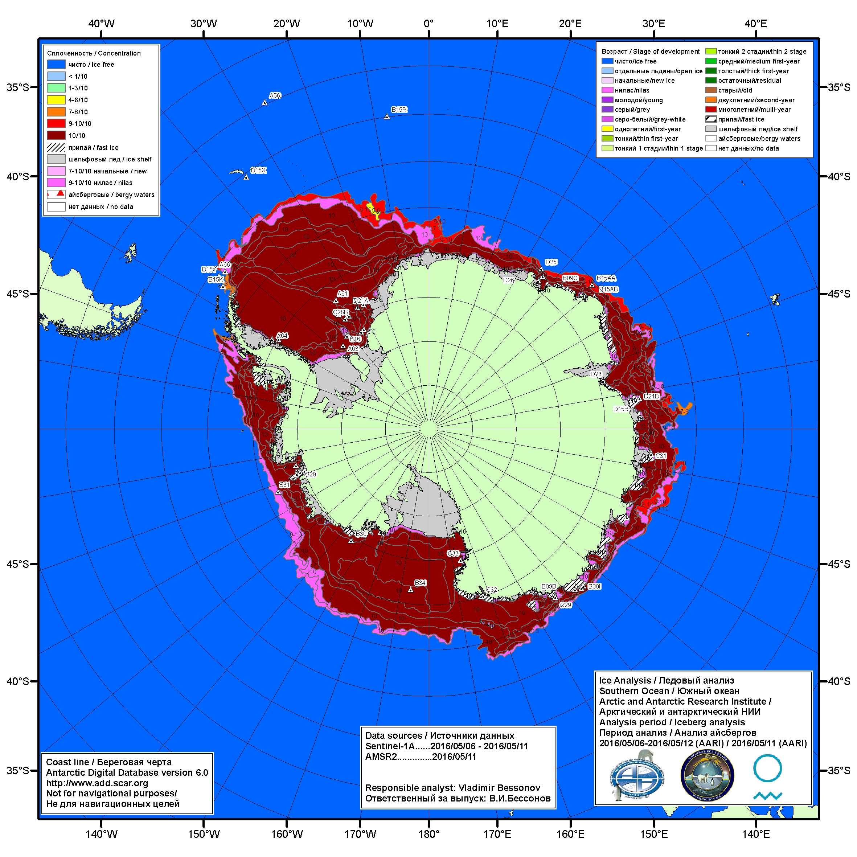
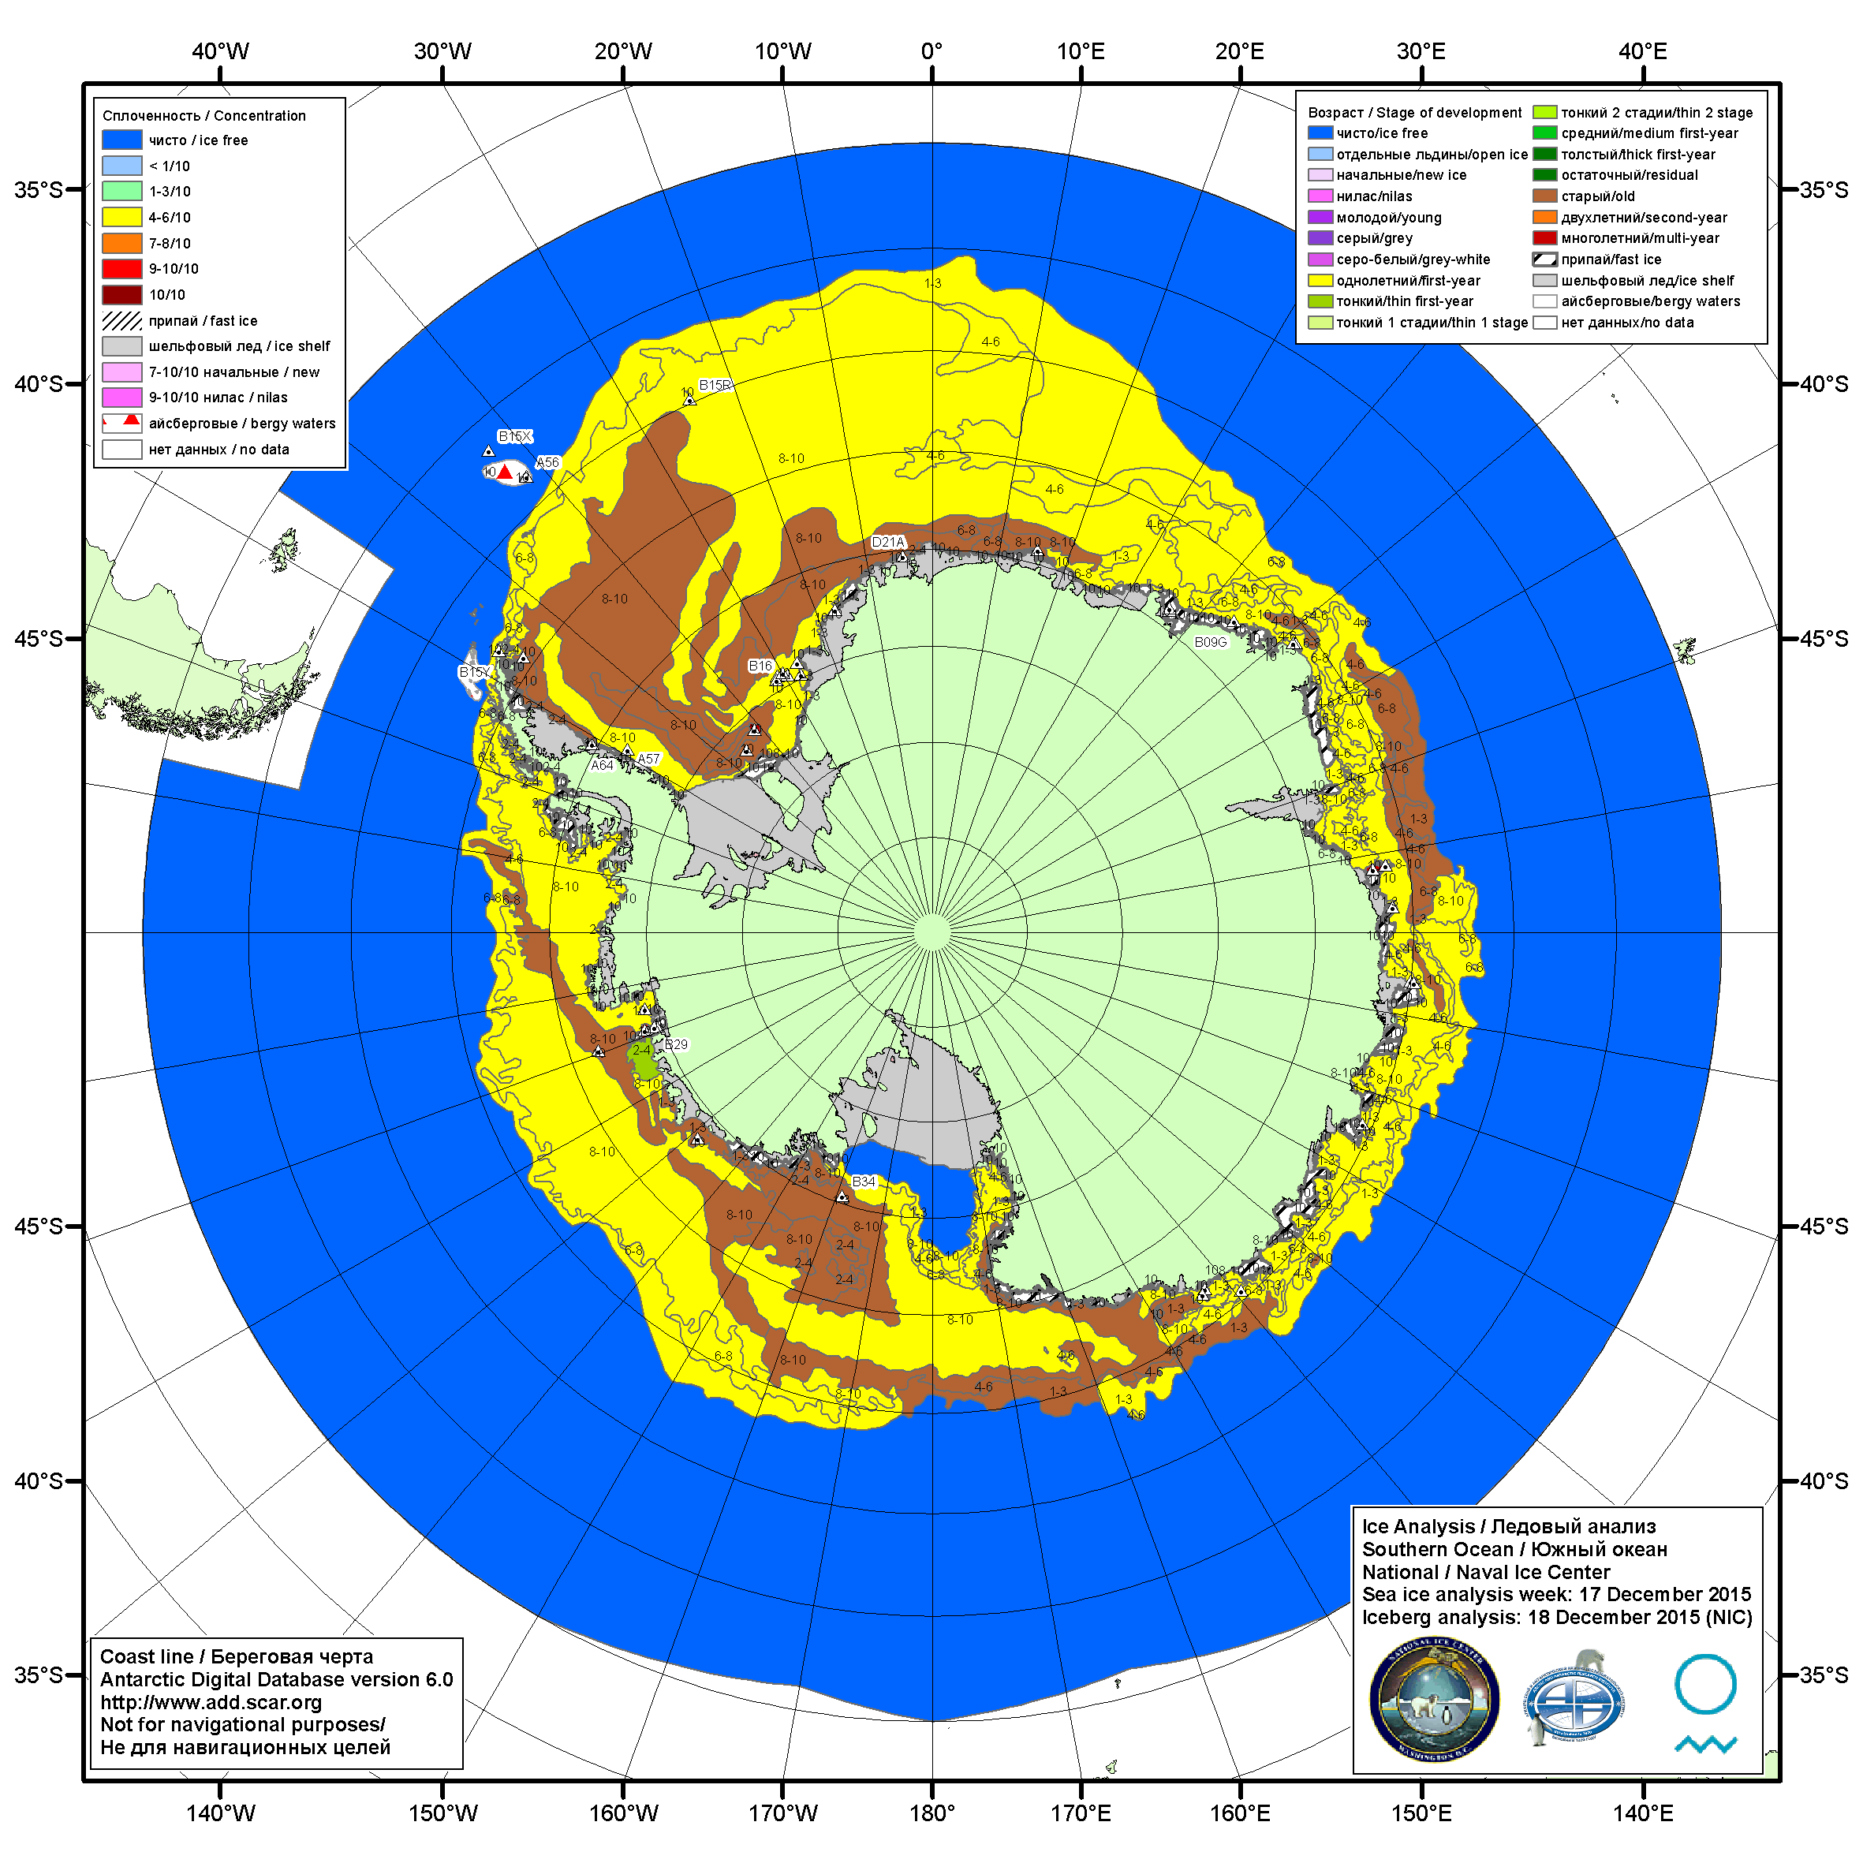
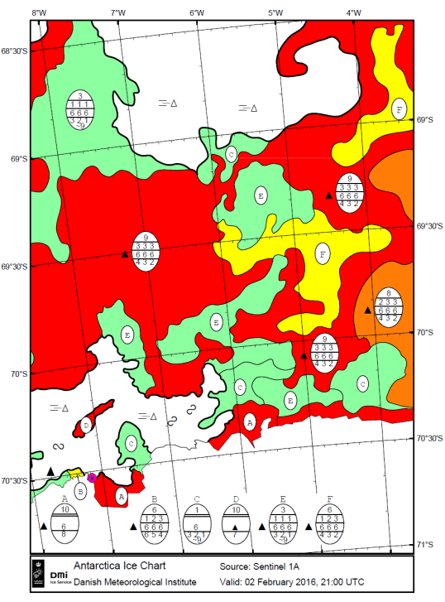
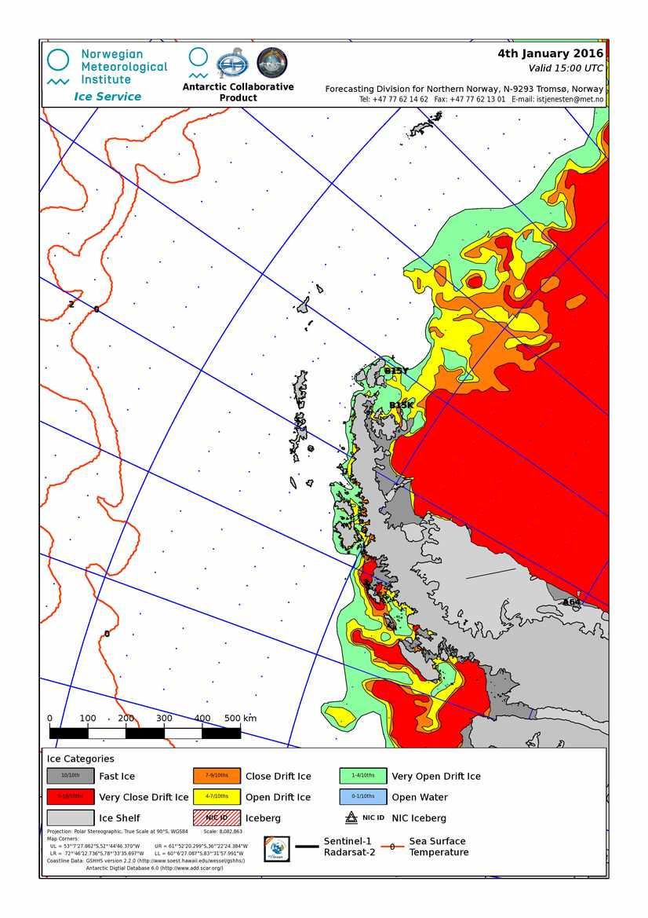
Sample ice charts for the Southern Hemisphere
Russia (AARI)
USA(NIC)
Norway (met.no)
Denmark (DMI)

Slide 9
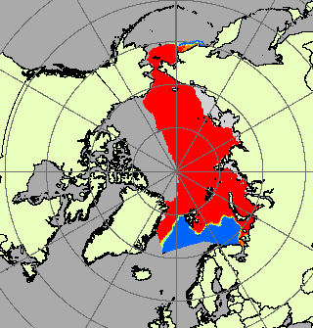
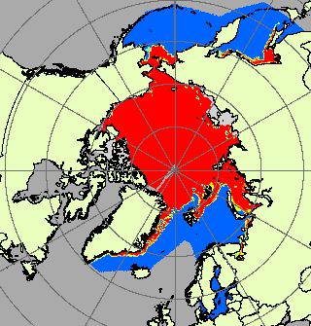
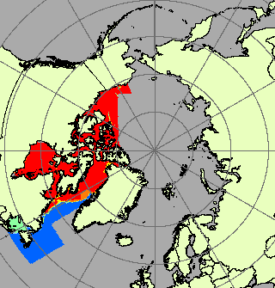
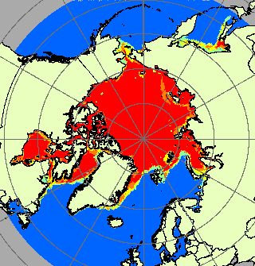
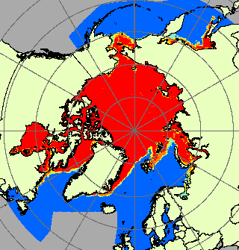
GDSIDB data sources used for blending by ice services (1)
1. Russian Federation AARI (a) Eurasian Arctic (Greenland – Chukchi Seas, Arctic Basin and Bering Sea) ice charts with 10-days periodicity (with gaps) for 1933-1992 (~2400 charts) in SIGRID format and (b) 7-days period Eurasian Arctic (Greenland – Beaufort Seas, Arctic Basin, and Bering, Okhotsk, Baltic Seas) ice charts for 1999-2016 (~6000 charts) in SIGRID-3 format.
2. Canadian Ice Service (CIS) (a) 7-days period ice charts for Canadian Arctic (East Arctic, West Arctic, Hudson Bay and Eastern Coast) for 1958-1998 (~3500 charts) in SIGRID format and the same (b) for 2006-2016 (~1400 charts) in SIGRID-3 format.
3. USA National Ice Center (NIC) (a) 7 days period (weekly) and 14 days period (bi-weekly) Northern hemisphere charts for 1972-2002 (~1600 charts) in Ease-Grid format and the same (b) bi-weekly charts for 2003 - 2016 (~400 charts) in SIGRID-3 format.
4. Baltic Sea Ice Meeting (BSIM), jointly compiled by Swedish Hydrological and Meteorological Institute (SHMI) and Finnish Institute for Marine Research (FIMR), 3-4 days period ice charts for the Baltic Sea for 1960-2014 (~2000 charts) in Baltic code translated to SIGRID format.
5. In addition to 1-4 the “Monthly Arctic Sea Ice Concentration Grids (January 1901 – Dec 2005)” (Walsh and Chapman dataset) was used to gain ice analysis prior to 1972 from Danish Meteorological Institute (DMI), Japan Meteorological Agency (JMA) and Naval Oceanographic Office (NAVOCEANO.

Slide 10
GDSIDB data sources used for blending by ice services and periods (2)

Slide 11
Blending technique
Exporting layers of particular sea ice parameters (CT, SD) from the ice charts in SIGRID, SIGRID-3 formats to geo grid 0.25°x0.25°, including:
  Exporting sea ice parameters from raster SIGRID format charts
  Rasterization of vector SIGRID-3 ice charts
  Co-location (nearest node) of CT data from Walsh and Chapman ~1° dataset with 0.25°x0.25°geo grid
Statistical processing of 5-30 days period initial datasets
  Monthly mean, median, extreme values, number of cases with monthly period for each node
Exporting monthly statistics to a binary BIL, netCDF and ASCII TSV formats
  Header (YYYY.MM.DD) + matrix for BIL
  Separate files for mean, median, extreme, number of cases, data origin
Quality control carried out manually checking decadal extreme statistics

Slide 12
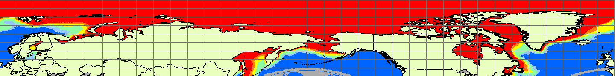
Formal of resulting dataset (CT)
Total concentration in % within interval ‘0’…’100’, plus ‘101’ & ‘122’, where ‘101’ is for fast ice, 122 – no data
Stage of development in a form of mean weighted thickness of level ice in cm within interval ‘0’…’250’, plus ‘251’ for values > 250 and ‘252’ – no data
Grids cover area 90°N…45°N 0°….360° with 0.25°х0.25° resolution, , or 1440 cols by 180 rows, top leftmost 90N,0
Currently period Jan 1901 – Dec 2015
Separate files for 4 statistics (mean, min, max, median), number of cases and source of data
Code of data source can be ‘5’ for mixed data or ‘10’…’90’ for individual sources (DMI, JMA, BSIM, AARI, CIS, NIC, NAVOCEANO, Kelly)

Slide 13
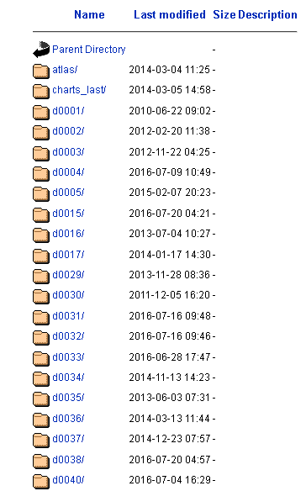
Access through WDC-SI at AARI (http://wdc.aari.ru)
Initial ice charting data (SIGRID)
  http://wdc.aari.ru/datasets/d0004
Initial ice charting data (SIGRID-3)
  http://wdc.aari.ru/datasets/d0004
  http://wdc.aari.ru/datasets/d0031
  http://wdc.aari.ru/datasets/d0032
  …
Blended datasets, documentation, sample f90 codes
  http://wdc.aari.ru/vms/blended/
Copyright – JCOMM, AARI

Slide 14
CT Statistics for AARI, CIS and US NIC initial datasets in seasonal cycle

Slide 15
AARI, 1933-1992

Slide 16
AARI, 1997-2015

Slide 17
CIS, 1958-1998

Slide 18
CIS, 2006-2015

Slide 19
NIC, 1972-2007

Slide 20
NIC, 2003-2015

Slide 21
CT blended statistics, (max/min/trimean)
1901 – 2015

Slide 22
January - December

Slide 23
August, by decades

Slide 24
Perspectives and applications
Regular annual update
Calculation of additional statistics, assessment of uncertainties, errors
Finalization of blended ice thickness dataset using stages of development as proxy
Finalization of Antarctic blended dataset
Inclusion of additional sources, e.g. linear ice edge from met.no for the first part of the 20th century, old Baltic Sea data, Caspian Sea…
Restoration of gaps (principal components, wavelet-analysis)
Availability of data through GCW portal, polar GDAC/CMOC
Some hints for applications:
Regional atlases
JCOMM quasi-centennial hemispheric ice edge in seasonal cycle, e.g. for GEBCO project
Validating / feeding climatic models

Slide 25
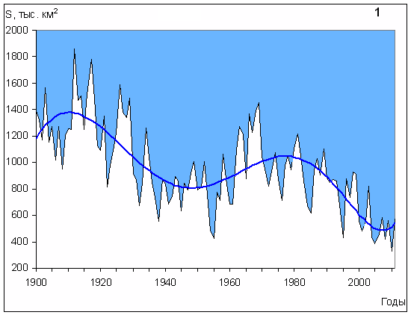
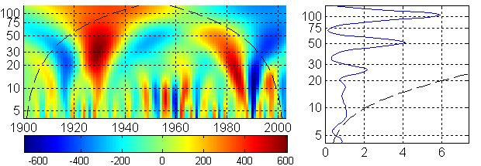
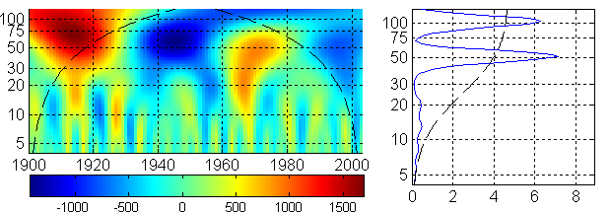
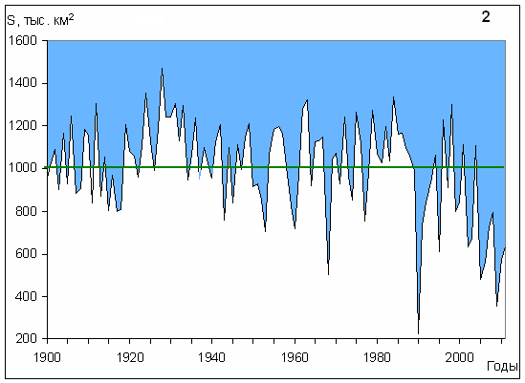
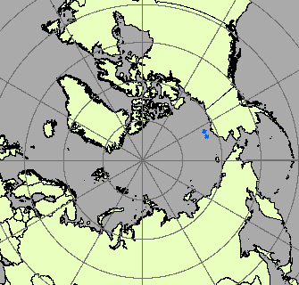
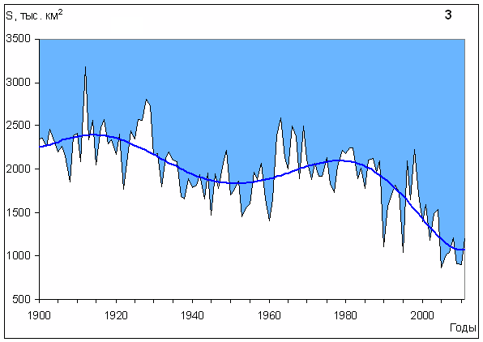
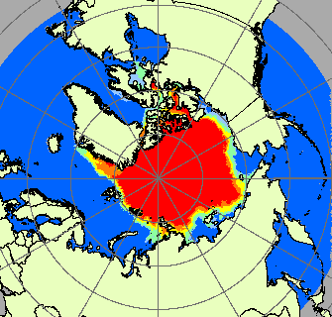
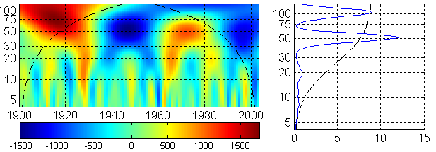
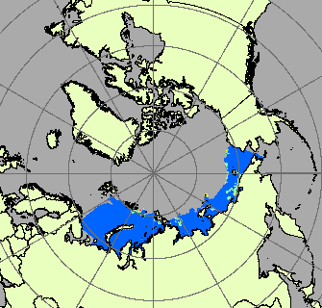
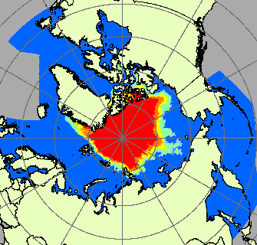
Changes in ice extent at the end of August for 1) western Eurasian Arctic (Greenland – Kara Seas), 2) Eastern Eurasian Arctic (Laptev – Chukchi) and 3) Eurasian Arctic
?
September, 1971-1980
September, 1936 – 1943
September, 2006 – 2012

Slide 26
Thanks for attention
Questions ?

