Slide 1
E-nav project creation of e-nav pilot zone in the gulf of finland
March 2017

Slide 2
thesis
THESIS is a cloud-based platform that brings together fleet operations, ship solutions, academy functions, and ship traffic control solutions on one interactive, flexible platform with unparalleled functionality.
Notes:
Transas leads the way in creating an ecosystem of harmonized integrated solutions in safety, navigation and ship operations. In creating these solutions Transas unites the global maritime stakeholders in the future of e-Navigation and operations.

Slide 3
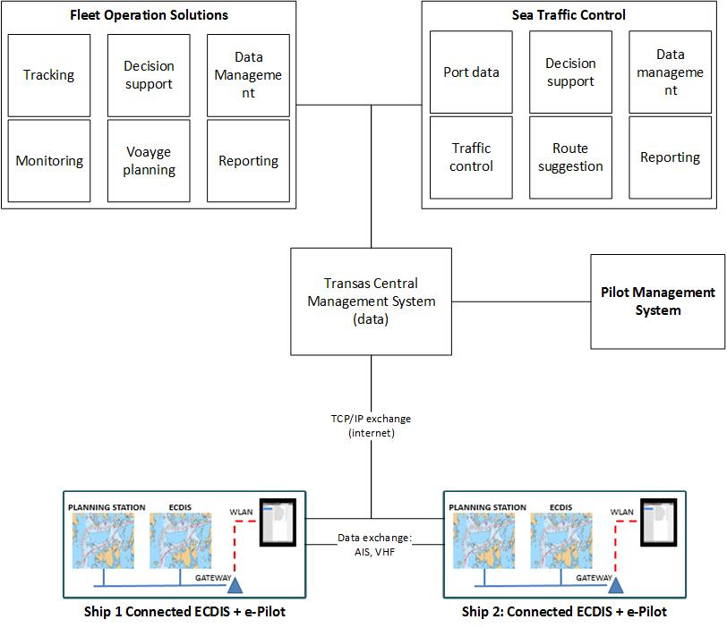
E-Nav Project
Project Goals
Development of E-NAV technologies that allow optimization of processes and information sharing between vessels, operators, service providers and authorities in the test bed area.
Deploy the technologies into Transas products
Prepare test platforms for live testing of the solutions.

Slide 4
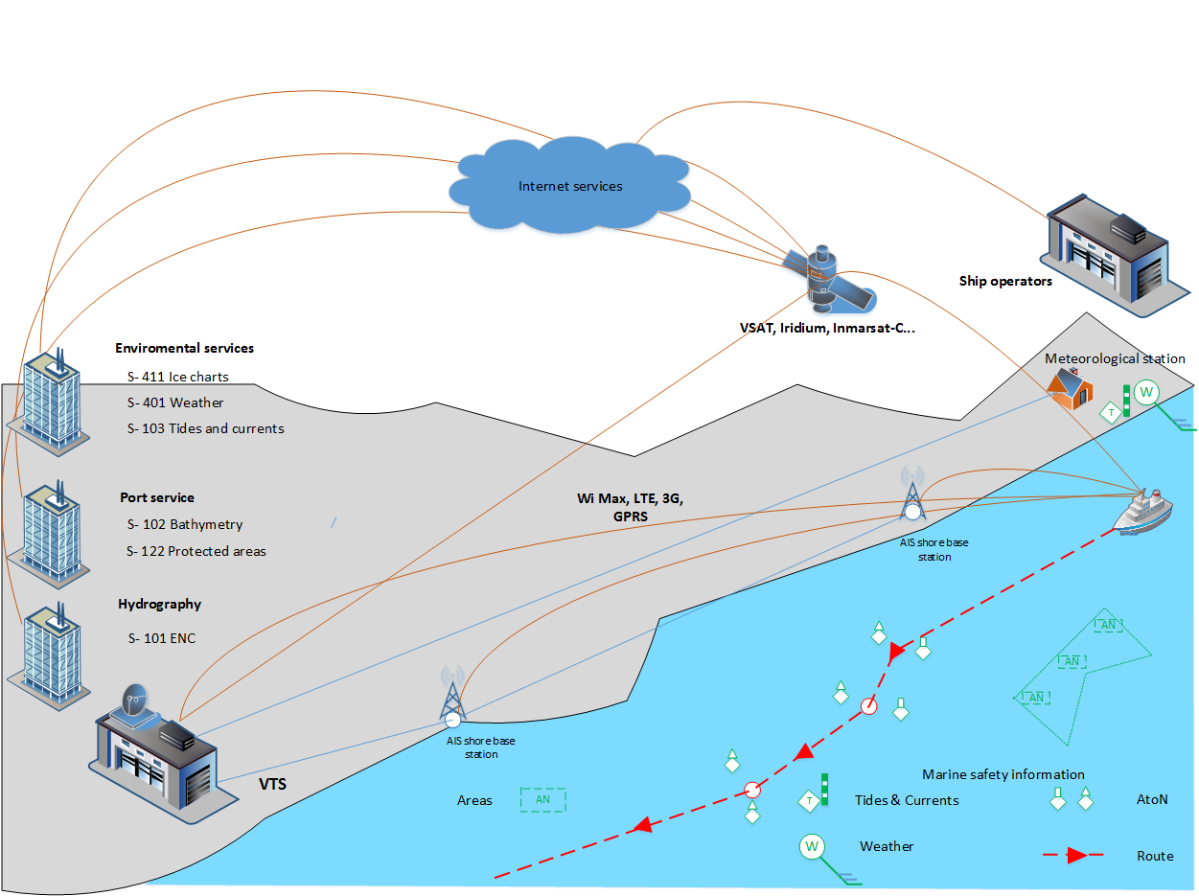
E-Nav Project
E-Nav project stakeholders:
Project stakeholders;
  VTS /STC operators
  Ship owners and ship operators
  Pilots
  Seagoing vessels
Data service providers
  Transas – accumulates data from own production and external providers:
  AARI (ice charts, weather forecast, tides and currents)
  Hydrographic service (survey data, protected sea areas, ENC data)
  Weather forecasts providers

Slide 5
E-Nav Project
List of IP – products developed in the e-nav framework
The NTI E-Nav project covers development of the following Transas IPs
Solutions | SHS | FOS | STC
Products | Connected ECDIS 4000 | Fleet Operations Solutions | STC 5000
 | e-Pilot | Pilot Management System
 | UNINAV ECDIS 5000

Slide 6
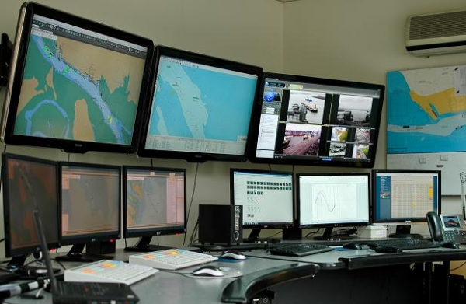
E-Nav Project
Result of implementation – VTS/STC
Ship position tracking from different sources
Presentation and exchange of ship planned and monitored routes
Hydro-meteo and hydrographic data
Access to port services – tug operators, pilots, terminals.
Information sharing via AIS and TCP/IP communication instead of VHF
Decision support – collision avoidance

Slide 7
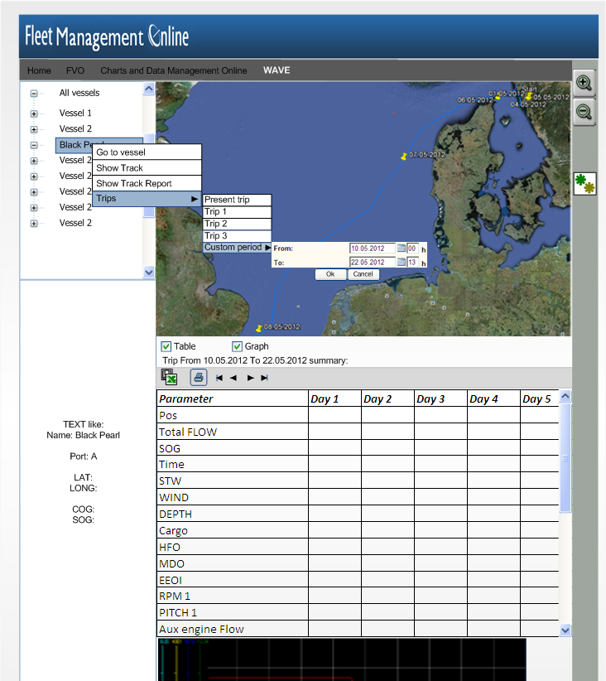
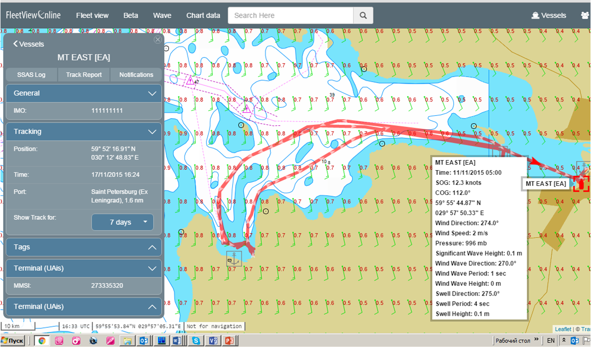
E-Nav Project
Result of implementation - Ship owner and charterer
Vessel voyage performance monitoring saves cost of equipment maintenance (service, spare parts etc)
Effective planning of voyages. Assessment of possibilities ETA, QTA -Quickest time of arrival saves time & cost
Planning and acknowledgement of arrival services
Vessel route and safety monitoring
Decision support and post-analysis of near-miss situations

Slide 8
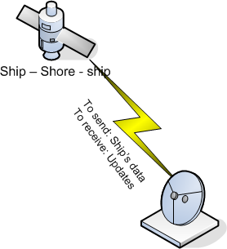
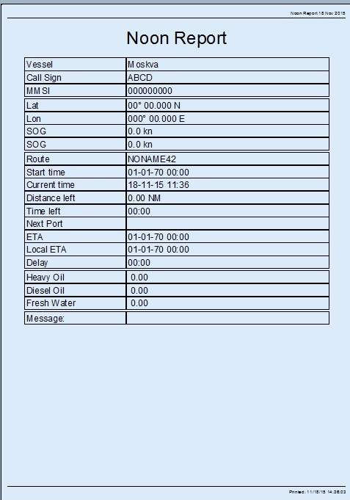
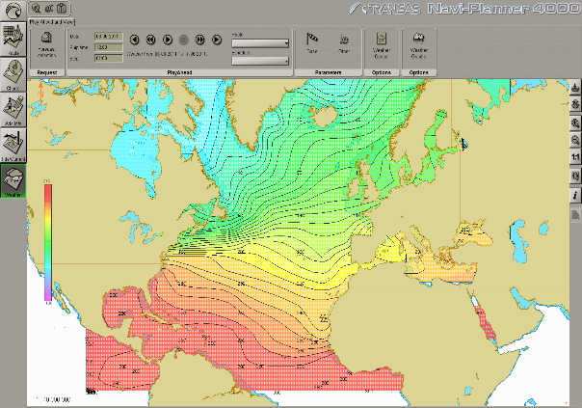
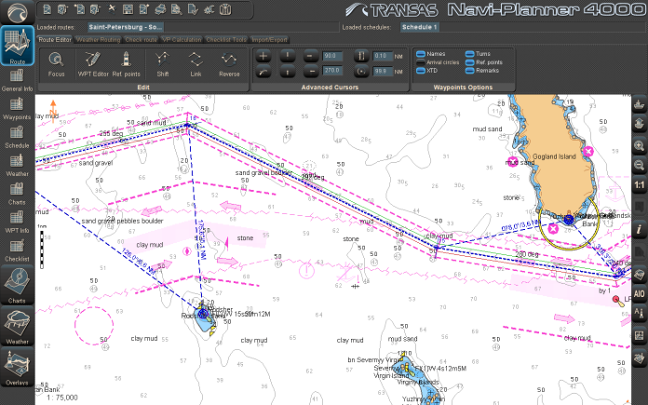
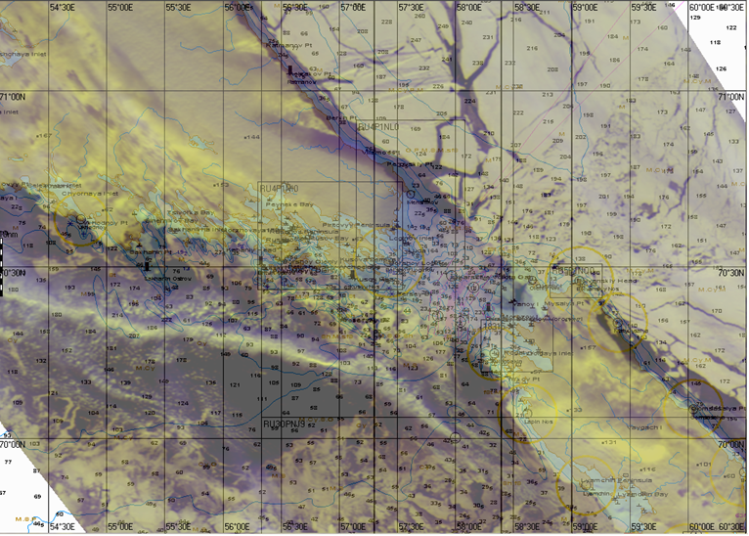

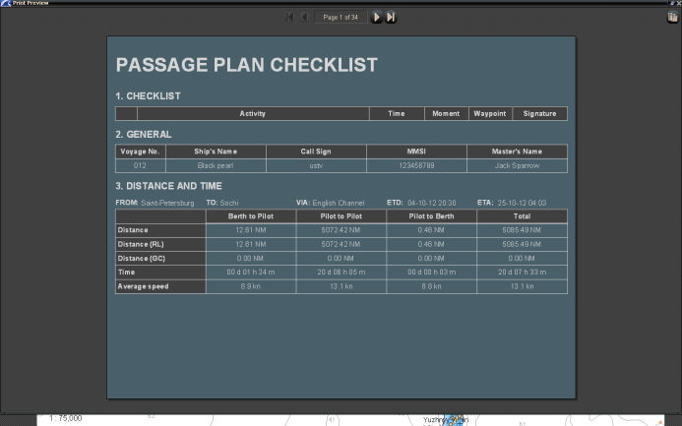
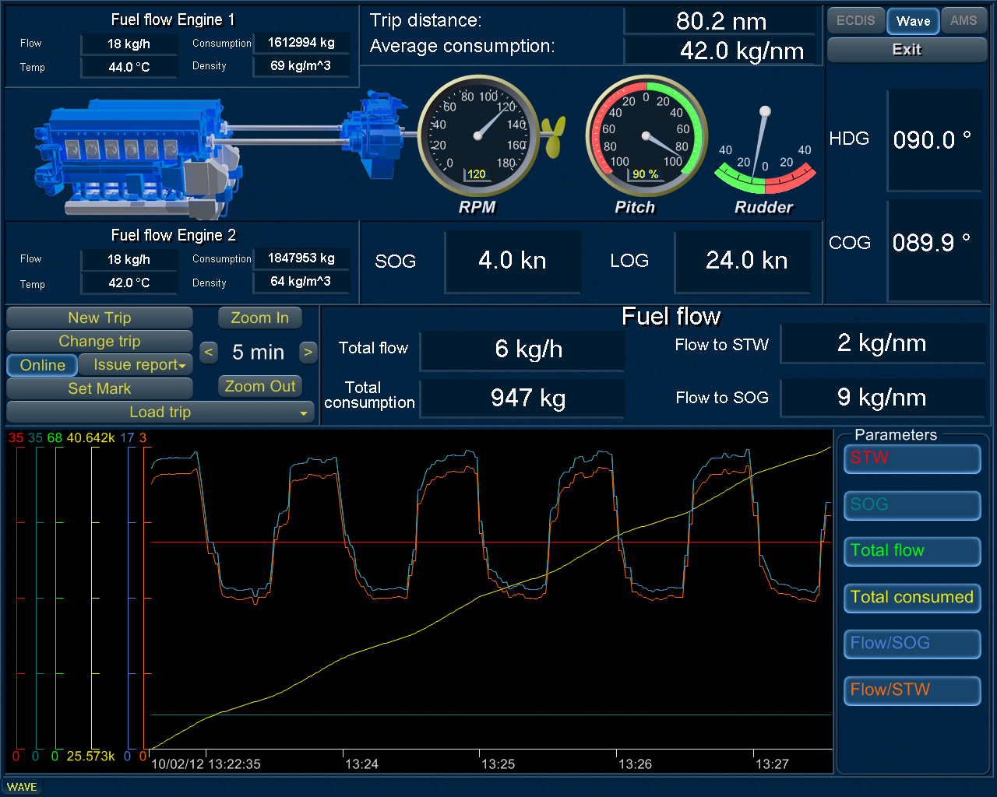
E-Nav Project
Result of implementation - Ship
Automated reporting to VTS, operator, owner
Effective planning of voyages in cooperation with VTS and STCC
Planning and acknowledgement of arrival services – terminal, pilot, tug
Real time safety information
Advanced voyage planning and monitoring
Routes and intentions of other vessels in the area
Hydrographic and meteorological data

Slide 9
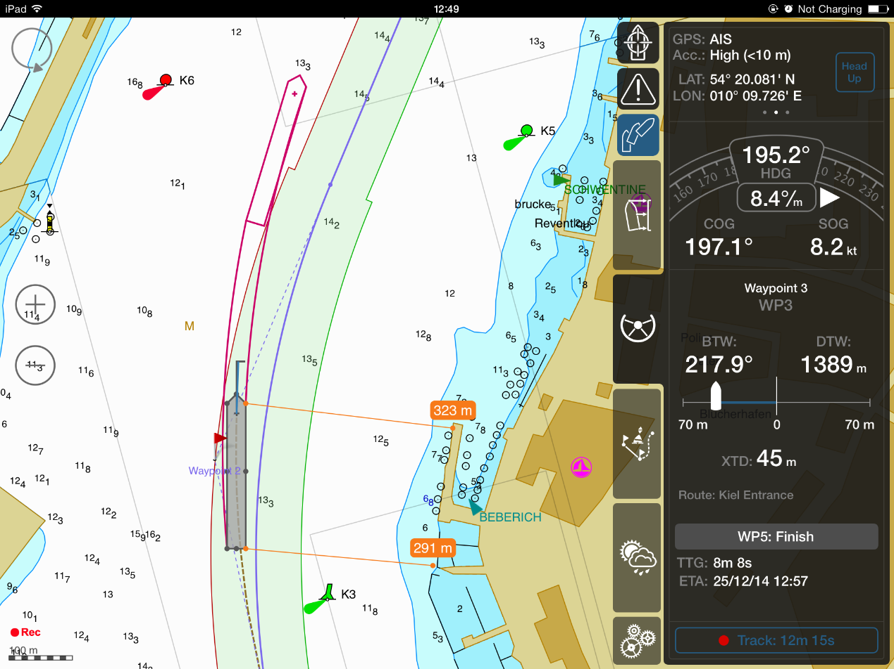
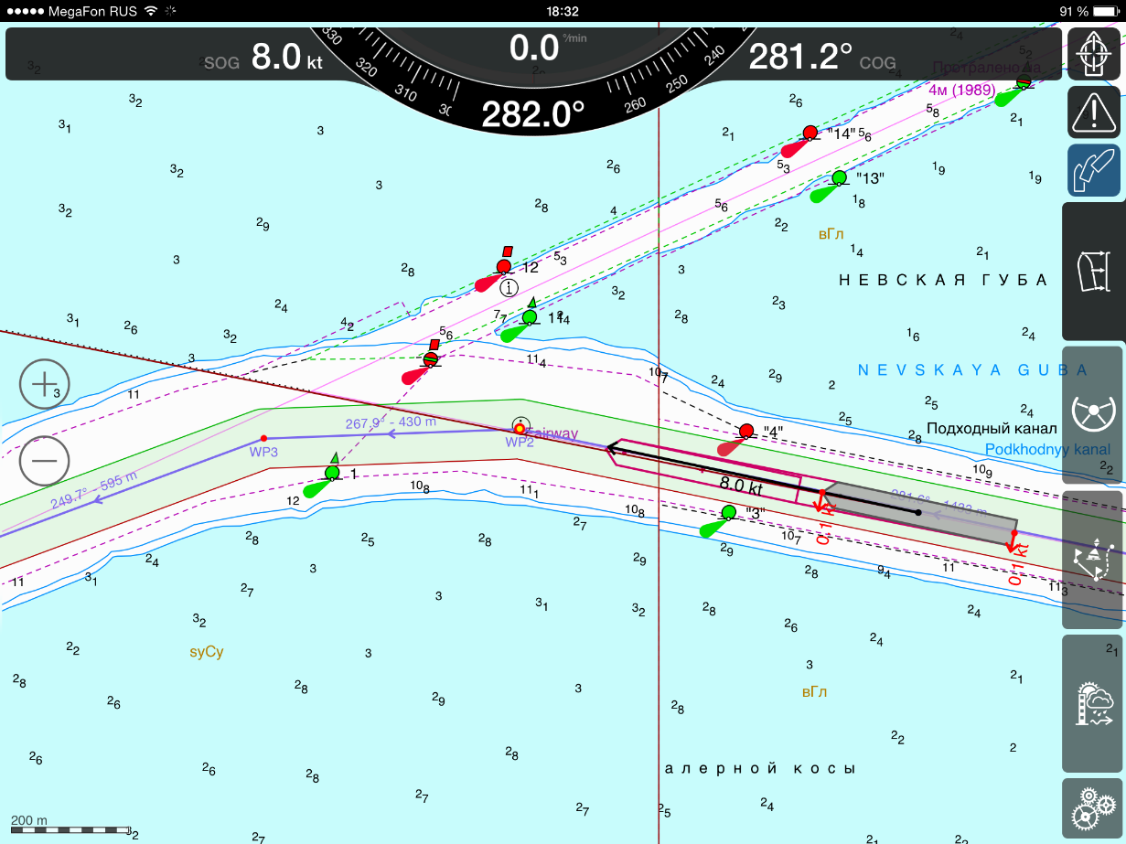
E-Nav Project
Result of implementation - Pilot
Lightweight PPU equipment
Quick and seamless connection to ships nav. equipment.
Communication to STC - quick updates regarding pilot status and routes
Effective planning of pilot operations in the Pilot Management System.
Timing and accounting of the pilot operations
Real time safety information exchange.

Slide 10
E-Nav Project
Project stages and deliverables
Stage 1. By Dec 2016. Clarification of E-Nav architecture and prototyping of e-nav functions (route exchange, AIS data exchange, text chat). Demonstration in the office test bench (demo stand)
  Linked project: “E-More” – e-navigation infrastructure in the Gulf of Finland
Stage 2. By July 2017. Additional E-Nav functions: remote support, meteo messages, S-124 areas. Stable version demonstrated at the office test bench (demo stand).
  Linked projects: STM Validation, Connected Ship 4000
Stage 3. By Dec 2017 – New E-Nav functions – hydrographic and weather data, decision support system, UNINAV, Pilot messenger. Demonstration at the office test bench.
  Linked project: Sabeta – E-Nav solutions delivery for LNG tankers entering port Sabeta.
Stage 4 By July 2018 – new functions (reporting, port information, DSS, SAR, telemetry). Commercial release of IPs, commercial delivery of the E-Nav solutions.

Slide 11
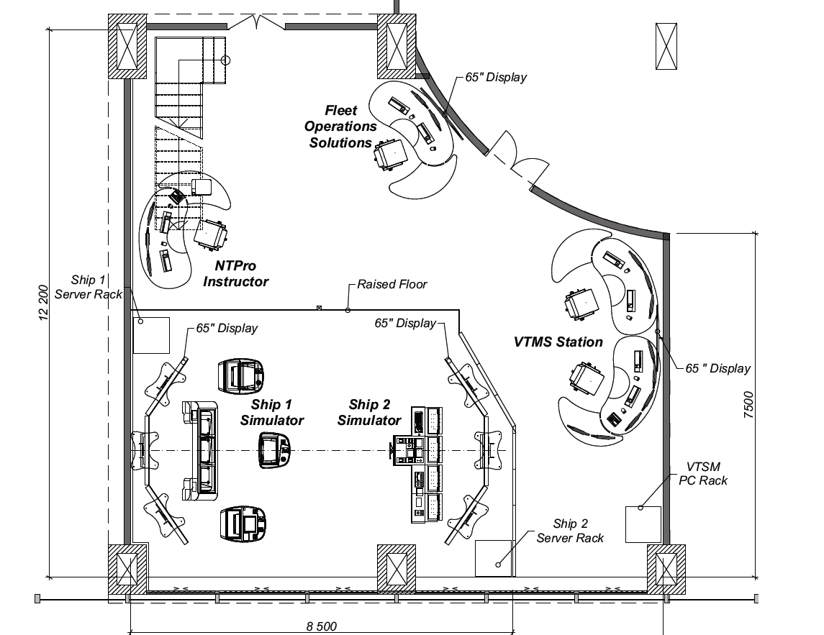
E-Nav Project
Configuration of the E-Nav Test bench and demo room
Location – Transas office at St. Petersburg , ground floor, demo room 104

Slide 12
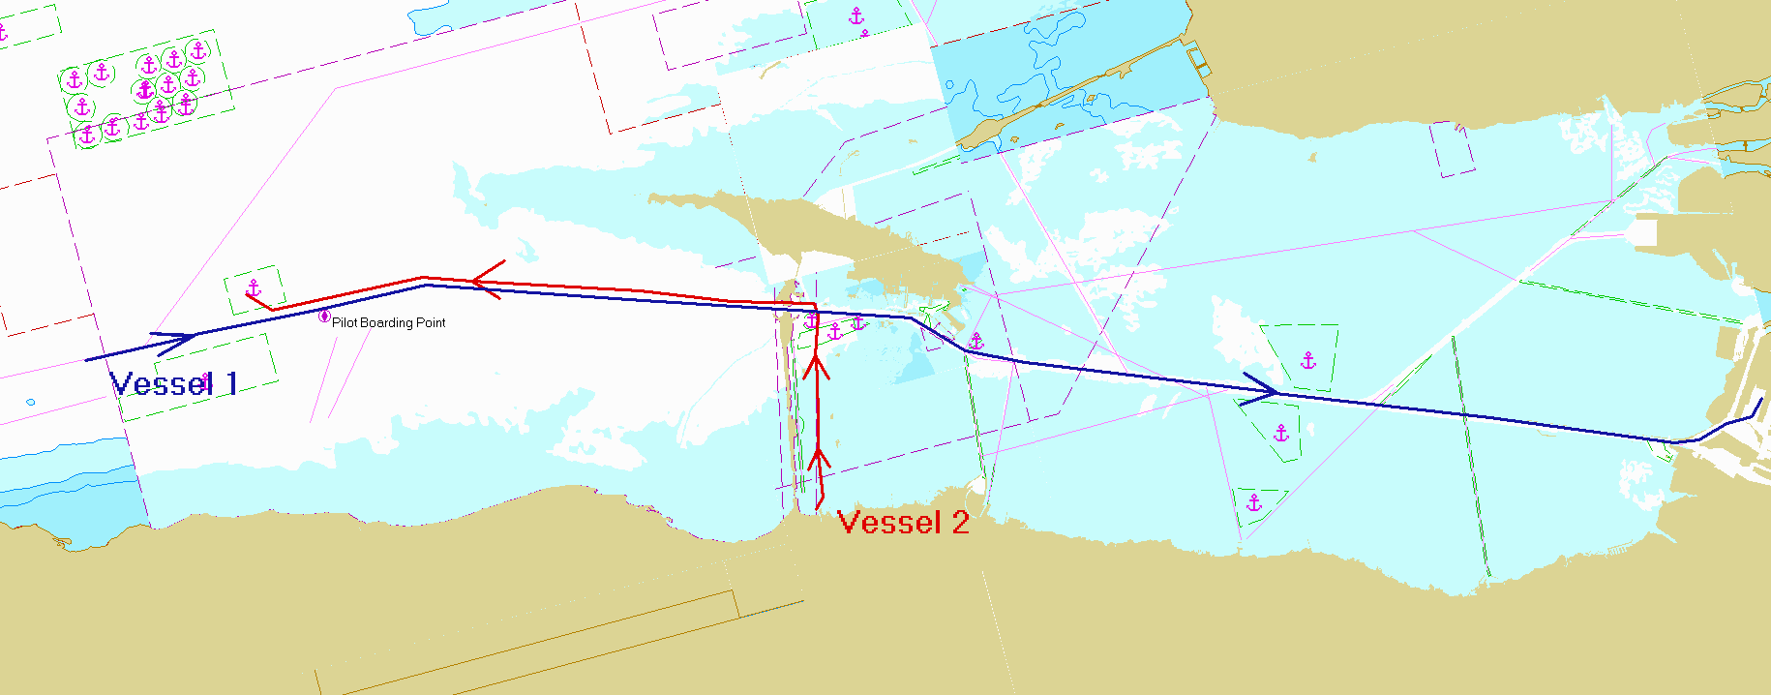
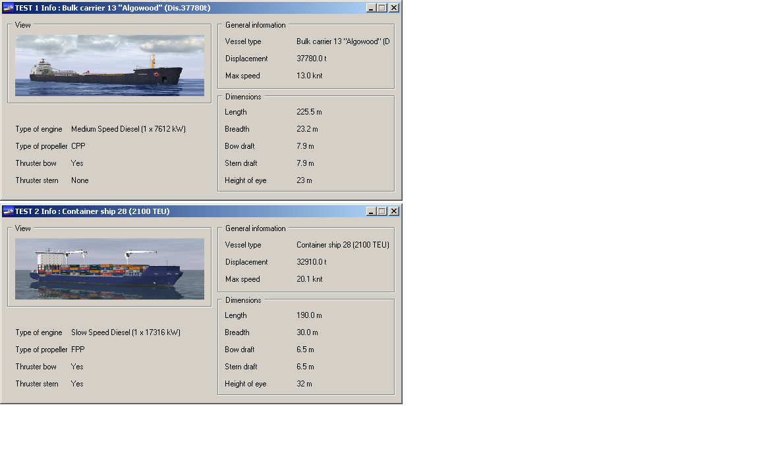
Scenario description
Sample of scenario
Vessel 1
  Inbound to Port of Saint-Petersburg
  Pilot onboard at PBP
Meeting of vessels in the during passage of the Saint-Petersburg Maritime Channel.
Vessel 2
  Outbound from Port of Bronka Pilot onboard
  Leaving pilot at BPP

