Slide 1

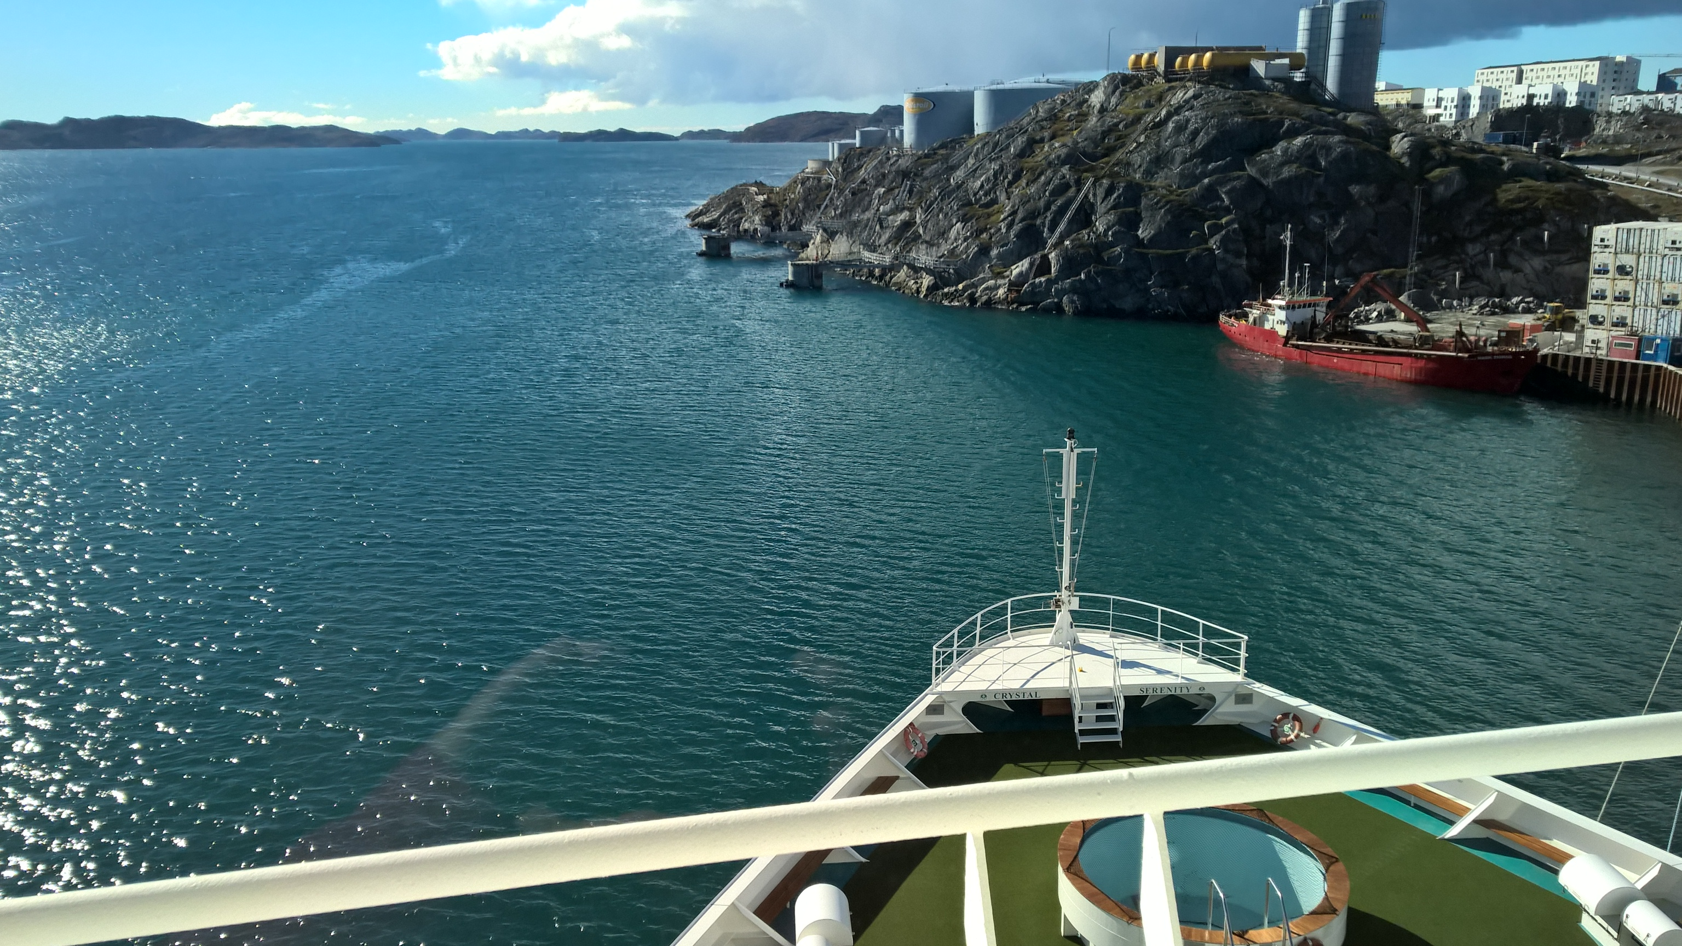
Polar Code Implications for Operational Ice Services
Keld Qvistgaard
Senior Ice Advisor & Client Relations Manager
Email: kqh@dmi.dk
Danish Meteorological Institute
JCOMM ETSI VI 28th February – 03 March 2017
Notes:
Background photo: iceberg grounded in Baffin Bay at a water depth of 340m (1000+ feet)

Slide 2
Terminology used in the IMO Polar Code
Refers to:
Old ice
Thin/Medium first-year ice
First year ice
Ice free waters
Open waters
Bergy water
Less than 1/10th ice concentration
Ice image information
Avoid ice and/or temperatures….
… foreseen ice conditions
… potential hazards of intended voyage
… current information on sea ice and icebergs along intended route
…statistical information on ice and temperature…
… ice concentration of more than 2/10th
… weather/ice forecast for the intended area of operation
Ice shelf
Fastice
Ridging
…Global and localized forecasts…
… low visibility..
Hazardous ice
Icing
Air temperature
Severe weather
Mean daily low temperature over 10 years
Current air temperature
The frequency of updates should provide enough advance notice that the ship can take refuge or use other methods of avoiding the hazard if the conditions are forecast to exceed its capabilities.
Not mentioned: swell/waves, ice pressure, snow cover on ice, melting stage, floe size, ……
Notes:
New Polar shipping regulations are coming into force from 2017-18, implemented by the International Maritime Organization, also known as the Polar Code, which is a new set of regulations addressing shipping safety and environmental protection in Polar Waters. A significant part of the Polar Code is not new to the industry as it is based on recognized guidelines, recommendations, operators experience, best industry practice on reducing navigation risk in ice infested waters

Slide 3
The Polar Code recognizes the risk of operating at polar latitudes
1) Ship categories
Category A: ship designed for operation in polar waters in at least medium first-year ice, which may include old ice inclusions.
Category B: ship means a ship not included in Category A, designed for operation in polar waters in at least thin first-year ice, which may include old ice inclusions.
Category C: ship means a ship designed to operate in open water or in ice conditions less severe than those included in Categories A and B
The ship Category is a reflection of the expected severity of ice conditions that the ship is anticipated to operate in.
2) Polar Service Temperature
3) Operational Limitations (included in Polar Ship Certificate)
4) Operational Assessement
Validate operational limitations
Establish operational procedures
Establish Survival Ressources
Lloyds list of hazards: ice is listed as no. 1
Polar Waters Operating Manual
Meet Polar Code Requirements

Slide 4
PWOM shall include risk based procedures for the following:
.1 voyage planning to avoid ice and/or temperatures that exceed the ship’s design capabilities or limitations;
.2 arrangements for receiving forecasts of the environmental conditions;
.3 means of addressing any limitations of the hydrographic, meteorological and navigational information available;
.4 operation of equipment required under other chapters of this Code; and
.5 implementation of special measures to maintain equipment and system functionality under low temperatures, topside icing and the presence of sea ice, as applicable.
Example:
9.2.1 Nautical information
Ships shall have the ability to receive up-to-date information including ice information for safe navigation.
Example: Crystal Serenity NW Passage journey requires a PWOM → to obtain Polar Ship Certificate
Notes:
Icebergs occur in areas where ships operate. Here is an example of the global shipping overlayed with an outline of the areas where there is a risk of encountering icebergs. Titanic was lost southeast of New Foundland, at latitude 41 degrees north. This is 2000 km south of Greenland. Illullissat is at 69 degrees north.

Slide 5
11 VOYAGE Planning (extracted from Lloyds Guidelines)
The goal of this chapter is to ensure that the Company, master and crew are provided with sufficient information to enable operations to be conducted with due consideration to safety of ship and persons on board and, as appropriate, environmental protection.
11.2 Functional requirement
In order to achieve the goal set out in paragraph 11.1 above, the voyage plan shall take into account the potential hazards of the intended voyage.
11.3 Requirements
In order to comply with the functional requirement of paragraph 11.2 above, the master shall consider a route through polar waters, taking into account the following:
.1 the procedures required by the PWOM;
.2 any limitations of the hydrographic information and aids to navigation available;
.3 current information on the extent and type of ice and icebergs in the vicinity of the intended route;
.4 statistical information on ice and temperatures from former years;
.5 places of refuge;
.6 current information and measures to be taken when marine mammals are encountered relating to known areas with densities of marine mammals, including seasonal migration areas;
.7 current information on relevant ships’ routing systems, speed recommendations and vessel traffic services relating to known areas with densities of marine mammals, including seasonal migration areas;
.8 national and international designated protected areas along the route; and
.9 operation in areas remote from search and rescue (SAR) capabilities.
Notes:
We have already seen the initial consequences of global warming and retreating ice. For example here, in the Disko Bay. Earlier, 15-20 years ago, it was always frozen in the winter season for 4-5 months and no local shipping. Now it is often only frozen for days or weeks and shipping is possible most of the year.
Internationally we would likely see new ship routes develop, in the Arctic Ocean, Northeast Passage (Russia) and the Northwest Passage (Canada). This requires investments, infrastructure, monitoring, regulations. Transiting ships will also come into Greenland Waters and ask for products and services. Currently we see the first large cruise ship (Crystal Serenity) in the NW passage and the Cruise Line has already annouced the vessel will come back next year. If succesful other cruise lines will probably follow.
The sea ice waters will continue to pose a hazard to shipping as sea ice free waters cannot be considered as icefree………….. We will see more ships in those waters and derived increased requirements for ice monitoring and reporting. This is another good reason for international collaboration. Note the size/location of the current operations area compared with the future Arctic shipping routes.

Slide 6
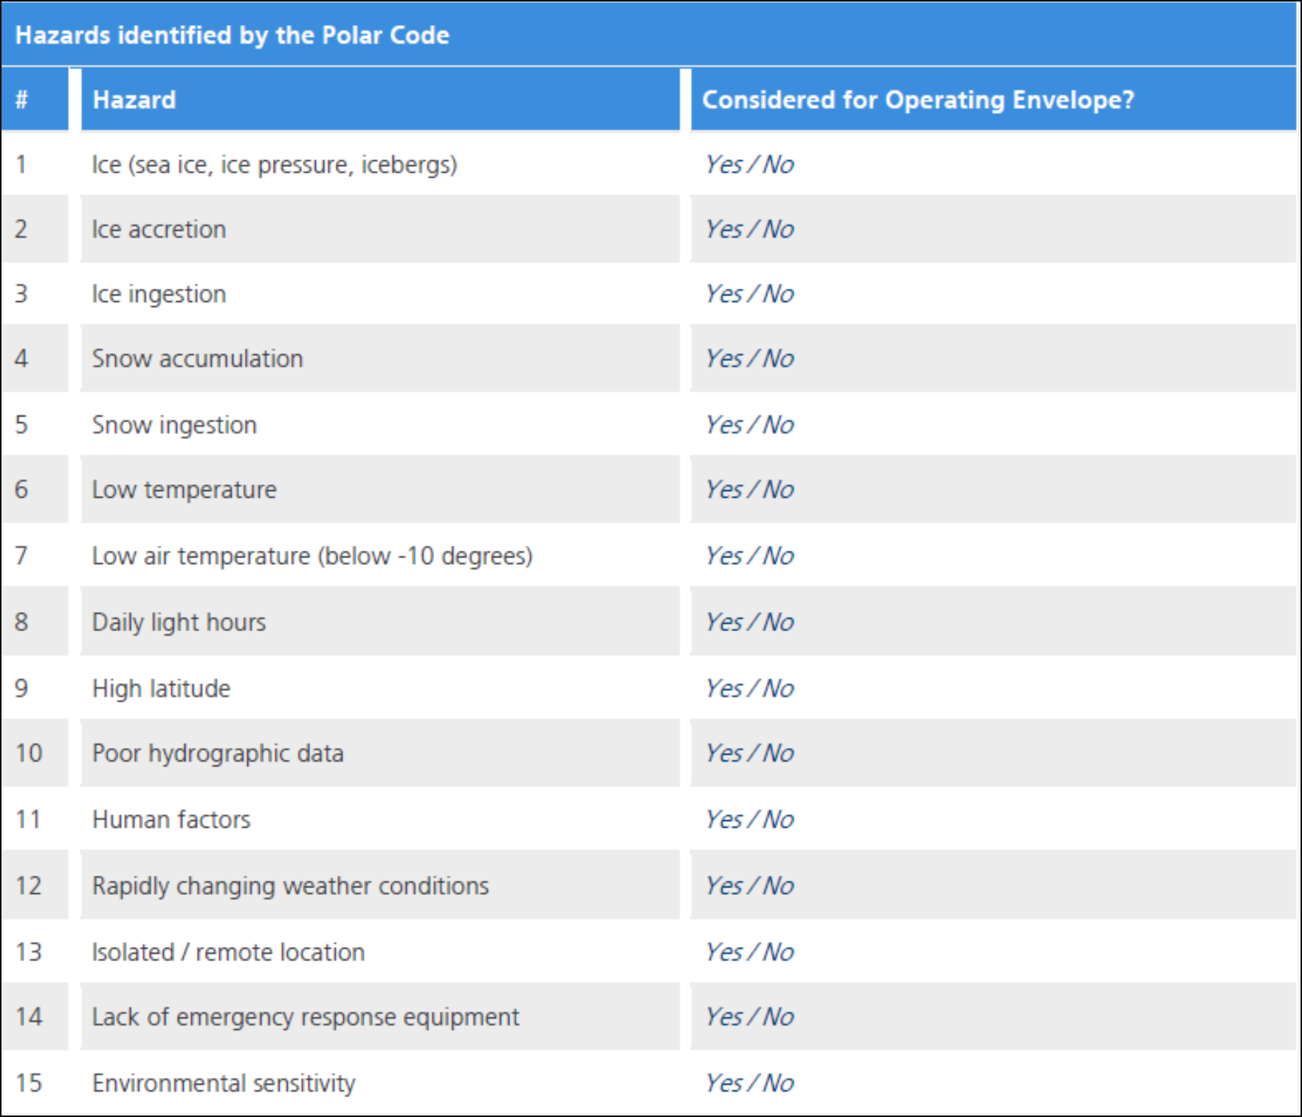
APPENDIX 2 - Model Table of Contents for the Polar Water Operational Manual (PWOM)
Example
Operations in ice. 1.1 Operator guidance for safe operation
Guidance: The PWOM should establish the means by which decisions as to whether ice conditions exceed the ship’s design limits should be made, taking into account the Operational Limitations on the PSC. An appropriate decision support system, such as the Canada’s Arctic Ice Regime Shipping System, and/or the Russian Ice Certificate as described in the Rules of Navigation on the water area of the Northern Sea Route, can be used... Bridge personnel should be trained in the proper use of the system to be utilized. For ships that will operate only in ice-free waters, procedures to ensure that will keep the ship from encountering ice should be established.

Slide 7
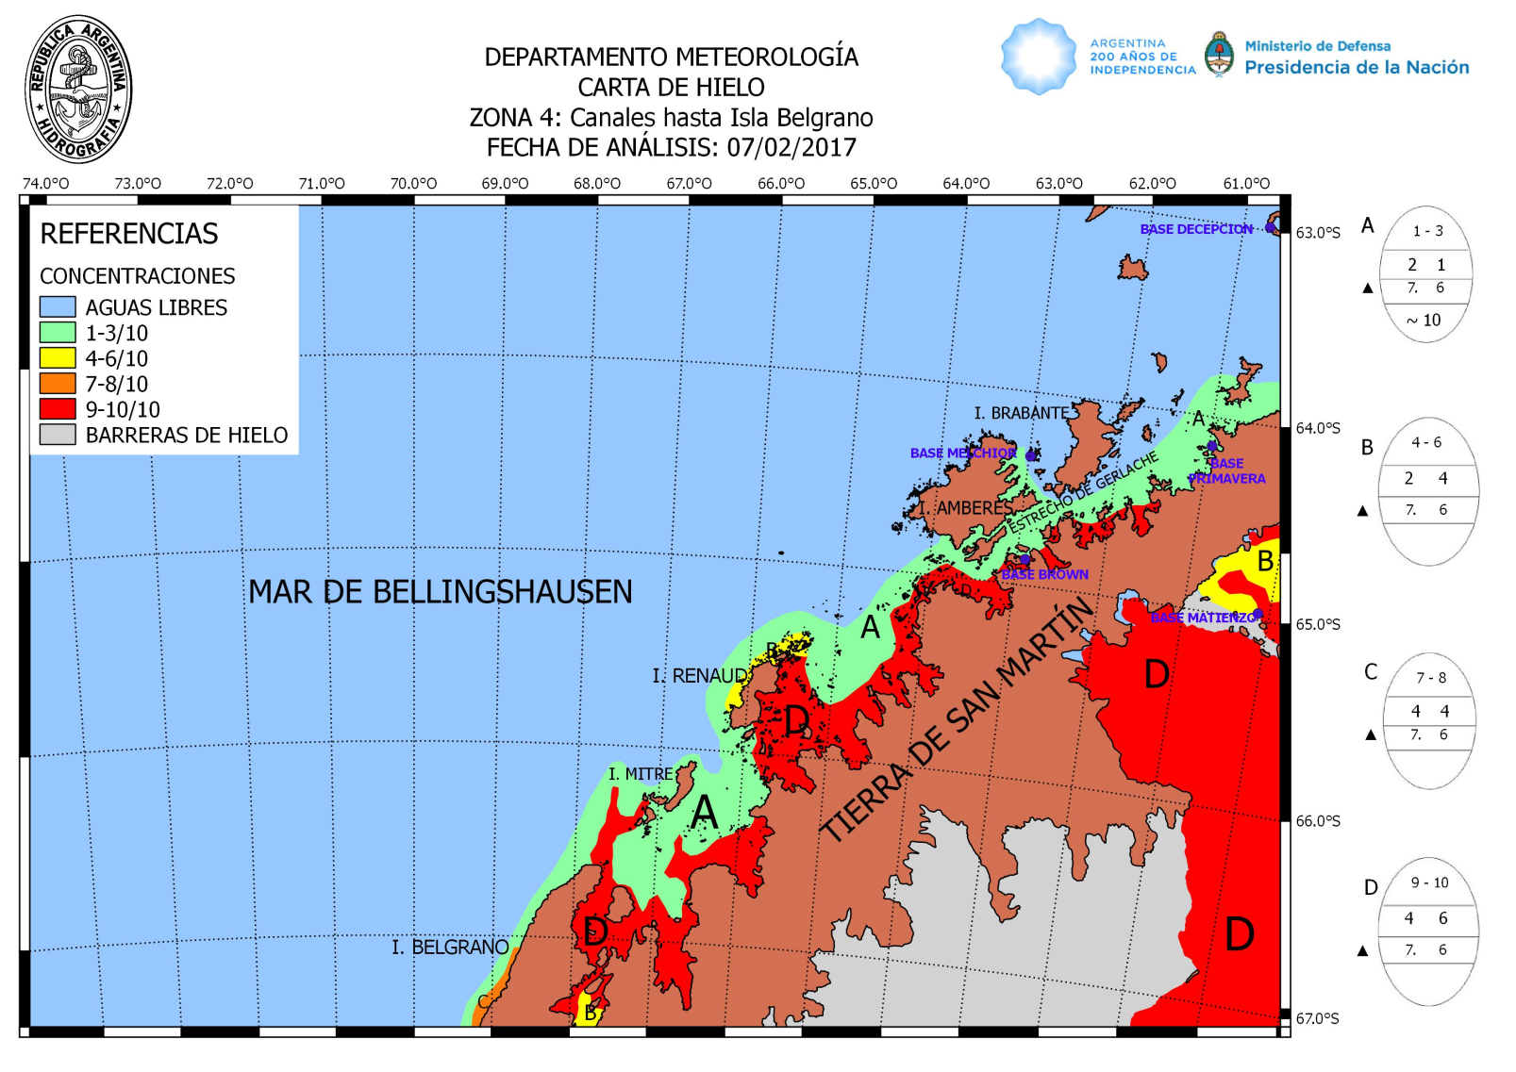
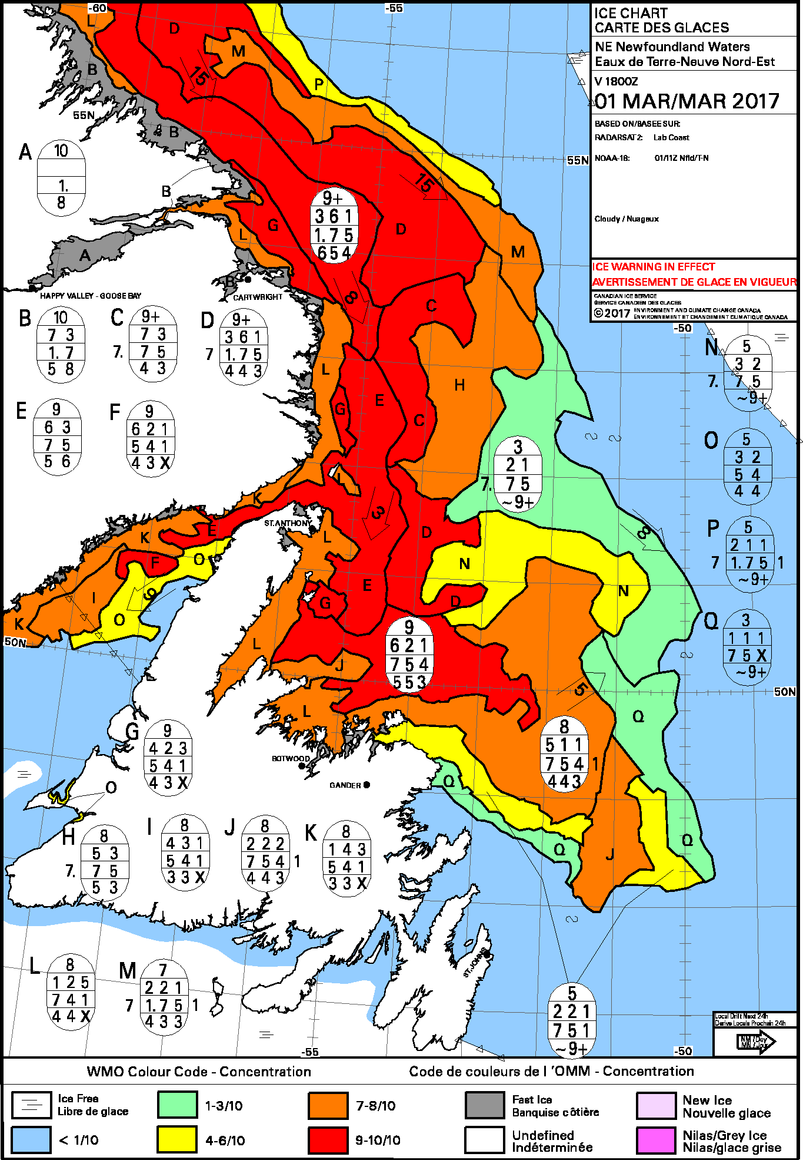
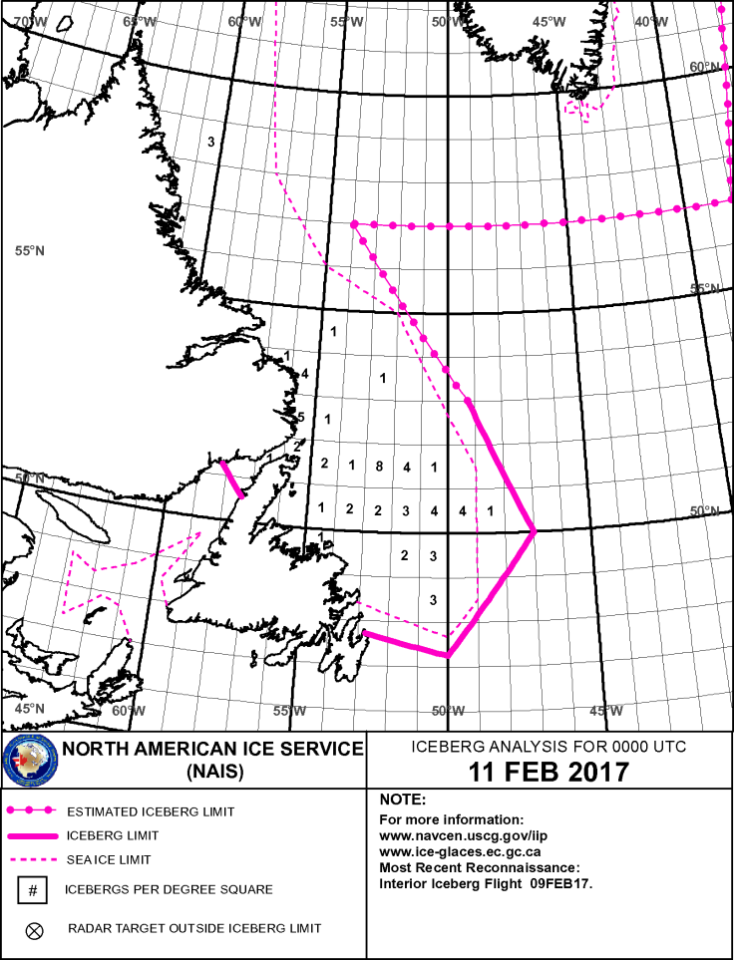
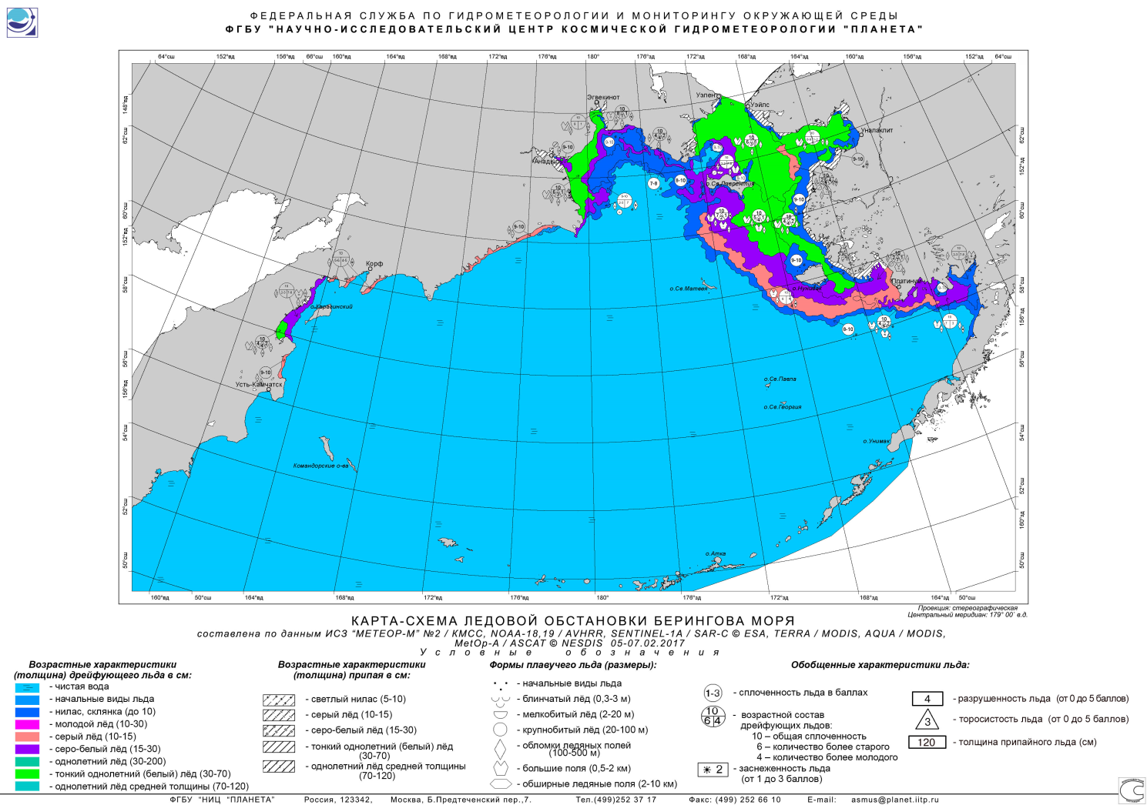
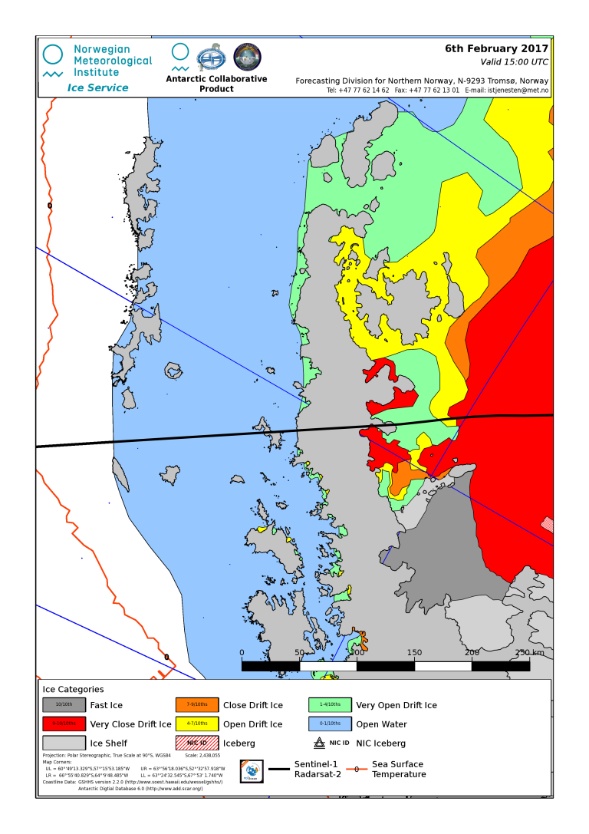
Ice charts for navigation issued daily from government services
Notes:
New Polar shipping regulations are coming into force from 2017-18, implemented by the International Maritime Organization, also known as the Polar Code, which is a new set of regulations addressing shipping safety and environmental protection in Polar Waters. A significant part of the Polar Code is not new to the industry as it is based on recognized guidelines, recommendations, operators experience, best industry practice on reducing navigation risk in ice infested waters

Slide 8
Three types of vessels use of ice-metocean information for risk management
Requirement for Type of operation | Historical information | Current information | Forecast information
Operations in ice | Parameter portfolio ”in ice” | Parameter portfolio ”in ice” | Parameter portfolio ”in ice”
Operations near ice edge | Parameter portfolio ”near ice edge” | Parameter portfolio ”near ice edge” | Parameter portfolio ”near ice edge”
Operations far from ice | Parameter portfolio ”avoid ice” | Parameter portfolio ”avoid ice” | Parameter portfolio ”avoid ice”
→ Break down to specific vessel ice class and requirements …
Notes:
New Polar shipping regulations are coming into force from 2017-18, implemented by the International Maritime Organization, also known as the Polar Code, which is a new set of regulations addressing shipping safety and environmental protection in Polar Waters. A significant part of the Polar Code is not new to the industry as it is based on recognized guidelines, recommendations, operators experience, best industry practice on reducing navigation risk in ice infested waters

Slide 9
Status, gaps to address for Ice Services
Historical data to shipping overall OK
some harmonization , more parameters, display tools needed
Current icemetocean info overall OK
                Benefit from high res data
                Benefit from large data volume
                Automated versus manual production chain
                Customized products, formats to mariners
                Update frequency
                Ice parameters significanse in satellite data
Forecasts icemetocean room for improvement
resolution near shore
                short time/spatial scales for tactical navigation
integration of high resolution satellite data in models
Notes:
New Polar shipping regulations are coming into force from 2017-18, implemented by the International Maritime Organization, also known as the Polar Code, which is a new set of regulations addressing shipping safety and environmental protection in Polar Waters. A significant part of the Polar Code is not new to the industry as it is based on recognized guidelines, recommendations, operators experience, best industry practice on reducing navigation risk in ice infested waters

Slide 10
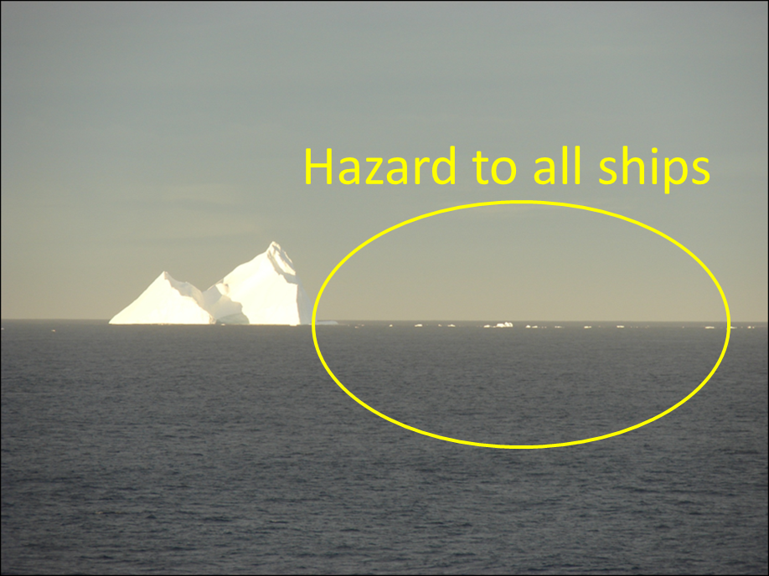
Ice centers addressing IceMetOcean and Polar Code :
Serve ships where ships go (in ice, near ice edge, far from ice edge)
Serve different types of ships (from ”no ice class” to ”Polar Class Icebreakers”)
Ability to provide relevant historical icemetocean information (marine climatology, planning)
Ability to provide relevant current icemetocean information (situational awareness)
Ability to provide necessary icemetocean forecasts (along route safety and decision making)
Many routine products and services already available !
Understand our users requirements
Make ice products visible and easy accessible
Understand shipping/market development
Sea ice retreat impact on shipping
INTERNATIONAL COLLABORATION !
Notes:
From the DMI side we have decided to review what we already do, include technical advances and most important discuss the issue with major users and clients at meetings and workshops
International ice services have the same challenge so secondly we will be very focused on international collaboration, learn from each other, harmonize products etc. We are already in close contact with the North American Ice Service and look forward to the outcome

Slide 11
Ice services can individually / jointly decide what they consider as best practice:
    Best products suite
    Government services available for all
    Commercial services
→ Developed in cooperation withmarine community, insurance, regulators, authorities…
→ within the WMO / JCOMM framework (ncluding IMO/IHO ?)
→ JCOMM ETSI to provide advice, guidance to ice charting community (IICWG)
Notes:
New Polar shipping regulations are coming into force from 2017-18, implemented by the International Maritime Organization, also known as the Polar Code, which is a new set of regulations addressing shipping safety and environmental protection in Polar Waters. A significant part of the Polar Code is not new to the industry as it is based on recognized guidelines, recommendations, operators experience, best industry practice on reducing navigation risk in ice infested waters

