Slide 1

ETSI-6/GDSIDB-14/Doc. 2.2
Report of ETSI Chair
Dr Vasily Smolyanitsky
Arctic and Antarctic Research Institute (AARI)
St.Petersburg, Russia
EXPERT TEAM ON SEA ICE (ETSI)
Sixth Session
STEERING GROUP FOR THE PROJECT GLOBAL DIGITAL SEA ICE DATA BANK (GDSIDB)
Fourteenth Session
Helsinki, 28 February to 3 March 2017

Slide 2
Sea ice / <ETSI & IICWG> activities concept schema
GMDSS polar components
GFCS
CryoNet
WIS
SaftyNet NAVTEX text
RFx transmission
Ice charting
Ice obs
Docs
Integrated
Ice Services
Charting, Obs
SAR/Vis/IR imagery
Ice forecasts
MetOcean
Docs
Training
ENC/ECDIS

Slide 3
ETSI ToR and membership (JCOMM-4 resolution 12.4/4)
Up to eight core-Members, including the chairperson, representative of a range of activities related to sea ice and the ice-covered regions within JCOMM, and to maintain an appropriate geographical representation.
ETSI representatives will also act as full members of ETMSS and ETMC.
Representatives of regional and international sea ice bodies in particular the Baltic Sea Ice Meeting, European Ice Service, International Ice Charting Working Group and North American Ice Service
Additional experts may be invited as appropriate, representative of the range of activities related to sea ice
Alvaro SCARDILLI (Argentina)
Darlene LANGLOIS (Canada)
Gonzalo CONCHA (Chile)
Sihai LI (China)
Keld QVISTGAARD (Denmark)
Antti KANGAS (Finland)
Jurgen HOLFORT (Germany, vice-chair)
Keiji HAMADA (Japan)
Nicholas HUGHES (Norway)
Vasily Smolyanitsky (Russia, chair)
Caryn PANOWICZ (USA)
Part of the Team is the Task Group on Electronic Navigational Chart Ice Objects (TG ENCIO) with an objective “to develop and to maintain an international standard for Ice Objects as a class of Marine Information Objects (MIO) for ENC

Slide 4
ETSI WP for 2012-2017
Current ETSI WP developed at ETSI-V (March 2014) on the basis of the JCOMM intersessional work programme, decisions of the 7th Session of the Services Coordination Group (Tokyo, Japan March 2013).
Recommendations from the 4th Sessions of the ETMSS are also used in the past intersessional work.
A significant impulse for the current ETSI work is from the 5th Ice Analysts Workshop (IAW-5) carried out jointly by the Team and IICWG with support from the ESA, in May 2016, US National Ice Center.
Key issue of the Team’s activity included
  response to a new level of requirements for sea ice products and services and, as a part of that support for ENC/ECDIS,
  support for extending nomenclature and formats for coding, exchange and archival of sea ice and icebergs products
  support for full operational capability of the Arctic METAREAS XVII-XXI
  extending sea ice and icebergs analysis within the METAREAs of the Southern Ocean.

Slide 5
ETSI WP projects for 2013-2017
Project #13: Training and capacity development for sea ice
Project #26 Support and enhance the polar components of GMDSS
Project #27: Support and enhance ENC/Electronic Chart Display Information System (ECDIS) for ice navigation
Project #28: Maintain and update sea ice technical documentation
Project #29 Support for Sea ice climatology and ice in information systems
Project #31: Enhance the integrated ice services and forecasting

Slide 6
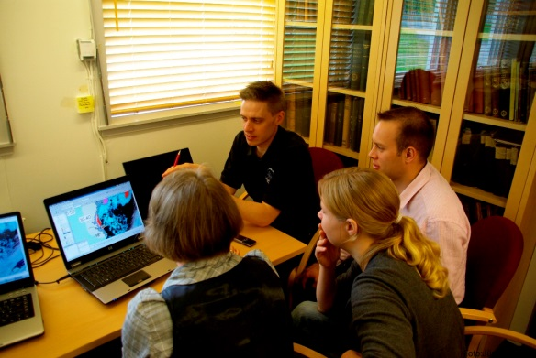
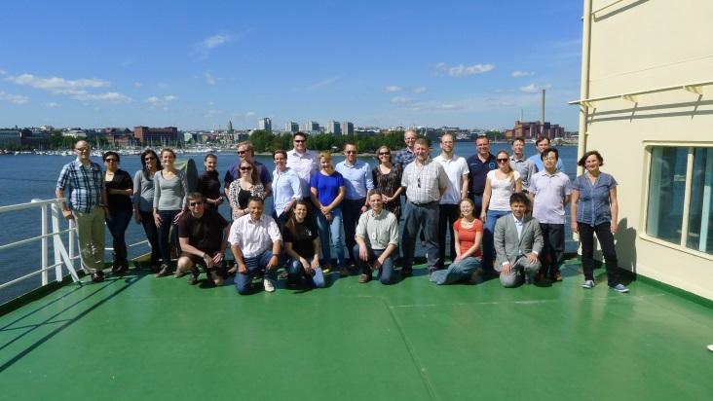
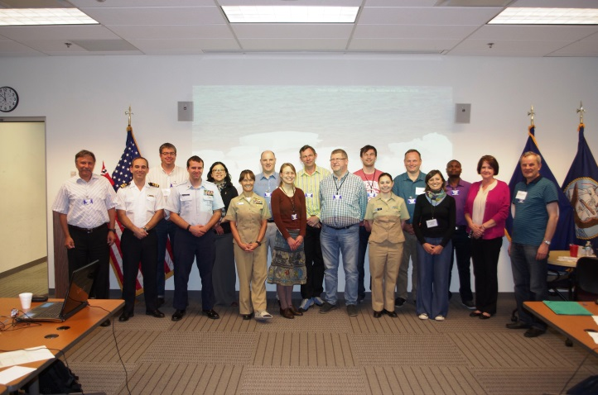
#13 Support Capacity Development workshops
4th “Ice Analysts Workshop” (IAW) held in June 2014 (FMI, Helsinki)
  cases studies for sea ice analysis during dynamic processes
  in transition periods (melt, freeze-up),
  Southern Ocean sea ice analysis
  production of the GMDSS reports.
  procedures and software initially developed for the Arctic Ocean METAREAs were tested for the Antarctic waters.
IAW-5 held in May 2016 (NIC, Washington DC)
  very successfully contributed to the training in the Southern Ocean sea ice and icebergs analysis
  construction of the GMDSS SafetyNet bulletins using open-source Bifrost GIS developed by NIS
  developing new specifications for icebergs in GMDSS and SIGRID-3 format.

Slide 7
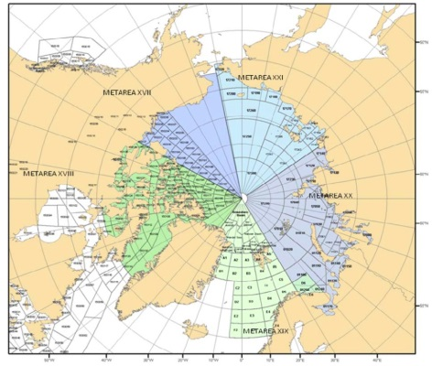
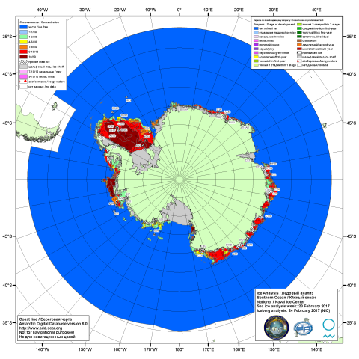
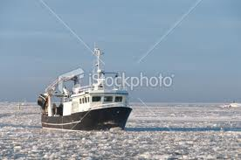

#26 Support and enhance the Polar components of GMDSS
Consolidated input for the new 558 edition developed by ETSI-5 further cross-checked In October 2015 – January 2017 with corrections provided to ETMSS
Harmonization of the ice in SavetyNET bulletins is now regularly examined for the Arctic METAREAs by ETSI and IICWG. Content of the bulletins as shape-files is available at http://gmdss.aari.ru.
Extension of experience to the SO METAREA as well as other METAREAs with sea ice presence is from 2014 a regular agenda item for ETSI/IICWG meetings. Standards for the iceberg presentation in SIGRID-3
From December 2014 Russia, the United States and Norway commenced cooperative production of weekly Antarctic ice and icebergs charts (http://ice.aari.aq), which initially they had been doing separately. Additionally 2015, the Argentine Naval Hydrographic Service commenced regular ice chart production.
In tight collaboration with IICWG, led by David Jackson (CIS), the ETSI has followed the development of the Mandatory Polar Code at the IMO and provided consolidated and harmonized view of the national ice services on the matter to IMO (requirements for ice information, Ice Navigator training and POLARIS decision making system for ice navigation)

Slide 8
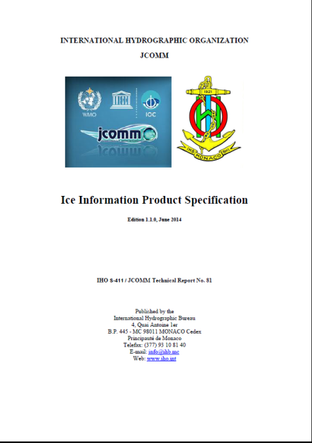
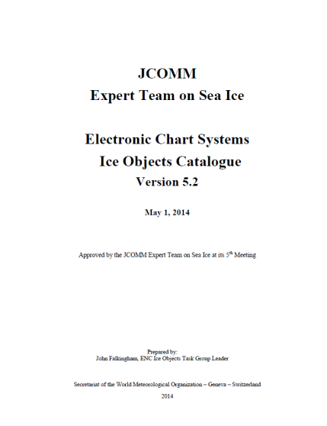
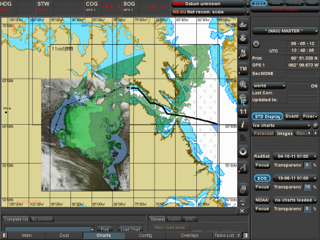
#27 Support and enhance ENC/ECDIS for ice navigation
Version 5.2 of the “Ice Object Catalogue” (JCOMM-TR-080) developed and adopted by ETSI in May 2014.
Version 1.1.0 “S-411 Ice Information Product Specification” (JCOMM-TR-081) produced by BSH as part of JCOMM/ETSI, adopted by ETSI in June 2014.
  S-411 includes specifications for encoding the sea ice for navigational purpose as well as portrayal for polygon, linear and point ice classes, all fully compliant with the WMO Sea-Ice Nomenclature, Vol.III.
Interactions with ENCS manufactures on S-411 support in corresponding SDKs were initiated in August 2014, including Canada, Germany and Russia.
ETSI progressive reports on S-411 and Ice Objects Catalogue submitted to IHO HSSC in Nov 2014 and Nov 2015.
The BSH is managing software and is carrying out conversion of the Arctic and Antarctic ice charting material in SIGRID-3 exchange format from the national ice services to S-411.

Slide 9
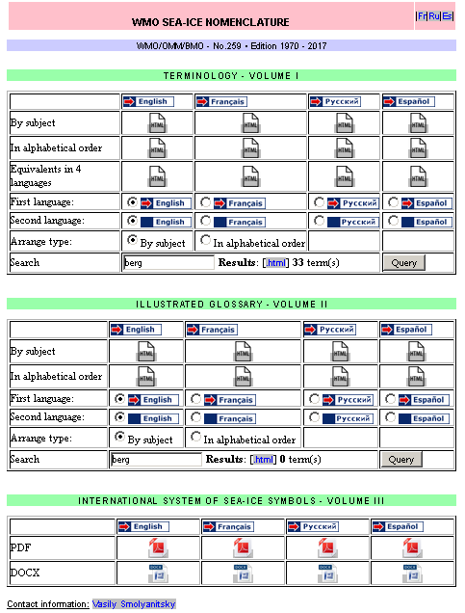
#28 Maintain and update sea ice technical documentation
The WMO-No.259 Sea-Ice Nomenclature Vol. I was updated by ETSI-V in March 2014 with 27 new terms, 2 terms amended.
  The new terms included definitions for lake ice thus answering request from the Cryonet for a comprehensive ice format.
Version 3 of the SIGRID-3 exchange format developed and adopted by the ETSI in May 2014.
  now states for “Sea-Ice Georeferenced Information and Data”,
  fully harmonized with the “Ice Objects Catalogue”,
  supports both the sea and fresh-water ice analysis and observation
Version 1.1 of the Ice Chart Color standard was developed and adopted by ETSI-V in March 2014.
Further additions to SIGRID, Ice Chart Color standard and the WMO Sea-Ice Nomenclature will be discussed during ETSI-VI
  new colour portrayal and additional symbology for icebergs and ice edge/limit related ice features.
A consolidated section for sea ice regulatory documents is now maintained at JCOMM publication site and at the GCW portal.

Slide 10
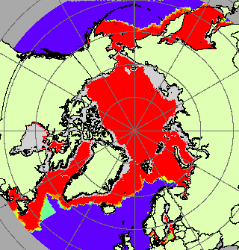
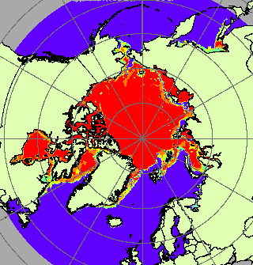
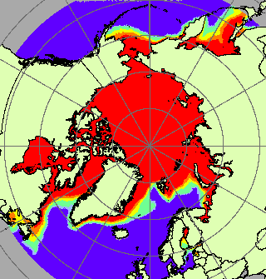
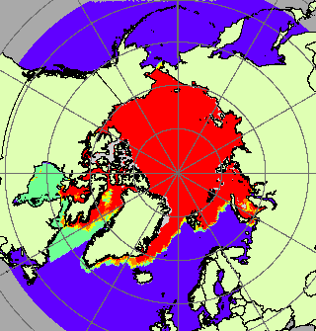
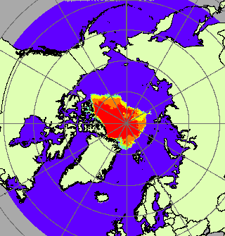
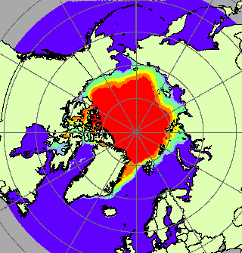
#29 Support for Sea ice climatology and ice in information systems (2)
Global Digital Sea Ice Data Bank (GDSIDB) depositories at AARI and NSIDC are regularly updated with the routine sea ice charting material from the national ice services (5-7 days charts)
Contains ice charting material in SIGRID (1,2,3) spanning period 1933-2016 from BSIM, Canada, Denmark, Japan, Russia, USA
Blended sea-ice climatology is now accepted by the ETSI-5 (March 2014) and by ETMC-5 (June 2015) as a practical approach to present sea ice charting material for scientific community.
The ETMC-5 agreed on reinforcement of the GDSIDB by integration with the Marine Climate Data System (MCDS) as a CMOC,
  accomplishment of that is a critical task the team for next years.
Most likely availability of the historical sea ice charting material in WIS will be achieved through integrating GDSIDB and GCW portal resources.
March: Max, Min and Med (blended)
September: Max, Min and Med (blended)

Slide 11
Major themes for ETSI-VI/GDSIDB-XIV
Update on services and best practices and new edition of the WMO-574
GMDSS polar components, jointly with ETMSS with a final check of WMO-558 & 471 including coding of icebergs information
Updates to the WMO Sea Ice standards - SIGRID-3, Colour Standard and Sea Ice Nomenclature
Sea ice in ECDIS (additions Ice objects Catalogue, S-411, S-412)
Polar code and future concept of the ice services related to implications of Polar Code/ e-navigation, portfolios and predefined packages
Sea ice climatology and sea ice in Marine Climate Data System
Support for GCW (WIGOS, CryoNet), YOPP, Arctic PRCC-network, GEBCO
Presentation for JCOMM-V

