Slide 1
TC Warnings and need to update guidelines for ship decision making

Slide 2
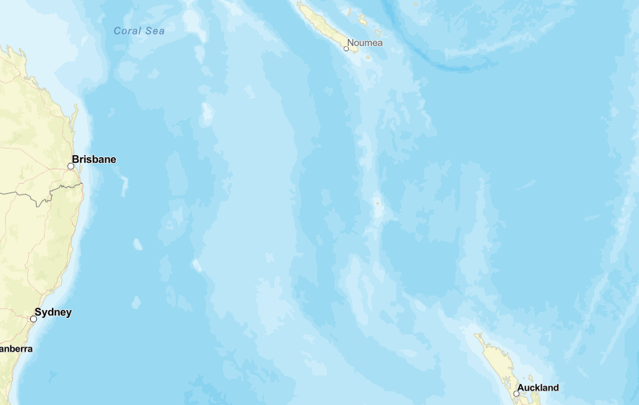
Day 0
Tropical Cyclones travel ~100nm in 24 hours
+24hrs
+24hrs
Ships travel ~200nm in 24 hours

Slide 3
Day 1
+24hrs
+24hrs

Slide 4
Day 2
+24hrs

Slide 5
Cost of route change at last minute
+24
T0
+48
Decision made 48 hours earlier would yield an 8 hour time and fuel advantage
Decision based on 24 hour lead-time would cost 8 hours in time and fuel, and risk safety of crew and vessel

Slide 6
Considerations
Need to update avoidance tactics to consider WWMIWS TC warning service and forecast positions.
Promote the WWMIWS TC warning service

Slide 7
Considerations
Typical radius of gales is 100nm
This equates to 12 hours travel time.
Need to update education to mariners
“Stay 12 hours transit time or 100nm away from a TC.”

