Slide 1

METAREA VI
Report

Slide 2
Service-related activities:

Slide 3
MARINE SERVICES
INTENDED IMPLEMENTATION: ENDING OF 2018
Redefinition of subareas within MetArea VI
New coastal bulletin
New procedures are being implemented for cases of accidents that occurred on the Argentinian maritime platform.

Slide 4
MARINE SERVICES
Services for the high seas
Services for coastal waters “coastal waters will be considered within the range of maritime zone 1 and of the dsc in vhf. (50 nm)”
Offshore Services “offshore waters will be defined as beyond coastal waters up to a certain limit (250 mn)”
For the above Services, the Wind Warnings will be issued as a separate product.

Slide 5
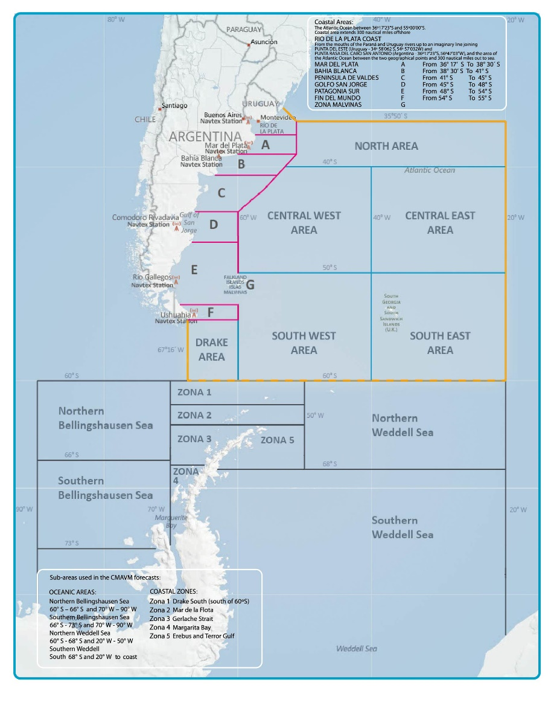
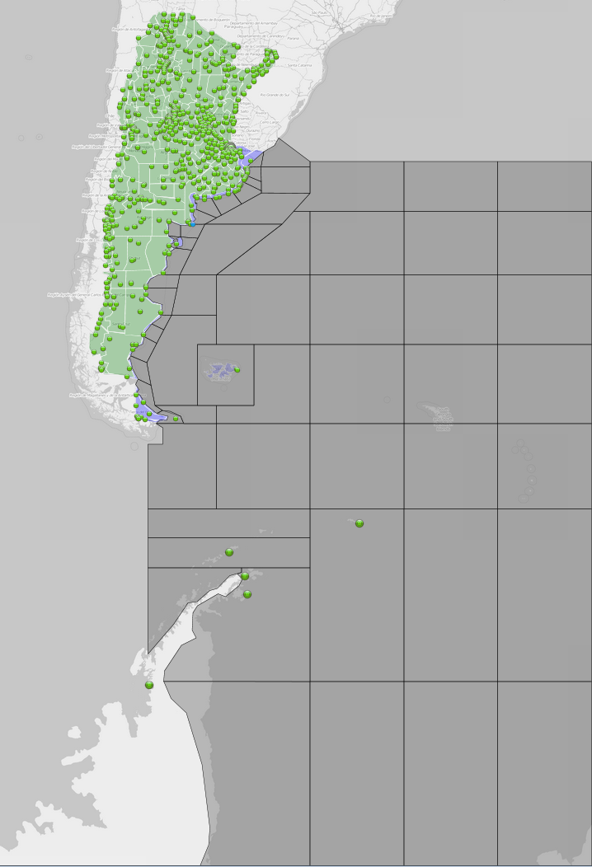
REDEFINITION OF SUBAREAS WITHIN METAREA VI
(scheduled implementation: December 2018)
Current
Redefinition

Slide 6
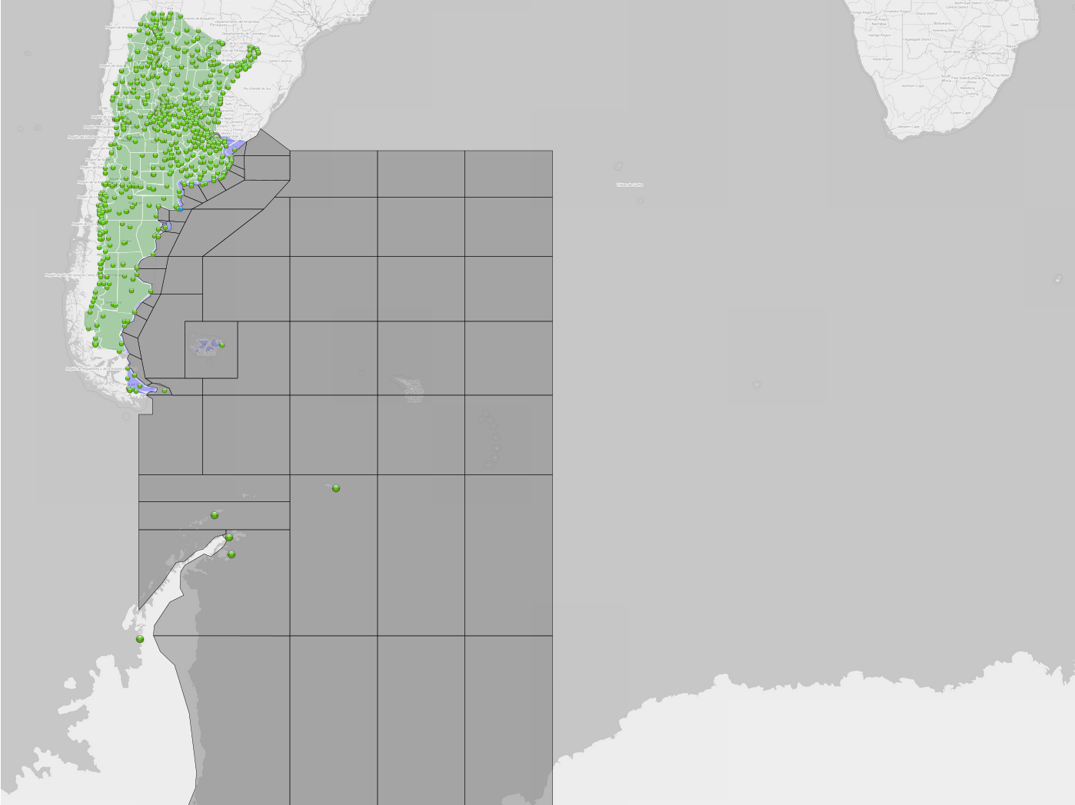
AREAS OF RESPONSIBILITY
Redefinition of the sub-areas used by the NWS to conform to the limits of the METAREAS

Slide 7
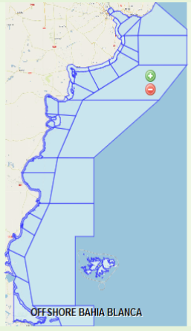
NEW SERVICES FOR COASTAL WATER AND REDEFINITION OF OFFSHORE COAST
Procedures for Wind Warnings
issued as a separate product

Slide 8
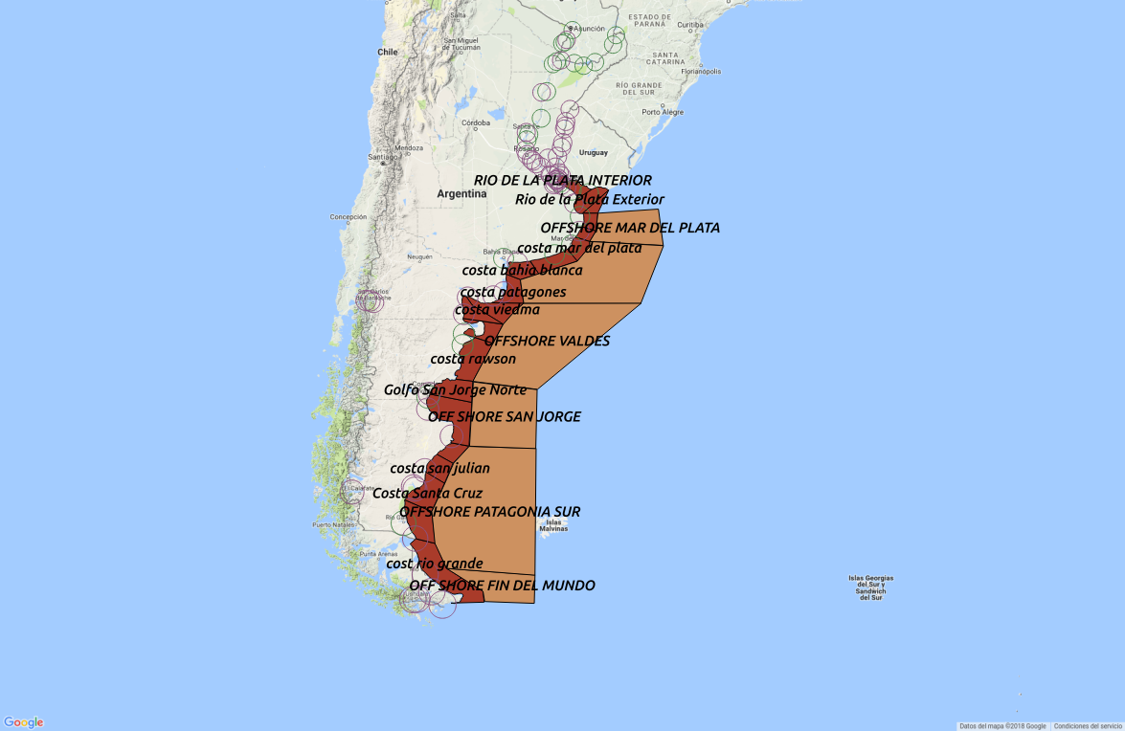
NAVTEX STATIONS
Coastal coverage

Slide 9
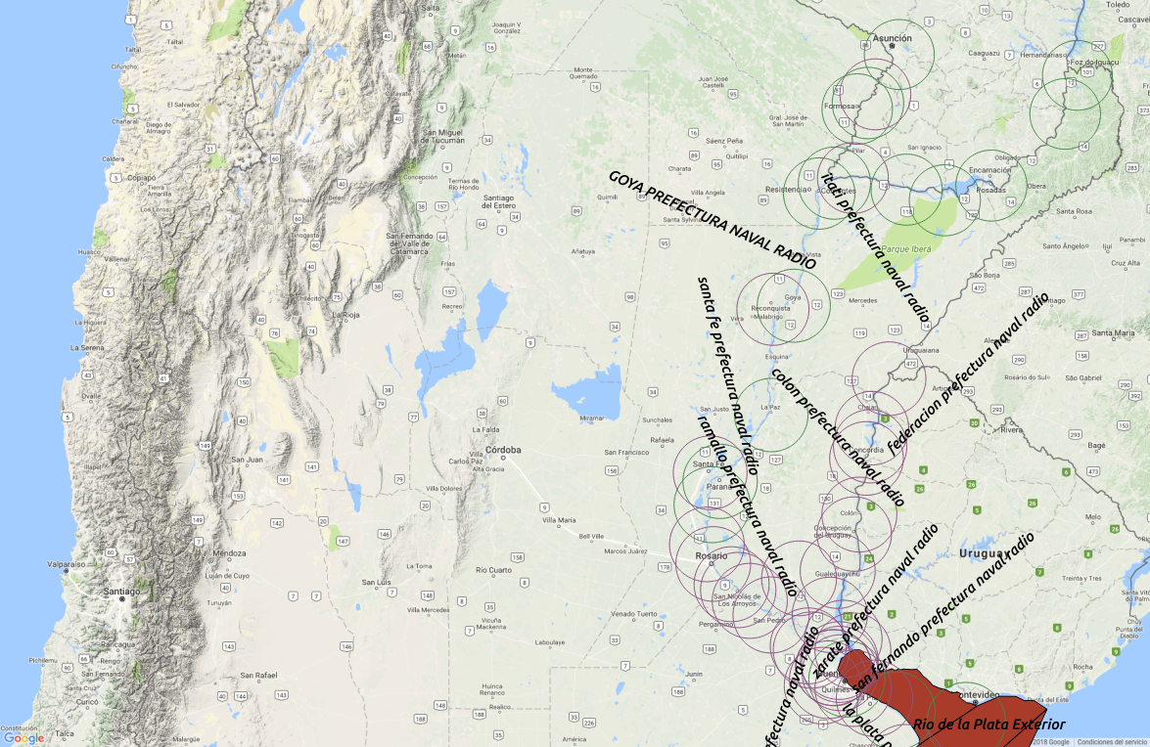
RIVERS FORECASTS NEW BULLETINS
In the most important navigable rivers

Slide 10
EXAMPLES OF
CURRENT AND NEW HIGH SEA WARNING
CURRENT BULLETIN
WWST02 SABM 201200
1:31:06:01:00
SECURITE
WEATHER BULLETIN FOR SHIPPING - METAREA 6-
2018-08-20, 12:00 UTC.
NATIONAL WEATHER SERVICE
SEA ICE AND ICEBERGS ISSUED BY SHN
PRESSURE HPA
BEAUFORT SCALE WINDS.
PART 1 GALE WARNING:
WARNING 318: STRONG BARIC GRADIENT MOV E PROVOKES WINDS FORCE 8 FROM SECTOR W
WITH GUST IN FIN DEL MUNDO COASTS SOUTH EAST AREA (50S- 60S AND 20W- 40W) SOUTH
WEST AREA (50S- 60S AND 40W- 60W) DRAKE AREA (55S- 60S AND 60W- 67W)
PART 2 GENERAL SYNOPSIS AT 09:00UTC
LOW 1015HPA 35S 46W MOV SE DPN EXP 42S 45W BY 21/1200 EXTENDS CFNT AT 36S 46W
34S 47W 30S 48W MOV E ASOCIATED WITH WFNT AT 36S 46W 40S 43W 43S 35W
LOW 1024HPA 37S 52W MOV SE EXP 42S 47W BY 21/1200 EXTENDS OFNT AT 36S 47W 40S
51W 36S 55W MOV E
LOW 973HPA 60S 76W MOV E DPN EXP 58S 66W BY 21/1200 EXTENDS CFNT AT 58S 76W 55S
80W 49S 85W MOV E ASOCIATED WITH WFNT AT 58S 75W 58S 62W 56S 53W
LOW 949HPA 65S 30W MOV E DPN EXTENDS CFNT AT 60S 23W 55S 30W 55S 50W MOV E
HIGH 1037HPA 36S 64W MOV E NC EXP 35S 63W BY 21/1200 EXTENDS RIDGE AT 36S 63W
NEW HIGH SEA WARNING
WWST02 SABM 0904
1:31:06:11:00
SECURITE
HIGH SEAS WARNING FOR METAREA VI ISSUED BY SMN ARGENTINA 17 AUGUST 2018/1200UTC.
GALE WARNING NRO 63 AREA CENTRO ESTE (N 45 W 30) AREA SUDOESTE (S 55 E 50)
GENERAL SYNOPSIS:
LOW 991HPA PROVOKE WINDS FORCE 8 IN AREA CENTRO ESTE (N 45 W 30) AREA SUDOESTE (S 55 E 50)
FROM 17 AUGUST 2018 1200 UNTIL 18 AUGUST 2018 0600 UTC.
FORECAST:
AREA CENTRO ESTE (N 45 W 30):E 8/7 BACK ENE 7 .OCCASIONAL RAIN LATER SPRAY , ICE PELLETS TOWARDS THE END OF THE PERIOD.WAVES ENE 1.5/1 LATER NE 1.5.GOOD.
AREA SUDOESTE (S 55 E 50):WNW 6 BACK NW 6 BACK NNW 5.OCCASIONAL RAIN LATER PROB RAIN.WAVES N 1.5/2 LATER NE 2.GOOD OR MODERATE.
----------------------------------------------------------------- NNNN=

Slide 11
EXAMPLES OF
CURRENT AND NEW COASTAL WARNING
CURRENT BULLETIN
WWST02 SABM 201200
1:31:06:01:00
SECURITE
WEATHER BULLETIN FOR SHIPPING - METAREA 6-
2018-08-20, 12:00 UTC.
NATIONAL WEATHER SERVICE
SEA ICE AND ICEBERGS ISSUED BY SHN
PRESSURE HPA
BEAUFORT SCALE WINDS.
PART 1 GALE WARNING:
WARNING 318: STRONG BARIC GRADIENT MOV E PROVOKES WINDS FORCE 8 FROM SECTOR W
WITH GUST IN FIN DEL MUNDO COASTS SOUTH EAST AREA (50S- 60S AND 20W- 40W) SOUTH
WEST AREA (50S- 60S AND 40W- 60W) DRAKE AREA (55S- 60S AND 60W- 67W)
PART 2 GENERAL SYNOPSIS AT 09:00UTC
LOW 1015HPA 35S 46W MOV SE DPN EXP 42S 45W BY 21/1200 EXTENDS CFNT AT 36S 46W
34S 47W 30S 48W MOV E ASOCIATED WITH WFNT AT 36S 46W 40S 43W 43S 35W
LOW 1024HPA 37S 52W MOV SE EXP 42S 47W BY 21/1200 EXTENDS OFNT AT 36S 47W 40S
51W 36S 55W MOV E
LOW 973HPA 60S 76W MOV E DPN EXP 58S 66W BY 21/1200 EXTENDS CFNT AT 58S 76W 55S
80W 49S 85W MOV E ASOCIATED WITH WFNT AT 58S 75W 58S 62W 56S 53W
LOW 949HPA 65S 30W MOV E DPN EXTENDS CFNT AT 60S 23W 55S 30W 55S 50W MOV E
HIGH 1037HPA 36S 64W MOV E NC EXP 35S 63W BY 21/1200 EXTENDS RIDGE AT 36S 63W
NEW COASTAL WARNING
FQST02 SABM 101200
1:31:06:01:00
SECURITE
COASTAL WARNING FOR METAREA VI ISSUED BY SMN ARGENTINA 17 AUGUST 2018/1200UTC.
GALE WARNING NRO 65 BAHIA BLANCA CARMEN DE PATAGONES COMODORO RIVADAVIA
GENERAL SYNOPSIS:
STRONG GRADIENT
PROVOKES WINDS FORCE 8-9 IN BAHIA BLANCA CARMEN DE PATAGONES COMODORO RIVADAVIA
FROM 17 AUGUST 2018 1500 UNTIL 18 AUGUST 2018 0000 UTC.
FORECAST:
BAHIA BLANCA:NNE 2 BACK E 2 AUMTD 3 BACK NW 2 BACK NNE 2.WAVES VRB 1.GOOD.
CARMEN DE PATAGONES:N 2 BACK NNW 2 BACK NNE 2 BACK NNW 2 BACK N 2.WAVES VRB 1.GOOD.
COMODORO RIVADAVIA:W 3 BACK SW 3 BACK WNW 1 BACK NNW 1 BACK NNE 2.WAVES VRB 1.GOOD.
----------------------------------------------------------------- NNNN=

Slide 12
VOS PROGRAM STATUS
AND IMPLEMENTATION
Action proposed:
The SMN, through a note, has requested the collaboration of the SHN and the Argentine Navy in the VOS programme.
The recruited vessels would be:
BUQUE OCEANOGRÁFICO PUERTO DESEADO
BUQUE OCEANOGRÁFICO AUSTRAL
BUQUE HIDROGRÁFICO COMODORO RIVADAVIA
TRANSPORTE CANAL BEAGLE
ROMPEHIELOS ALMIRANTE IRIZAR
BUQUE ESCUELA FRAGATA LIBERTAD
AVISO ISLAS MALVINAS
AVISO ESTRECHO SAN CARLOS
AVISO PUERTO ARGENTINO

Slide 13
VOS PROGRAMME STATUS AND IMPLEMENTATION
To achieve the incorporation of these vessels to the VOS Program, it will be necessary to visit each vessel in order to register and verify the meteorological instruments and make the necessary arrangements and/or calibrations to finally obtain the ocean meteorological information.

Slide 14
SMN IMPLEMENTATION OF THE COMPETENCY FRAMEWORK
CURRENT AND EXPECTED STATUS OF IMPLEMENTATION OF
FORECASTERS COMPETENCIES:
National adaptation of the competency framework for aeronautical meteorology personnel:
Started in 2015 - to date, 100% of Aeronautical meteorological forecasters and 50% of Aeronautical Meteorological Observers have been evaluated.
Framework of competencies for forecasters of the volcanic ash advisory center (VAAC Buenos Aires)
Currently under development. Implementation scheduled for the end of 2018.
The next stage is the national adaptation of the competency framework developed for maritime meteorology forecasters.
Forecasters training is being developed as part of the strengthening of their competences.

Slide 15
Recent challenges:

Slide 16
FIRST MetArea COORDINATORS SOUTH AMERICA MEETING
Chile, Brasil, Perú and Argentina
Held on may 30, the first of a series of south American MetArea coordinators meetings have started.
As a result we have identified and discussed several issues:
WE DISCUSSED ABOUT THE WARNINGS AND THE FORECAST OVER LIMITS OF THE METAREAS AND THE FORECASTS SUPERPOSITION. WE KNOW THAT IT IS CONFUSING FOR THE USERS. ALL THE METAREA COORDINATORS WILL WORK ON THIS IMPORTANT TOPIC.
IN METAREA VI, THE NATIONAL WEATHER SERVICE PROCEDURES ARE UNDER REVIEW, INCLUDING MAPS AND BULLETINS. WE DETECTED PROBLEMS REGARDING WARNINGS AND FORECASTS OVERLAPPING.
WE TALKED ABOUT ALL THE DOCUMENTATION FROM THE WMO, AND DECIDED THAT WE WILL HELP EACH OTHER BY MAIL, IN CASE SOMETHING IS NOT CLEAR.
ALL SOUTH AMERICAN METAREA COORDINATORS ARE CONCERNED ABOUT THE COSTS RELATED TO THE ADMISSION OF IRIDIUM ON SAFETYNET.
THE NATIONAL REGULATION FOR THE MARINE METEOROLOGICAL SERVICE OF METAREA V COORDINATOR IS UNDER REVIEW. IT WAS SUGGESTED THAT BORDERING METAREA COORDINATORS SHOULD BE IN CONTACT WITH EACH OTHER, IN CASE OF TROPICAL OR SUBTROPICAL CYCLONES THAT MIGHT POSE A THREAT TO EITHER METAREA.

Slide 17
Education activities:

Slide 18
UNIVERSITY OF BUENOS AIRES
The Department of Atmospheric and Ocean Sciences of the University of Buenos Aires is interested in developing a course on Marine Meteorology as a part of BIP-M. We will work in collaboration with them taking into consideration WMO competencies.
The university is interested in any of these:
Syllabus of similar courses at other Universities.
Text books on the subject used in these courses.
Any other resources or information you consider we should take into account.
Professor in charge: Moira Doyle (doyle@cima.fcen.uba.ar)

Slide 19

Alicia Guadalupe Cejas
Sector Marino
SERVICIO METEOROLOGICO NACIONAL
ARGENTINA
Thank you
Merci
Gracias

