Slide 1
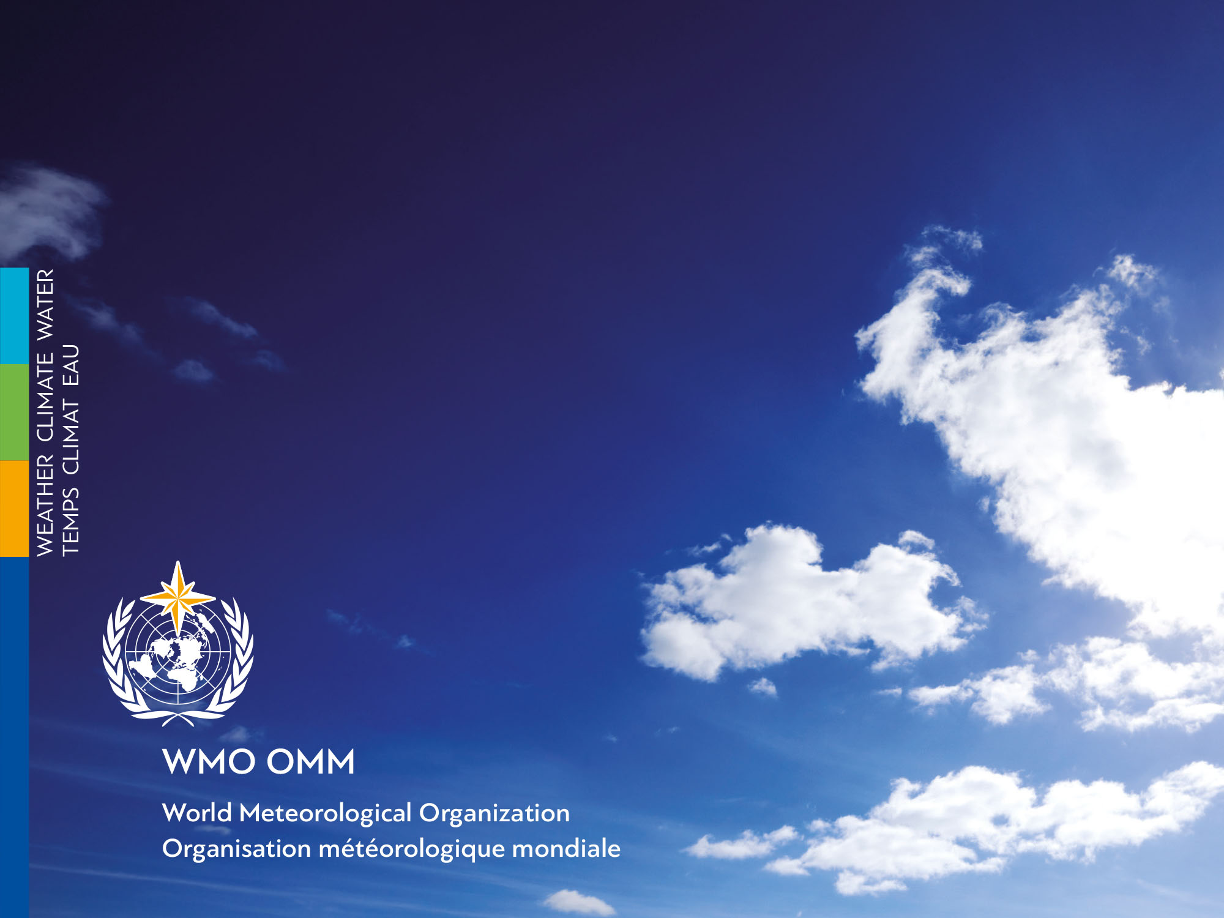
METAREA X
Report
Lucie Blom
WWMIWS-1, August 2018
Australian Bureau of Meteorology

Slide 2
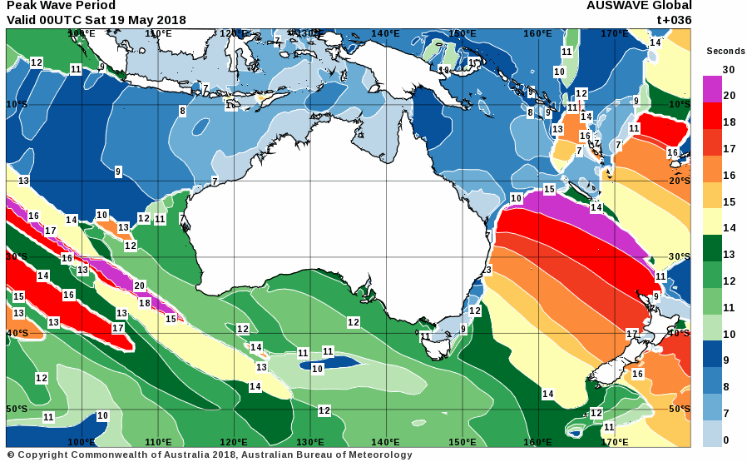
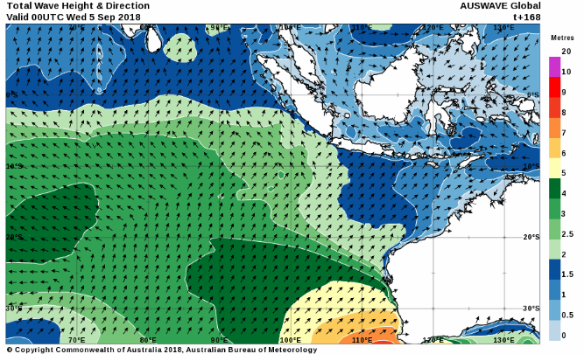
New service-related activities
Charts available on data-lite web services
(e.g. for offshore access, satellite phone)
Notes:
http://www.bom.gov.au/marine/lite/

Slide 3
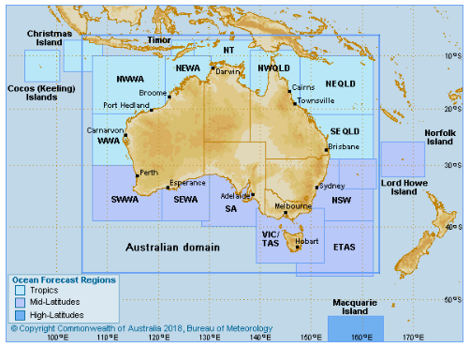
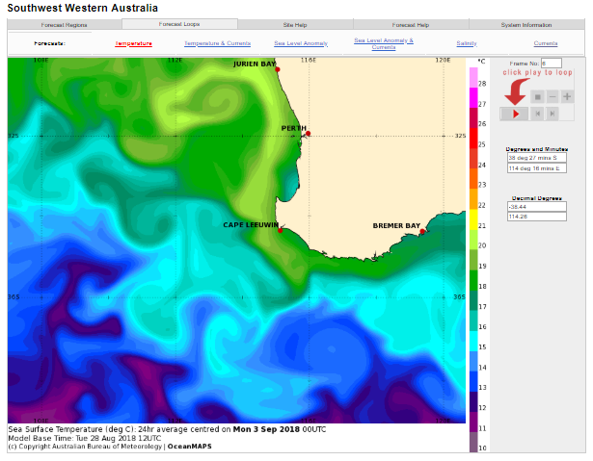
Improved ocean current web viewer
Notes:
http://www.bom.gov.au/oceanography/forecasts/

Slide 4
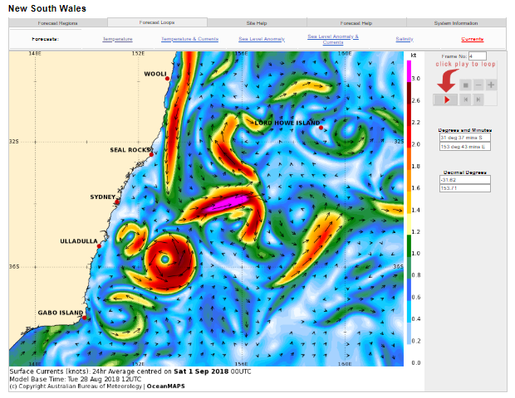

Slide 5
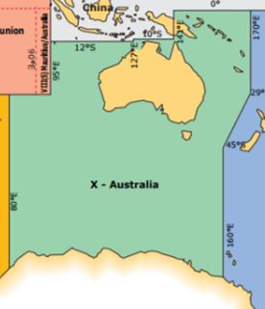
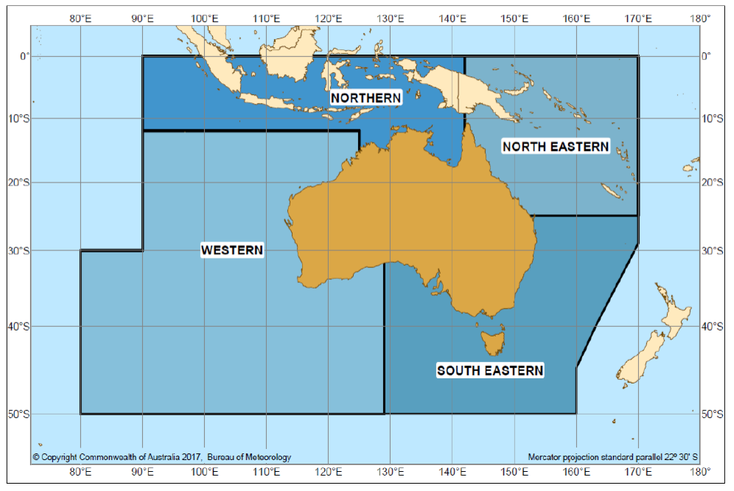
Planned service-related activities
Extend service below 50°S to ice edge
Improvements to wave modelling capabilities, and nomination to become recognized wave modelling centre

Slide 6
Recent challenges encountered with MSI provision or coordination
Interaction of TC warning areas with METAREA boundaries
Coordination with other national met services overlapping in regional areas within METAREA

Slide 7
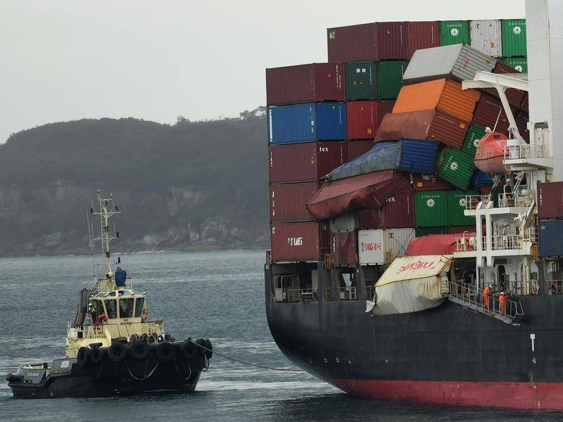
MSI challenge: warnings issued, but incidents still occur…
YM Efficiency lost 81 containers on 1 June 2018
Access to commercial weather routing services and Bureau gale wind warnings
Clean up and investigation ongoing
  43 containers missing
  1042 m³ debris so far
Notes:
https://www.atsb.gov.au/publications/investigation_reports/2018/mair/344-mo-2018-008/
http://www.rms.nsw.gov.au/maritime/using-waterways/container-incident.html
https://www.amsa.gov.au/marine-environment/incidents-and-exercises/locating-containers-lost-ym-efficiency

Slide 8
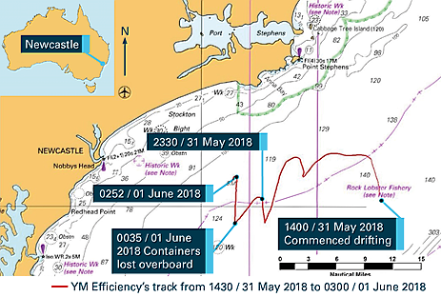
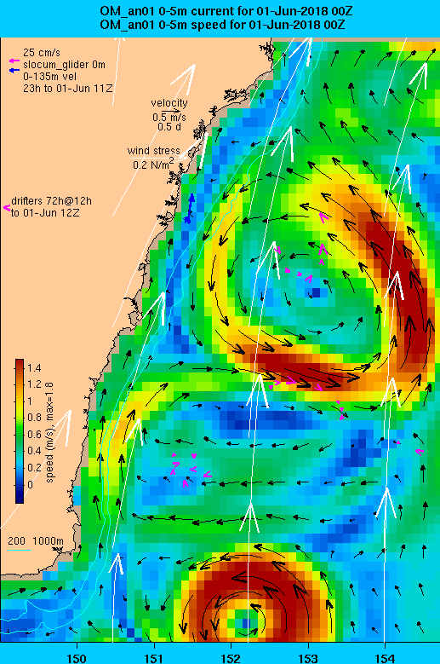
The forecast was for large waves (7m) but ocean currents and steep waves possible factors

Slide 9
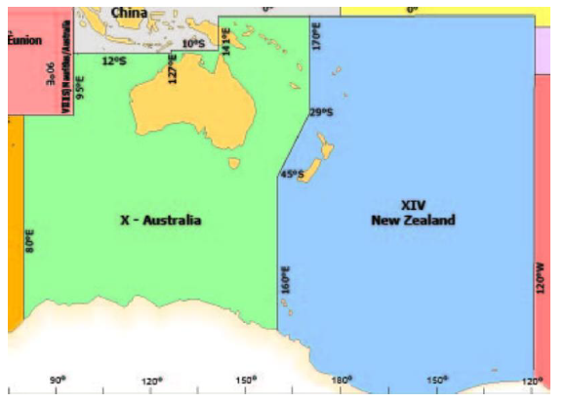
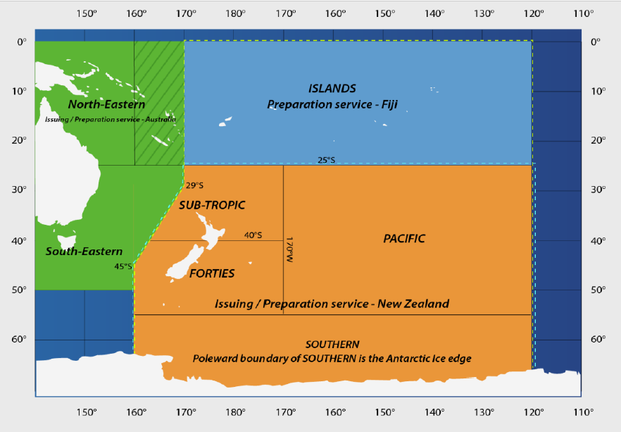
Significant examples of stakeholder interactions or education activities
Boundary alignment with METAREA XIV
AMSA Maritime Emergencies Workshop
Hosted delegation from Korea Meteorological Administration
Feedback via Port Met Officers

Slide 10
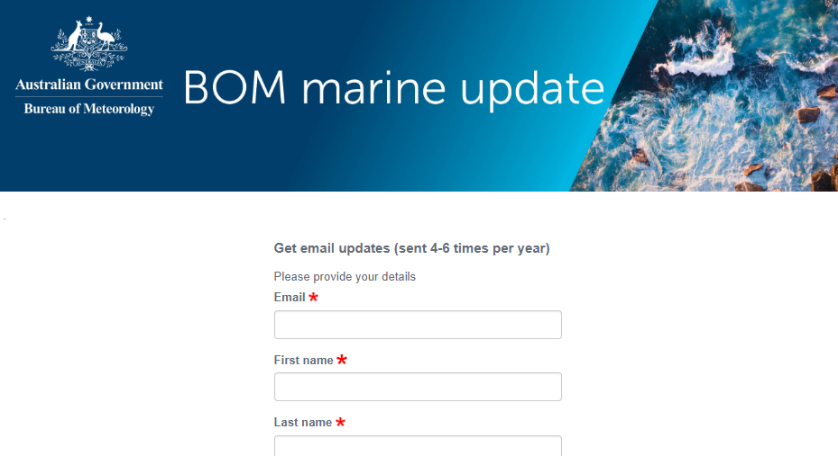
Communicating service changes
E-news for marine services updates
Notes:
https://e.bom.gov.au/bommarineupdatesub

Slide 11
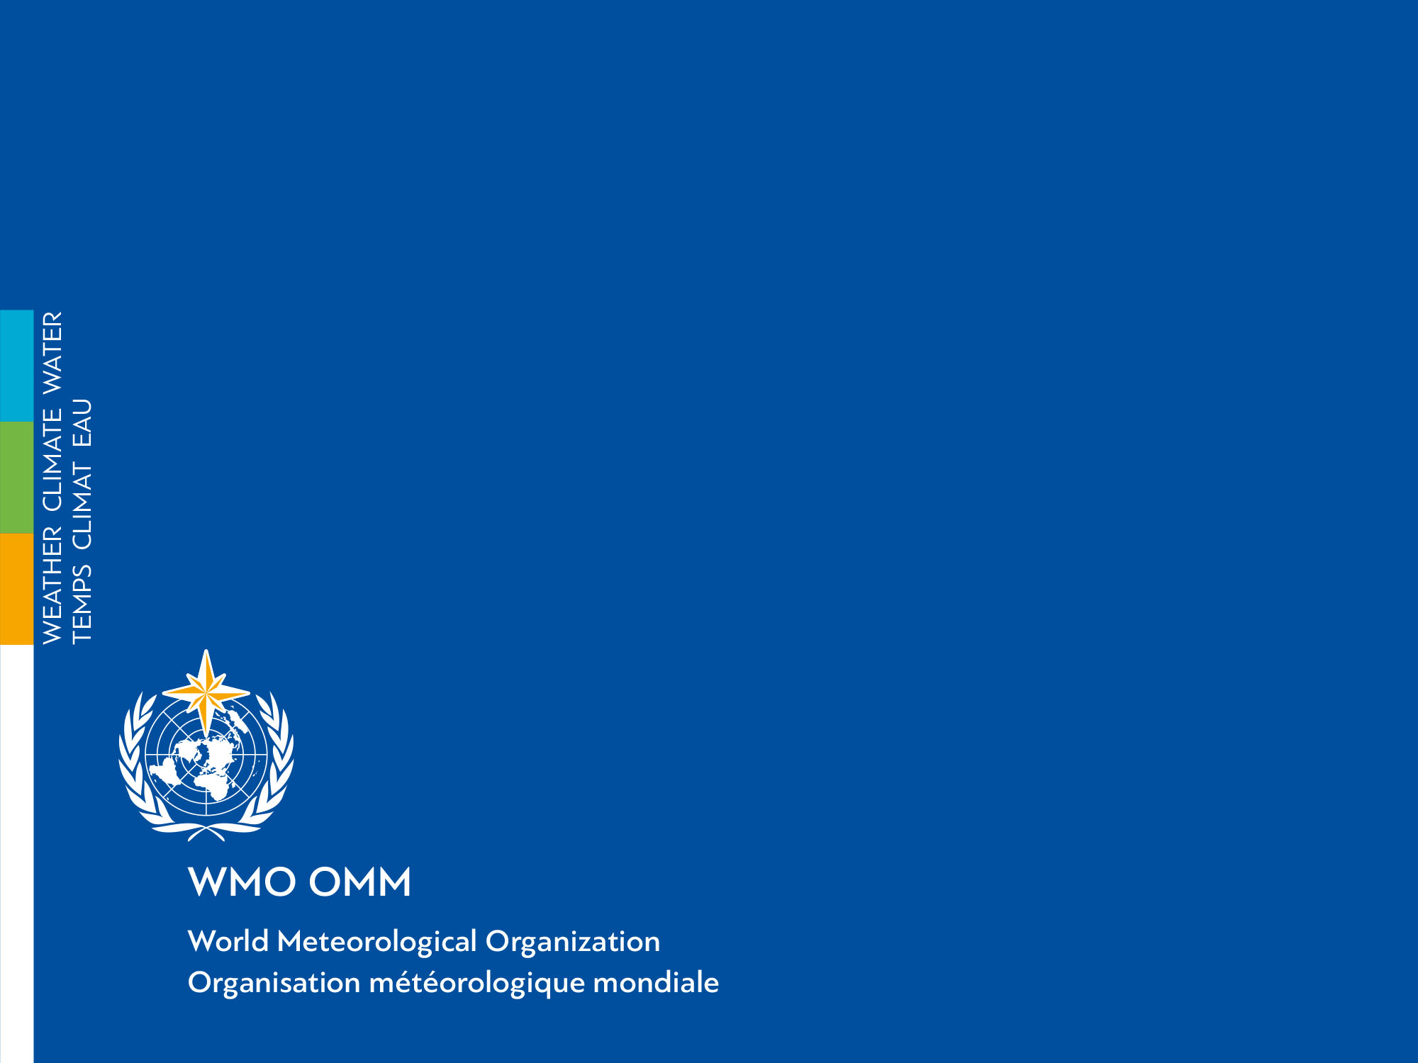
Thank you
Merci

