Slide 1

METAREA V
Report
Daniel Peixoto de Carvalho
Centro de Hidrografia da Marinha
WWMIWS-1, Monaco, 2018
Notes:
CHM – Centro de Hidrografia da Marinha/Navy Hydrographic Center under DHN´s Administration (Directorate of Hydrography and Navigation)

Slide 2
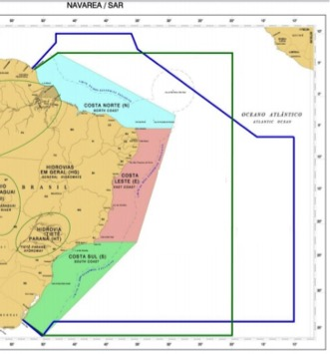
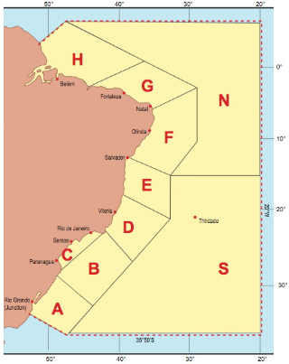
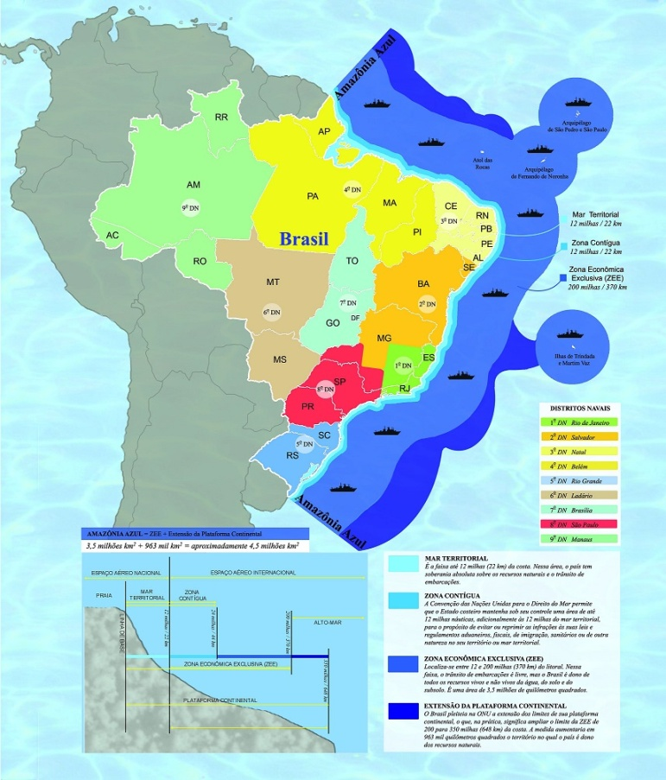
BRAZILIAN AREAS AT SEA
NAVAREA V
METAREA V
BLUE AMAZON
area
13.703.846 km²
area
12.047.648 km²
area
4.493.444 km²
Brazil´s territorial area: 8.515.759 km²
Notes:
Blue Amazon is a Brazilian trademark that denotes Brazil´s EEZ (exclusive economic zone)

Slide 3
Brazil – METAREA V
Well-integrated NAVAREA/METAREA coordination at Centro de Hidrografia da Marinha – CHM (Navy Hydrographic Center)
CH-12: METAREA V Coordinator
CH-33: NAVAREA V Coordinator
Fleet and “Coast Guard”, SAR assets and MSI producers/issuers under one Command: the Brazilian Navy.
Notes:
There are no significant NAVAREA/METAREA coordination difficulties because we are under the umbrella of the same institution. Even our SafetyNET transmission contract is only one.

Slide 4
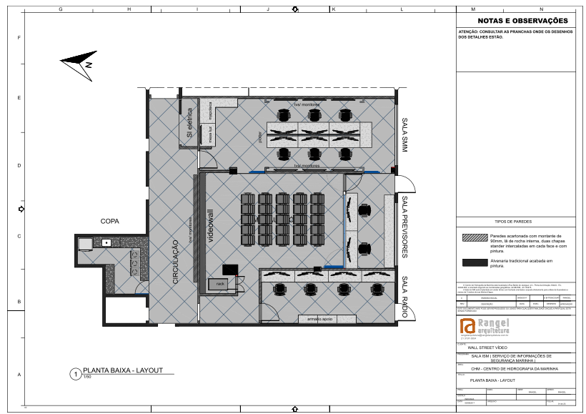
New or planned service-related activities
Even closer NAVAREA-METAREA integration in a future Maritime Safety Information room.

Slide 5
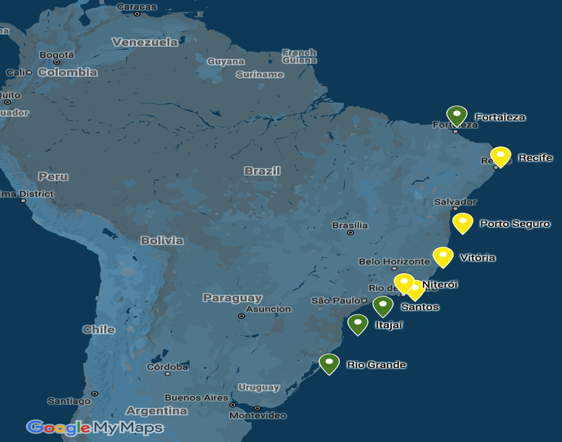
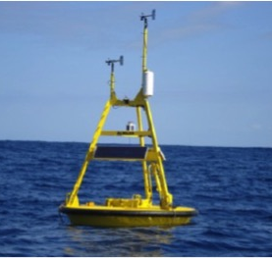
Increment of National Buoy Program (PNBOIA) from 4 to 9 deployed buoys.
PLANNED | OPERATIONAL
9 | 4
http://www.goosbrasil.org/pnboia/
Notes:
Priority was given to the Southern buoys due to regular cold front paths, and to the Northern-most buoy for tropical cyclones watch.

Slide 6
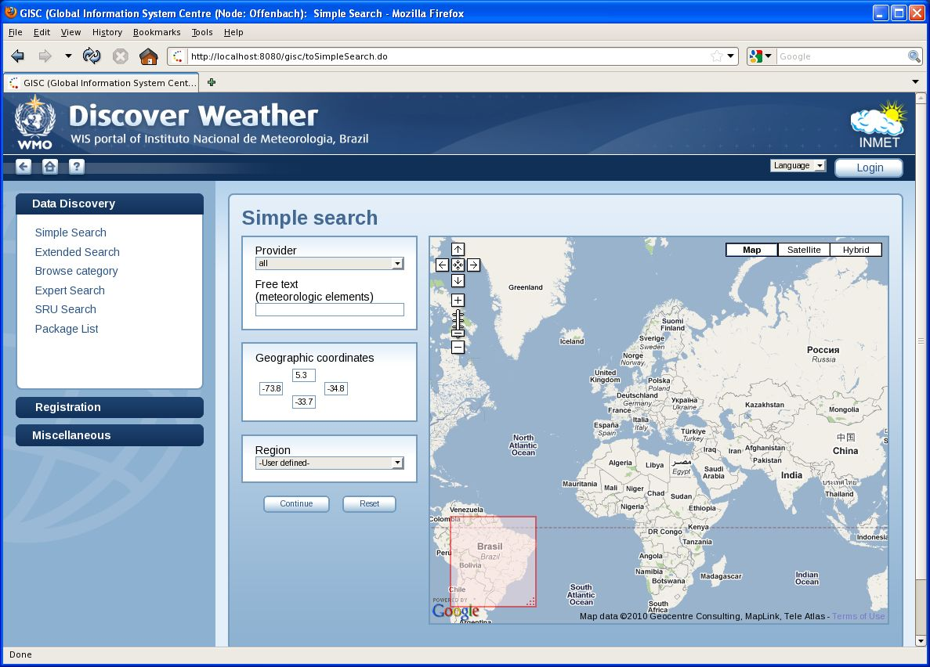
Integration of Marine Weather Stations and Met-Ocean Buoys to WIGOS via INMET underway.
GISC BRASILIA
WIS portal of Instituto Nacional de Meteorologia (INMET), Brazil
Notes:
CHM-INMET Agreement 2017-2022, CHM – Navy Hydrographic Center, INMET – Meteorology National Institute (WMO Permanent Representative)

Slide 7
Recent review of Brazilian Maritime Authority Law for MMS (NORMAM-19) – Weather MSI are now included in the national legislation.
Videoconference among South America METAREA Coordinators.

Slide 8
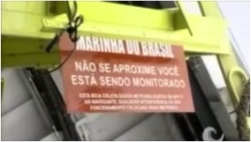
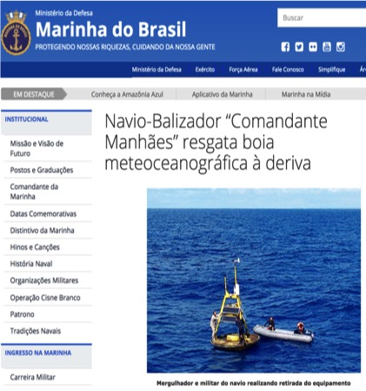
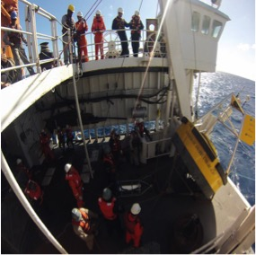
Recent challenges encountered with MSI provision or coordination
Frequent damages to buoys – Awareness Program run with support from the media.
Notes:
Most of occurrences are in near shore buoys. Fishermen use buoys as anchors of sort causing overweight and damages to payload/solar panels.

Slide 9




High costs of weather station network, NWP servers and transmission – Partnerships are the key.
Notes:
CPTEC is one of the 13 GPCLRFs (Global Producing Centres of Long-Range Forecasts)

Slide 10
Significant examples of stakeholder interactions or education activities
CHM Briefing Room is permanently open to universities, mariners and enthusiasts during daily weather briefing: 10 am sharp, 40-60 min discussion, 6-8 visits per month.
All CHM Weather Forecasters (15 as of today) are deployed at least once every 2-3 years on Navy ships for gaining experience at sea.
Notes:
Deploying Meteorologists on a regular basis happens on board Navy ships, both war and survey ships.

Slide 11
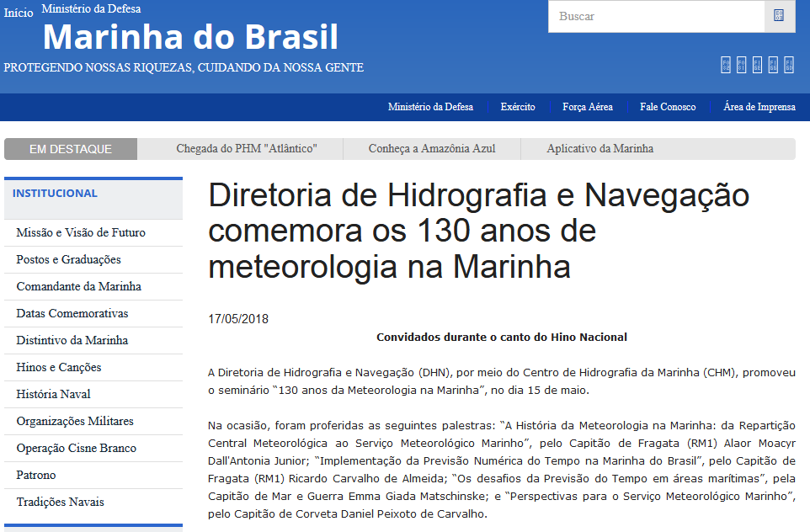
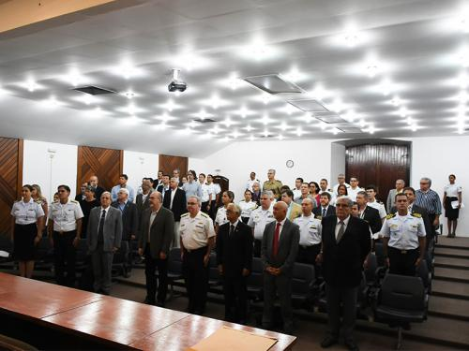
May 15, 2018: Seminar “130 years of the Meteorology in the Navy” – effort to gather all main institutions at DHN and talk about MSI.
Notes:
Institutions on federal, state and local levels were present.
Article @ https://www.marinha.mil.br/noticias/diretoria-de-hidrografia-e-navegacao-comemora-os-130-anos-de-meteorologia-na-marinha

Slide 12
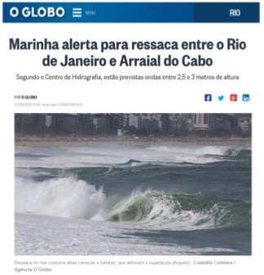
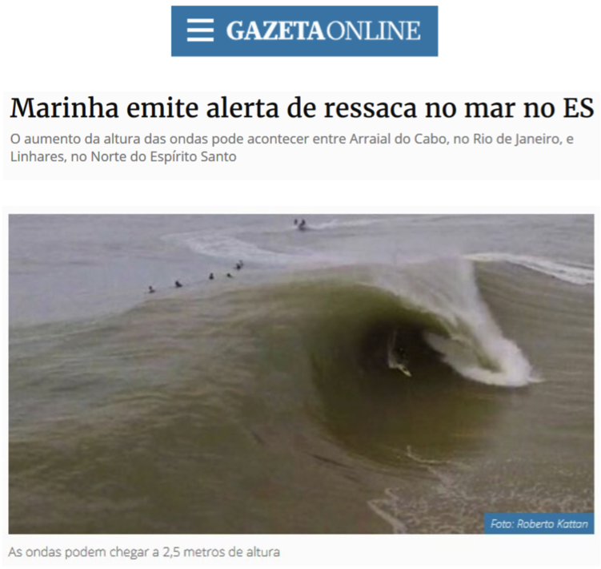
On a daily basis, warnings are converted to press releases that are not only made available to reporters, but actively sent to them
Notes:
Significant increment in press articles and interviews (both live and recorded, radio and tv) requested by press.
We´ve seen the need for augmenting the effectiveness of weather warnings that reach mariners, so this could be more tool at our disposal.

Slide 13

Thank you
Merci
Daniel Peixoto de Carvalho
Centro de Hidrografia da Marinha
peixoto.carvalho@marinha.mil.br

