Slide 1

METAREA II
Report
Mireille Mayoka, France
WWMIWS-1, August 2018

Slide 2
France within WWMIWS
2
France (Météo-France) is Issuing Service (RSMC) for :
  METAREA II - Toulouse
METAREA VIII (S) – tropical cyclone warnings for West of 90°E – La Réunion / Tropical Cyclone RSMC
  Scheduled bulletins (forecasts) prepared by Mauritius are broadcast on SafetyNET by Météo-France Toulouse
France is Preparation Service for :
  Western part of METAREA III – scheduled bulletins and warnings, for Greece
  METAREA VII - forecasts for area 30°S/50°S - 50°E/80°E & tropical cyclone warnings West of 90°E, for South Africa.

Slide 3
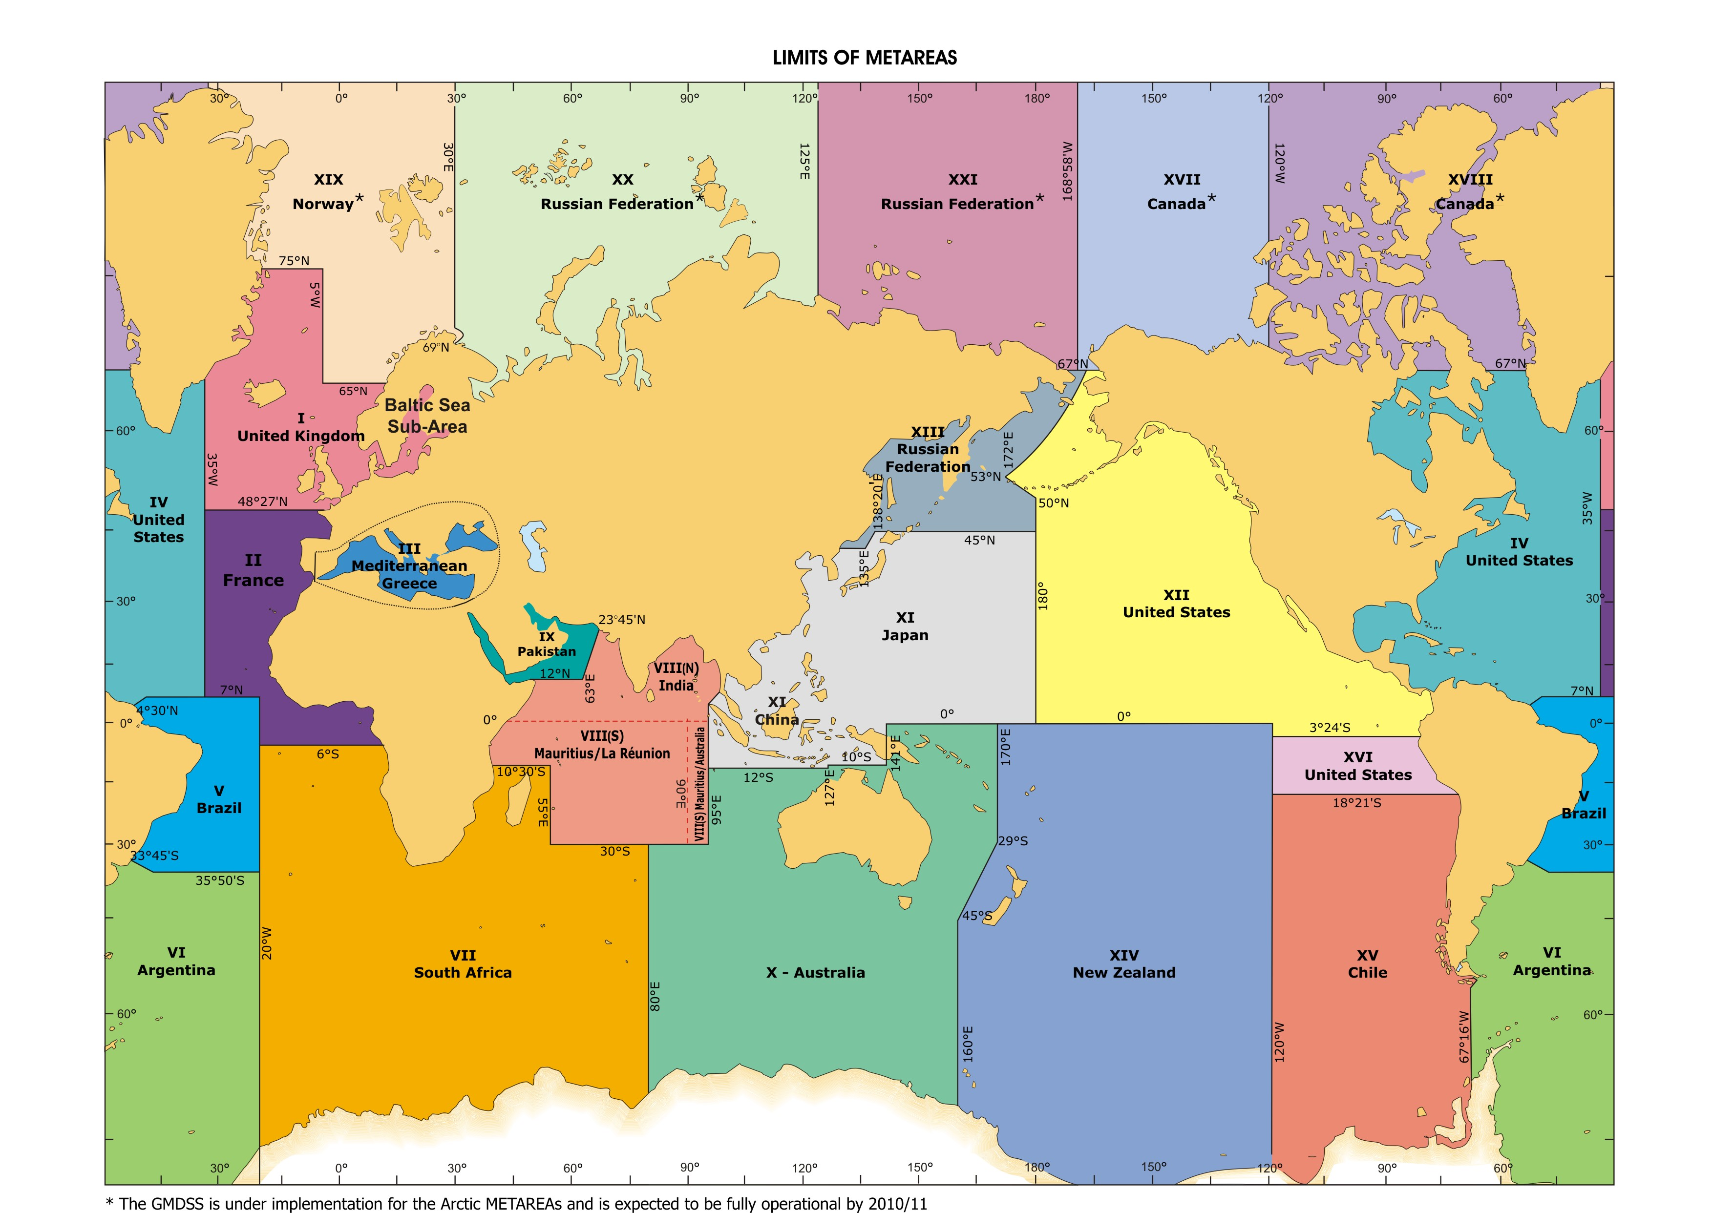
METAREA II - Boundaries
Geographic boundaries :
  Atlantic waters
  east of 35°W, from 7°N to 48°27’N
  east of 20°W from 7°N to 6°S
  including the Straits of Gibraltar
All SafetyNet messages are issued by the Marine & Oceanography Department, Météo-France, Toulouse.
VII
South Africa

Slide 4
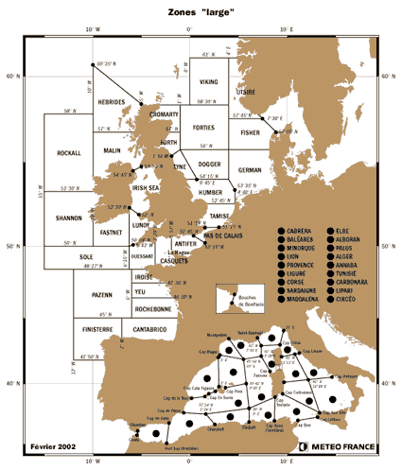
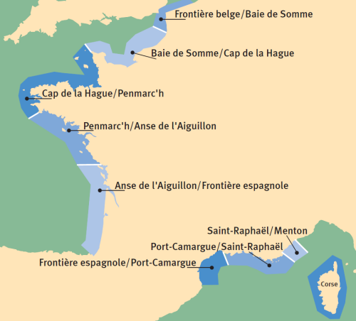
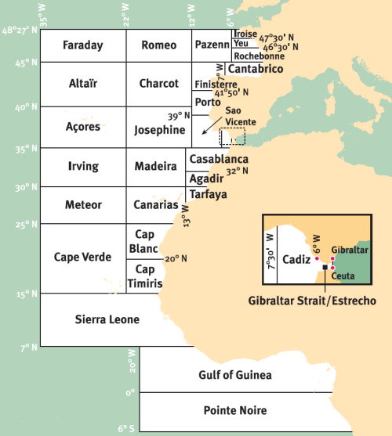
Marine Safety Information
Coastal areas
All forecasts and warnings are issued by the National Prediction Centre in Toulouse
Offshore areas
High seas areas
Notes:
GMDSS = Global Maritime Distress & Safety System
SMDSM = Système Mondial de Détresse et de Sécurité en Mer

Slide 5
New or planned service-related activities
New public web portal planned for 2019 :
A better presentation of the marine section, with easier access to MSI bulletins and graphical forecasts, added access to outputs of the wave models of Météo-France
These improvements aim to meet the demand of users via the Marine Commission of the CSM (Superior Council of Meteorology) – our client listening instance.
New WWMIWS portal by the end of 2018
New web portal (extranet) for authorities :
Access to coastal MSI
Access to storm surge information and outputs of wave models
Access to new bulletins for authorities : to help flood referents for coastal districts to manage crisis in case of waves / storm surge warning

Slide 6
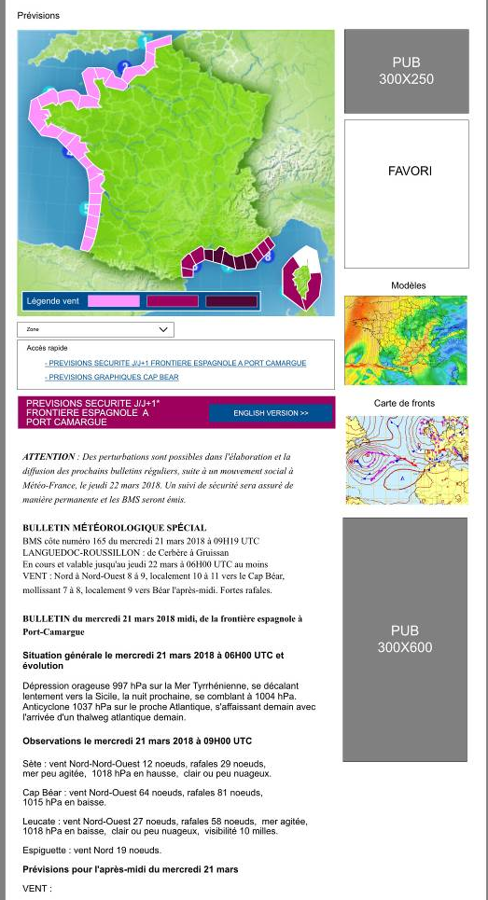
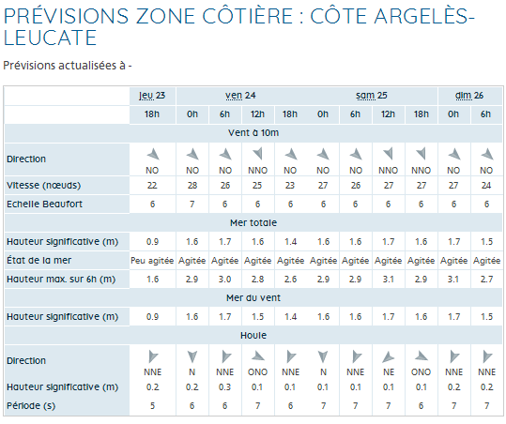
New Marine Section of the public web portal (template)
Example for the coastal access
Wind
Total sea
Wind sea
Swell

Slide 7
Recent challenges encountered with MSI provision or coordination
Centralization of all MSI provision at the National Prediction Centre in Toulouse (2012-2018)
New reorganization planned for 2022 with downsizing :
  All coastal centers will close except one specialized in commercial marine assistance (offshore and harbour activities) problems to keep in touch with maritime users
  For MSI, request to automatically initialize the bulletins to save time/ressources MSI cannot be automated !
Plan to make an arrangement with the NAVAREA Coordinator Service (Shom) for a mutual backup of MSI provision on Imarsat SafetyNET we are waiting the implementation of SafetyNET II system in Météo-France to do it

Slide 8
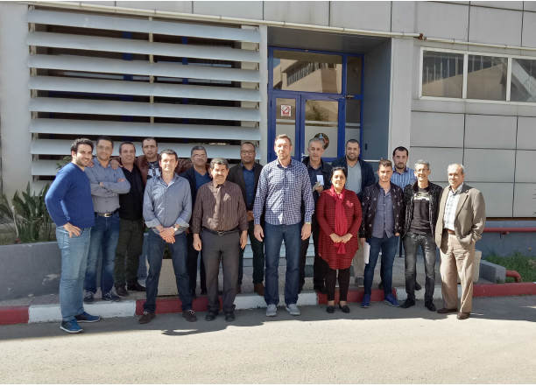
Significant examples of stakeholder interactions or education activities
Interactions with Civil Protection : provision of useful products, weekly video briefing, training on waves and storm surges at coast
Ajustment of the Marine Meteorology Training schedule, to take account of the WMO Marine Forecaster Competency Framework
Contribution to capacity building and training activities within Metarea II :
Training on fog and visibility reduction in Casablanca, Marocco, 2017
- Eumetsat Workhop on user of scatterometer and altimeter data in marine meteorology, Casablanca, Marocco, 2017
- Training in marine meteorology, Algeria, 2018 – new training expected for 2019
Mission of expertise on the operation of a marine forecasting service in Tunisia, 2018

Slide 9

Thank you
Merci

