Slide 1
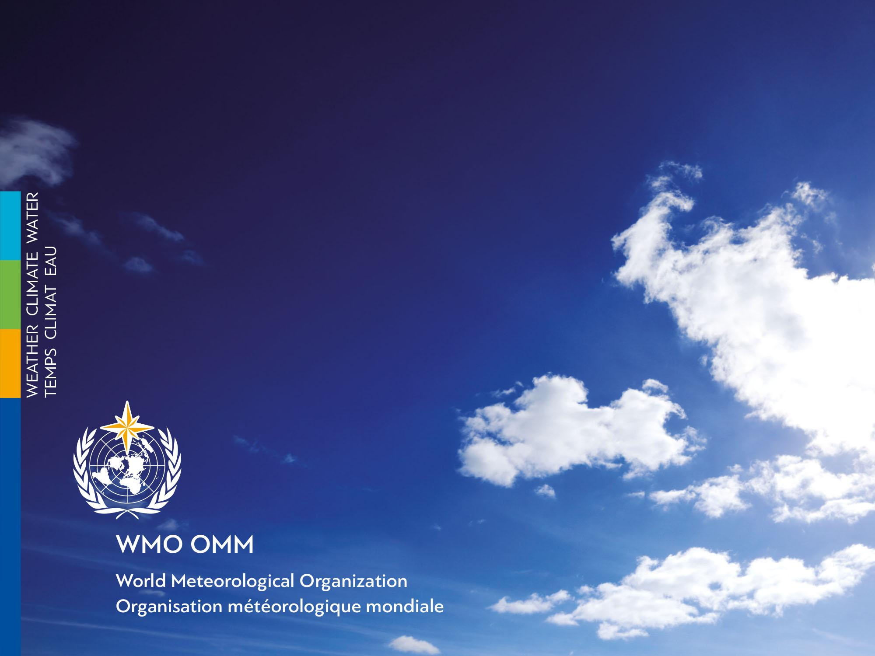
METAREA XX, XXI, XIII
Report
Vasily Smolyanitsky, Arctic and Antarctic Research Institute, Roshydromet, Russia
Monaco, August 2018

Slide 2
Service-related activities
Russian Federation is responsible for SafetyNET and NAVTEX services within METAREAs XX and XXI in the Arctic Ocean and METAREA XIII in NW Pacific
In addition to that the Russian Federation is responsible for preparing NAVTEX services in the coastal areas in the Black, Azov, Caspian and Baltic Seas
The Preparation Service is the Russian Federal Service for Hydrometeorology and Environmental Monitoring (Roshydromet), including the Arctic and Antarctic Research Institute (AARI) and Roshydromet marine regional departments
We do have national manuals and standards for national competency and schedules for regular training and assessing competency of the forecasting staff
The Issuing Service for all METAREAS is the Ministry of Transport of Russia through its regional branches

Slide 3
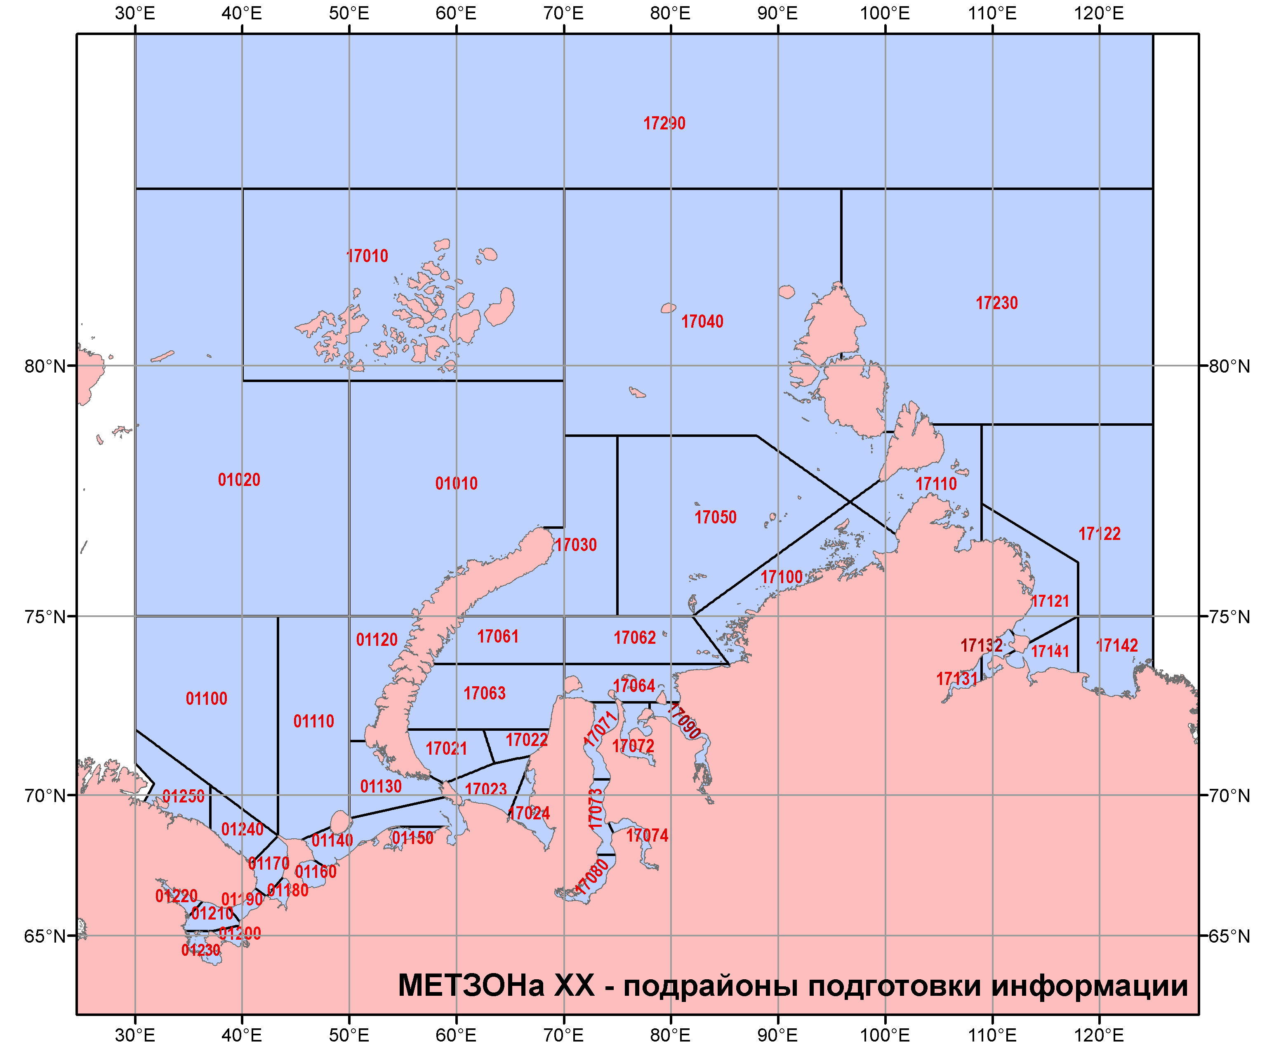
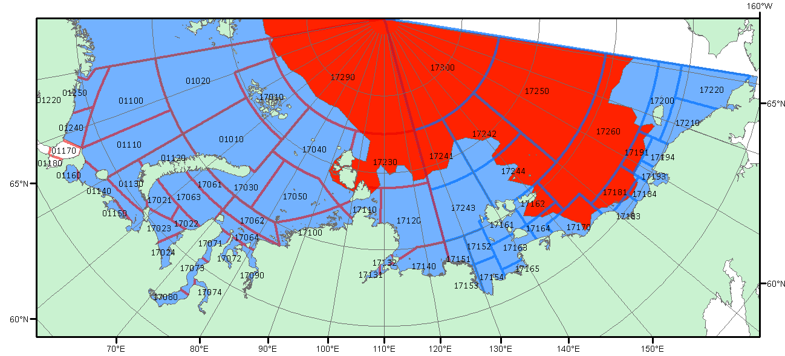
METAREA XX
GMDSS SafetyNET services for METAREA XX are coordinated by the AARI and are provided by 47 subregions within METAREA in cooperation with Roshydromet departments in Murmansk & Arkhangel’sk
SafetyNET bulletin includes weather and sea ice synopsis and weather, sea state, ice accretion forecast and warnings
NAVTEX services are provided for coastal areas near Murmansk peninsula, for White Sea, SE part of the Barents and SW parts of the Kara Seas
NAVTEX services include weather synopsis, weather and sea-state 24 hours forecast and warning, no ice accretion and sea ice information is included
Sustained provision of sea ice and icebergs services is critical for METAREA XX
Ice edge is provided daily and ice charts are provided 2 times a week in graphic, SIGRID-3/S-411

Slide 4
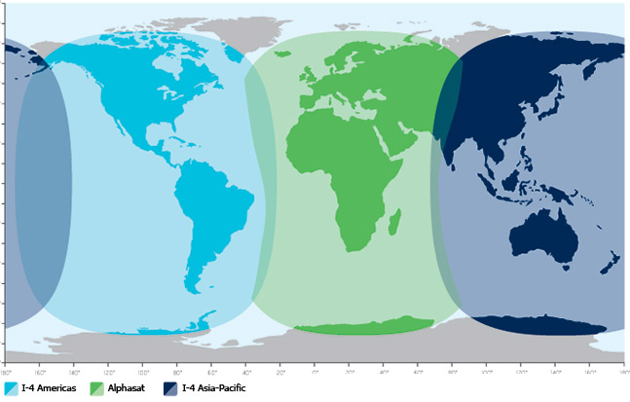
Recent challenges for METAREA XX encountered with MSI provision or coordination
(does not relate to ice services)
Transition to I4 generation makes a significant gap in the Kara Sea
There is a need of extending NAVTEX services eastward

Slide 5
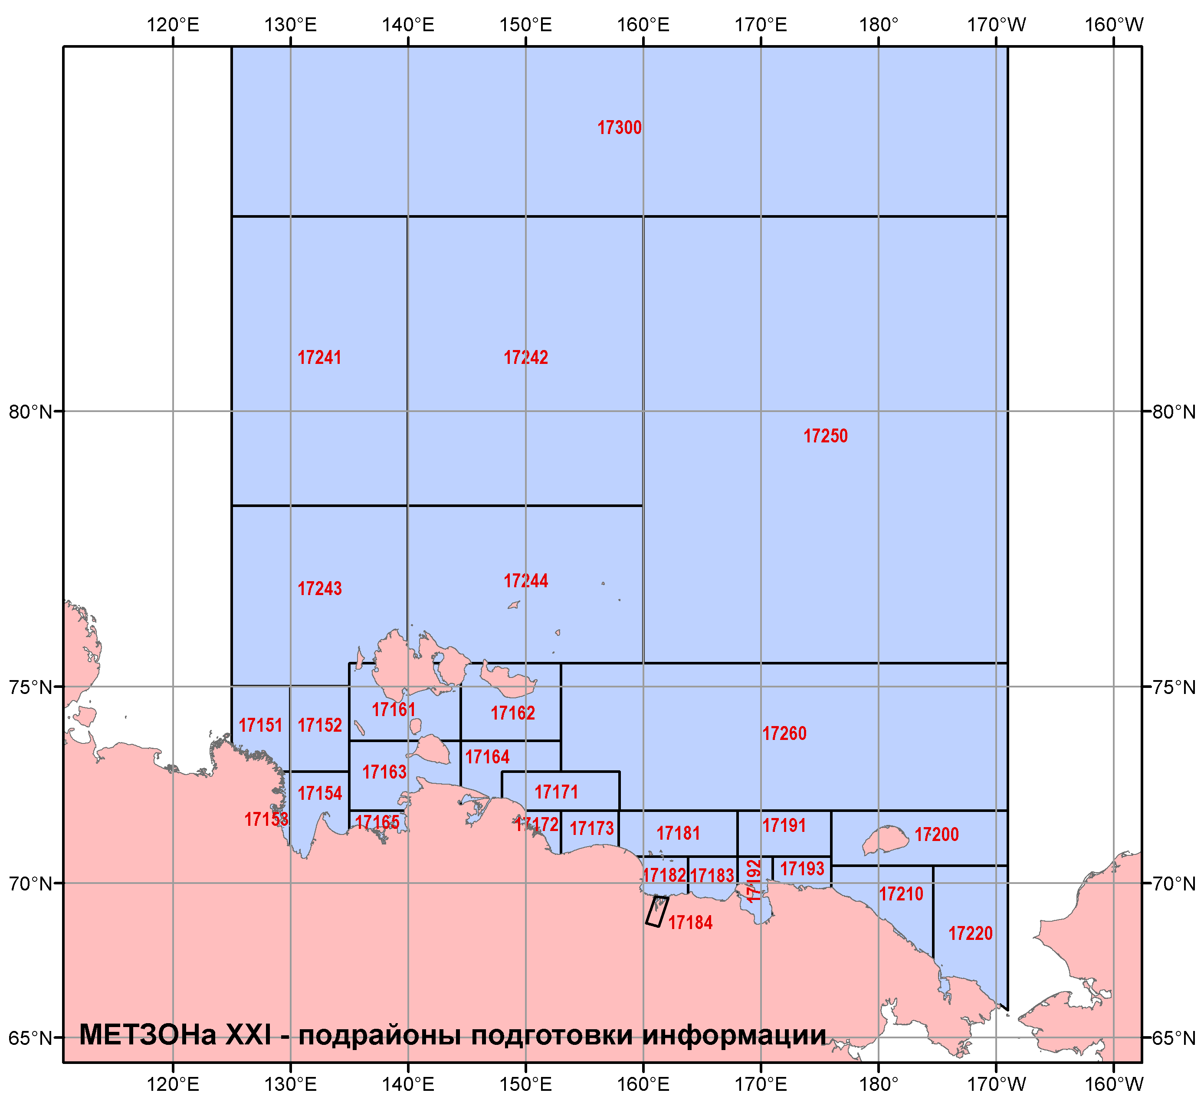
METAREA XXI
GMDSS SafetyNET services for METAREA XXI are coordinated by the AARI and are provided by 31 subregions within METAREA by AARI in cooperation with Roshydromet departments in Yakutsk and Pevek
SafetyNET bulletin includes weather and sea ice synopsis and weather, sea state, ice accretion forecast and warnings
No NAVTEX services are currently provided
Sustained provision of sea ice services is critical for METAREA XX
Ice edge is provided daily and ice charts are provided 2 times a week in graphic, SIGRID-3/S-411

Slide 6
Recent challenges for METAREA XXI encountered with MSI provision or coordination
(does not relate to ice services)
Transition to I4 generation leaves a significant gap in the Laptev Sea
There is a strong need of resuming NAVTEX services within METAREA XXI

Slide 7
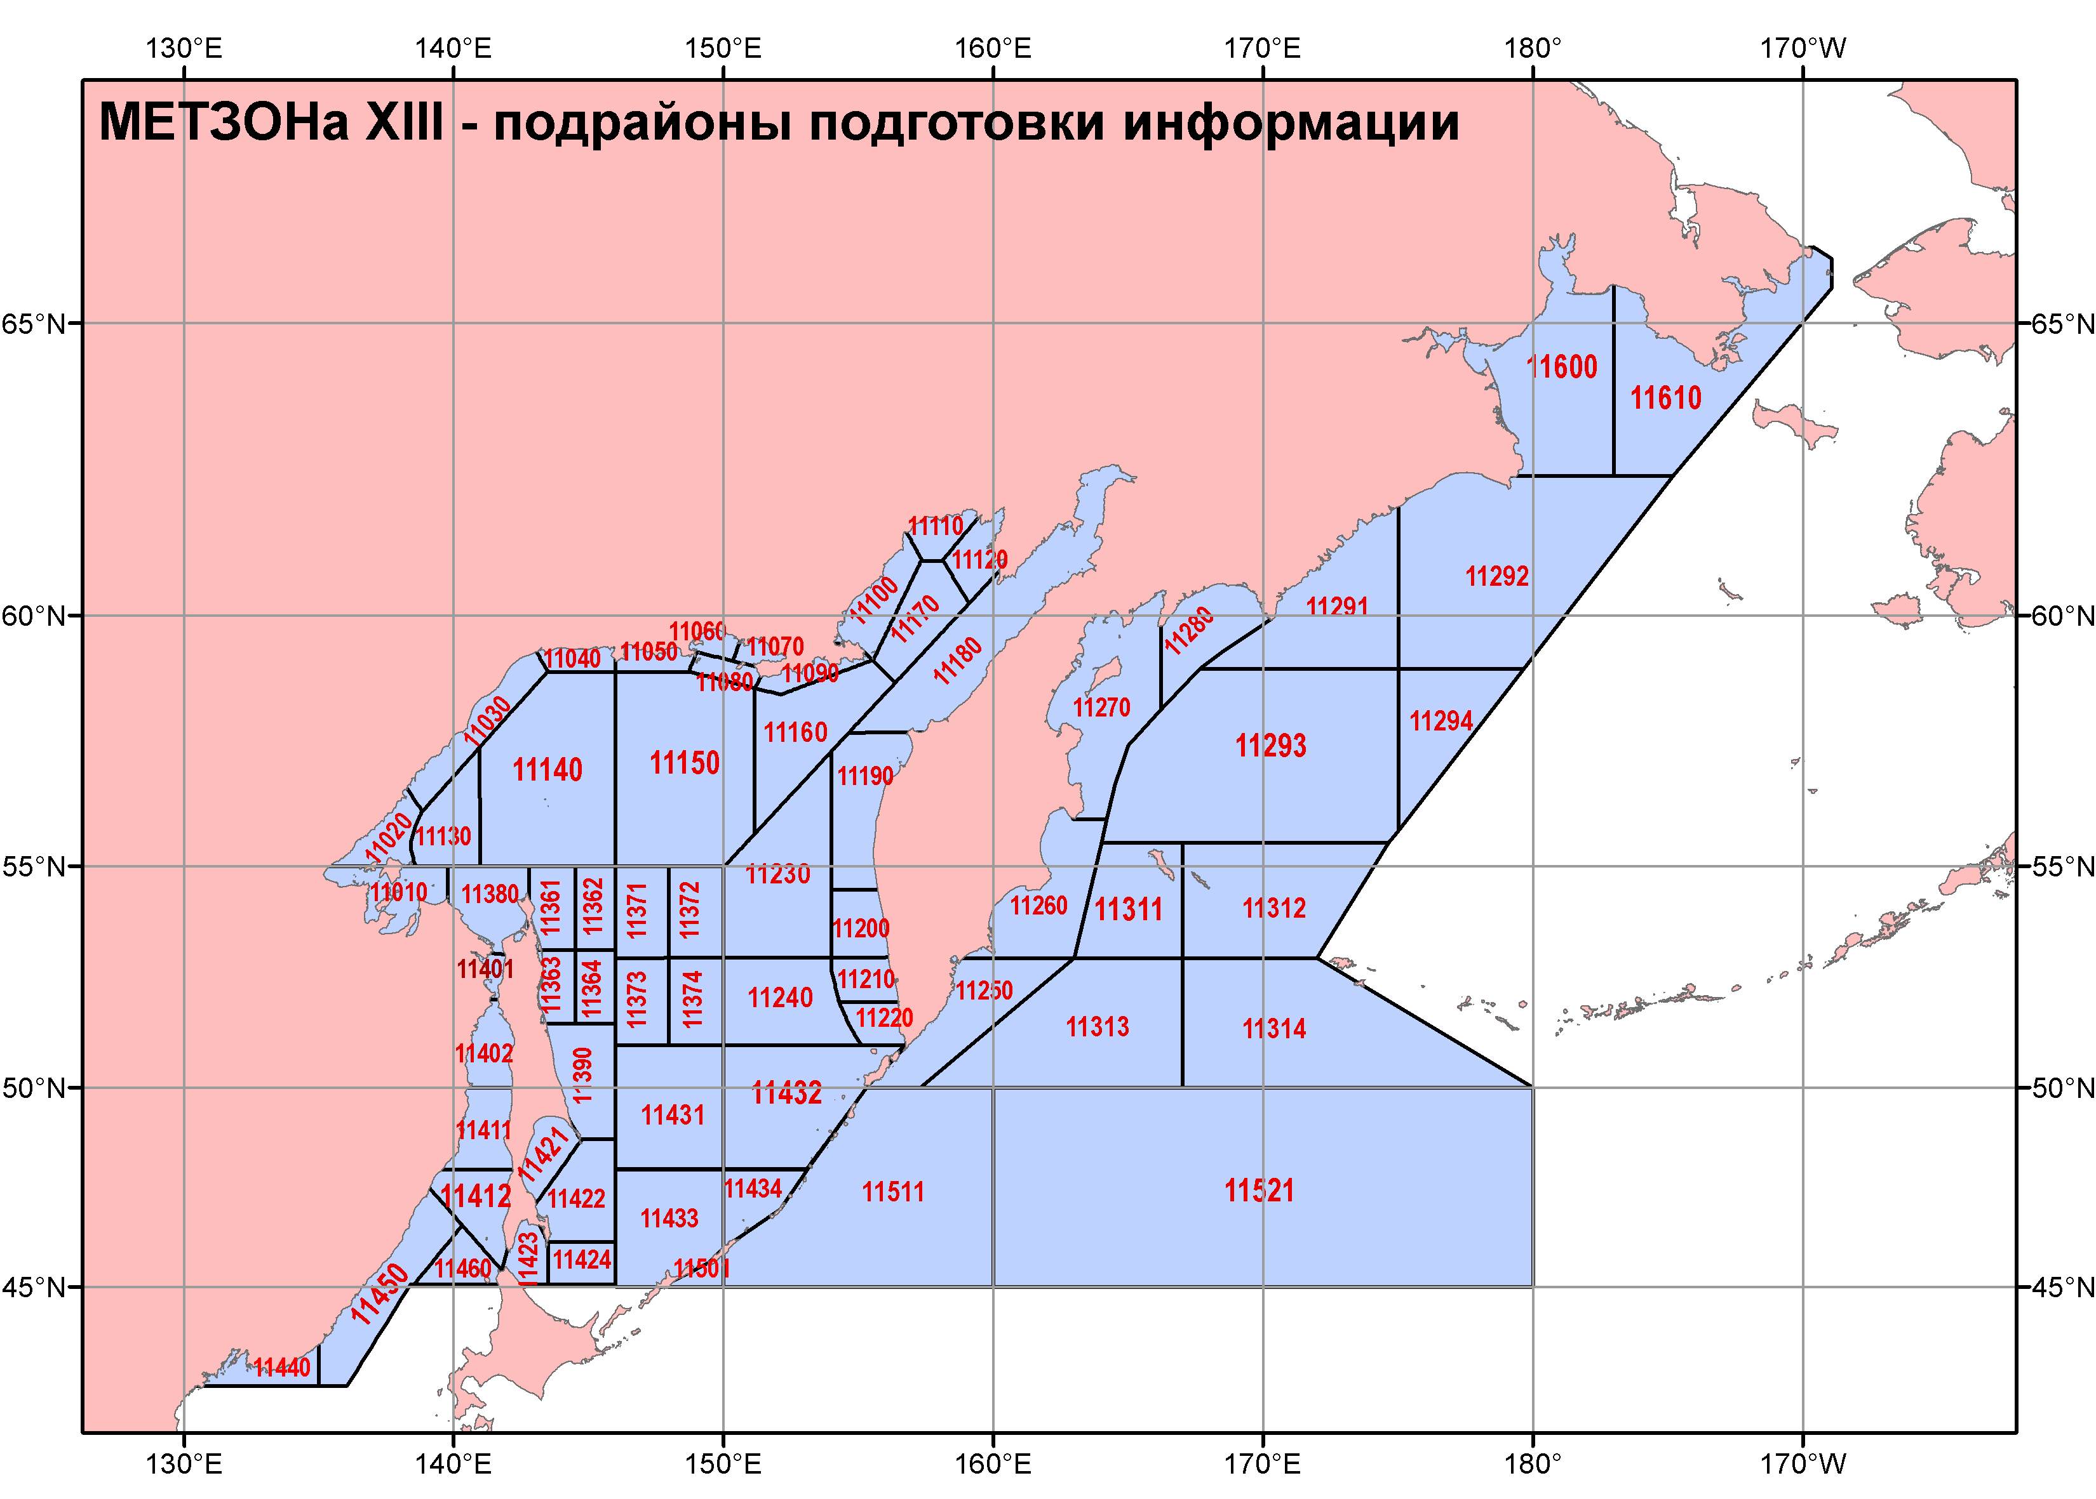
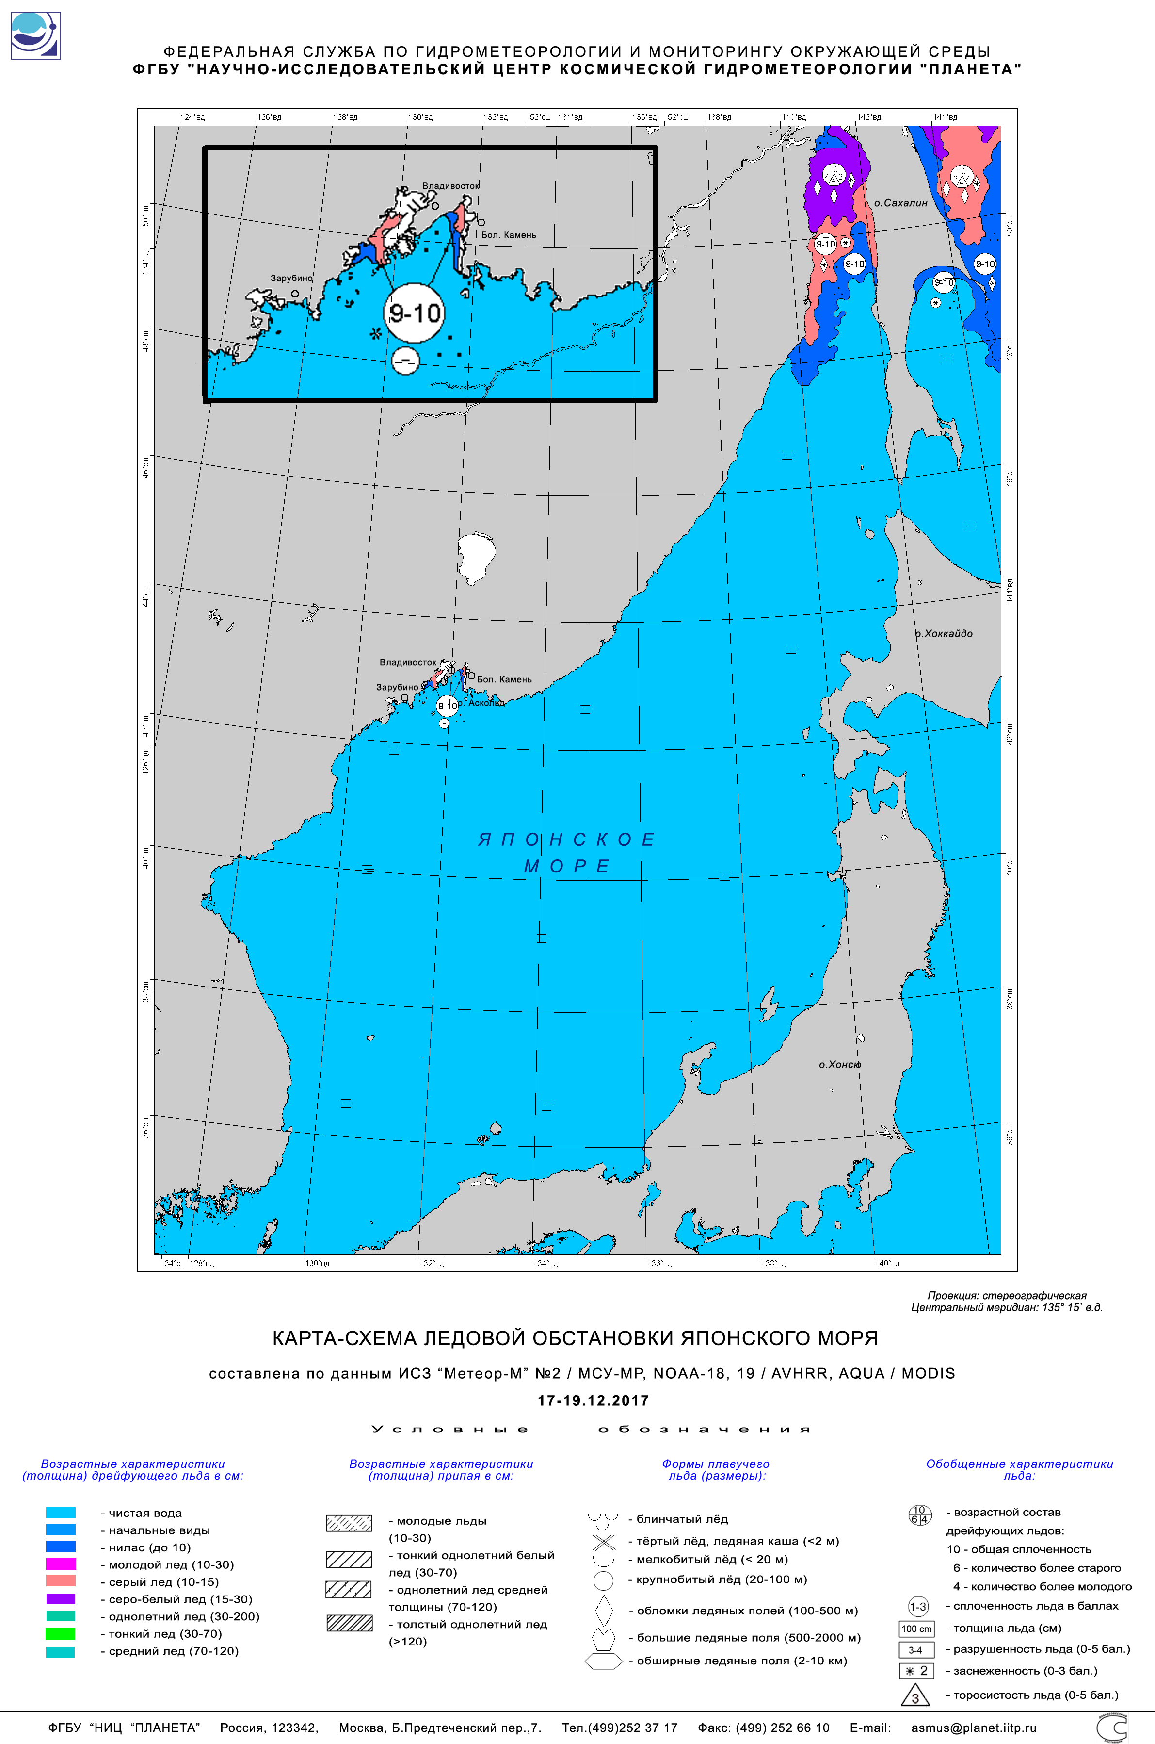
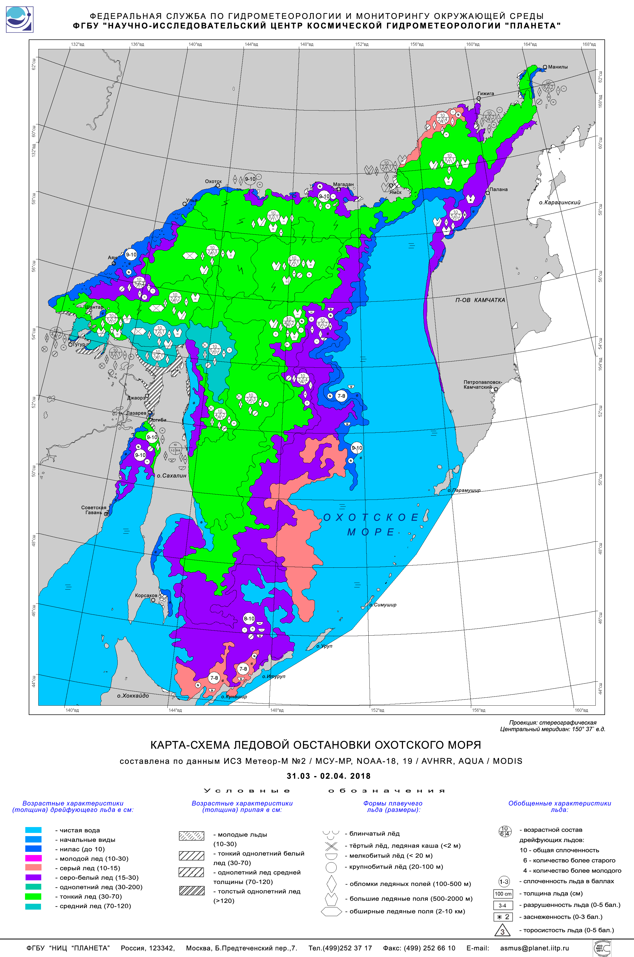
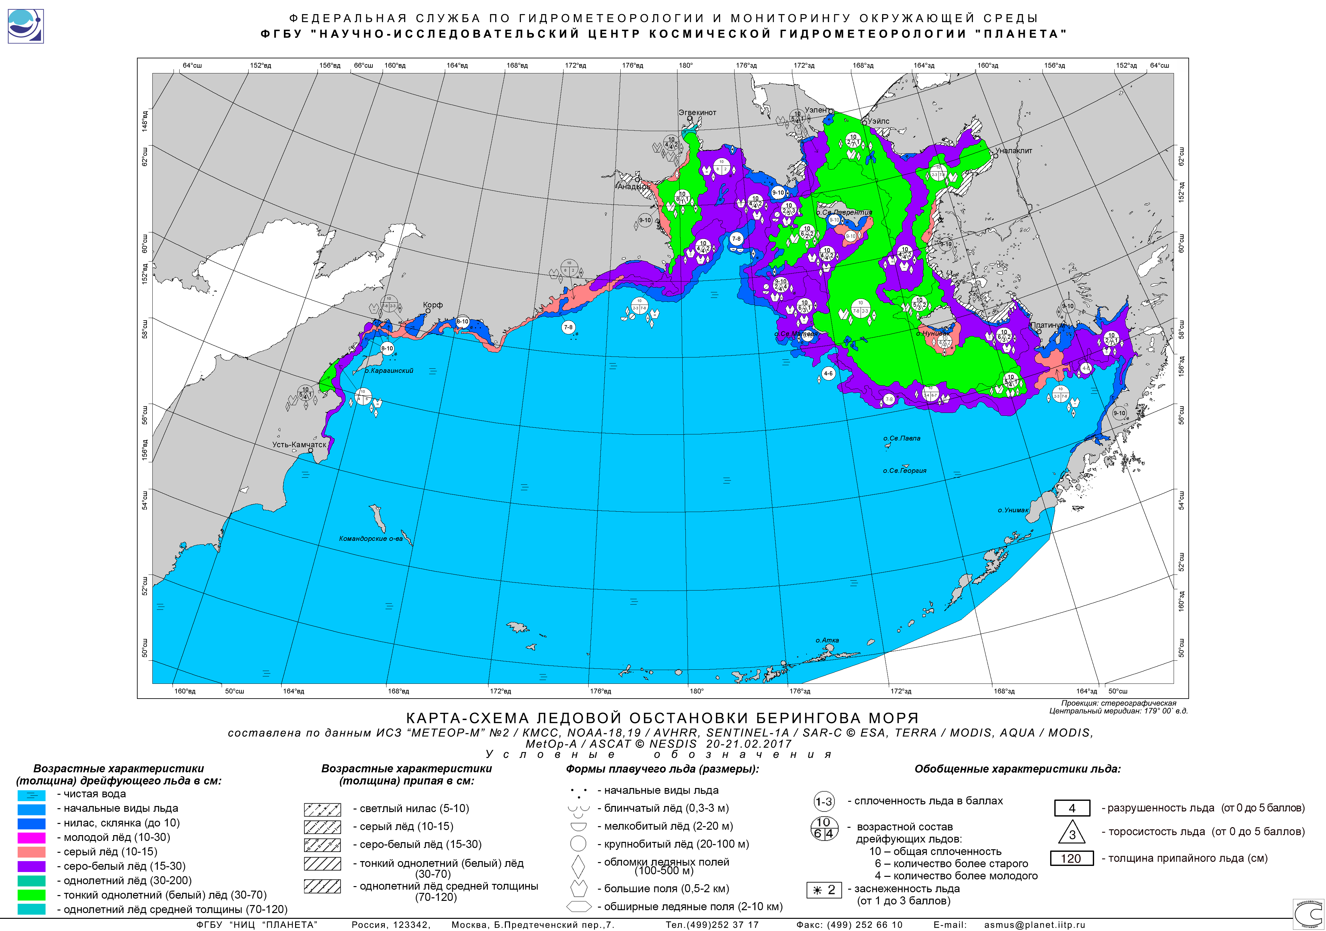
METAREA XIII
Currently there are no GMDSS SafetyNET services for METAREA XIII
the SafetyNET production is coordinated by the Primorskoe department (Vladivostok) and, in cased of resuming will be provided by 66 subregions within METAREA by in cooperation with Roshydromet departments in Vladivostok, Yuzhnosakhalinsk, Petropavlovsk-Kamchatskii, Magadan, Pevek
NAVTEX services are provided for most of the navigable areas within METAREA for the NE part of the Sea of Japan, Sea of Okhotsk, areas near Kamchatka peninsula
NAVTEX services include weather and sea ice synopsis, weather ice accretion and sea-state 24 hours forecast and warnings
Sustained provision of ice services is critical for METAREA XIII in winter time (Nov - May)
ice charts are provided 1-2 times a week by RSC Planeta and AARI in graphic, SIGRID-3/S-411

Slide 8
Recent challenges for METAREA XIII encountered with MSI provision or coordination
(does not relate to ice services)
There is a strong need of extending NAVTEX services northward to Bering Strait
There is a strong need of resuming SafetyNET services within METAREA XIII

Slide 9
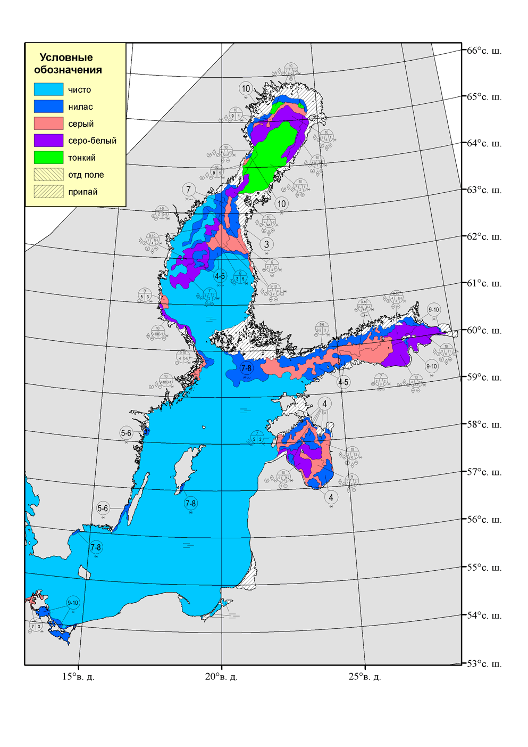
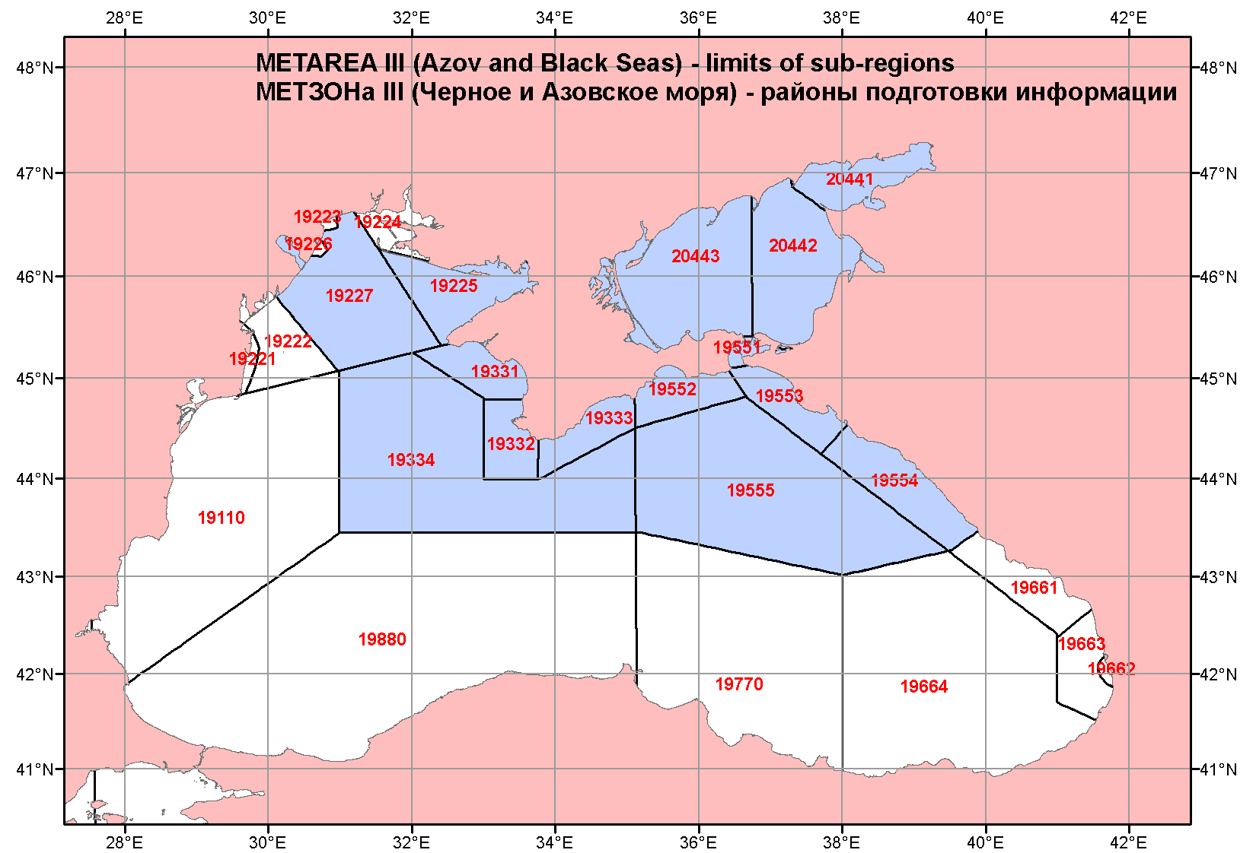
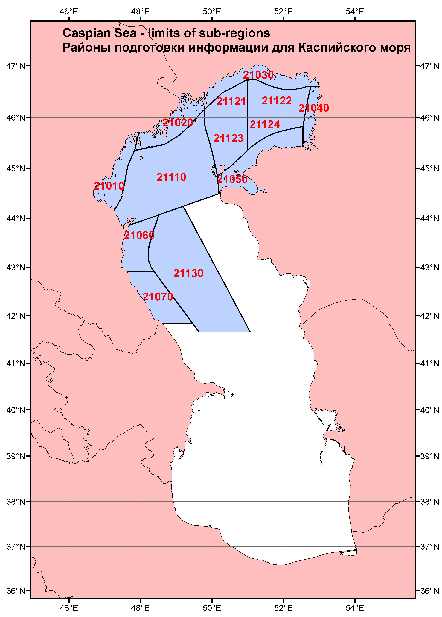
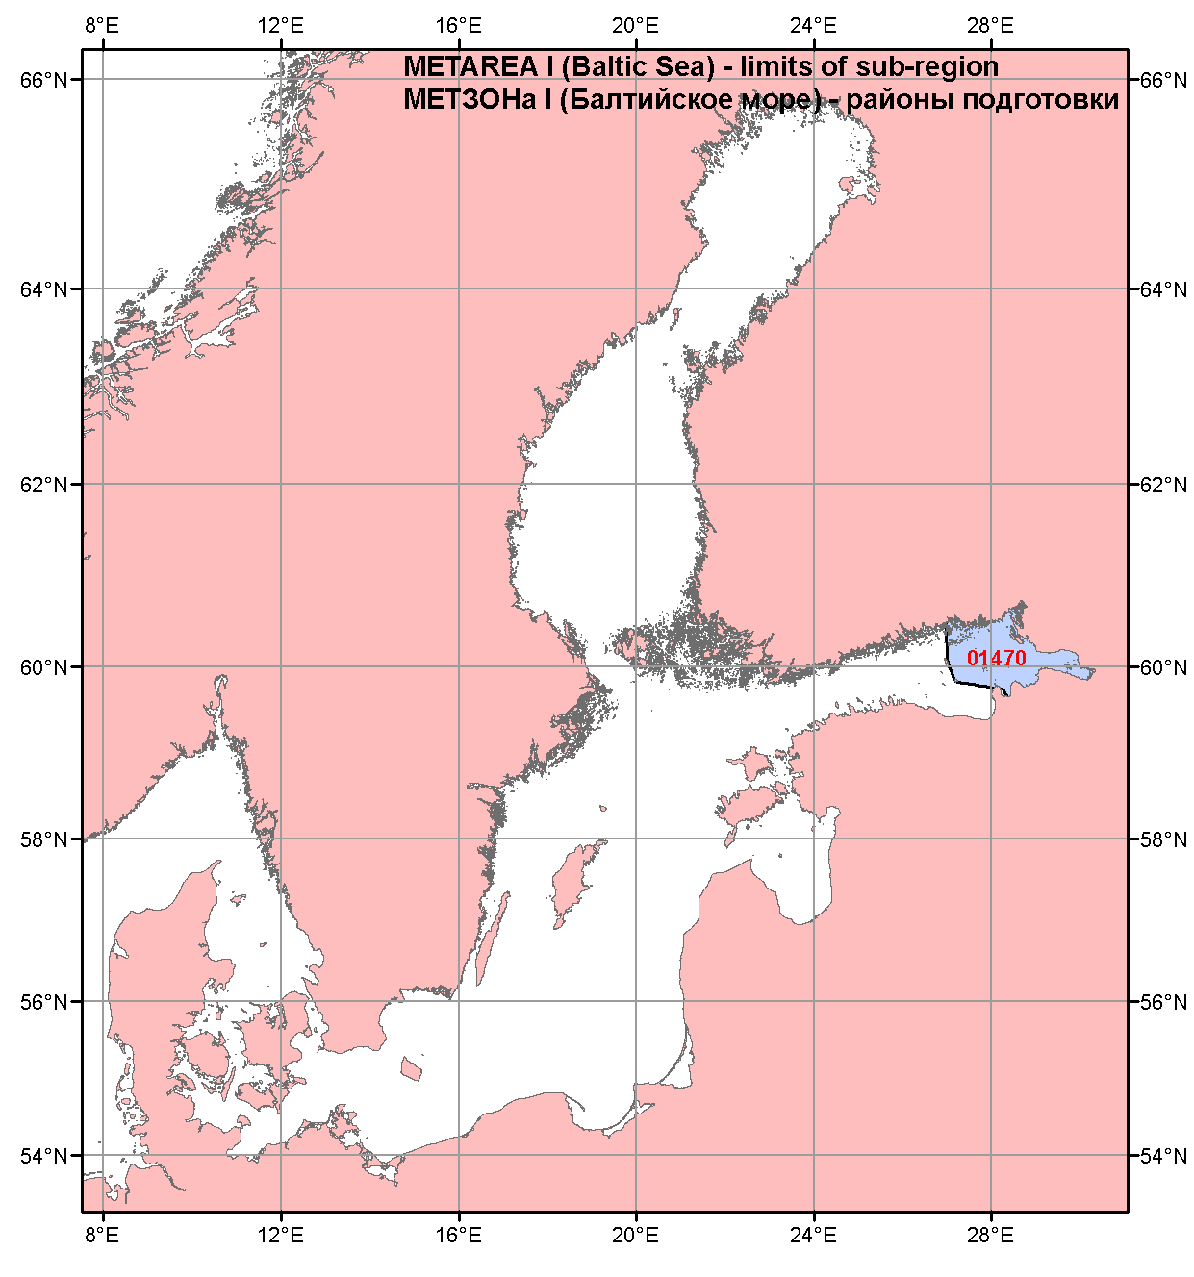
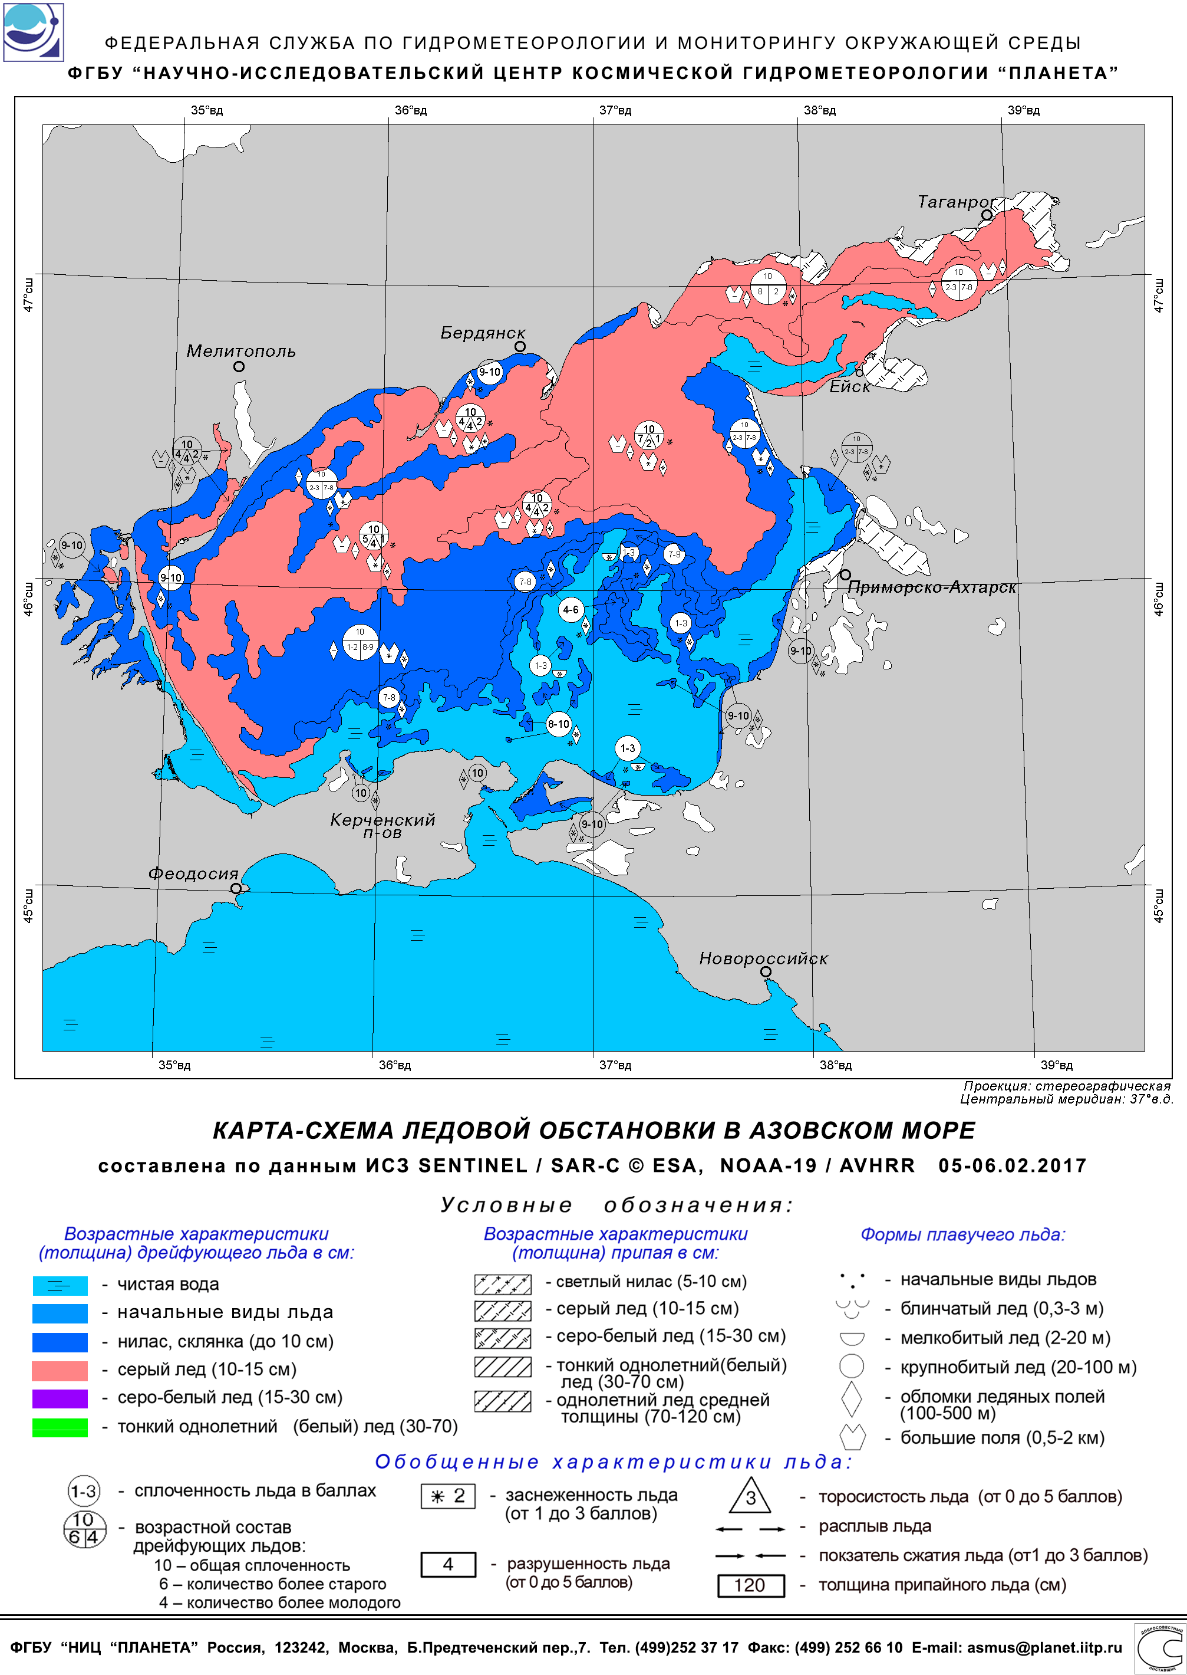
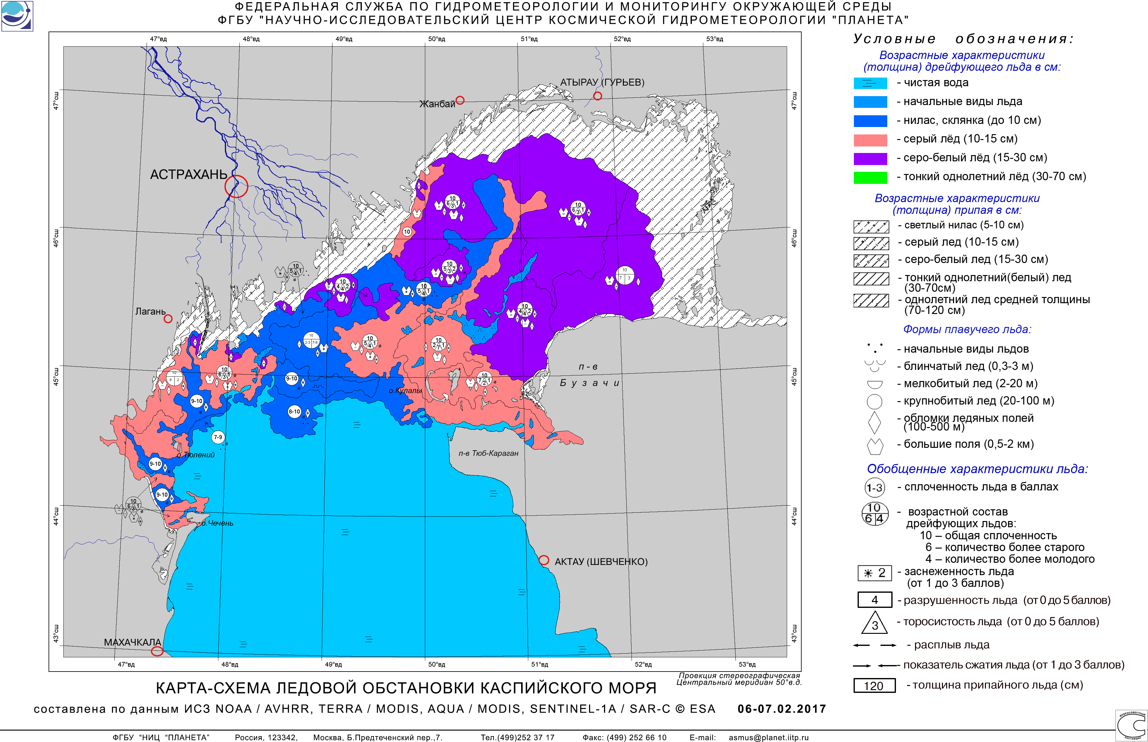
Coastal areas within Black, Azov, Caspian and Baltic Seas covered by NAVTEX services by ROSHYDROMET departments
NAVTEX services are provided for all coastal areas in the Sea of Azov, NE part of the Black, NW part of Caspian Seas and E Gulf of Finland by relevant Roshydromet departments
NAVTEX services include weather and sea ice synopsis, weather sea-state 24 hours forecast and warnings
Sustained provision of ice services is critical for the Azov, Caspian and Baltic Seas in winter time (Dec - Apr)
ice charts are provided 1-2 times a week by HMC Moscow, RSC Planeta and AARI in graphic, SIGRID-3/S-411

Slide 10
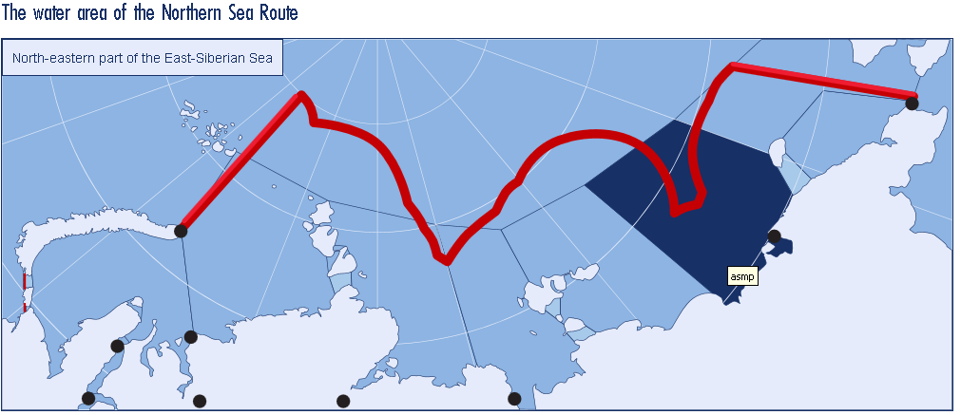
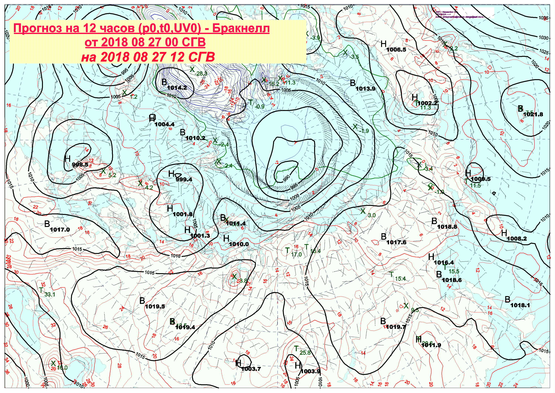
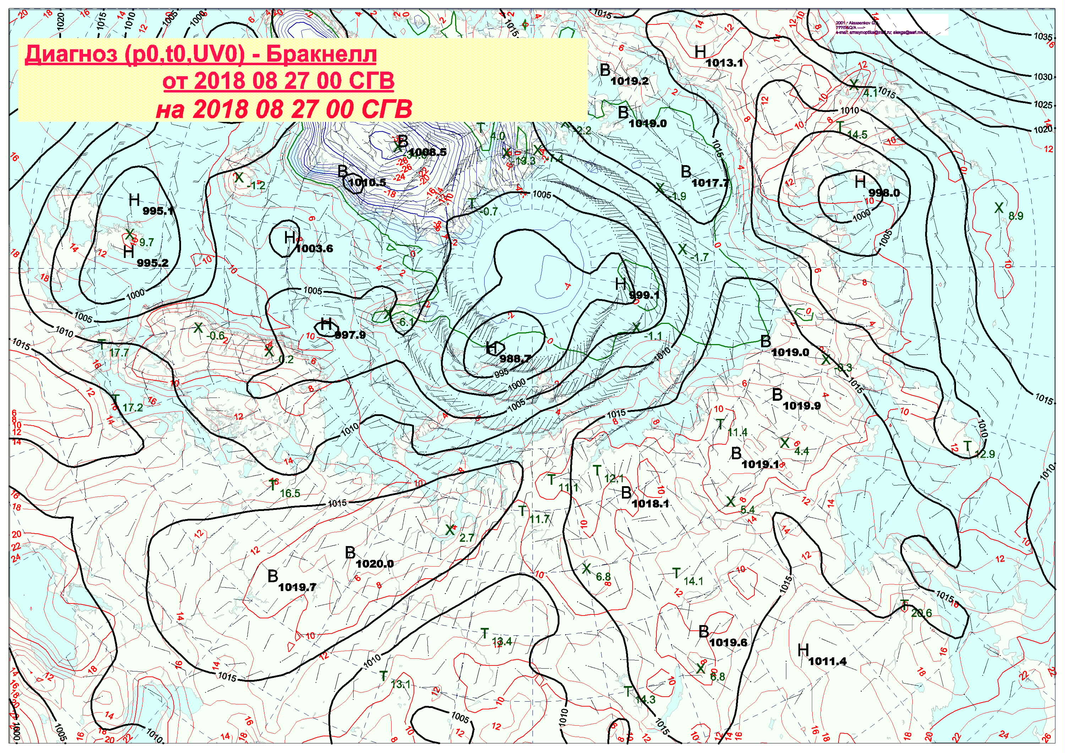
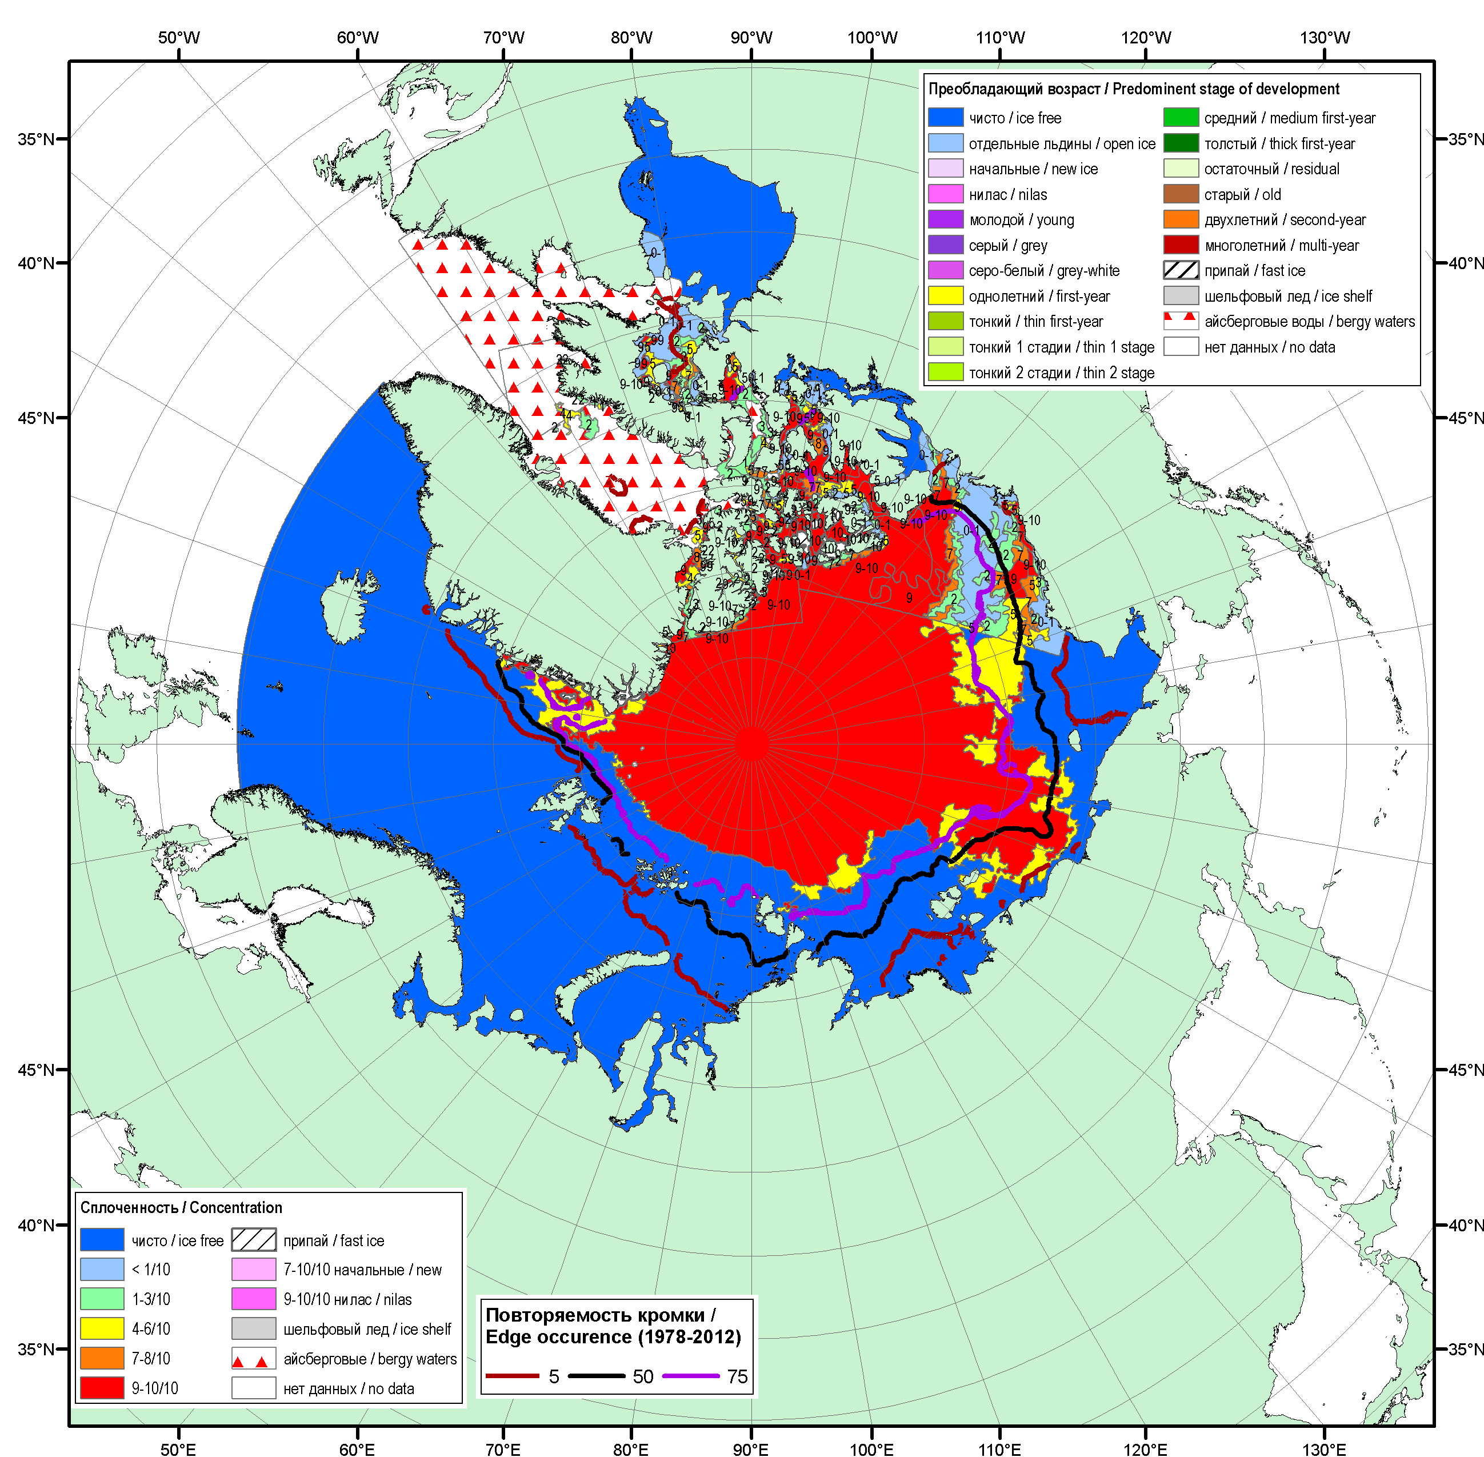
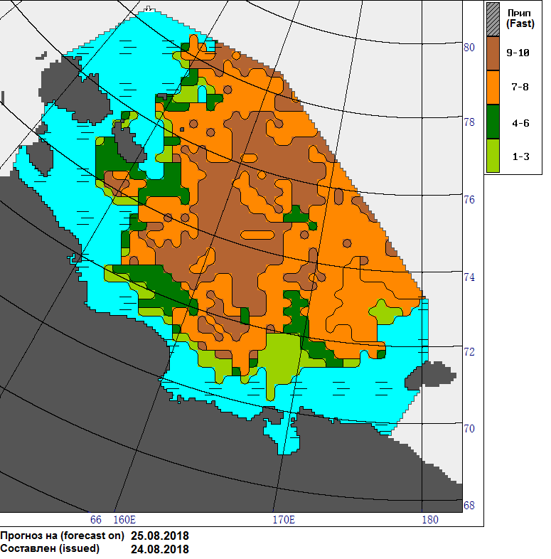
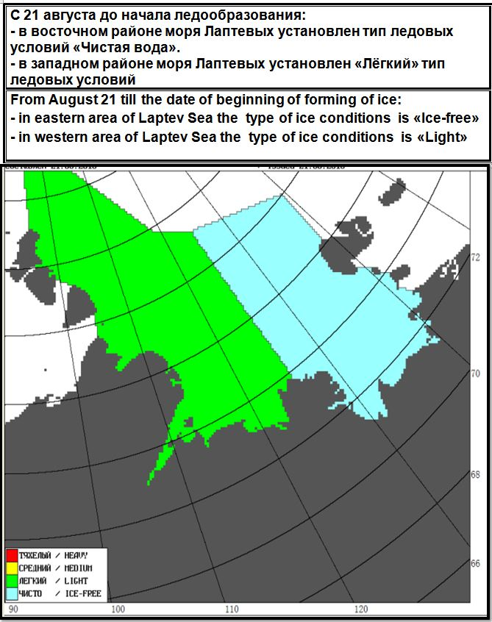
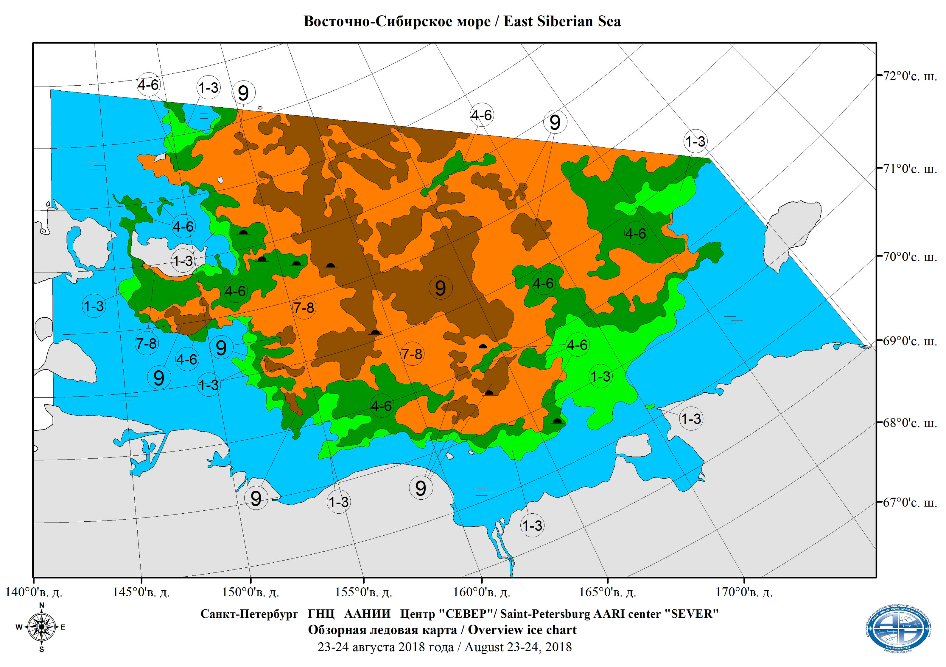
METAREA XX, XXI, NSR and SAR
METAREA XX
SECURITY
WEATHER BULLETIN FOR METAREA XX
ISSUED BY THE ARCTIC AND ANTARCTIC RESEARCH INSTITUTE
ST PETERSBURG ON THE 27 AUGUST 2018 AT 0600UTC
PART 1
AT 270600UTC
GALE WARNING
01130
FROM 271200UTC TO 280000UTC
WINDS S S/W GUSTS 17 TO 20 MS
AARI and Roshydromet marine dep:
Twice daily weather synopsis and forecast
Daily ice edge in text and SIGRID-3 shape
Twice a week ice chart, 3 days numeric forecast of ice and type of ice conditions
Weekly Arctic Ocean ice chart (blended AARI & CIS & NIC)
http://nsra.ru http://gmdss.aari.ru

Slide 11
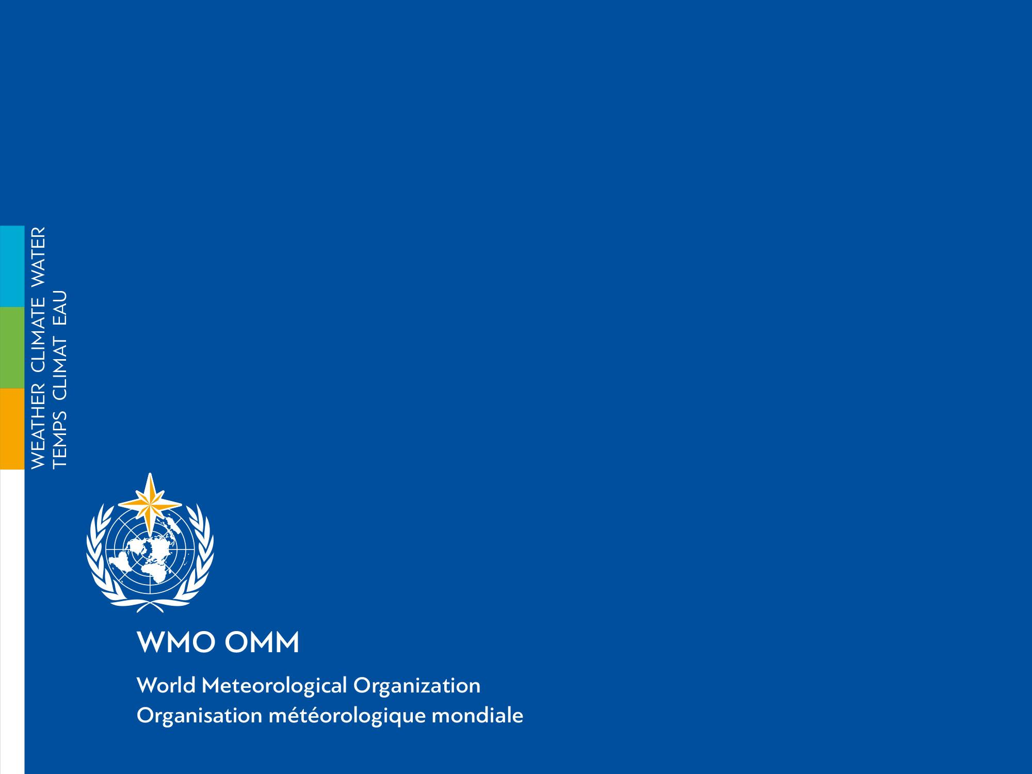
Thank you
Merci
Благодарю за внимание

