Slide 1

METAREA VII
Report

Slide 2
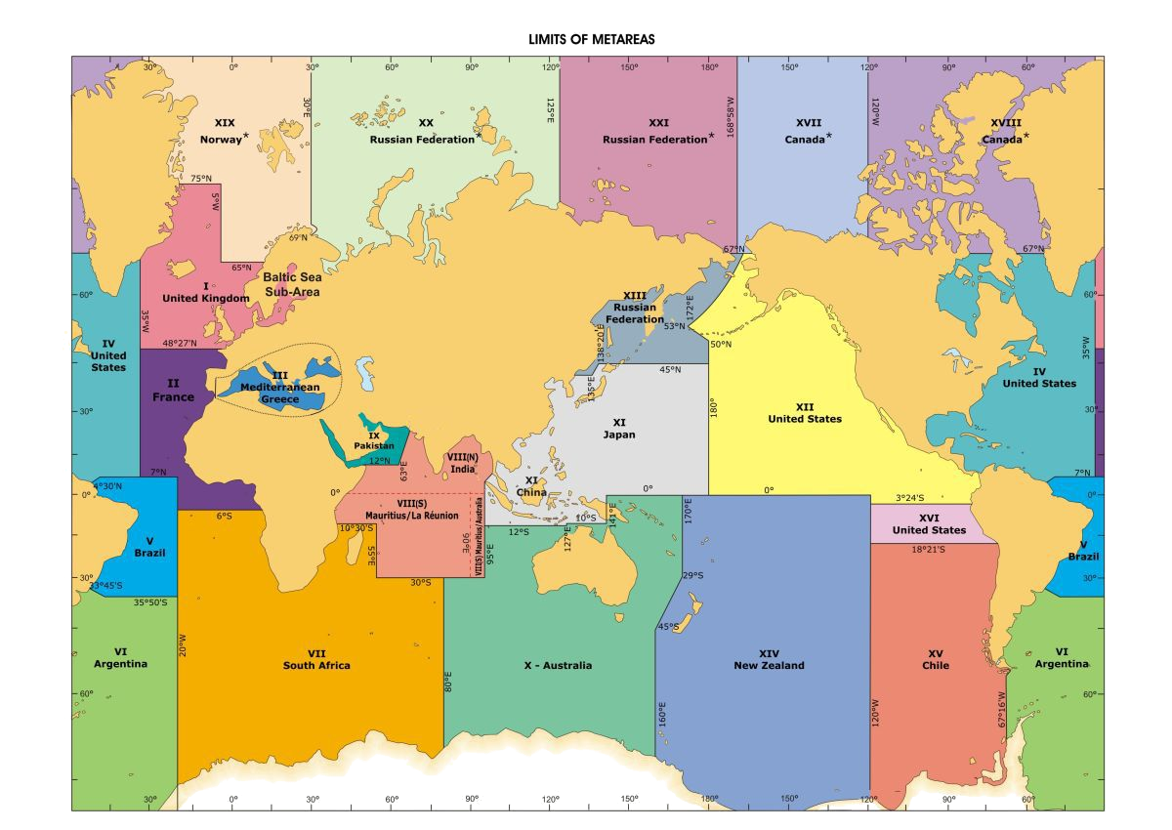

Slide 3
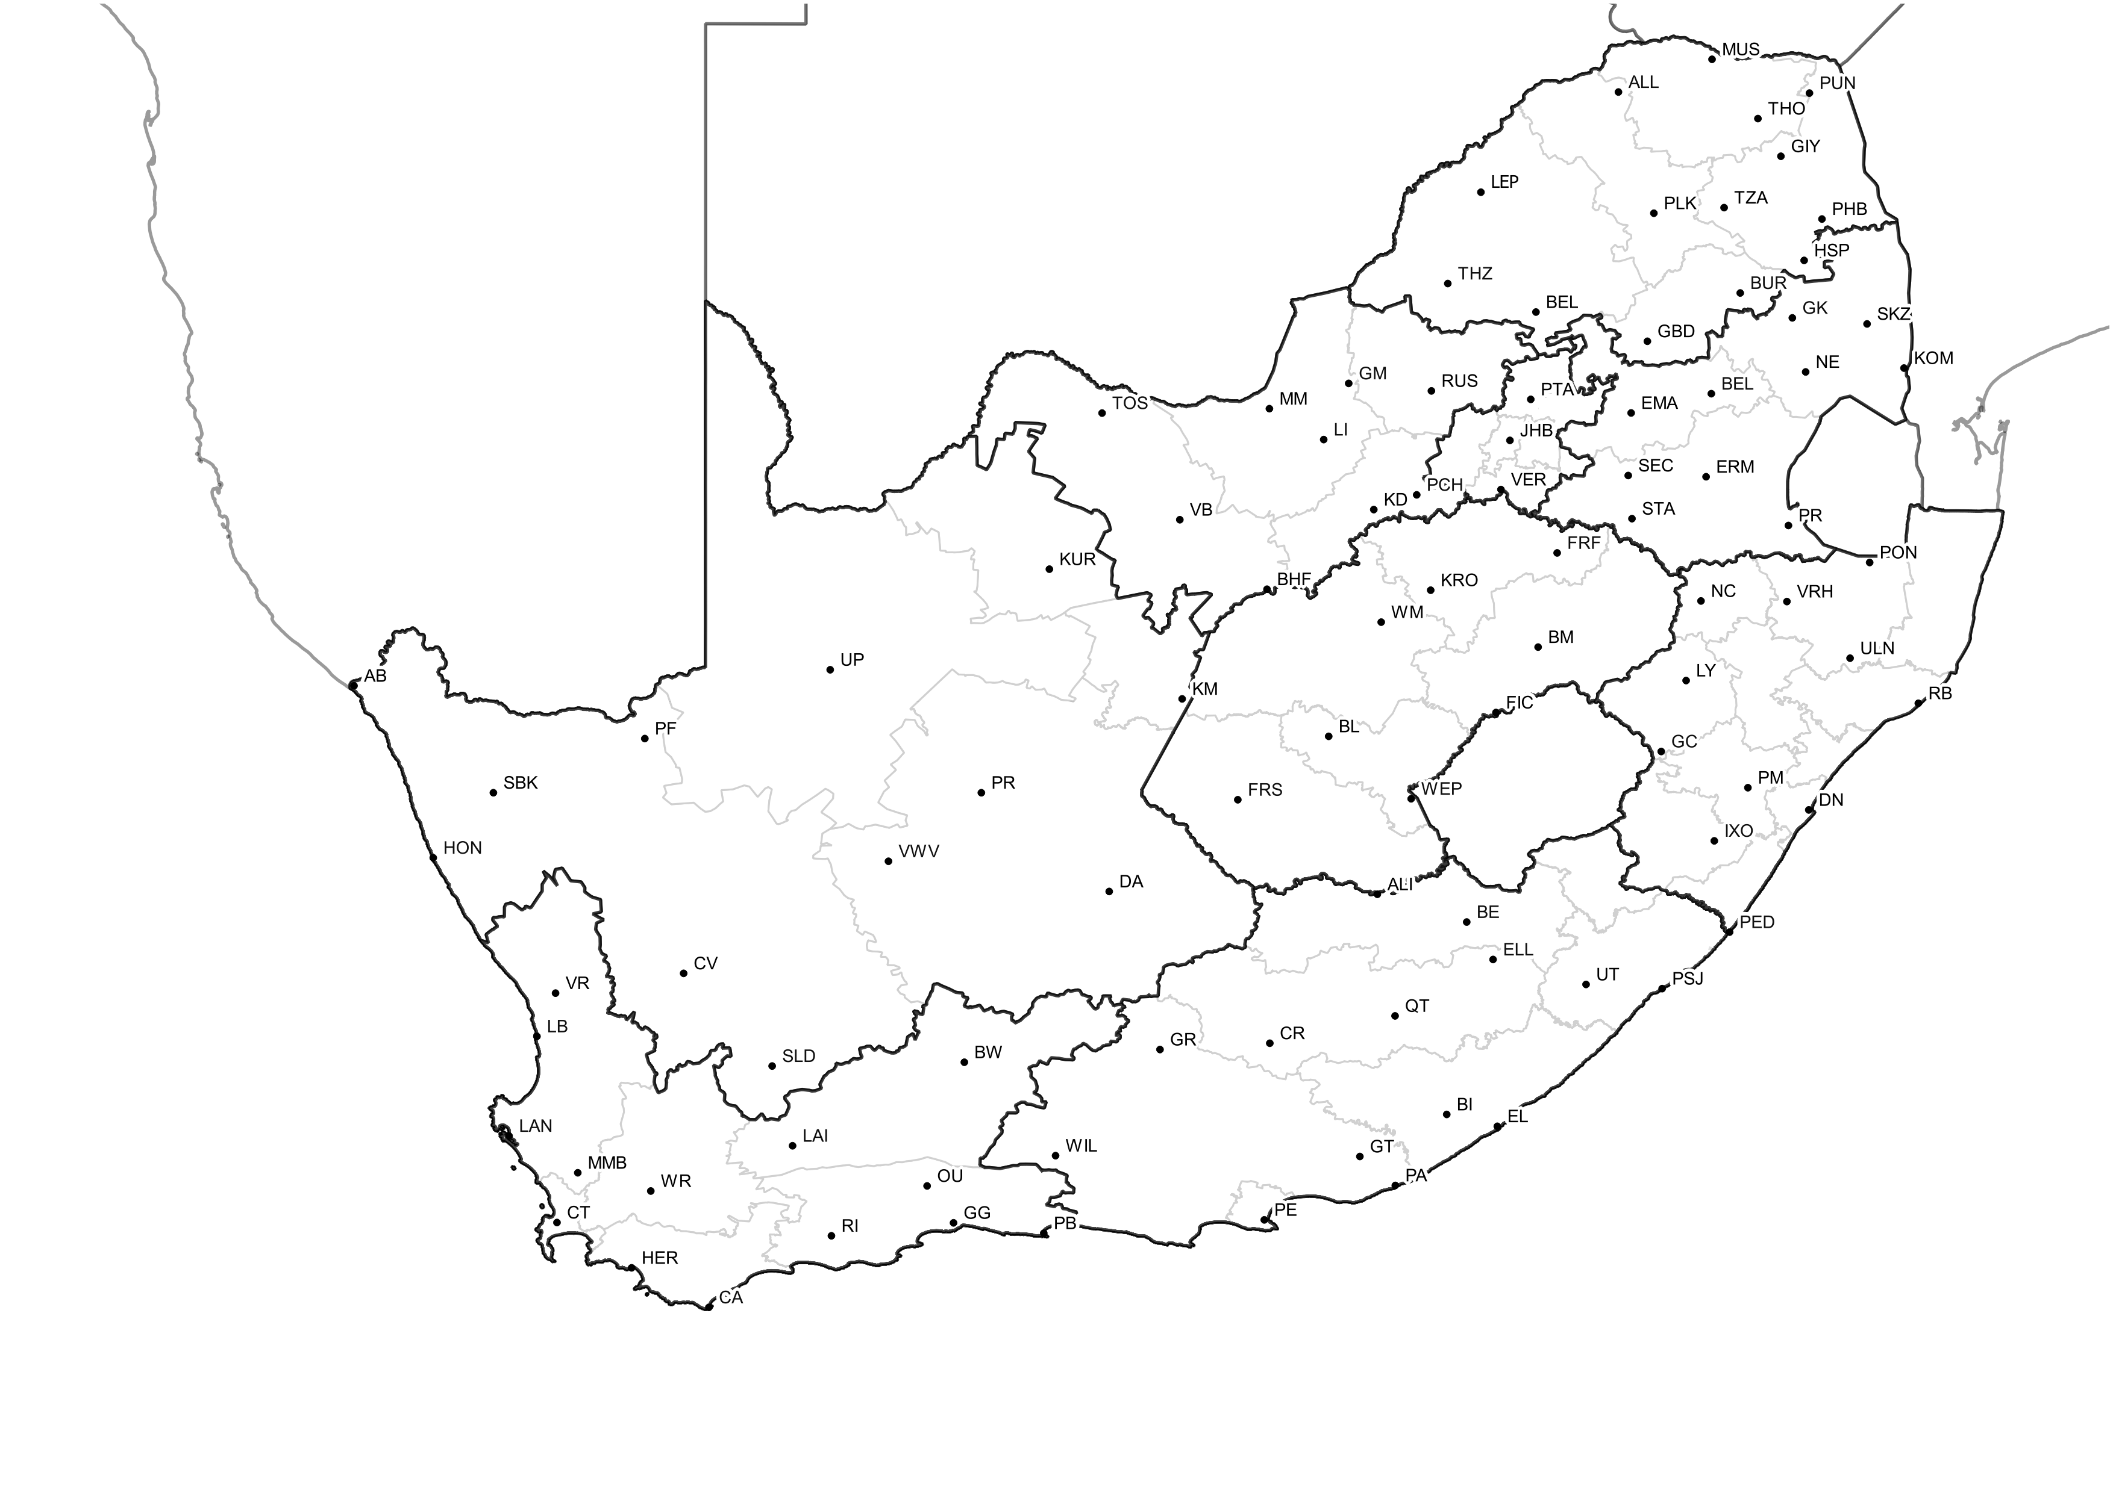
New or planned service-related activities
Pretoria:
Marine unit forecasting head-office
Issues coastal and high seas forecast bulletins
Regional Offices who assist with coastal forecasts:
Cape Town
Port Elizabeth
Durban
Forecasting part of Marine unit to be moved to Cape Town from April 2019:
More specialised unit to improve and provide new products and services

Slide 4
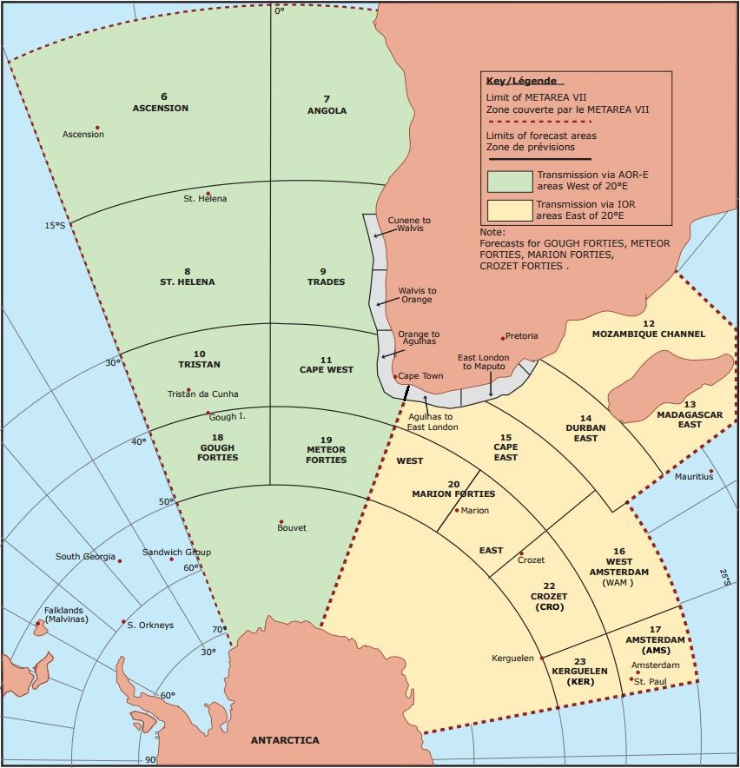
New or planned service-related activities
Forecasts issued daily
Forecasts issued by La Reunion/Meteo-France
Only forecasted for on request
We plan to include the entire METAREA into the forecast and warning products

Slide 5
New or planned service-related activities
A number of gaps exist and need to be addressed or improved;
  Consistency across boundaries –communications with neighboring METAREAS
  Format of forecasts and warnings
  Monitoring forecasts and warnings
  Verifying forecast and warnings
  Contingency/backup plan
  SOP

Slide 6
New or planned service-related activities
Plan to provide sea ice products and services
  Plan to deploy sea ice buoys
Plan to implement a storm surge model
Introducing impact based marine warnings along the coast
  For inshore products and disaster management

Slide 7
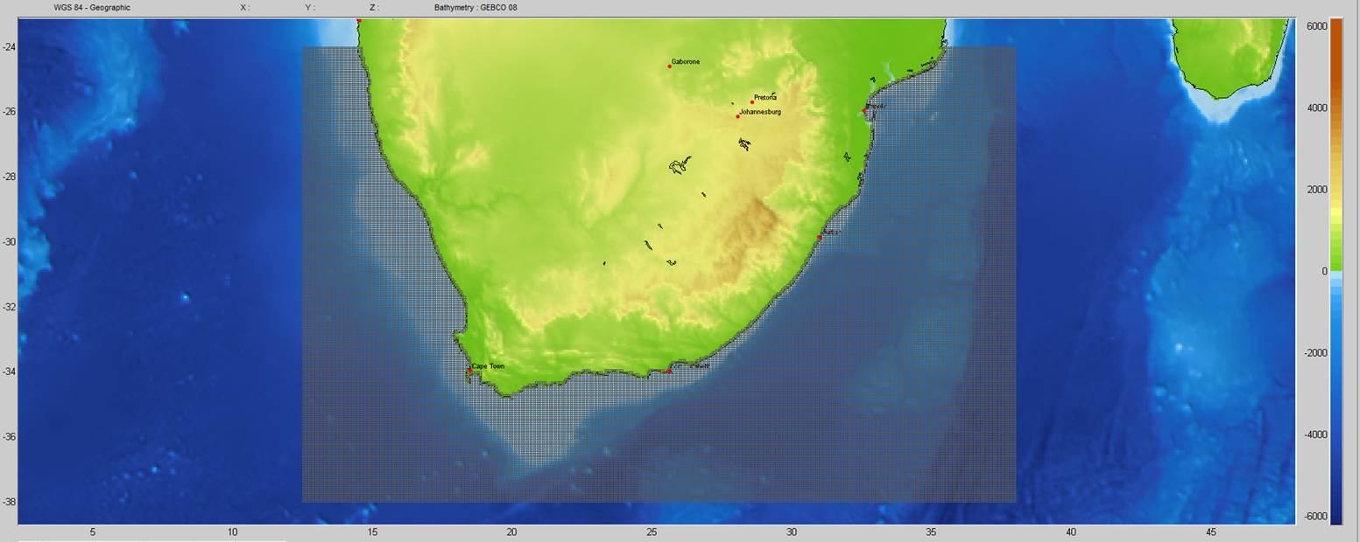
New or planned service-related activities
Plan to implement high resolution wave models along the coast
  model is built in SWAN and forced with NCEP spectral boundary conditions

Slide 8
Recent challenges encountered with MSI provision or coordination
Head office in Pretoria moved in May – caused some disruption to services
  Received a number of complaints from IMO/IHO during this period
Currently having issues with viewing Buoy data (data format issues)

Slide 9
Significant examples of stakeholder interactions or education activities
Permanent Meteorological Trainer: Marine forecasting appointed
Marine Forecasting training course currently being aligned to address the forecaster competencies

Slide 10
Significant examples of stakeholder interactions or education activities
In December 2017 SAWS held a Marine Master plan workshop
  To enhance marine meteorology capabilities
Stakeholders included into the workshop and requirements incorporated in the master plan
  Department of Environmental Affairs: Oceans and coast (government)
  South African Earth Observation Network
  South African Marine Safety Authority
  CSIR
  Academic institutions (UCT, UP etc)
  Etc.

Slide 11
Significant examples of stakeholder interactions or education activities
Master plan was completed in 2018 and has been approved by the board
Implementation of this master plan will be led by a Marine Governance Committee, overseeing a Project Steering Committee and a Technical Committee
Collaboration extends beyond the implementation team – partnerships will remain key cornerstones of any eventual operational capability (including government, academic institutions etc.)

Slide 12

Thank you
Merci

