Slide 1

METAREA XI
China Report
Wei Zhao
National Meteorological Center , CMA

Slide 2
Outline
Marine Met. Info broadcast network
Service-related activities(New or planned)
Challenges
Stakeholder interactions or education activities

Slide 3
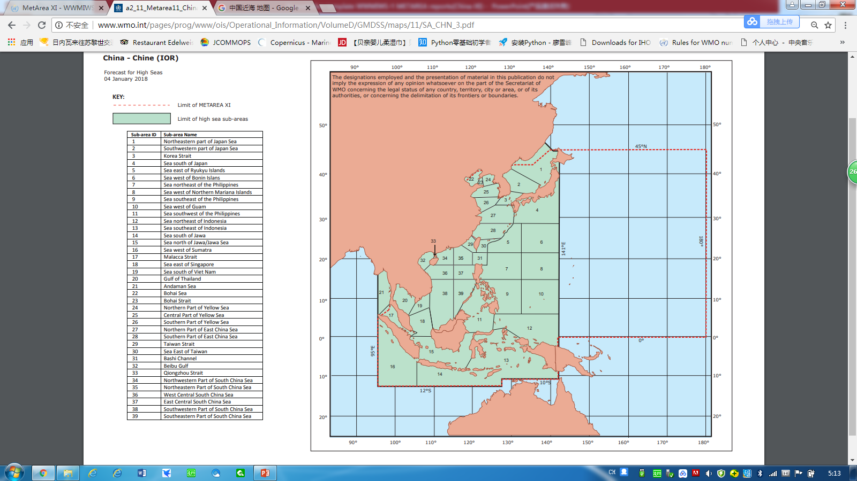
Marine Met. Info broadcast network
CMA help Hong KONG to send their forecast to LES Beijing.
Beijing
Dalian
Shidao
Shanghai
Zhoushan
Guangzhou
HongKong
SafetyNET
Maoming
Navtex (English)
Radio Broadcast(Chinese)
Notes:
To broadcast Marine Weather forecast and warning for vessels sailing over Metarea XI(IOR)

Slide 4
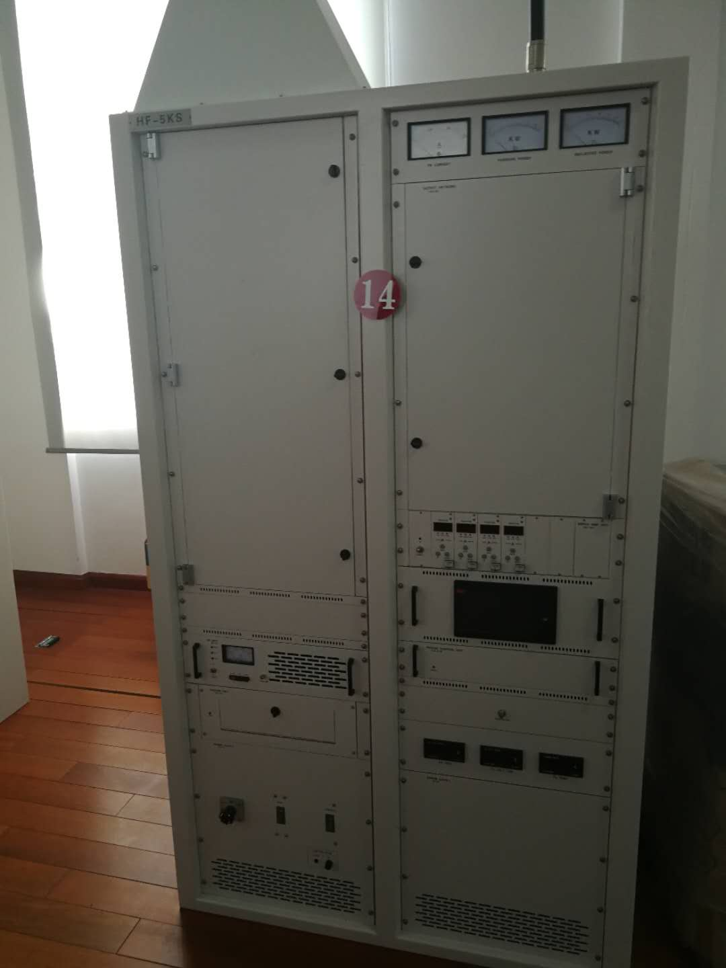
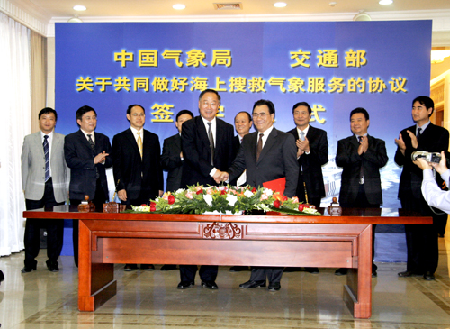
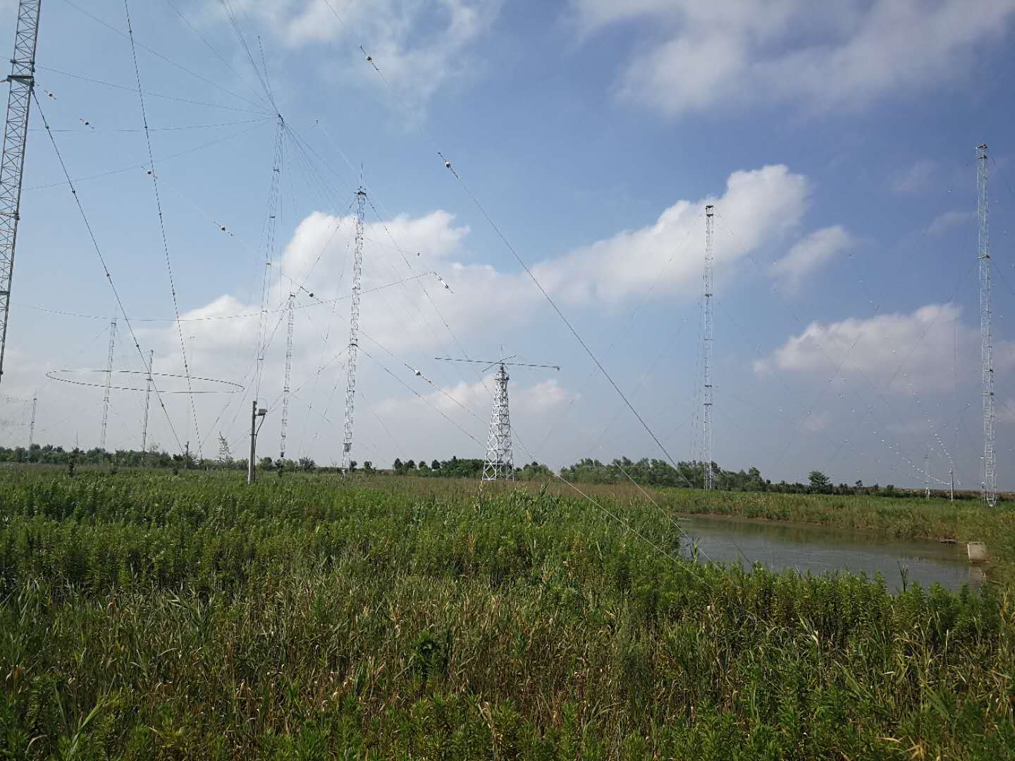
New or planned service-related activities
To restore the Radiofax Service
History
Beijing Radiofax Service started in 1974, but ceased on 30th Sep. 2002.
Ministry of Transport (MOT) and CMA have established effective coordination on the met. service for marine rescue operations on 13th Oct. 2006.
Navigation Safety Administration of East China Sea, MOT reached an agreement with Shanghai Met. Service on the provision of marine met. charts for Radiofax Service in September 2014.
The frequencies(4170、8302、12382、16559kHz) and the license was authorized by Shanghai Radio Administration Bureau on
30th Oct. 2017.
In the same year the broadcast equipment was set up in Shanghai Coastal Radio Station.
In Oct,2018 the Radiofax Service will be in operation.
Notes:
but with the developpment

Slide 5
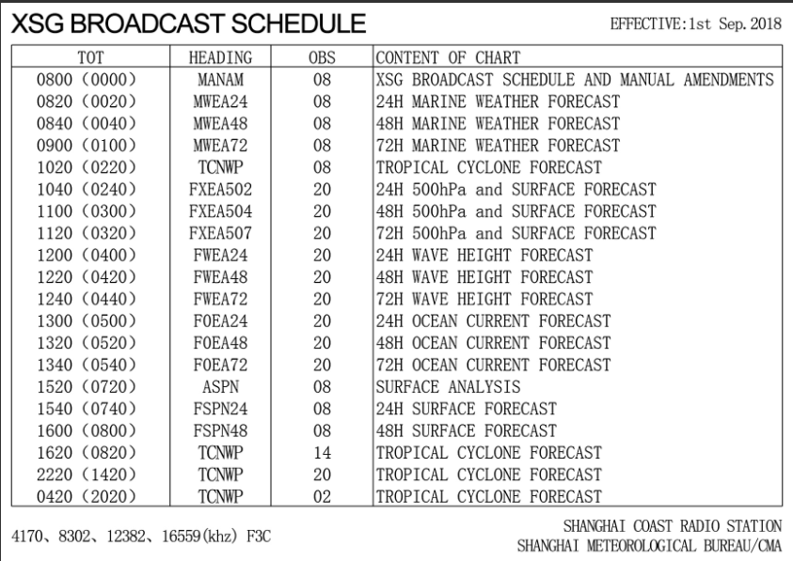
To restore the Radiofax Service
Charts include: Surface and 500hPa analysis, wave and sea current forecast , FY-4 satellite images and TC Forecasts
Transmitting speed: 20min per chart 72charts per day

Slide 6
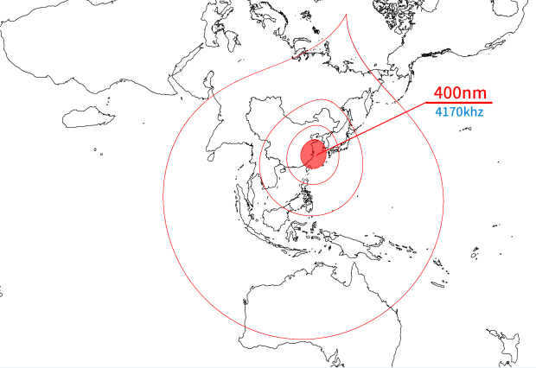
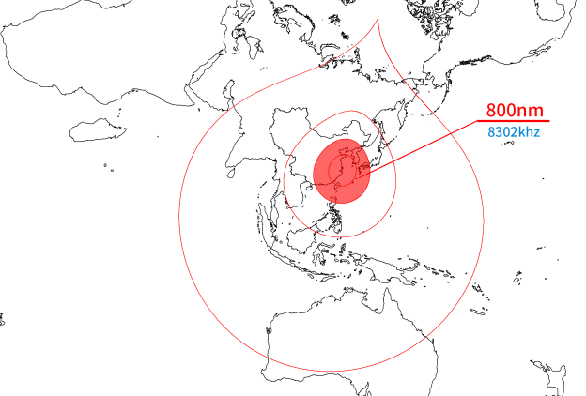
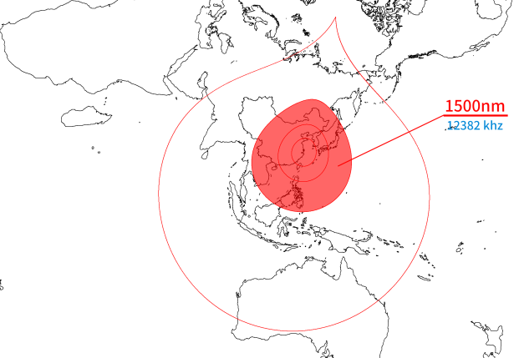
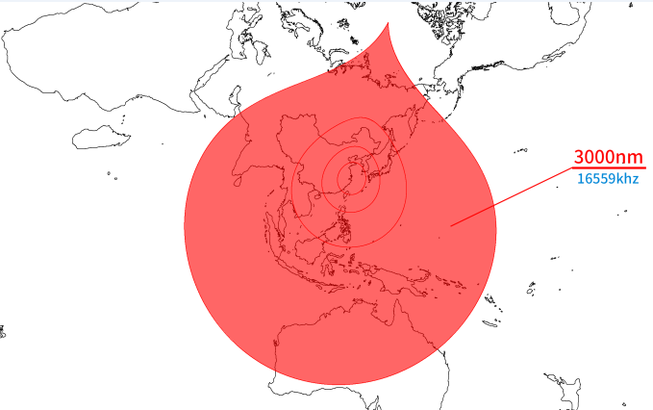
Cover area

Slide 7
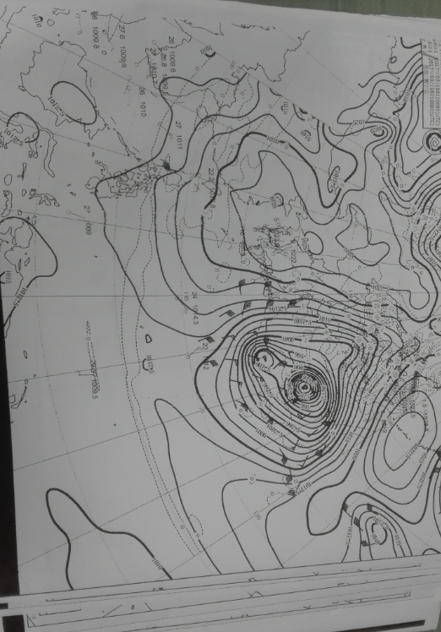
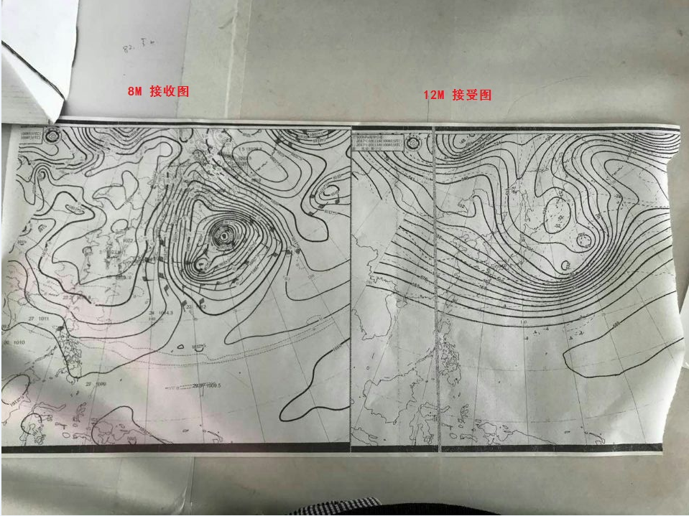
Testing
Received by MV GUANGHENGHAI
On 20th Apr. 2018
N30°59.155′
E122°41.908′
Received by MV XINNANSHA
Frequency:4170 MHz

Slide 8
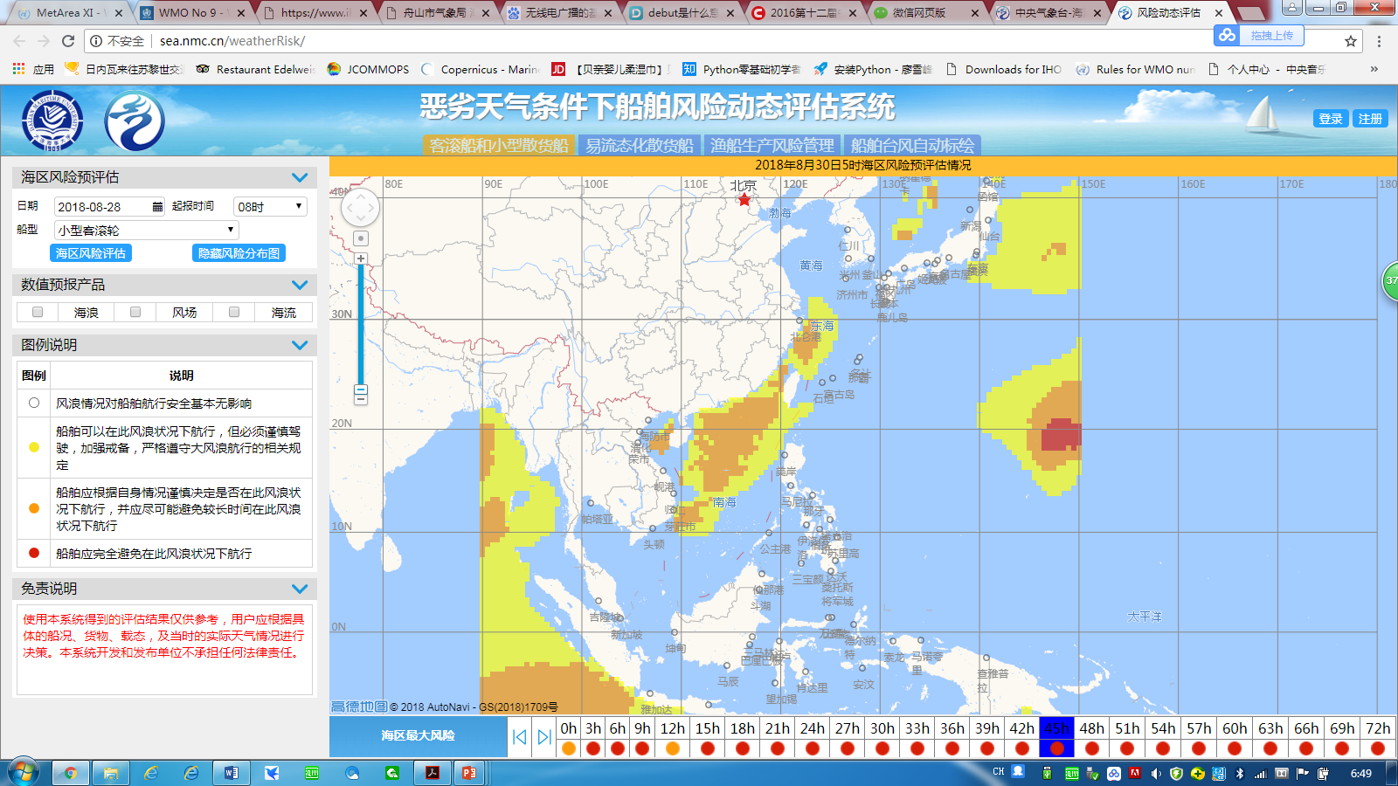
RISK BASED FORECAST
The sailing risks of 6 type vessels can be evaluated based on winds and waves.
(Ro/Ro passenger ship（big and medium size）, general cargo carrier(3000-4000/4000-5000 tons), Liquefy bulk carrier and fishing boat) in testbed

Slide 9
Recent challenges encountered with MSI provision or coordination
Management
Marine competency framework
Quality management for marine service(Only 1 municipal met service adopted)
Technology and management
Small scale severe convective weather at seas(Phuket sinking accident)
More observations, NWP => accurate forecast
Service delivery, tight regulations, effective coordination => disaster mitigation

Slide 10
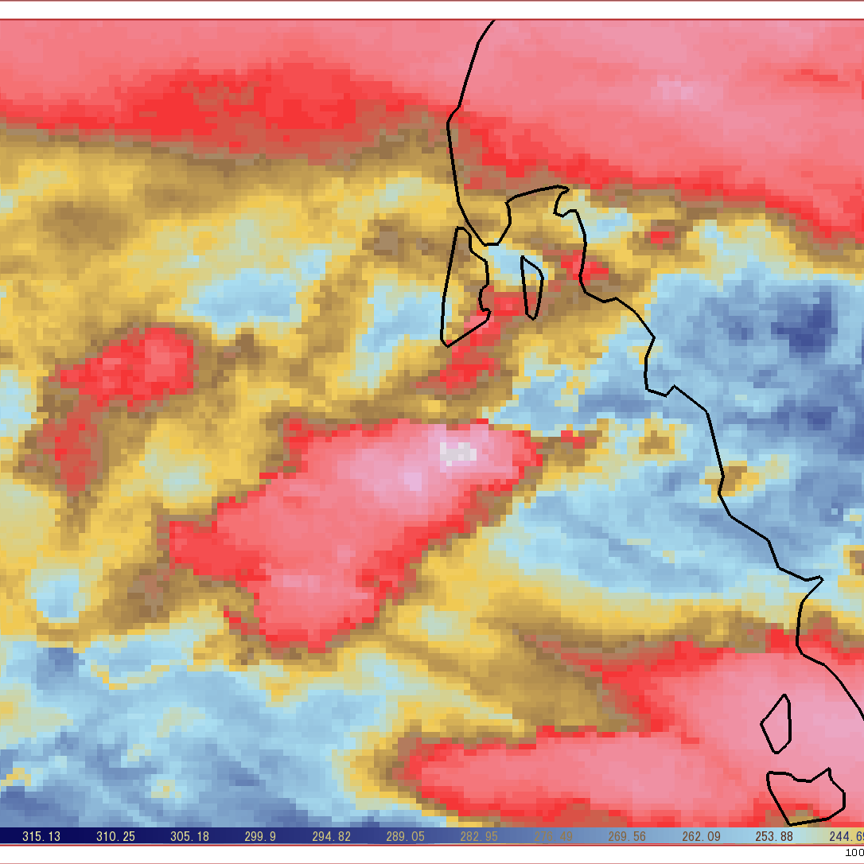
2018-07-05 17:30-19:30(Beijing Time,UTC+8)
Severe convective clouds developed from Sat Infrared animation near Phuket Island

Slide 11
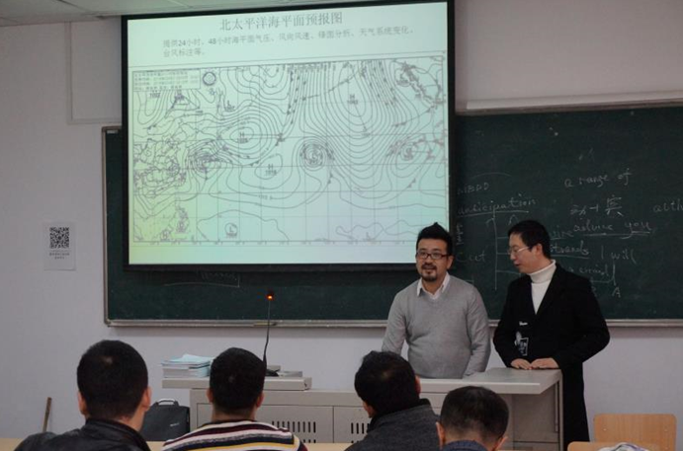
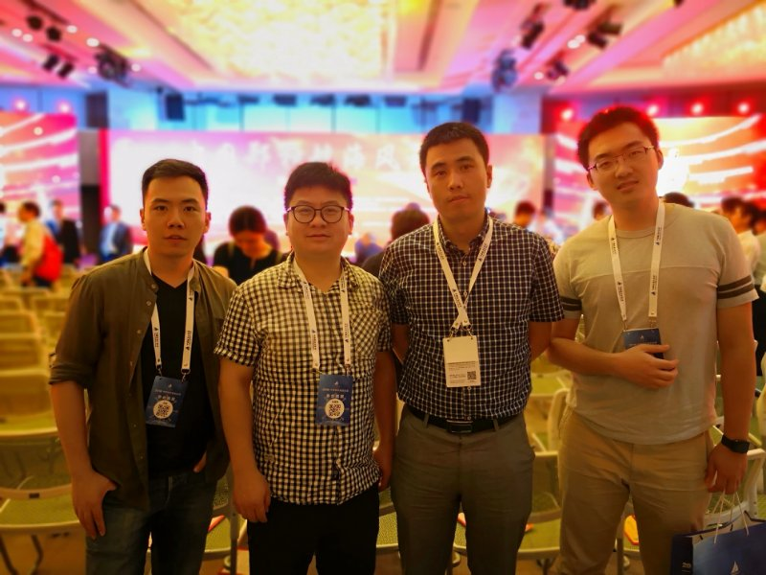
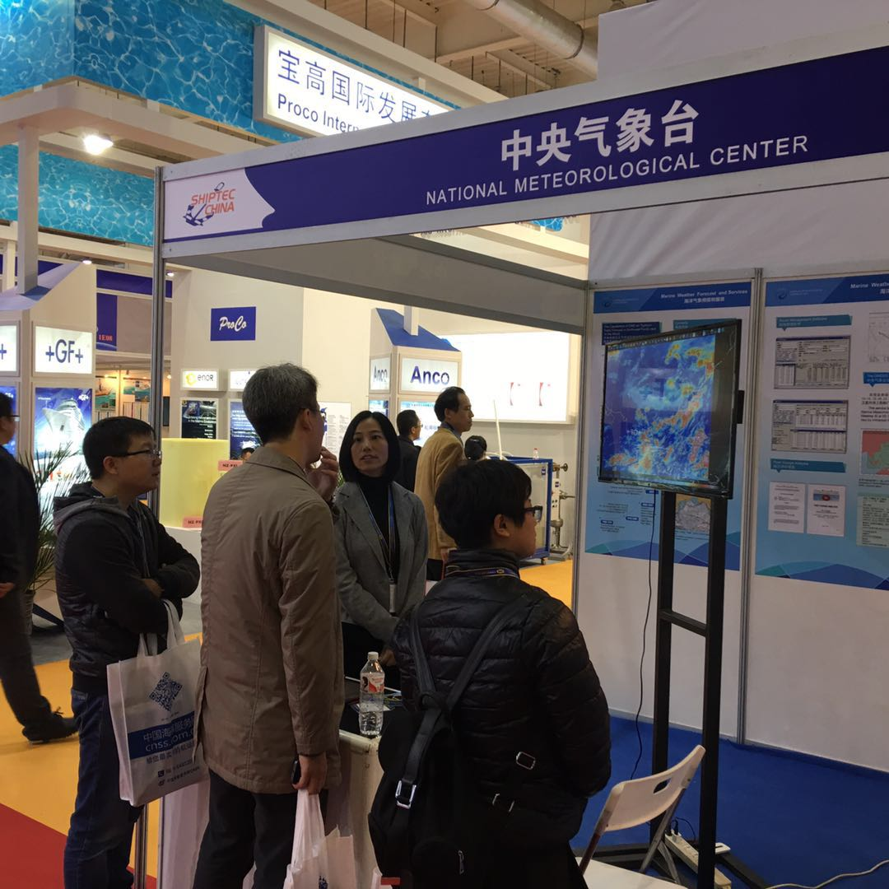
Outreach activities
In March 2018, Shanghai Met Service visited Shanghai Maritime Academy and the marine meteorological products for captains and first mates.
On 11th July, 2018 NMC attended “China Maritime Day” activities in Shanghai.
In Oct. 2016, NMC debuted in the 2016 international Dalian Maritime Expo.

Slide 12

Thank you
Merci

