Slide 1

METAREA XIV Report
WWMIWS-1 Monaco
29-31 August 2018
Elke Louw
Manager Marine Weather Services

Slide 2
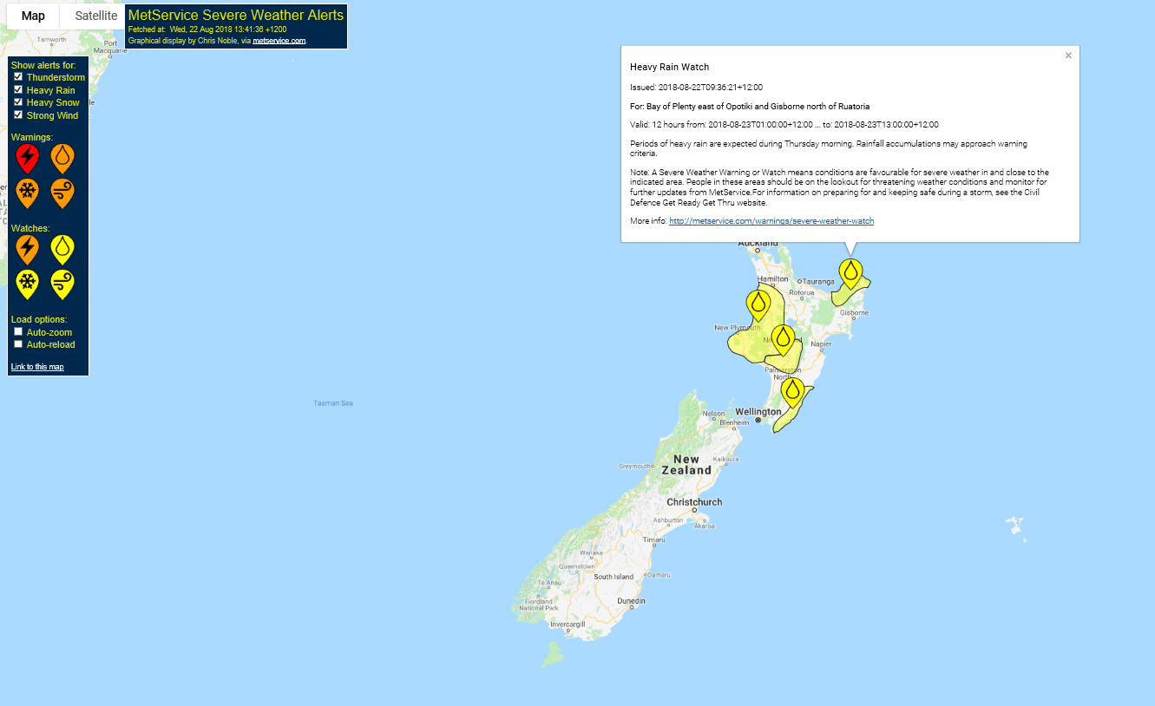
New or planned service-related activities
Key stakeholder workshops planned for later this year/early next year
Graphic to text oceanic/high seas production of forecasts
High seas warnings being made available in CAP.

Slide 3
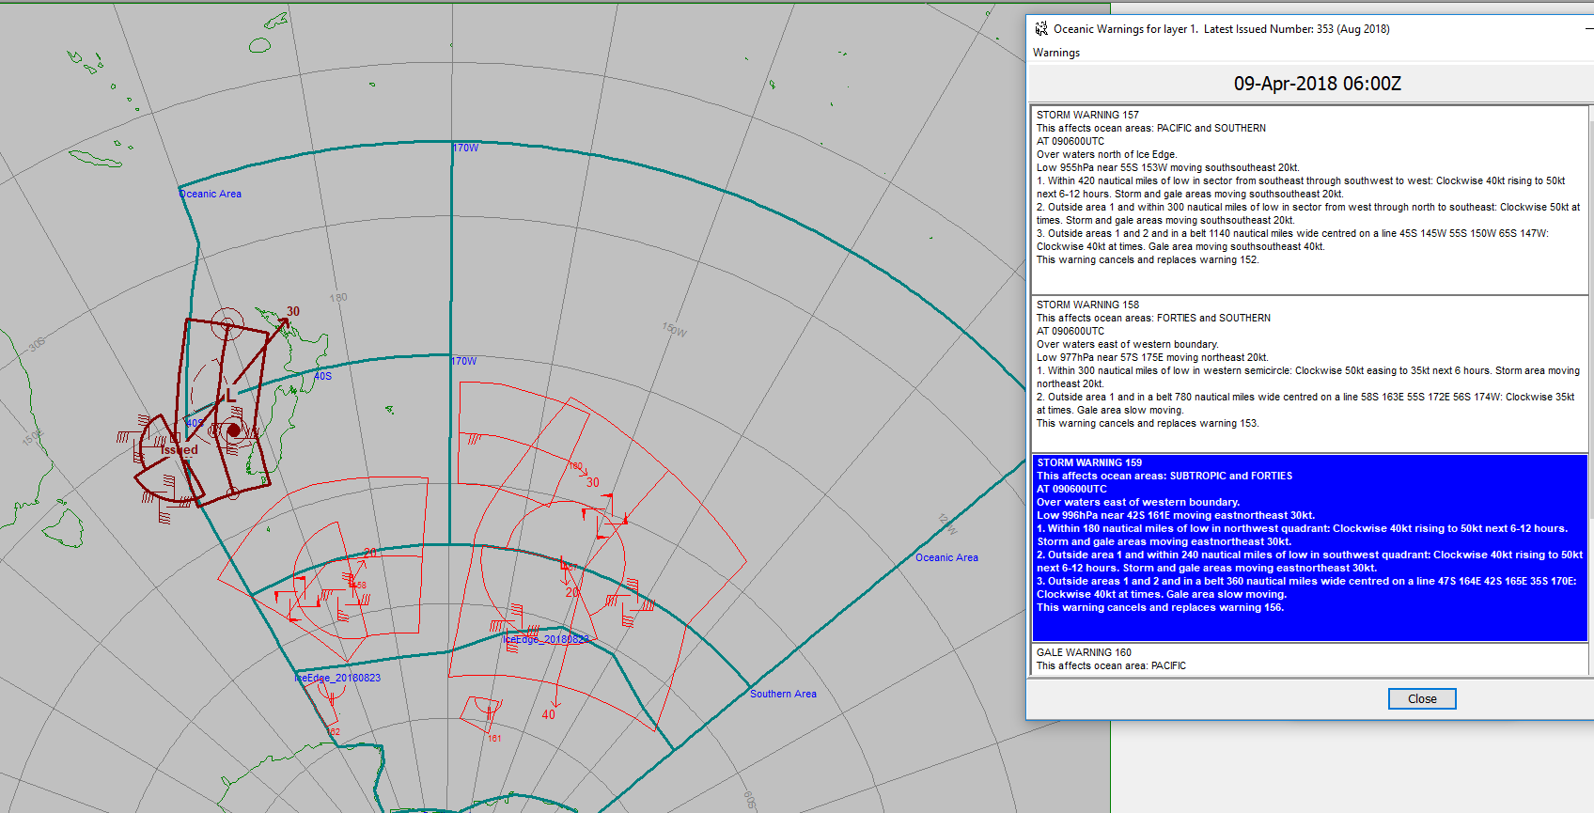
Current tools - improvements
Graphic to text production of our high seas/oceanic warnings – implement it for the production of our high seas forecast.

Slide 4
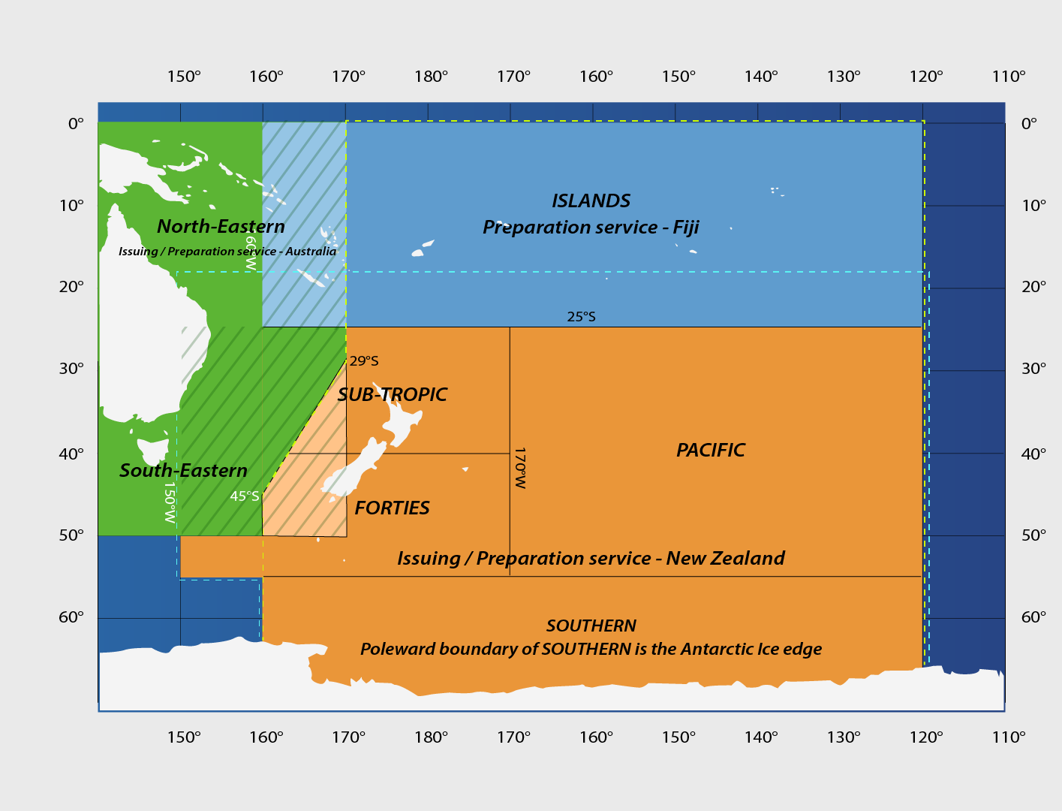
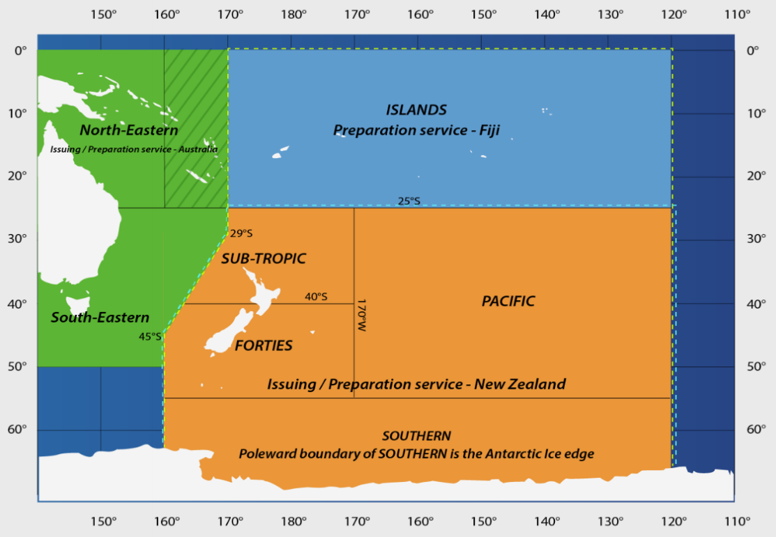
High seas boundary re-alignment
Took effect on 16 December 2017
Notes:
Warnings used to line up to 160E, both for BoM and MetService, with overlap in forecast areas.

Slide 5

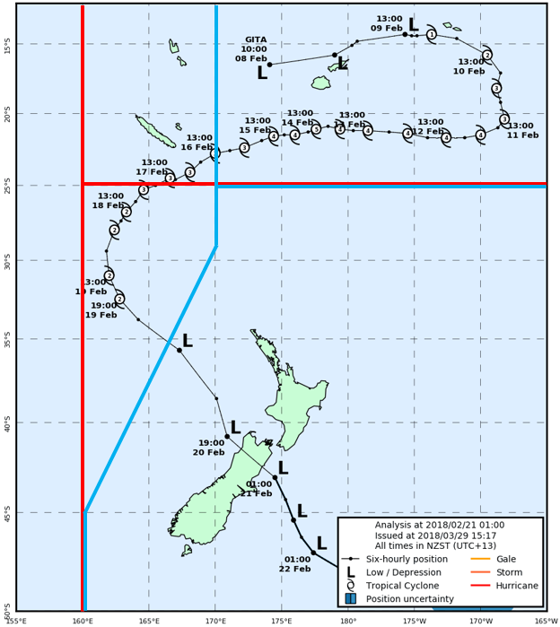
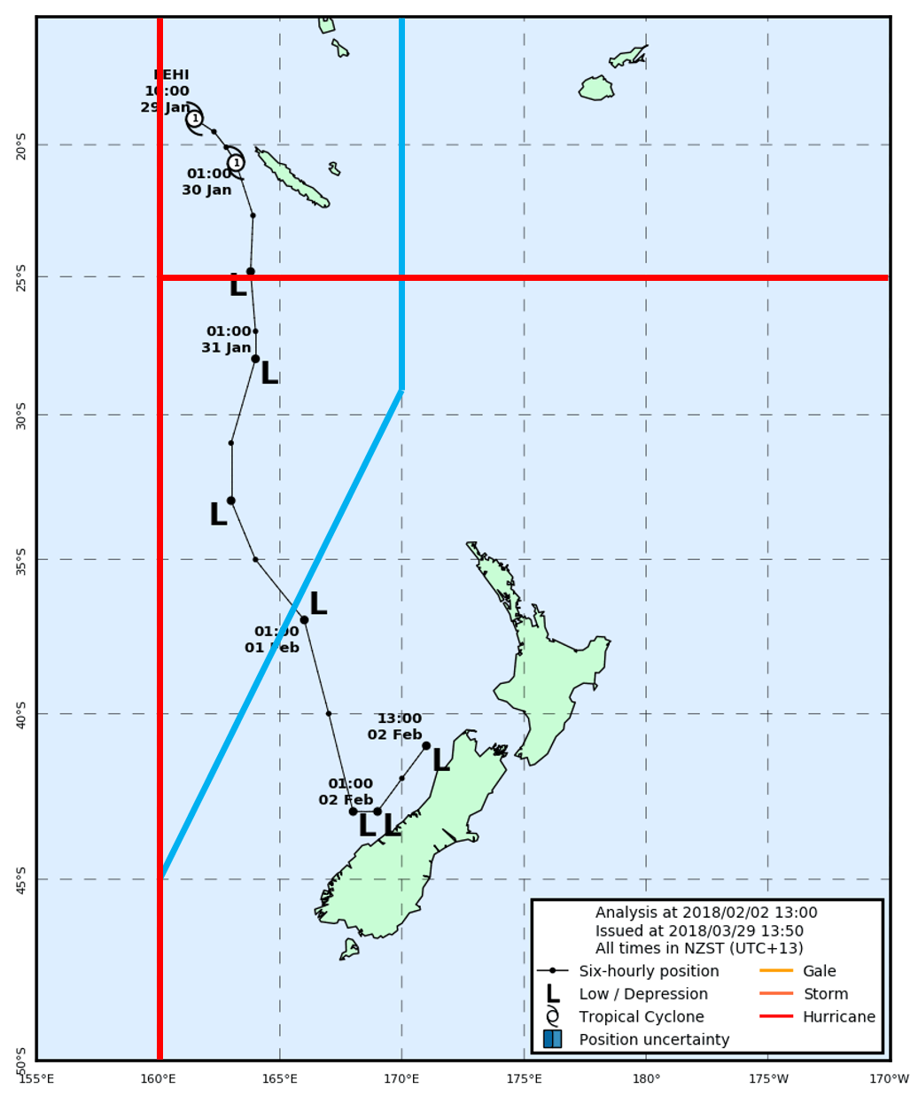
Recent challenges encountered with MSI provision or coordination
TC Warning vs High Seas Boundaries
Red = TC warning boundaries
Blue = high seas boundaries
Notes:
However, while the boundary realignment was implemented for high seas forecasts and warnings, it did not formally apply to TC Warnings and RSMC/TCWC boundaries as specified in the Tropical Cyclone Operational Plan (TCOP) for the South Pacific and South-East Indian Ocean (WMO-1181/TCP-24).
As a result, there is currently an overlap area between the TCWC Wellington AOR and METAREA X in which warnings may come from one of two agencies depending on whether the warning is for a Tropical Cyclone or not (ie for a system south of 25S the warning will come from New Zealand for a TC, but from Australia for a non-TC). Additionally, while a TC Warning will come from New Zealand in this overlap area, the High Seas forecast will come from Australia.
The new boundaries were put to the test twice in the 2017/18 Cyclone Season, as both Fehi and Gita transited through the overlap area between TCWC Wellington and METAREA X. Fehi, in particular, was a challenge as the system was reclassified on the boundary necessitating a double handover for warning responsibility. Fiji handed TC warning responsibility to New Zealand, but as the system was immediately reclassified, warning responsibility on the ex-TC transferred to Australia (despite this not being communicated within the final TC warning issued by Nadi to the north of 25S). An example of the different boundaries with the track of TC Gita are shown below;

Slide 6
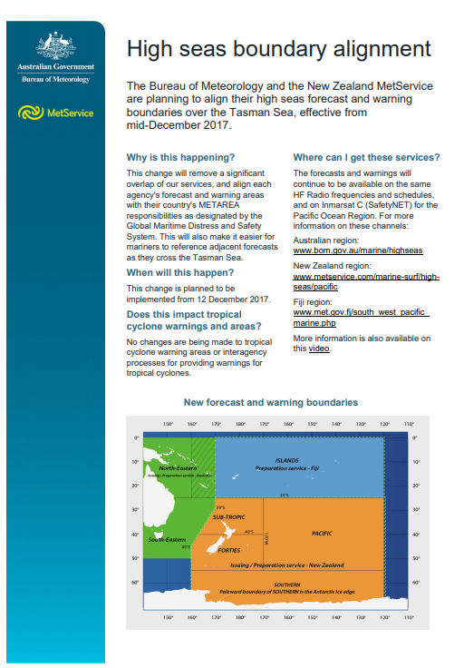
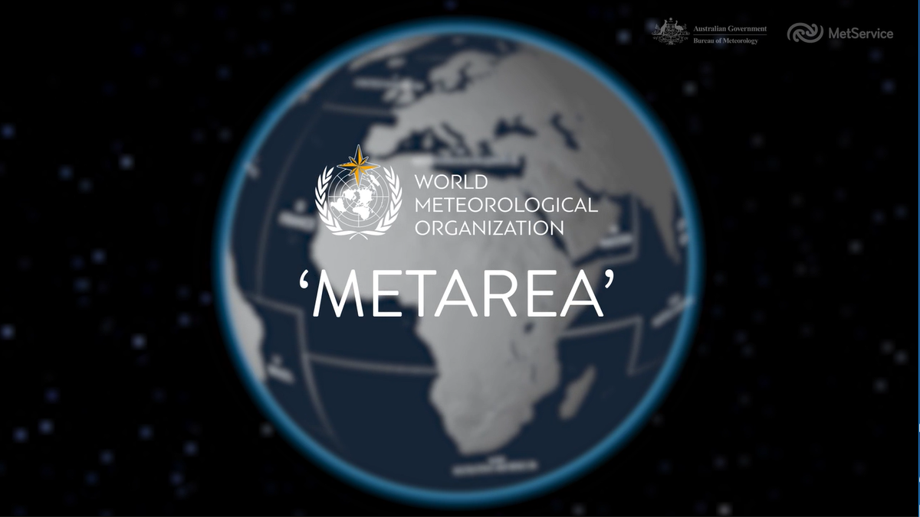
MetArea Boundary Re-alignment
Video placed on social media channels
Websites
Notification to mariners also put in place 3-4 weeks ahead of the change
Notes:
Educational tools used by BoM and MetService for education on the changes.
Video and information pamphlet.

Slide 7
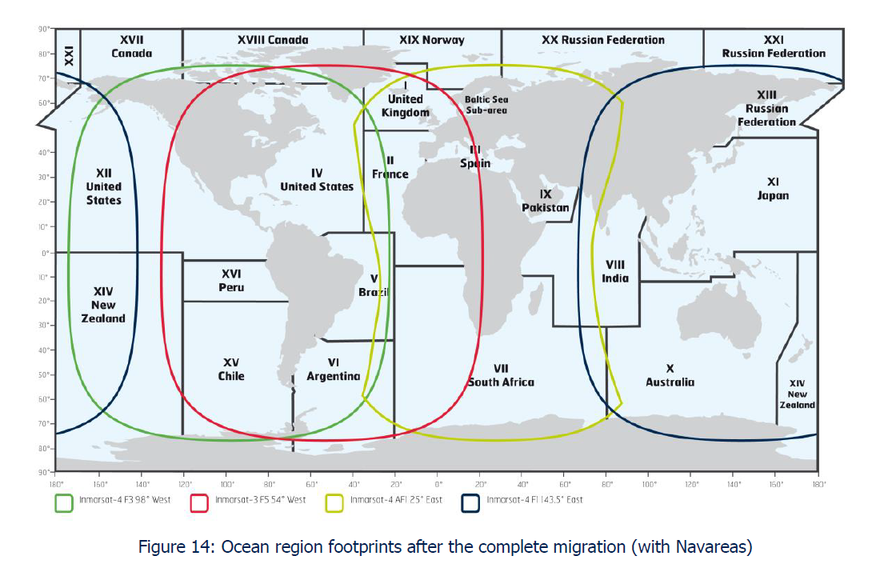
Future challenges
Migration from I3- I4 INMARSAT
Broadcasting to two satellites
POR and AROW Oceanic region
Monitoring MSI – will now be a challenge for the AORW region.

Slide 8
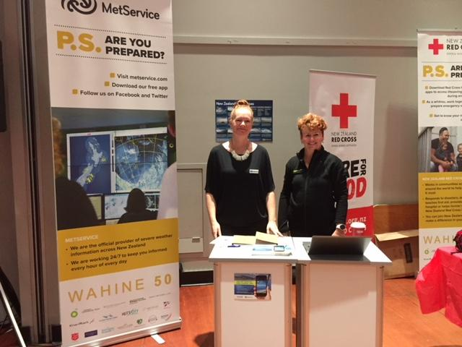
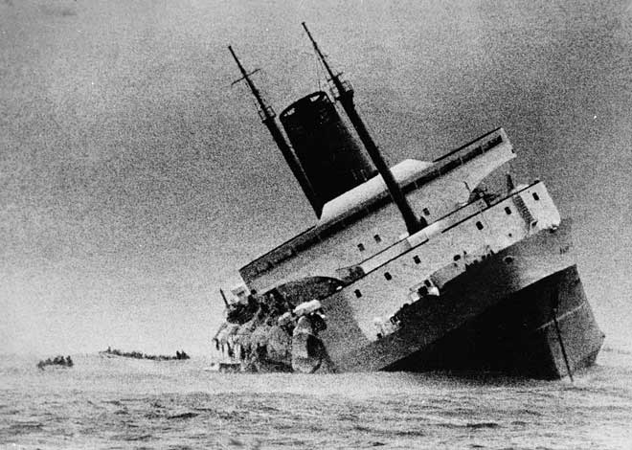
Significant examples of stakeholder interactions or education activities
Tuesday 10 April 2018, marked 50 years since the Lyttelton to Wellington ferry Wahine sank in the Wellington Harbour in what is considered New Zealand’s worst modern maritime disaster.
Boat/Yacht shows
Speaking at Yacht clubs ahead of races
Customer centric workshops planned later this year – are our products still relevant?
Members of our meteorology team also took part in the “PS: Are you prepared?” exhibition, reinforcing the message that the MetService weather forecast should always be part of preparations, regardless of what you are doing.
Notes:
50th anniversary of sinking of Wahine – stands around the safety aspect.
Re tweets of maritime NZ things on our social media accounts.

Slide 9
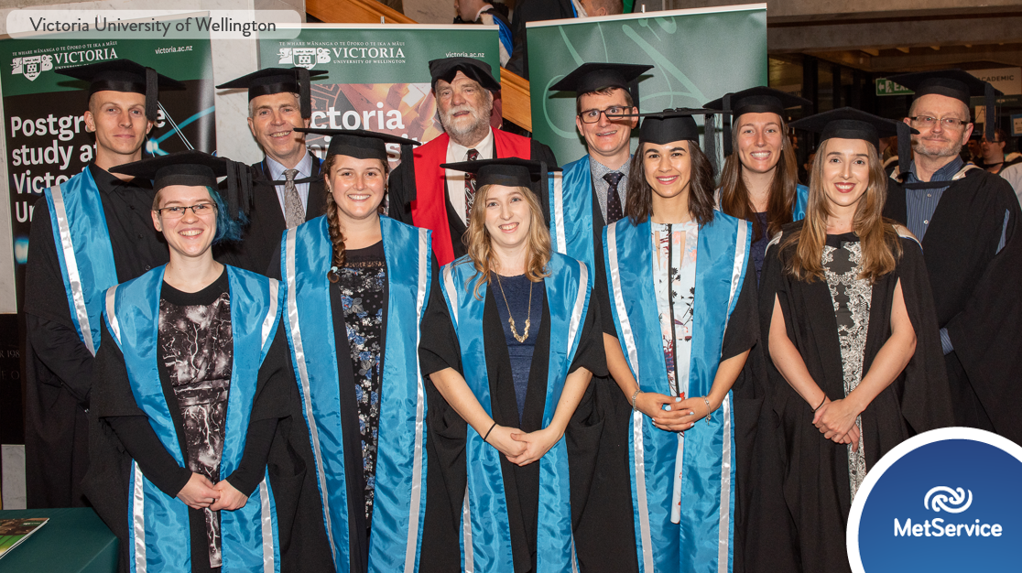
Masters of Meteorology course
May 2018, we welcomed the first ever graduates from the Masters in Meteorology programme, run in partnership between MetService and Victoria University of Wellington (VUW).
Graduates with majors in maths and physic degrees.

Slide 10
Thank you
Merci
elke.louw@metservice.com

