Slide 1

METAREA XI (Japan)
Report
Shigeharu NISHIKAWA
Japan Meteorological Agency

Slide 2
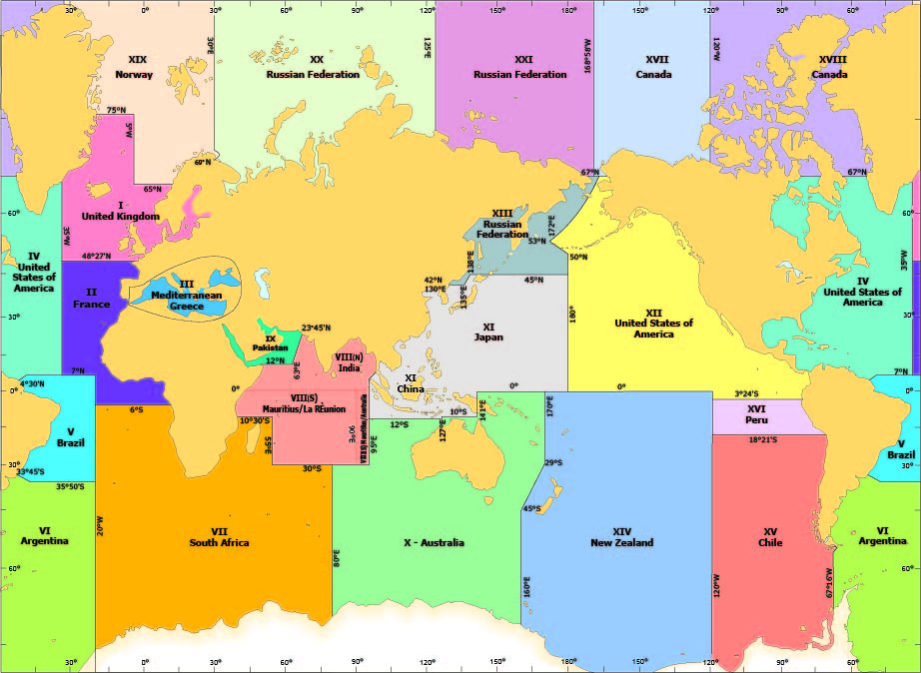
METAREA XI
Issuing Service
China
Japan
Indonesia (Tropical Cyclone Warning)
Preparation Service
Australia (south of the equator)

Slide 3
New or planned service-related activities
NEW
  2018 Plan for Improvement of Maritime Safety Information
  JMA started to distribute new messages WWJP27 and WWJP28 on 19 June 2018.
  WMO OPERATIONAL NEWSLETTER
  Technical information at JMA Website

Slide 4
Improvement of maritime safety information
Major changes (scheduled implementation: 19 June 2018)
1. Forecast and current wind information will both be available (except for tropical depressions (typhoons))
(a) Storm/gale warnings associated with low-pressure areas
Information in current warnings:
Current wind speed or maximum wind speed expected within the next 24 hours^{*1}
Maximum radius of ≥30-kt winds (“30-kt wind radius”) expected within the next 24 hours^{*2}
Information in new warnings:
Current wind speed
Current 30-kt wind radius
Maximum wind speed expected within the next 24 hours
Maximum 30-kt wind radius expected within the next 24 hours
⇒ Detailed information to be provided
(b) Storm/gale warnings for ocean areas denoted with latitudes and longitudes or geographical names such as “the Sea of Japan” (30-kt wind radius not included in current or new warnings)
Information in current warnings:
Current wind speed or maximum wind speed expected within the next 24 hours^{*1}
Information in new warnings:
Current wind speed
Maximum wind speed expected within the next 24 hours.
⇒ Detailed information to be provided
*1: Information on current wind speed is provided when: 1. the current value is 34 kt or more and the expected maximum is less than 48 kt; 2. the current value is 48 kt or more and the expected maximum is less than 64 kt; and 3. the current value is 64 kt or more. Otherwise, information on the maximum wind speed expected within the next 24 hours is provided.
*2: The 30-kt wind radius is that of the area affected by winds with speeds of 30 kt or more around a low-pressure area.
2. Information on the expected formation of low-pressure areas will be provided (except for tropical depressions (typhoons)). (In cases when a storm/gale warning is necessary for an expected low-pressure area (i.e., where the maximum wind speed is expected to exceed 34 kt within the next 24 hours))
Information in current warnings:
Wind speed/direction over ocean areas denoted with latitudes and longitudes or geographical names such as “the Sea of Japan”
Information in new warnings:
Warnings on expected winds caused by new low-pressure areas with information on position and movement
⇒This improvement will support decisions on routing and contribute to maritime safety.
naval（海軍の）は削除。Officer’s decision と書いたのが誤解されたのだろう。

Slide 5
New or planned service-related activities
NEW
  10th-generation supercomputer system
  The Japan Meteorological Agency (JMA) began the operation of its new supercomputer system on 5 June 2018.
  The system has 10 times more capacity in terms of meteorological numerical calculation than its predecessor, and can also process larger amounts of data at higher speeds.

Slide 6
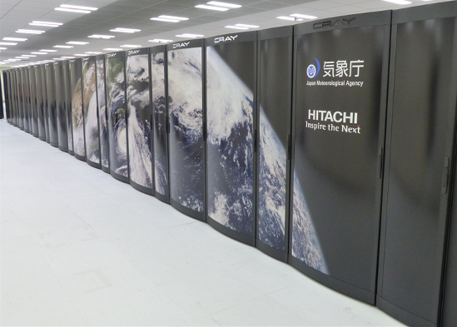
10th-generation supercomputer system
Four Forecast information planning to improve with new super computer.
  Extension of typhoon intensity forecast range
  Improvement of precipitation prediction information
  Launch of fortnight forecasts on five day-average temperatures
  Improvement of Aeolian dust prediction

Slide 7
New or planned service-related activities
Planed
  Improvement Typhoon forecast
  JMA plans to extend the forecast period from the current 3 days-ahead to 5 days-ahead for typhoon intensity (central pressure, maximum wind speed, etc)
  Scheduled implementation by late March 2019.

Slide 8
Improvement Typhoon forecast
Current Forecast
  3-Day Track and Intensity Forecast
  5-Day Track Forecast
  50kt wind probability
Improvement
  5-Day Track and Intensity Forecast
  50kt wind probability

Slide 9
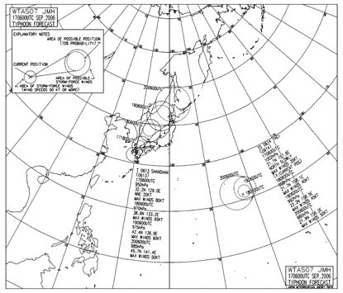
Improvement Typhoon forecast
JMH BROADCAST
  WTAS07 (discontinue) -> WTAS12 (new)
  WMO No.9 “WEATHER REPORTING”
    Volume D “INFORMATION FOR SHIPPING”
      CONTENTS OF BROADCAST SCHEDULES

Slide 10
Recent challenges encountered with MSI provision or coordination
Difficulty in spreading new bulletin (in the WIS)
  e.g. WWJP27 and WWJP28
    JMA started to distribute these messages on 19 June 2018.
    Essential Data
  WIS Metadata
    (GISCs are required to support) Synchronization of the comprehensive WIS discovery metadata catalogue with other GISCs. (WMO No 1060)
  Actual Data
    Each GISC shall collect from its area information that is intended for global exchange and shall share such information with other GISCs so that all GISCs have a common holding of information available for global exchange. (WMO No 1060)

Slide 11
WIS Metadata (WWJP25 vs WWJP27)
GISC | Searchable?
GISC Tokyo | WWJP25:Yes WWJP27:Yes
GISC A | WWJP25:Yes WWJP27:Yes
GISC B | WWJP25:Yes WWJP27:No
GISC Tokyo already created and stored WIS metadata of WWJP27 and WWJP28 at the GISC Tokyo web portal.
GISCs collect/harvest WIS metadata from the other GISCs.
But some user can not find the WIS metadata of WWJP27, WWJP28 from nearest GISC.

Slide 12
Actual Data (WWJP25 vs WWJP27)
GISC | Downloadable?
GISC Tokyo | WWJP25:Yes WWJP27:Yes
GISC A | WWJP25:Yes WWJP27:Yes
GISC B | WWJP25:Yes WWJP27:No
Routing Catalog of RTH Tokyo
"WWJP25 RJTD","RJTD","EGRR","RKSL","RUHB","VTBB","RPMM","AMMC","KWBC","VHHH","BABJ"
"WWJP26 RJTD","RJTD","EGRR","EDZW","RKSL","RUHB","VTBB","RPMM","KWBC","VHHH","BABJ"
"WWJP27 RJTD","RJTD","EGRR","RKSL","RUHB","VTBB","RPMM","AMMC","KWBC","VHHH","BABJ"
"WWJP28 RJTD","RJTD","EGRR","EDZW","RKSL","RUHB","VTBB","RPMM","KWBC","VHHH","BABJ"
EGRR : EXETER
RKSL : SEOUL
RUHB : KHABAROVSK
VTBB : BANGKOK
RPMM : MANILA
AMMC : MELBOURNE
KWBC : WASHINGTON
VHHH : HONG KONG
BABJ : BEIJING

Slide 13
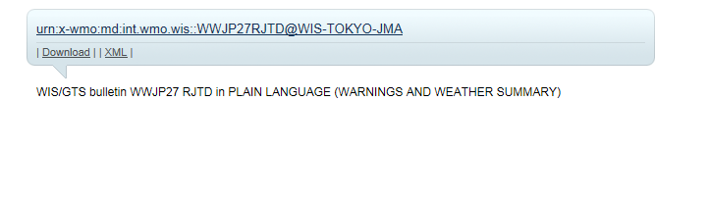
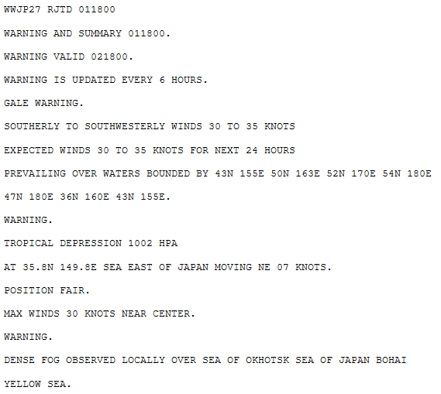
GISC Tokyo
Metadata!
New One!

Slide 14
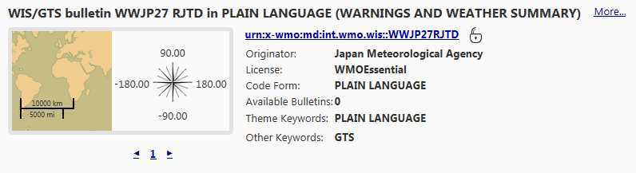
GISC A
Metadata!
No Data!

Slide 15
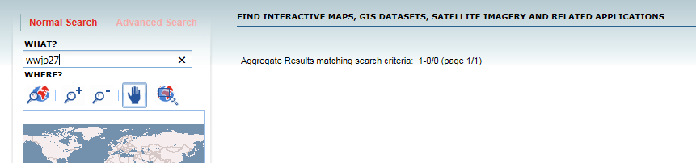
GISC B
No Metadata!

Slide 16
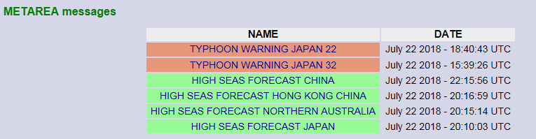
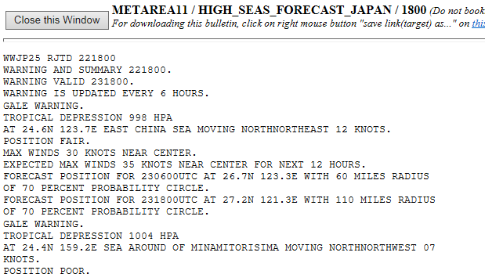

Actual Data (WWJP25 vs WWJP27)
WWMIWS Webpage
Old One!

Slide 17
Significant examples of stakeholder interactions or education activities
Toward to alignment with the standard (WMO No 558)
  Investigation of User’s Needs
    Face to Face interview, Questionnaire
    Association of ship-owners, passenger-ship, fisheries and so.
  Preparing specification for JMA's forecast system

Slide 18

Thank you
Merci

