Slide 1
Background on WWMIWS workplan item 1
Reference card for ships on how to use products issued for the WWMIWS

Slide 2
Problem statement
Meteorological products use language terms to convey information about categories of severity, likelihood, timing, spatial features
A proportion of the user community use numerical values for their decision-making
Therefore, it is important that Met Services provide explanatory material to help users to understand and effectively utilise the products

Slide 3
Current state of play
There are numerous examples of users finding their own reference material for operational purposes on the ship bridge.
In some cases, they refer to IMO publications, whereas others simply print from the internet.
There is an opportunity for WMO and Met Services to brand reference material suitable for use on the ship bridge

Slide 4
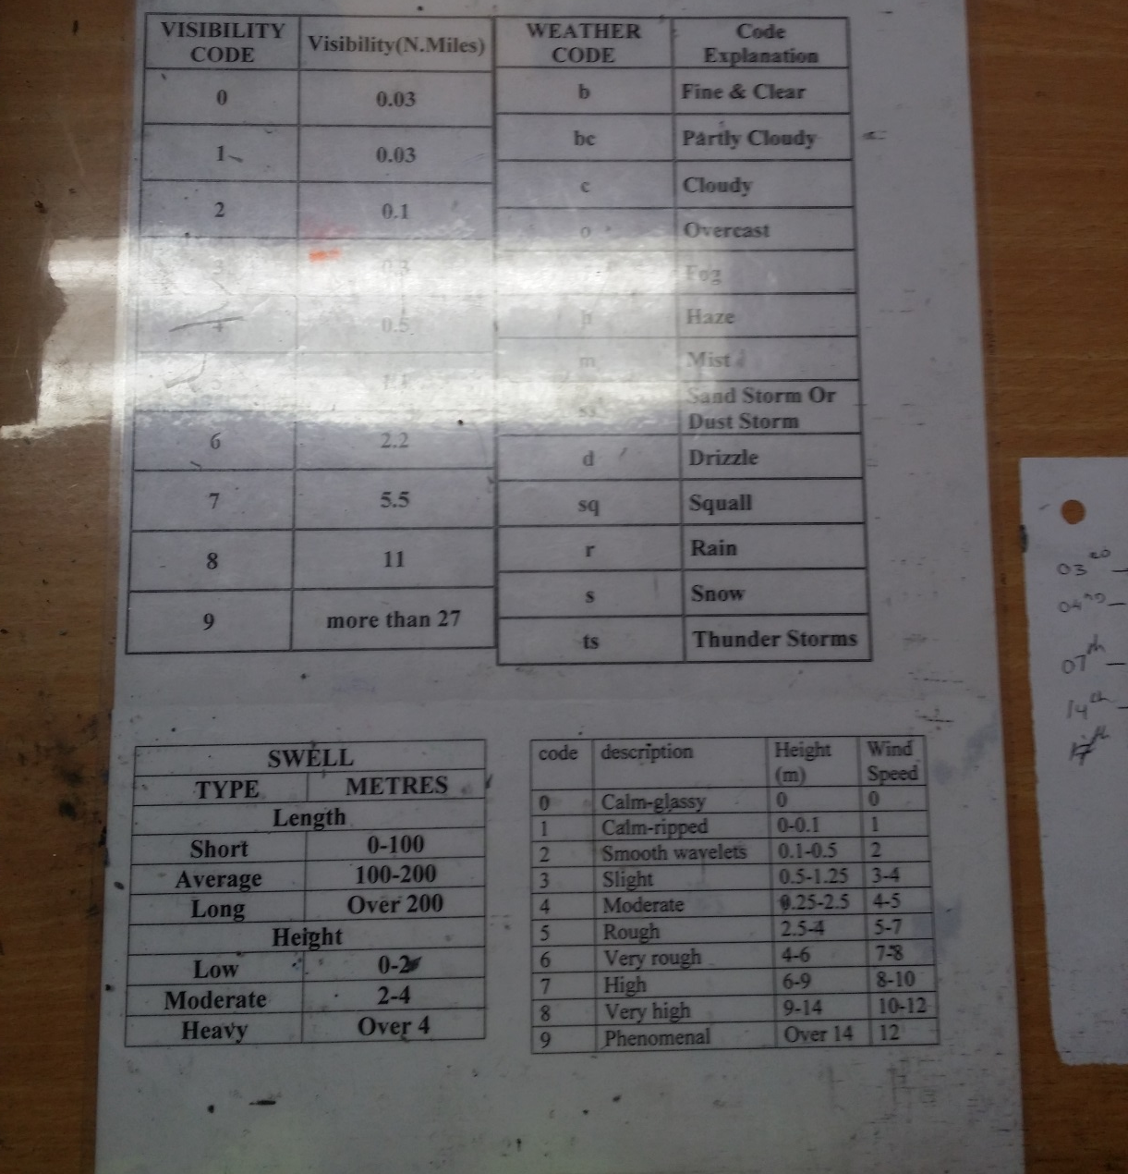
Photos from a ship’s bridge
(Visibility, swell categories)

Slide 5
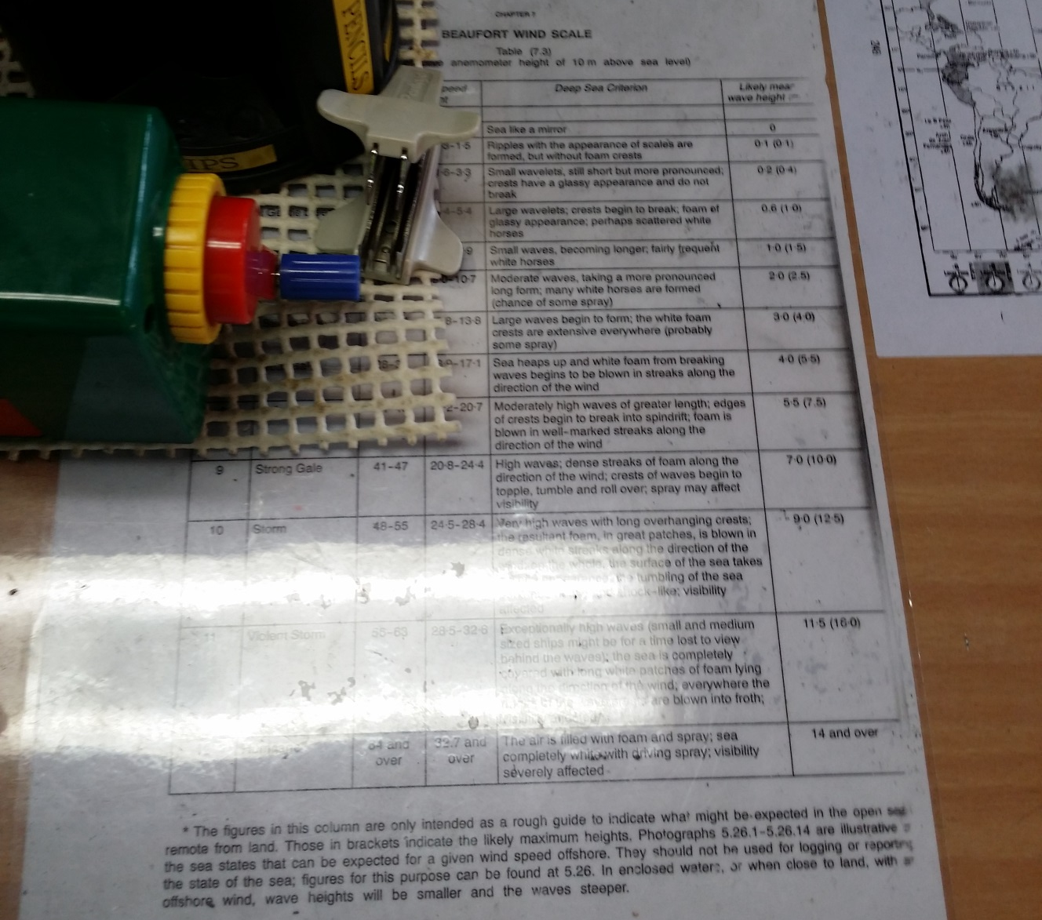
Example of Beaufort scale

Slide 6
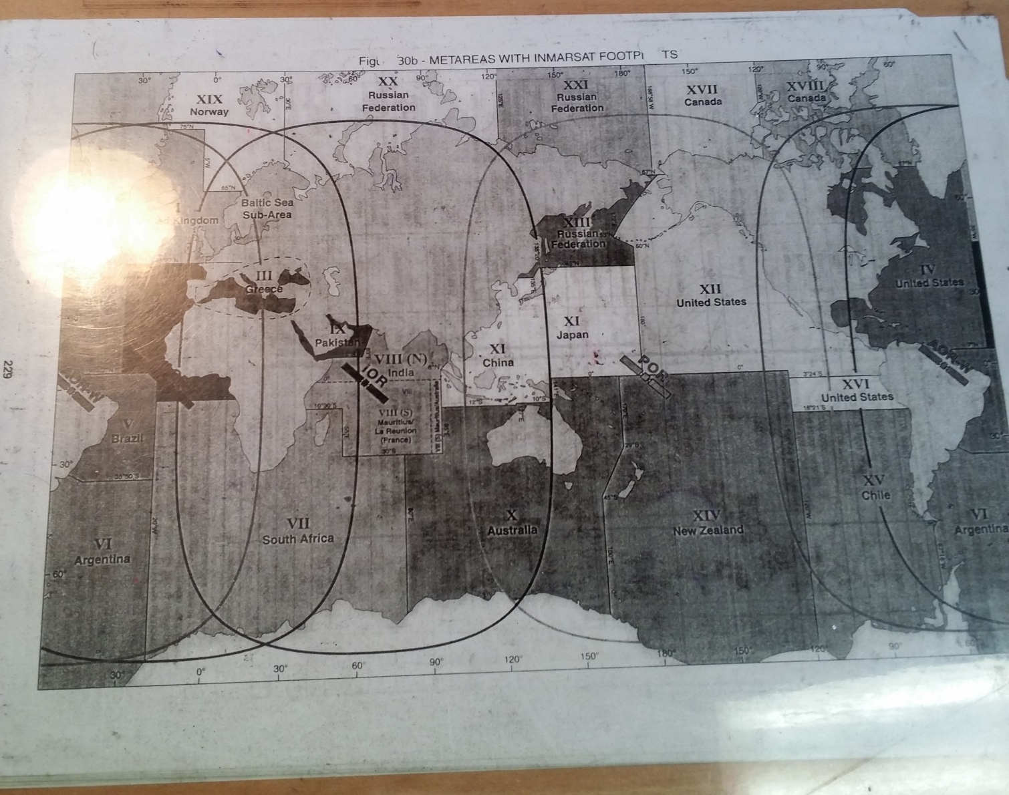
Example of METAREA map

Slide 7
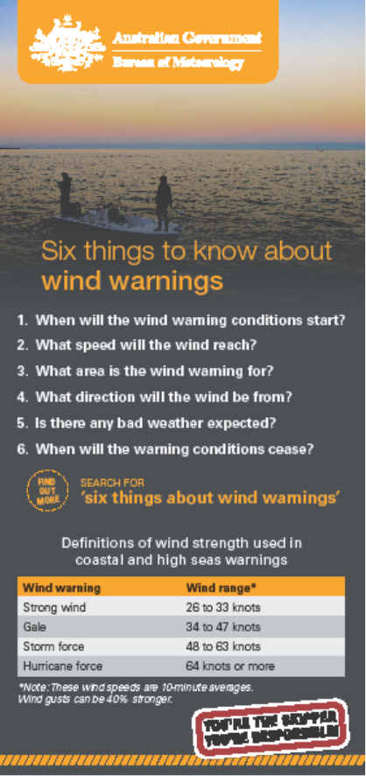
Example of brochure with wind warning categories

