Slide 1

WWMIWS web portal
update
Mireille Mayoka, France
Thanks to Neal Moodie and
Daniel Peixoto de Carvalho

Slide 2
WWMIWS web portal redevelopment
‹#›
Presentation of the current website :
  The WWMIWS (GMDSS) website is hosted by Météo-France, in partnership with JCOMM and WMO: http://weather.gmdss.org/.
  It has been operational since June 2003 and has gradually evolved
  This website displays the marine forecast and warning products that are provided to mariners via SafetyNet and Navtex, as part of the WWMIWS
  The website displays products that are shared on the WMO Information System (WIS, formerly known as the GTS).
A new WWMIWS web portal
  Météo-France suggested to the ETMSS (JCOMM’s Expert Team on Maritime Safety Services) to plan a complete redesign of this website, including technical improvements, ergonomic improvements and new features
  The main lines were adopted at the ETMSS-5 meeting in Helsinki (2017).
  Since JCOMM-5, the new WWMIWS Committee shall “plan and coordinate the redesign of WWWMIS website scheduled for 2018 and its regular updates.”
  Meteo-France are planning to update the WWMIWS web portal in late 2018.
  Need to finalise specifications and content to continue the development process

Slide 3
A new WWMIWS web portal
‹#›
Technical improvements
  The website will be hosted on a new server, and data will be stored in a data base
  However there won’t be any archive of the messages, as in the current website
  The source code will be separated from the configuration in order to facilitate future changes
  A web development framework is used, to permit more efficiency and provide reusable tools
Ergonomis improvements and new features
  The new website will remain light, with a reduced data volume, adapted to low flows - no video or heavy pictures or animations
  A new domain and a new URL - with wwmiws
  The new website will be responsive : it will be adapted to all screens (large or small)
  A new page with all links to bulletin sets
  A new page with links to national meteorological services involved
  A new administration tool will be associated, in order to allow the administrators of the website to manage all metadata

Slide 4
WWMIWS web portal to-do list
‹#›
Need to finalise specifications and content of the new web portal
General structure and presentation of the web portal
Home page : precise content to be defined
Label policy and application for each Metarea web page :
  Label policy for SAFETYNET bulletins
  Label policy for NAVTEX bulletins
Bulletin sets :
  We need to define lists of bulletins for all METAREAs, with precise conditions of retention
Links for websites :
  Do we need more than one link for each country ?

Slide 5
WWMIWS web portal to-do list
‹#›
Need to finalise specifications and content of the new web portal
General structure and presentation of the web portal
Home page : precise content to be defined
Label policy and application for each Metarea web page :
  Label policy for SAFETYNET bulletins
  Label policy for NAVTEX bulletins
Bulletin sets :
  We need to define lists of bulletins for all METAREAs, with precise conditions of retention
Links for websites :
  Do we need more than one link for each country ?

Slide 6
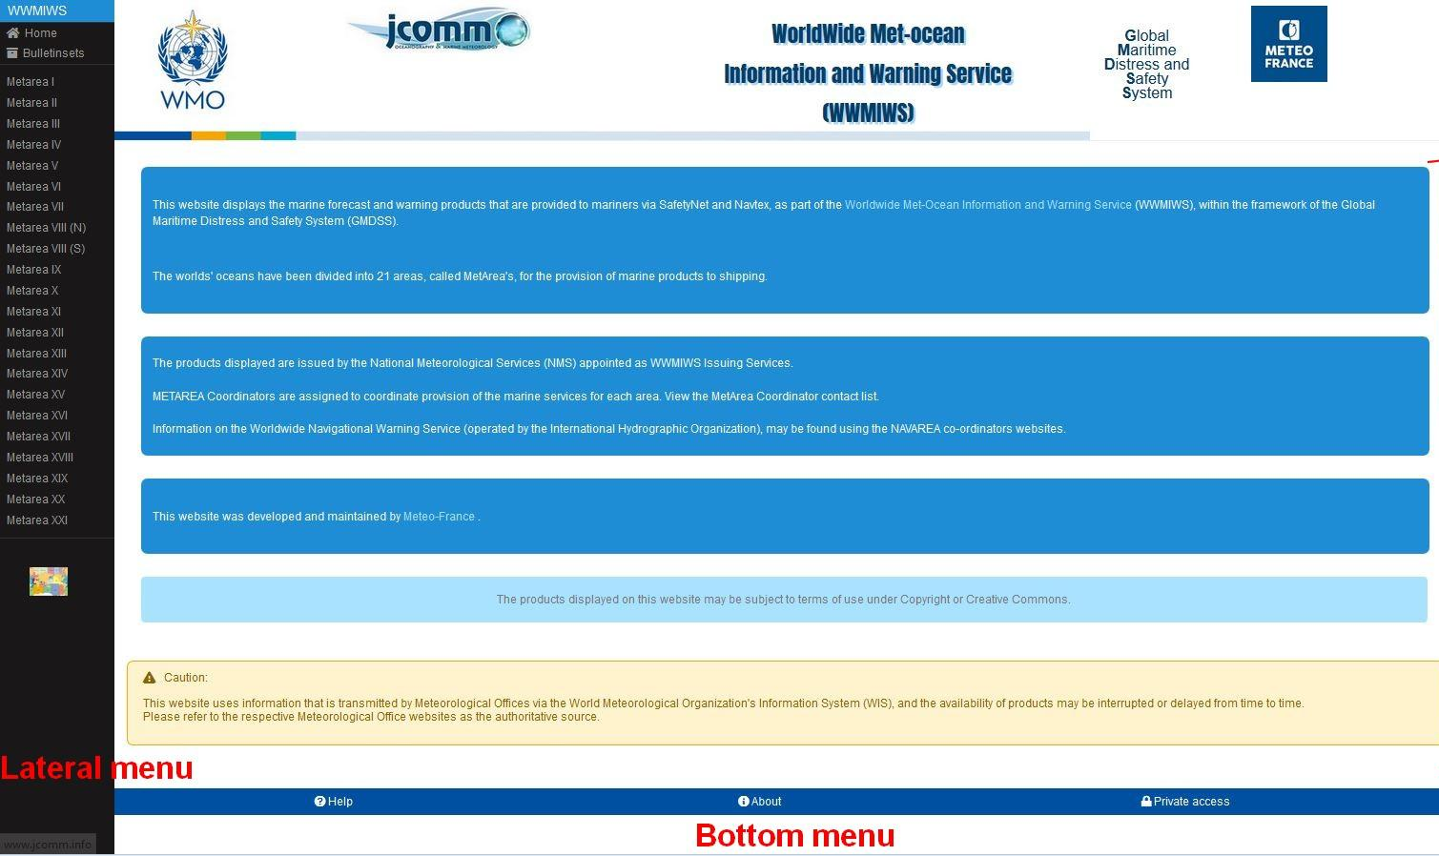
Home page : header, content and menus
Header
Information on WWMIWS
Metareas’ map

Slide 7
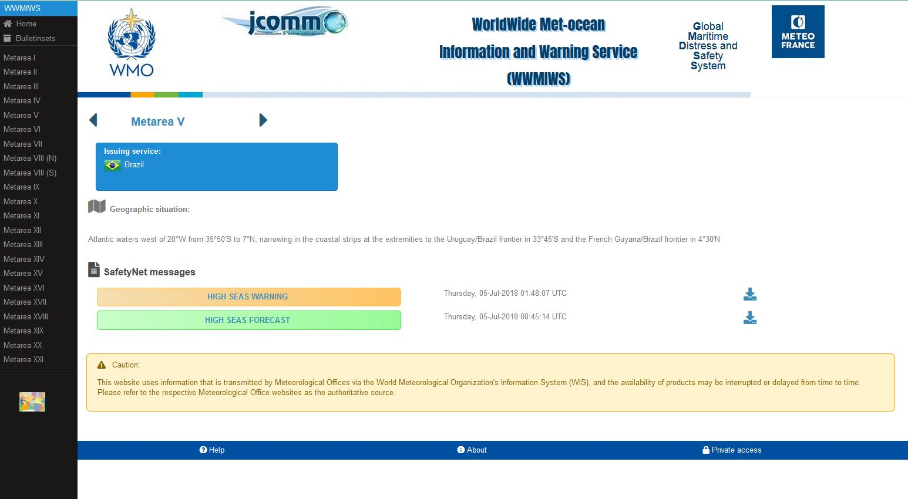
Structure and content of a Metarea page
Presentation of the Metarea
Issuing service – link to the website
SafetyNET bulletins

Slide 8
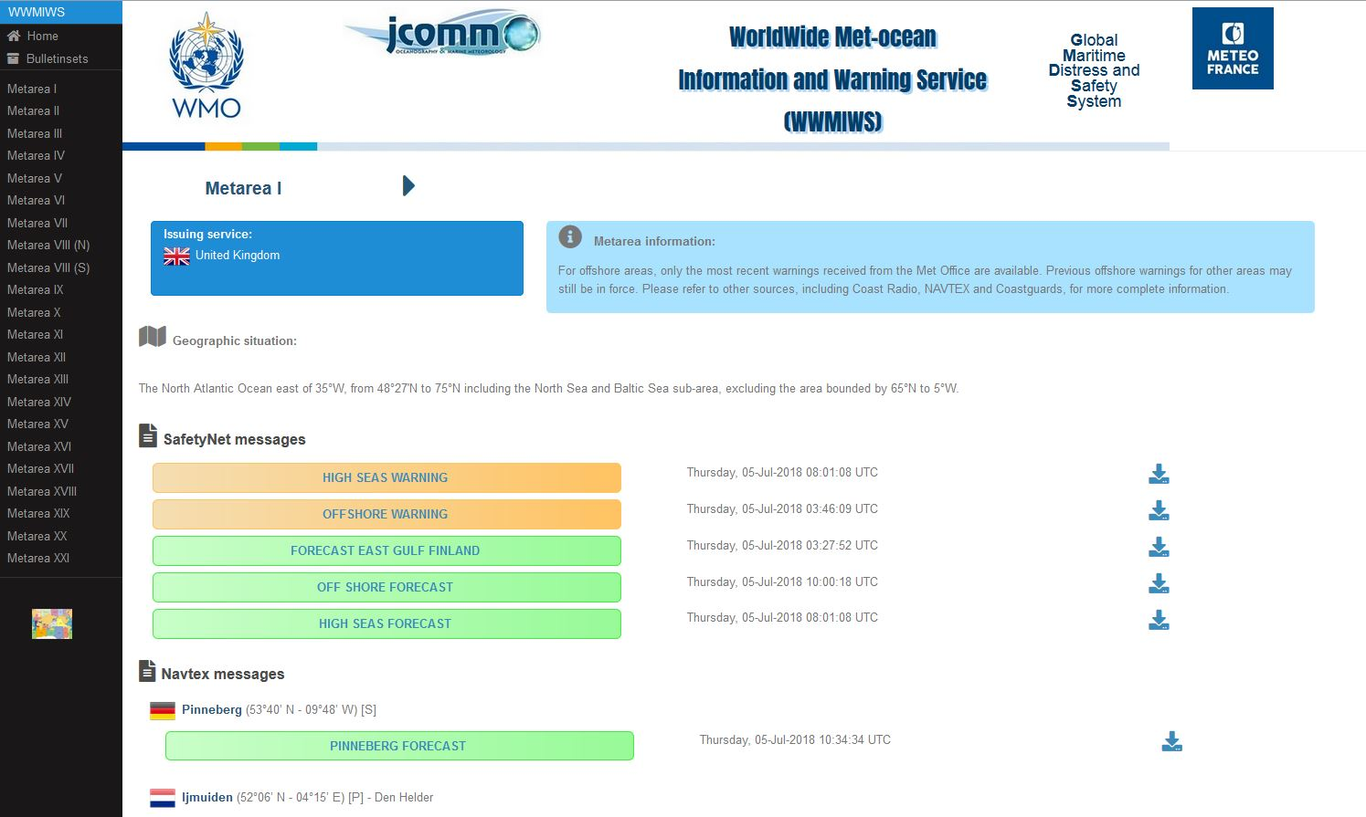
Structure and content of a Metarea page
Presentation of the Metarea
SafetyNET bulletins
Navtex bulletins

Slide 9
Structure of a Metarea page
‹#›
Metarea information area
  Metarea’s name : links to the WMO website “general information” for the Metarea
  Issuing service(s) : names of countries with links to the NMHS website
  Preparation service(s): if any, same display as issuing service(s)
  Metarea information: complementary information about Metarea, displayed if any
  Geographic situation: description of the area; displayed for every Metarea
Bulletins area
  Bulletins are distinguished into 3 categories with specific colours for each :
  “FORECAST”: scheduled messages, including all forecasts (high seas, offshore, coastal, ice) ==> Green
  “WARNING”: Warning messages ==> yellow orange
  “CYCLONE”: Tropical cyclones warnings (hurricane, typhoon, etc.) ==> red
  A new colour for forecast messages related to ICE FORECAST ==> light blue
  Bulletins are ordered by gravity category (1 Cyclone, 2 Warning, 3 Forecast)
  Inside a category, an order can be set with the administration tool
  The date displayed is reception date on the website system
  Each bulletin can also be downloaded

Slide 10
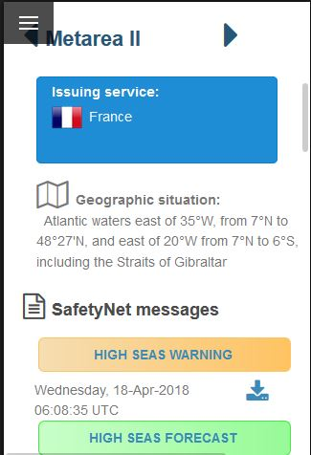
Metarea page displaying on small screens
Access to the vertical menu on the left
Direct access to the next Metarea page

Slide 11
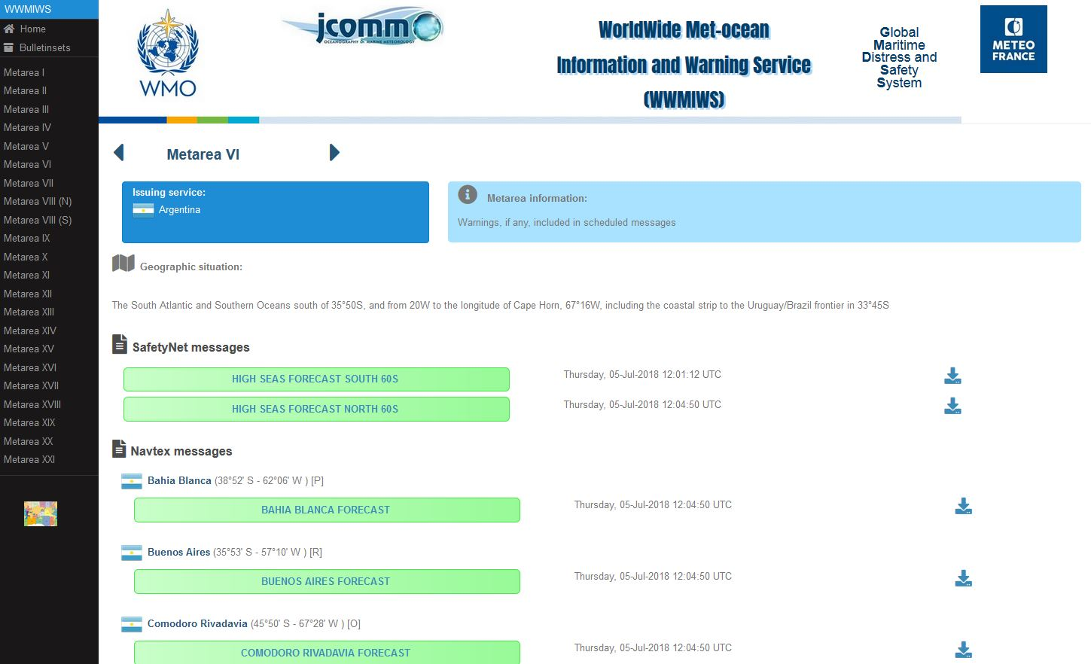
Example of Metarea VI page

Slide 12
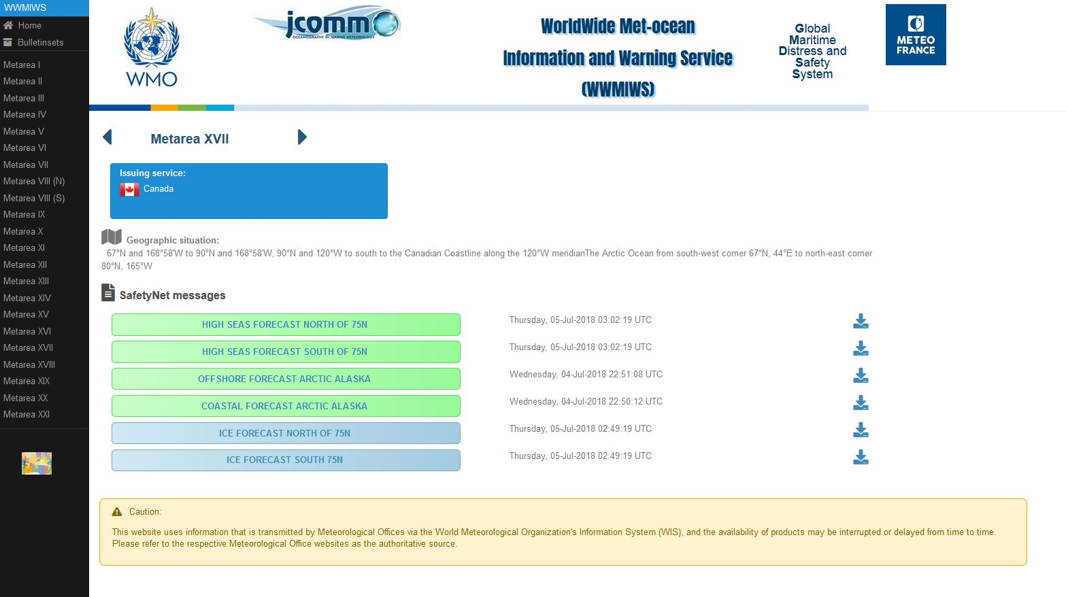
Example of Metarea XVII page

Slide 13
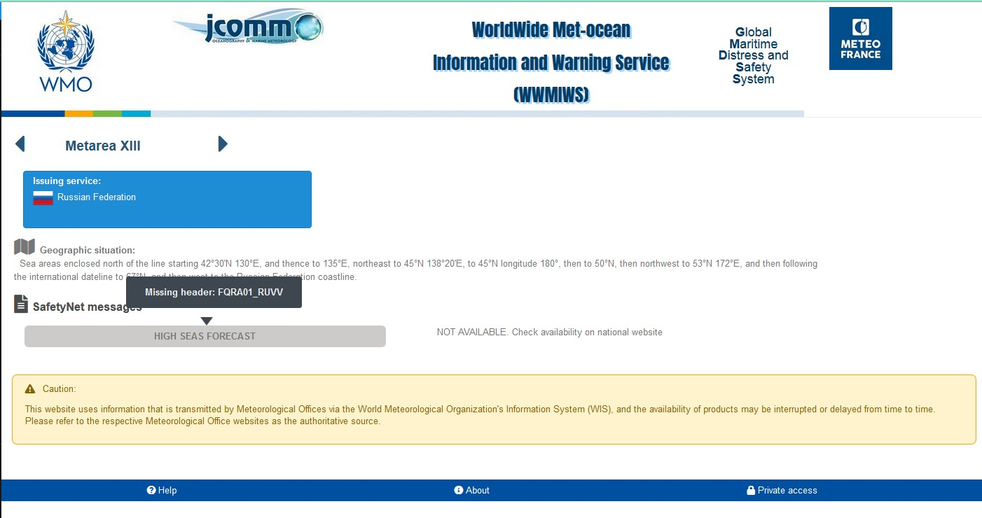
More information when messages are not available

Slide 14
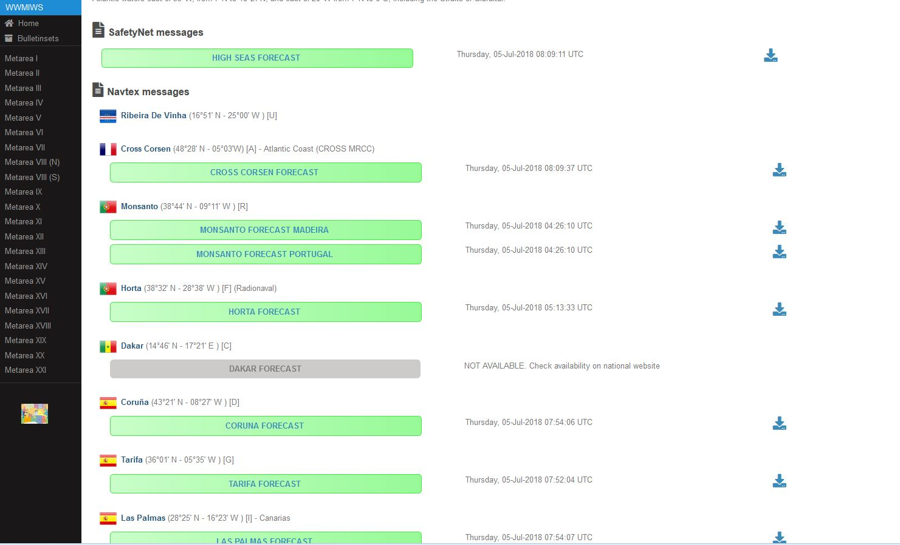
Metarea page : access to all Navtex messages

Slide 15
WWMIWS web portal to-do list
‹#›
Need to finalise specifications and content of the new web portal
General structure and presentation of the web portal
Home page : precise content to be defined
Label policy and application for each Metarea web page :
  Label policy for SAFETYNET bulletins
  Label policy for NAVTEX bulletins
Bulletin sets :
  We need to define lists of bulletins for all METAREAs, with precise conditions of retention
Links for websites :
  Do we need more than one link for each country ?

Slide 16
Policy on label naming for bulletins
‹#›
Aim : to provide guidance on the consistency of labels used for SafetyNET bulletins displayed on the WWMIWS website
Purpose of the webpage portal
  The WWMIWS portal is used by ship masters to plan their journey, or as backup onboard the vessel. It is also used by fleet managers overseeing ocean basins.
  The portal provides access to the range of products to view the detail. Some colour is used to help users to identify forecasts vs warnings.
  The list of product links is generally short and a reader can locate any product within a single screen – reducing the need to be concerned about ordering the list of products.

Slide 17
Policy on label naming for SafetyNET bulletins (1)
‹#›
Principles for label naming of SafetyNET bulletins
  Character constraints restricted to 40 characters for labels
  Keep labels consistent to assist users to understand bulletins in different METAREA’s
  Need to encourage users to click into the bulletin to read the detail, rather than interpret the label
  Terminology should be consistent with what is used in IMO Resolution A.1051 governing the WWMIWS and Met-Ocean Maritime Safety Information
  Abbreviations should be avoided, but suitable abbreviations may be used to fit within the 40 character label limit.
Policy on label naming of SafetyNET bulletins
  Geographical or multiple issuing sources
  An additional label should be added for forecasts or warnings that relate to a sub-region of a METAREA. E.g. High Seas Forecast South 25S
  If the domain of a neighbouring METAREA’s forecast or warning product partially covers a METAREA, these products should be included in the list.

Slide 18
Policy on label naming for SafetyNET bulletins (2)
‹#›
Policy on label naming of SafetyNET bulletins
  Geographical or multiple issuing sources
  An additional label should be added for forecasts or warnings that relate to a sub-region of a METAREA. E.g. High Seas Forecast South 25S
  If the domain of a neighbouring METAREA’s forecast or warning product partially covers a METAREA, these products should be included in the list.
  Warnings
  Labels for warnings will include reference to the phenomena. E.g. Wind Warning, Tropical Cyclone Warning, Ice Accretion Warning
  Labels will not include reference to severity of the phenomena. E.g. Not include Gale, Storm, or Severe.
  Labels for two warning typesof High Seas and Coastal wind warnings, then we will include the regional variations. E.g. High Seas Wind Warning, Coastal Wind Warning.
  Forecasts
  Labels for forecast types will use consistent terminology, and regional variations can be applied. E.g. High Seas, Ice, Coastal

Slide 19
Policy on label naming for SafetyNET bulletins (3)
‹#›
Application of naming policy for each product
  Forecasts
  High Seas Forecast
  Ice Forecast
  Coastal Forecast, Offshore Forecast
  Warnings
  Wind Warning
  Tropical Cyclone Warning, Typhoon Warning, Hurricane Warning
  Ice Accretion Warning
  Coastal Wind Warning
  Offshore Wind Warning

Slide 20
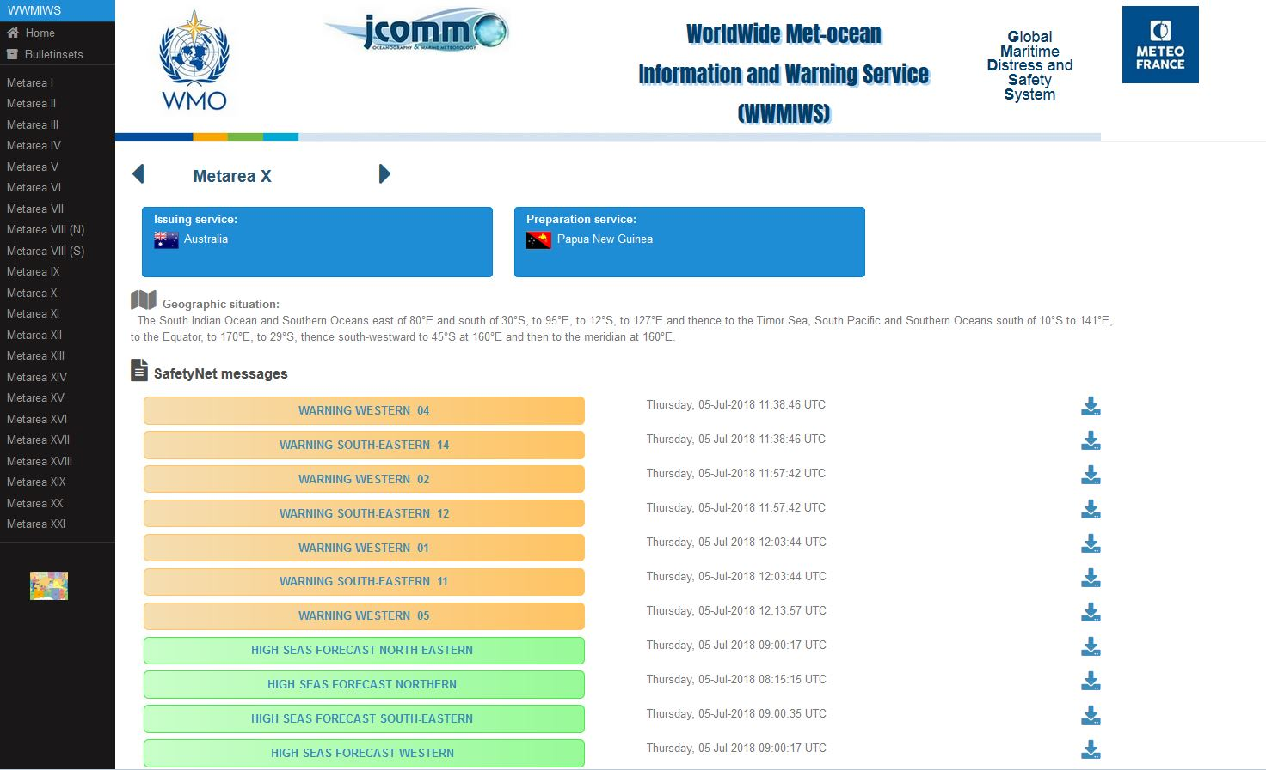
SafetyNET bulletins
Labels of SafetyNET messages

Slide 21
Policy on label naming for Navtex bulletins (1)
‹#›
Characteristics of Navtex bulletin display on the new upgraded web portal
  NAVTEX bulletins will be displayed under a sub-heading for an area
  The sub-heading could include a country designation, NAVTEX transmitter number, and area description
  Colours may be used to distinguish different bulletin types.
Principles for label naming of Navtex bulletins
  Character constraints restricted to 40 characters for labels
  Avoid duplication of area information on the label for the bulletin (because the sub-heading has this detail)
  Keep labels consistent to assist users to understand bulletins in different METAREA’s
  Need to encourage users to click into the bulletin to read the detail, rather than interpret the label
  Terminology should be consistent with what is used in IMO Resolution A.1051 governing the WWMIWS and Met-Ocean Maritime Safety Information
  Abbreviations should be avoided, but suitable abbreviations may be used to fit within the 40 character label limit.

Slide 22
Policy on label naming for Navtex bulletins (2)
‹#›
Policy on label naming of NAVTEX bulletins
  Warnings
  Labels for warnings will include reference to the phenomena. E.g. Wind Warning, Tropical Cyclone Warning, Ice Accretion Warning
  Labels will not include reference to severity of the phenomena. E.g. Not include Gale, Storm, or Severe.
  Labels for two warning typesof High Seas and Coastal wind warnings, then we will include the regional variations. E.g. High Seas Wind Warning, Coastal Wind Warning.
  Forecasts
  Labels for forecast types will use consistent terminology, and regional variations can be applied. E.g. High Seas, Ice, Coastal
  Geographical or multiple issuing sources
  An additional label should be added for forecasts or warnings that relate to a sub-region of a METAREA. E.g. High Seas Forecast South 25S
  If the domain of a neighbouring METAREA’s forecast or warning product partially covers a METAREA, these products should be included in the list.

Slide 23
Application of naming policy for each Navtex product
‹#›
Forecasts
  High Seas Forecast
  Ice Forecast
  Coastal Forecast, Offshore Forecast
Warnings
  Wind Warning
  Tropical Cyclone Warning, Typhoon Warning, Hurricane Warning
  Ice Accretion Warning
  Coastal Wind Warning
  Offshore Wind Warning

Slide 24
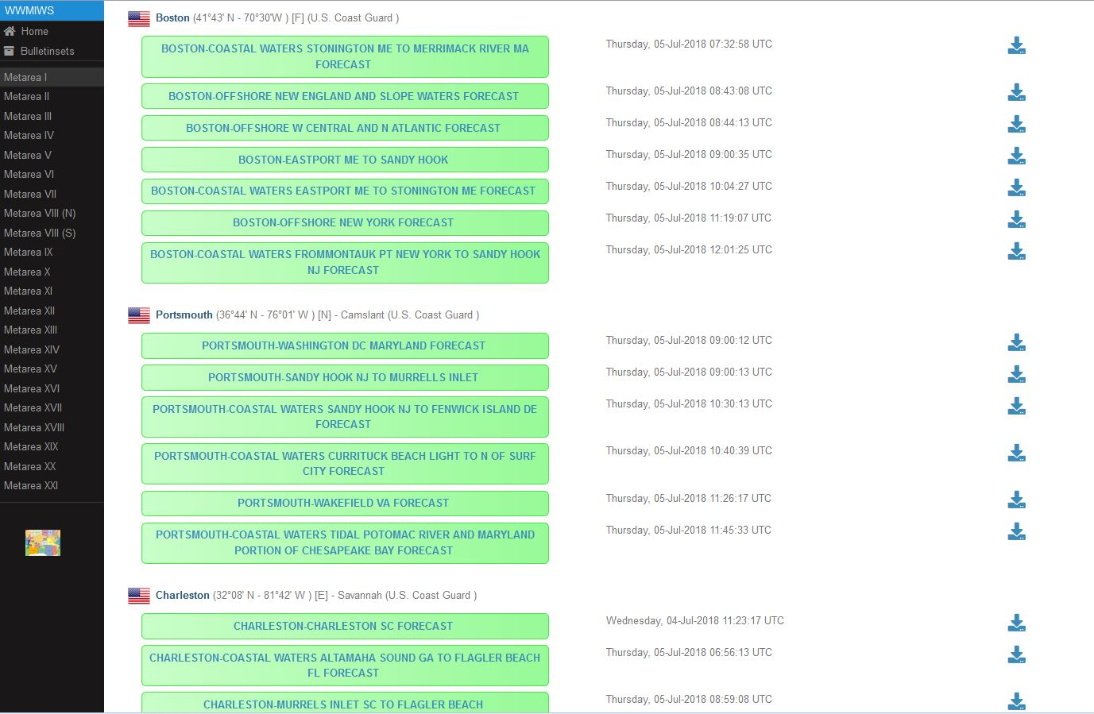
Labels of Navtex bulletins (Metarea IV)

Slide 25
WWMIWS web portal to-do list
‹#›
Need to finalise specifications and content of the new web portal
General structure and presentation of the web portal
Home page : precise content to be defined
Label policy and application for each Metarea web page :
  Label policy for SAFETYNET bulletins
  Label policy for NAVTEX bulletins
Bulletin sets :
  We need to define lists of bulletins for all METAREAs, with precise conditions of retention
Links for websites :
  Do we need more than one link for each country ?

Slide 26
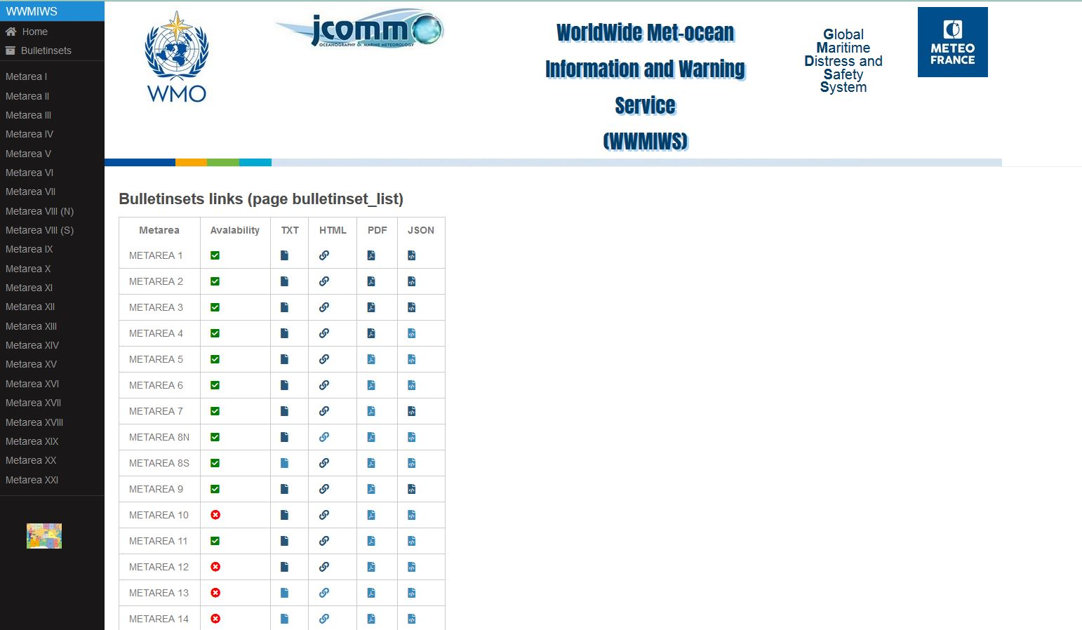
Bulletin sets
What is a « bulletin set » ?
A predefined set of bulletins grouped together in a single message
For example high seas forecasts and warnings for a given Metarea, accessible through specific links

Slide 27
WWMIWS web portal to-do list
‹#›
Need to finalise specifications and content of the new web portal
General structure and presentation of the web portal
Home page : precise content to be defined
Label policy and application for each Metarea web page :
  Label policy for SAFETYNET bulletins
  Label policy for NAVTEX bulletins
Bulletin sets :
  We need to define lists of bulletins for all METAREAs, with precise conditions of retention
Links for websites :
  Do we need more than one link for each country ?

Slide 28
List of actions for Metarea coordinators
‹#›
METAREA Coordinators are responsible :
  For getting their bulletins onto the WIS, and ensuring the product headers are correct
  To inform Meteo-France in case of new messages or changes in WIS headers in order to update the website – configuration changes have to be made if there are new products and/or new WIS headers
  To check the products displayed on their METAREA webpage(s) regularly, at least every 6 months, and to send updates to Météo-France if necessary.
To-do list for the new WWMIWS web portal :
  Precise content of each Metarea page : Issuing and preparation services, Geographic situation, Meatarea information if needed
  List of messages to display : Headers, Labels and category, Retention
  Bulletin sets : Lists of bulletins with conditions of retention
  Link(s) for website(s)

Slide 29

Thank you
Merci

