Slide 1












Overview of the
Arctic Regional Climate Centre Network
(ArcRCC-N)
Helge Tangen
Norwegian Meteorological Institute
ArcRCC Network Coordinator
PARCOF-3, Rovaniemi, May 8, 2019

Slide 2

PARCOF logo, design Tommi Mäkelä

Slide 3



What’s the difference?
Weather
Conditions of the atmosphere over a short period of time
Reported in terms of hours and days for a city, town, region
It answers these questions
What is the temperature right now?
Will I need a coat this afternoon?
Will it snow this weekend?
Climate
Average weather of a place over period of many years
Tells us what’s normal for an area.
It answers these questions
What is an average winter like in Rovaniemi?
Was 2015 the warmest summer on record?
Will Tromsø have above normal temperatures this summer?
Climate is what you expect, weather is what you get
(sources: NOAA, NSIDC and WMO and websites)

Slide 4
New levels of Climate Information
Time Scale | Days | Weeks | Months (sub-seasonal) | Seasons (3 months) | Years | Decades | Centuries
Weather or Climate Information | Weather forecasting |  | New climate products with scientific advances |  |  | Climate Change Models
Geographic Scale | Local |  | Regional |  |  | Global
Filling an information gap between
  Local and global
  Daily/weekly and decadal
Our focus is on regional coverage at sub-seasonal (monthly) and seasonal (3 months) scales
Notes:
Your weather provides local information in days/weeks
Global climate models provide information for the globe for decades and centuries in advance
Advance in science and technologies now allow us to monitor and model better
We can now fill a gap and provide information at a regional coverage for monthly/seasonal scales

Slide 5
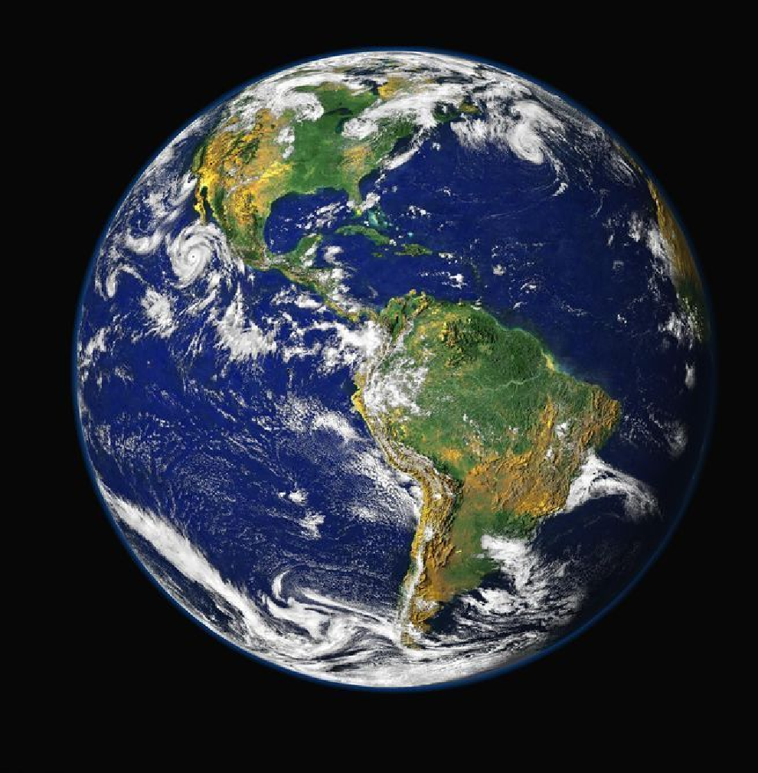
WMO Regional Climate Centres
  Climate goes beyond national borders
Regional Climate Centres of excellence that link national meteorological services.
To share, coordinate and enhance climate products and services to:
Fill geographical gaps in products and services between countries
Fill gaps in products and services between countries
Deliver and potentially harmonize products and services
Enhance Research and development
Source: NASA

Slide 6
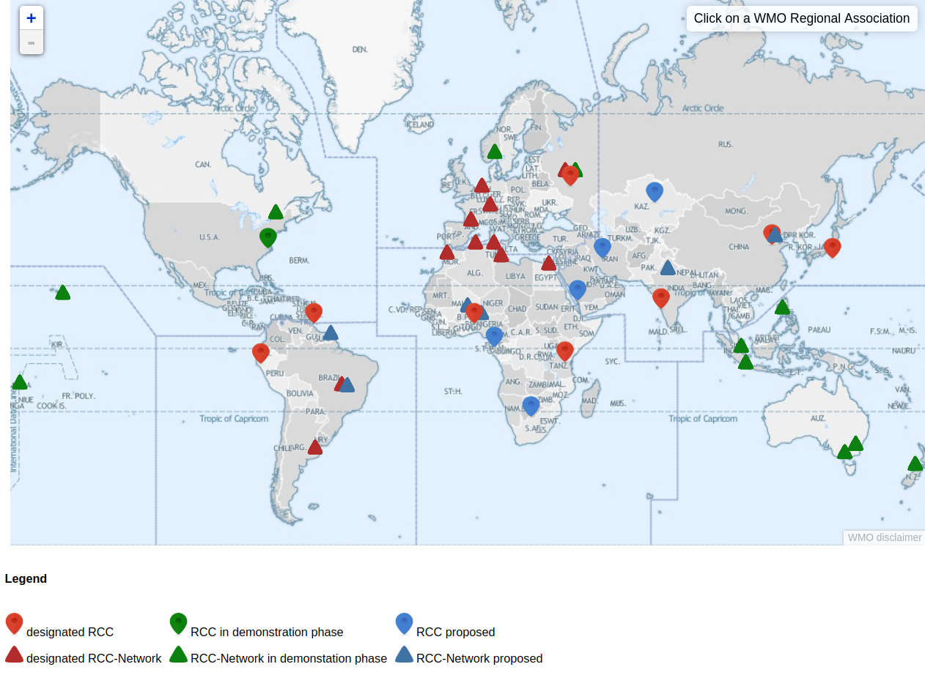
WMO Regional Climate Centres
Note: Gaps over the Arctic
Notes:
Implementing an RCC in the Arctic has not been attempted because historical and current data are sparse, and the available computer models have had limited skill at seasonal to yearly scales.
As a legacy of the International Polar Year, an Arctic Polar Regional Climate Centre (ArPRCC) concept was put forth and approved by the WMO.
Areas identified on the map are the modelling centres

Slide 7
The Arctic Regional Climate Centre
NATIONAL |  | REGIONAL |  | CIRCUMPOLAR
Countries | Meteorological Organizations | Regional Climate Centres (RCCs) |  | Arctic Regional Climate Centre
United States | NOAA | North American Node | Forecasting
Canada | ECCC
Denmark | DMI | Northern European / Greenland Node | Data Services/ web site
Iceland | IMO
Norway | NMI
Sweden | SMHI
Finland | FMI
Russia | AARI | Northern Eurasia Node | Monitoring
Collaboration/Networking across Arctic regional nodes and Meteorological Organizations
Coordinated by MET Norway
Notes:
The Arctic PRCC-Network falls across three of the WMO Regional Associations, Asia, Europe and North America.
The participating nations are the 8 Arctic Council states
The structure for the Arctic PRCC-Network will be on two levels.
Each Regional Association (node) will perform all mandatory functions for the countries in its domain:
Canada will lead the North American Node (Canada and USA);
Norway will lead the Northern Europe and Greenland Node (Denmark, Finland, Iceland, Norway, and Sweden); and
the Russian Federation will lead the Eurasian Node, see Figure 1.
4th mandatory function is training that is shared across the Nodes

Slide 8
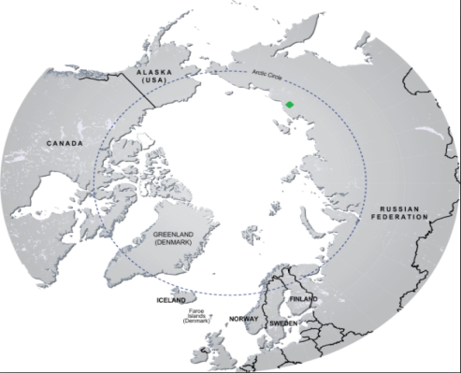
Arctic Regional Climate Centre
1
2
3
Benefits:
Link Arctic nations and fill geographical gaps in coverage
Improve collaboration on climate forecasting and monitoring
Collaboration on climate products, accessible through one website
Understanding regional variability, climate processes and climate change adaptation needs
Notes:
Example of the potential coverage

Slide 9
PARCOF
Pan-Arctic Regional Climate Outlook Forum
Face-to-face meeting every spring, to interact with users and between users (summer outlook)
Virtual meeting every fall (winter outlook)
Present and discuss Consensus Statement among delegates
For the ArcRCC-Network to better know user needs

Slide 10
ArcRCC Products
  Seasonal Outlooks for the upcoming season: outlooks from models on
    temperature,
    precipitation and
    sea-ice forecasts
  Seasonal Summaries of the past season: describes actual temperature, precipitation and sea-ice details based on monitoring observations, including in the climate change context
  Arctic Consensus Statement a collaborate effort by the network which reviews
    Trends in the historical monitoring data
    Forecasts from the models
    Using Met/Ice climate expertise, fill gaps in the data
    Develop a consensus outlook for the Arctic for the upcoming season

Slide 11
Status for the ArcRCC NETWORK
Demonstration Phase started May 2018 (at PARCOF-1)
2018 to show Proof of Concept; WMO to acknowledge the network model to function
Web site created, arctic-rcc.org
Plan to seek designation as a WMO RCC Network by mid-2020
Prove ability to deliver Mandatory Functions

Slide 12
Objectives for PARCOF-3
Present outlooks/Long Range Forecasts for the summer 2019
Review the performance of previous forecasts

Slide 13
This information is different from
The Arctic Council’s Arctic Monitoring and Assessment Programme (AMAP)
i.e. the Snow Water Ice and Permafrost Assessment (SWIPA) report discusses trends and future predictions, updated once every 5-6 years
Arctic Report Card
Annual Summary of the Arctic climate over the past year
ArcRCC products are ongoing operational Arctic climate summary and forecast products that are updated every Winter and Summer
Notes:
Hand off to John to explain the PARCOF

Slide 14
Thank you!
http://arctic-rcc.org

