Slide 1
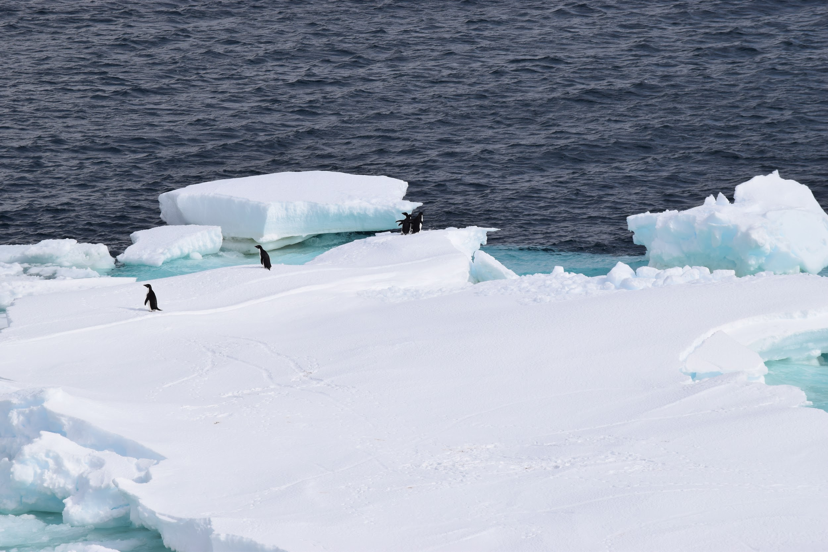
5th International Ice Analyst Workshop
May 16-20, 2016 – US National Ice Center, Suitland, MD
“Ice Analysis and Forecasting in the Southern Hemisphere”
Photo Credit: Chris Readinger, U.S. National Ice Center, 2016

