Slide 1
Proposals for icebergs additional codes and symbols for further consideration by JCOMM ETSI and IICWG sub-committee on icebergs
Vasily Smolyanitsky, ETSI chair / AARI
IAW-5, USNIC, 16-20 May 2016

Slide 2
What documents?
WMO Sea Ice Nomenclature, volume III (coding table, symbols)
SIGRID-3 (additional field name, coding table)
Ice Objects Catalogue (additional attributes)

Slide 3
Ice Objects Catalogue, version 5.2
NOBJNM: The individual name of an object in the national language
OBJNAM: The individual name of an object in English
INFORM: Information – Textual information about an object
NINFORM: Information – Textual information about an object in the national language
SCAMIN: Scale Minimum - The minimum scale at which the object may be used; e.g. for ECDIS presentation.
SCAMAX: Scale Maximum - The Maximum scale at which the object may be used; e.g. for ECDIS presentation.
TXTDSC: Textual Description - A string encoding the file name of an external text file that contains the text in English.
NTXTDS: Textual Description - A string encoding the file name of an external text file that contains the text in the national language.
PICREP: Pictorial Representation - A string encoding the file name of an external graphic file (pixel or vector).
RECDAT | Date/Time | 10-22 | ISO 8601 | Date and time of observation
SORDAT | Date/Time | 10-22 | ISO 8601 | Date and time of validity

Slide 4
Ice Objects Catalogue, version 5.2
Polygone class
BRGARE iceberg area In SIGRID-3
POLY_TYPE I / .pl_x.shp
Attributes:
NOBJNM The individual name of an object in the nat’l language no
OBJNAM The individual name of an object in English no
INFORM Information – textual information about an object no
NINFORM: Information – …same in the nat’l language no
….
ICEBNM Number of Icebergs in Area integer yes
ICEBSZ Iceberg size enumerated BL
ICEDDR Ice drift direction enumerated yes
ICEDSP Ice drift speed floating yes
IA_OBN Number of ice objects Integer/enumerated BN
IA_BCN Iceberg concentration enumerated no
IA_BFM Prevailing iceberg form enumerated BL
IA_BUH Maximum Height of Above Water integer yes
Part (iceberg/grounded hummock)
Proposal: add OBJNAM, INFORM, IA_BCN to SIGRID-3

Slide 5
Ice Attribute: Number of ice objects
Acronym: IA_OBN
nBnB Number of icebergs within the area
nGnG Number of growlers and bergy bits within the area
Code Figure Code figure
00 None 15 15
01 1 16 16
02 2 17 17
03 3 18 18
04 4 19 19
05 5 20 1– 9
06 6 21 10– 19
07 7 22 20– 29
08 8 23 30– 39
09 9 24 40– 49
10 10 25 50– 99
11 11 26 100– 199
12 12 27 200– 499
13 13 28 500 or more
14 14 99 No indication because counting has been impossible
N o t e s :
(1) If the exact number, 1 to 19, is known, code figures 01 to 19 shall be used.
(2) If the number is more than 19, or if the exact number can only be estimated, code figures 20 to 28 shall be used.
(3) Code figure 99 shall only be used when it is absolutely impossible to make a reasonable estimate of the number.

Slide 6
Ice Attribute: Iceberg Concentration
Acronym: IA_BCN
Code: 30353
Attribute Type: Enumerated
Expected Input:
ID Meaning
10 >45 nm between bergs
12 >15 nm between bergs
20 15 - 44 nm between bergs
23 10 - 44 nm between bergs
30 10 - 14 nm between bergs
34 7 - 14 nm between bergs
40 7 - 10 nm between bergs
45 5 - 10 nm between bergs
50 5 - 6 nm between bergs
56 3 - 6 nm between bergs
60 3 - 4 nm between bergs
67 1 - 4 nm between bergs
70 1 - 2 nm between bergs
78 0.5 - 2.0 nm between bergs
80 0.5 - 1.0 nm between bergs
89 <1.0 nm between bergs
90 <0.5 nm between bergs
98 No Icebergs
99 Undetermined/Unknown
Definitions: IA_BCN specifies the total concentration of icebergs in an area.
References: “Manual on conducting ice air reconnaissance”
Distinction: ICEBNM
Remarks: An alternative to ICEBNM

Slide 7
Ice Objects Catalogue, version 5.2
Line class
BRGLNE iceberg limit In SIGRID-3
LINE_TYPE BRGLNE / .ln_x.shp
Attributes:
NOBJNM The individual name of an object in the nat’l language no
OBJNAM The individual name of an object in English no
INFORM Information – textual information about an object no
NINFORM: Information – …same in the nat’l language no
….
IA_LOC Location of ice relative to line feature enumerated yes/ICE_LOC
Proposal: Do we need additional line classes ?

Slide 8
Ice Objects Catalogue, version 5.2
Point class
ICEBRG iceberg In SIGRID-3
POINT_TYPE ICEBRG/ .pt_x.shp
Attributes:
NOBJNM The individual name of an object in the nat’l language no
OBJNAM The individual name of an object in English no
INFORM Information – textual information about an object no
NINFORM: Information – …same in the nat’l language no
….
ICEBSZ Iceberg size enumerated BL
ICEDDR Ice drift direction enumerated yes
ICEDSP Ice drift speed floating yes
IA_OBN Number of ice objects Integer yes
IA_BFM Prevailing iceberg form enumerated BL
IA_BUH Maximum Height of Above Water integer yes
Part (iceberg/grounded hummock)
Consider:
IA_BLN Maximum Length of iceberg, meters integer
IA_BWD Maximum Width of Iceberg, meters integer
Proposal: add IA_BLN, IA_BWD to IOC and SIGRID-3

Slide 9
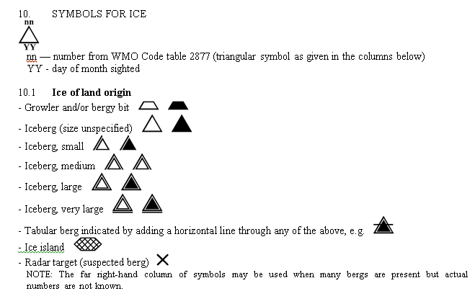
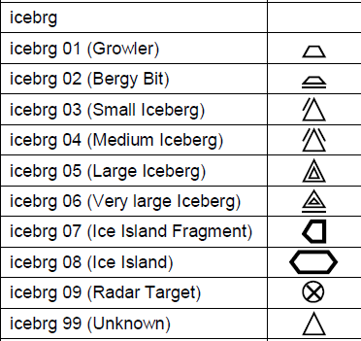
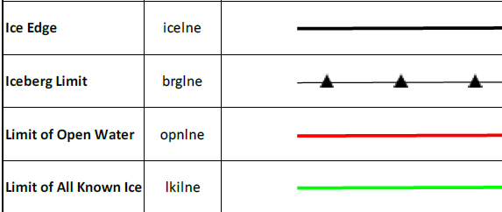
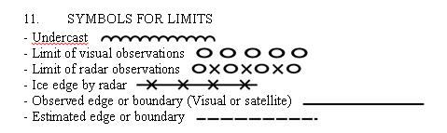
WMO Sea Ice Nomenclature, vol. III
(other concerned docs Colour standard, S-411 presentation schema)
WMO SIN, vol.III
S-411

Slide 10


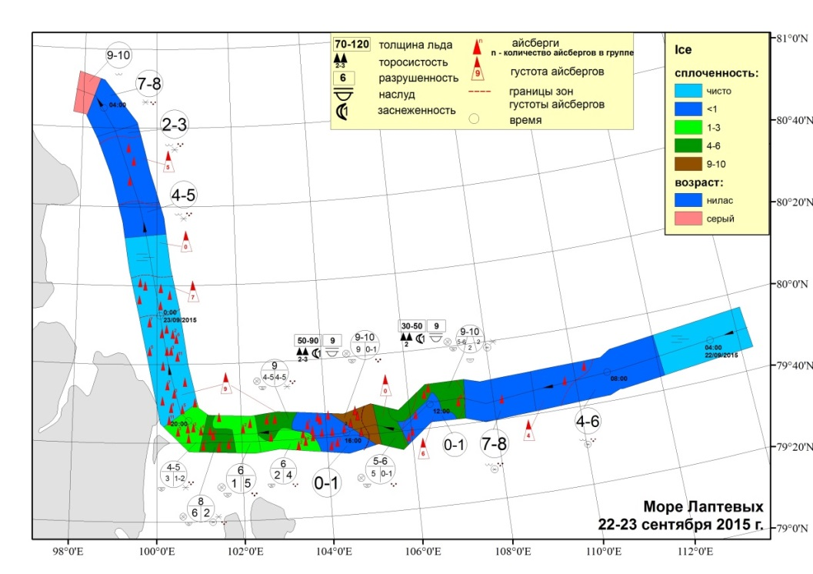
WMO Sea Ice Nomenclature, vol. III
(other concerned docs Colour standard, S-411 presentation schema)
Consider adding:
IA_OBN (Number of icebergs within the area)
IA_BCN (icebergs concentration within the area)
estimated boundary of IA_BCN or IA_OBN zone
RECDAT / T1 (Date and time of observation)
IA_BCN
Color value
1(10)
………………………………
9 (90)

Slide 11
Sample coding for the weekly US NIC antarctic tabular iceberg analysis
nic_antarc_20160513_pt_a.XXX
Iceberg,Length (NM),Width (NM),Latitude,Longitude,Remarks,Last Update
A23A,44,40,-75.88,-41.17,belle (grounded),05/13/16
A56,14,7,-49.52,-26.40,weddw,05/13/16
A57A,11,5,-70.12,-59.12,belle,05/13/16
POINT_TYPE, OBJNAM, IA_BLN, IA_BWD, RECDAT, INFORM
ICEBRG, A23, 80000, 78000, 2016-05-13, belle (grounded)
ICEBRG , A56,27000, 12000,2016-05-13,weddw
ICEBRG , A57A,20000,8000, 2016-05-13, belle

Slide 12
Summary
harmonize ICEBSZ table (MANICE, SIN, SIGRID)
consider adding polygone attibutes OBJNAM, INFORM, IA_BCN to SIGRID-3
consider adding IA_BCN table to SIGRID-3 (2 digits or 1 digit ?)
consider adding point attributes IA_BLN, IA_BWD to IOC and SIGRID-3
consider adding symbols for IA_BCN, IA_OBN(icebergs)
consider rewording of standards (SIN, IOC, Colour standard) for unambiguous interpretation (e.g. ice of land origin in oval symbol or as a separate layer)
consider definitions of other pending terms (e.g.iceberg clusters)

Slide 13

Subcommittee Recommendation to WMO JCOMM ETSI
Size (1st Character) | Height (m) | Length (m) | Code | Shape (2nd Character) | Code
Growler | <1 | <5 | A | Tabular | 1
Bergy Bit | 1-<5 | 5-<15 | B | Non-Tabular | 2
Small Iceberg | 5-15 | 15-60 | C | Domed | 3
Medium Iceberg | 16-45 | 61-120 | D | Pinnacled | 4
Large Iceberg | 46-75 | 121-200 | E | Wedged | 5
Very Large Iceberg | 75-? | 201-400 | F | Drydocked | 6
 | TBD | 401-800 | G | Blocky | 7
 | TBD | 801-1600 | H | Ice Island | 8
 | TBD | 1601-3200 | I | Not Specified | 0
 | TBD | 3201-18520 | J | Undetermined (Radar) | X
 | TBD | >18520 | K
Not Specified | N/A | N/A | L
Radar Target | N/A | N/A | M

Slide 14
Subcommittee Recommendation:
Length At The Waterline
Size (1st Character) | Length (m) | Code | Shape (2nd Character) | Code
Growler | <5 | A | Tabular | 1
Bergy Bit | 5-<15 | B | Non-Tabular | 2
Small Iceberg | 15-60 | C | Domed | 3
Medium Iceberg | 61-120 | D | Pinnacled | 4
Large Iceberg | 121-200 | E | Wedged | 5
Very Large Iceberg | 201-400 | F | Drydocked | 6
 | 401-800 | G | Blocky | 7
 | 801-1600 | H | Ice Island | 8
 | 1601-3200 | I | Not In Use | 9
 | 3201-18520 | J | Not Specified | 0
 | >18520 | K | Undetermined (Radar) | X
Not Specified | N/A | L
Radar Target | N/A | M

Slide 15
Subcommittee Recommendation:
Height Above The Sea
Size (1st Character) | Height (m) | Code | Shape (2nd Character) | Code
Growler | <1 | 1 | Tabular | 1
Bergy Bit | 1-<5 | 2 | Non-Tabular | 2
Small Iceberg | 5-15 | 3 | Domed | 3
Medium Iceberg | 16-45 | 4 | Pinnacled | 4
Large Iceberg | 46-75 | 5 | Wedged/Sloping | 5
Very Large Iceberg | 75-100 | 6 | Drydocked | 6
 | 101-125 | 7 | Blocky | 7
 | 126-150 | 8 | Ice Island | 8
 | >151 | 9 | Not In Use | 9
Not Specified | N/A | 0 | Not Specified | 0
Undetermined (Radar) | N/A | X | Undetermined (Radar) | X
The terms “weathered” and “glacier” are not specified in this table because they do not describe the shape of the iceberg.
“Non-Tabular” can describe Codes 3-7 or can be an iceberg that does not specifically fit into any of the other Non-Tabular categories.

