Slide 1
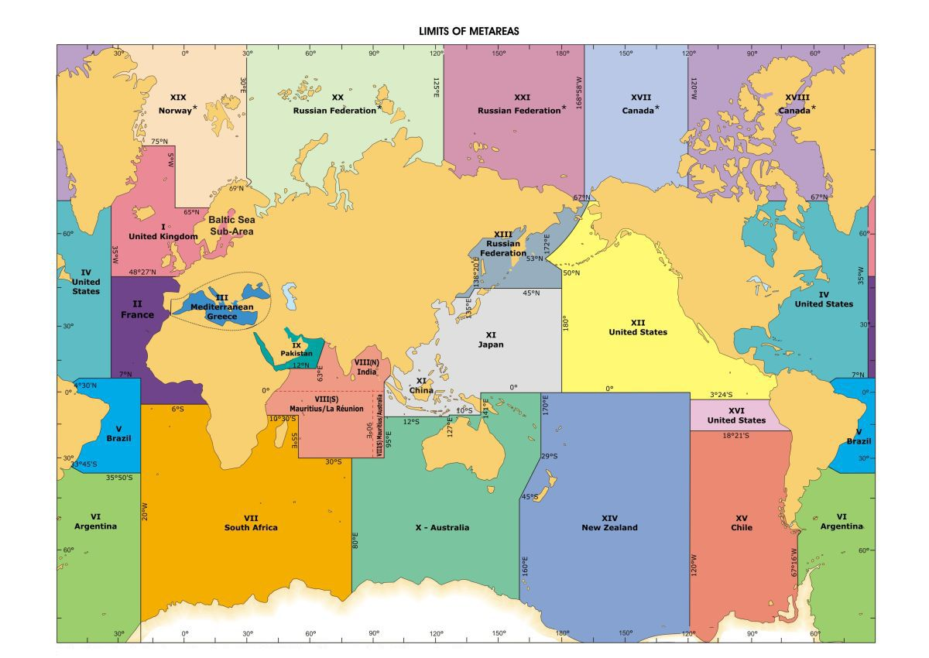


Global Maritime Distress System – Applicability to Ice Services
Vasily Smolyanitsky, ETSI chair / AARI / METAREA XX-XXI-XIII coordinator
IAW-5, USNIC, 16-20 May 2016

Slide 2
Themes for considerations
Connection between GMDSS, SafetyNet, MIS, NAVTEXT, METAREAS
Responsibilities of Countries ‘owning’ METAREAS
Regulations on preparation and dissemination of messages
Documentation on program-latest versions, location of information
WMO-No.558 Manual on Marine Meteorological Services
  1. GENERAL
  1.1 Marine meteorological services for the high seas shall form part of the World-wide Met-Ocean Information and Warning Service (WWMIWS) disseminated to Safety of Life at Sea (SOLAS) ships through the Global Maritime Distress and Safety System (GMDSS).

Slide 3
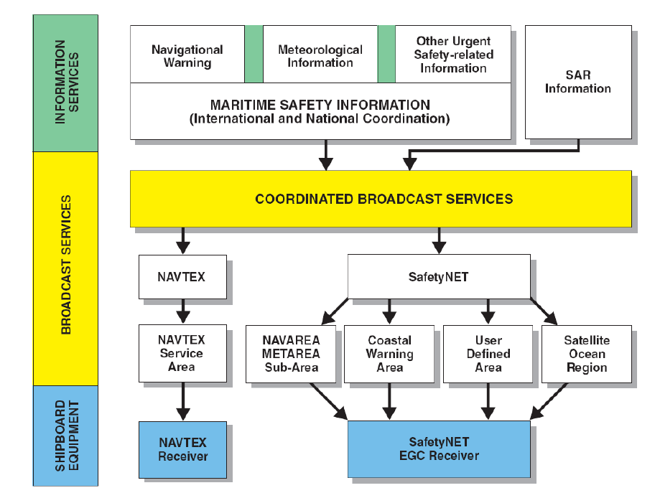
1 Connection between GMDSS, SafetyNet, MSI,
NAVTEX, METAREAS
1.1 Backbone is the “Revised Joint IMO/IHO/WMO Manual on Maritime Safety (MSI)”, MSC.1/Circ.1310/Rev.1, in effect 2016-01-01
Figure 1 − The maritime safety information service of the Global Maritime Distress and Safety System

Slide 4
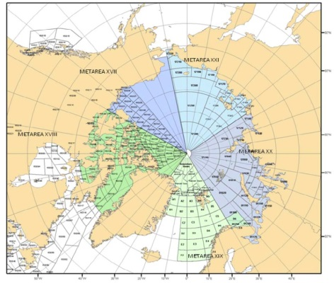
1.2 Sea ice and icebergs in GMDSS SafetyNET & NAVTEX bulletins
In Full operational Capacity from 1st July 2011

Slide 5
2 Responsibilities of Countries ‘owning’ METAREAS (practical wording !)
2.1 Polar GMDSS coastal and high-seas components should be in FOC, including following key criteria:
  Compliance with Joint IMO/IHO/WMO Manual on maritime safety information
  Compliance with WMO-No.558 Manual on Marine Meteorological Services
  Compliance with JCOMM ETMSS and ETSI decisions
  That includes:
    100% METAREA coverage for SafetyNET and NAVTEX (HF and/or INMARSAT (IRIDIUM TBD) or HF digital transmission)
    Twice daily coverage for synoptic in accordance with the schedule
    Content of the bulletins in accordance with WMO-No.558
    Coordination with adjacent METAREAs established
    Regular QC of the bulletins by METAREA coordinator with summaries and up-to-date metadata provided annually to JCOMM ETMSS as self-assessment reports
    Dissemination of GMDSS information through WMO GTS / WIS

Slide 6
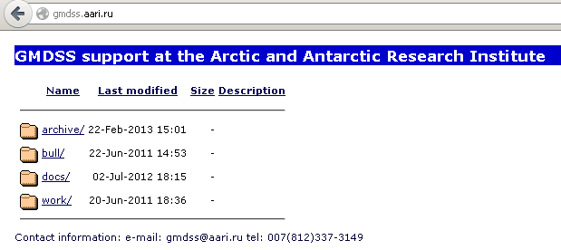
2.2 Best practices from METAREAs XVII-XXI for sea ice GMDSS bulletins (in effect from Jul’11)
Schedule
03 UTC – XXVII and XXVIII (automatic)
06 UTC – XX and XXI (automatic)
11 UTC – XIX (automatic)
15 UTC – XXVII and XXVIII (manual update)
18 UTC – XX and XXI (manual update)
23 UTC – XIX (manual update)
and back to top
Ice and met are given as a single bulletin and coded in accordance with updated WMO 558 (JCOMM-4 Rec. 6); ice information is given in majority of cases as ice edge position
300 n.m. intersection zone between METAREAs used to ensure continuity of ice edge
Ice GMDSS server ftp://gmdss.aari.ru is used for operational exchange between the ice analysts from the Preparation Services (currently AARI and met.no, CIS expected)

Slide 7
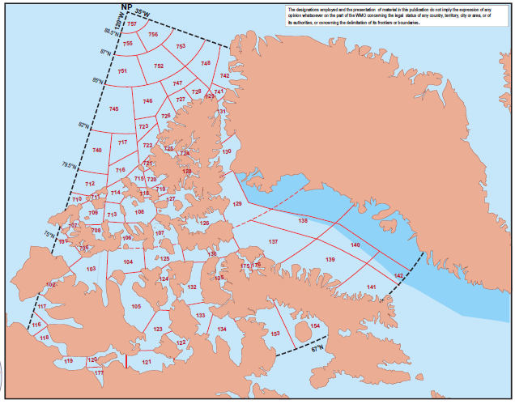
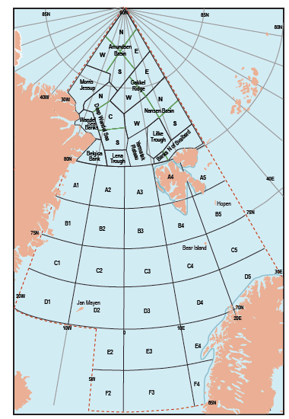
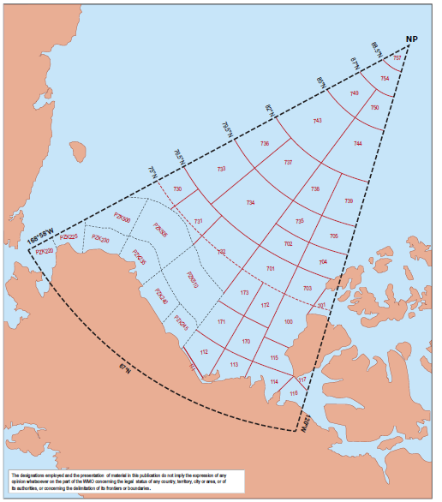
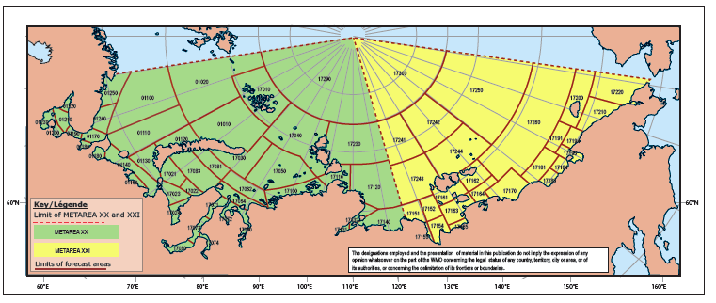
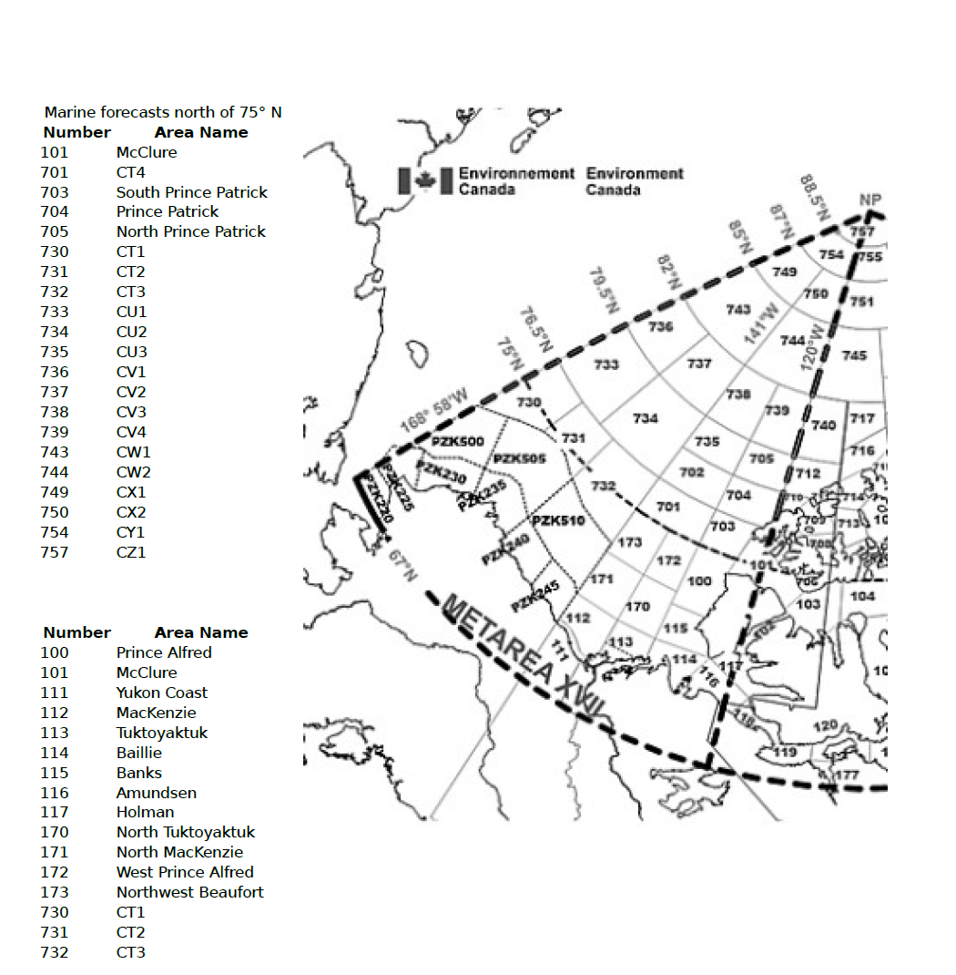
2.3 METAREAs 17-21 schema
http://weather.gmdss.org/XVII.html
http://weather.gmdss.org/XVIII.html
http://weather.gmdss.org/XIX.html
http://weather.gmdss.org/XX.html
http://weather.gmdss.org/XXI.html

Slide 8
2.4 Sample ice bulletins (Feb 26 2013 & Oct 5 2012)
300 n.m.
intersection zone
FICN23 CWIS 050300
ICE BULLETIN FOR METAREA XVIII NORTH OF 75N ISSUED BY ENVIRONMENT CANADA AT 0300 UTC 5 OCTOBER 2012.
SECURITE.
AT 050300 UTC.
GREENLAND WATERS:
ICE E OF 7555N 6626W, 7550N 6201W, 7500N 6024W.
CLARENCE, GREENLAND WATERS:
ICE N AND W OF 7500N 7400W, 7759N 7215W.
NNNN
Oct 5 2012

Slide 9
3 Regulations for preparation and information exchange for ice in GMDSS bulletins
  Joint IMO/IHO/WMO Manual on maritime safety information (edition Nov 2014, in effect 2016-010-01) (mandatory, shall !)
WMO-No.558 Manual on Marine Meteorological Services (edition 2016/2017, to be adopted by JCOMM-5 and WMO EC in 2017) (mandatory, shall !)
  WMO-No.471 Guide to Marine Meteorological Services (edition 2016/2017, to be adopted by JCOMM-5 and WMO EC in 2017) (should)
  WMO sea ice regulatory material (No.259 Sea Ice Nomenclature, JCOMM

Slide 10
3.1 Manual on Marine Meteorological Services
(WMO- No. 558)
Part II: Synopses
….
3.22 The synopses given in Part II of weather and sea bulletins shall have the following content and order of items:
  (a) Date and time of reference in UTC;
  (b) Synopsis of major features of the surface weather chart;
  (c) Direction and speed of movement of significant pressure systems and tropical disturbances;
  (d) Limit of all known ice or iceberg coordinates , where applicable.

Slide 11
3.1 Manual on Marine Meteorological Services
(WMO- No. 558)
Part III: Forecasts
….
3.28 For MetAreas where ice accretion and ice conditions pose a hazard to ship navigation, the forecast shall include information about:
Ice accretion;
Ice conditions (total concentration, stage of development, icebergs , etc)

Slide 12
3.1 Manual on Marine Meteorological Services
(WMO- No. 558)
Issue of ice information
  3.33 Information on ice edge (where applicable) shall be provided in MSI prepared for the GMDSS.
  3.34 Note: Sea-ice and iceberg terminology shall be in accordance with standards.
Note: The standards are specified in WMO Sea-ice Nomenclature (WMO-No . 259) (link !).

Slide 13
3.1 Manual on Marine Meteorological Services
(WMO- No. 558)
Preparation and issue of warnings
….
Procedures for ice-related warnings
  3.46 Members shall issue warnings for ice accretion.
  3.47 Members should include the rate of ice deposition on the superstructure of the vessel within warnings of ice accretion.
  3.48 Members should issue warnings for strong ice pressure, and hazardous sea-ice conditions, as capabilities are developed.
Note: Warnings for icebergs are issued through the NavArea Warning program.

Slide 14
3.1 Manual on Marine Meteorological Services
(WMO- No. 558)
PROVISION OF GRAPHICAL FORECAST INFORMATION
4.1 E-Navigation transmissions shall have the capability of providing marine users with comprehensive marine environmental information for display on ship navigation systems. Additionally, mariners shall have the ability to overlay forecast and hazard data over charts, route plans, and other S-10x data sets in the ships Electronic Chart Display and Information Systems (ECDIS).
4.2 Radio facsimile transmissions shall have the capability of providing marine users with comprehensive marine environmental information, both in pictorial form and in the form of texts.
Note: Graphical charts likely to be of use to marine users are:
(a) Surface-weather analyses;
(b) Surface-weather prognoses;
(c) Surface wind-field analyses;
(d) Wave analyses;
(e) Wave prognoses;
(f) Sea-surface temperature analyses;
(g) Sea-surface temperature prognoses;
(h) Sea-ice information;
(i) Significant weather depiction;
(j) Ocean current information.

Slide 15
3.1 Manual on Marine Meteorological Services
(WMO- No. 558)
PROVISION OF GRAPHICAL FORECAST INFORMATION
….
4.12 Members should produce sea-ice information charts using symbols, or in vector or gridded format.
Note: Formats for sea-ice information are described in WMO Sea-ice Nomenclature, Volume III – International System of Sea-ice Symbols (WMO-No. 259), and SIGRID-3: Sea Ice GeoReferenced Information and Data (WMO/ TD-No. 1214), and SIGRID gridded and vector archive formats for sea-ice charts (WMO-No. 716, WMO-No. 792) (links !!!)
Procedures for E-Navigation displays
4.13 Information provided shall be in a compatible format.
Note: Information must be compatible with the IHO S-10x format, as defined by the WMO Met-Ocean Feature Catalogue, or WMO Sea-Ice Feature Catalogue (link !)

Slide 16
Rules for SafetyNET are now in WMO-No.471
Rules for NAVTEX are now in Appendix II.2, WMO-No.558
Example bulletins for SafetyNET and NAVTEX are now in WMO-No.471

Slide 17
3.2 Guide on Marine Meteorological Services (WMO- No. 471)
….
Information on ice edge (where applicable) shall be provided in MSI prepared for the GMDSS.
Following practices should be used for the ice edge information prepared for SafetyNET bulletins:
no more than 10 lat/long points for each Sub-Area;
latitude 4 digits; longitude 5 digits (add preceding 0 if needed);
N/W/E must be added for areas bordering the E/W divide;
lat/long pairs separated by comma;
period at the end of the lat/long string to define end of information;
no local names used (exception – reference chart is to be prepared with acceptable well-known place names which are allowed in addition to Sub-Area names);
location of sea ice relative to ice edge must be given before lat/long string;

Slide 18
3.2 Guide on Marine Meteorological Services (WMO- No. 471)
continued…
additional information on ice edge form state may be added – diffuse, compact, movement, growth;
can cut across small islands as if they weren’t there;
for bulletins prepared for SafetyNET, extend into neighbouring METAREA by 150 nm (use issuing office ice boundaries as reference recognizing that, with different issue times, the boundaries may have moved);
when describing neighbouring METAREA ice, use Sub-Area names from that METAREA;
cannot create ice free “holes” in the ice pack unless they are significant as noted below; ice-free “inlets” in the ice pack will be ignored if the entrance is less than 30 nm wide:
  Significant open water within the main ice edge may be described with an ice edge if shipping is active within that area (significant means that an entire marine sub-area is open water);

Slide 19
3.2 Guide on Marine Meteorological Services (WMO- No. 471)
continued....
Include all sea ice within the ice edge – fast ice, strips and patches; ice edge is boundary between any sea ice and sea ice free (icebergs may be outside of the ice edge provided there is no sea ice);
idea is to be conservative and not endanger shipping.
in winter, when ice edge is outside of Sub-Area due to complete ice cover, bulletin to say “Ice covered”;
in summer, when ice edge is outside of region due to lack of sea ice, bulletin to say “ice free” or “bergy water”.
Sharing and operational exchange of information on ice edge position is essential to ensure its contiguity across the METAREA boundaries.”

Slide 20
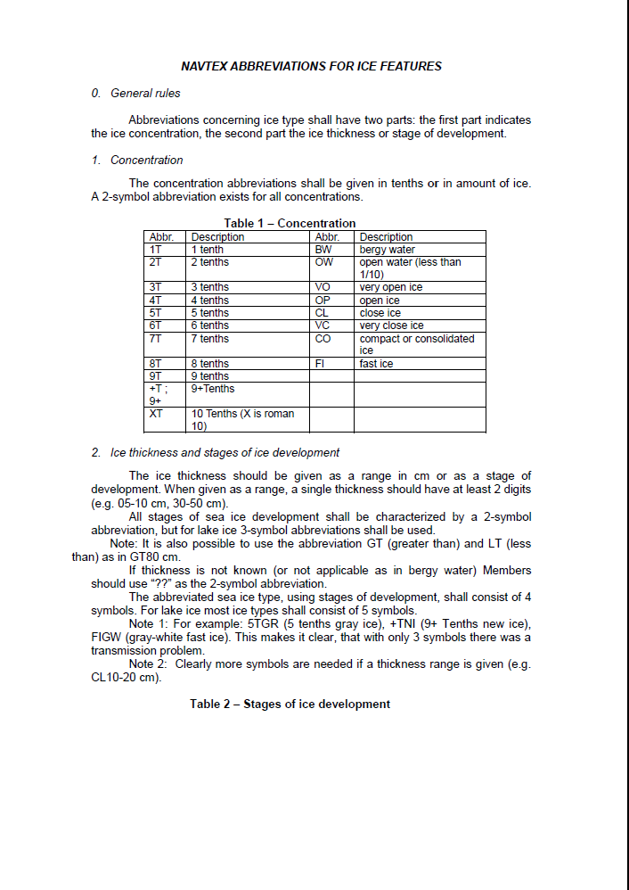
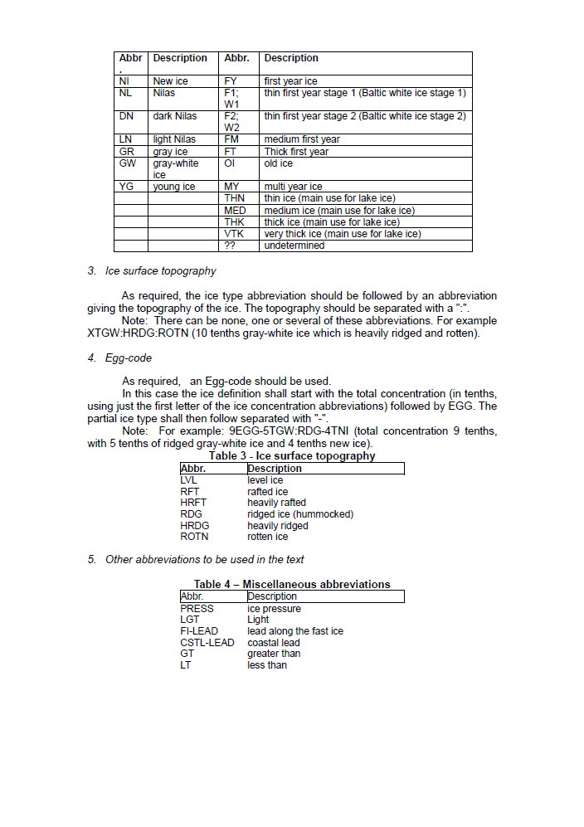
3.2 WMO-No.558 APPENDIX II.2
NAVTEX Abbreviations FOR Ice FEATURES

Slide 21
4 Documentation on program-latest versions, location of information
Documentation
  JCOMM publication section (WMO-No.558, WMO-No.471, sea ice regulatory material)
  IMO/IHO publication sections (Joint IMO/IHO/WMO Manual on Maritime Safety Information, Polar Code)
Location of information
  NMS / Ice Services Internal resources
  WMO GMDSS portal (GTS)– http://weather.gmdss.org
    Polar GMDSS portal – http://gmdss.aari.ru
  WMO WIS GISC (Global Information System Center), e.g.
    http://wispi.meteo.fr/openwis-user-portal/srv/en/main.home
  WMO WIS DCPC (Data Collection or Production Center), e.g.
    http://gcw.met.no/metamod/search (GCW portal)
  Other (icebreakers, routing administrations, etc)

Slide 22
Way forward
What we are missing ?
  Should we extend sea ice variables in SafetyNET
  Information on icebergs (limit, positions shall belong to NAVAREA or METAREA or be duplicated ?)
  Specifications for icebergs in METAREA SafetyNET (minimum wording – plain text)?
  How to provide info in S-41X ?
  ……………………………….
Recommendations from this workshop forwarded to IICWG and ETSI (all)
May – Oct 2016, interim discussions by IICWG Data and Icebergs Sub-Committees (IICWG)
If relevant and mature ETSI report to ETMSS (ETSI)
Oct 2016 report for IICWG (IICWG)
February 28 – 3 March 2017, joint ETSI-6/ETMSS-6 (ETSI)

Slide 23
