Slide 1
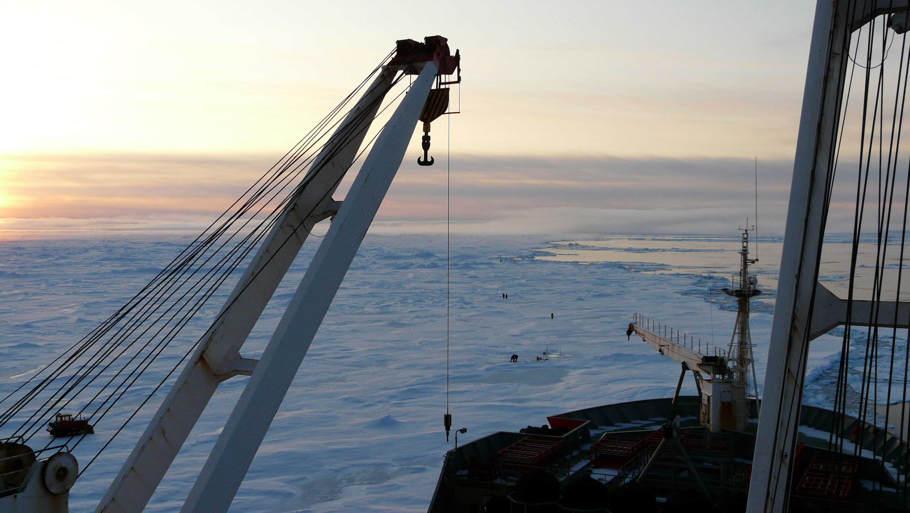
GIS in Ice Analysis at Arctic and Antarctic Research Institute
Vladimir Bessonov principal oceanographer
Arctic and Antarctic Research Institute, St.Petersburg, Russia

Slide 2
Summary
SIGRID-3 is the main format
  Ice charts in SIGRID-3 are available from 2016 (http://wdc.aari.ru/datasets/d0014/antarc)
ArcGIS 10.0 used
Analysis done:
  Prior to December 2014 – twice a month
  Since December 2014 – every two weeks
  Since 2015 iceberg analysis done weekly
3 ice analysts (including principal oceanographer) + 1 analyst for iceberg analysis
Main data sources:
  Terra & Aqua MODIS (summer time)
  Sentinel-1 SAR (year-round)
  AMSR (winter time)
  Starting to use Sentinel-2 (from spring 2016)

Slide 3
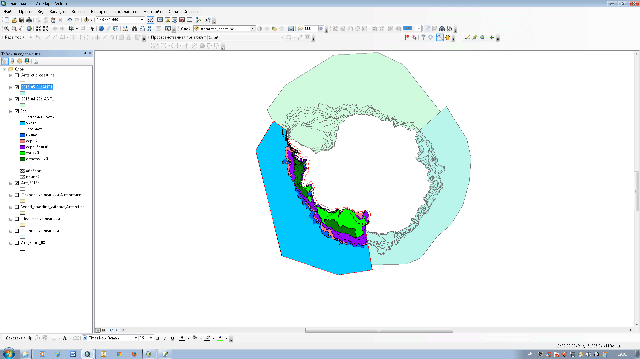
Ice Conditions analyzed by 3 sectors (Atlantic, Indian,Pacific)

Slide 4
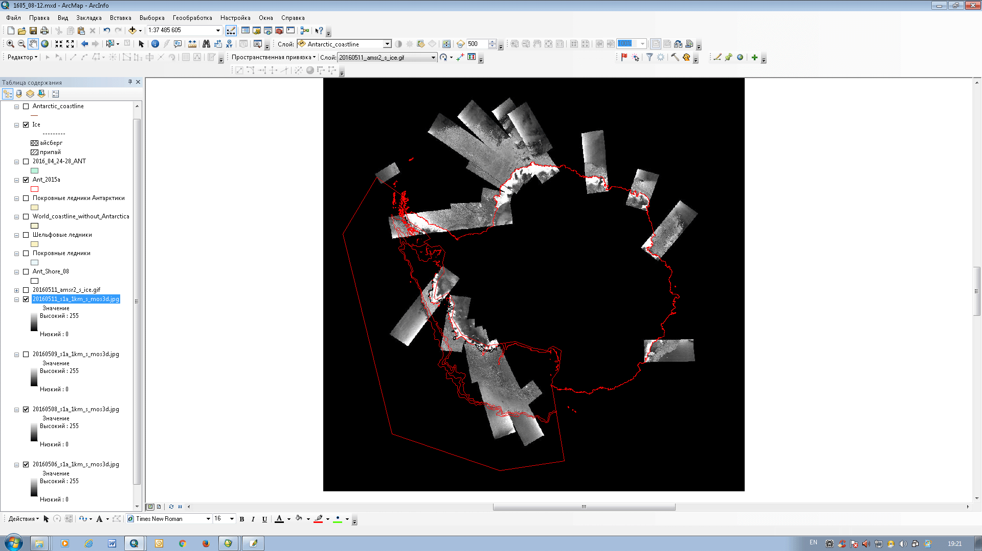
Sentinel-1A Data (most frequently 3 days mosaic)

Slide 5
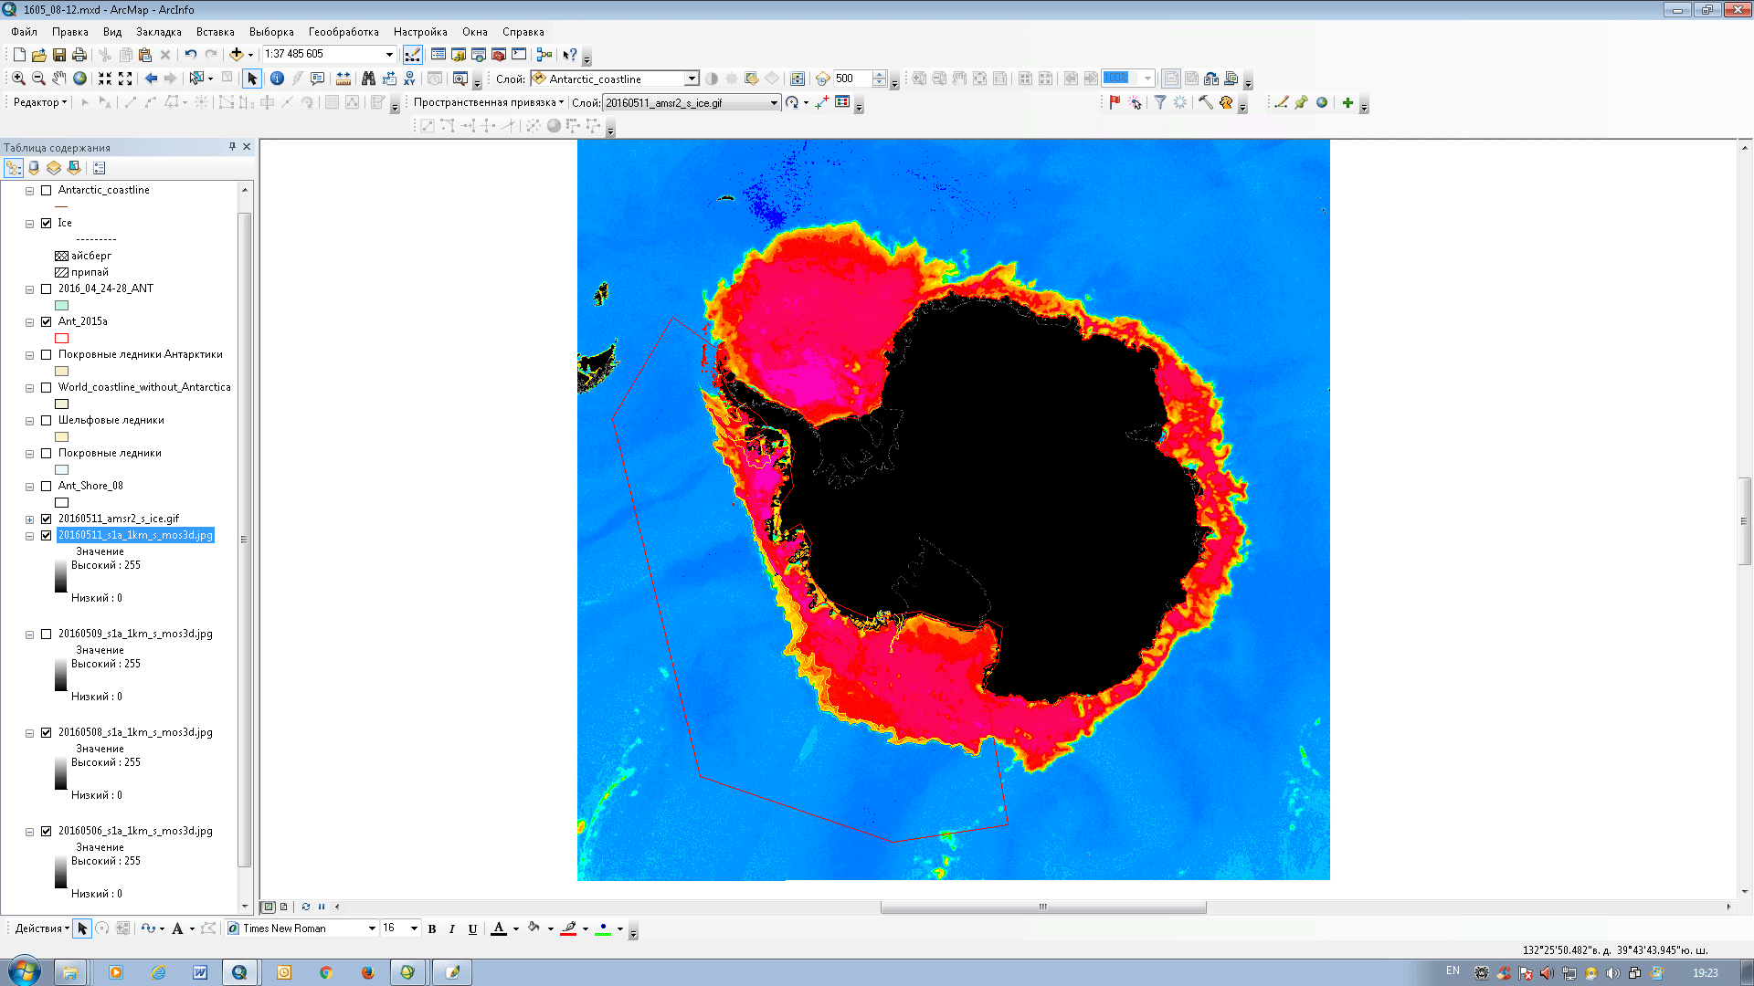
AMSR-2 Data

Slide 6
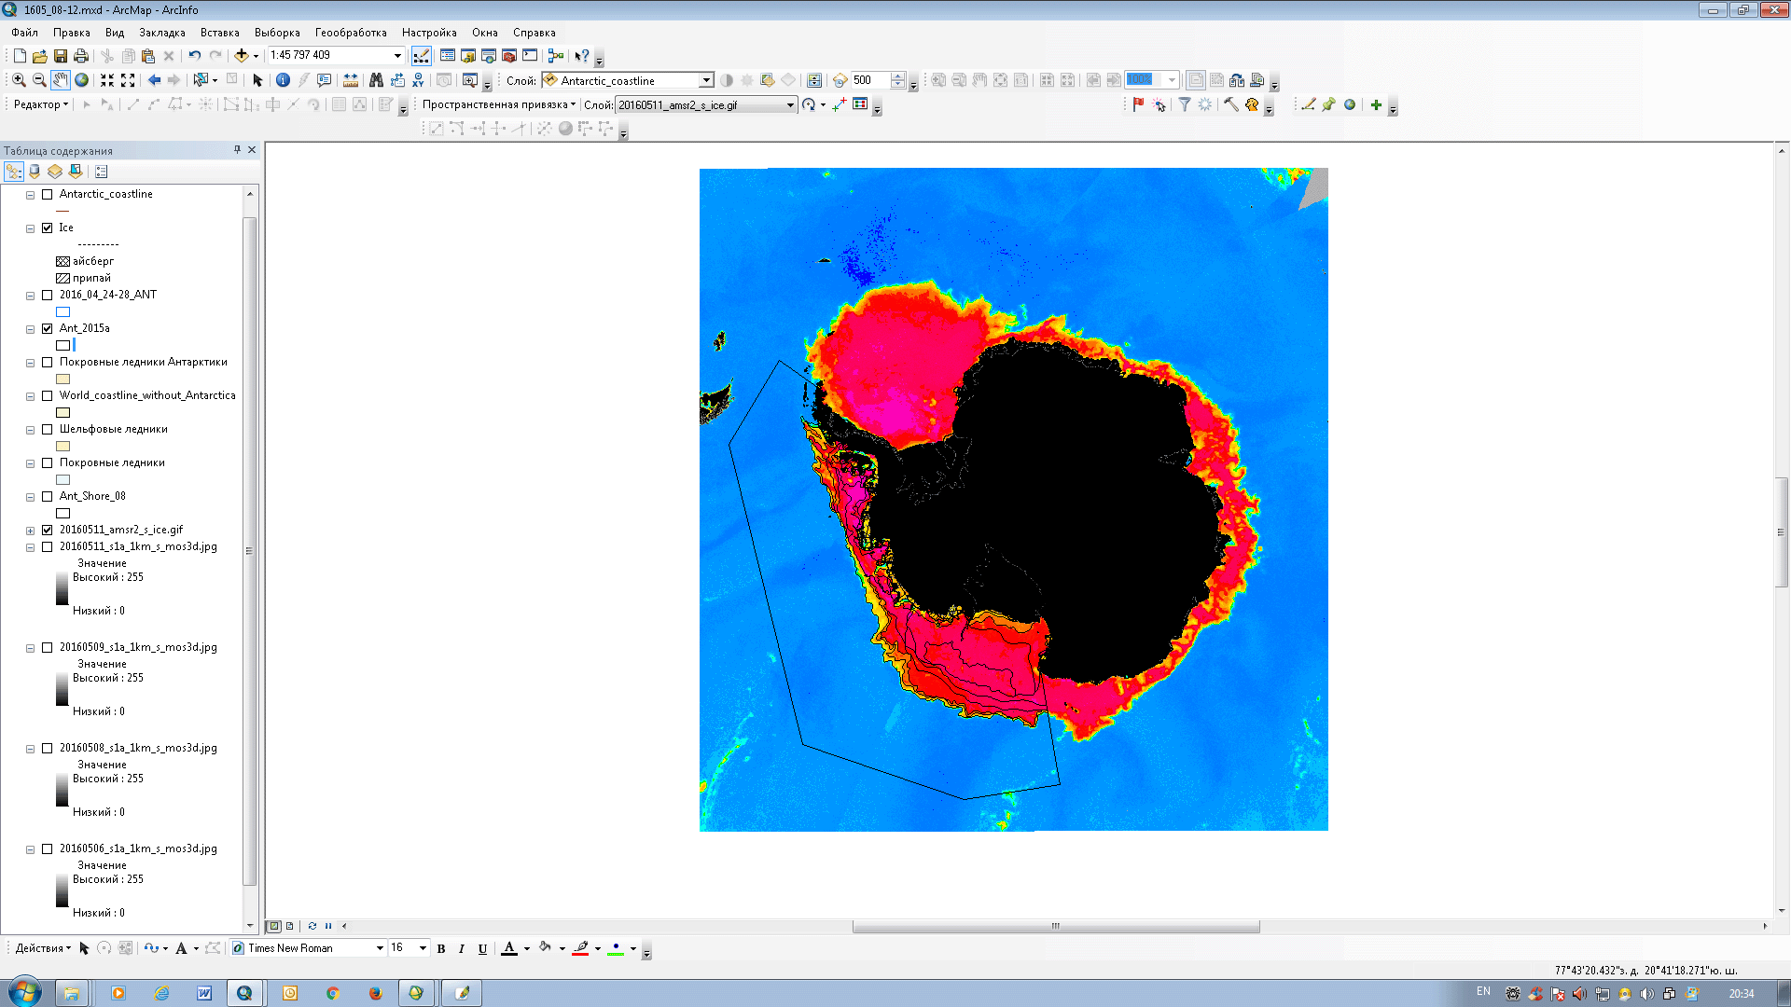
AMSR-2 imagery with ice zone boundaries

Slide 7
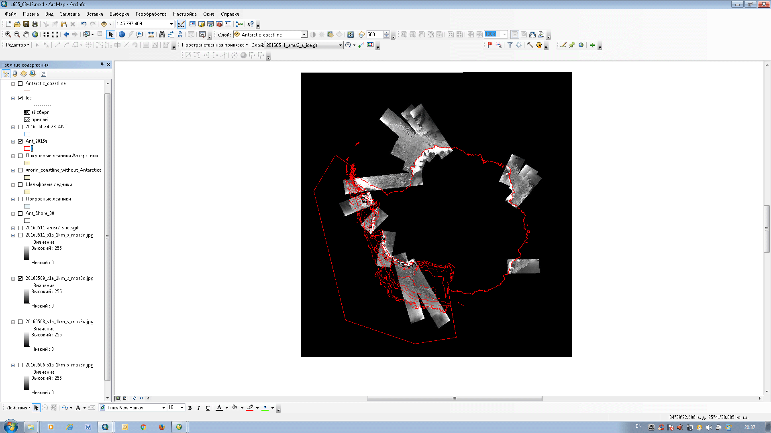
Sentinel-1a Ice Chart

Slide 8
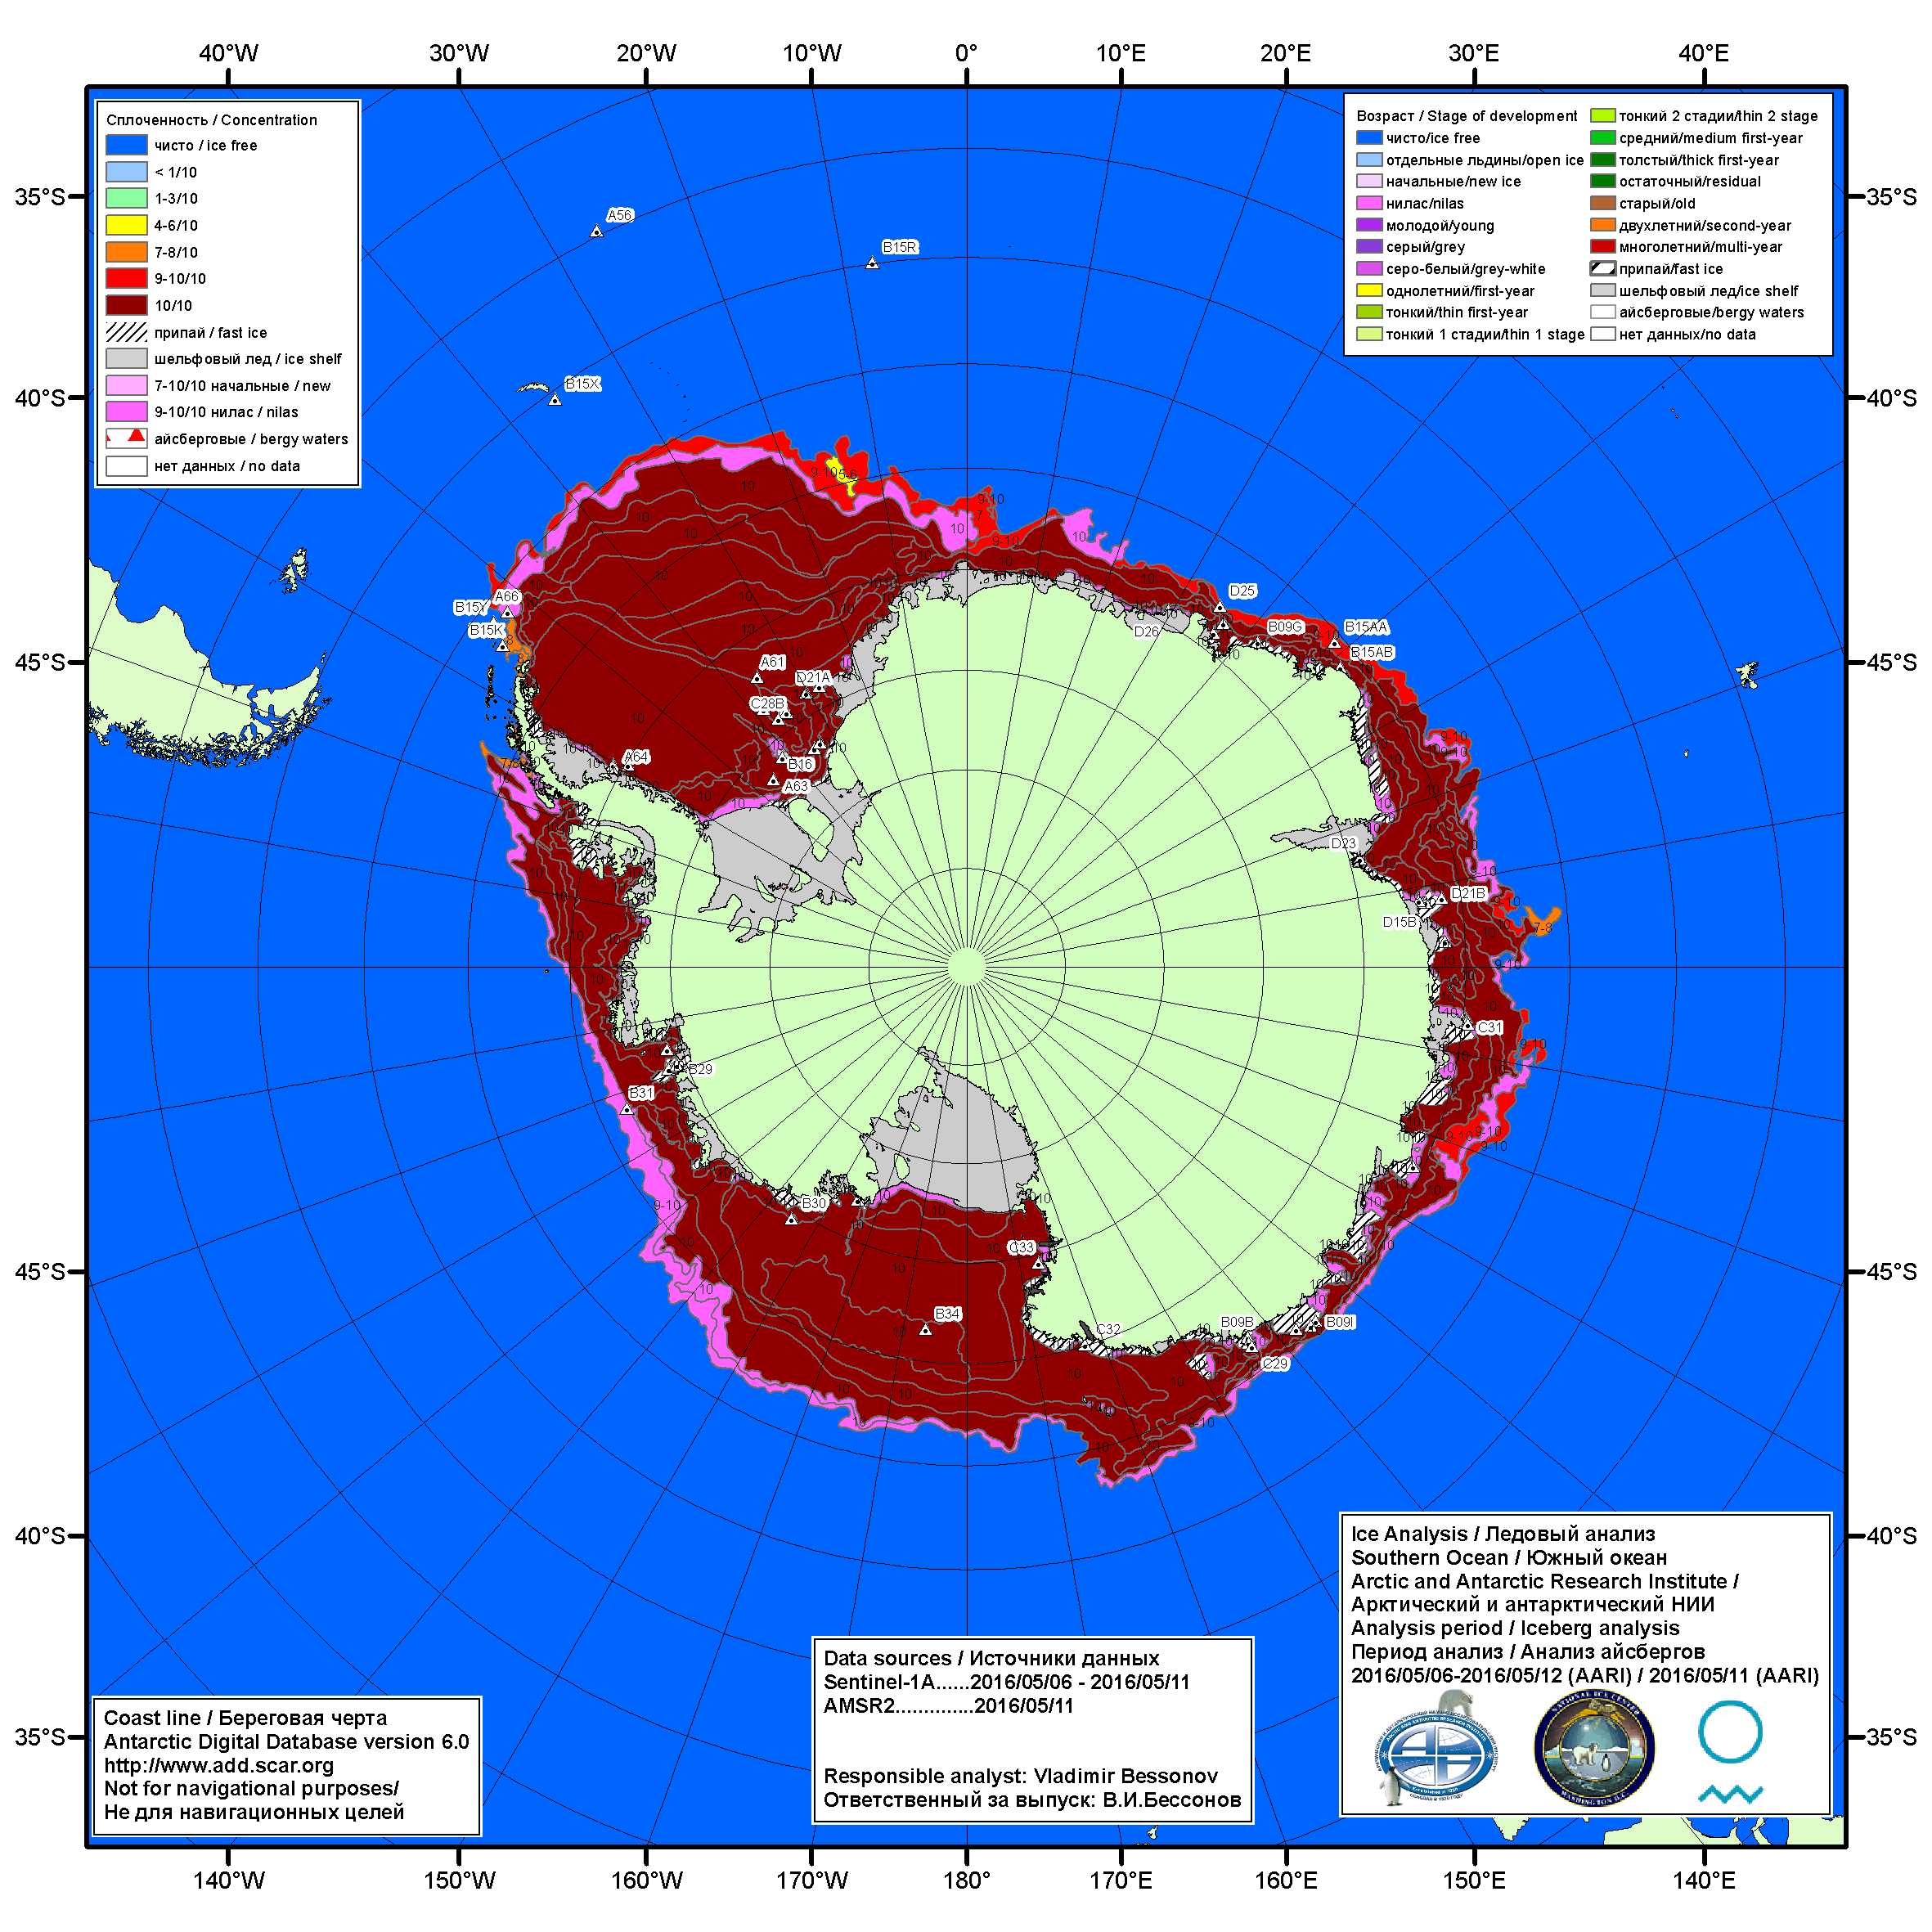
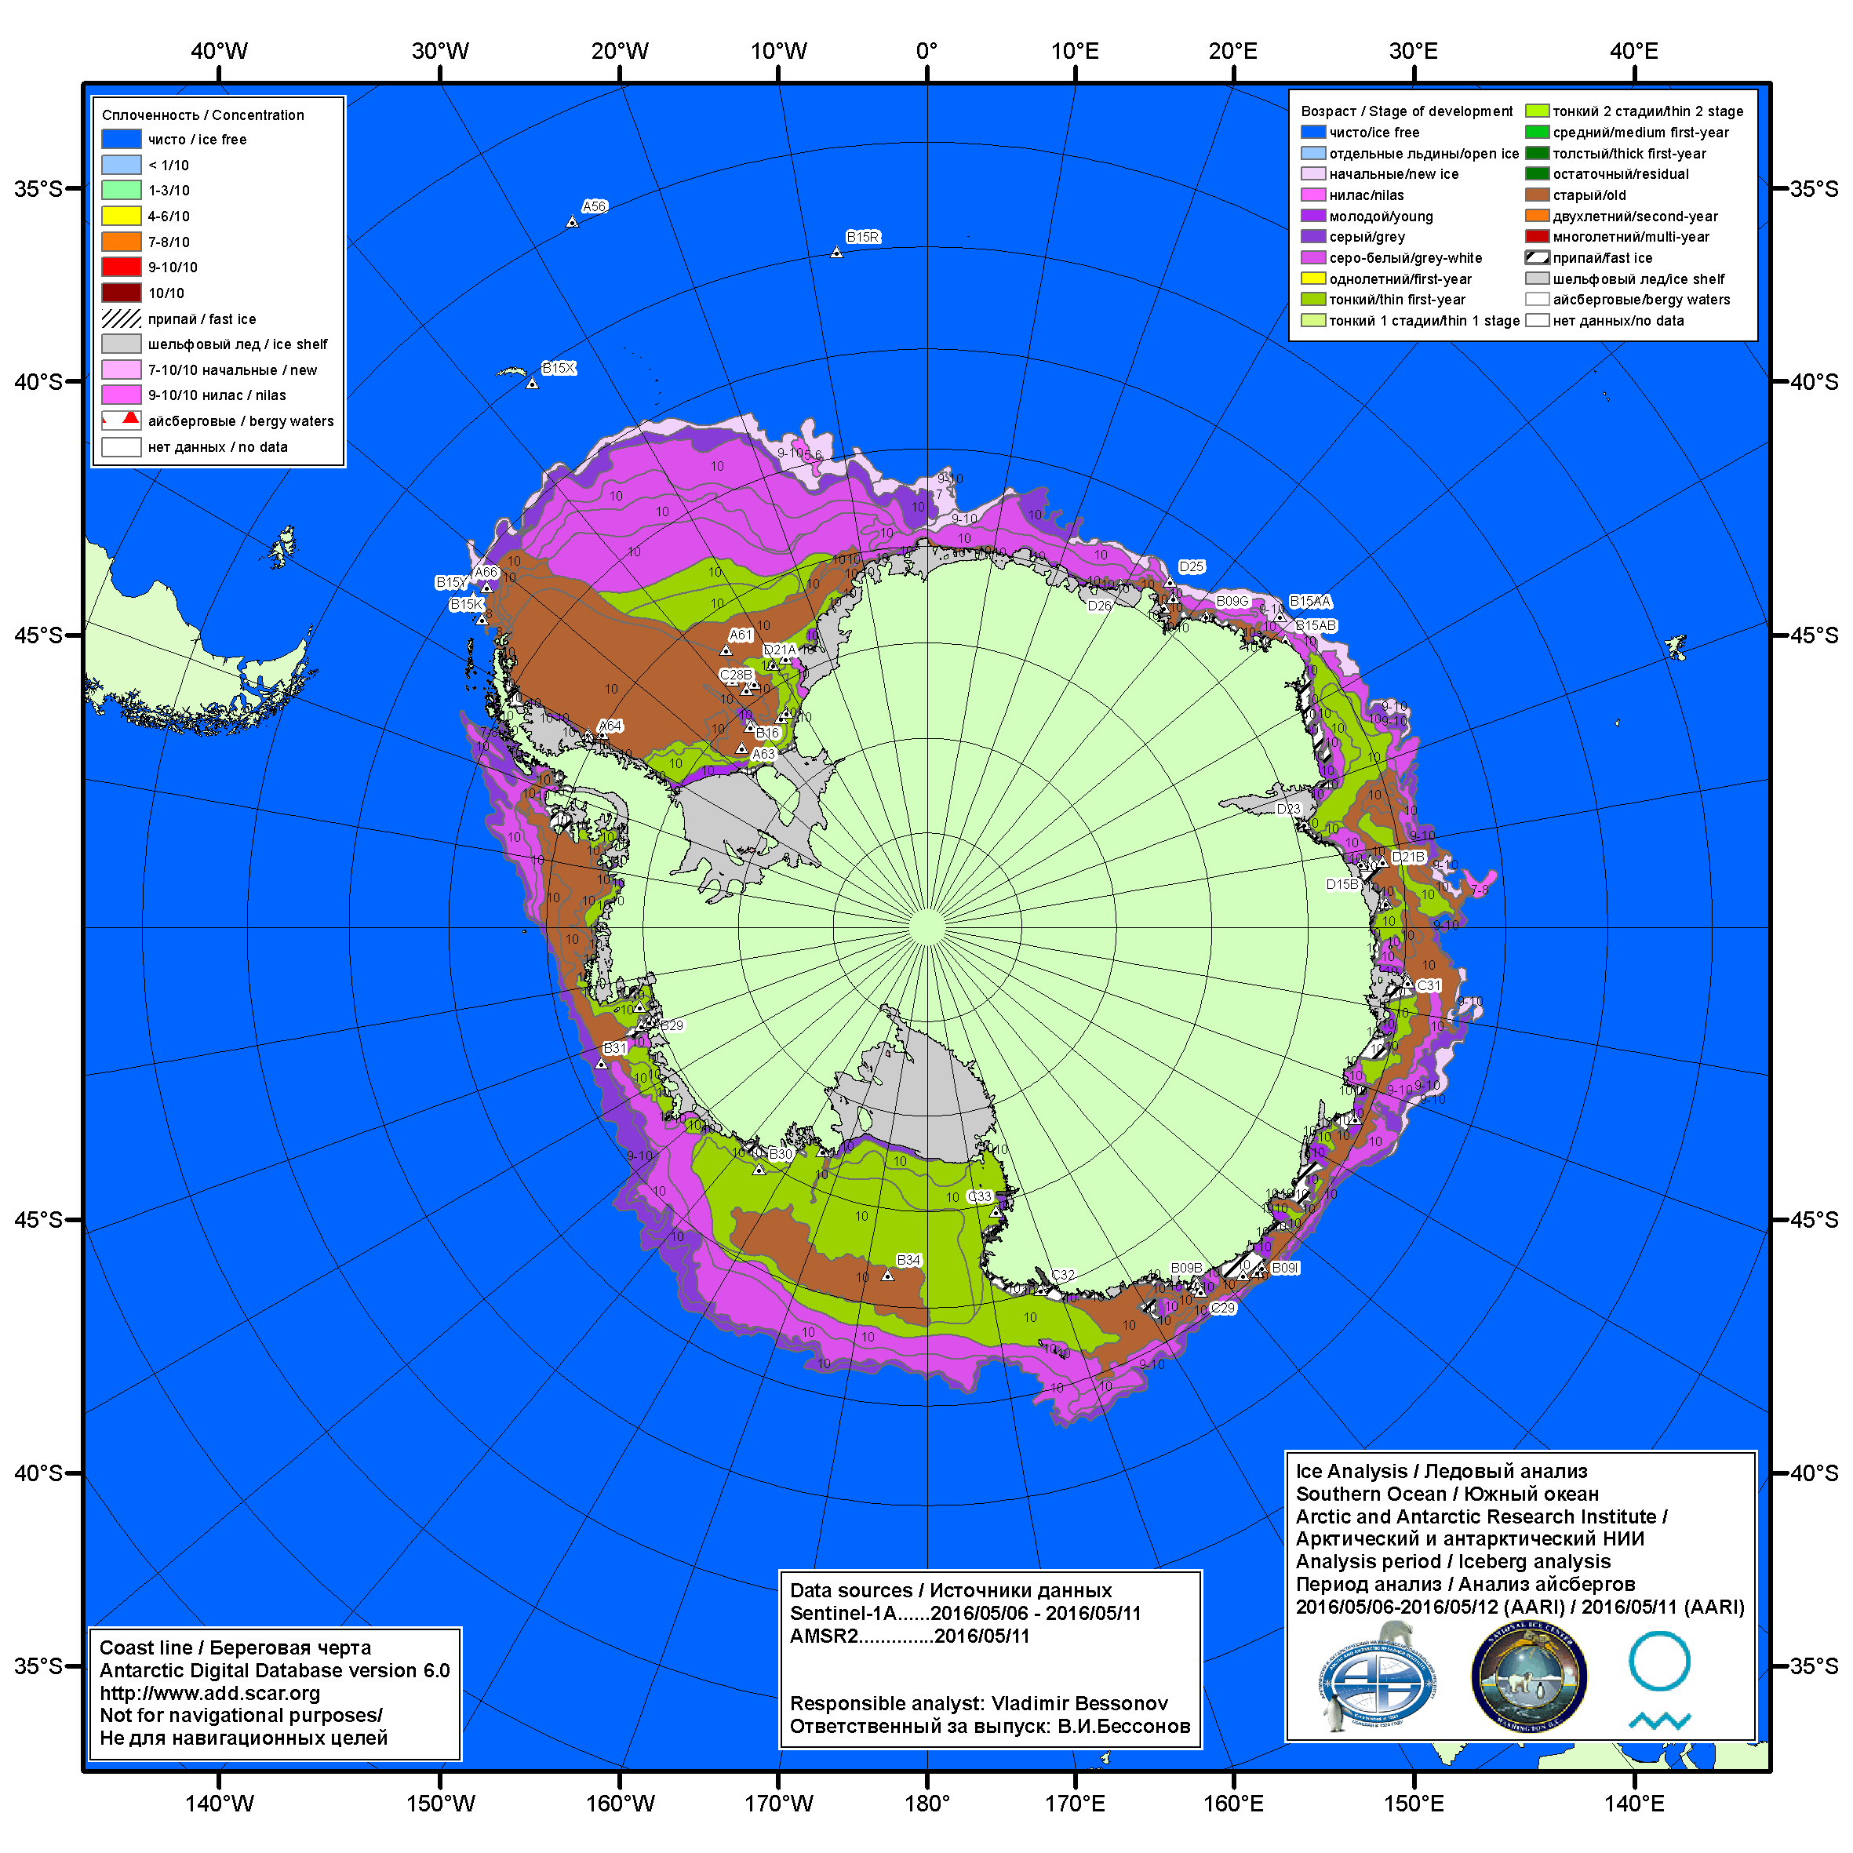
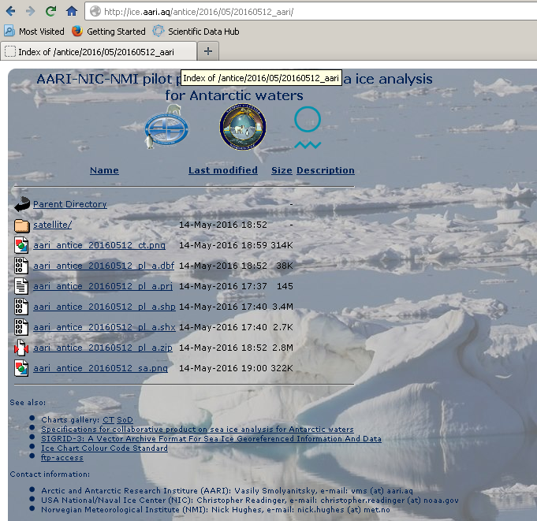
Latest ice chart (May 12th, 2016)
(with AARI iceberg analysis included)

