Slide 1


ANTARCTIC SEA ICE
PRODUCTS
Argentine Naval Hydrographic Service (ANHS)
Navy Weather Service
LT. Alvaro Scardilli Head of the Navy Weather Service asscardilli@hidro.gov.ar

Slide 2
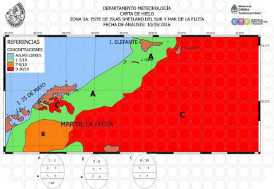
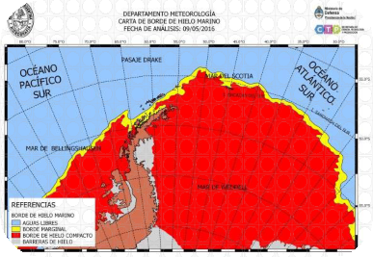
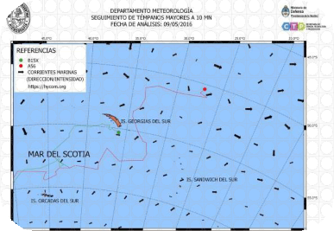
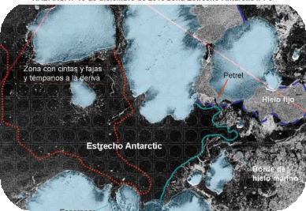
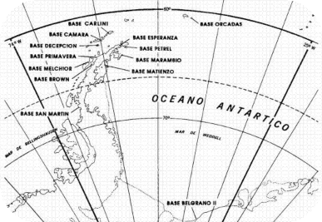

5th INTERNATIONAL ICE ANALYST WORKSHOP
Argentine Sea Ice Products
Ice Charts
Sea Ice Edge Chart
Iceberg Charts
Analysis for Navy Ships
Ice Observations
Coding

Slide 3
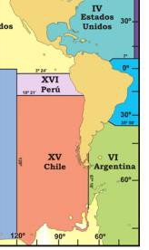
5th INTERNATIONAL ICE ANALYST WORKSHOP
Some interesting facts…
The number of tourists in Antartica has grown from a few hundred to more than 35000 each year (according with IAATO statistics), specially in Antartic Peninsula.
Safety at Sea in the rovided exclusively to G in 2014, and signs e its own Ice Charts,
015.
The ANHS provides the Public Service of
NAVAREA VI, since 1911.
Until 2015, the Sea Ice information was p
Argentine Navy Ships.
Argentina starts participating in the IICW its Charter in 2015.
In 2014 ANHS started working to develop
providing regular service since October 2

Slide 4
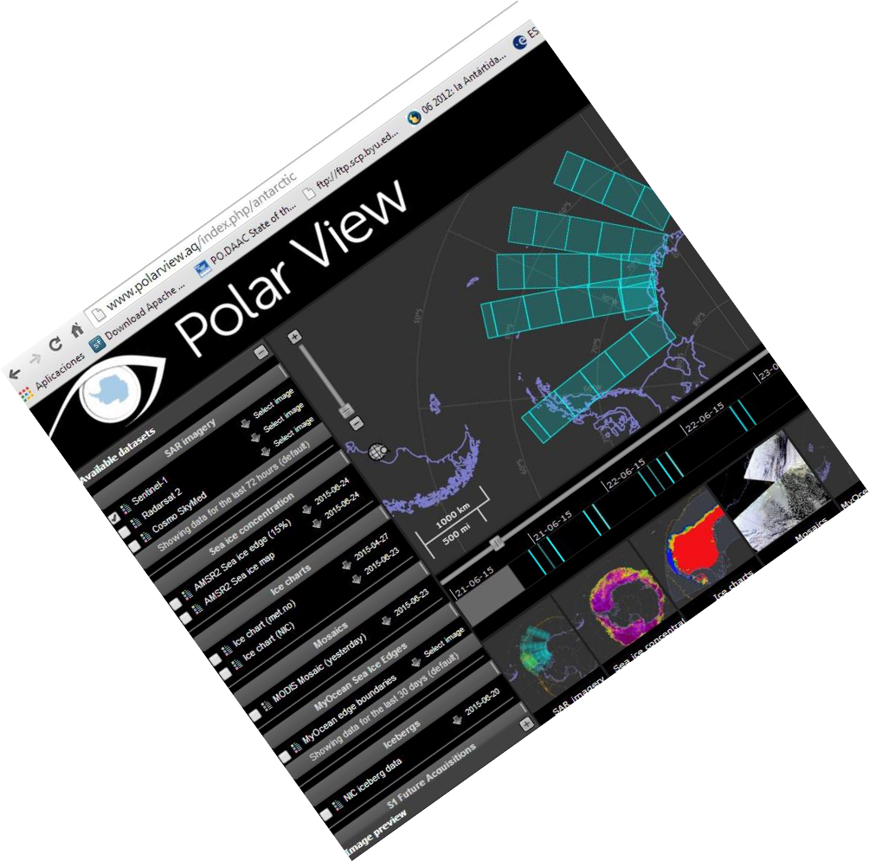
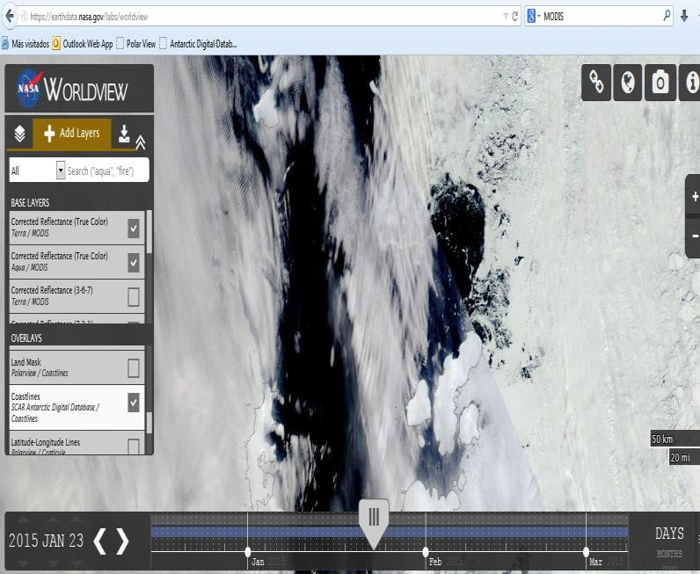
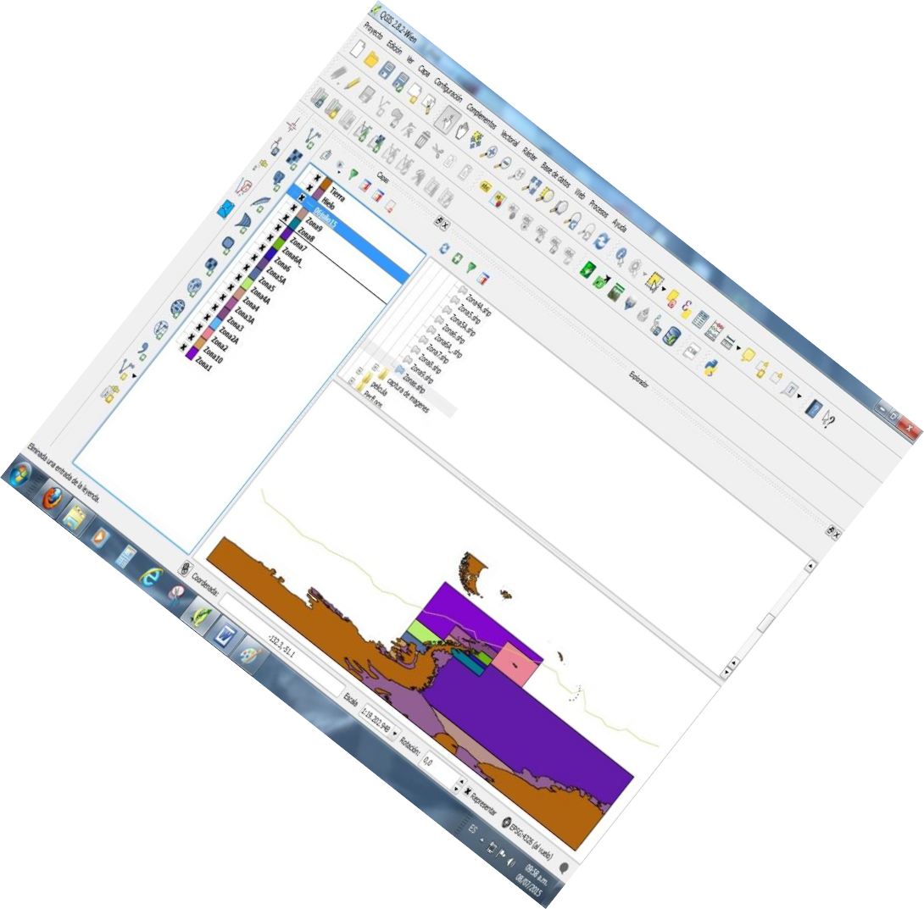
5th INTERNATIONAL ICE ANALYST WORKSHOP
How do we make Ice Products?

Slide 5
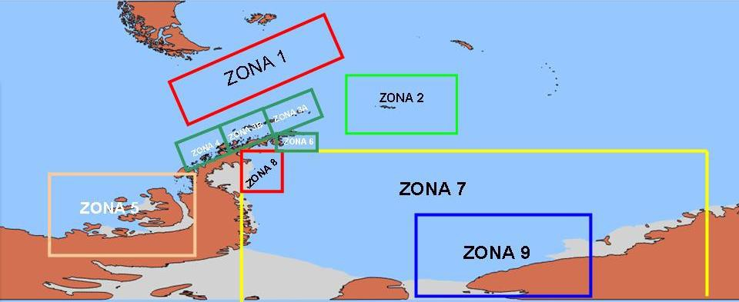
5th INTERNATIONAL ICE ANALYST WORKSHOP
Ice Charts

Slide 6
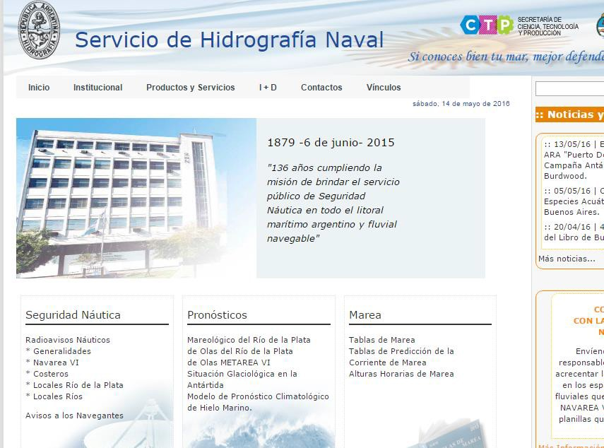
5th INTERNATIONAL ICE ANALYST WORKSHOP
www.hidro.gob.ar

Slide 7
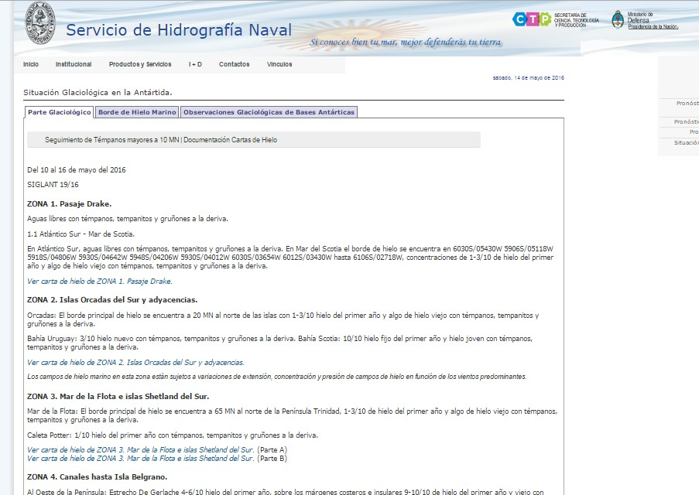
5th INTERNATIONAL ICE ANALYST WORKSHOP

Slide 8
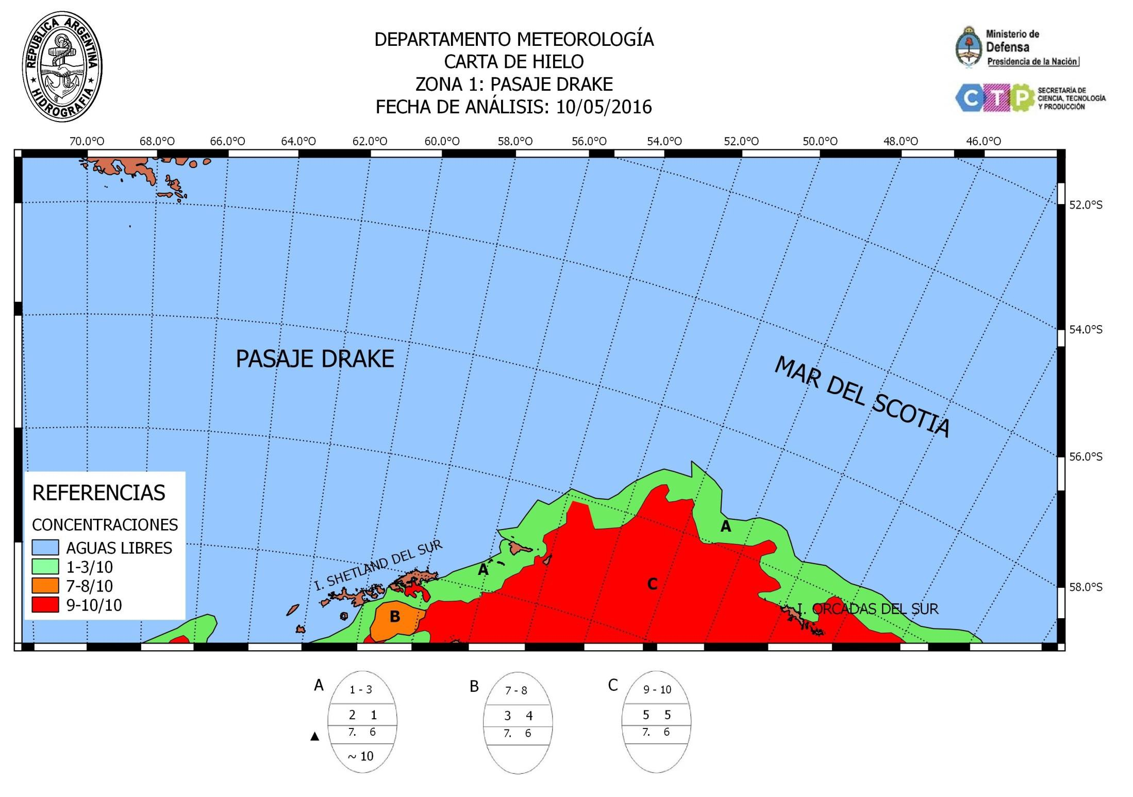
5th INTERNATIONAL ICE ANALYST WORKSHOP

Slide 9
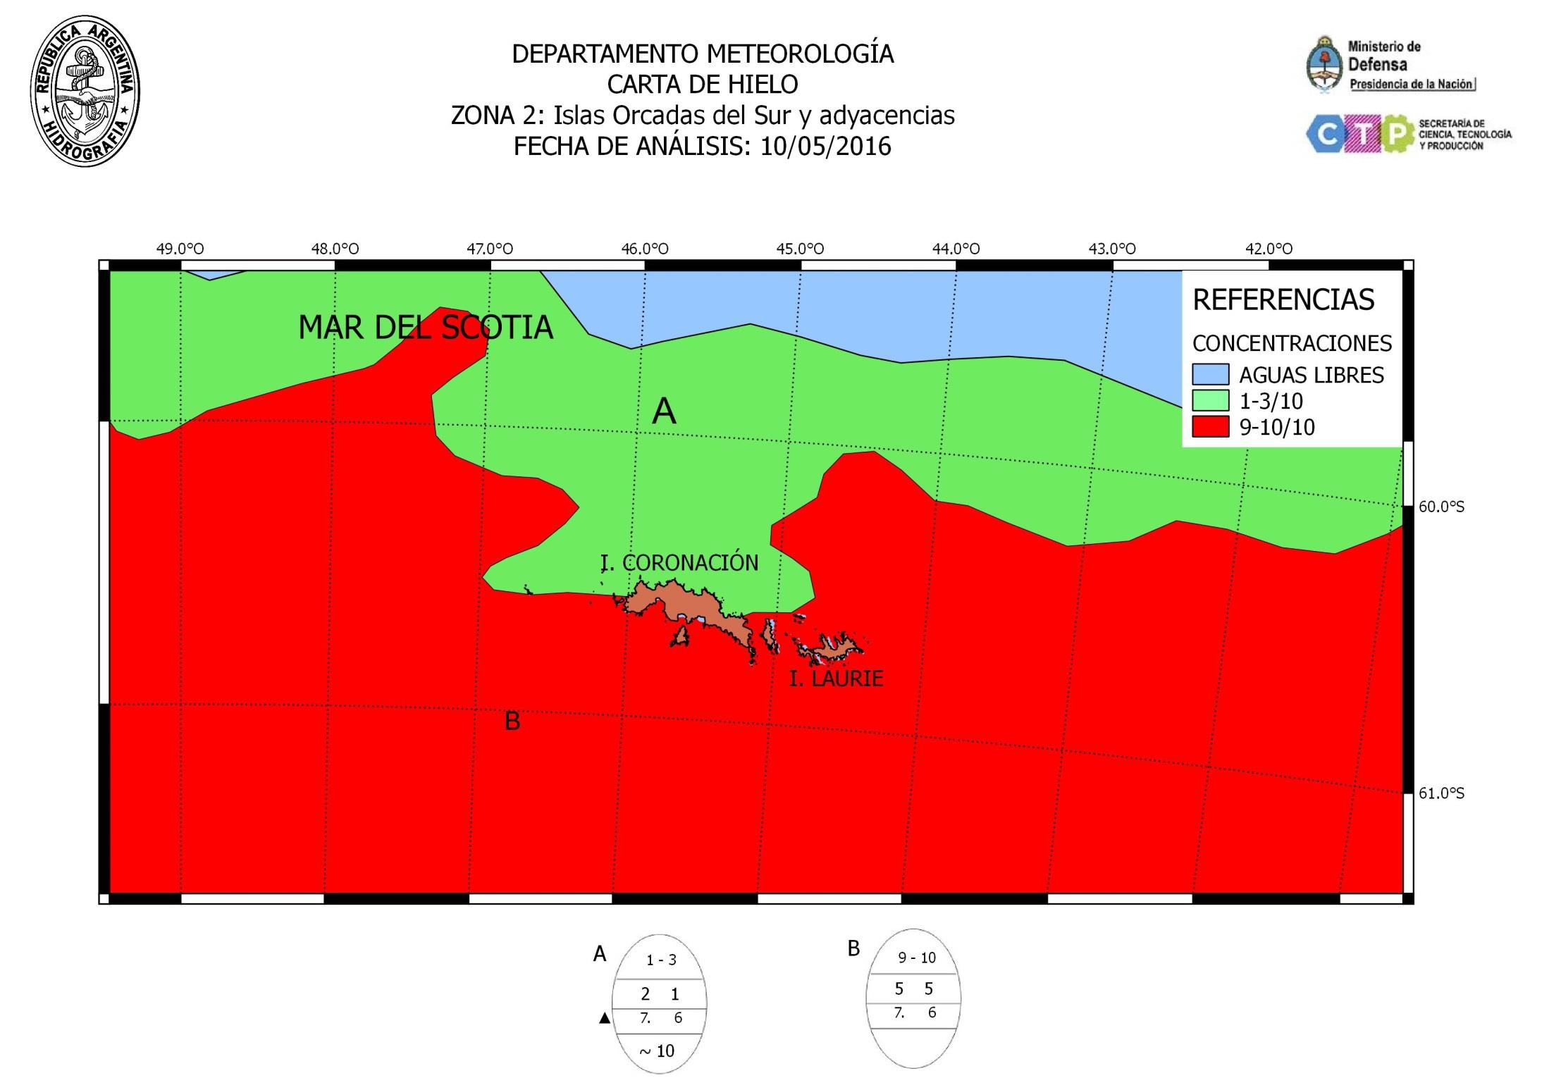
5th INTERNATIONAL ICE ANALYST WORKSHOP

Slide 10
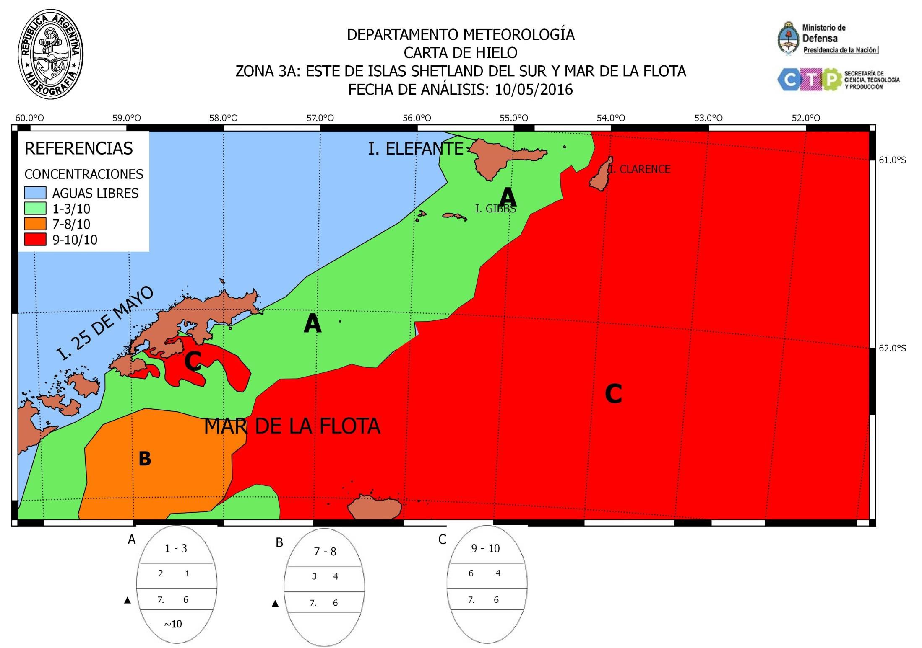
5th INTERNATIONAL ICE ANALYST WORKSHOP

Slide 11
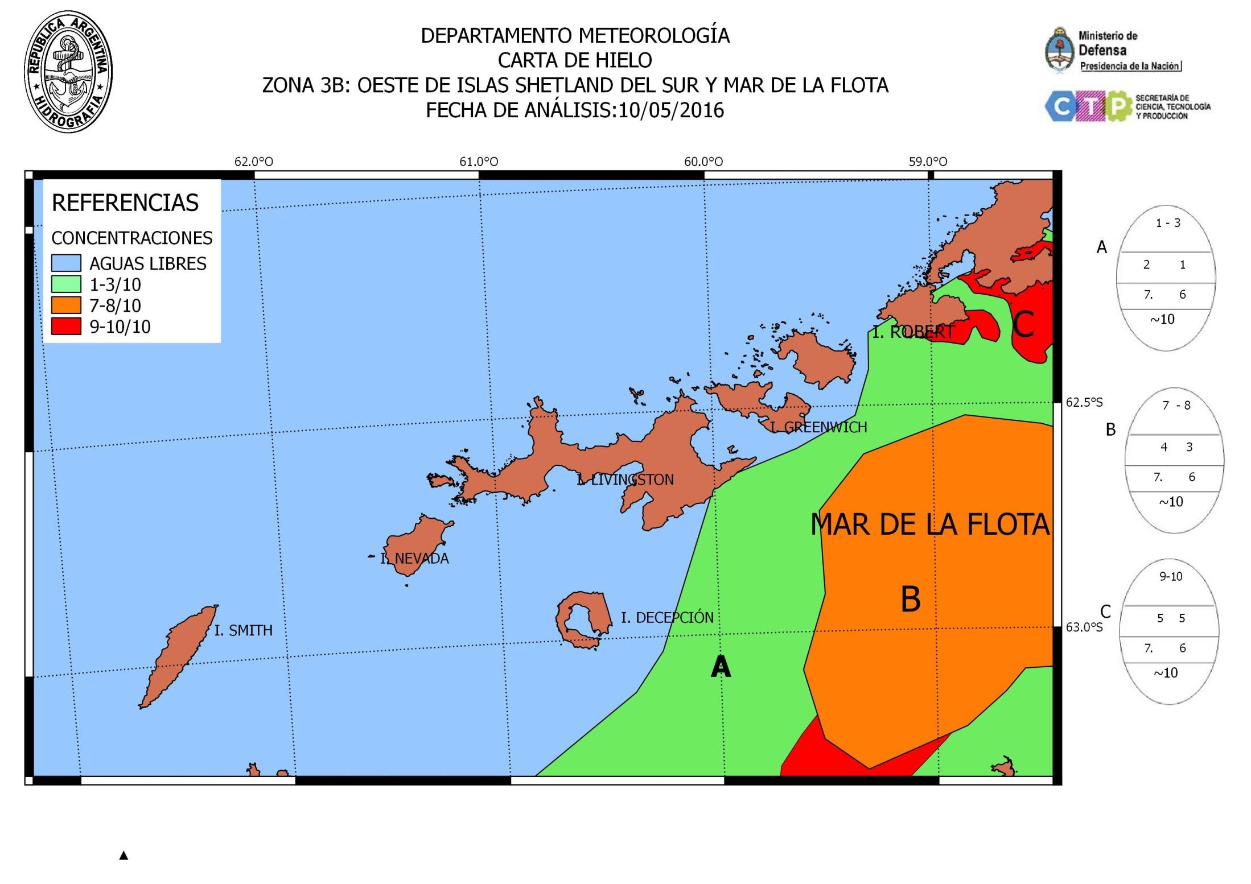
5th INTERNATIONAL ICE ANALYST WORKSHOP

Slide 12
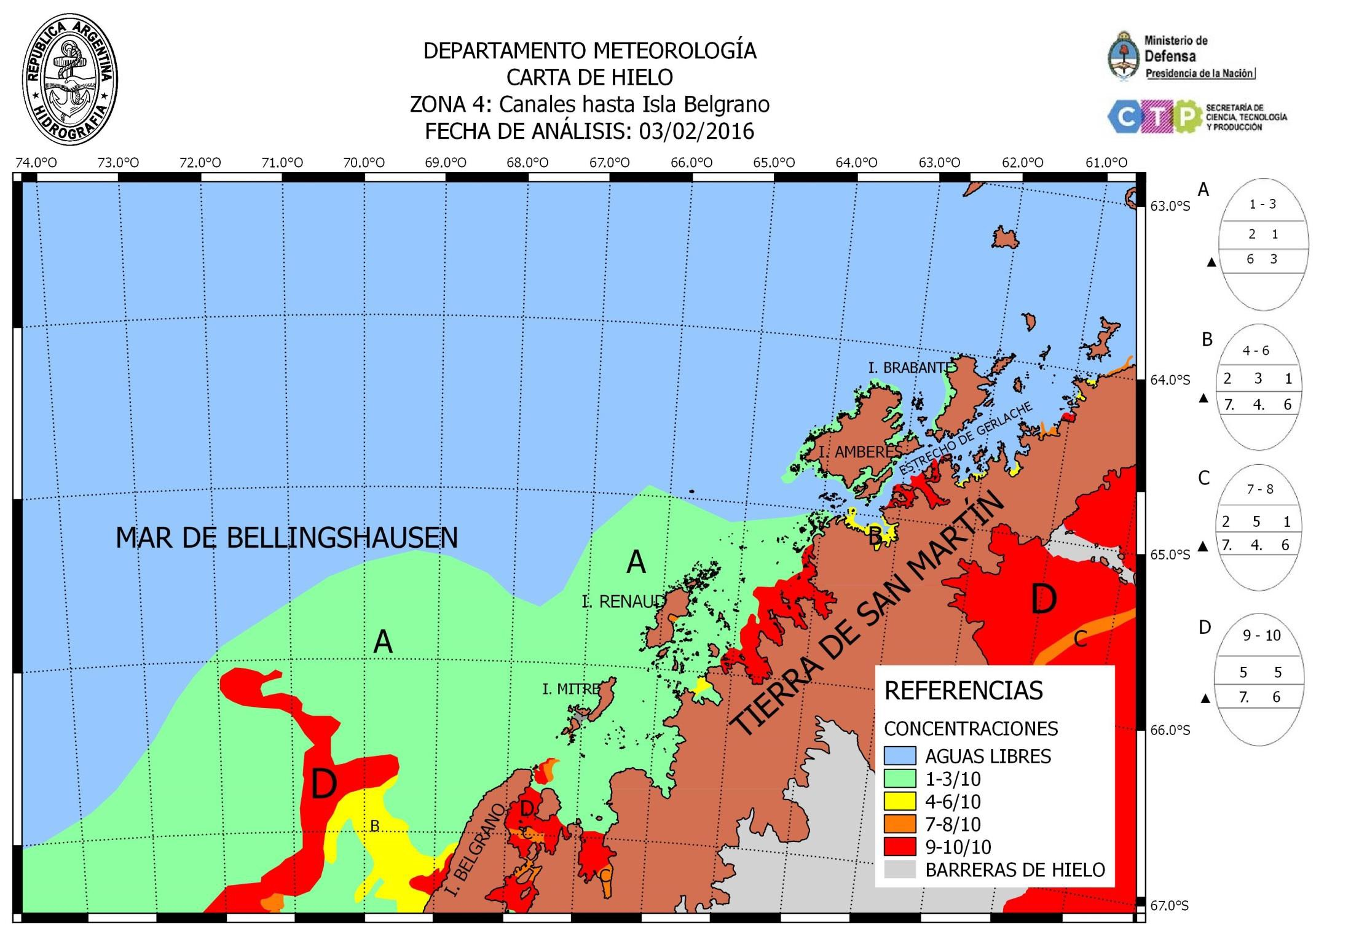
5th INTERNATIONAL ICE ANALYST WORKSHOP

Slide 13
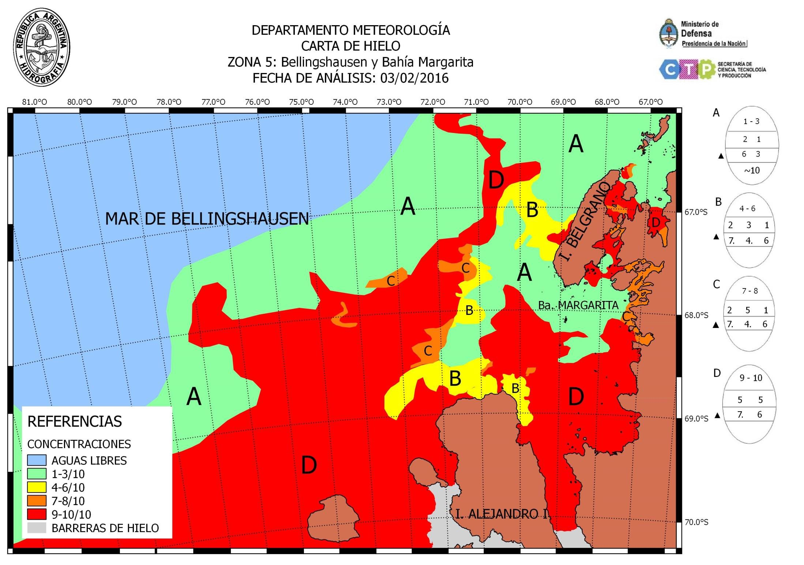
5th INTERNATIONAL ICE ANALYST WORKSHOP

Slide 14
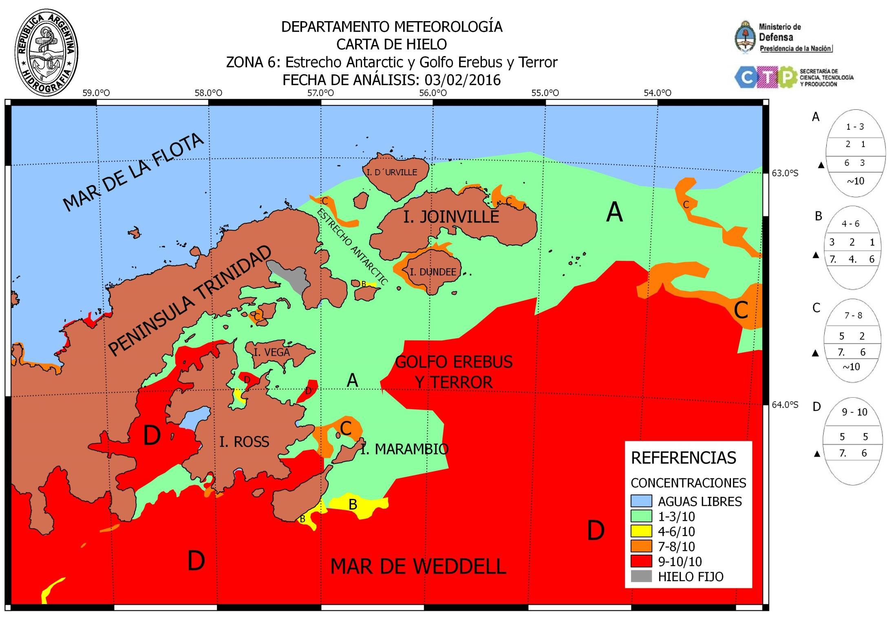
5th INTERNATIONAL ICE ANALYST WORKSHOP

Slide 15
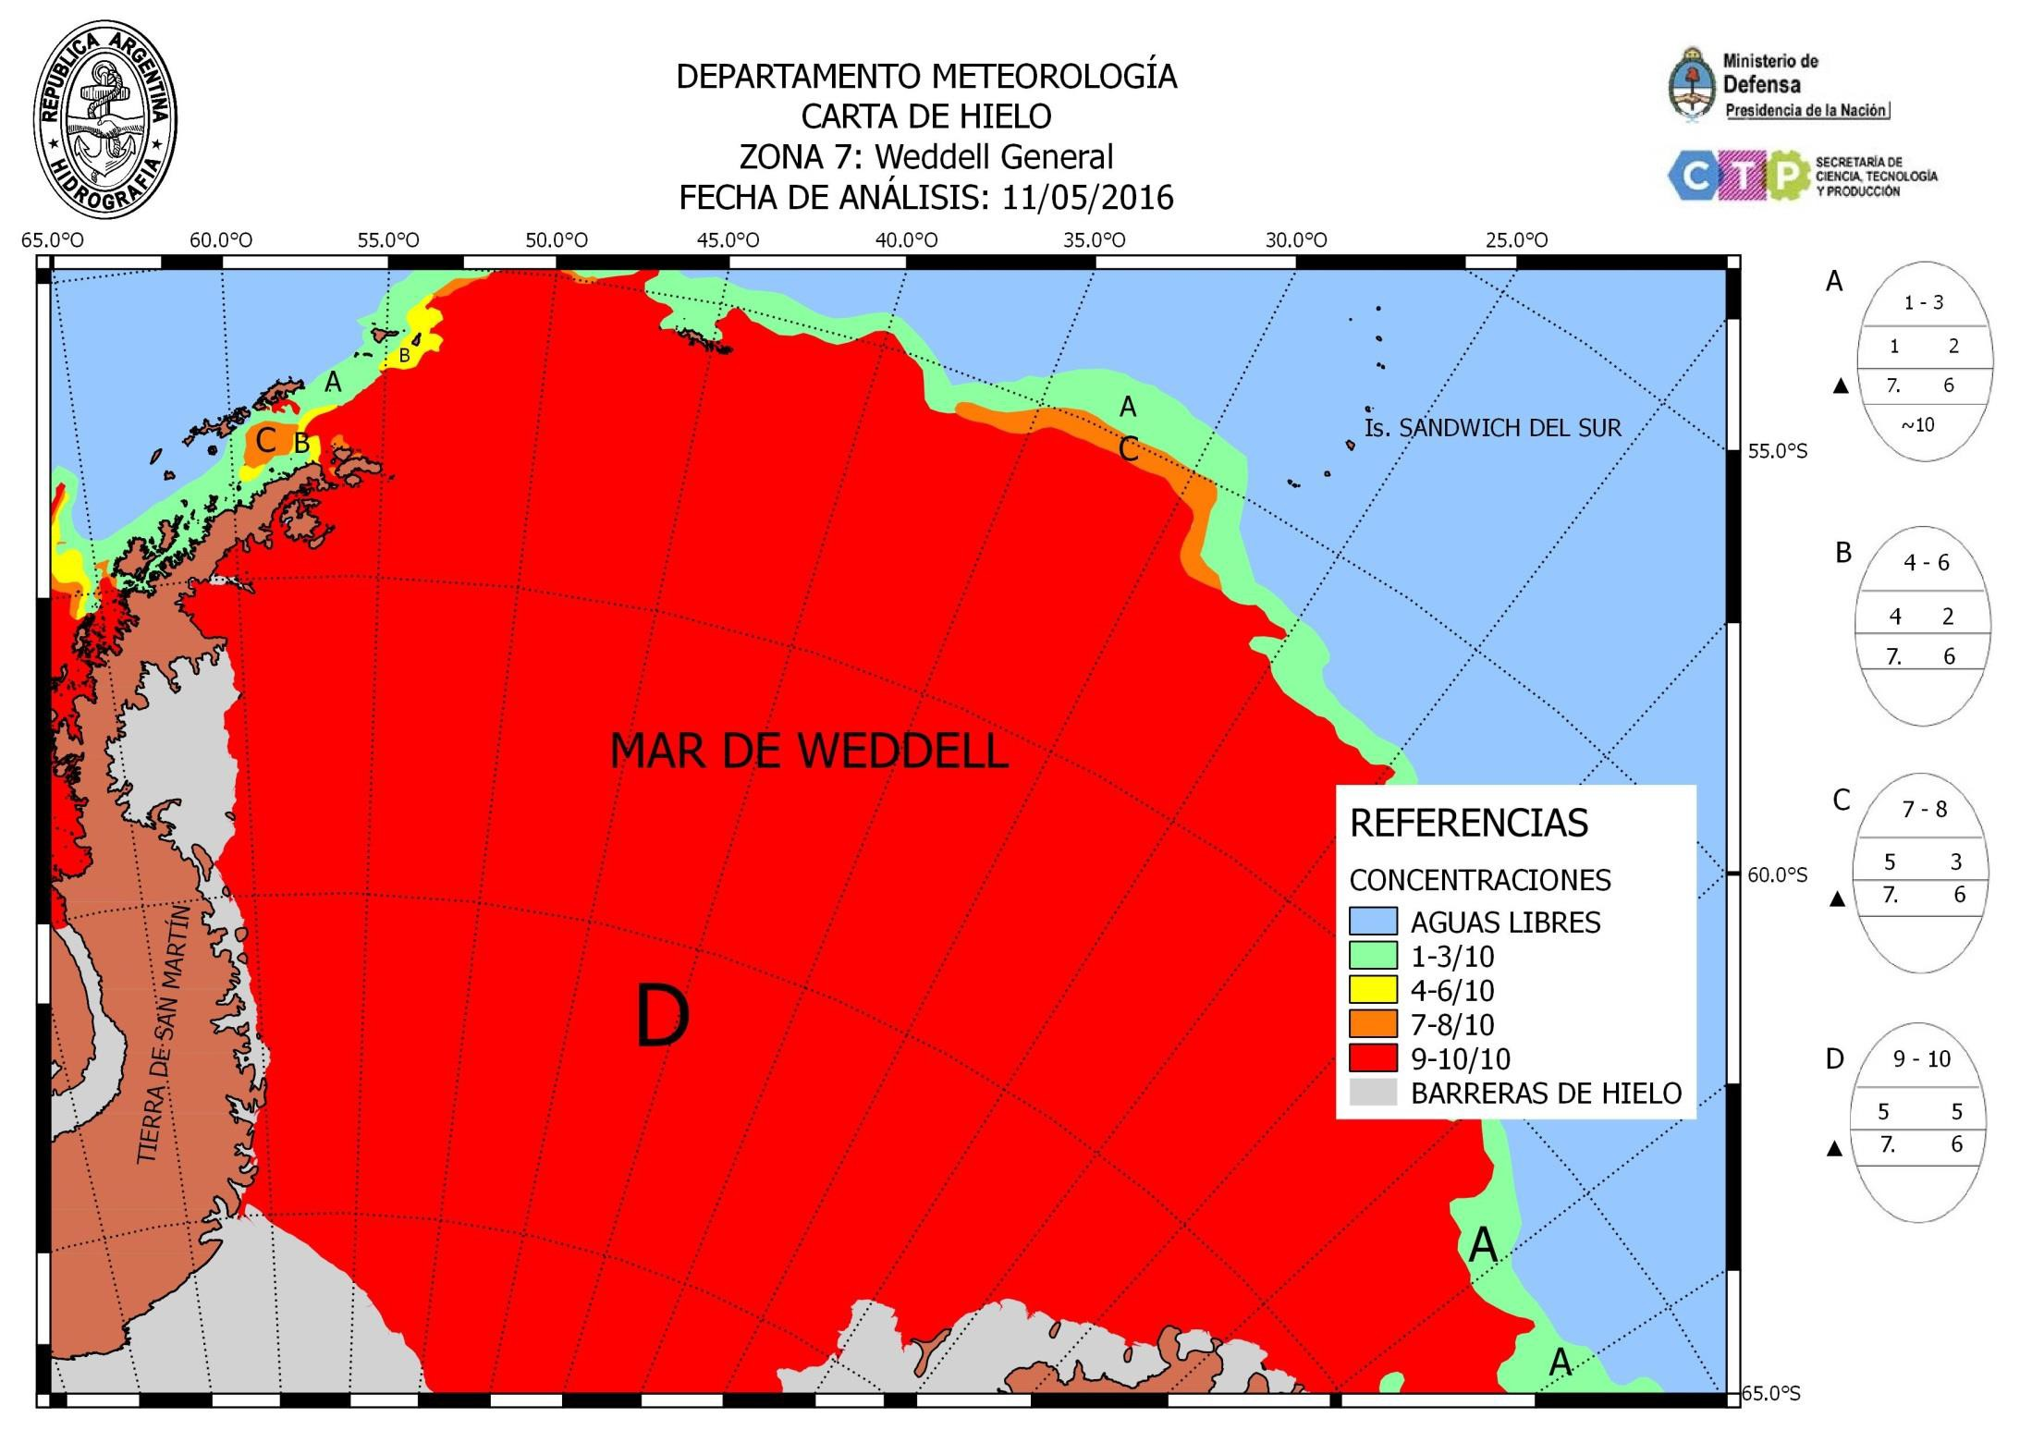
5th INTERNATIONAL ICE ANALYST WORKSHOP

Slide 16
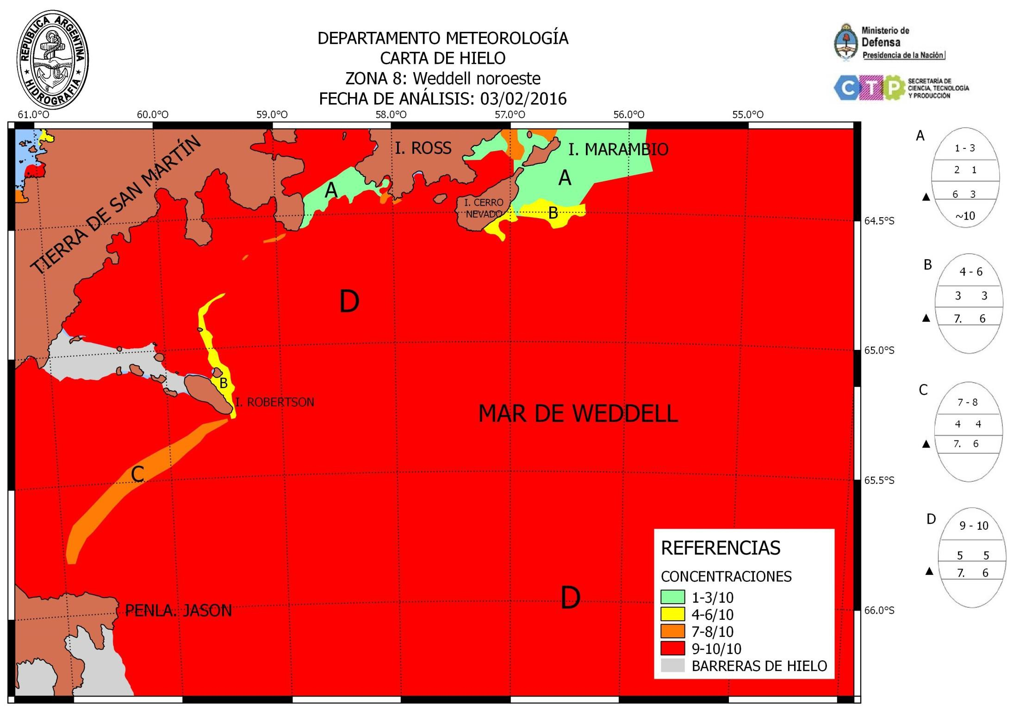
5th INTERNATIONAL ICE ANALYST WORKSHOP

Slide 17
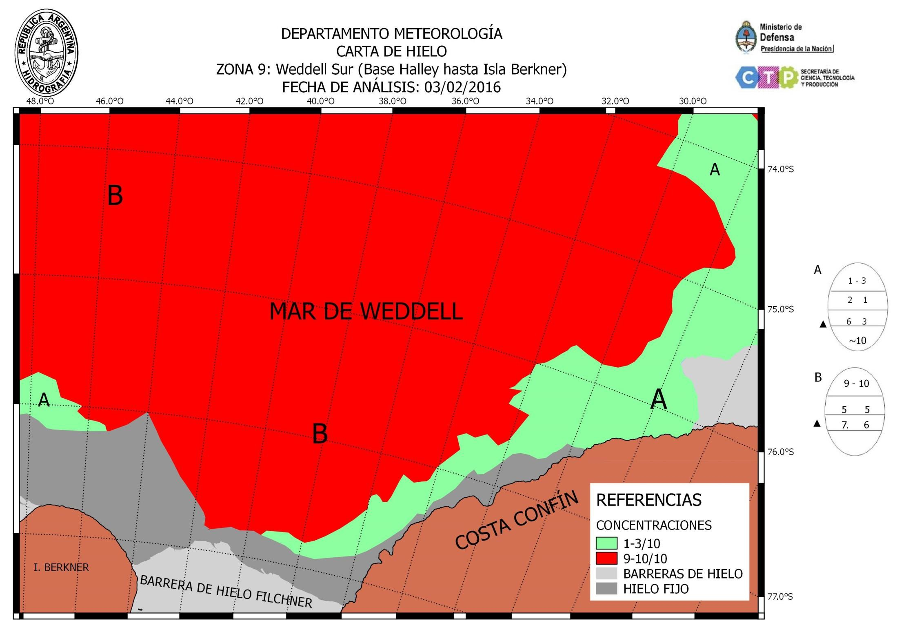
5th INTERNATIONAL ICE ANALYST WORKSHOP

Slide 18
5th INTERNATIONAL ICE ANALYST WORKSHOP
Sea Ice Edge Charts
www.hidro.gob.ar

Slide 19
5th INTERNATIONAL ICE ANALYST WORKSHOP

Slide 20
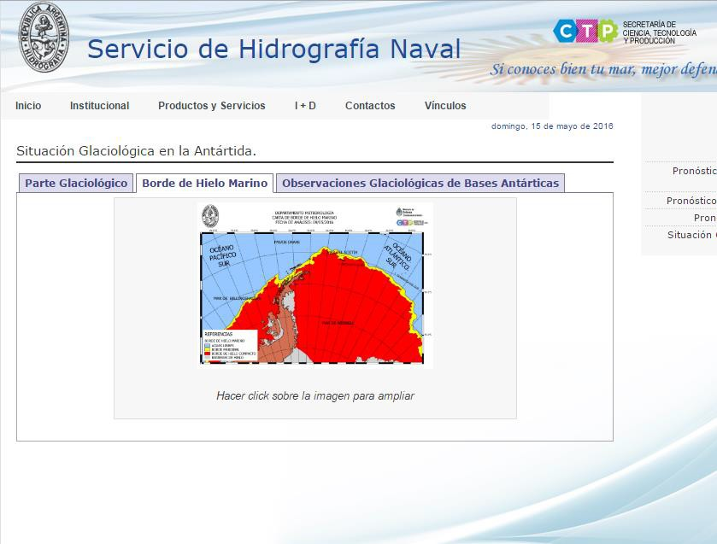
5th INTERNATIONAL ICE ANALYST WORKSHOP

Slide 21
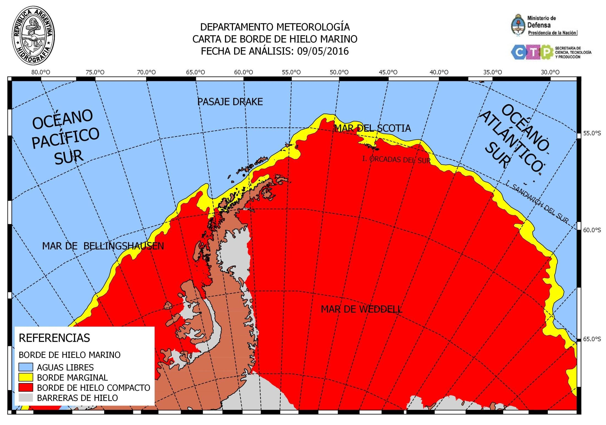
5th INTERNATIONAL ICE ANALYST WORKSHOP

Slide 22
5th INTERNATIONAL ICE ANALYST WORKSHOP
Icebergs Charts
www.hidro.gob.ar

Slide 23
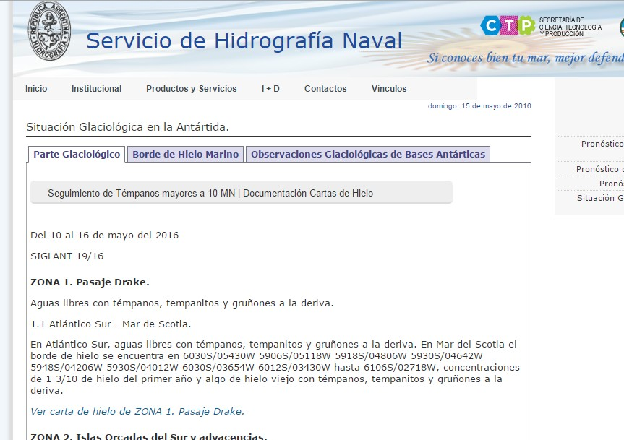

Slide 24


















DEPARTAMENTO METEOROLOGiA SEGUIM!EtlTO DE TEMPANOS MA¥0RES A 10 MN
FECHA DE ANAus!S: 09/05/2016
6
DEPARTllMENTO METEOROLOG A SEGUIMIENTO DE TEMPANOS MiiYORES A 10 MN
-­
GD
lO.O'O
==-
FECHA DE ANAuS S: 01102/2016
......
·-
.....
'°·"°
JSQOC
,.....
......
lC.O'C
l!O'C
REFERENCIAS
I
I
..
...
\
,
-
•
•
B15X
AS6
1.,,_,,.,
•
•
I
...
,_
,,
- CORRlEtlTES MARINAS (OlRECOCN/ INTENSIDAD)
' '
-
httpo:/.lhycom.org
•
, ,
......... -.;.__
-
..
> 15.SANDWIC DEL SUR ...
....
IS GEORGL\$ DEL SUR
\
- ..
-
--
"" I
-"'
/ "
..
...
·" IS. GEORGIAS DEL SUR
'
MAR DEL SCOTIA
\
'
⁻ ,,
,
....
SJ.O"S
1
·-
'MAR,DEL SCOTIA
,,./'.
,1'> 'i.6Nl"M'ICH Off '1JR
...
IS. ORCAD.\S DEL SUR
, -
\
, , , ,
,
REFERENC!AS
- CORIENTES MARINAS
e BlSR
e Bl SX
I!>. OKc.AU tL K
55.0"S
•
,
..
•A56
e TEMPAAOS MENORES A 10 f"N
,.
DEPARTAMENTO METEOROLOGiA
SEGUIM!ENTO DE TEMPANOS MAYORES A 10 MN
FEOiA DE ANAl..JSIS: 14 03/2016
DEPARTAMENTO METEOROLOGiA
SEGU MIENTO DE TIMPANOS MAYORES A 10 MN FECHA DE ANAUSIS: 04/04/2016
1s.ro
..,_,..,
..·
25.0'0
......
"·"°
2S.OCO
REFERENC!AS
e A56
e BJSR
e BlSX
e TEMPANDS MENORES A J 0 MN
- CORRIElfftS MARINAS
-- AREA DE TEMPANDS OISGREGADOS
/
•
•
.IS.₋GEORGlAS DEL SUR
.· \
IS. GEORGIAS DEL Stn
•
MAR DEL SCOTIA
SO.D'S
I
·-
15.SAHDIVICH DEL SUR
MAR DEL SCOTIA
REFERENC!AS
e B15X
AS6
e B15R
•
IS. ORCAOAS
......
TE'1PANOS MENOnES A 10 MN
•
- CORRIENTES MARINAS

Slide 25


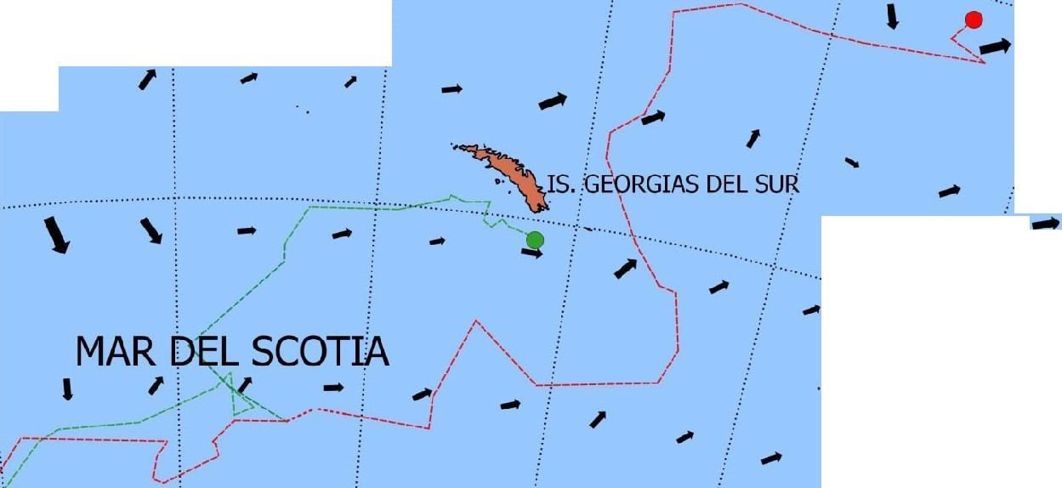

DEPARTAMENTO METEOROLOGIA SEGUIMIENTO DE TEMPANOS MAYORES A 10 MN
FECHA DE ANALISIS: 09/ 05/ 2016
Ministsrio de
Defensa
Prosldencia de la HildenI
StCRETARIADE
CIEHC14. rtCNOlOGI>.
y PflOOUCCIOtl
45.0°0
40.0°0
.......
35.0°0
30.0°0
2s.0°0
20.0°0
REFERENCIAS
l
I
\
,
···...:.. •.
...
e BlSX
e A56
_,. CORRIENTES MARINAS
(DIRECCION/ NTENSIDAD)
I
4s.0°s
''"·?·"···················· ······.........: .
...
······
'
' -
..... .
https:// hycom.org
....
,
- I i
. ·i..
....
...
\
...
'):"·.
..... _. ...
'
so.o•s
....
-
...
•
··..;
....
··..
.:.:....'•.
...
>IS/SANDWICH DEL SdR
...
·.... :/·.... .
· ·-··•"'"'*"'''''''''' •. ···"':' '"'"'"'''"'.... .........:......
, , ,
I i
.. ...........
...
, · I: \
,.
,. .·.:.. . ..
·······. ....
. ;
_,, ..../"·
..........
ss.o•s
IS. ORCADAS DEL SUR .!
....
...
.
i
.
,: -
i ..
,:
.....

Slide 26
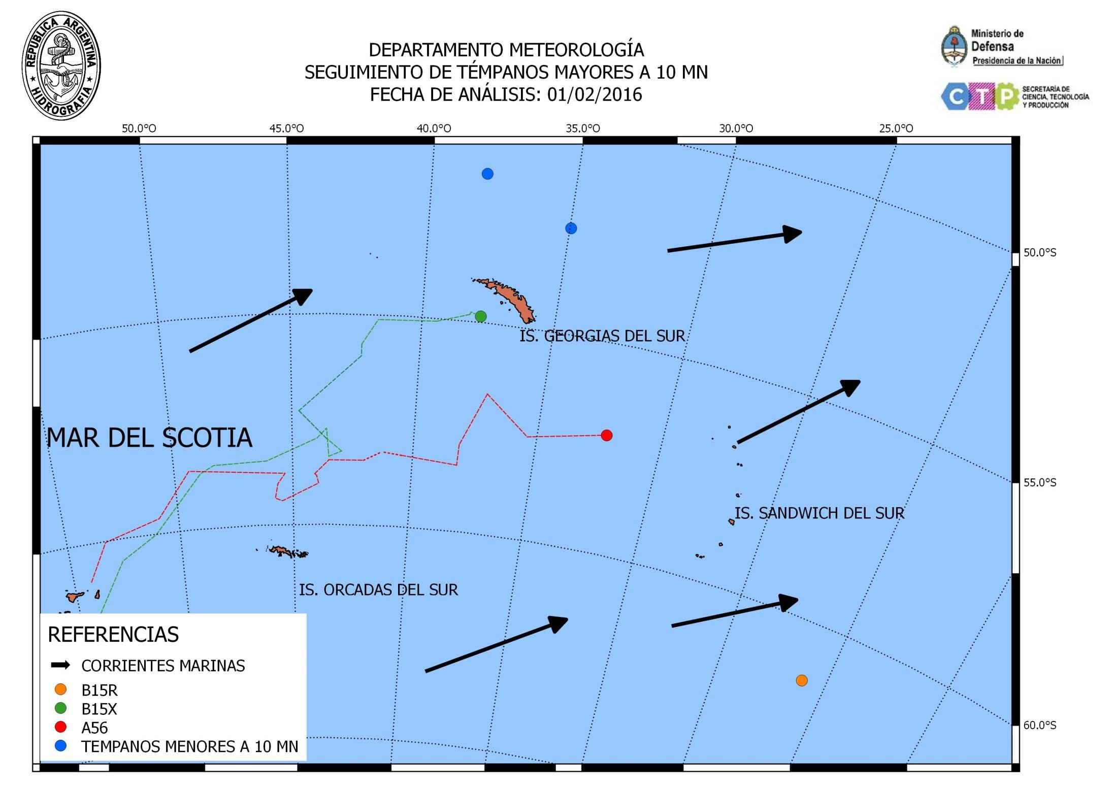

Slide 27
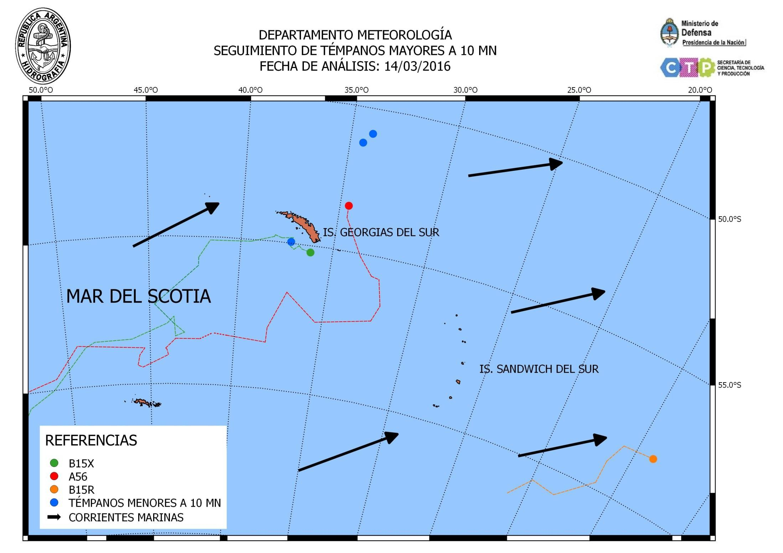

Slide 28
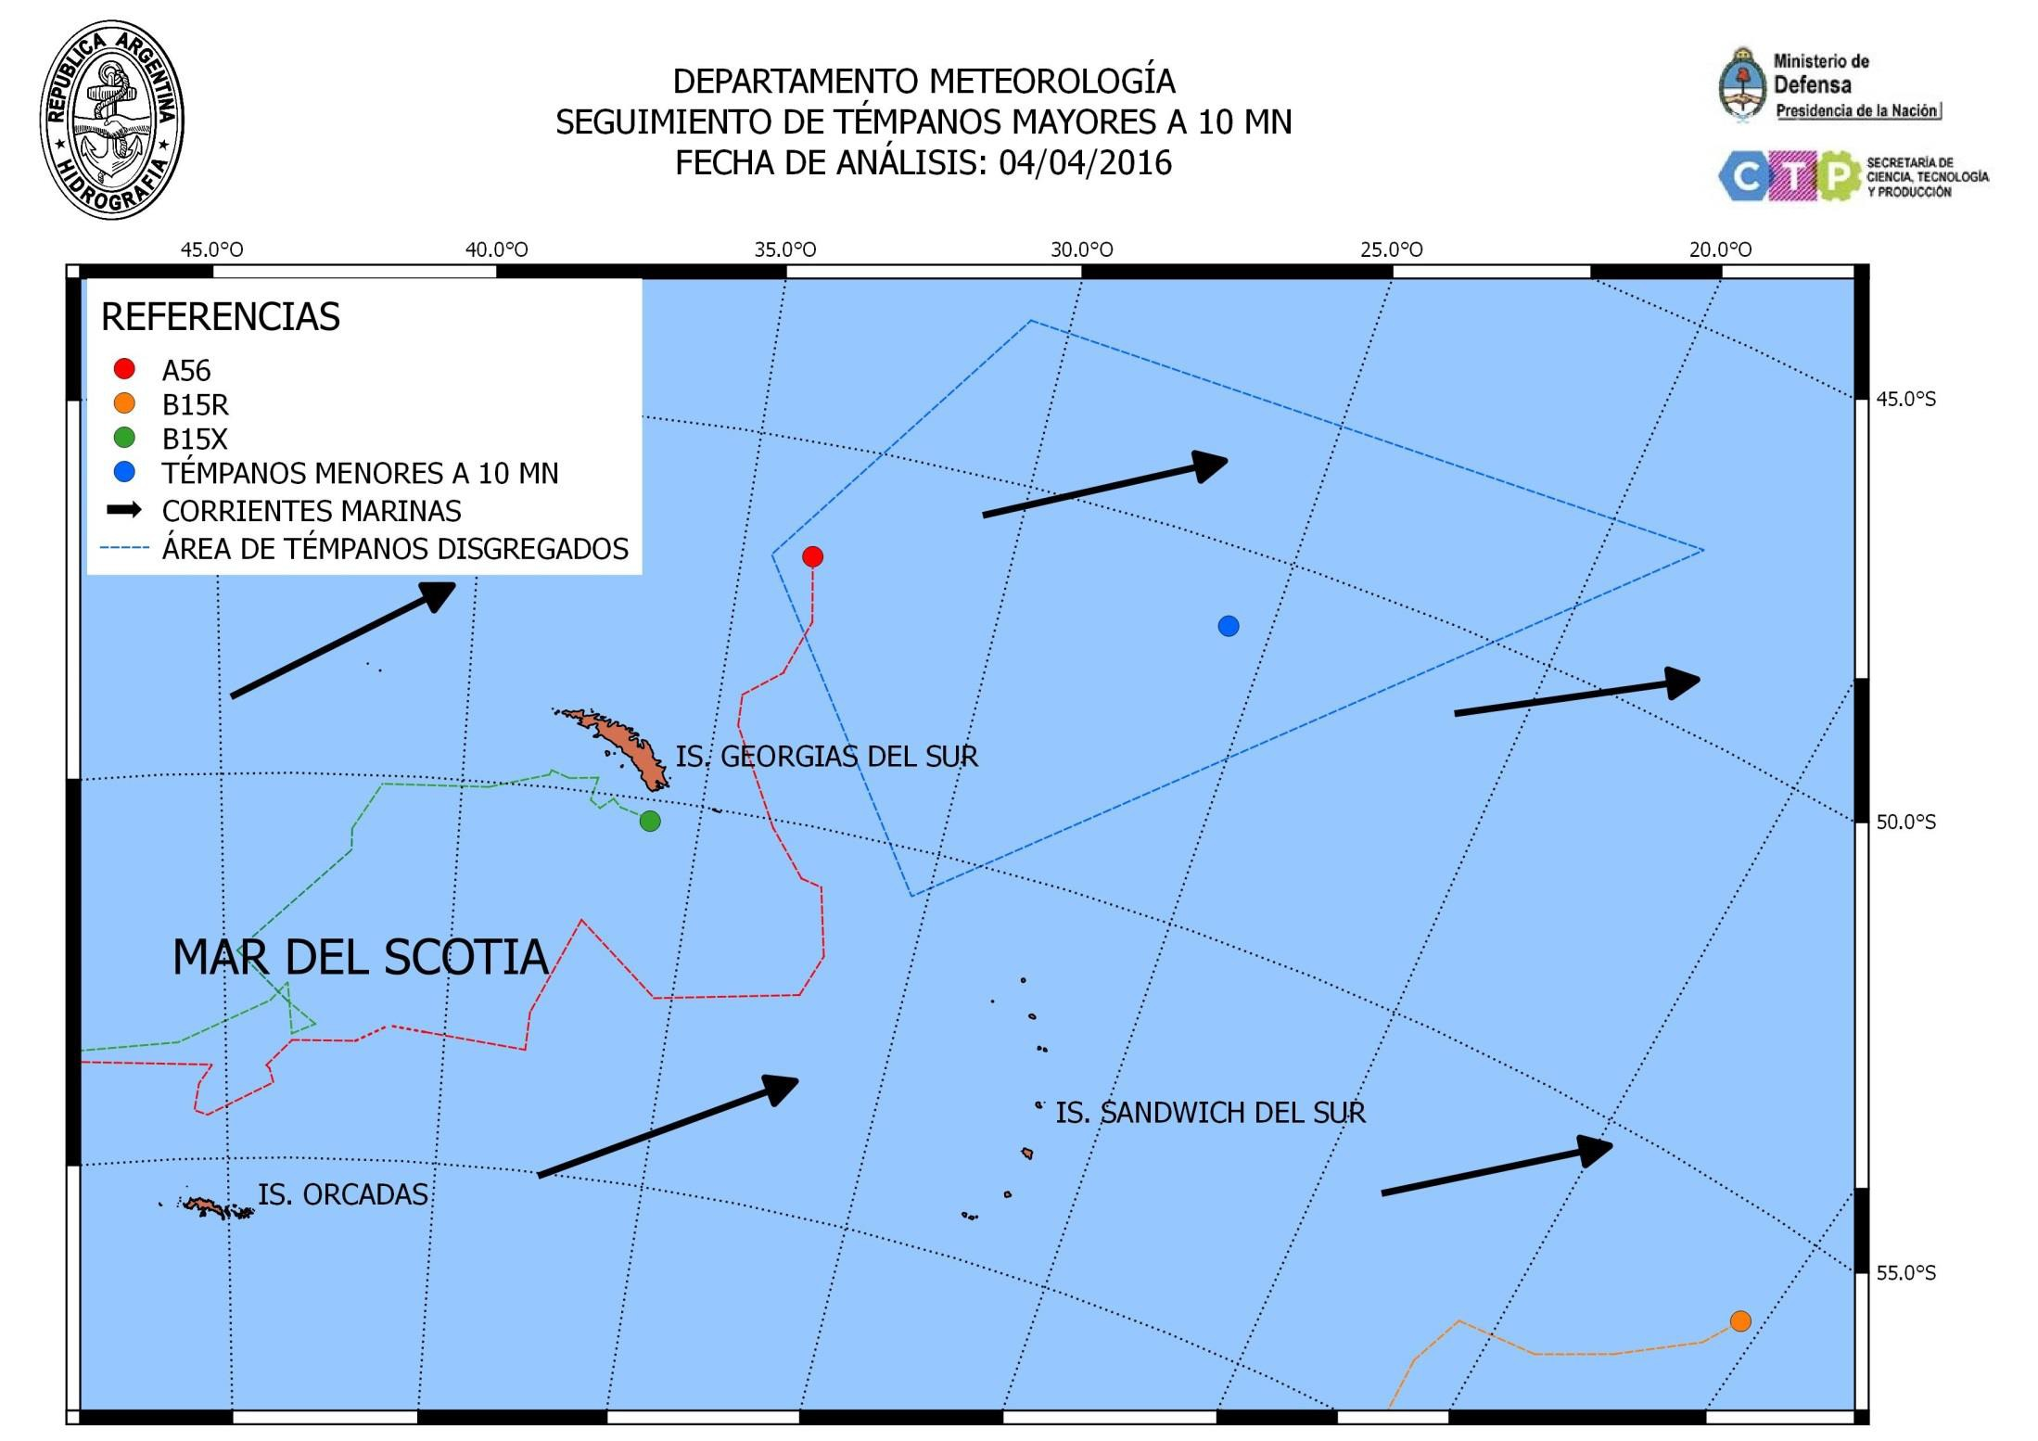

Slide 29
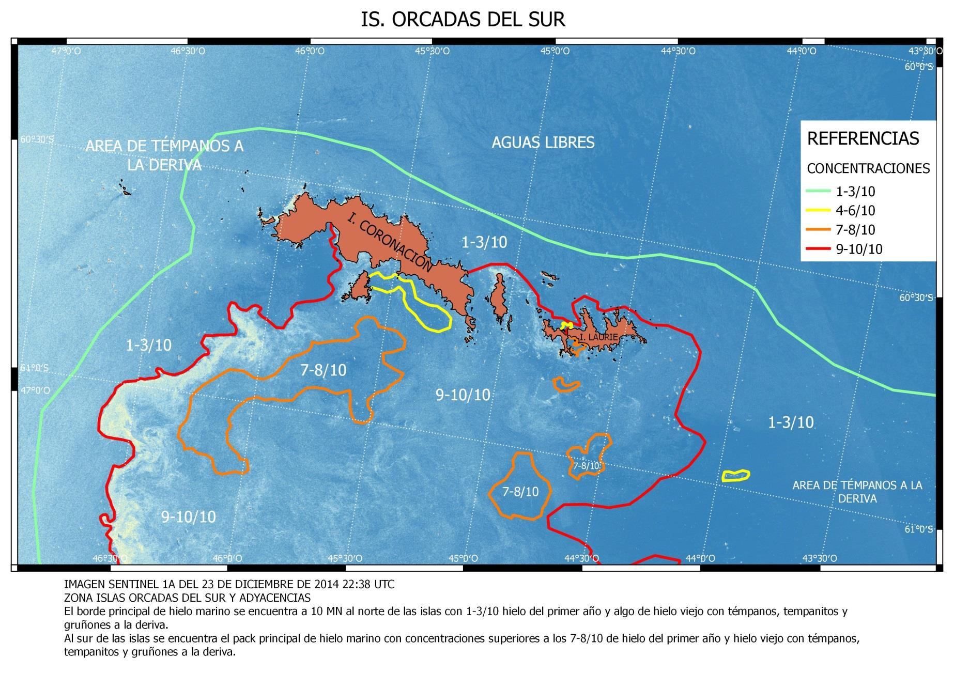
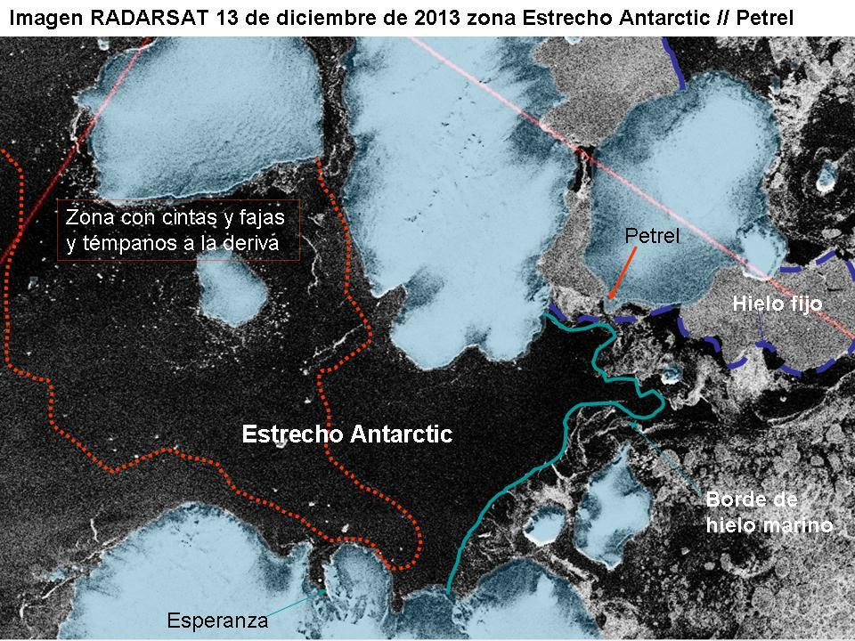
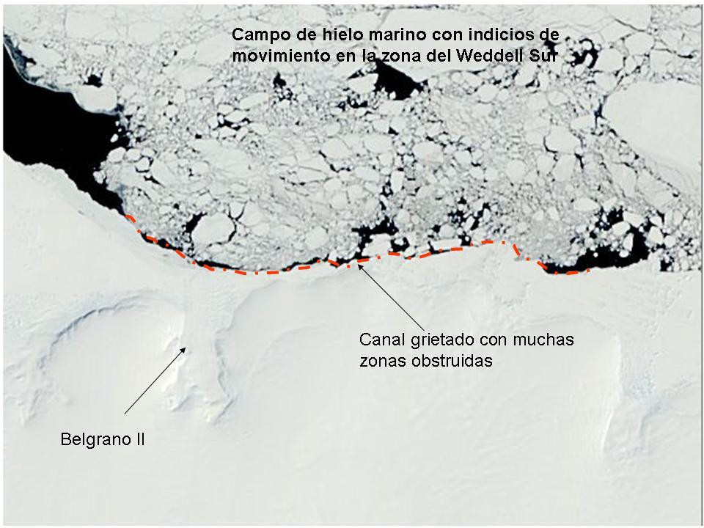
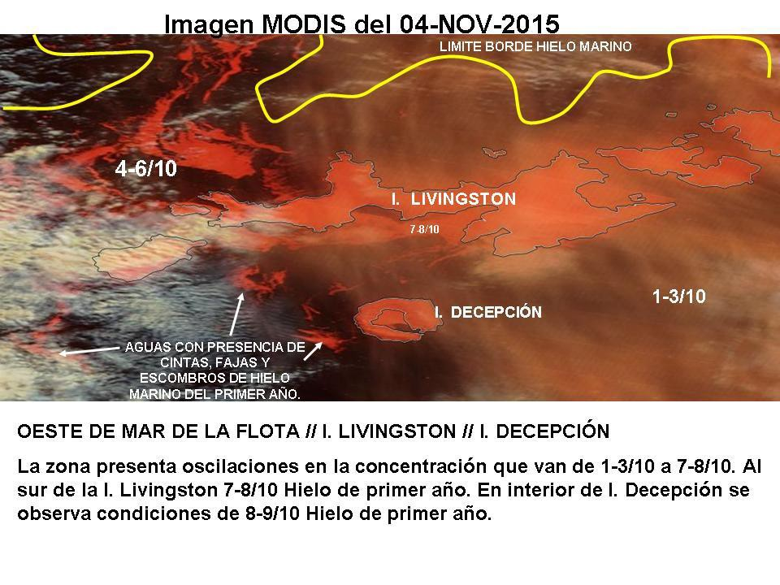
5th INTERNATIONAL ICE ANALYST WORKSHOP
Analysis for Navy Ships

Slide 30
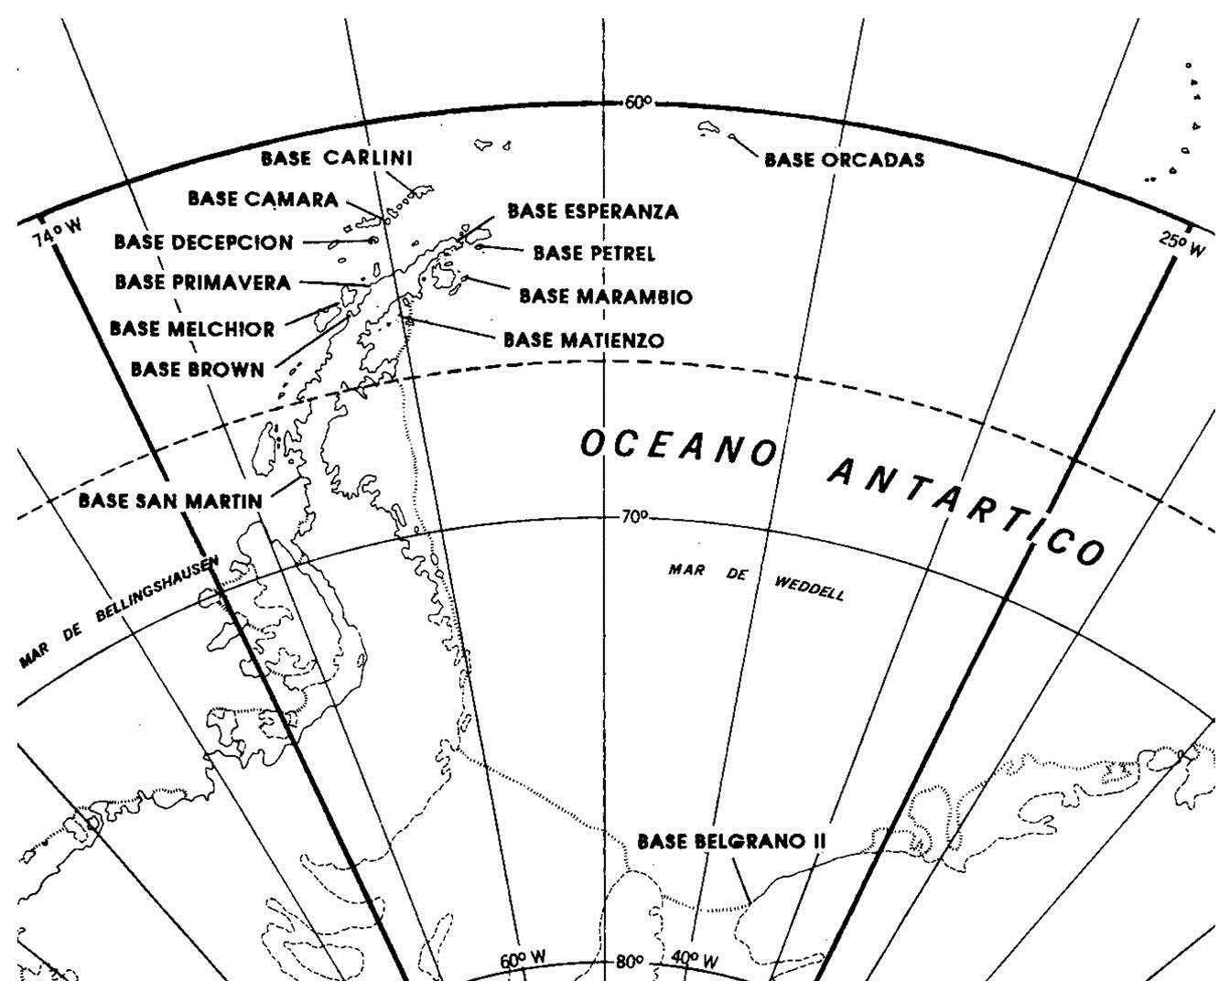
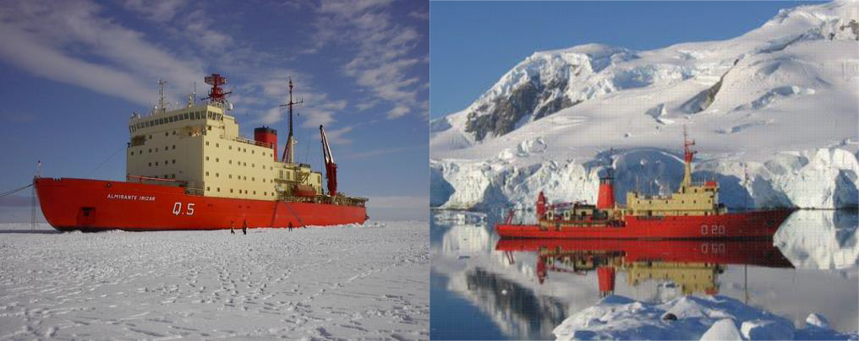
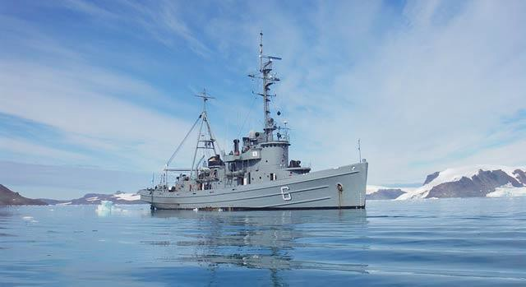
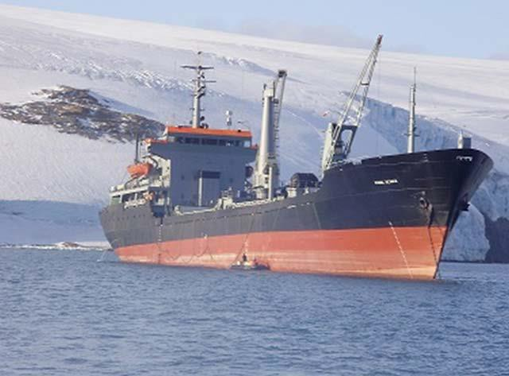
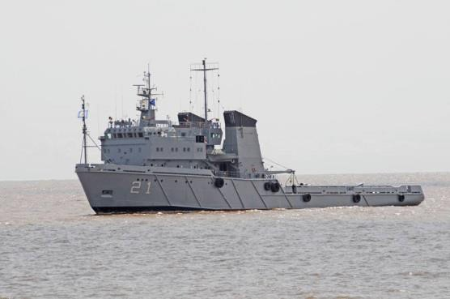
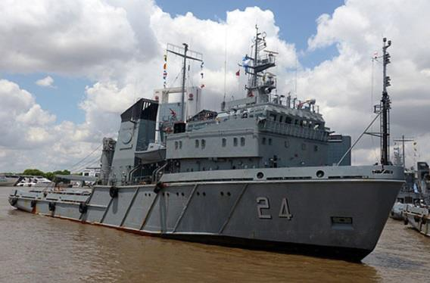
5th INTERNATIONAL ICE ANALYST WORKSHOP
Ice Observations
Every six hour, coded information.
Twice a week, and if
required.

Slide 31
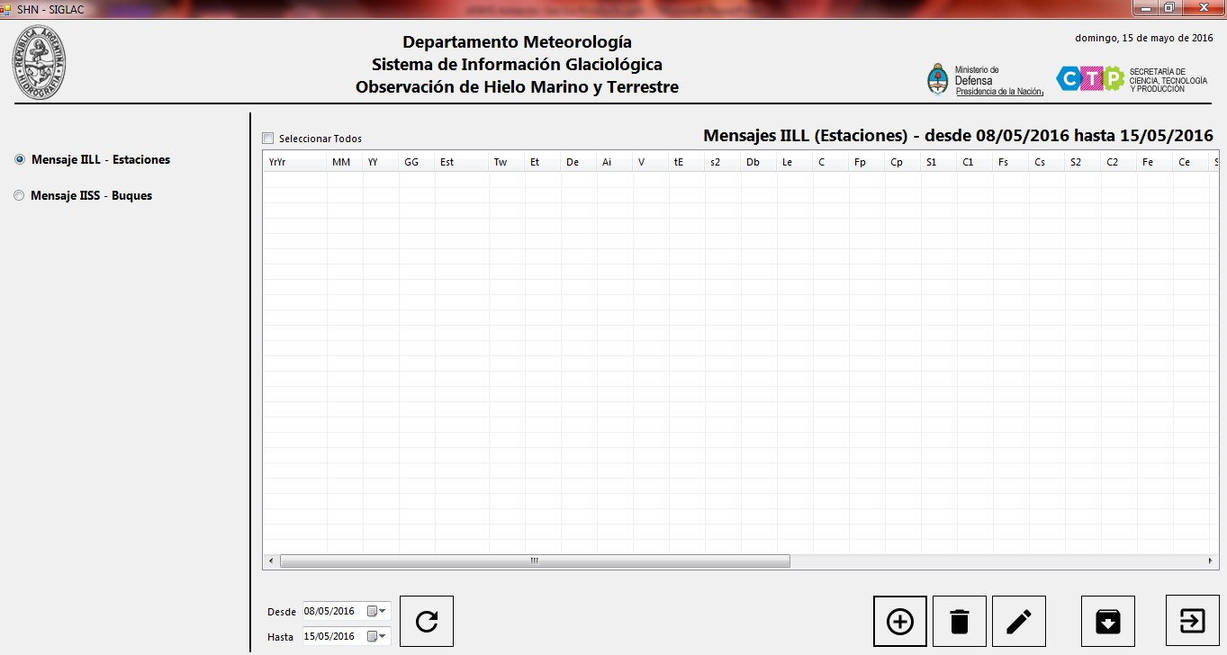
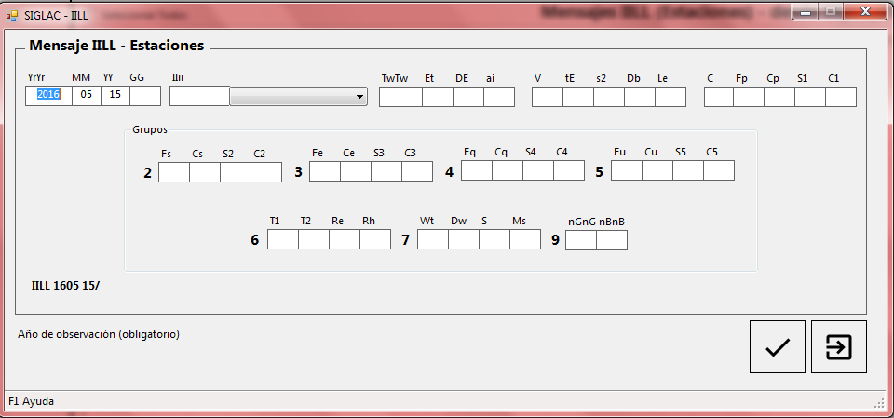
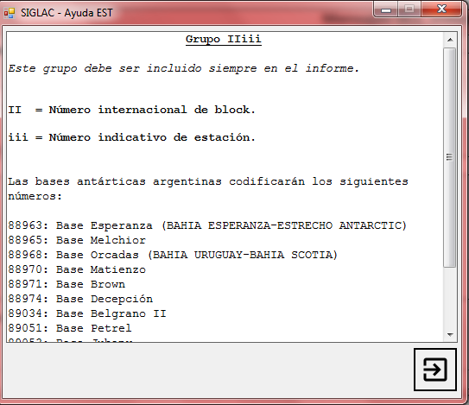
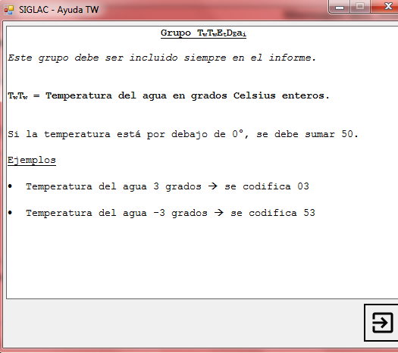
5th INTERNATIONAL ICE ANALYST WORKSHOP
SIGLAC

Slide 32
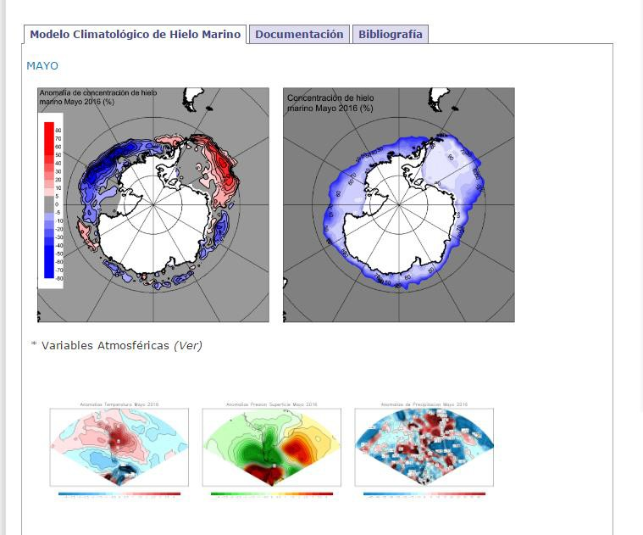
5th INTERNATIONAL ICE ANALYST WORKSHOP
Sea Ice Model…
Next Wednesday… Stay tune!!!

Slide 33
5th INTERNATIONAL ICE ANALYST WORKSHOP
Conclusions and challenges
Ice and Icebergs Charts have been of a great improvement in this last summer season in Antartica. The possiblity of deliver these through our web page gave us a very good feedback with research and tourist vessels.
By counting with our own Navy Ships and Bases, give us a lot of in site information about ice conditions and presence of growlers and small icebergs.
Exploratory flights are very usefull, but we don’t have as many as we need or want.
Having a forecast model for iceberg drift in Antartic will be of a great improvement.
There is a huge limitation in the aquisition of SAR images (frequency and quantity). And it doesn’t look is getting any better…
SIGRID 3 code needs to be included in our Ice Charts.
We are still working in having the Ice Charts in the S-411 formats...

Slide 34


5th INTERNATIONAL ICE ANALYST WORKSHOP
Servicio de Hidrografía Naval
www.hidro.gob.ar
1879 – June, 6th – 2016
«137 years accomplishing the mission of providing the public service of Safety at Sea in the Argentine Sea»
¡¡¡Thank you very much
for your atention!!!

