Slide 1




Towards Coordinated and Collaborative
Antarctic Sea-Ice Service Delivery
Jan L Lieser, PhD

Slide 2

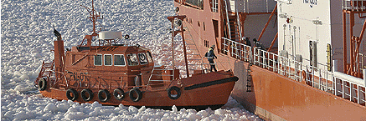
Outline
Sea-Ice Service requirements and competence;
Australian sea-ice advice;
The way ahead.
Image: Ice Advisors Oy
Notes:
The talk outlines the requirements for a sea-ice service, and I will talk about a proposed competency standard for maritime ice analysts and consultants;
This will be followed by a brief overview of Australian sea-ice advice in terms of images and words;
I’ll conclude with a funding proposal for a sustainable and reliable service delivery.

Slide 3
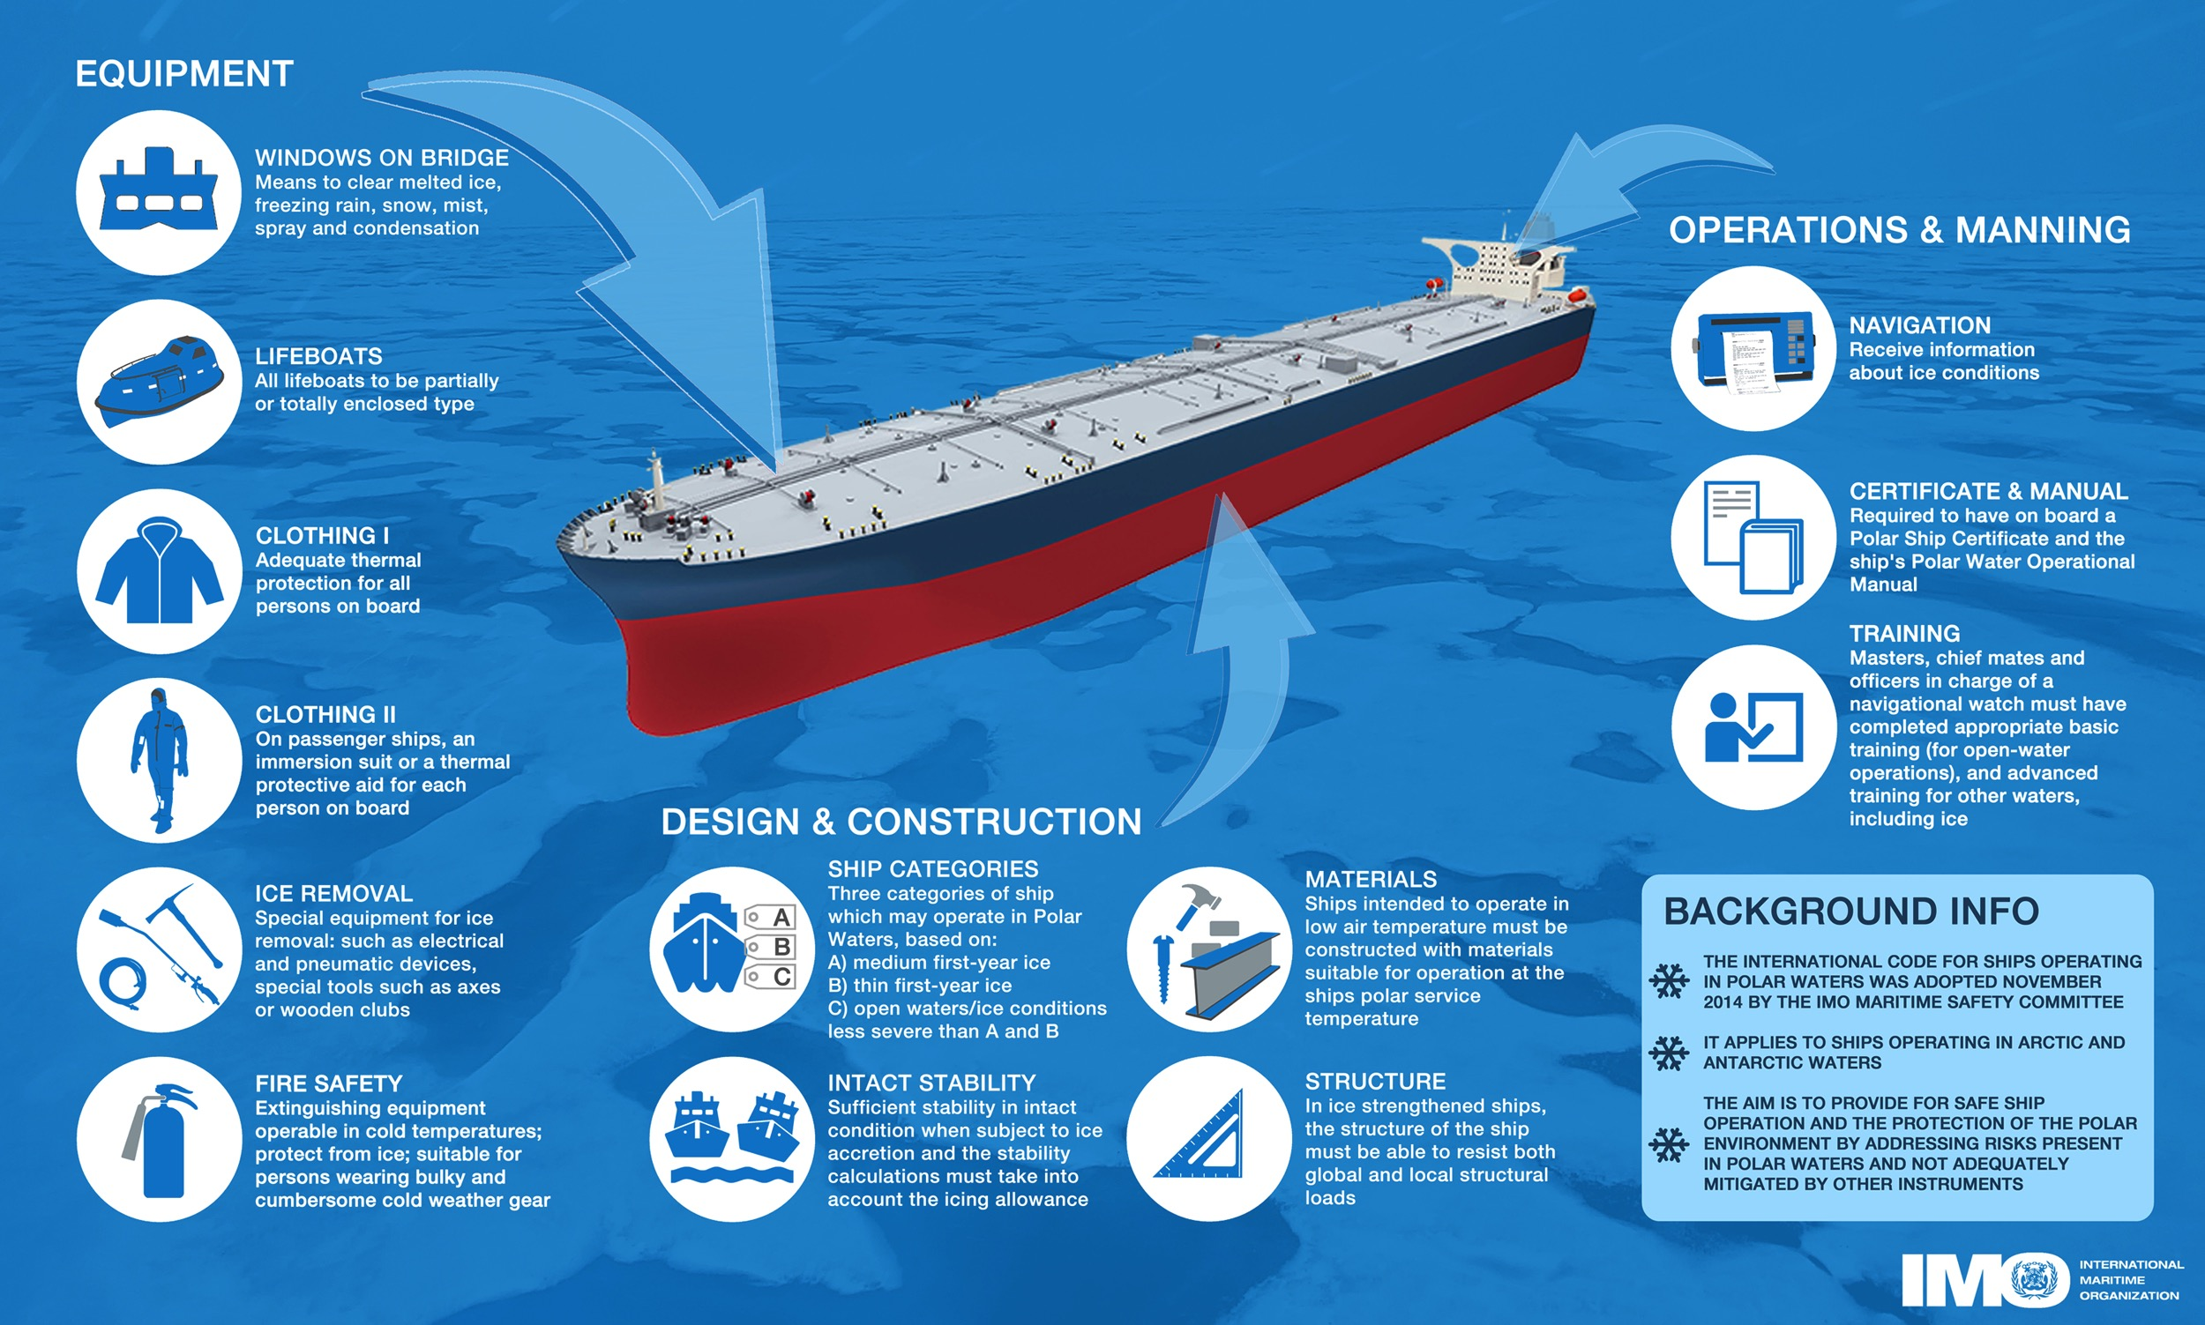
IMO’s Polar Code (1 Jan. 2017)
Notes:
Polar Code has been ratified by the International Maritime Organisation and will come into effect on 01 Jan. 2017.
We may not be concerned with equipment or design and construction, but we can contribute to operations and manning, when we provide navigational aids (for example: satellite data, charts and maps, or bulletins and reports) and offer training to sea-going officers and crew.

Slide 4
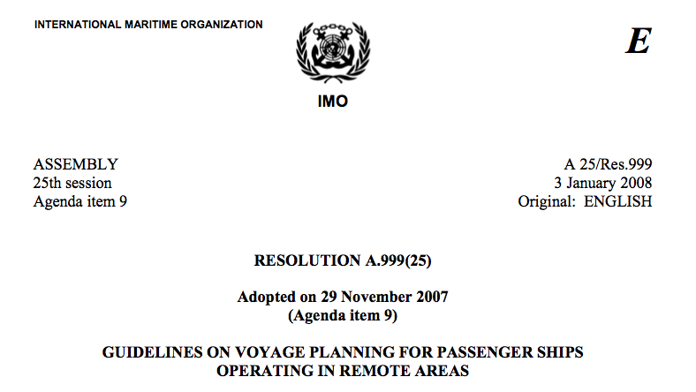
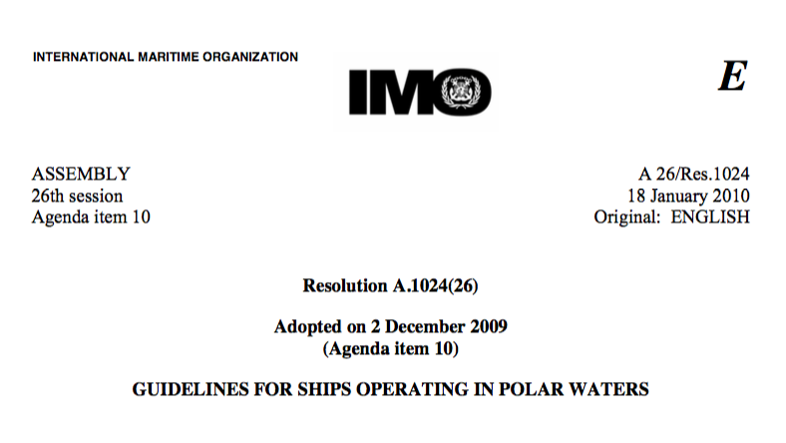
IMO’s Guidelines
Resolutions A.999(25) and A.1024(26)
Knowledge of sea-ice formations;
Current information on extent, type, icebergs;
Historical analysis;
Operational limitations;
Availability and use of Ice Navigators;
Ice routing equipment (charts & imagery)
Notes:
IMO has issued guidelines on their minimum requirements for sea-ice navigation.

Slide 5
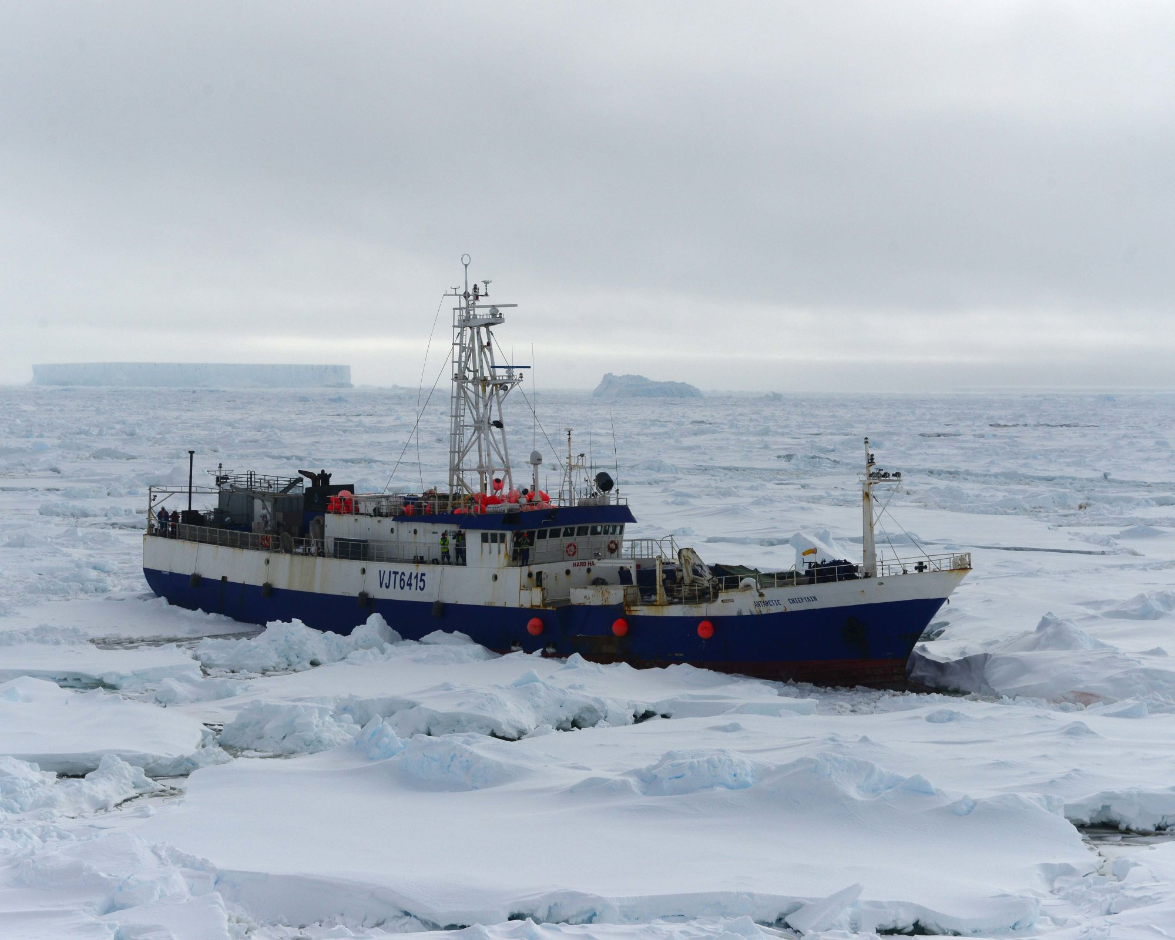
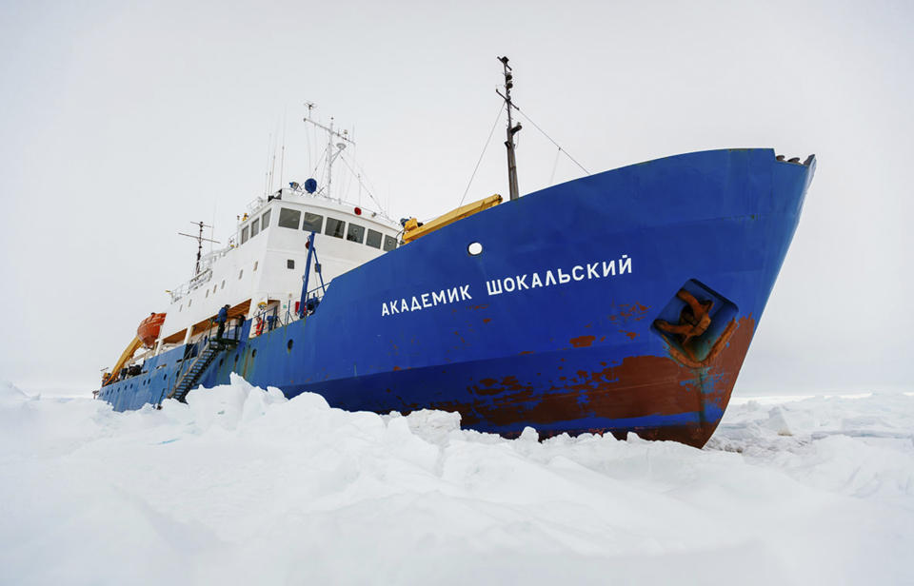
Recent near misses
13/02/2015
24/12/2013
Image: US Coast Guard
Image: Huffingtonpost.com
Notes:
Two near misses of commercial operators highlight the need for readily available and accessible sea-ice advice. There have been other incidents before and it is not limited to tourist/fishing vessels that difficult conditions are encountered.

Slide 6
ETSI common ground
Notes:
This list shows the common ground from which the sea-ice consultants community starts off when preparing analysis charts and delivering advice to ice-going vessels, namely:
Nomenclature for terminology and symbology;
SIGIRD-3;
Ice chart colour code standard; and
S-411 ice information product specification.
Plus:
Manual on Marine Meteorological Services (WMO-No. 558: http://www.jcomm.info/558);
Manual on the WMO Integrated Global Observing System

Slide 7
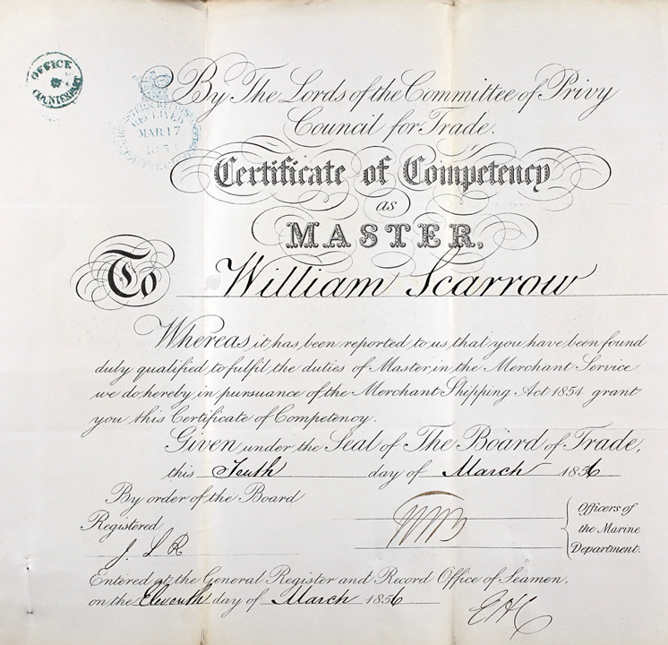
Quality management system
Qualification vs. Competency:
Competency expires.
Elements of competency:
Application of skills and knowledge;
Measurable performance criteria;
Training material and assessment tools.

Slide 8

Competency standards
Create/Agree on Analyst Competency Standards:
Establish best practice and sustainability;
Avoid multiple overlap of service;
Avoid inconsistent minimum standard of service.

Slide 9
Competency standards
WMO Aviation top level competencies:
Analyse and monitor;
Forecast;
Warn of hazards;
Ensure quality;
Communicate efficiently.
Forecast
Warn
Competent
Analyst
Analyse
Check
Communicate

Slide 10
Antarctic weather service delivery
Purpose: To provide information for safety in navigation through polar (ice covered) areas.
available
and timely
dependable
and reliable
authentic
responsive
and flexible
Service
Delivery
credible
usable
useful
sustainable
expandable
The WMO strategy for Service Delivery and it's implementation
Notes:
Does your service provider meet these criteria?

Slide 11
AUS 20 year strategic plan
Recommendation 27 (of 35):
[…]
Maritime skills training (including operations in sea ice);
Antarctic meteorological services, weather forecasting, and provision of sea ice assessments for shipping;
[…]
Notes:
The Australian Antarctic Division of the Department of the Environment, in consultation with other agencies, should explore opportunities to establish partnerships with the State, other organisations, and industry in Antarctic related activities, including:
• The provision of training and services in medical and allied health services;
• Maritime skills training (including operations in sea ice);
• Antarctic meteorological services, weather forecasting, and provision of sea ice assessments for shipping;
• Scientific instrument and technology development;
• Antarctic field training and support;
• Training in Antarctic related trades;
• The provision of goods and services; and
• Polar infrastructure research and development.

Slide 12
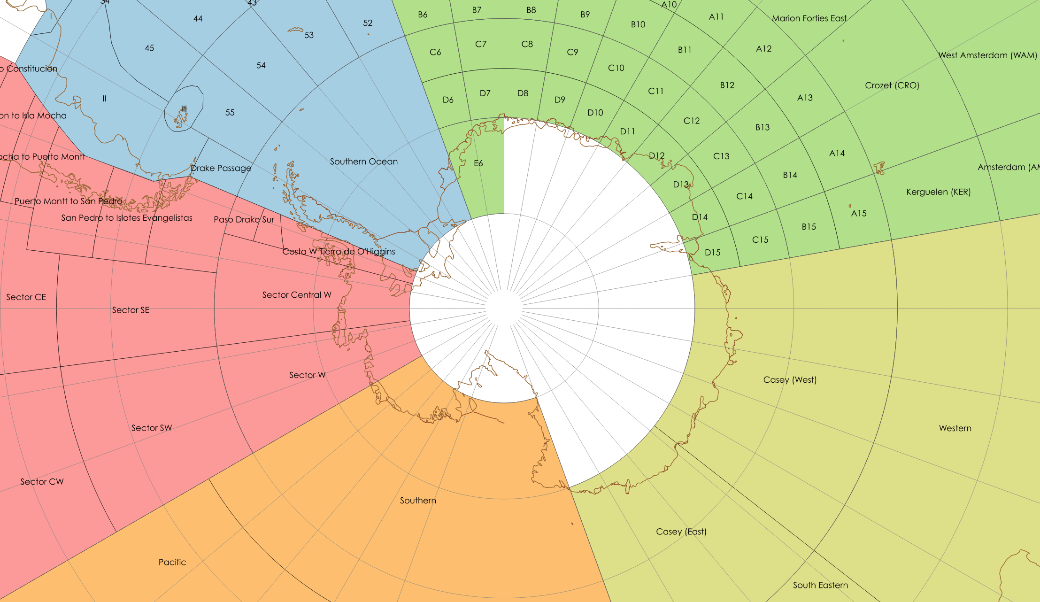

Antarctic METAREAs/NAVAREAs
Notes:
Countries with a responsibility for marine and sea ice services
Hazard information for NAVAREAs

Slide 13





The Antarctic Gateway Partnership
Australian Government funding of AU$24 million over three years for an Antarctic and Southern Ocean science program;
Capacity-building development for Tasmania as a gateway for Antarctic research, education, innovation and logistics;
Partners are
Collaboration with
Australian Research Council's Special Research Initiative for Antarctic Gateway Partnership (Project ID SR140300001)

Slide 14
The Antarctic Gateway Partnership
Key objectives:
Marine technology hub;
Sea-ice charting and forecasting capability;
Research into:
  Antarctic ice sheet loss and sea level rise;
  Marine life in and around Antarctic ice shelves; and
  Sea level since the last major glacial expansion 20,000 years ago.
Notes:
Marine technology hub: design, built and deploy an under-ice AUV

Slide 15
Sea-Ice Service
Purpose | Required information
Sea-ice avoidance | Extent
Sea-ice zone passage | Concentration, thickness, roughness, snow cover, drift; Icebergs
Sea-ice studies | Concentration, thickness, roughness, snow cover, drift; Icebergs
Notes:
Hazard information for ice avoidance
Safe passage planning for though-ice transit

Slide 16
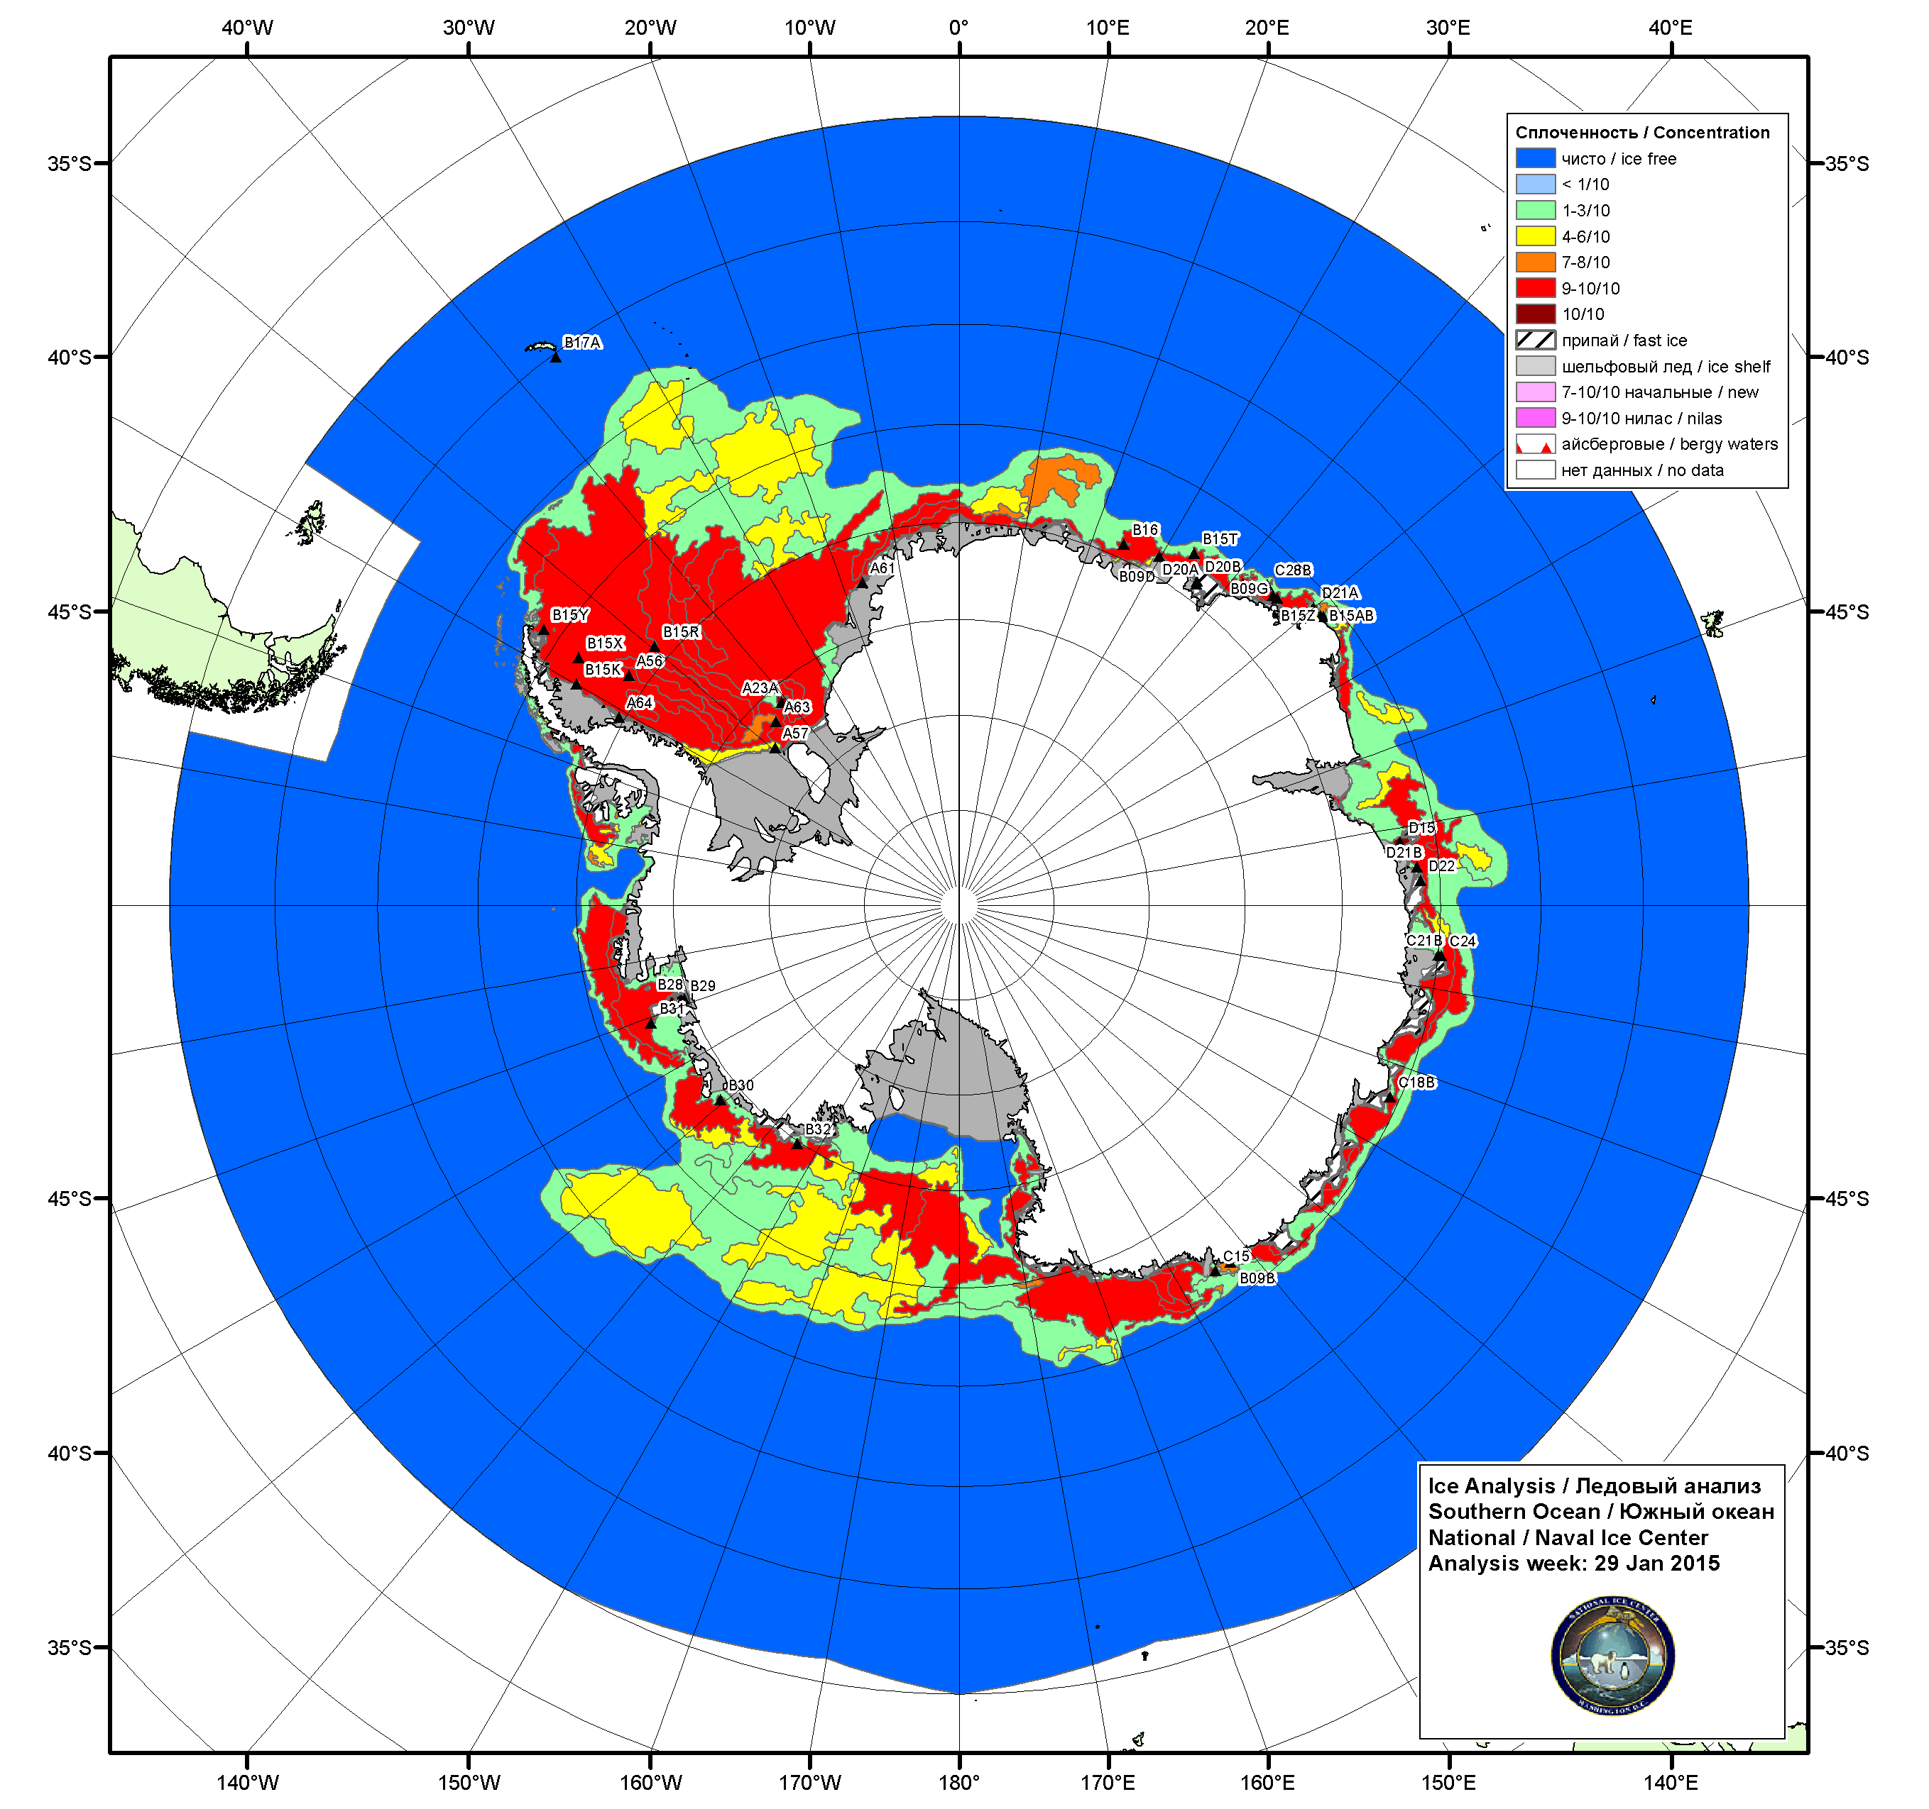
2 Modes of Sea-Ice Service: Charts
NIC 29/01/2015
Notes:
Collaborative effort between the US NIC and the Russian AARI: producing pan-Antarctic maps of sea-ice conditions on alternating weeks, plus Norwegian NIS for the Weddell Sea on Mondays.

Slide 17
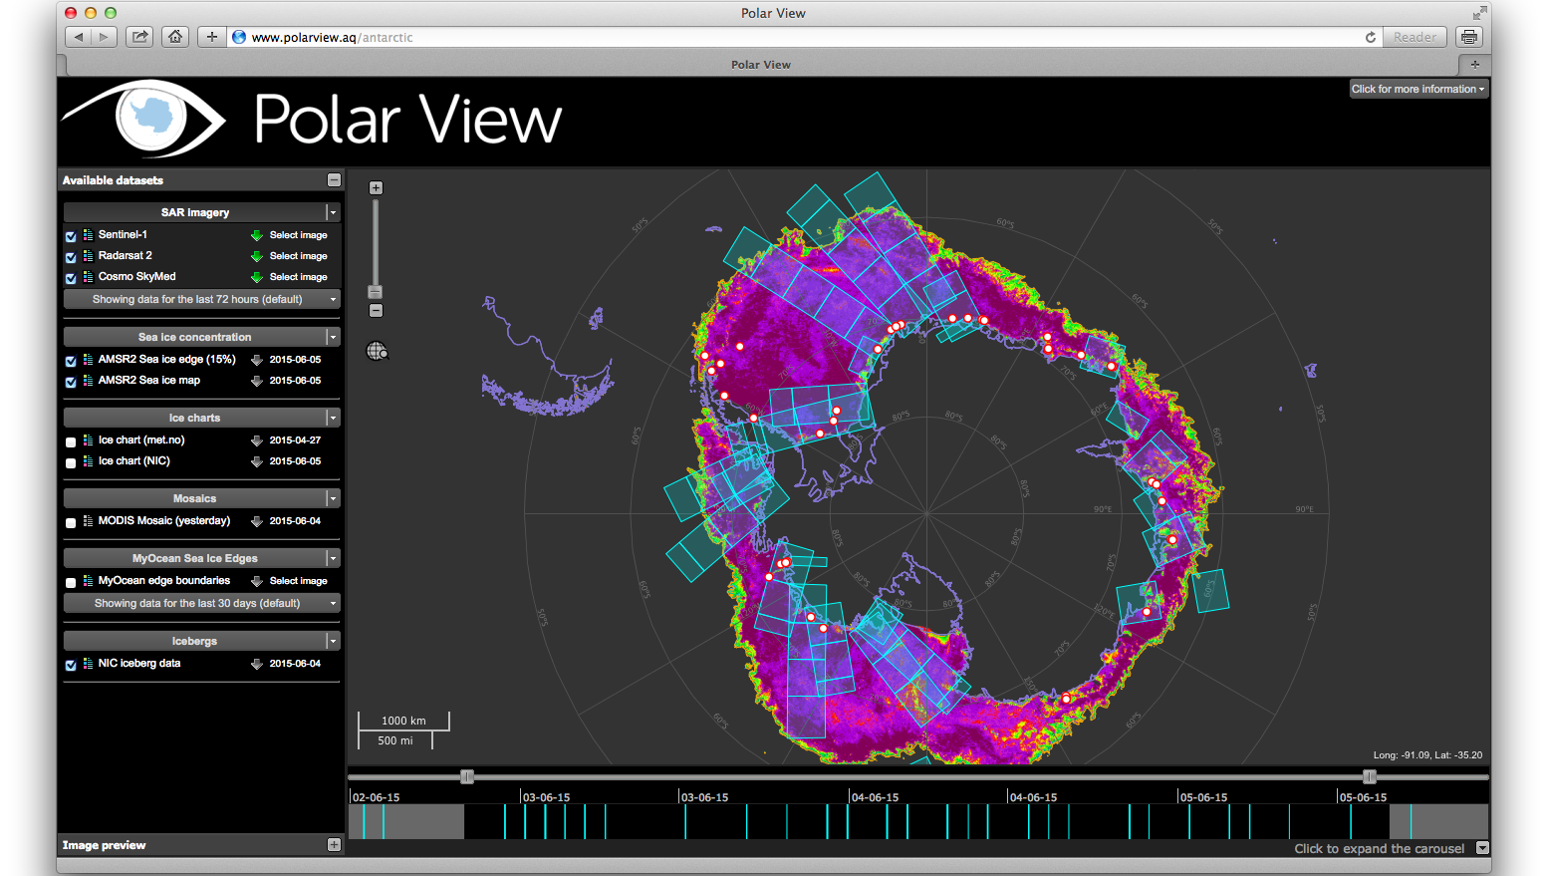
2 Modes of Sea-Ice Service: Charts
Notes:
online delivery of content (pull service) requires internet access by the user/receiver.
Map server type, zoom, pan, focus, select product...
Other services include push-service of remote sensing products in near-real time

Slide 18
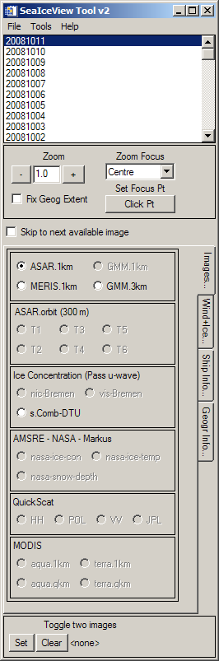
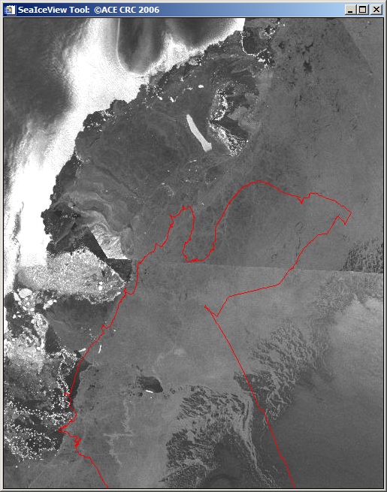
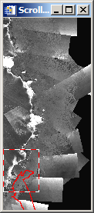
2 Modes of Sea-Ice Service: Charts
Notes:
SeaIceView Tool the front end of our NRT sea-ice data push/pull service

Slide 19

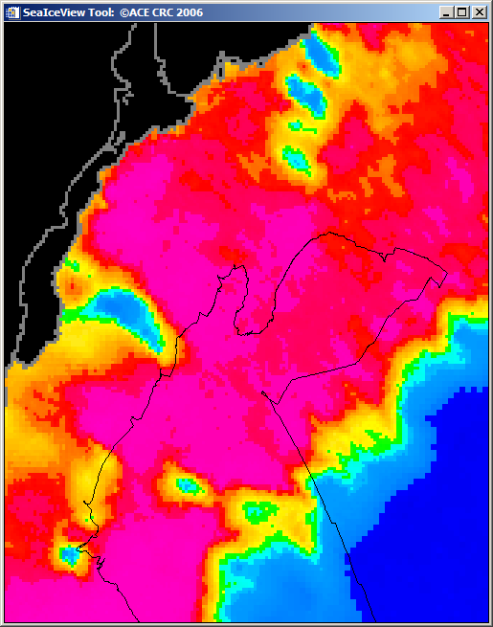


2 Modes of Sea-Ice Service: Charts

Slide 20
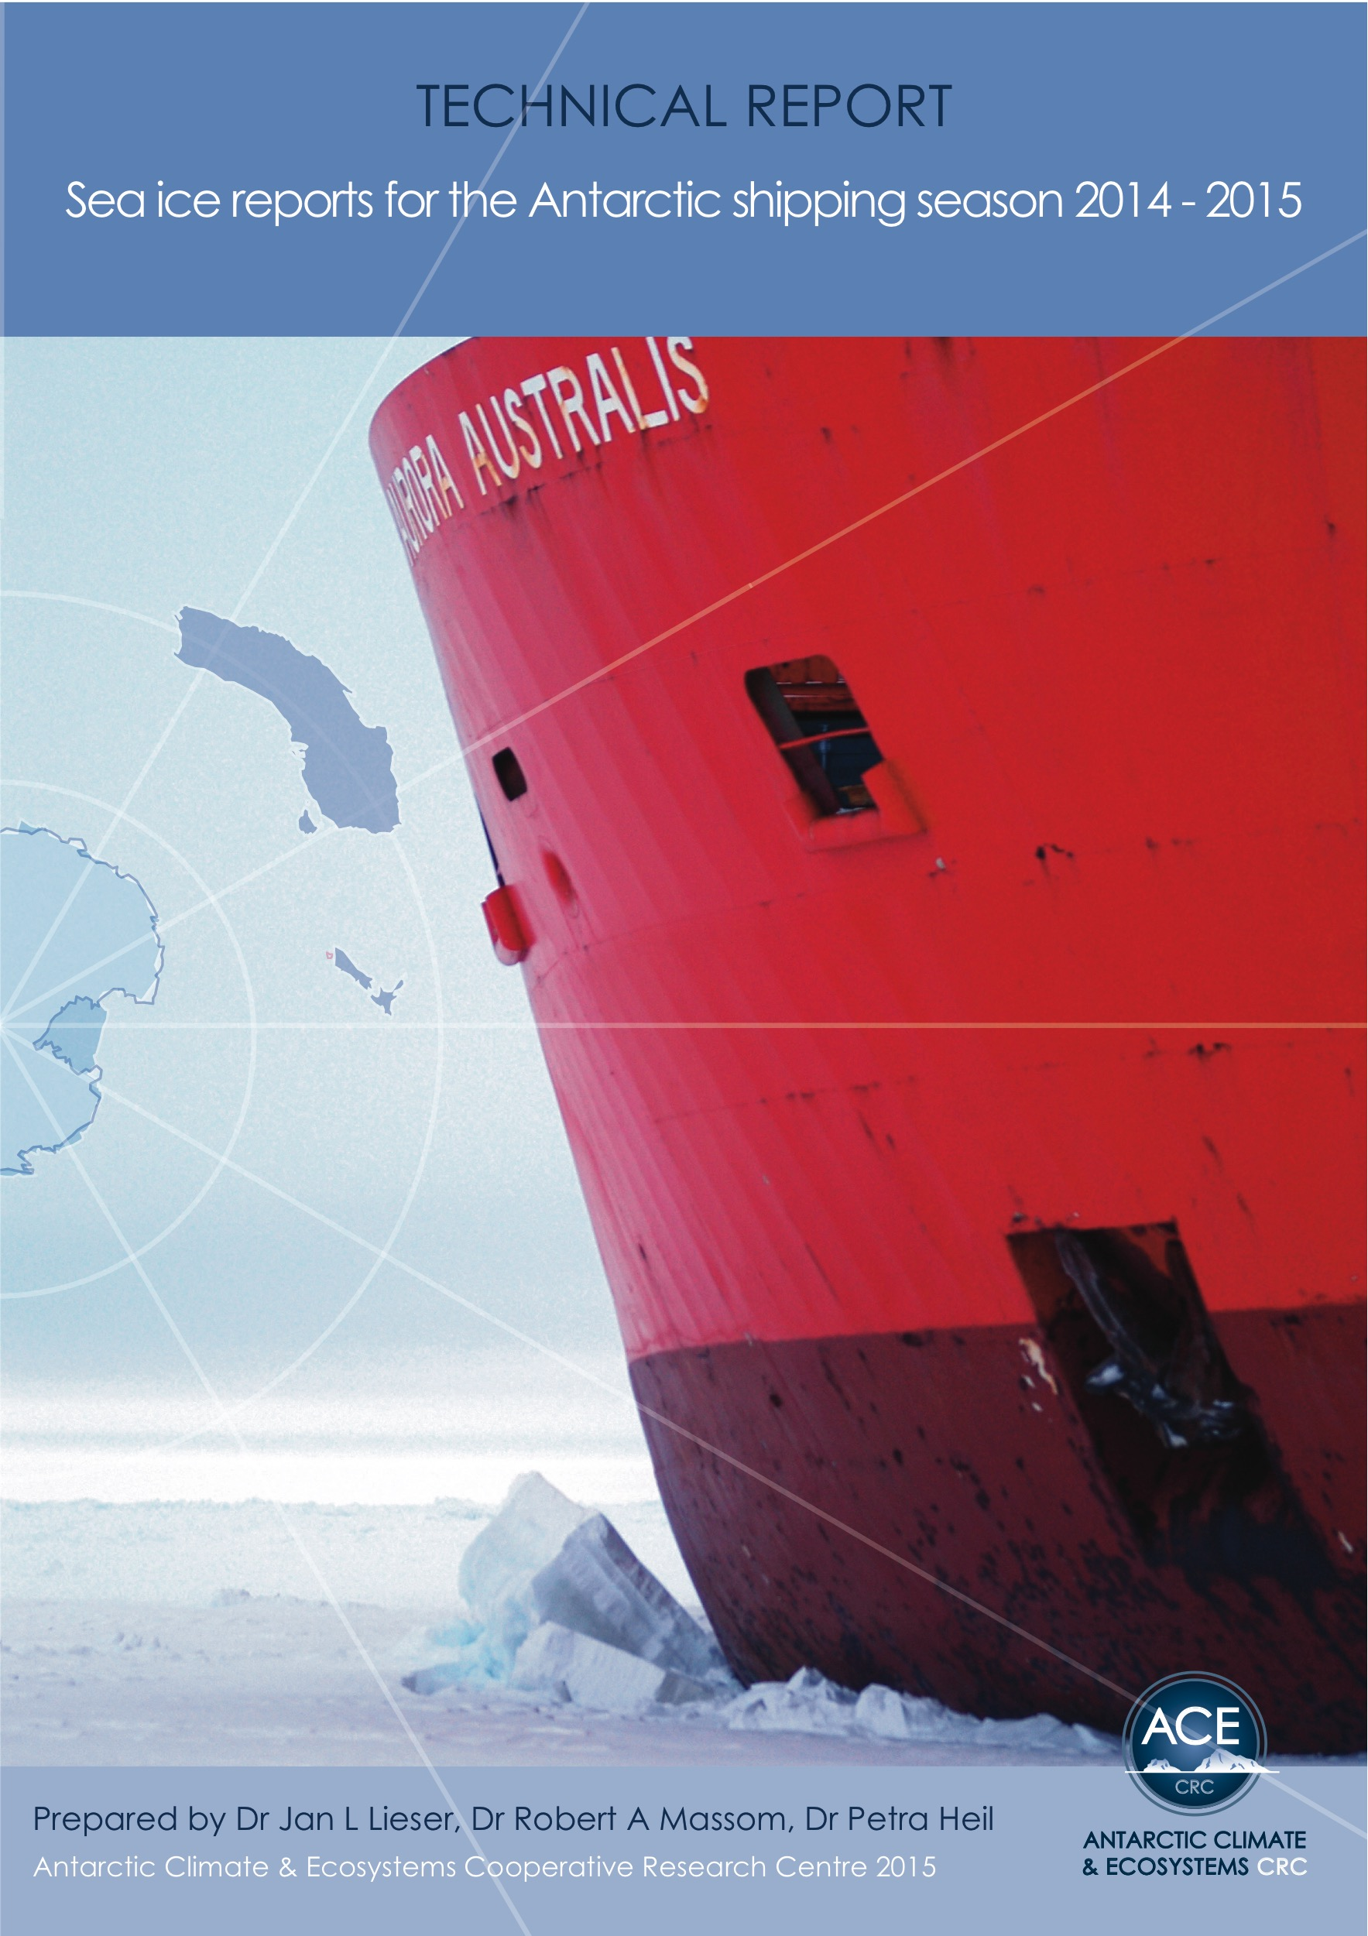
2 Modes of Sea-Ice Service: Reports
http://acecrc.org.au/publication/sea-ice-reports-2014-2015-vol-4/
Notes:
value added service of annotated charts/images with narrative;
compares to Sea Ice Bulletin in the Baltic / Arctic.

Slide 21
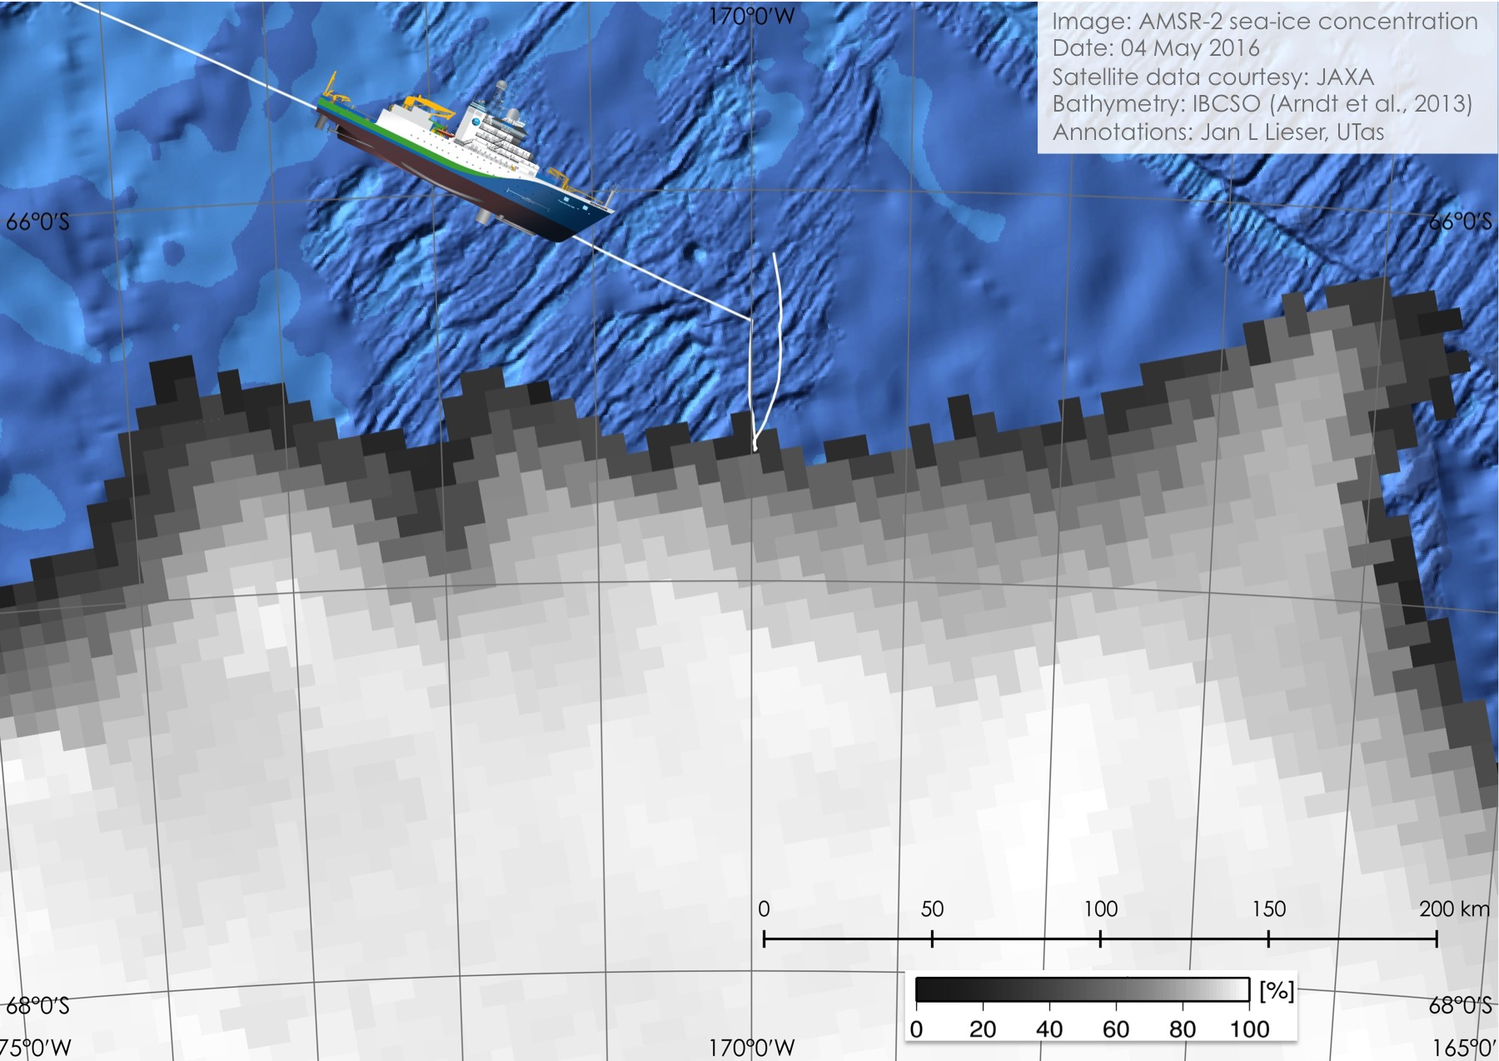
Now-casting
Tailored to user’s needs;
The right information to the right people at the right time;
Synoptic assessment (images and words):
Subject to availability:
  Remote sensing data;
  NWP forecasts;
  Ocean state forecasts.

Slide 22
Sea Ice Reports
Notes:
in 2014/15 season: supported 7 institutions from 5 nations on 16 voyages, all on time
in 2015/16 season: supported 5 institutions from 4 nations on 13 voyages, all on time

Slide 23

Community funding proposal
COMNAP members co-funding on a pro-rata basis;
Augmented by commercial services;
Might become a line item in
research funding proposals.
Notes:
The Australian Aviation Service model:
Operators fund a dedicated workforce;
Requirement of best practice:
Quality management systems
Training and competency assessment
Educational material for users
Tailor Made products
Consistent, Reliable, Useful, Expandable, Sustainable
“Flughafen” [Airport] (2005) by Ho-Yeol Ryu (Korea)

Slide 24

Benefits to the user
Safer, more efficient operations;
Mitigate Search & Rescue;
Insurers and funding agencies expect best practice;
Access to resources of all member nations.
Notes:
Tailor made services support safer and more efficient running of all Antarctic operations;
Mitigate Search and Rescue - A risk that COMNAP members are particularly exposed to;
Simplify communication pathways;
Insurers and governments expect best practice;
Leverage off an organisations infrastructure, QMS's, MOU's and SLA's;
Would access the satellite and modelling resources of all member nations.

Slide 25
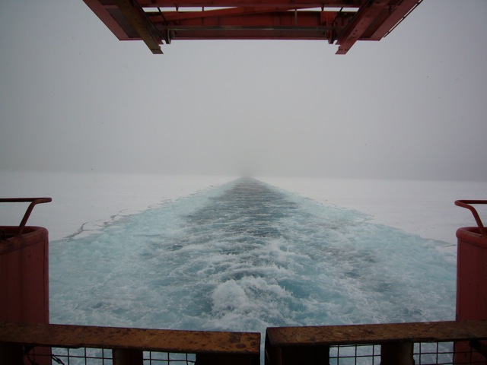
In summary
Requirement/obligation for remote area operations;
Different levels of support for different needs;
Pan-Antarctic service not established;
Develop competency standards;
Deliver best practice.
20 m
Notes:
Arctic and Baltic nations have 100+ years of experience;
For the Antarctic, no such service exists;
BoM is working on an Antarctic Weather Forecasting Competency.
JCOMM is leading the High Seas Forecasting Competency.

