Slide 1






Antarctic Sea Ice Analysis Collaboration
Nick Hughes, Caryn Panowicz, Vasily Smolyanitsky,
Penelope Wagner
5th International Ice Analysts Workshop
Washington D.C., 16-20 May 2016

Slide 2
Overview
Background
Original Specification for Collaborative Product
Discussions at IICWG-XVI (Germany 2015)
Ice.aari.aq
Issues to resolve
Specification for Collaborative Product

Slide 3
Background
Antarctic collaborative chart discussed at meetings in 2014 and production started December 2014
Includes ice charts from
  NIC and AARI
    Thursdays, full hemispheric chart
  MET Norway
    Mondays (October to April), Weddell Sea and Antarctic Peninsula
Common point of access at http://ice.aari.aq/
Charts to include
  Ice concentations, total and partial for 2 classes
  Stage of development
  Icebergs

Slide 4
Original Specifications for Collaborative Product
Concentrations | In accordance with SIGRID-3 standard
Ice Types | In accordance with SIGRID-3 standard; expected values at least include: 1 - New ice, 3 - Young ice, 7 - Thin first-year ice, 6 - First-year ice for ice thicker than 7, 7* - Old ice, ^* - Iceberg
Color Code | Based on CT and SoD (varies in season)
Partial concentrations | Only for 7*, to continue tracking the amount of old ice, which is the ice type vessels are most interested in.
Eggs/SIGRID | Online content should be available in SIGRID-3 and in graphics with colour coding. Graphic replica with WMO egg-code is desirable but not critical.
Icebergs | Continue to analyze icebergs that exceed 10NM. They're usually not hard to find with MODIS (while daylight), or use previous analysis or our table to help find them. Many are grounded/fasted and do not move. Common layer of icebergs should be present on a collaborative product, with a common database managed by the partners, NIC database with NIC namings is a starting point for complementing by AARI and met.no
Product Dissemination | Analyses to be posted on each organizations websites, as image files and SIGRID-3 in advance of 1 day before the time of analysis for any side. Access to a common set of satellite imagery supporting sustained hemispheric analysis is critical. Partners will investigate possibility of a single point of access similar to ftp/http gmdss.aari.ru
Antarctic Shoreline Update | Common single coastline will be chosen within the 3 or 4 possible coastlines: AARI, met.no, NIC and SCAR. Update of the Antarctic coastline is necessary starting with the most significant parts (e.g. McMurdo station, Progress station), partners should be timely informed about the changes, consult/contact Austral Data Center of the Australia Antarctic Division for possible collaboration, make a note that coastline is ‘NOT FOR NAVIGATION’
Chart valid each week | NIC/AARI charts should come opposite NIS charts in the week so that customers would see two products/week and work would not be duplicated. All charts should not be contradictory, in particular if products are for the -3/+3 days interval. Agree on Thursday for AARI/NIC hemispheric odd/even week product, Monday for met.no weekly Weddell/Amundsen Seas analysis, odd/even week choice is insignificant but needs to be fixed prior to production, charts should be available 1 (2-3) days prior to the day of analysis

Slide 5
Discussions at IICWG-XVI (Germany 2015)
Activity
  Overview presentation by the Executive Secretary of the Council of Managers of National Programs (COMNAP)
  Discussion on the nature of ice information needed in the Antarctic and business models for sustained services.
Conclusions
1. More partners required in collaborative charting to increase detail/ frequency
2. For ice edge, more investigation from responsible METAREAs to determine best practice
3. Need to develop standard training/manuals, computer tool for virtual training
5. More data sharing
6. Use of high resolution forecast models (in context of YOPP and PPP)
11. Use of IAATO shipboard observations

Slide 6
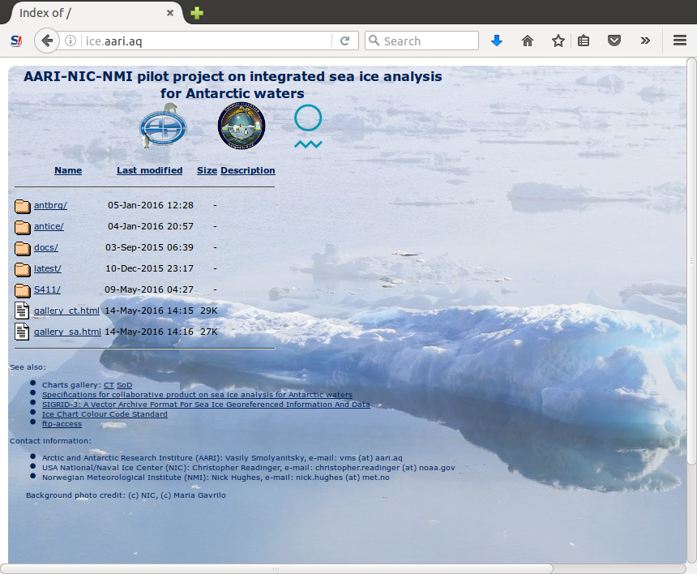
ice.aari.aq

Slide 7
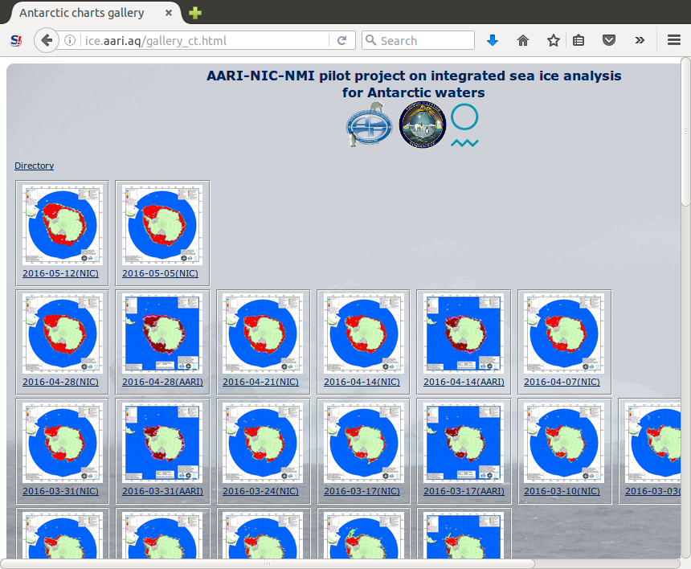
ice.aari.aq

Slide 8
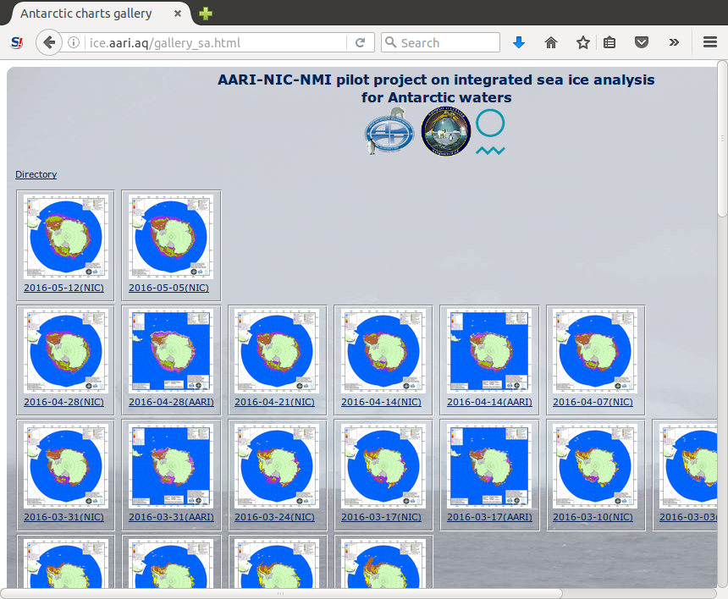
ice.aari.aq

Slide 9
Issues To Resolve
Presentation
  Need to include compact drift ice (10/10ths) [dark red], not just very close drift ice (9-10/10ths) [red]
  CT (concentration) charts should not include SA (stage of development)!
  Ice free region is including areas that are known to be ice-infested
    Highlights need for a limit of known icebergs, and area should be marked as “bergy water”
    Could 0°C isotherm be used as a proxy until we develop more data?
  Can NIC and AARI charts also have subsets?
    User feedback indicates subarea charts are appreciated, hemispheric charts less so as there is not enough detail
Charting
  Norway to continue ice charts through winter (May-September)

Slide 10
Specifications for Collaborative Product
Concentrations | In accordance with SIGRID-3 standard.
Ice Types | In accordance with SIGRID-3 standard; expected values at least include: 1 - New ice, 3 - Young ice, 7 - Thin first-year ice, 6 - First-year ice for ice thicker than 7, 7* - Old ice, ^* - Iceberg
Colour Code | Based on CT and SoD (varies in season).
Partial Concentrations | Only for 7*, to continue tracking the amount of old ice, which is the ice type vessels are most interested in.
Eggs/SIGRID | Online content should be available in SIGRID-3 and in graphics with colour coding. Graphic replica with WMO egg-code is desirable but not critical.
Icebergs | Continue to analyze icebergs that exceed 10NM. They're usually not hard to find with MODIS (while daylight), or use previous analysis or NIC table to help find them. Many are grounded/fasted and do not move. Common layer of icebergs should be present on a collaborative product, with a common database managed by the partners, NIC database with NIC namings is a starting point for complementing by AARI and MET Norway.
Product Dissemination | Analyses to be posted on each organizations websites, as image files and SIGRID-3 in advance of 1 day before the time of analysis for any side. Access to a common set of satellite imagery supporting sustained hemispheric analysis is critical. Common point of access at http://ice.aari.aq/,
Antarctic Shoreline Update | Coastline is SCAR Antarctic Digital Database (ADD) (http://www.add.scar.org/). Update of the Antarctic coastline is necessary starting with the most significant parts (e.g. McMurdo station, Progress station), partners should be timely informed about the changes, consult/contact Austral Data Center of the Australian Antarctic Division (AAD) for possible collaboration, make a note that coastline is ‘NOT FOR NAVIGATION’
Chart Valid Each Week | NIC/AARI charts should come opposite MET Norway charts in the week so that customers would see two products/week and work would not be duplicated. All charts should not be contradictory, in particular if products are for the -3/+3 days interval. Agree on Thursday for AARI/NIC hemispheric odd/even week product, Monday for MET Norway weekly Weddell Sea/Peninsula analysis, odd/even week choice is insignificant but needs to be fixed prior to production, charts should be available 1 (2-3) days prior to the day of analysis.

Slide 11
The End

Slide 12
Discussion from IICWG-XVI
As noted at IICWG-XVI (Germany 2015)
  The initiation of the production of regular ice charts and text bulletins for Antarctic regions by the Argentine Naval Hydrographic Service. These products use international symbology and build on practices that have been proven in the Arctic.

