Slide 1




QGIS at the Norwegian Ice Service
Nick Hughes
5th International Ice Analysts Workshop
Washington D.C., 16-20 May 2016

Slide 2
Overview
Background
QGIS
Why Bifrost?
Flexible installation
Infrastructure
  Multiple Analyst Workstations
  Networking
Database System
Programming
Server Capabilities
  AMSR2
  MODIS
  Sentinel-1
  Sentinel-2
  SST
Ice Chart Generation
Bifrost and GMDSS
Development Plans
Conclusions

Slide 3
Background
A brief history of GIS at Norwegian Ice Service
  Started using ArcView in 1997
  Experimented with QGIS from 2010 on research projects
  Antarctic production ice charts started using QGIS in 2012-13
  Main Arctic ice chart production moved to QGIS and ArcView retired in July 2014
  New development version of ice charting system started in spring 2015 under the name OPICS (“Open Polar Ice Charting System”)
  Portable development version of ice charting system constructed in March 2016 and released at IAW5 under the name “Bifrost”

Slide 4

QGIS
Cross-platform free and open-source desktop geographic information system (GIS) application
  Previously known as Quantum GIS
  Provides data viewing, editing, and analysis
  Development began in early 2002, with version 1.0 released January 2009
  Small file size compared to commercial GIS’s and requires less computer memory and processing power

Slide 5
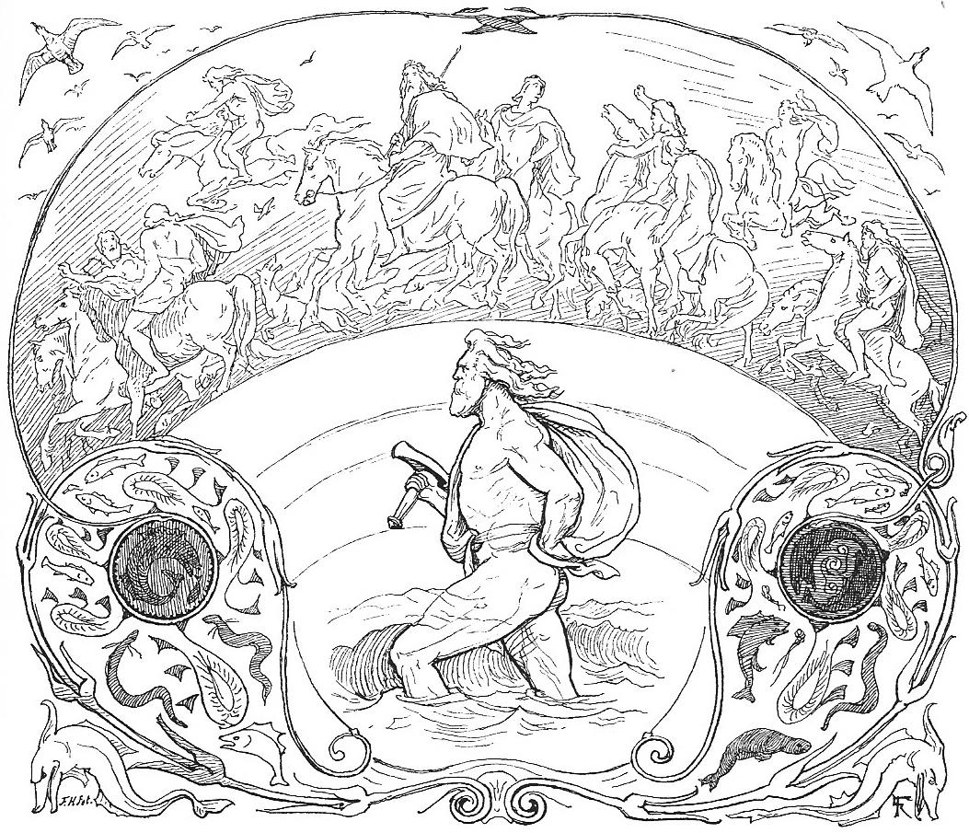
Why Bifrost?
Names of existing GIS systems at
ice services
  SIKU (Denmark), IceMap (Finland and
  Sweden), Vanadis (Finland), ISIS and
  POLARIS (Canada), SIPAS (USA)
Bifrost
  In Norse mythology, a burning rainbow
  bridge between Midgard (Earth) and Asgard (realm of the gods)
Ice charting system
  Links mapping the Earth’s surface with use of satellite images
  “Bi” polar (Arctic and Antarctic) and server-client system set up
  “Frost” for polar application

Slide 6




Flexible Installation
Development goals
  Flexible (portable) installation on different computing environments
  Allow collaboration between multiple users
  Support tasks
    Overall data management
    Pre-processing (satellite images)
    Ice charting GIS
    Post-processing (dissemination)
  Use free and open-source software (FOSS)
Technologies
  Lubuntu
    Lightweight Linux distribution based on Ubuntu but using LXDE desktop environment
    Version 14.04 (Trusty)
  Oracle VM VirtualBox
    Creation and management of guest virtual computers
  Ansible
    Platform for configuring and managing computers
  Vagrant
    Creates and configures virtual development environments

Slide 7



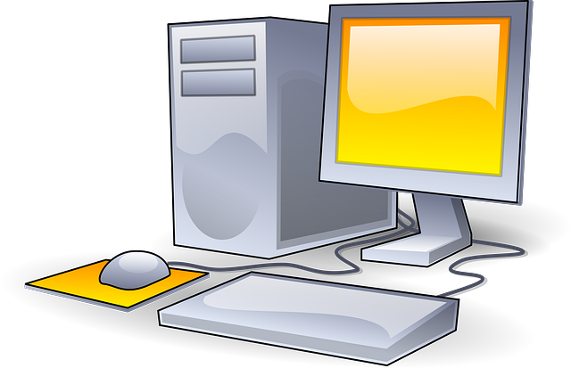
Infrastructure
Server
Client
+
=
Two components
  Server
    Database management
    Pre-processing of satellite images, model forecast data, and in situ observations
    Post-processing, generating output ice chart files and graphics, dissemination via e-mail and to web servers
  Client (Analyst Workstation)
    GIS for generating ice charts
    Software for creating GMDSS text reports
System can be combined onto
one laptop PC

Slide 8

Multiple Analyst Workstations
Server
Server
  Supports common networking protocols
    Database communications
    Satellite image file
Multiple clients
  Can work on
    Independent production ice charts
    Collaborative ice charts
    Training
Client
Client
Client

Slide 9



Networking
Server
Separate WiFi network for Bifrost at IAW5
  Allows multiple computers without web page login
  Isolated from NIC network and internet
SSID:
IAW5
Passcode:
antarctica

Slide 10


Database System
Key for management of data
  Allows control of satellite image download and processing
  Stores archived ice chart data (polygons, lines, points) from Antarctic collaborative chart (Norway, Russia and USA)
  Allows automatic distribution of information products
Bifrost relies on two database software packages
  PostgreSQL
    Object-relational database management system (ORDBMS),
    with an emphasis on extensibility and standards-compliance
  PostGIS
    Adds support for geographic objects to PostgreSQL
    Uses the Simple Features for SQL specification from the
    Open Geospatial Consortium (OGC)

Slide 11

Programming
Bifrost scripts are written in the Python language
  Version 2.7
    Plan to change over to version 3.x when all libraries are available
Bifrost uses a number of extension modules, including
  GDAL, Shapely, Matplotlib, Basemap, BeautifulSoup, netcdf4-python, psycopg2, pygresql, Pyproj, Reportlab, Paramiko, ScientificPython, NumPy, Mapscript
High level of customization and ability to add features

Slide 12
Server Capabilities
Processing satellite images
  AMSR2
  MODIS
  Sentinel-1
  Sentinel-2
  Also (not included here)
    Radarsat-2, COSMO SkyMed, AVHRR, OSI SAF
Processing supporting data
  Sea surface temperature (SST) from Copernicus
Post-production
  Generating ice chart graphics
  Dissemination of ice charts
    E-mail
    Upload to web servers

Slide 13
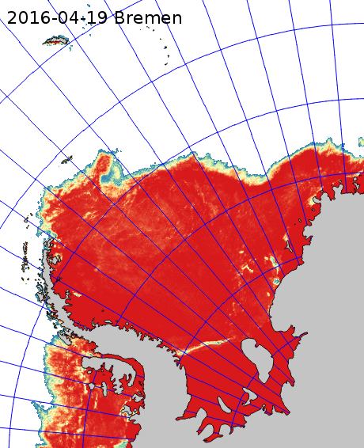
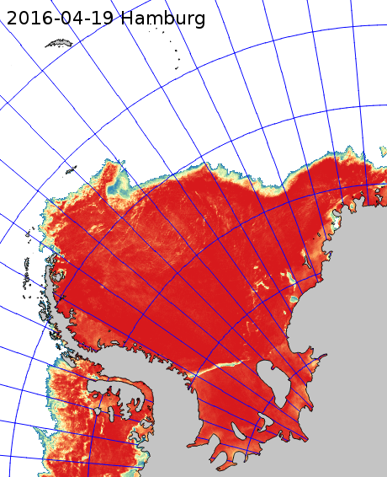
AMSR2
Sea ice concentration (SIC) from passive microwave
Two flavours
  University of Bremen, 6.25 km
  University of Hamburg, 3.125 km
Similar quality
  Bremen shows more noise over open ocean
  Hamburg has differences over ice shelf areas

Slide 14
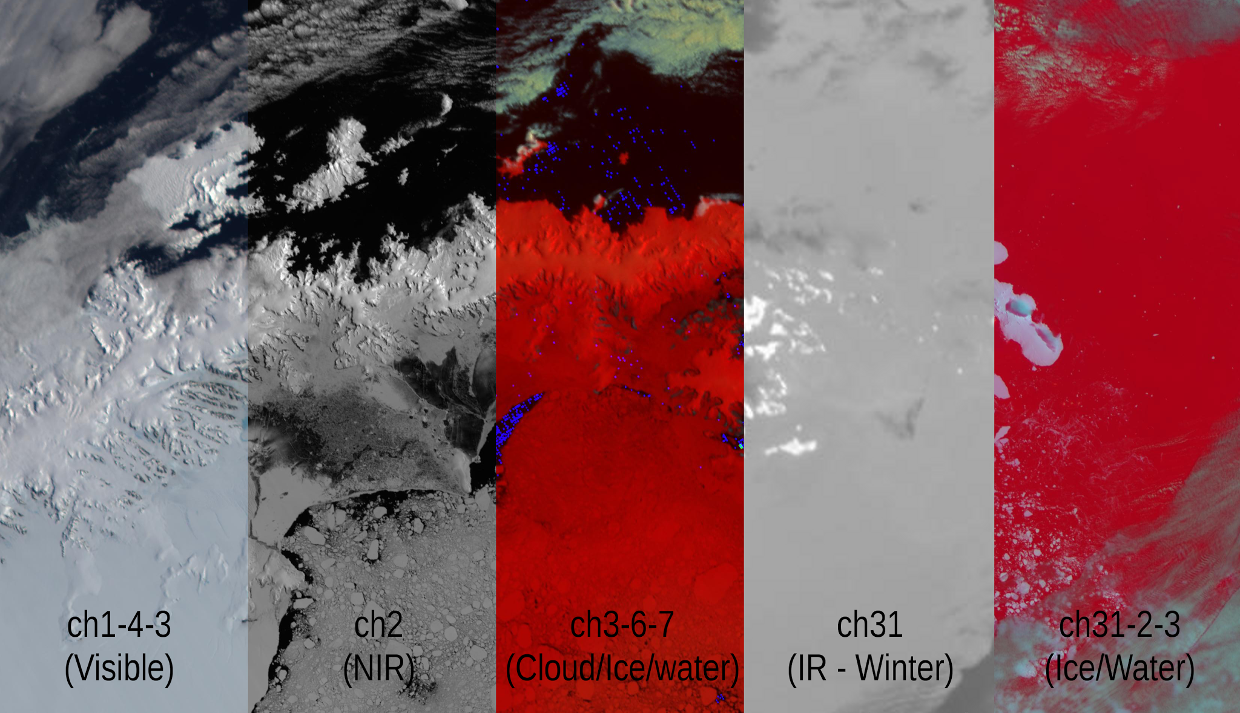
MODIS
Bifrost set to process from NASA Level 1 and Atmosphere Archive and Distribution Systems (LAADS)
Processing can be set for
  Specific areas
  Dates and times
Images from 5
channel
combinations

Slide 15
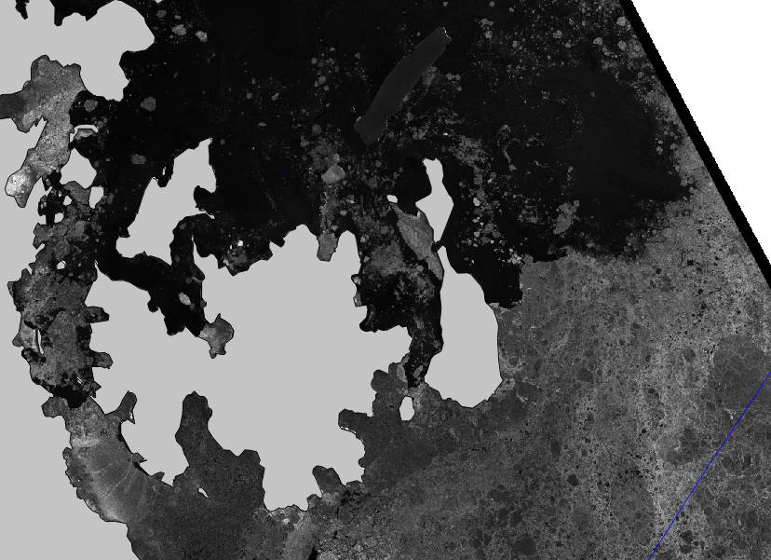
Sentinel-1
Bifrost capabilities for
Sentinel-1 include
  Getting updates on planned
  acquisitions
  Automatic download and
  processing of scenes for
  requested areas
    Needs Copernicus Marine
    Environment Monitoring Service
    (CMEMS) partner login,
    i.e. MET Norway, DMI or FMI
  Automatic processing of manually downloaded scenes
    Data can be selected and downloaded at Sentinels Scientific Data Hub (https://scihub.copernicus.eu/)

Slide 16
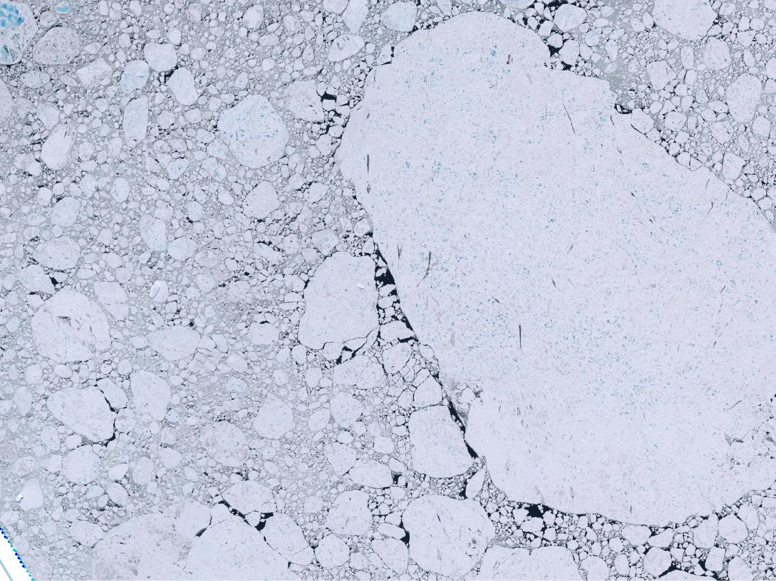
Sentinel-2
Capabilities include
  Getting updates on planned acquisitions
  Generation of high resolution visible quicklooks for scenes downloaded from Sentinels Scientific Data Hub (https://scihub.copernicus.eu/)

Slide 17
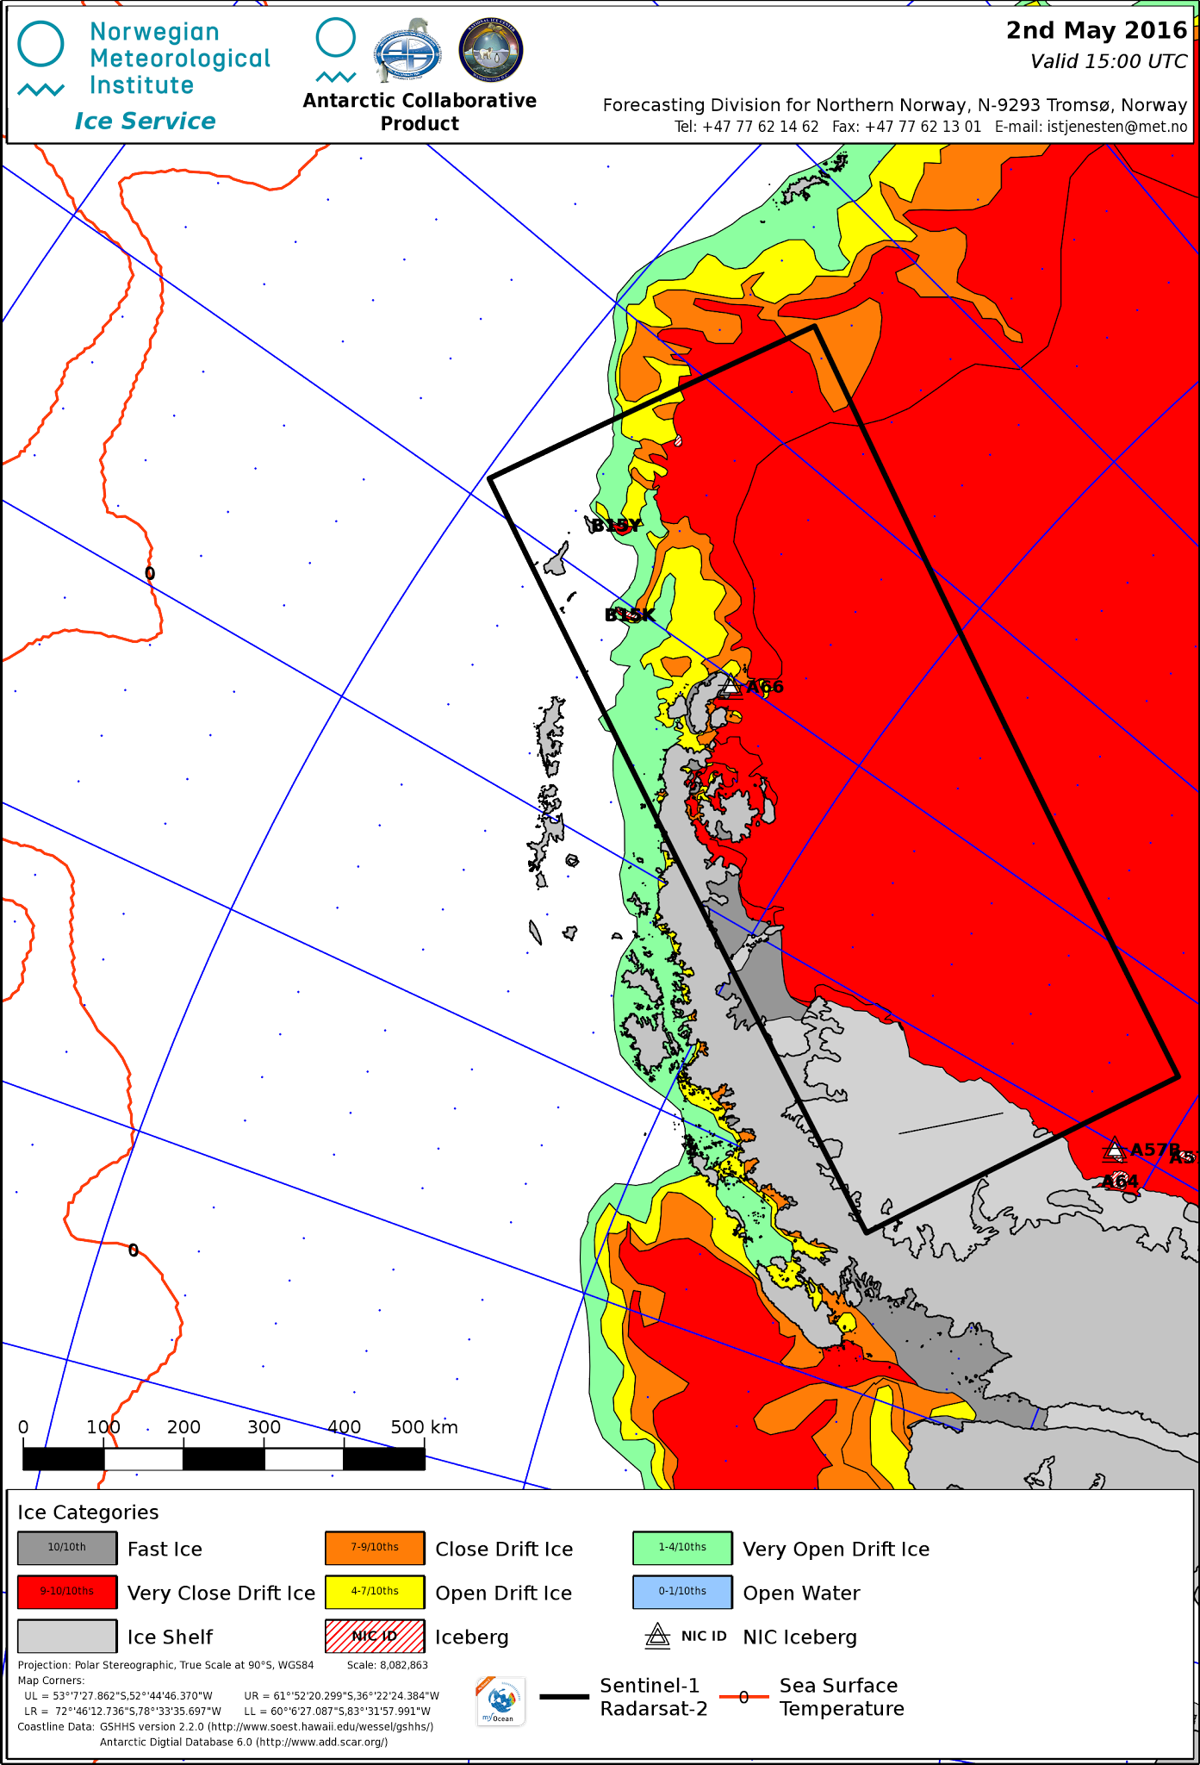
Sea Surface Temperature (SST)
Used in Norwegian ice charts
to indicate position of Polar
Front (0°C isotherm) and
areas where there is potential
for ice
  Download from Copernicus Marine
  Environment Monitoring Service
  (CMEMS)
    Free data, but requires login
    (see http://marine.copernicus.eu/)
  Convert gridded data to Shapefile
  of isotherms

Slide 18
Ice Chart Generation
Recipe for the analyst
  Initialise ice chart production on the client and establish a database entry to track process
    If this is routine, then the job can be set to be automatic
  Copy satellite images from server to client (and repeat as often as necessary)
    If this is routine, then the job can be set to be automatic
  Draw the ice chart
  Check the polygon geometries for errors (as often as necessary)
    Allows analyst to find polygons that self-intersect, are too small, or have repeated boundary points
  Finish the ice chart
Automatic routines on the server then take over...

Slide 19
Bifrost and GMDSS
Scripts for generation of ice edge text on the client

Slide 20
Development Plans
Update software
  Lubuntu to version 16.04 (Xenial) and Python to version 3.x
  Change routines from Mapscript to Mapnik libraries
Add more satellite data processing capability
Develop QGIS plugins for ice charting
  E.g. “Egg” code data entry, automatic image classification
Further refine Vagrant+Ansible system setup scripts

Slide 21
Conclusions
…
Updates to Bifrost are a project on Bitbucket
  See https://bitbucket.org/ and contact nick.hughes@met.no to arrange acess to the software repository

Slide 22
The End

