Slide 1

SATELLITE IMAGE PROCESSING AND ANALYSIS SYSTEM (SIPAS)
Behind the curtain with George Wachira

Slide 2
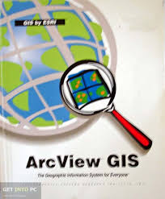


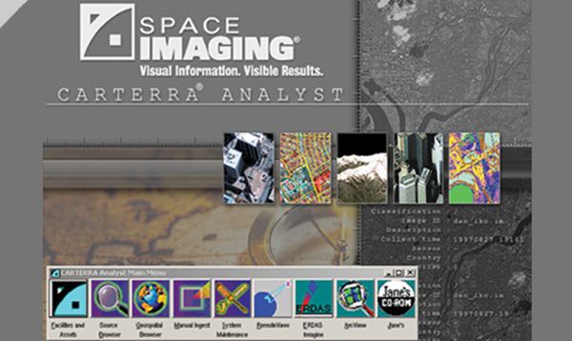



SIPAS the History

Slide 3






So what is SIPAS?

Slide 4
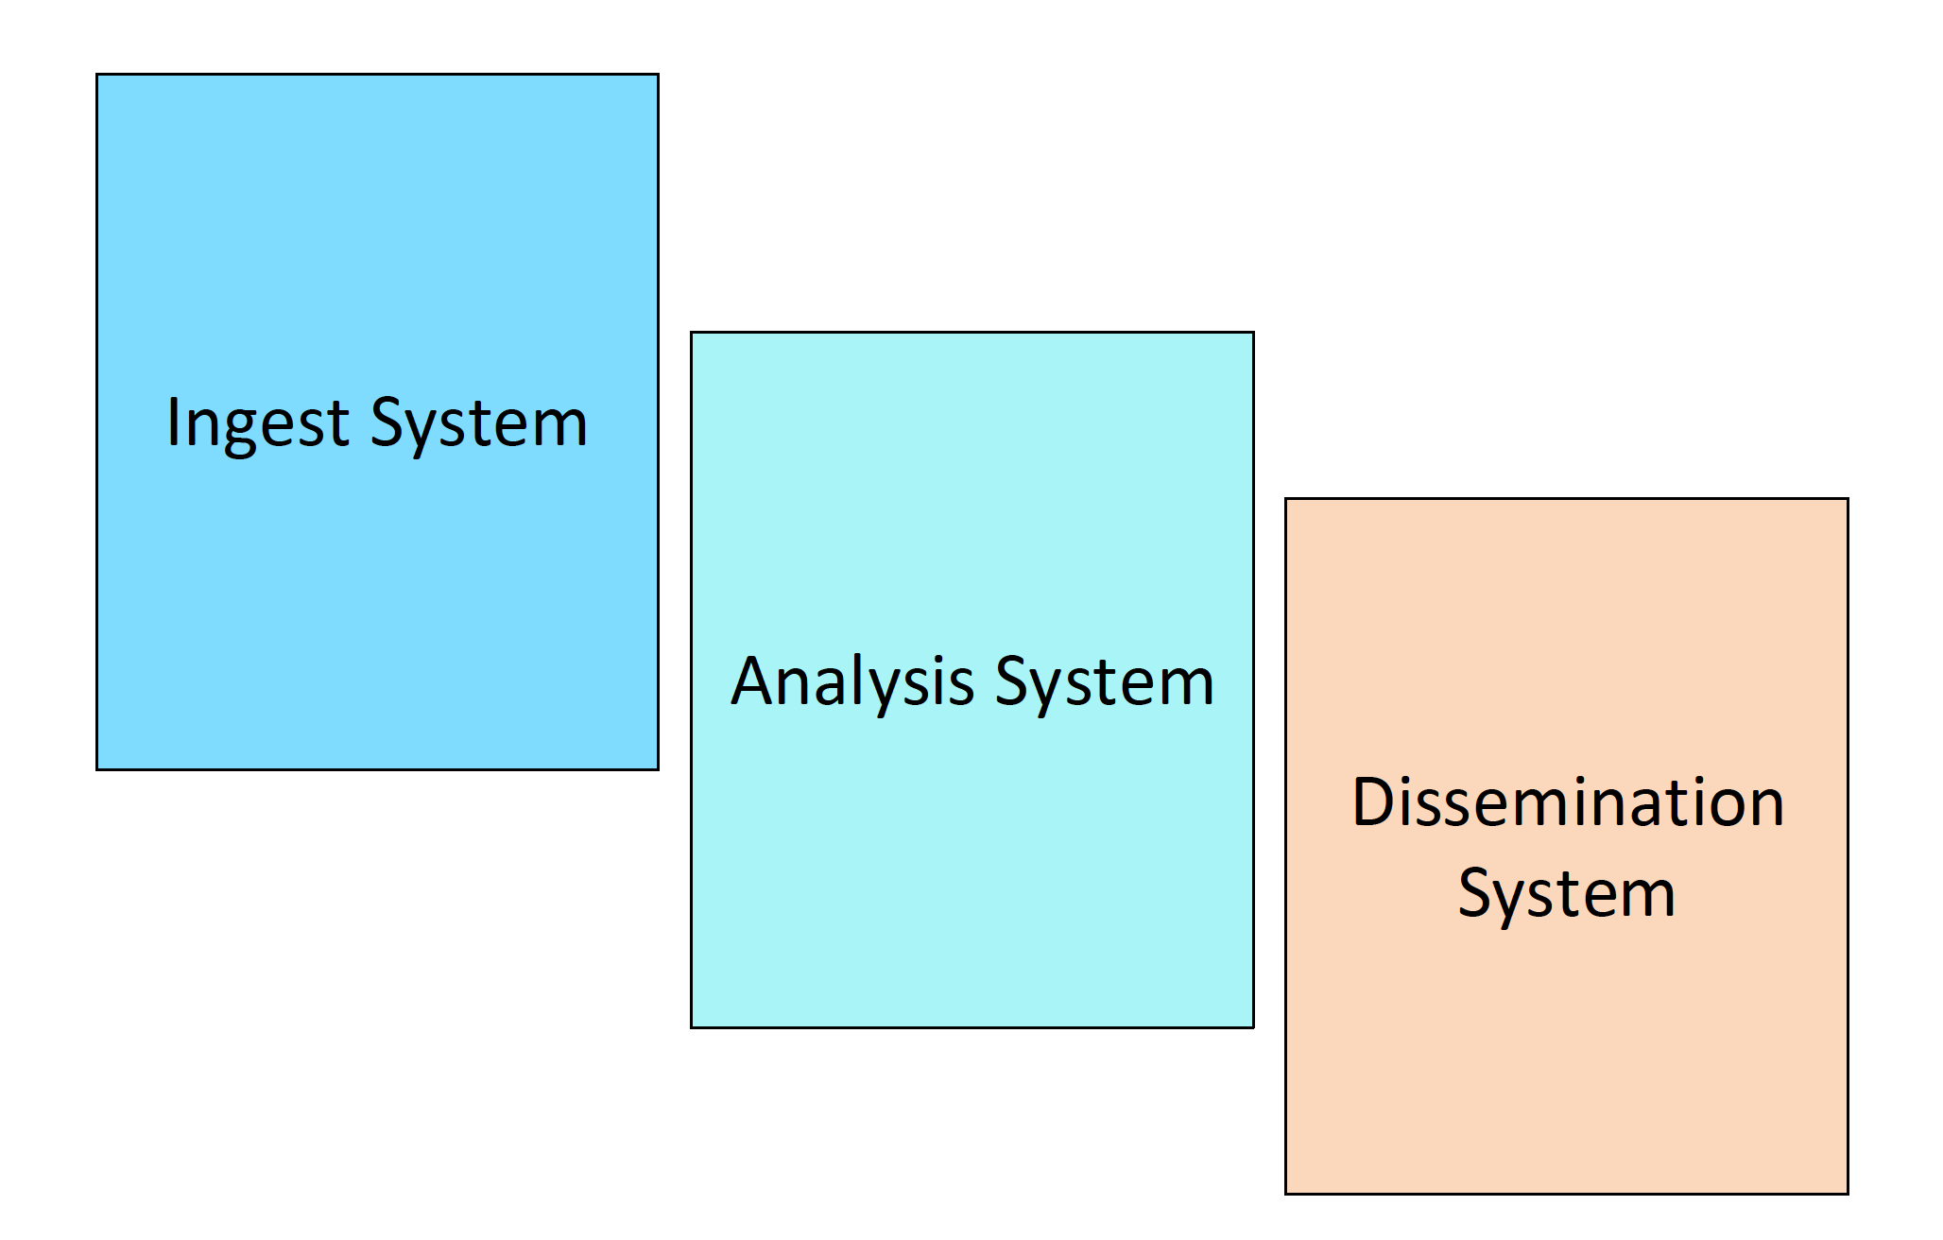
SIPAS Modules

Slide 5
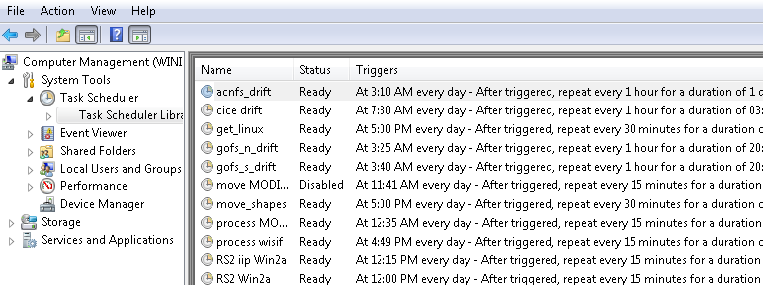
SIPAS Modules
Ingest System
Scheduled tasks
Python and Perl scripts
Get data and models
Get images from vendors, move the images to ingesters (Linux and Windows)
Move processed images to datafarms

Slide 6
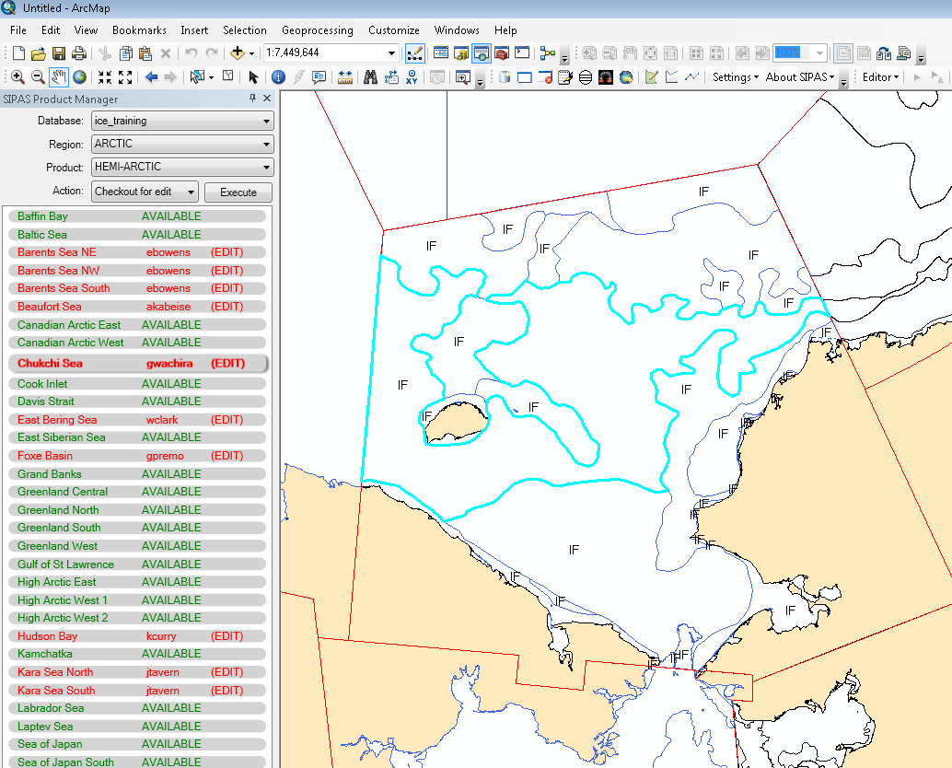

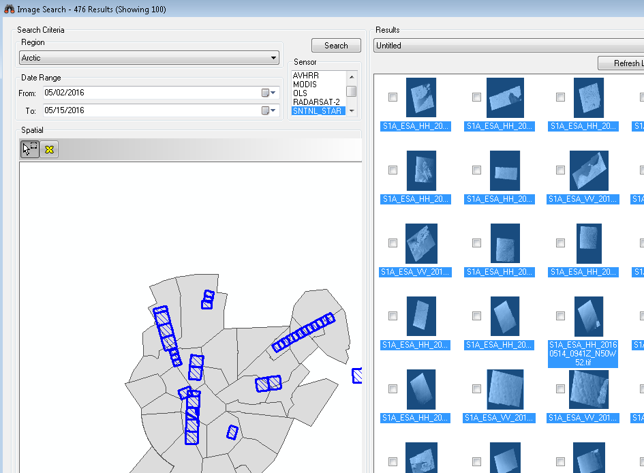
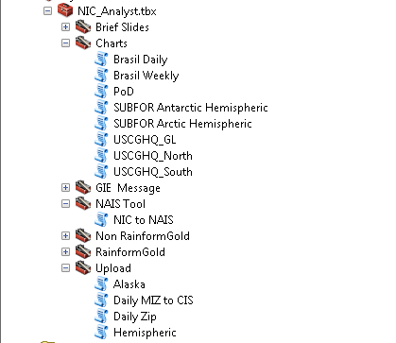
SIPAS Modules
Analysis System
Imagery browser
SIPAS Add In Toolbar
Process automation Tools

Slide 7
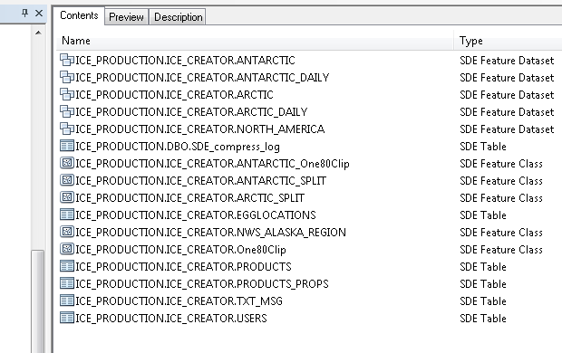
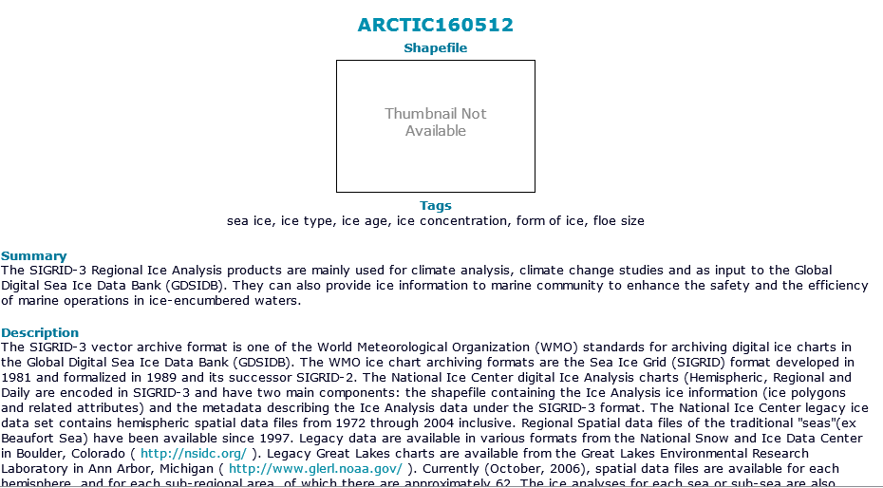
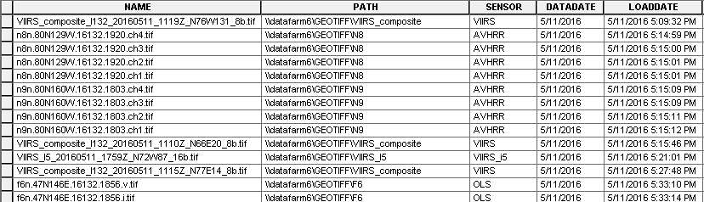
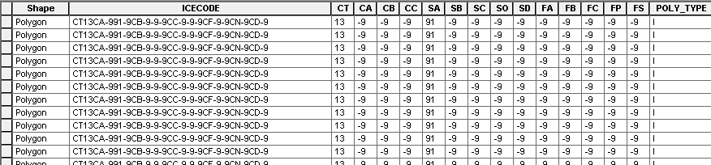
SIPAS Modules
Database
Production
Image
Archive

Slide 8
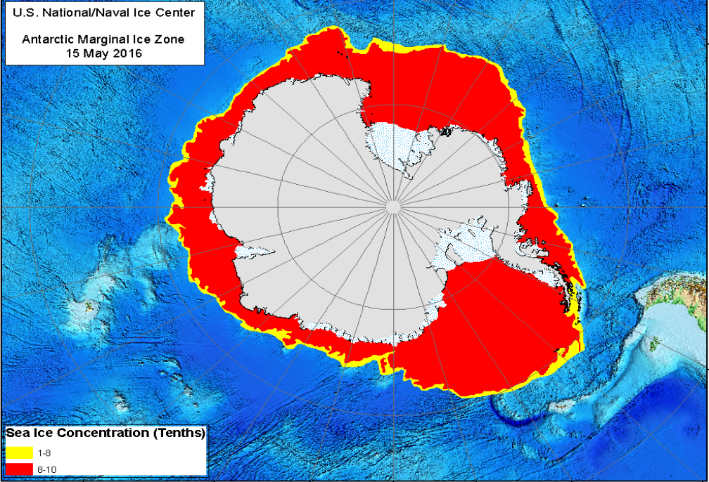
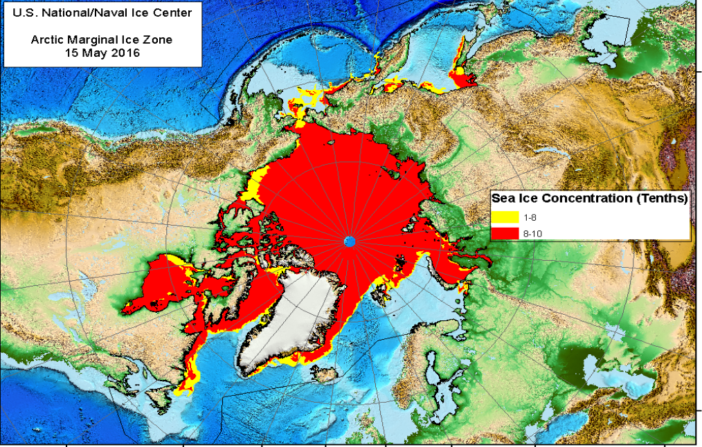
SIPAS Modules
Dissemination System
NIC Website
FTP Site

Slide 9
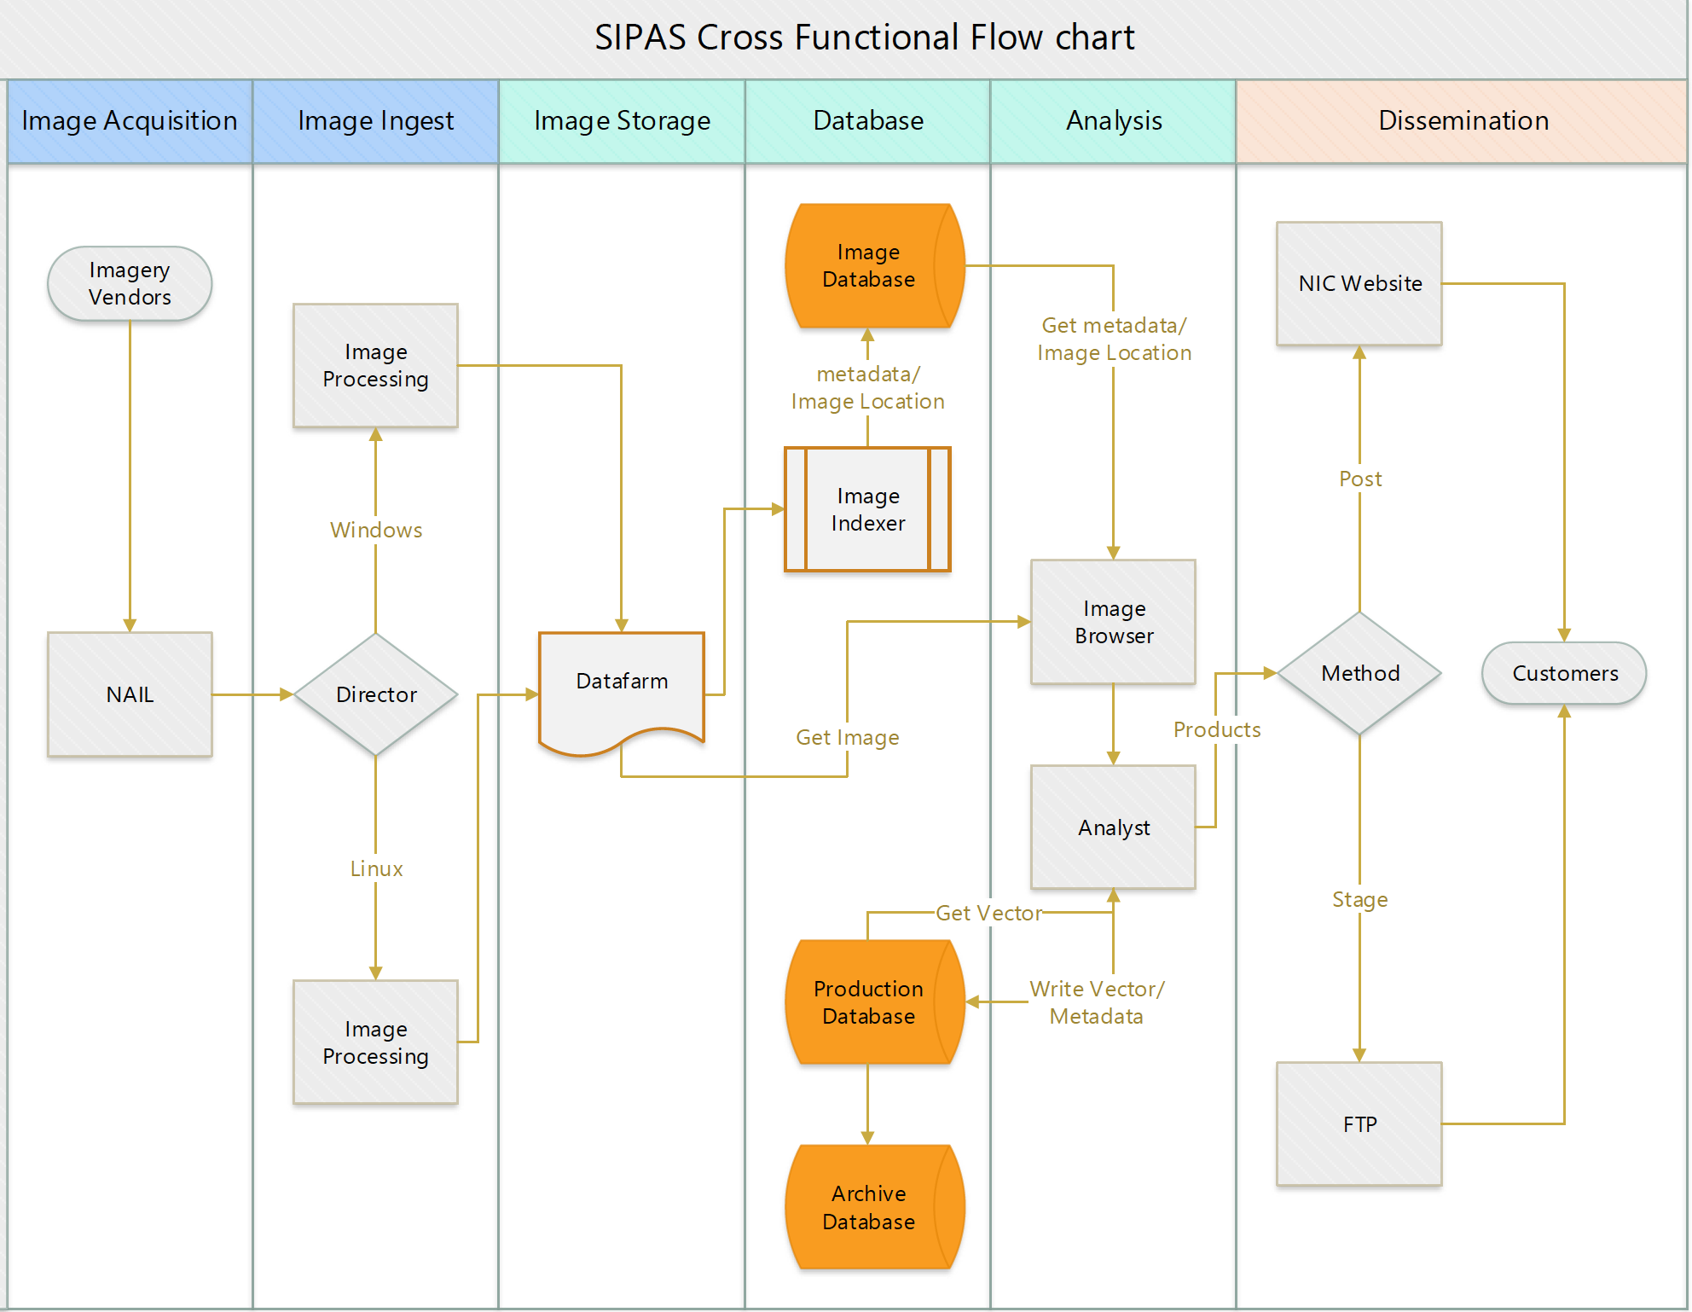

Slide 10
Milestones
1997
2002
1999(est)
2013
Transition from manual production (GRASS)
SIPAS Analysis System on ArcGIS 8.x - 9.x
1996 |  |  |  | 2002
Moved to CARTERRA Analysis System
SIPAS Analysis System on ArcGIS 10.1

Slide 11
Questions

