Slide 1
Antarctic Shelf Update Utility
Chris Readinger
Ice Analyst
National Ice Center
International Ice Analyst Workshop 5
5/17/2016

Slide 2
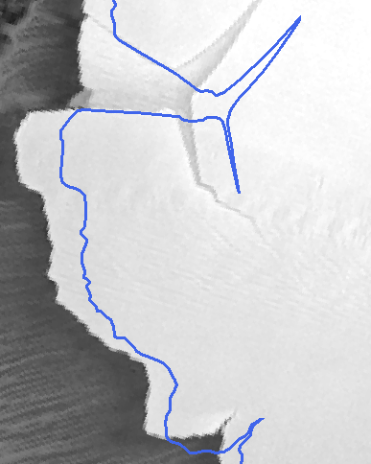
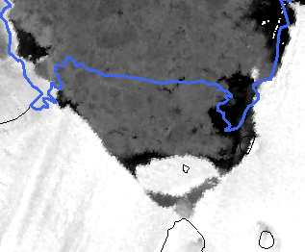
Why update the ice shelves?
Ice shelves make up large proportion of ocean interface with Antarctica
Ice shelves move continuously
  Shelf pushes out slowly over time
  Icebergs calve; edge moves back in
To keep an accurate geographical representation of Antarctic sea ice, we must update the ice shelves periodically.
  How often should this be done?
  Can we push updates to SCAR?

Slide 3
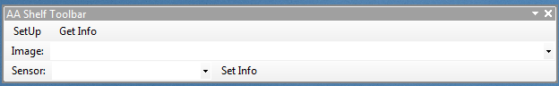
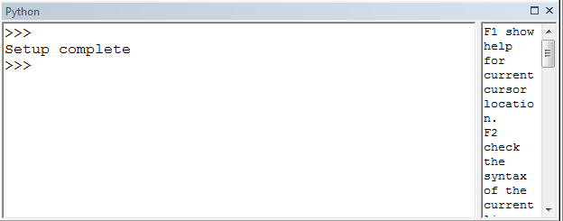
The Antarctic Shelf Update Tool
The Antarctic Shelf Update Utility is an add-in to ArcMap 10.X.
Simple to use tool bar with 3 buttons and 2 spaces for data entry
SetUp – Brings in 2 features layers
  ANTARCTIC: Current land and ice shelves
  Shelf_Updates: For recording proposed new shelf edges
  Also helpful to have python window open
Get imagery, and draw updated shelf lines
Get Info – Once an update is complete this will populate the image dropdown to quickly capture the specific image used
User Entered information
  Image: Filename of image used
  Sensor: The image type used

Slide 4
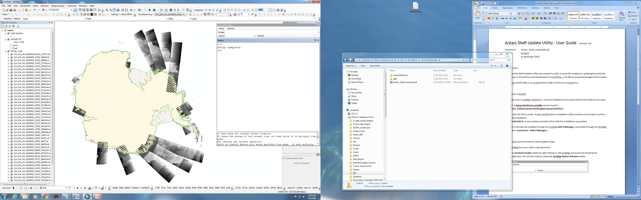

Slide 5
Proposed Workflow for shelf updates
Updates can be performed as needed
  Continental scale for periodical updates and regular changes (i.e. annually)
  Small areas to account for iceberg calving events (i.e. Drygalski ice tongue breaks off)
  Regional changes, if resources or imagery to perform a continental update are not available but an update is overdue
Organizes projects so updates can be tracked, QC’d and approved
  Stored in a geodatabase
Imagery
  SAR (Radarsat-2, Sentinel)
  cloudless visible imagery (VIIRS, MODIS)
Information capture
  The tool automatically captures basic information during edit sessions.
    Analysts name
    Date of update
  Analysts add
    Image type
    Filename

Slide 6
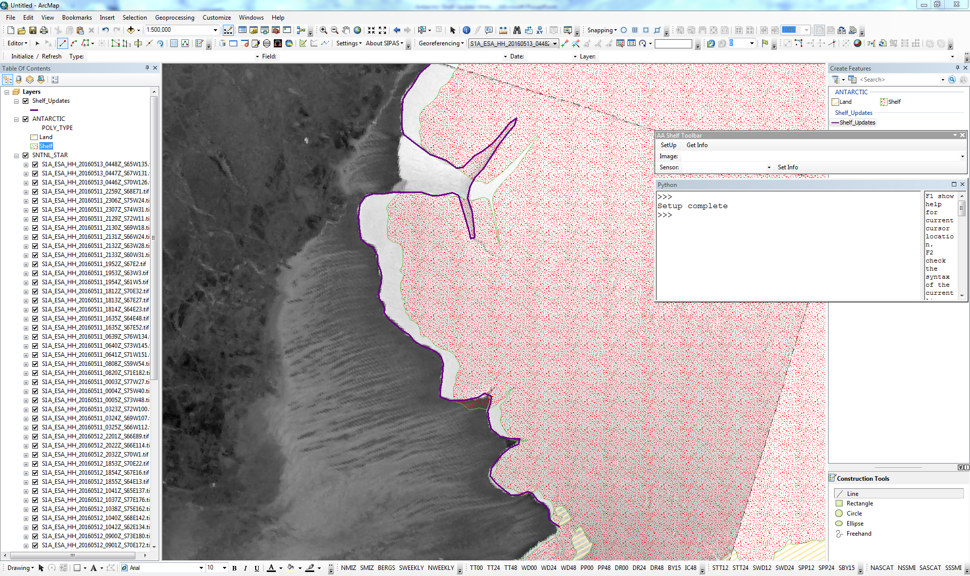
Amery Ice Shelf (Amery Sea)

Slide 7
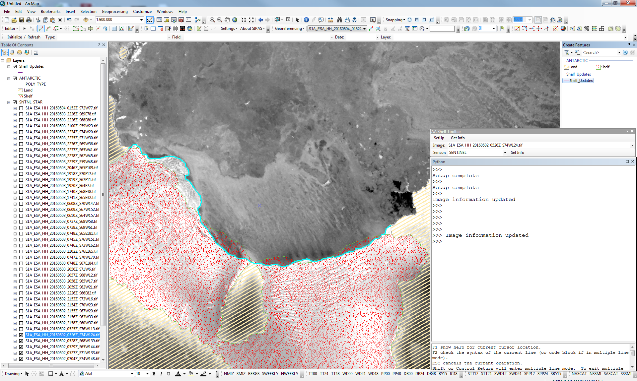
Getz Ice Shelf (Amundsen Sea)

Slide 8
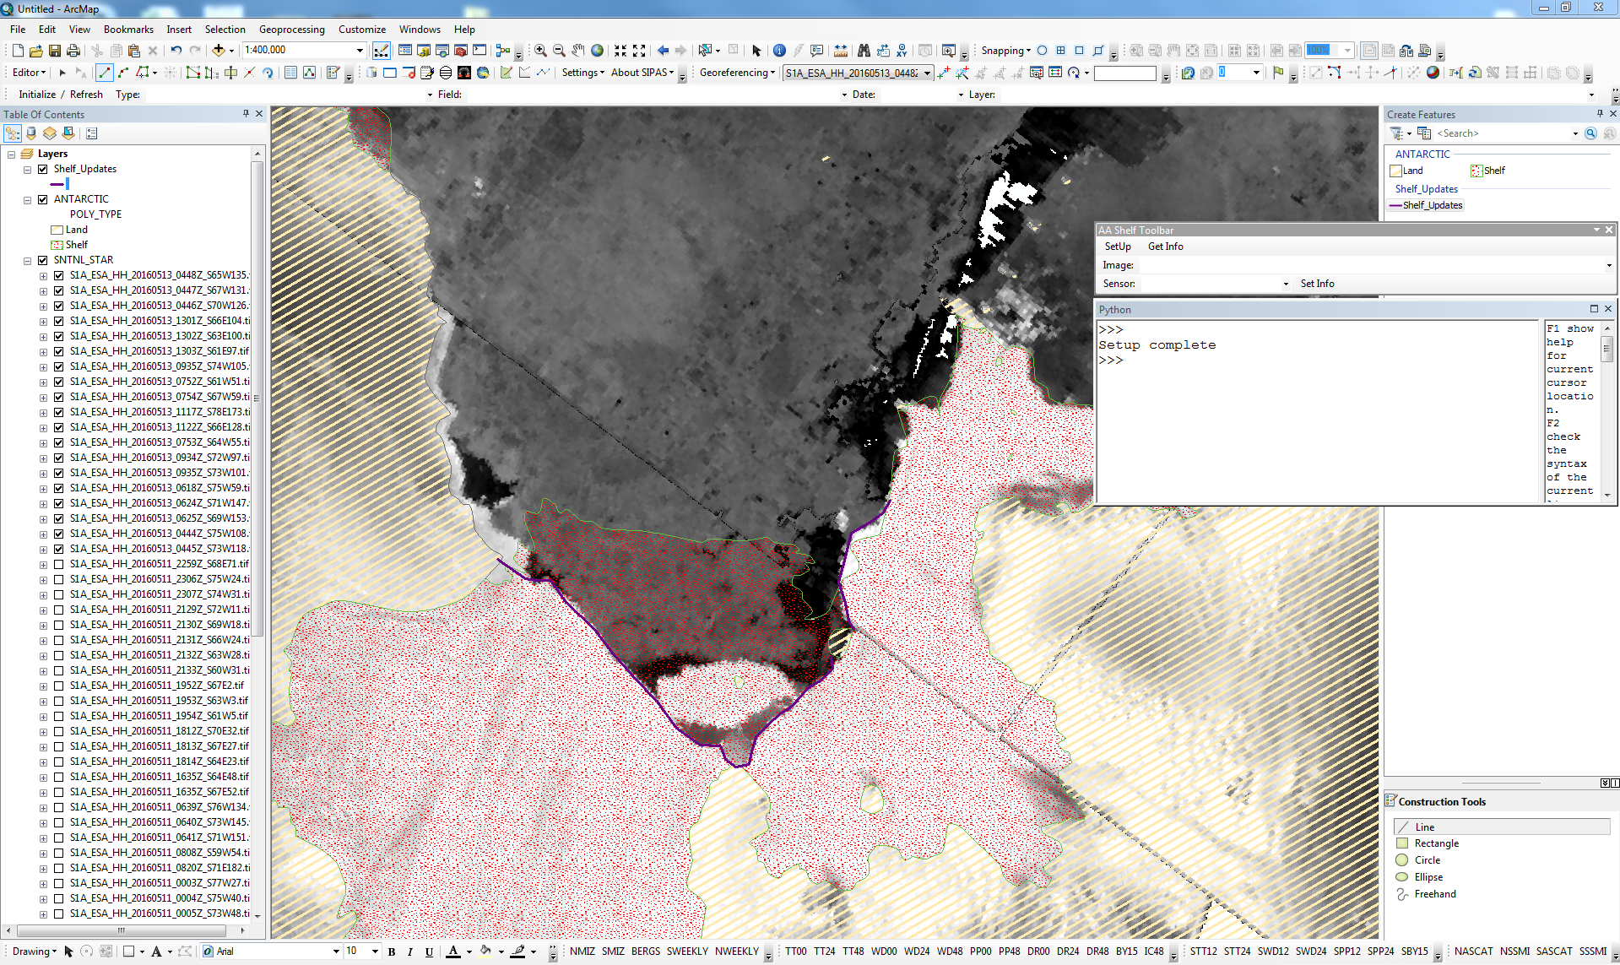
Pine Island Glacier (Amundsen Sea)

Slide 9
Summary
The tool is a simple add-in toolbar for ArcGIS 10.X
Updates can be performed as needed, or scheduled
Various image sources, but highest quality SAR recommended
Updates can be distributed to Antarctic partner organizations

