Slide 1
NIC Iceberg Database
MST1 Matt Tyson
Ice Analyst
National Ice Center
International Ice Analyst Workshop 5
5/17/2016

Slide 2
Evolution of the Iceberg Database
The NIC Began tracking icebergs in the Southern Hemisphere in 1978 with the tracking criteria being 10 NM or greater
The naming convention is based off the quadrant of Antarctica the iceberg originates from
Calving of a named iceberg results in a letter being affixed to the end of the iceberg designation (ex: D-15 calves and becomes D-15A and D-15B)
Original database was updated weekly when imagery was available
About 10 years ago, a tool was made to produce a graphical product
3 years ago we switched from ArcGIS 9.3 to 10.1 and the tool no longer works. We now create a spreadsheet of iceberg locations each week in PDF and CSV format
In January 2016, we changed out tracking criteria to include icebergs with an area over 20 square NM, adding 14 icebergs to the database

Slide 3
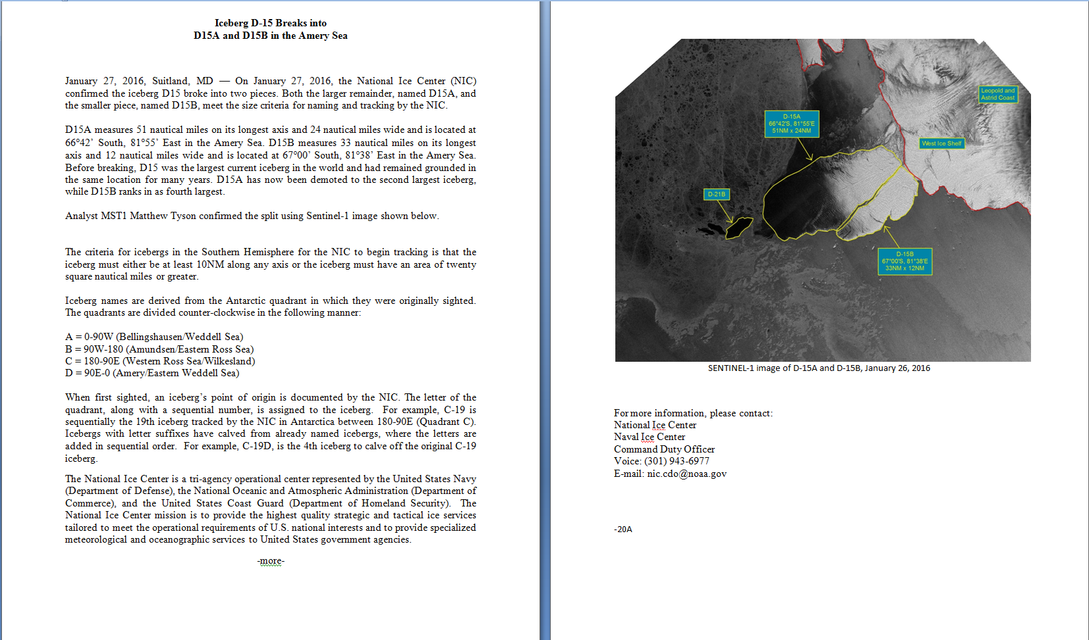
Press Release

Slide 4
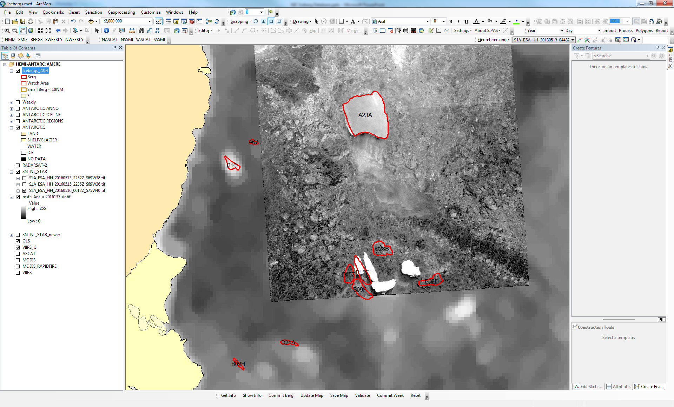
Updating

Slide 5
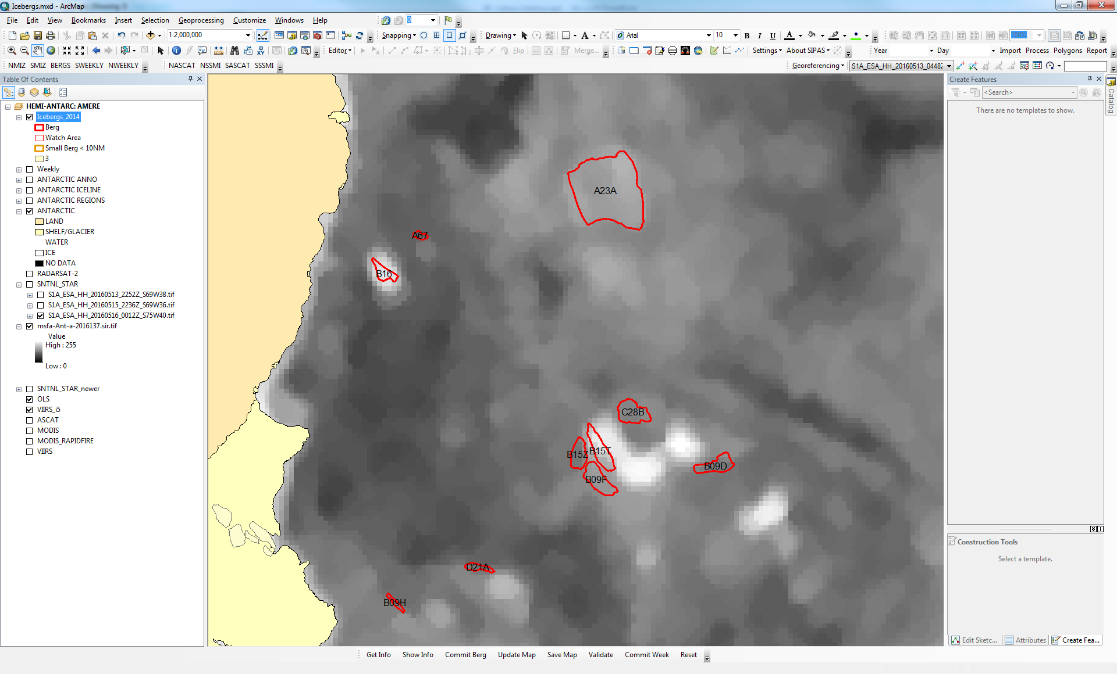
Updating

Slide 6
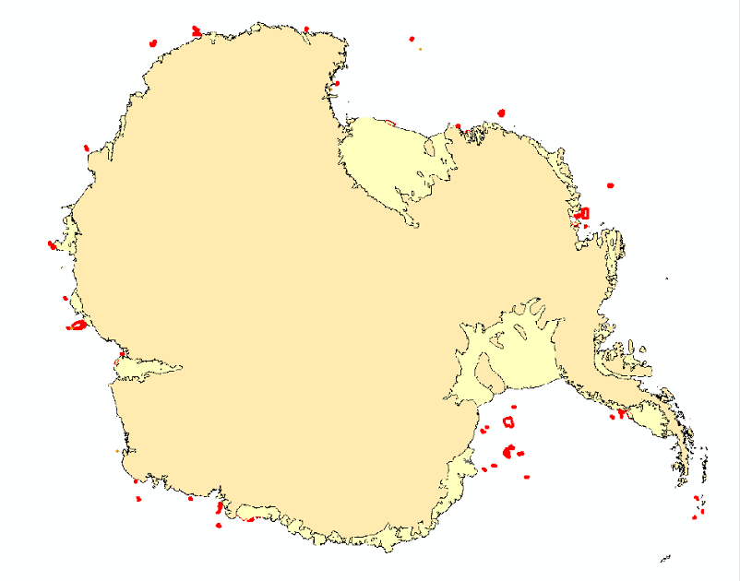
Current Icebergs

Slide 7
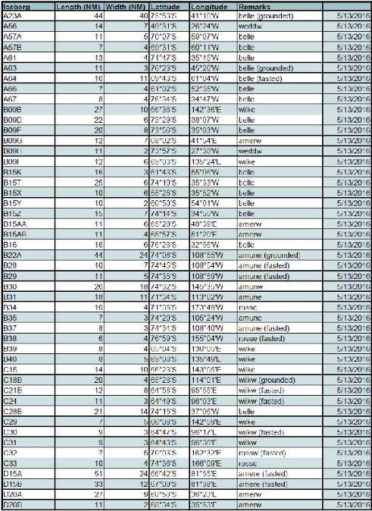
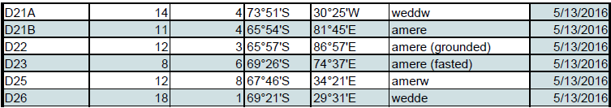
Current Icebergs

Slide 8
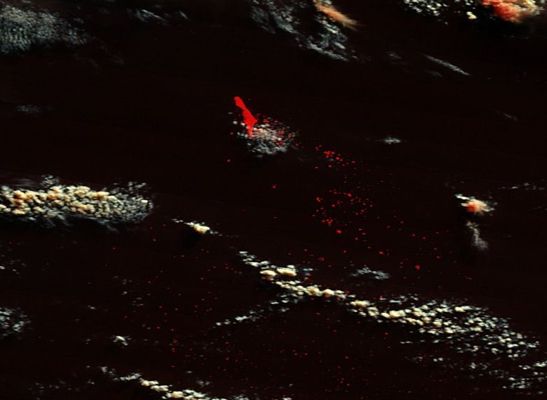
Hazard Areas
C16 - 47°S 28°E

Slide 9
The Future
Build a new tool to more efficiently track icebergs
Placing our archive database on our website so others can use it
Produce a weekly shape file of the iceberg database
A new graphical product so people can see the actual shape of each iceberg
Possible areas of danger when icebergs do not meet our tracking requirement

