Slide 1






Ship-based Sea Ice Observations in Antarctica
Penelope Wagner
Norwegian Ice Service

Slide 2
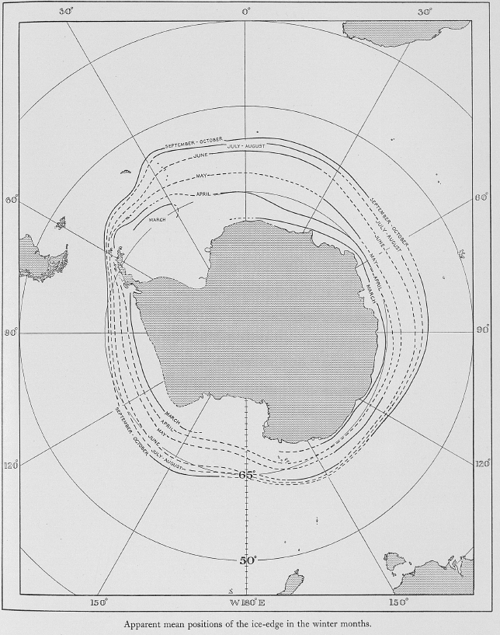
Historical Ice Extent Data
Mackintosh and Herdman (1940) first compilation of sea ice edge and extent observations from ships based on whaling records
Later updated with Mackintosh (1972)
Coarse mean monthly ice edge position
(Mackintosh, N. A. & Herdman, H. F. P. 1940: Distribution of the pack-ice in the Southern Ocean. Discovery Rep. 19, 285–296.)

Slide 3
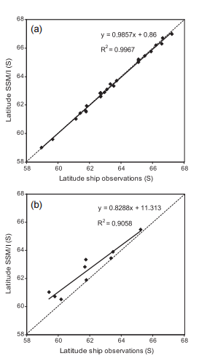
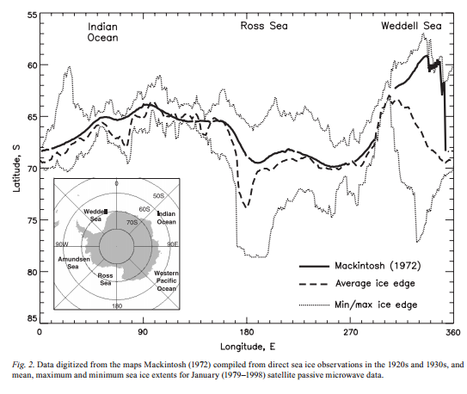
Historical Ice Extent Data
Winter (March - Oct)
Winter (March - Oct)
Summer (Nov - Dec)
Ackley, S., Wadhams, P., Comiso, J. C. and Worby, A. P. (2003), Decadal decrease of Antarctic sea ice extent inferred from whaling records revisited on the basis of historical and modern sea ice records. Polar Research, 22: 19–25. doi: 10.1111/j.1751-8369.2003.tb00091.x

Slide 4
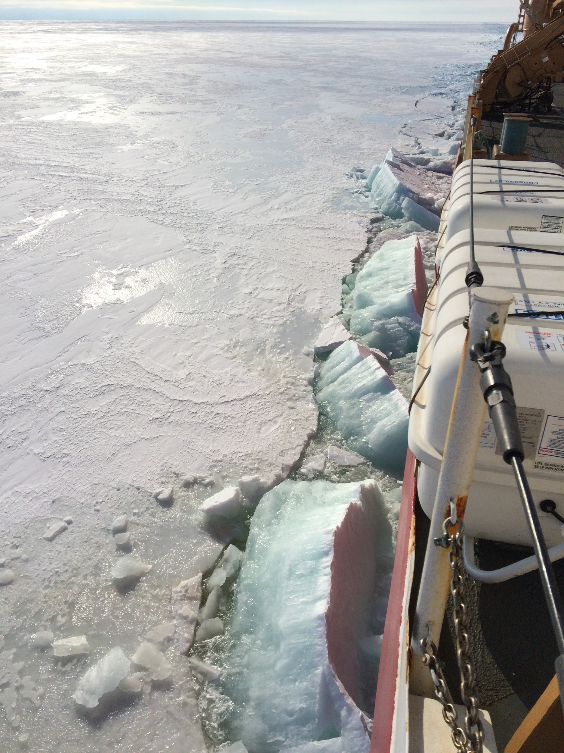
Importance of ship-based sea ice observations
Historical records indicate extent and edge location but no sea ice thickness information is available
Sea Ice
Extent and Thickness
Standardized Ship Obs
Sea Ice
Forecasts
Sea Ice
Volume

Slide 5

Antarctic Sea Ice Processes and Climate (ASPeCt)
The overall aim of ASPeCt is to understand and model the role of Antarctic sea ice in the coupled atmosphere-ice-ocean system by providing a collection of sea ice data recorded from systematic ship-based observations
Designed specifically for Antarctic sea ice conditions
Established protocol to be followed when conducting ship-based observations
Compatible with Windows, Mac OSX, and Linux
Overview and training documents accessed at: http://aspect.antarctica.gov.au/
Version 3 can be downloaded at: http://aspect-distribution.fullandbydesign.com.au/
For further information including access to the prototype version
please contact Petra Heil (Petra.Heil@utas.edu.au)

Slide 6
ASPeCt Background
Developed to determine the distribution and thickness of different ice types within the pack ice
Ice types and relevant sea ice codes from World Meteorological Organization (WMO) designations used for sea ice stage of development and ice form(1970)
Include the ship’s position, total ice concentration and an estimate of the areal coverage, thickness, floe size, topography, and snow cover characteristics of the three dominant ice thickness categories within a radius of approximately 1 km around the ship.
1.Worby, A. P. and I. Allison (1999), A technique for making ship-based observations of Antarctic sea ice thickness and characteristics, Part I: Observational technique and results, Antarctic CRC Research Report, 14, pp 1-23.
2. Worby, A. P. and V. Dirita (1999), A technique for making ship-based observations of Antarctic sea ice thickness and characteristics, Part II: User operating manual, Antarctic CRC Research Report, 14, pp 24-63.

Slide 7
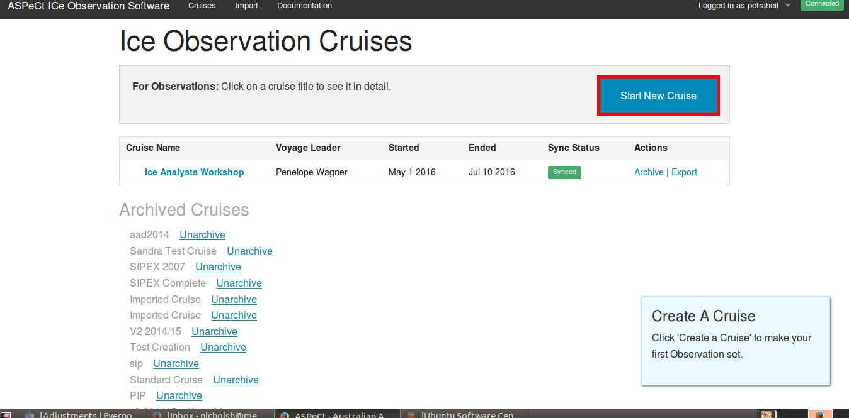
ASPeCt Interface

Slide 8
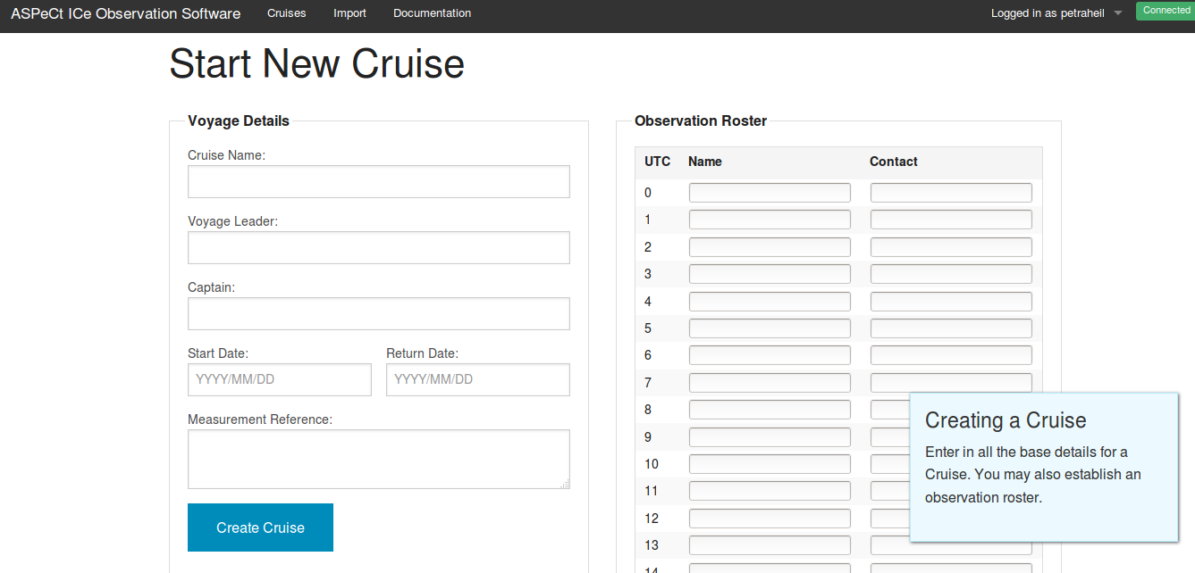

Slide 9
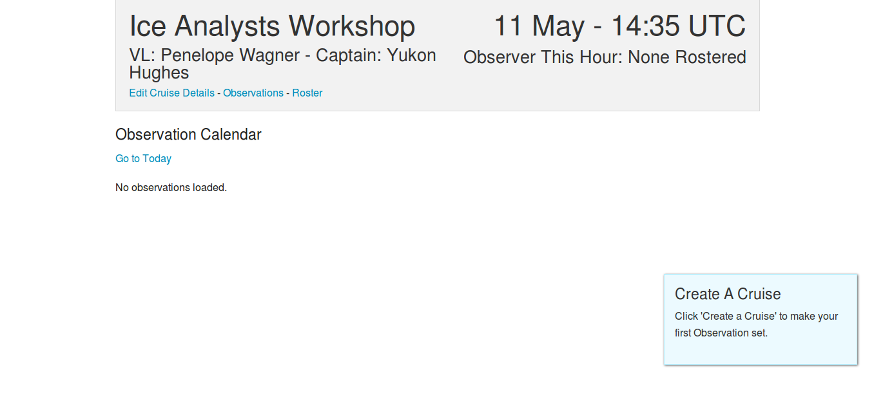

Slide 10
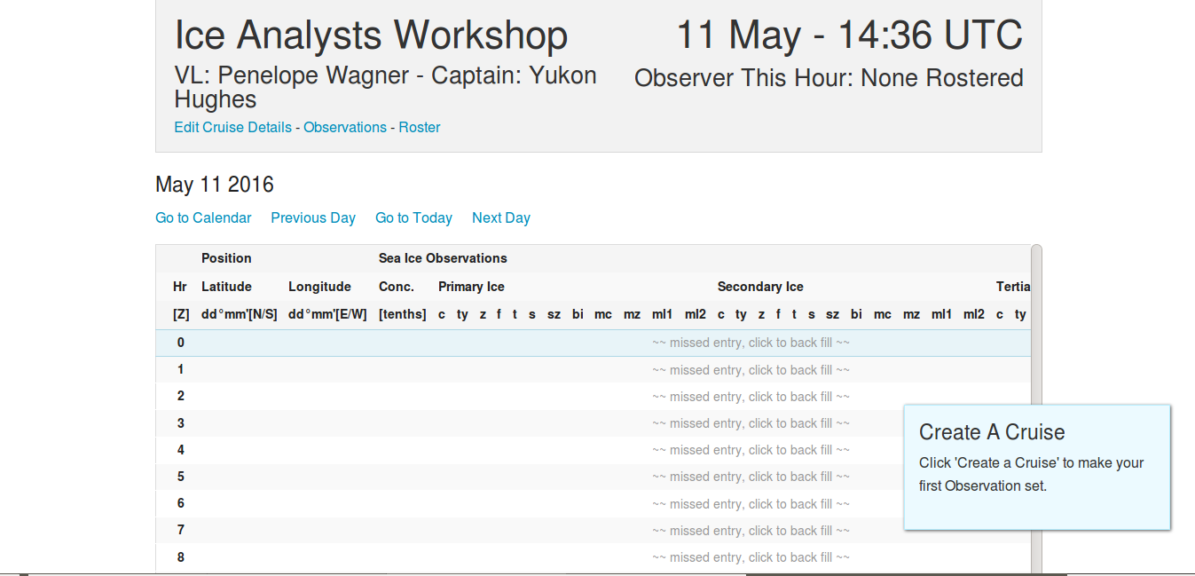

Slide 11
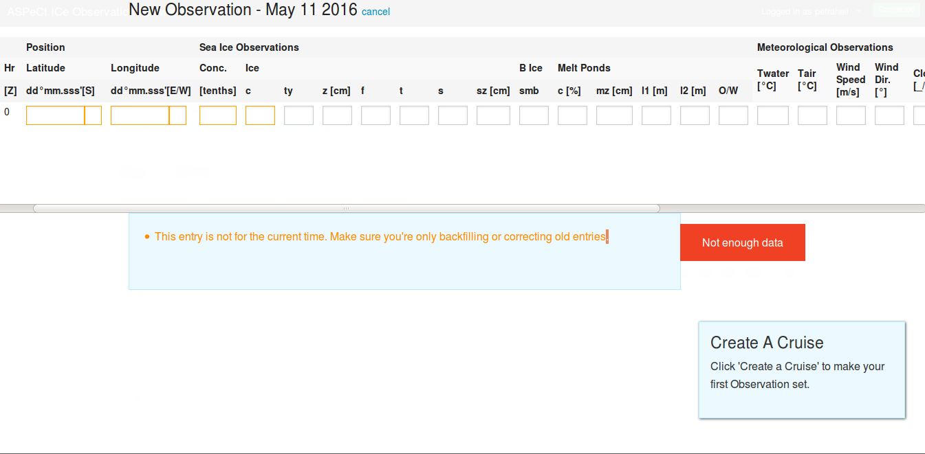

Slide 12
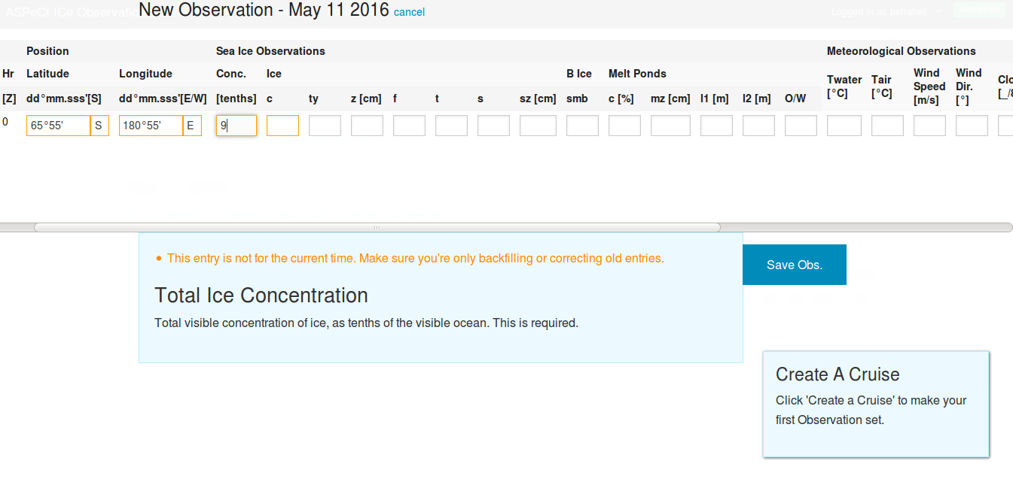

Slide 13
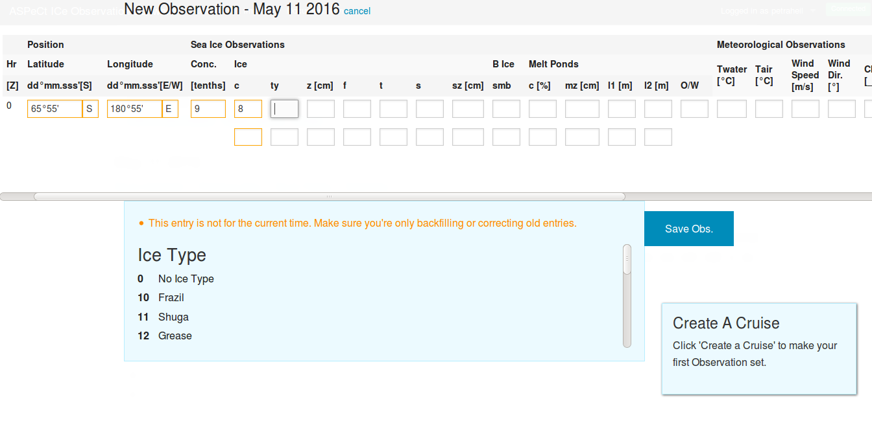

Slide 14
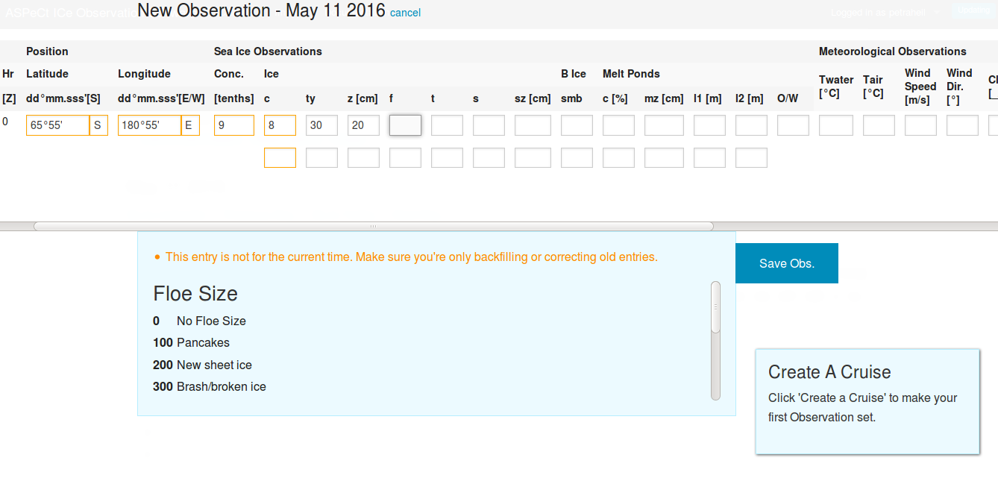

Slide 15
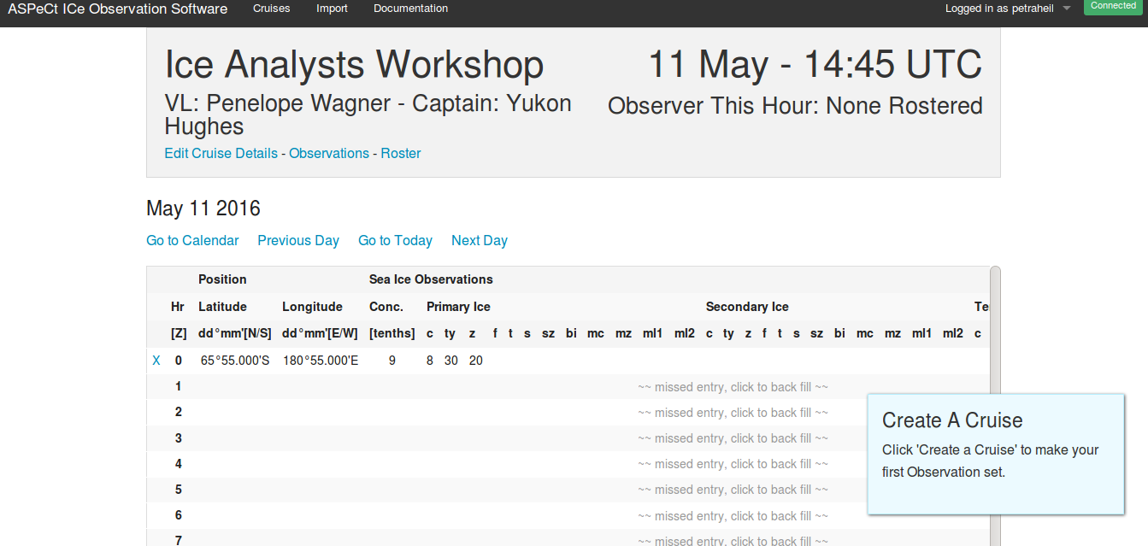

Slide 16
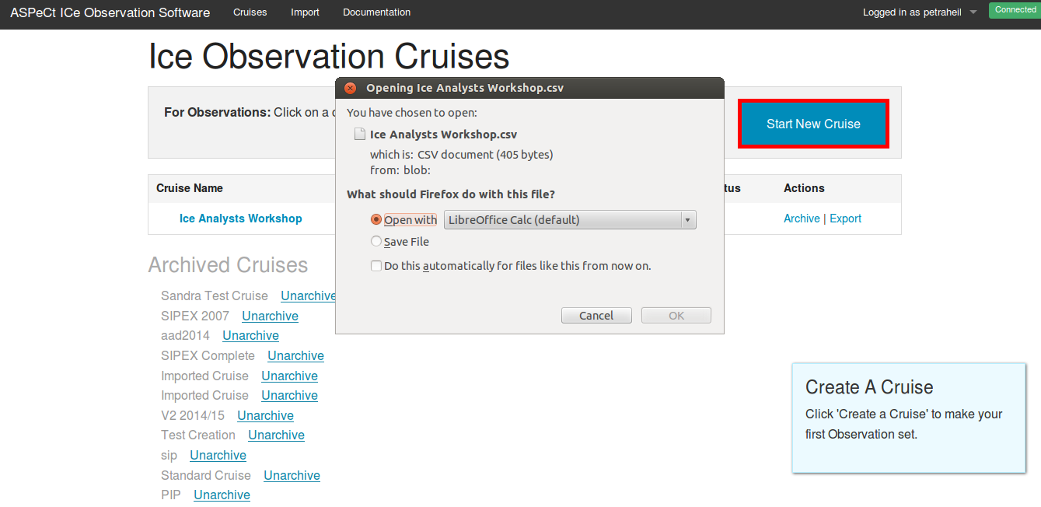

Slide 17

Arctic Shipborne Sea Ice Standardization Tool (ASSIST)
ASSIST and the Ice Watch campaign debuted in summer 2012 where Ice Watch is coordinating the collection and archival of visual sea ice observations recorded on ships in the Arctic, and can also be collected in the Southern Hemisphere.
Observations recorded with ASSIST for the Antarctic will be sent to the Australian Antarctic Division database for ASPeCt observations.
Near real-time observations of ice concentration, ice type, and distribution of multi-year ice
Compatible with Windows, Mac OSX, and Linux
Overview, software and training docs accessed at: https://sites.google.com/a/alaska.edu/ice-watch/
For further information including access to the prototype version
please contact :
Jenny Hutchings (jhutchings@coas.oregonstate.edu)

Slide 18
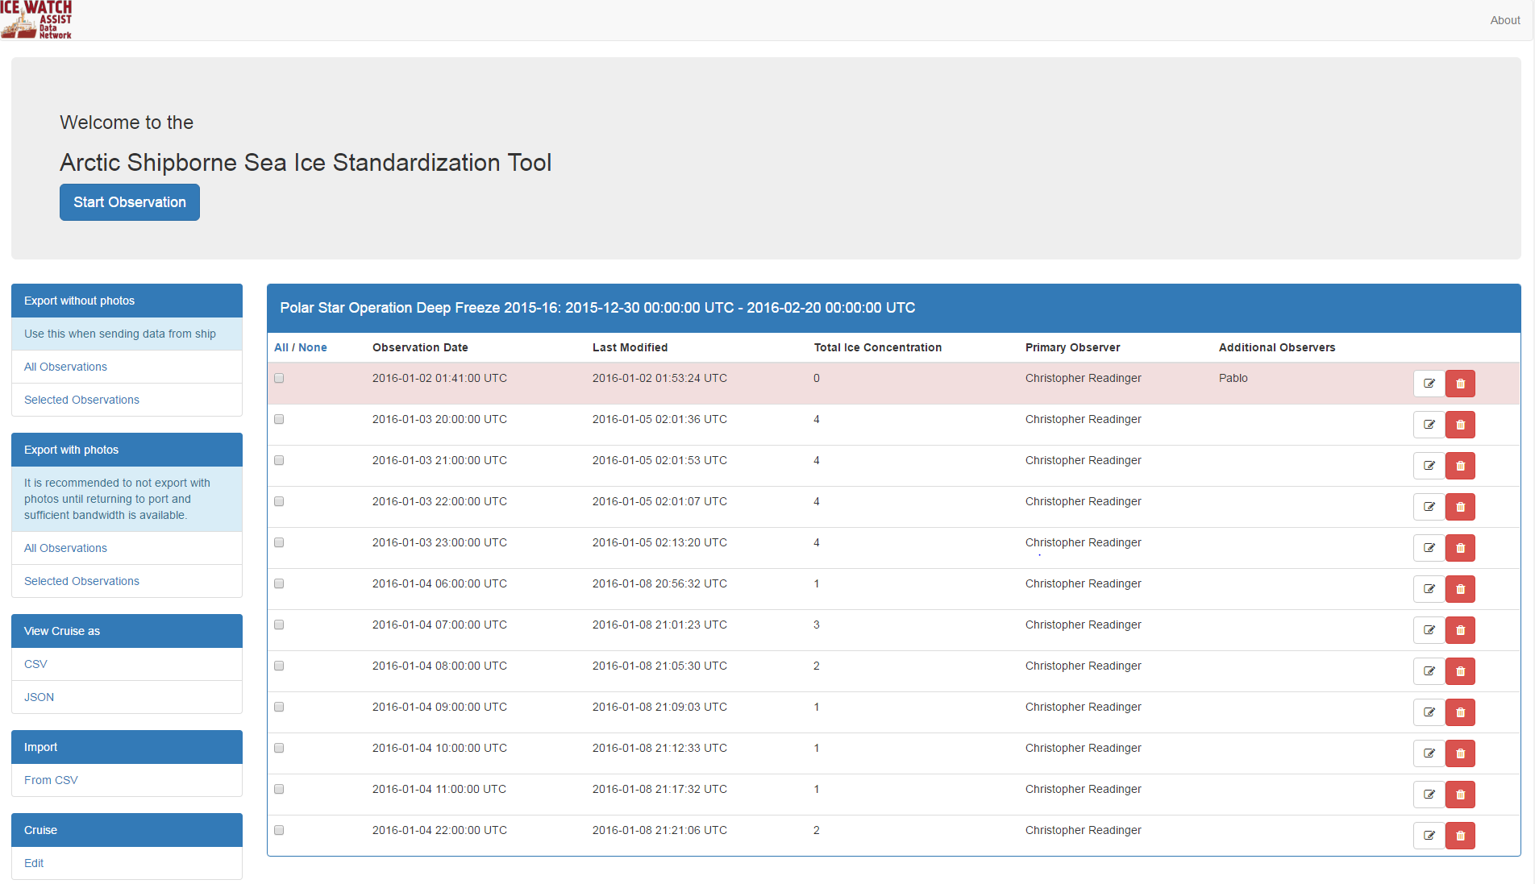

Slide 19
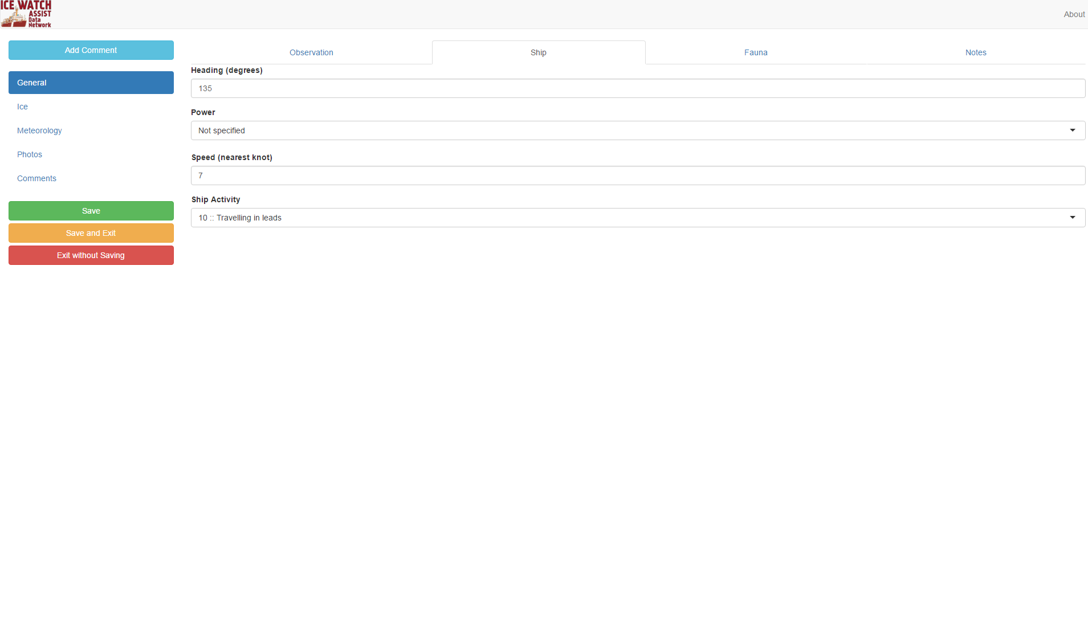

Slide 20
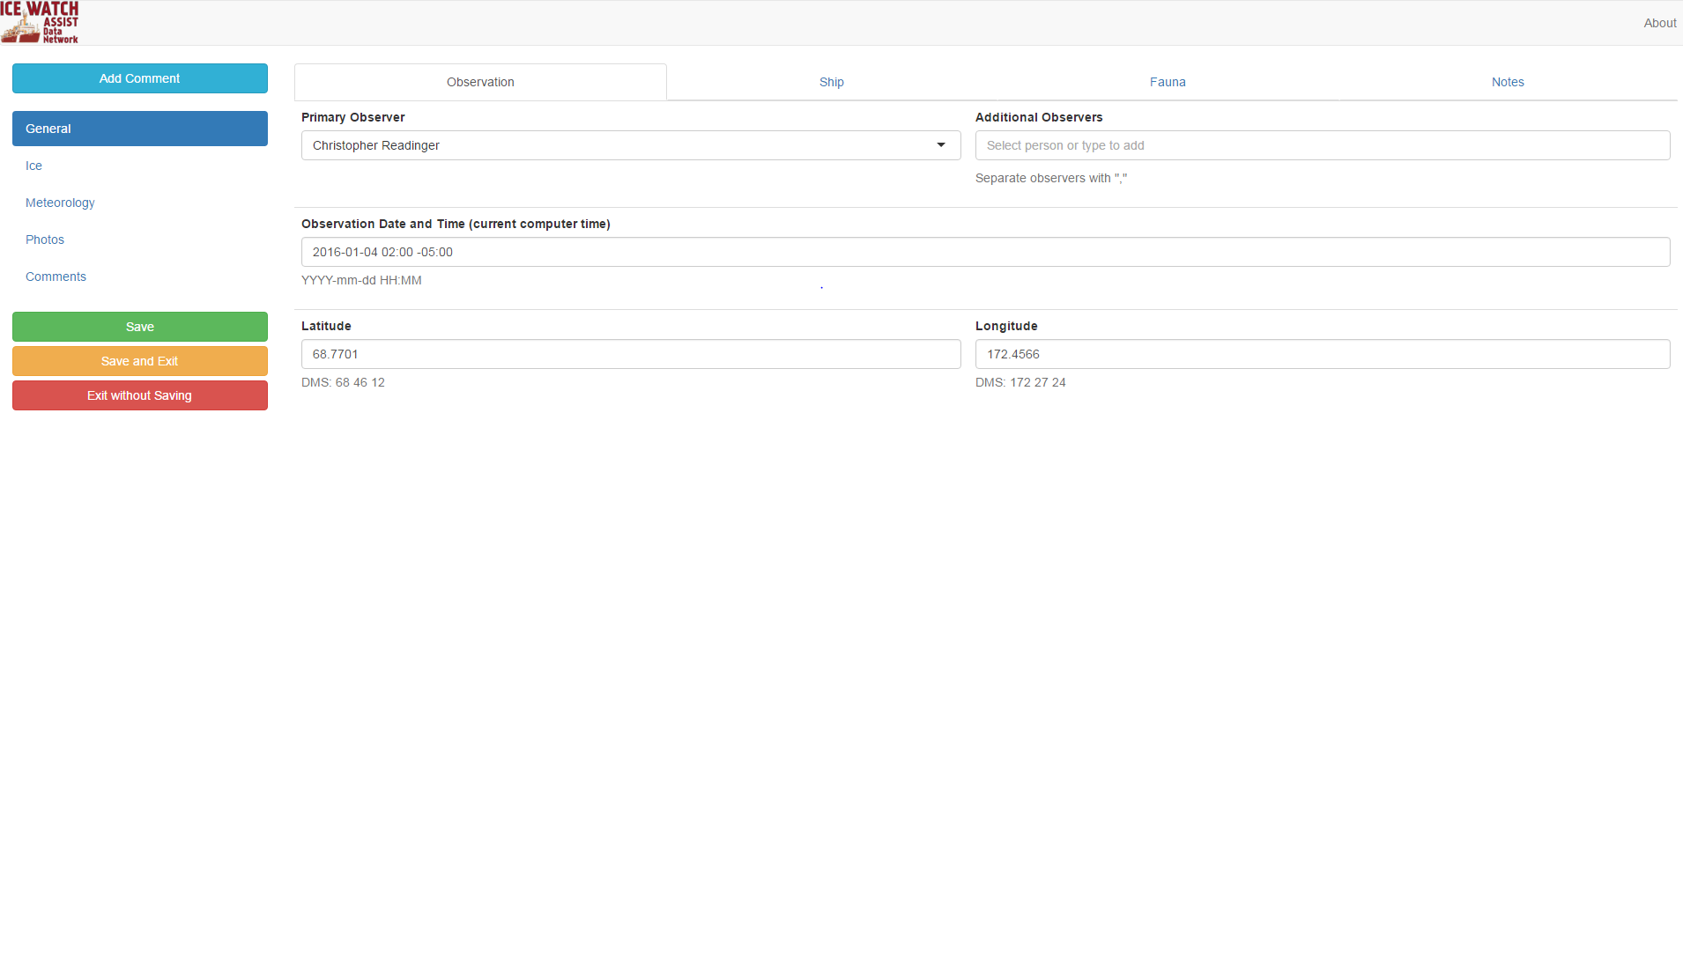

Slide 21
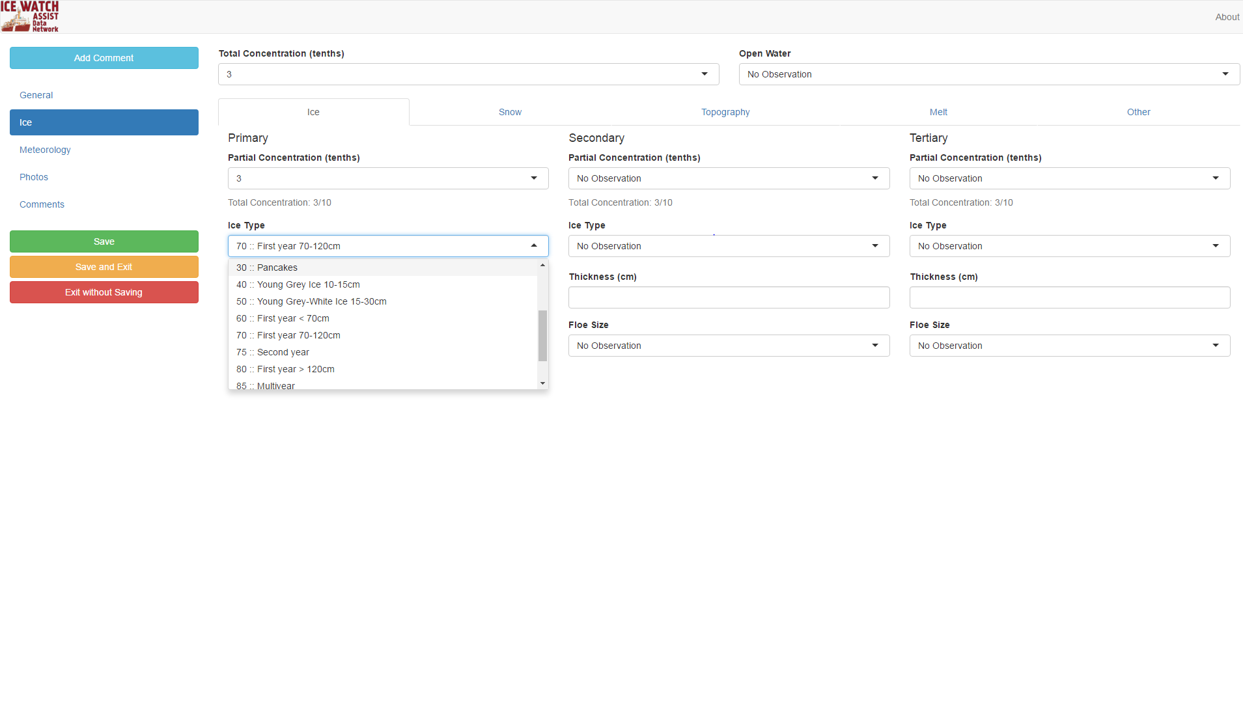

Slide 22
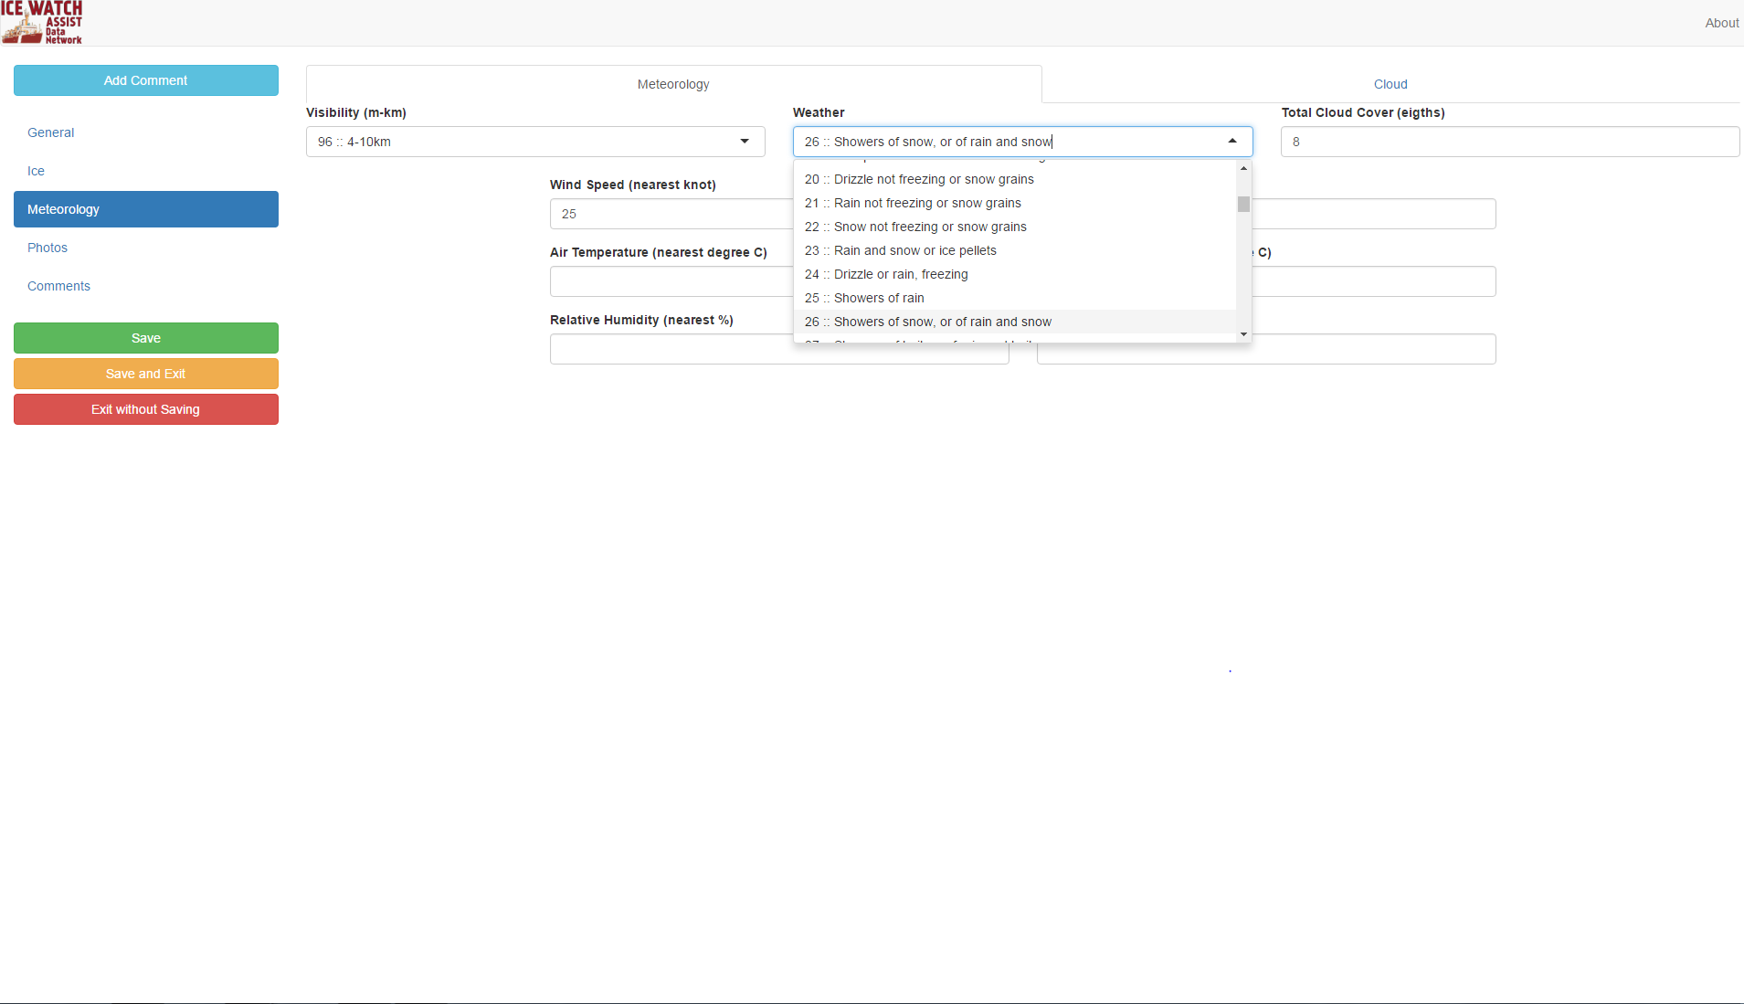

Slide 23
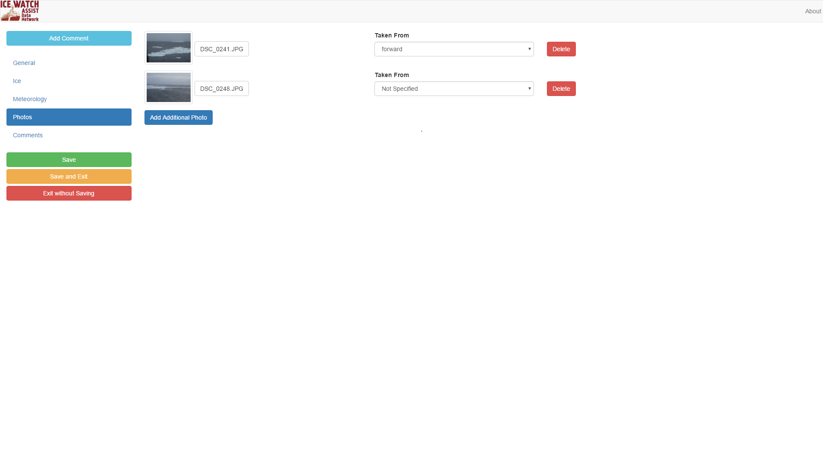

Slide 24
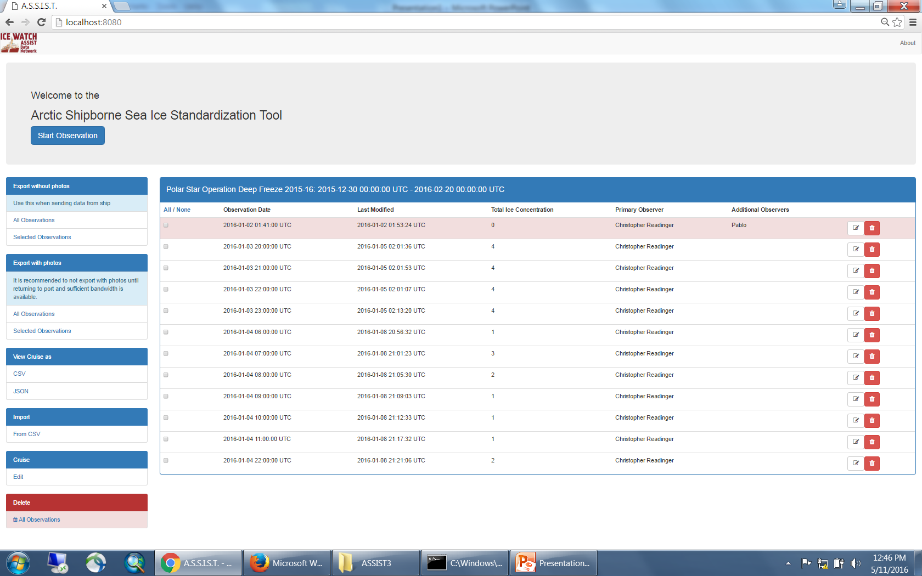
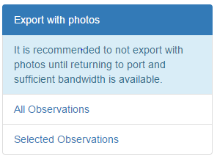

Slide 25
Differences with ASPeCt and ASSIST
ASSIST:
Additional fields in ASSIST to characterize ice conditions more typically found in the Arctic include:
  sediment and algae in ice
  fauna additional ice types
  meteorological fields
b) ASSIST is SIGRID-3 compatible
ASPeCt:
Has a longer record, particularly in the Antarctic
Includes large post-processing module to extract long-term or regional averages for level or ridged/deformed ice and ice volume in ridges etc etc.

Slide 26
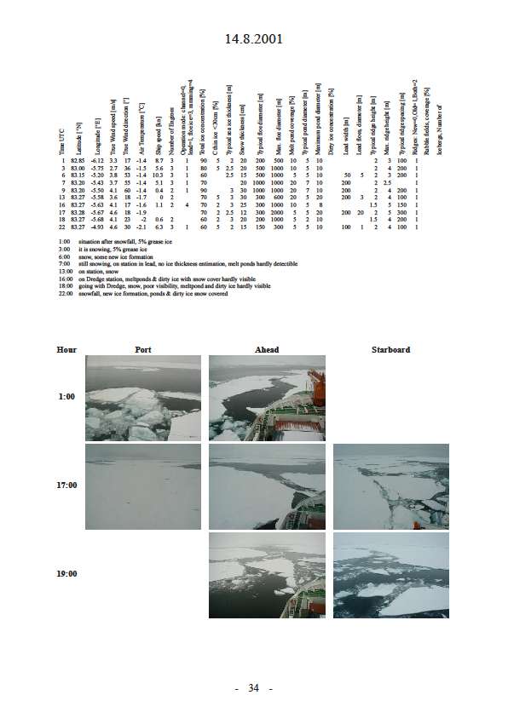
Automation to connect ship-based obs with Icecam
Haas, C. and Lieser, J. L. (2003):Sea ice conditions in the transpolar drift in August/September 2001 : observations during POLARSTERN cruise ARKTIS XVII/2 ,Berichte zur Polar- und Meeresforschung (Reports on Polar and Marine Research), Bremerhaven,Alfred Wegener Institute for Polar and Marine Research, 441 , 123 p. .

Slide 27
Questions and Discussion
Preferred ship-based observation protocol?
Similar input format but problematic to have several databases?
Central location needed for all ship observations
Need to get ship-based obs from all ships including logistic vessels (base resupply), tourist, research...etc.

