Slide 1

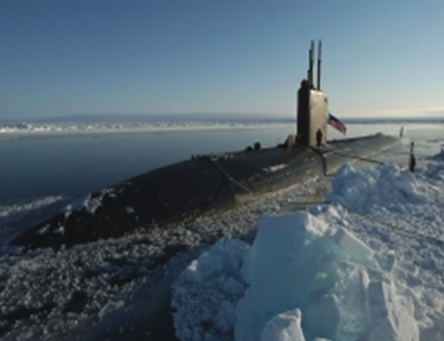
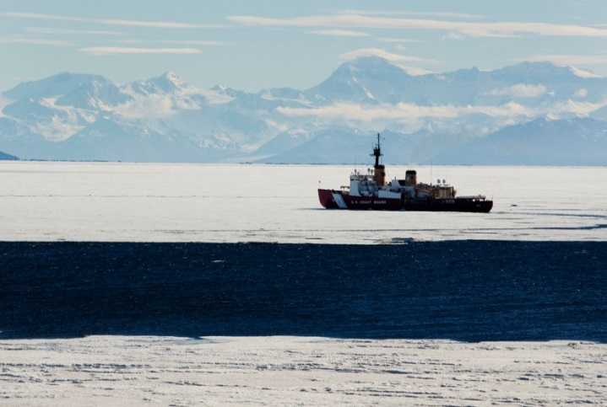
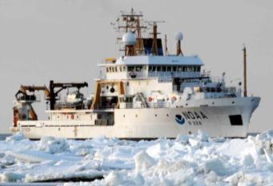
UNCLASSIFIED
Models In Southern Hemisphere
Group Discussion
5th International Ice Analyst Workshop (IAW5)
U.S. National Ice Center (NIC)
Suitland, MD, U.S.A. – 16-20 May 2016
USN
USCG
NOAA
Led by Pablo Clemente-Colón, NIC and Richard A. (Rick) Allard, NRL SSC
UNCLASSIFIED

Slide 2
Southern Hemisphere Sea Ice Forecasting
Group Discussion Guiding Questions
What requirements do ice services have for OPERATIONAL ice
forecasts?
What format(s) would be needed – GIS?
  How can (to) convert model data into usable forecast product?
Can sea ice and iceberg analysis data be included in models?
  Is there a plan for validation – how would that be done, through a
  Working Group??
Notes:
Real-Time availability of all-weather, day and night high resolution Synthetic Aperture Radar (SAR) imagery
Increase in analysis time
Cost – approx $3k per image. Purchases limited by funding
Current funding from NGA and NOAA and are not guaranteed
Total satellite coverage takes 3 days. Constellation of SAR required for tactical support
Global Hawk High-Altitude, Long-Endurance Unmanned Aerial Vehicle (HAE UAV) SAR payload is an option
Increased data volume increases processing and communications system requirement
More Analysts for increased detail and locations
Increased manning needed
Training 1-3 years for senior analyst qualification
Marine radar systems tuned to find and track ice
On board expertise by ice pilot or sea ice specialist
Deployable Ice Analysts from NIC
Increased manning needed
Ice and METOC expertise together
Seasonal ice buoy and open ocean drifting buoys
Current programs are in place but are not sufficient for requirement
Ice observation requirement for ships in Arctic waters

Slide 3

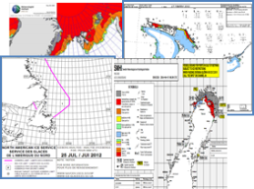

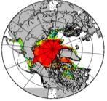
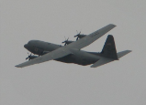
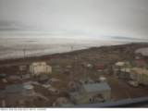
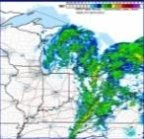
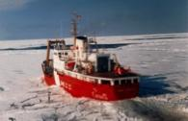

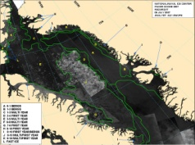
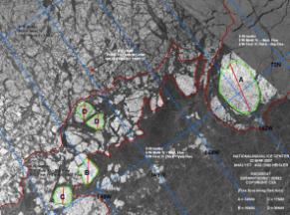
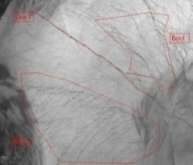
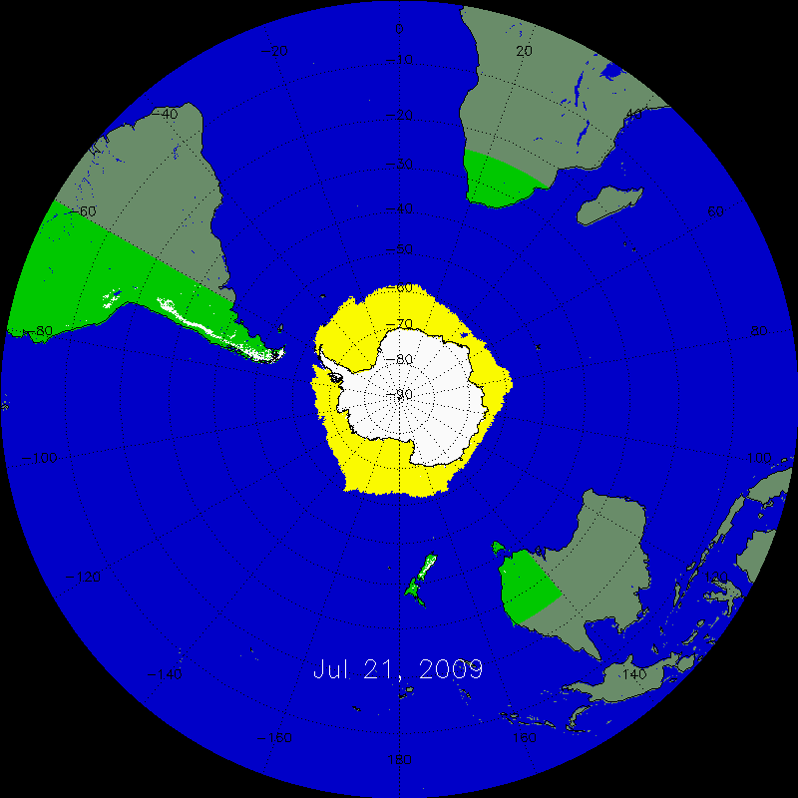
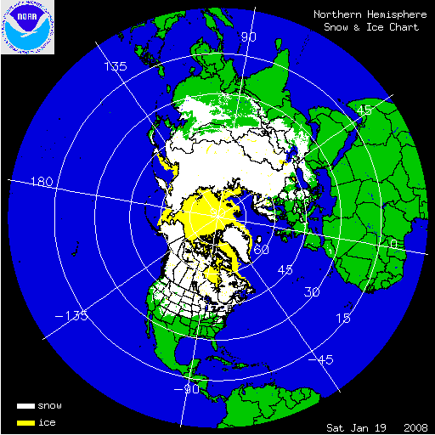
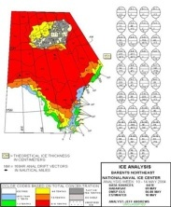
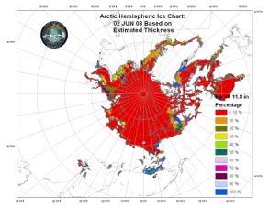
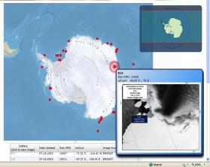
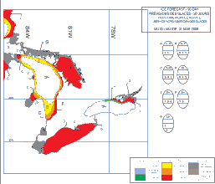
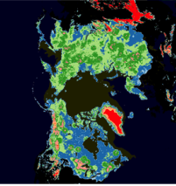
NIC Product Generation
UNCLASSIFIED
Arctic Maritime Domain Awareness
+
Buoys
Models
Aircraft
Webcam
Radar
Ship Obs
Surface Obs
International
Partners
Satellites
Geographic Information System
Fractures, Leads and Polynyas (FLAP)
Annotated Images
Interpretive Snow and Sea Ice Analysis and Sea Ice Forecasting
Meteorology
Automated Snow and Ice products
Blended Snow and ice cover
Semi-automation
Ice Thickness
Estimations
Antarctic Icebergs
Subject Matter Expertise
Hemispheric and Regional Ice Charts
Blended Snow Depth
Ice Outlooks
UNCLASSIFIED
Notes:
‹#›

Slide 4

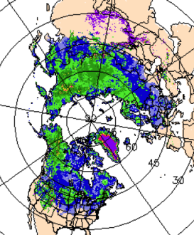
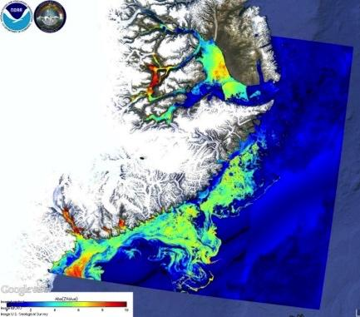
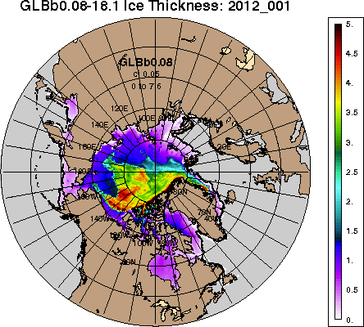
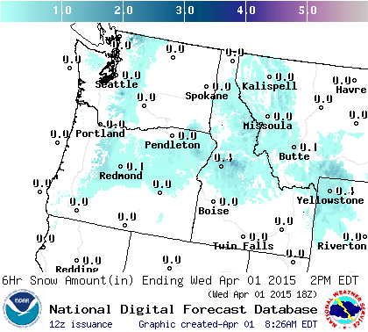
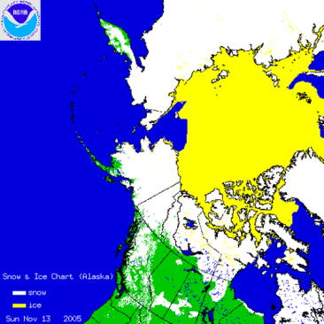
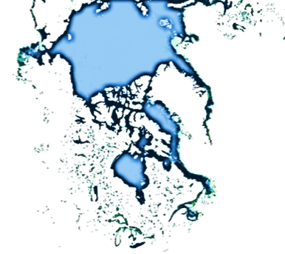

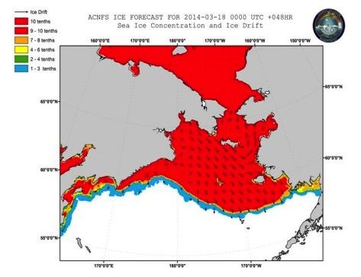
UNCLASSIFIED
Sea Ice and Snow Analysis
Integration with Models
NIC Analysis
CUSTOMERS & PUBLIC
Navy and NOAA Models
Models provide forecast guidance and NIC analysts incorporate real time data to produce interpretive analysis.
UNCLASSIFIED
Notes:
‹#›

Slide 5
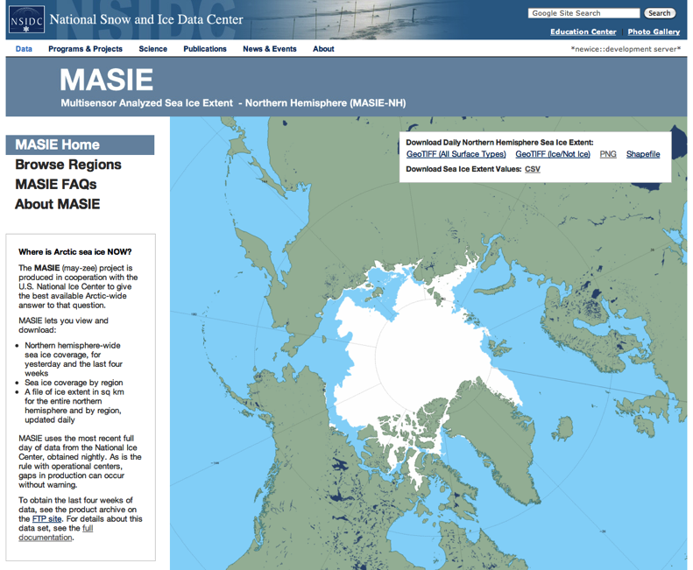
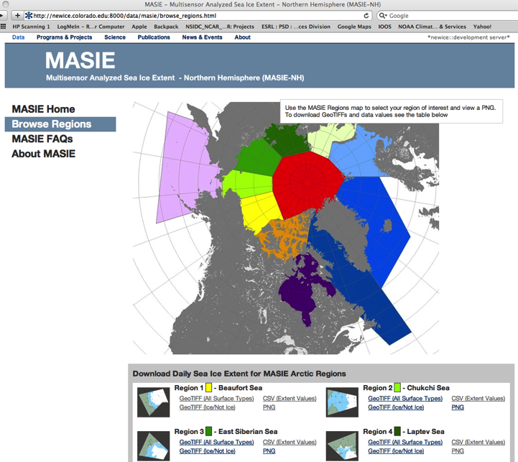
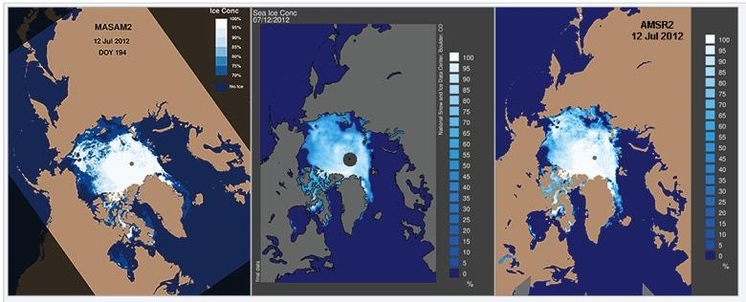
UNCLASSIFIED
MASIE and MASAM2: NSIDC Exploitation
of the NIC Ice Edge Analysis
UNCLASSIFIED
Notes:
‹#›

Slide 6
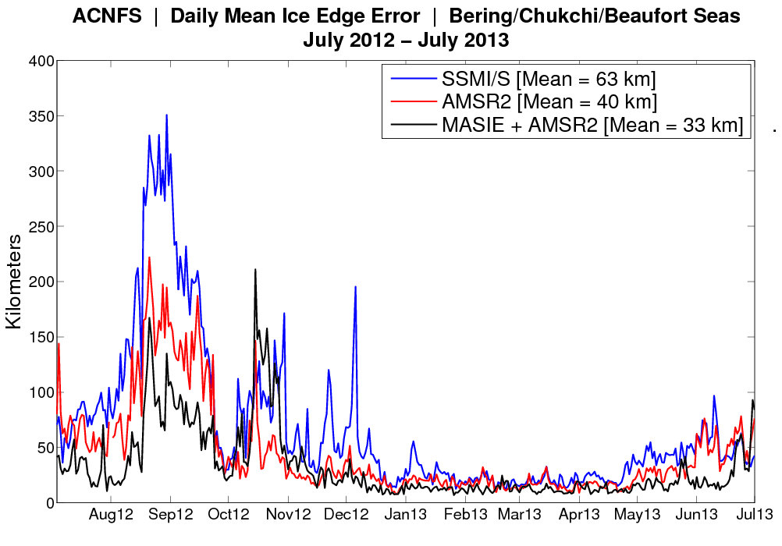
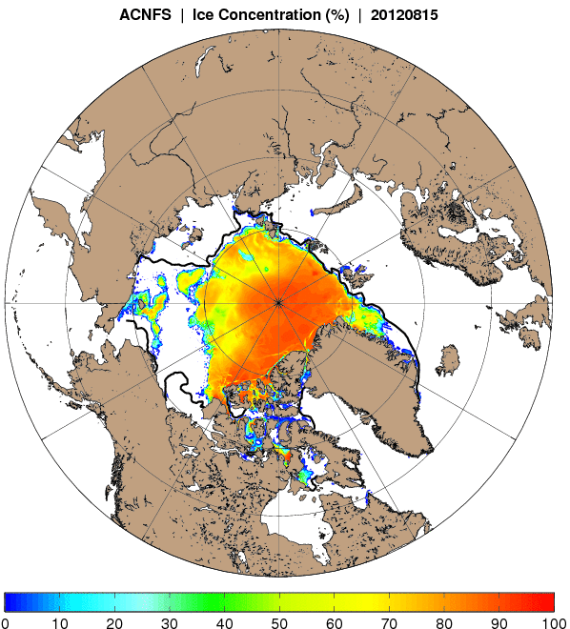
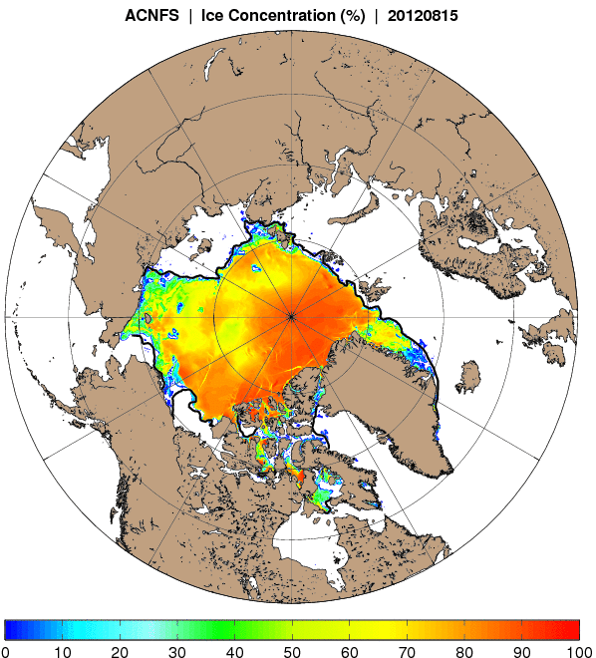
Improved Sea Ice Edge Forecasting
Through Assimilation of NIC Analysis
Since the late 1990’s, DMSP SSMI and then SSMIS ice concentration (25km) has been assimilated in the Navy’s ice forecast systems.
Passive microwave sensors have a known problem identifying melt ponds as open water which leads to underestimating sea ice especially during the summer.
Developed technique with National Snow and Ice Data Center (NSIDC) to assimilate: AMSR2 (10km) and NIC’s Interactive Multisensor Snow and Ice Mapping System (IMS) ice mask (4km).
The blended product (black) during the summer period (Aug/Sep) shows the greatest reduction in daily mean error.
ACNFS Ice Concentration
15 Aug 2012
SSMIS only
ACNFS Ice Concentration
15 Aug 2012
AMSR2 and IMS
Sensitivity studies assimilating SSMIS, AMSR2 and IMS data sources were completed.
Adding in new data sources (AMSR2 and IMS), overall ice edge errors in the Arctic were reduced by 36% and 56% (year and summer, respectively).
Submitted paper to “The Cryosphere” – Posey et al., 2015
Dark line is NIC’s
ice edge location
New data sources implemented into
ACNFS and GOFS 3.1 on 2 Feb 2015.
Notes:
Better daily sea ice forecasts for the Arctic following CU-Boulder-led innovation
Ice experts from the University of Colorado Boulder, the U.S. Navy, the U.S. National Ice Center and other institutions have developed a straightforward new technique for estimating sea ice concentration in the Arctic Ocean, and the new method improves the U.S. Navy’s short-term sea ice forecast of ice edge location by almost 40 percent . With shipping on the rise in the Arctic Ocean, improving these short-term forecasts makes navigating in Arctic waters safer.
The Navy, the National Oceanic and Atmospheric Administration (NOAA) and others have been seeking to improve sea ice forecasts, said Pamela Posey of the U.S. Naval Research Laboratory (NRL) in Mississippi. In the remote Arctic, unanticipated sea ice can slow science research vessels and create problems for Navy submarines.
“It’s especially important to have accurate forecasts given rapidly changing conditions in the Arctic,” Posey said.
The new system—which captures current sea-ice conditions more accurately and in greater detail by blending several streams of data—has been used operationally in Navy forecasting since February, Posey said. Florence Fetterer with the National Snow and Ice Data Center (NSIDC) and colleagues developed the blended input approach, and NRL has now shown it improves 6-hour forecast accuracy by 40 percent year-round. During the summer, forecasts improved even more than that, they reported in a paper in The Cryosphere, a journal of the European Geosciences Union.
NSIDC is part of the Cooperative Institute for Research in Environmental Sciences (CIRES) at the University of Colorado Boulder.
The new ingredients now going into the Navy’s official sea ice forecasts are satellite data and human interpretation of sea ice presence or absence from satellite sources, said Pablo Clemente-Colón, Chief Scientist of the U.S. National Ice Center, a collaboration of the Navy, NOAA and the U.S. Coast Guard. “This is one of the first times that human analysis is ingested operationally into a major forecast model,” he said.
A couple years ago, Posey and others recognized that sea ice forecast models—used by Navy submarines, the U.S. Coast Guard and many others just as they use weather forecasts—had improved, with more detailed or “higher resolution” output. But just as with weather forecasts, these models have to start with accurate initial conditions, and observations of sea ice had not kept pace with models. The Naval Research Laboratory asked experts at NSIDC to see what could be done. we'll update link as it becomes available

Slide 7
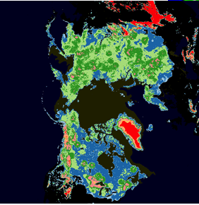
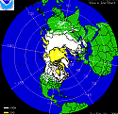
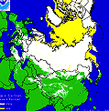
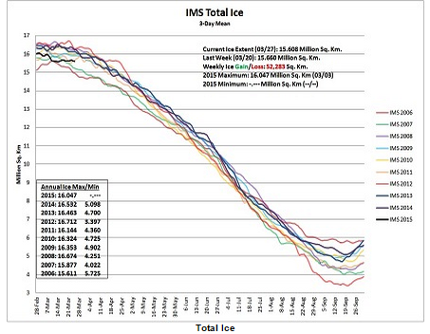
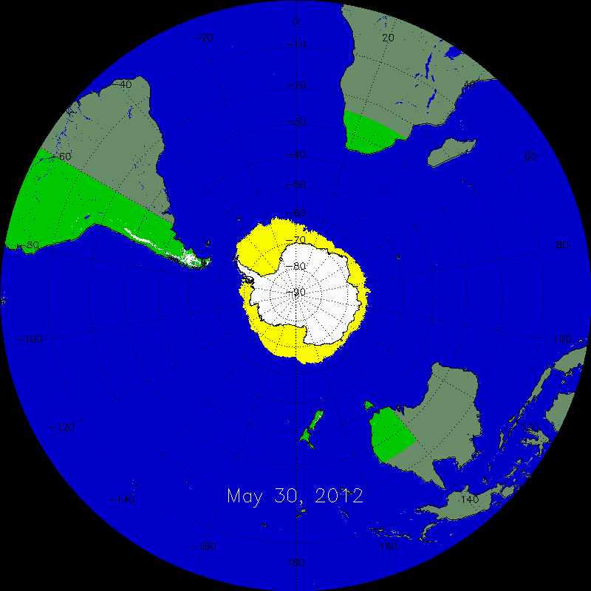
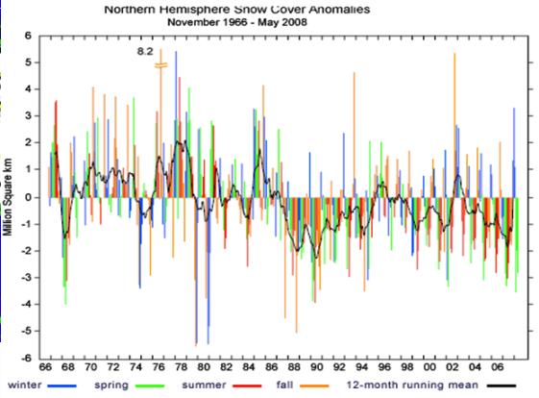
NIC Interactive Multisensor Snow and Ice
Mapping System (IMS) Products
UNCLASSIFIED
Primary Customers
  NOAA NWS NCEP Environmental Modeling Center (EMC)
  Climate Prediction Center (CPC)
Secondary Customers
  US Army
  US Air Force
  US Department of Agriculture
  Great Lakes Engineering Research Lab
  NOAA SSD
  US Department of Transportation
  Environment Canada
  ECMWF
  UK Met
  Fleet Numerical Meteorology and Oceanography Center
  Naval Oceanographic Office
  Numerous Universities
  Media Outlets such as: Weather Channel,
  AccuWeather
  Private Companies
  General Public
UNCLASSIFIED
Notes:
‹#›

Slide 8


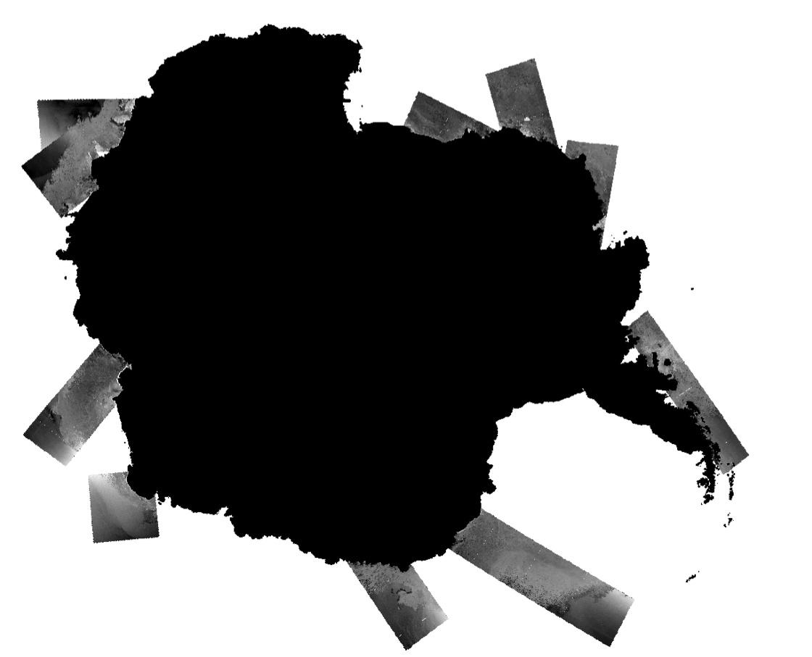

27 May 2015
Increased Synthetic Aperture Radar Coverage
Sentinel-1a (S-1a) SAR Arctic Mosaics

Slide 9
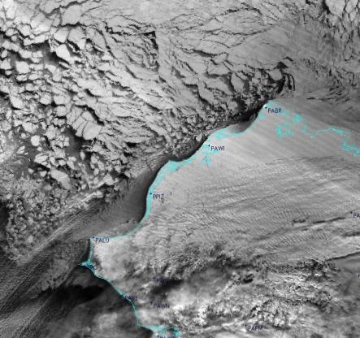
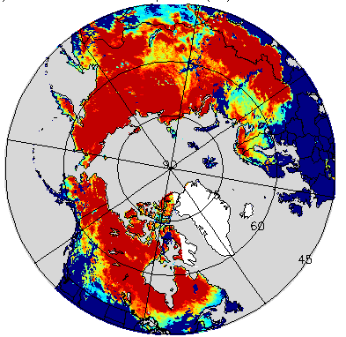
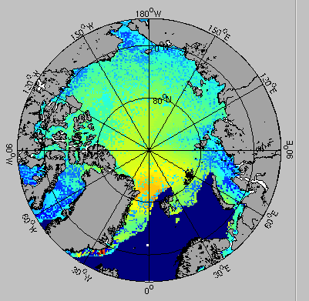

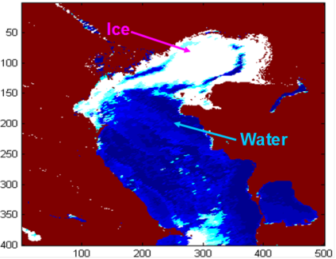
Increased Coverage from JPSS and GOES R Missions
NIC applies imagery and derived data from NASA/NOAA Suomi NPP
  High resolution visible channels
  High resolution infrared channels
  Visible imagery at night, needed for the polar winters
  Sea ice concentrations
  Snow cover detection
  Microwave snow depth and sea ice concentrations
SNPP Visible imagery at night over Alaska
Snow water equivalent (SWE) using microwave data. Hot colors = More SWE
JPSS & GOES R Next Generation NASA/NOAA Satellites should further enhance the ability to detect ice and snow
  JPSS will offer a follow-on to Suomi-NPOESS Preparatory Project
  JPSS algorithms more applicable to NOAA/NIC needs
  GOES R has better capacity
  Partnerships (ESA, JAXA, CSA) for global coverage
GOES R Simulated Ice Cover
JPSS Simulated Ice Thickness

Slide 10
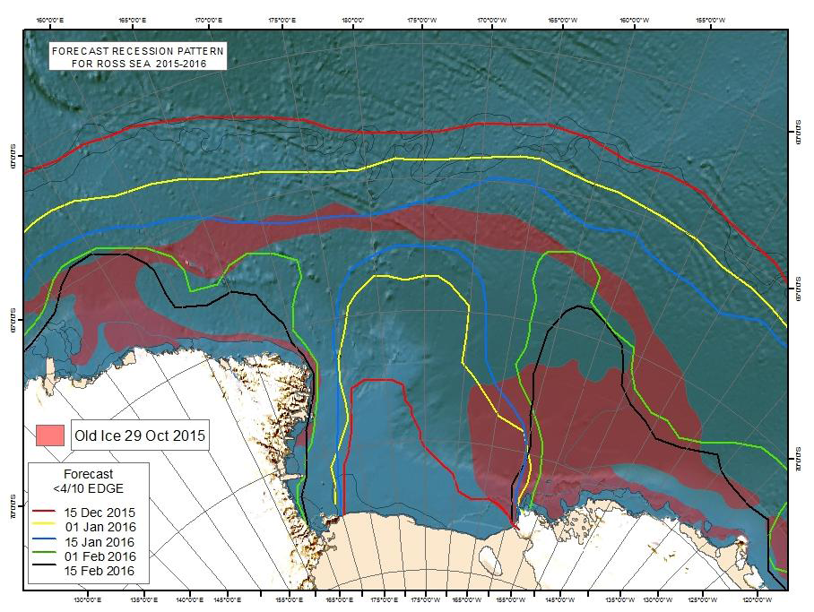
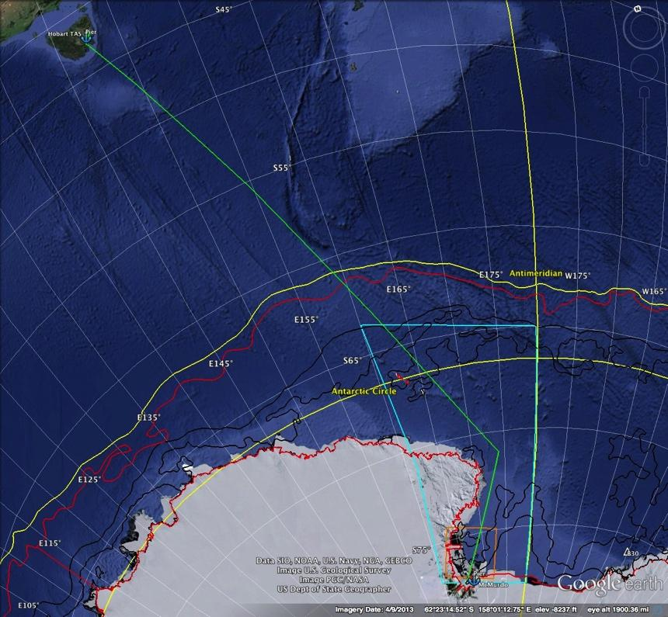
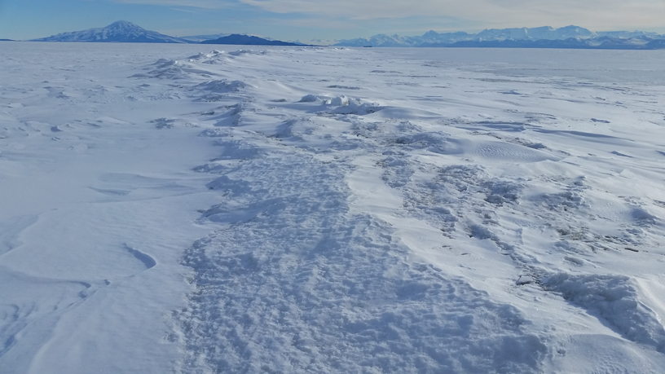
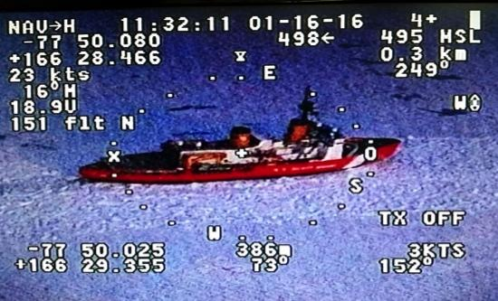
Operation Deep Freeze (ODF)
McMurdo Station Resupply Tactical Support
Operation Deep Freeze (ODF)
Annual Support ~ December-February
Military Sealift Command
AV Puma UAS
real-time video
Notes:
MSC – military Sealift Command

Slide 11
We Look Forward To
Strengthening partnerships and collaboration with other national ice services on Arctic and Antarctic data collection, sea ice charting, training, research, and other safety of navigation issues
Increasing exploitation of Synthetic Aperture Radar (SAR) and other satellite data resources
  Promoting operational access to near-real time availability of all-weather, day and night, high resolution (SAR) imagery
Increasing automation going into snow and sea ice blended products and analysis
  Expanding buoy programs data collection to include seasonal ice buoys; open ocean drifting buoys; hydrographic sensors; and unmanned airborne and underwater vehicles (UAVs and UUVs)
Improving modeling and forecasting capabilities for optimum track ship routing (OTSR) and other applications
Notes:
Real-Time availability of all-weather, day and night high resolution Synthetic Aperture Radar (SAR) imagery
Increase in analysis time
Cost – approx $3k per image. Purchases limited by funding
Current funding from NGA and NOAA and are not guaranteed
Total satellite coverage takes 3 days. Constellation of SAR required for tactical support
Global Hawk High-Altitude, Long-Endurance Unmanned Aerial Vehicle (HAE UAV) SAR payload is an option
Increased data volume increases processing and communications system requirement
More Analysts for increased detail and locations
Increased manning needed
Training 1-3 years for senior analyst qualification
Marine radar systems tuned to find and track ice
On board expertise by ice pilot or sea ice specialist
Deployable Ice Analysts from NIC
Increased manning needed
Ice and METOC expertise together
Seasonal ice buoy and open ocean drifting buoys
Current programs are in place but are not sufficient for requirement
Ice observation requirement for ships in Arctic waters

Slide 12
Southern Hemisphere Sea Ice Forecasting
Group Discussion Guiding Questions
What requirements do ice services have for OPERATIONAL ice
forecasts?
What format(s) would be needed – GIS?
  How can (to) convert model data into usable forecast product?
Can sea ice and iceberg analysis data be included in models?
  Is there a plan for validation – how would that be done, through a
  Working Group??
Notes:
Real-Time availability of all-weather, day and night high resolution Synthetic Aperture Radar (SAR) imagery
Increase in analysis time
Cost – approx $3k per image. Purchases limited by funding
Current funding from NGA and NOAA and are not guaranteed
Total satellite coverage takes 3 days. Constellation of SAR required for tactical support
Global Hawk High-Altitude, Long-Endurance Unmanned Aerial Vehicle (HAE UAV) SAR payload is an option
Increased data volume increases processing and communications system requirement
More Analysts for increased detail and locations
Increased manning needed
Training 1-3 years for senior analyst qualification
Marine radar systems tuned to find and track ice
On board expertise by ice pilot or sea ice specialist
Deployable Ice Analysts from NIC
Increased manning needed
Ice and METOC expertise together
Seasonal ice buoy and open ocean drifting buoys
Current programs are in place but are not sufficient for requirement
Ice observation requirement for ships in Arctic waters

Slide 13
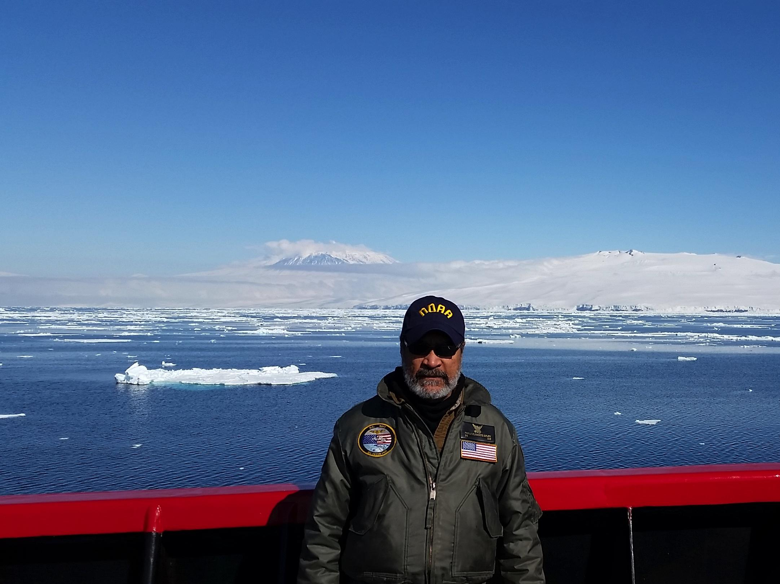
Thanks

