Slide 1
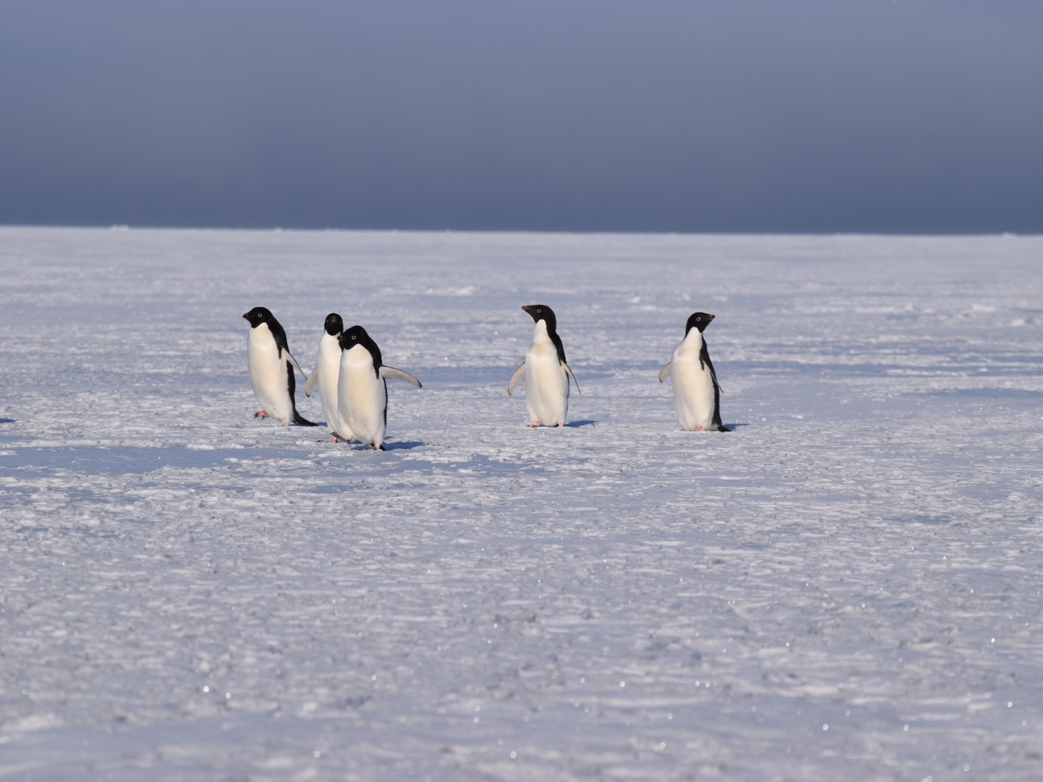
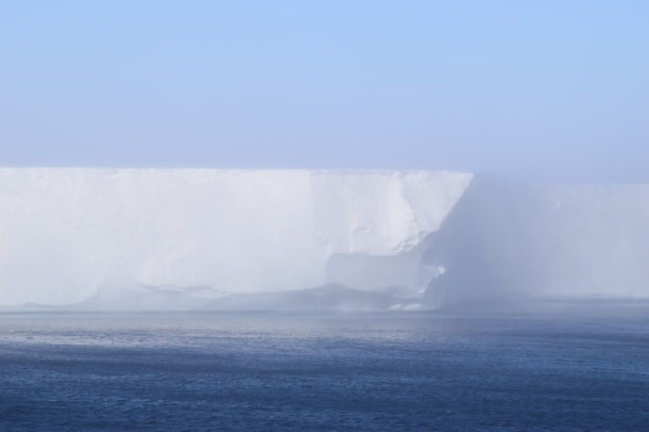
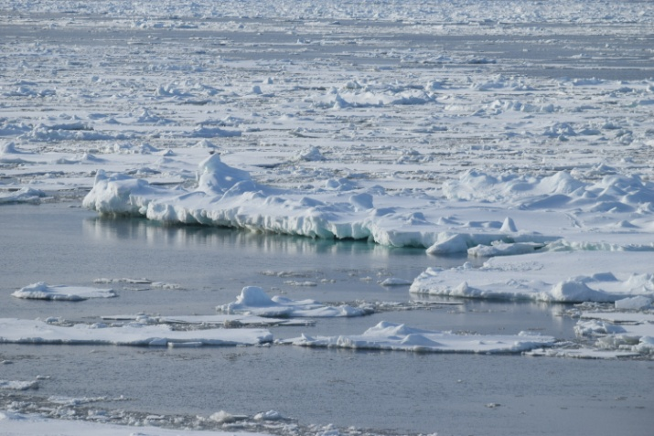
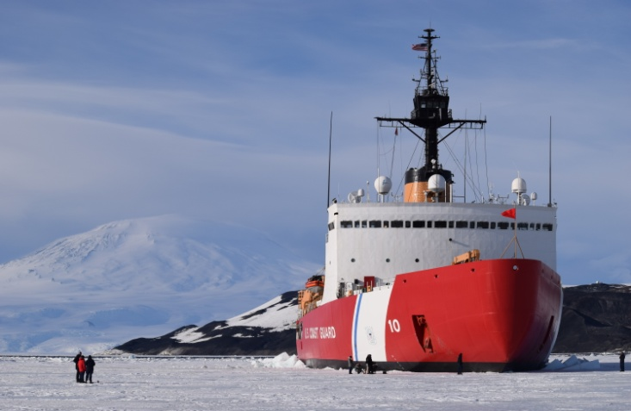
Operation Deep Freeze 2016
NIC Operational Support Onboard USCGC Polar Star
Chris Readinger
Ice Analyst
National Ice Center
IAW5 5/19/2016

Slide 2
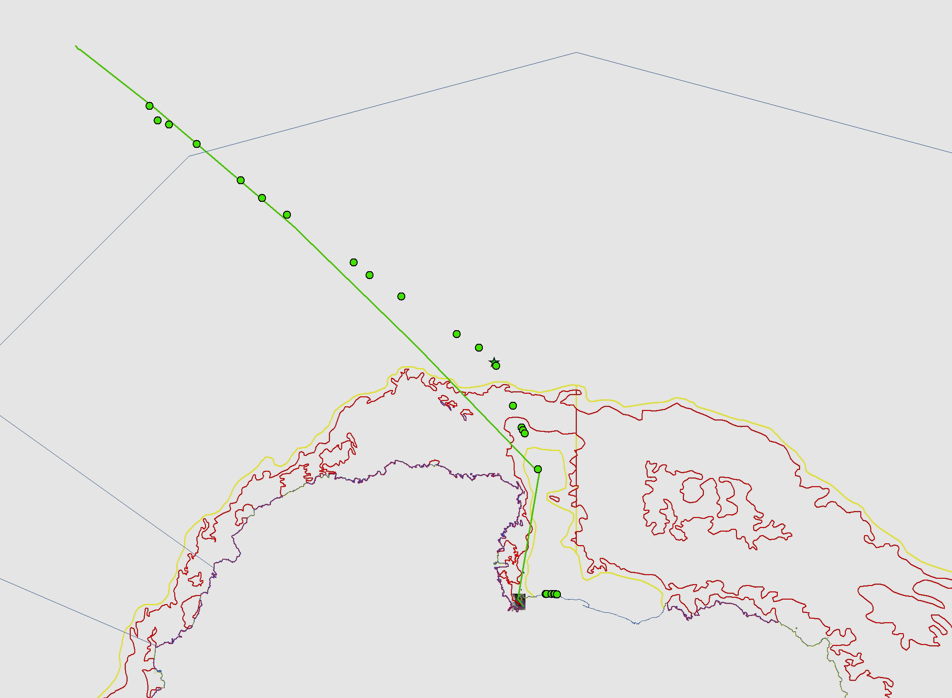
Track from Hobart to McMurdo Sound

Slide 3
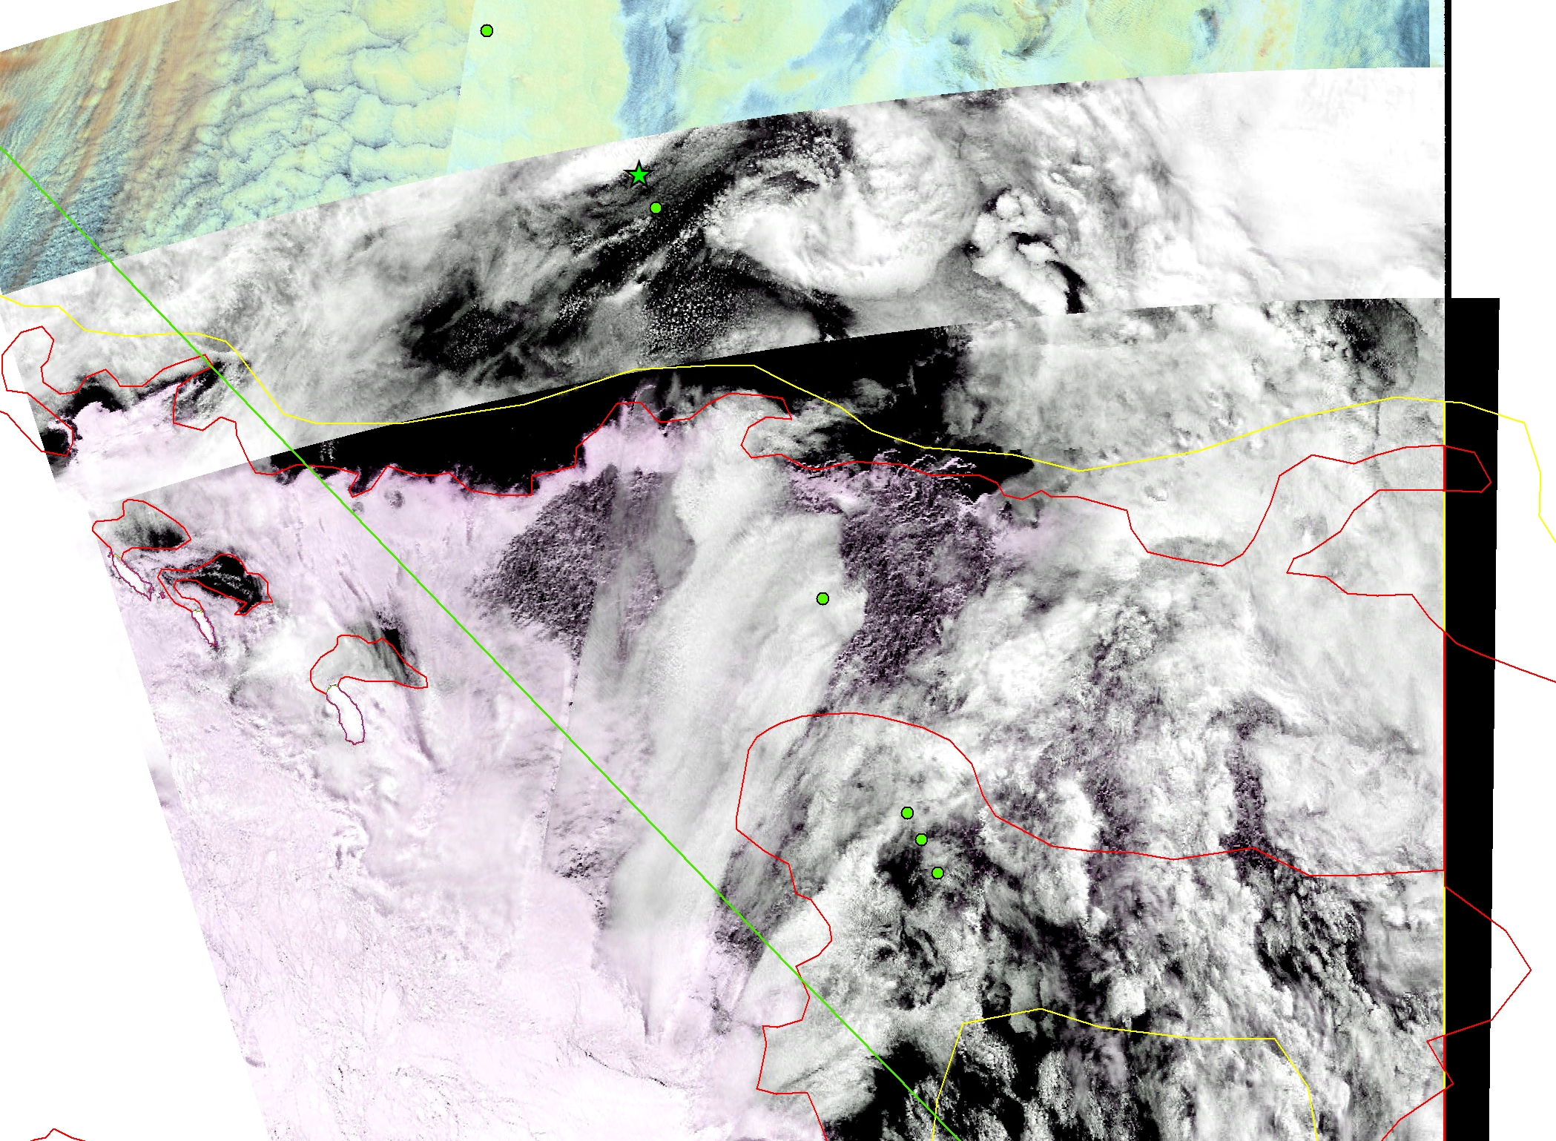
MODIS 5 JAN

Slide 4
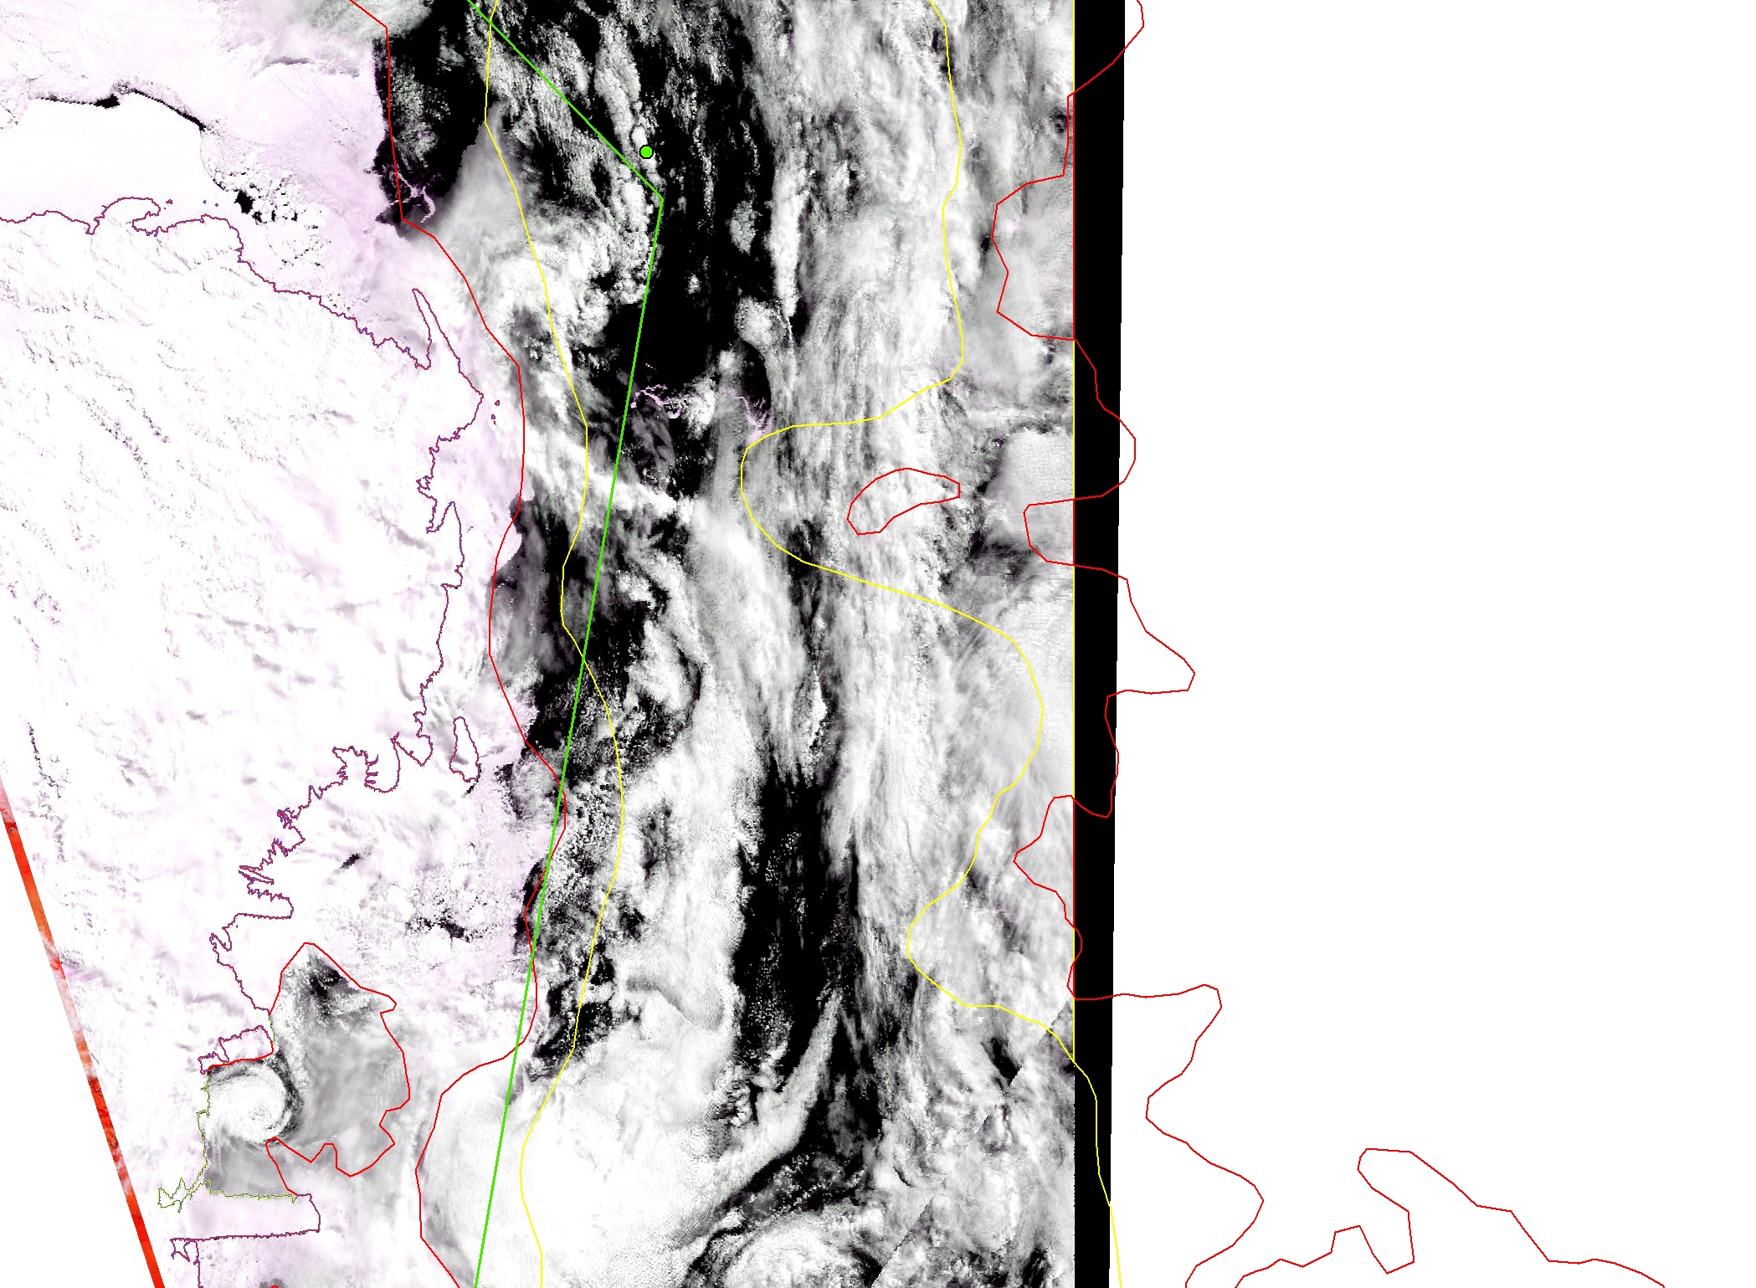
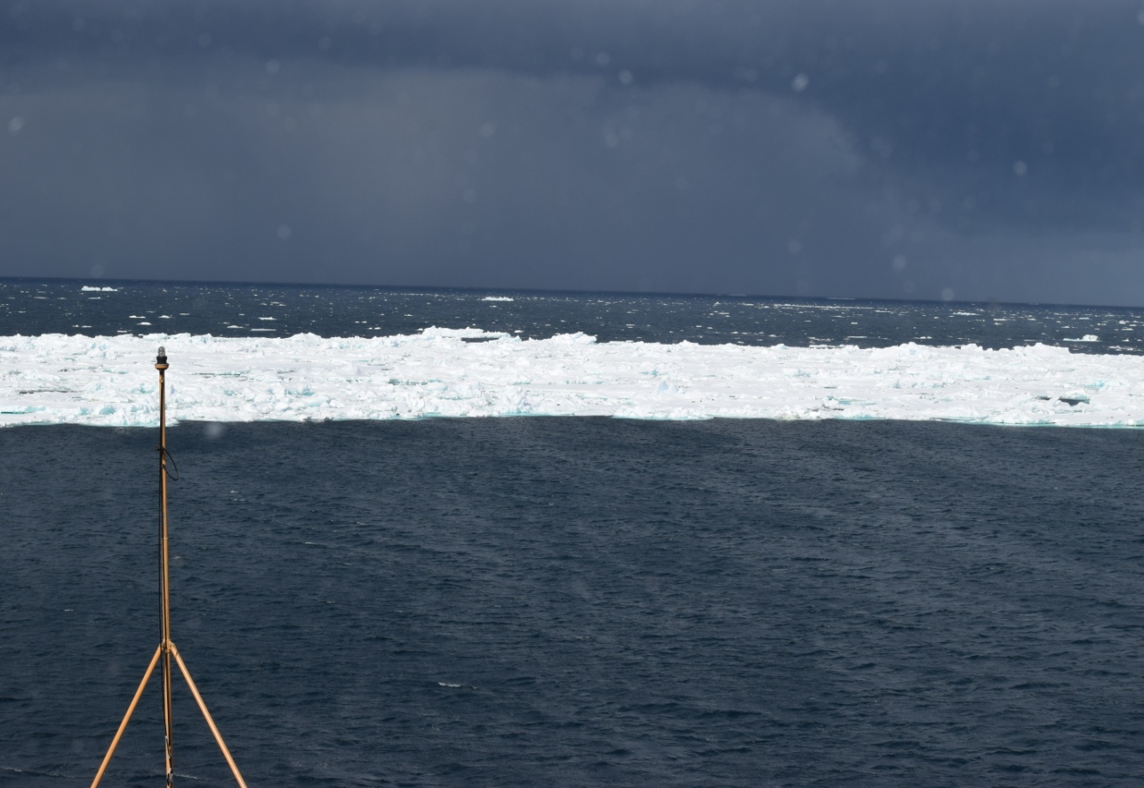
MODIS 5 JAN

Slide 5
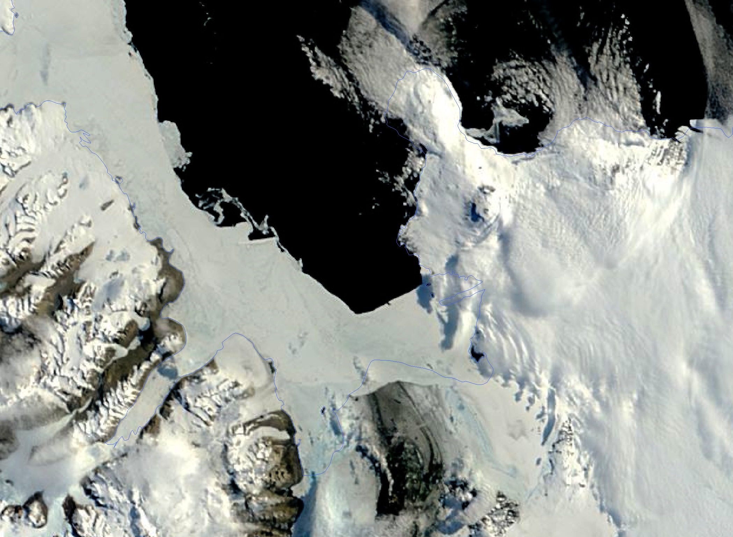
MODIS Terra 9 JAN
Marble Point
McMurdo

Slide 6
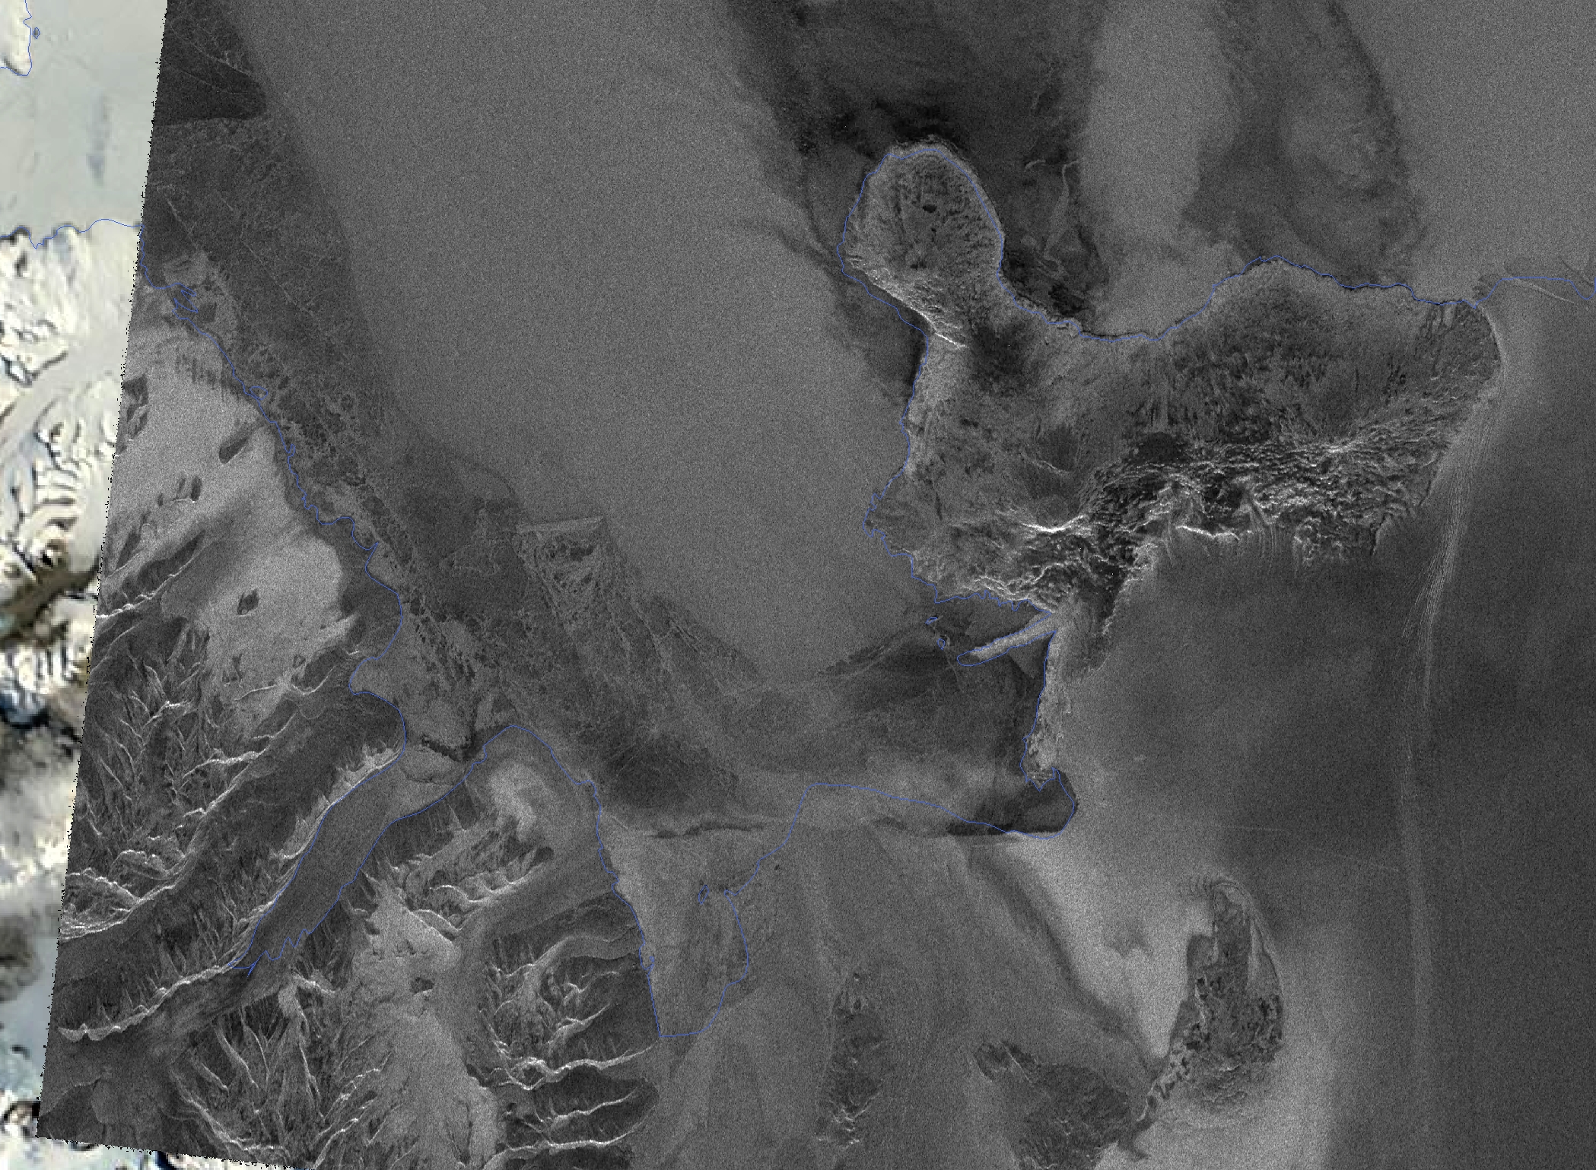
Radarsat-2 10 JAN
Marble Point
McMurdo

Slide 7
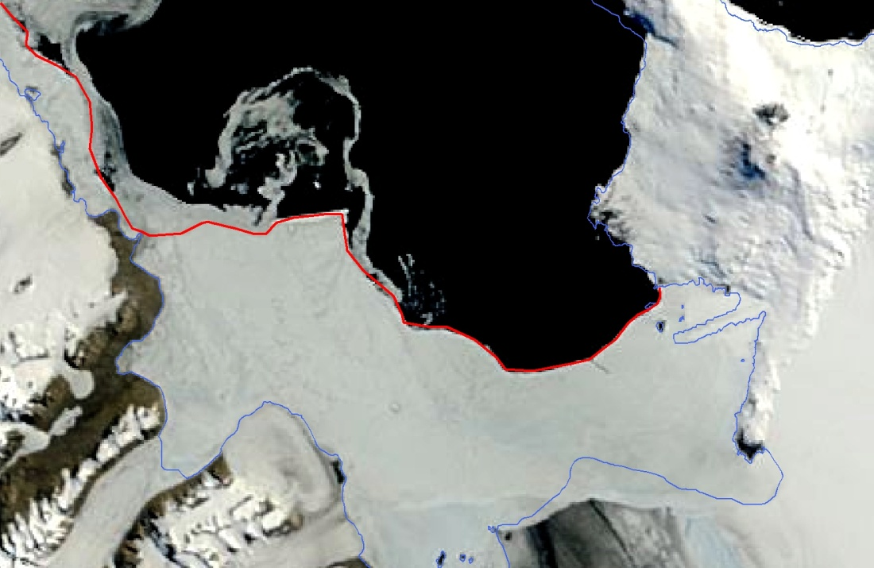
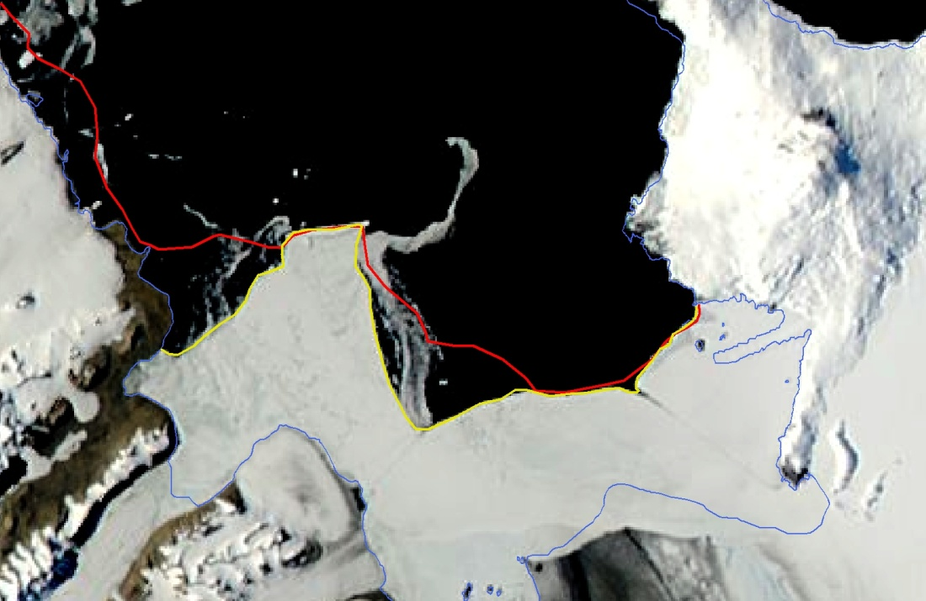
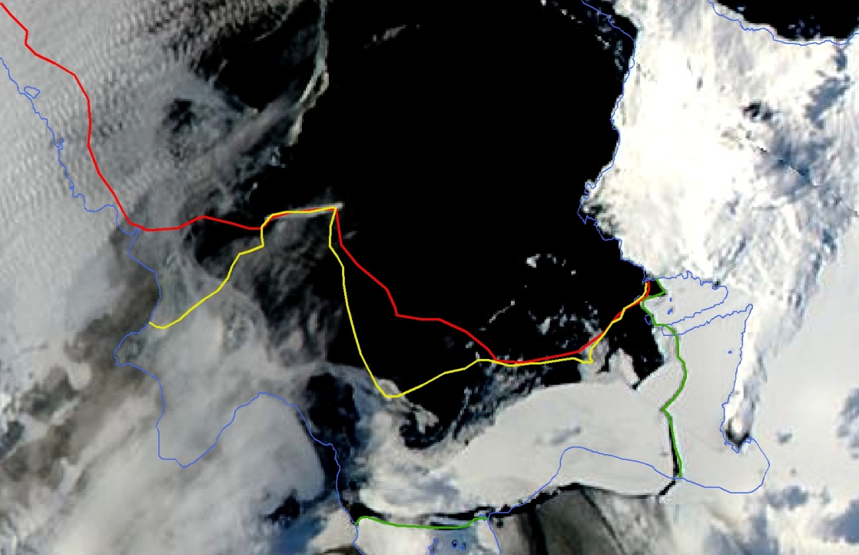
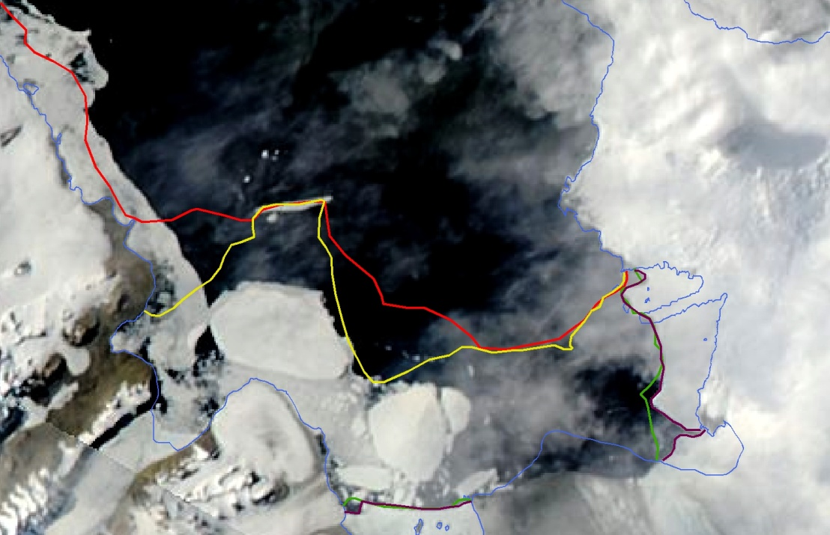
13 JAN
23 JAN
28 JAN
2 FEB

Slide 8
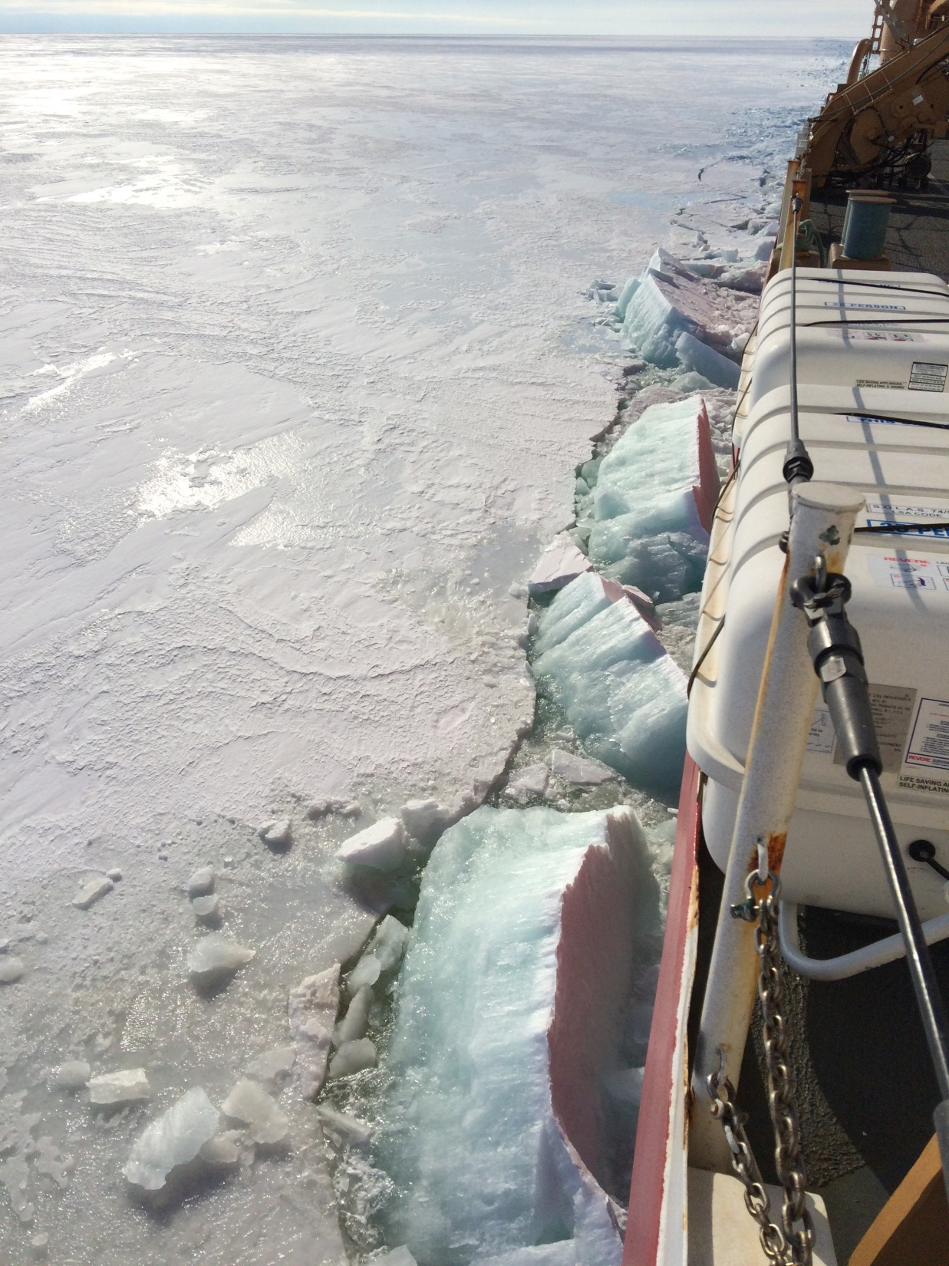
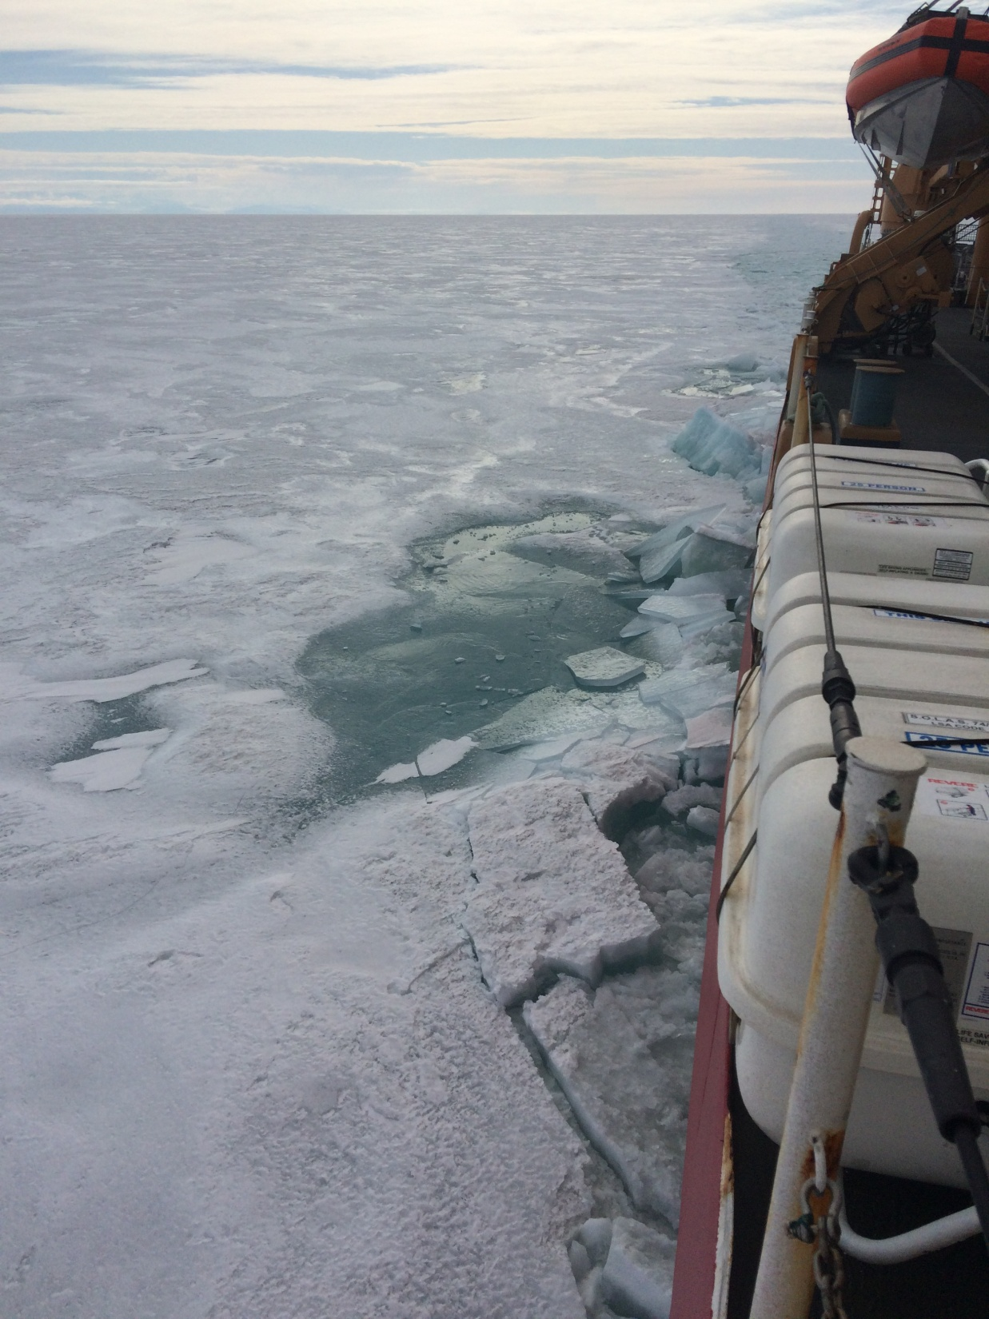
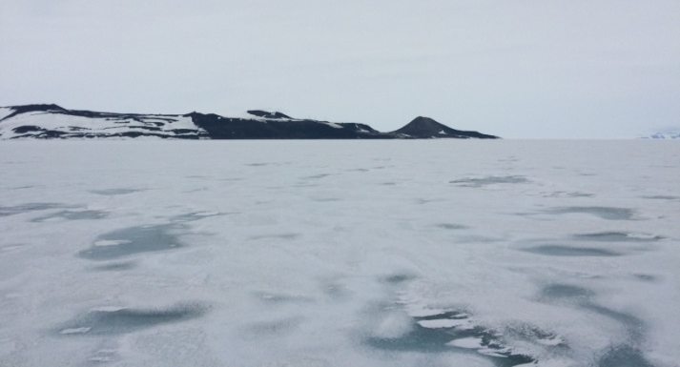
Typical First Year Fast Ice
Thickness ranged 4-8ft
(122- 244cm) thick
Closer to McMurdo numerous pockets of thin ice ~9in (23 cm)

Slide 9
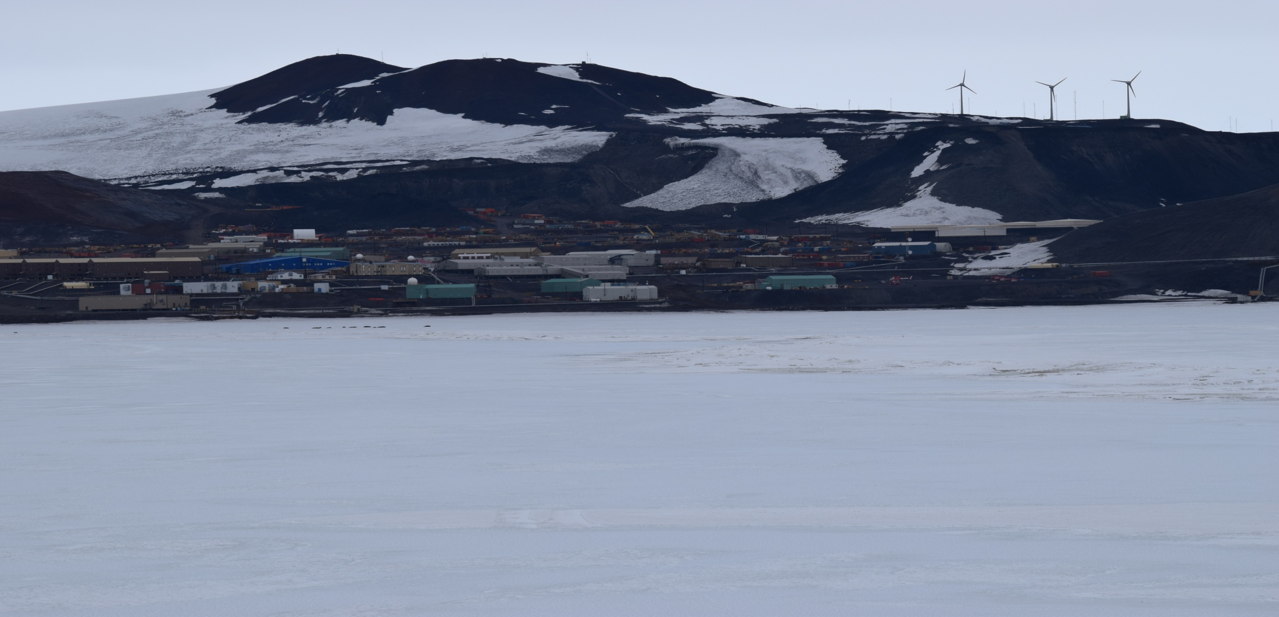
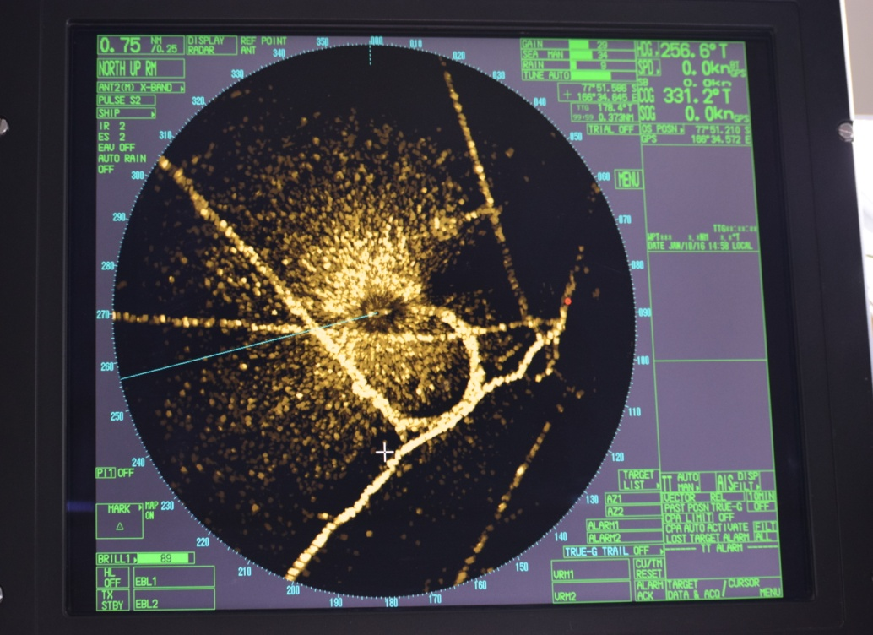
Ridge
Turning basin
A small “ridge” feature near McMurdo indicating thicker fast ice is visible above and in the ship’s radar at left.
After making slow progress through first year fast ice on the first pass into the channel, we recommended they not go into that ice if they didn’t have to.
Later, once the ice blew out we hove to in this ice.
Probably not 2nd year ice, but thicker than the first year.
McMurdo
Channel
Ridge

Slide 10
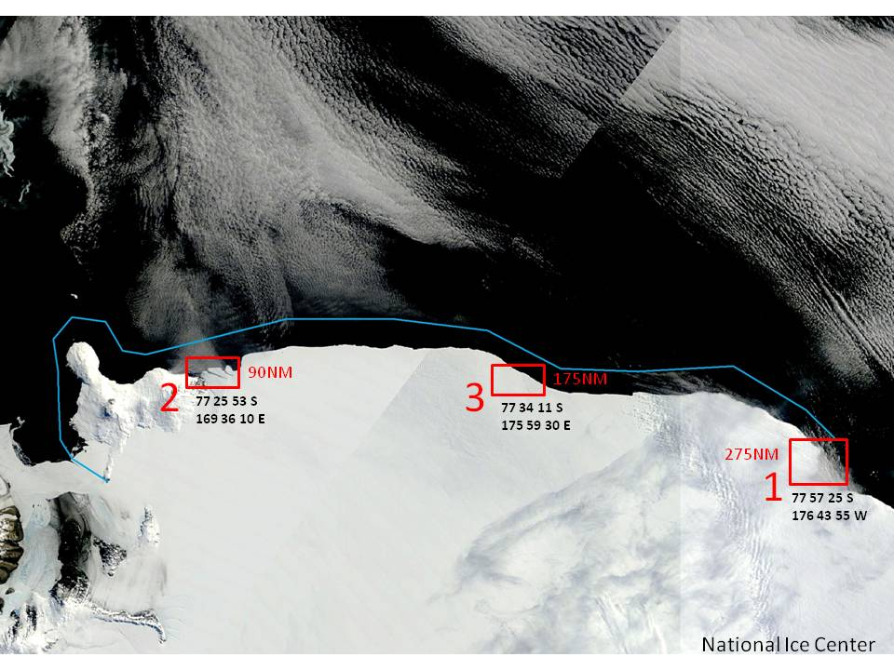
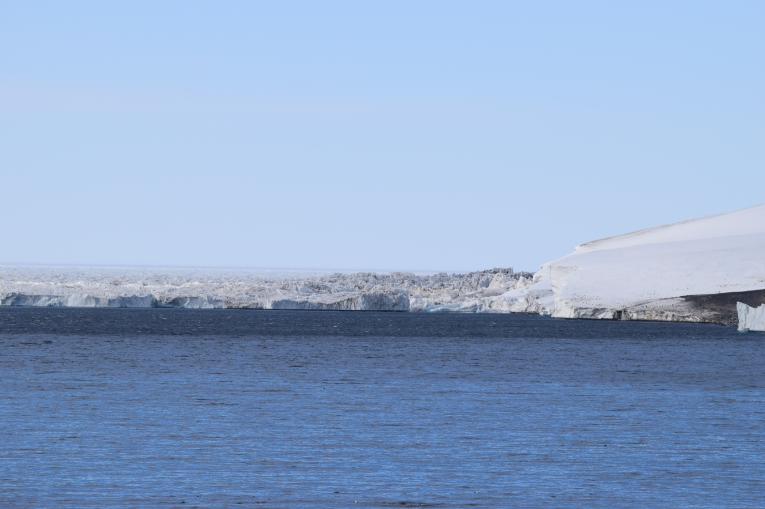
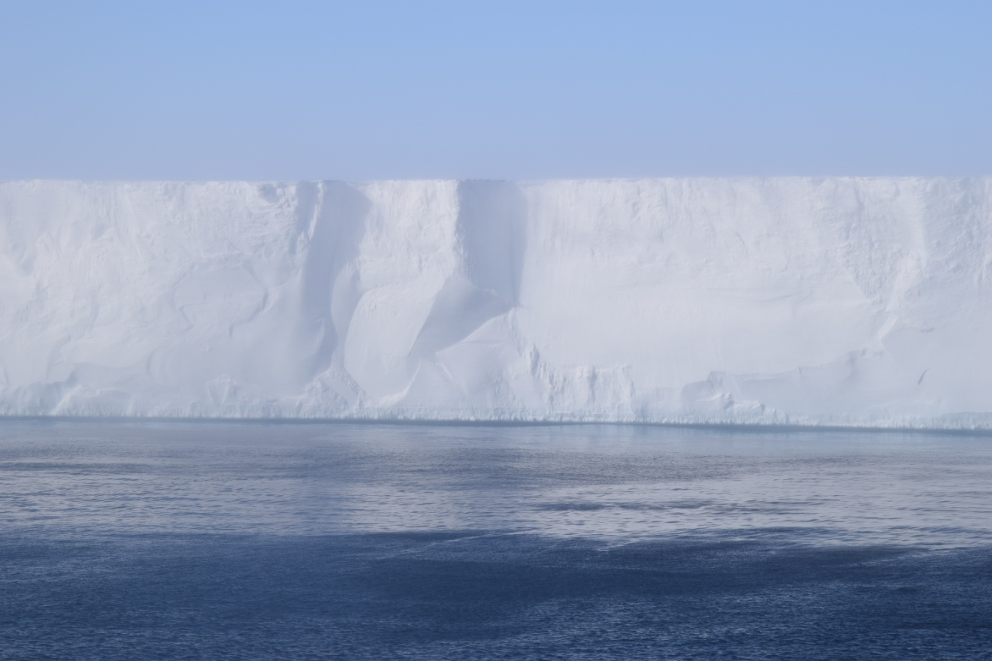
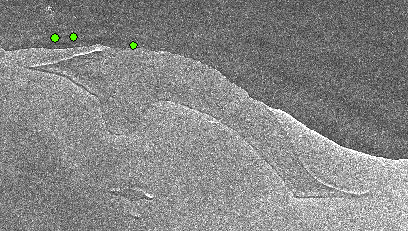
Investigating the Ross Ice Shelf

Slide 11
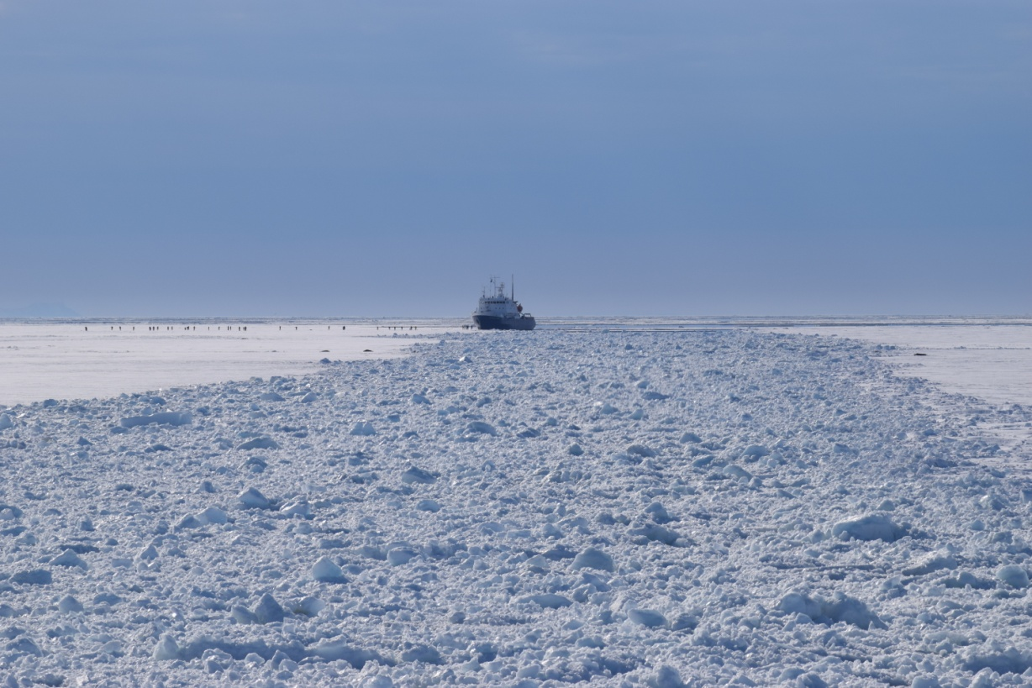
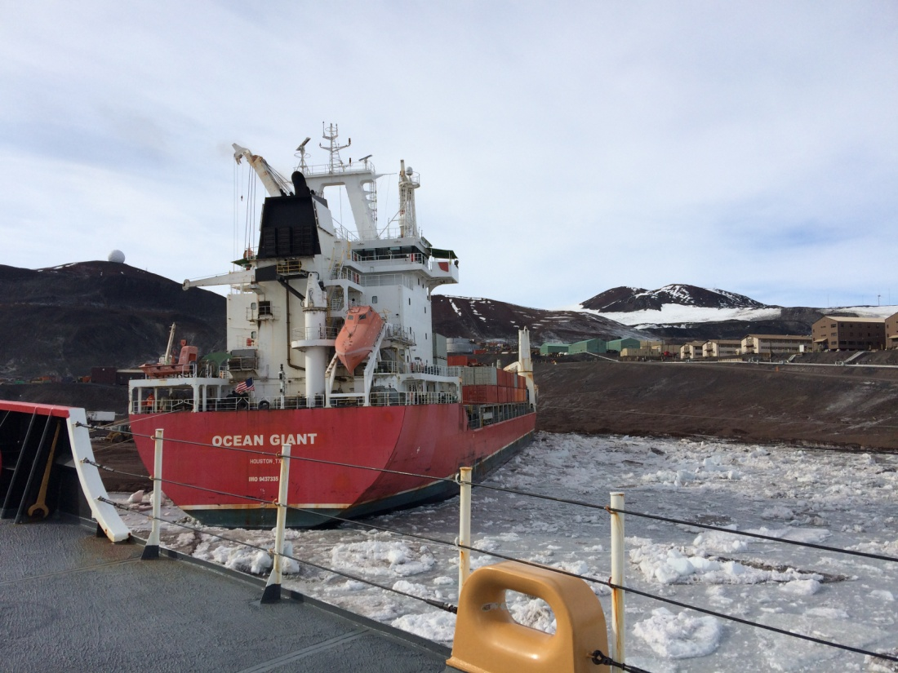
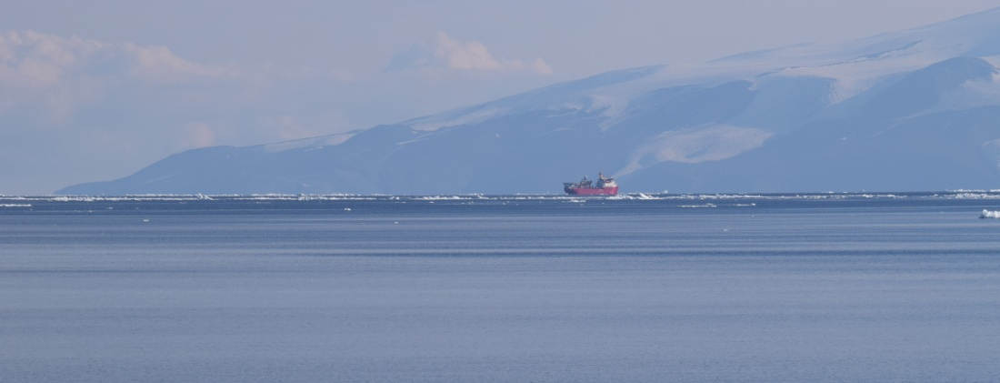
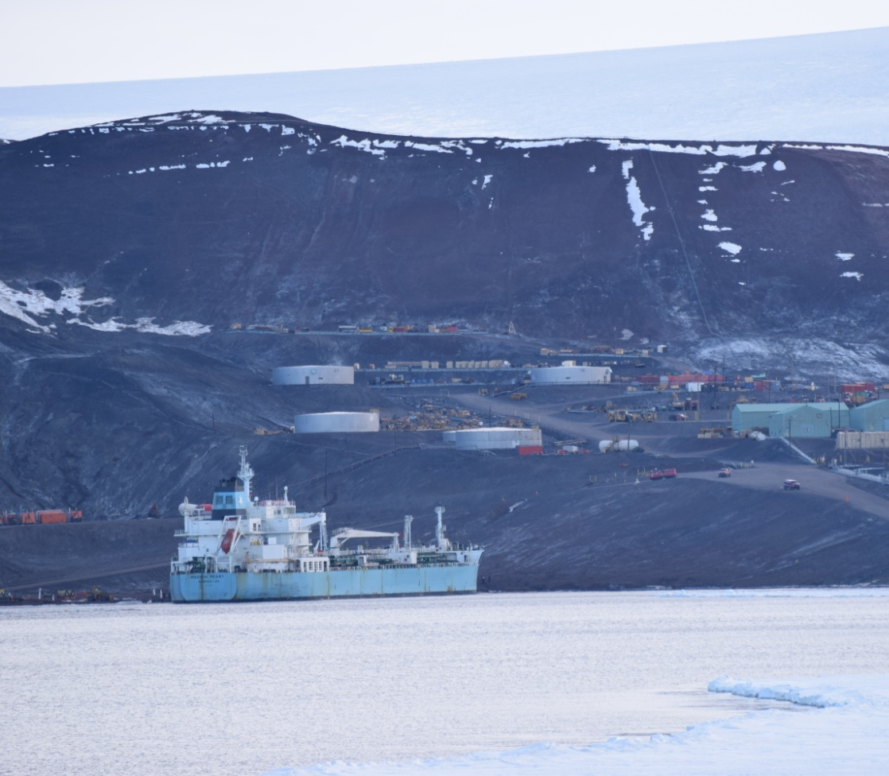
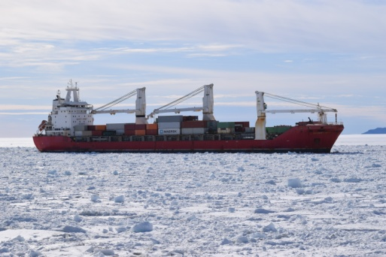
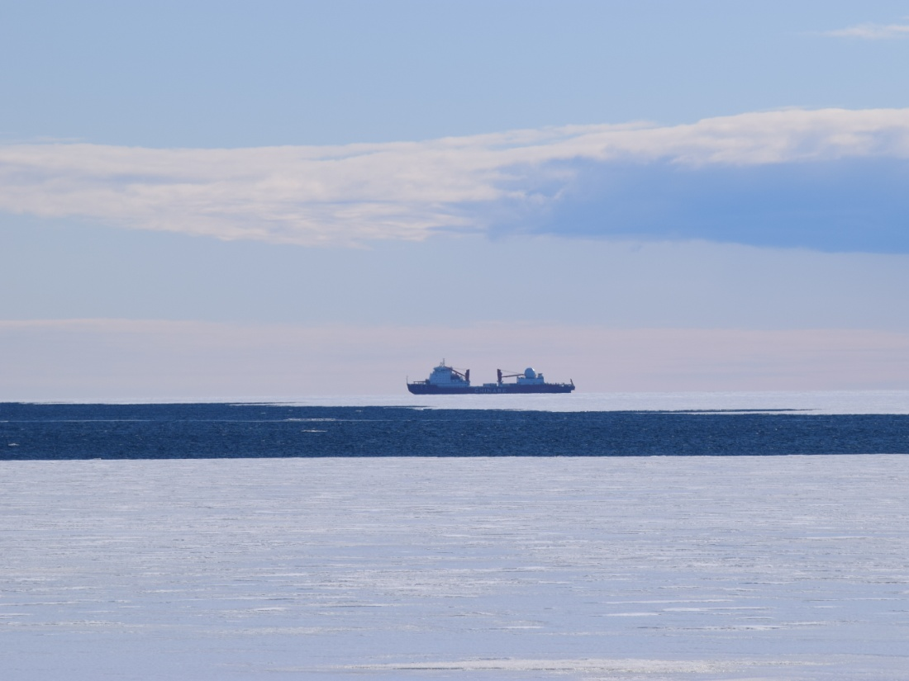
Visitors
Deep Freeze Resupply

Slide 12
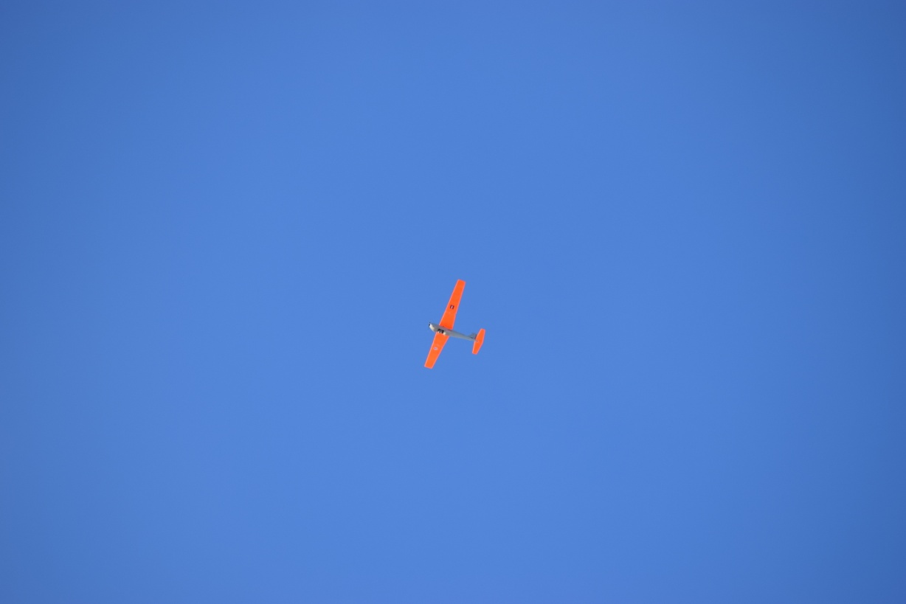
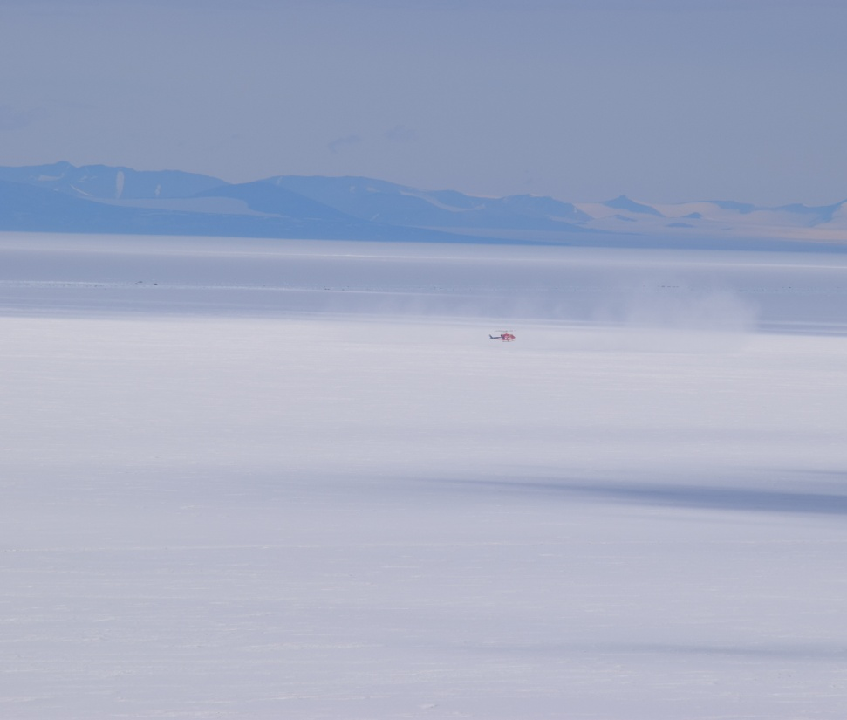
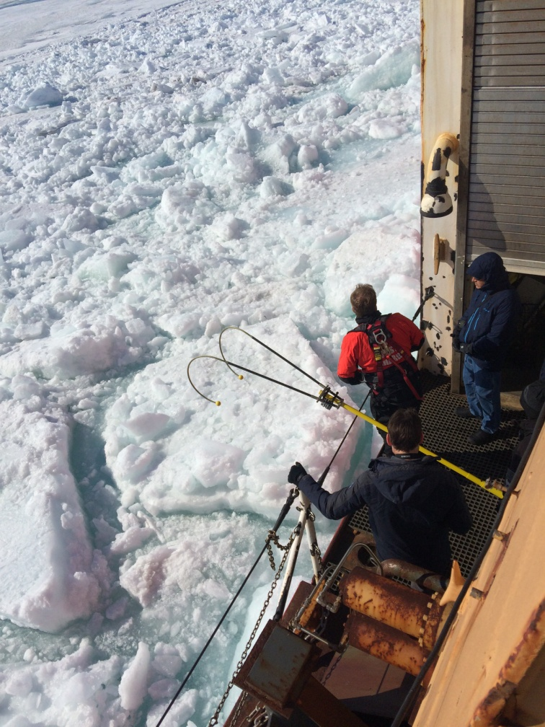
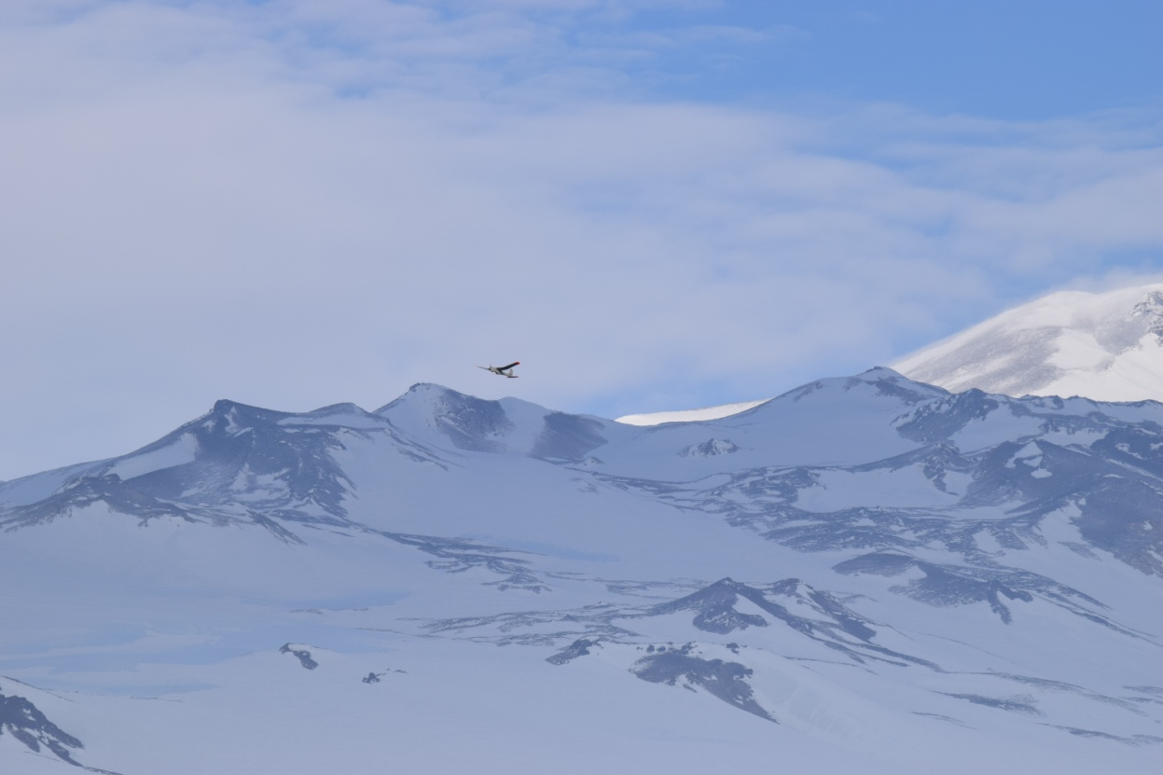
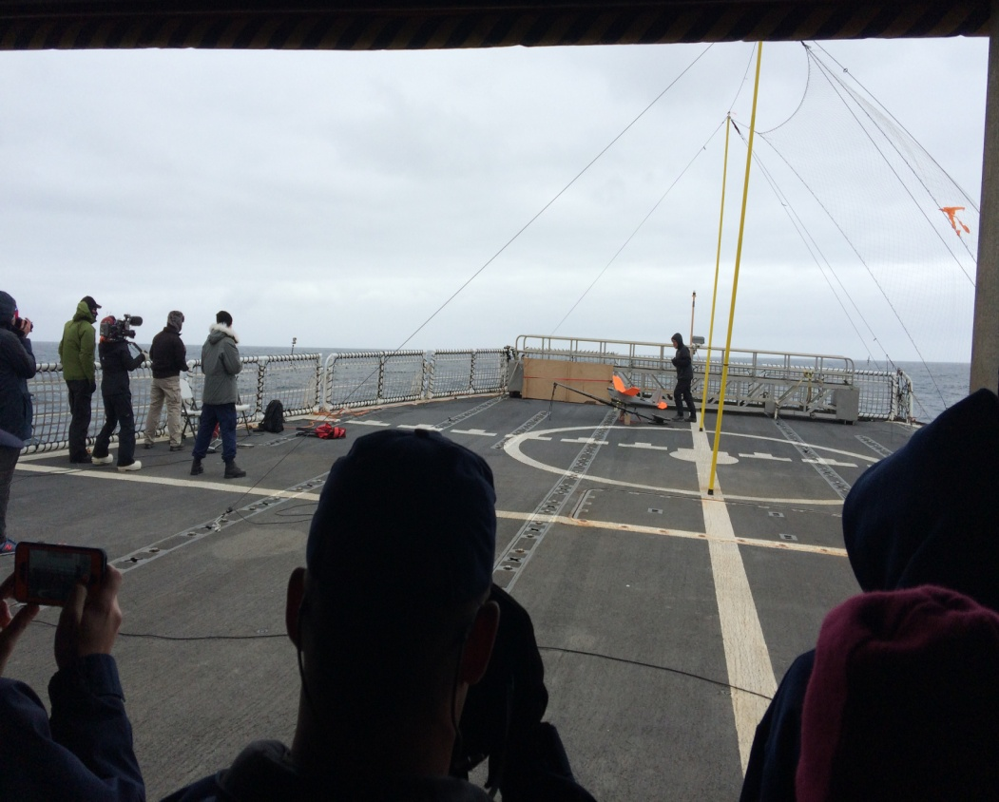
PUMA UAV

Slide 13
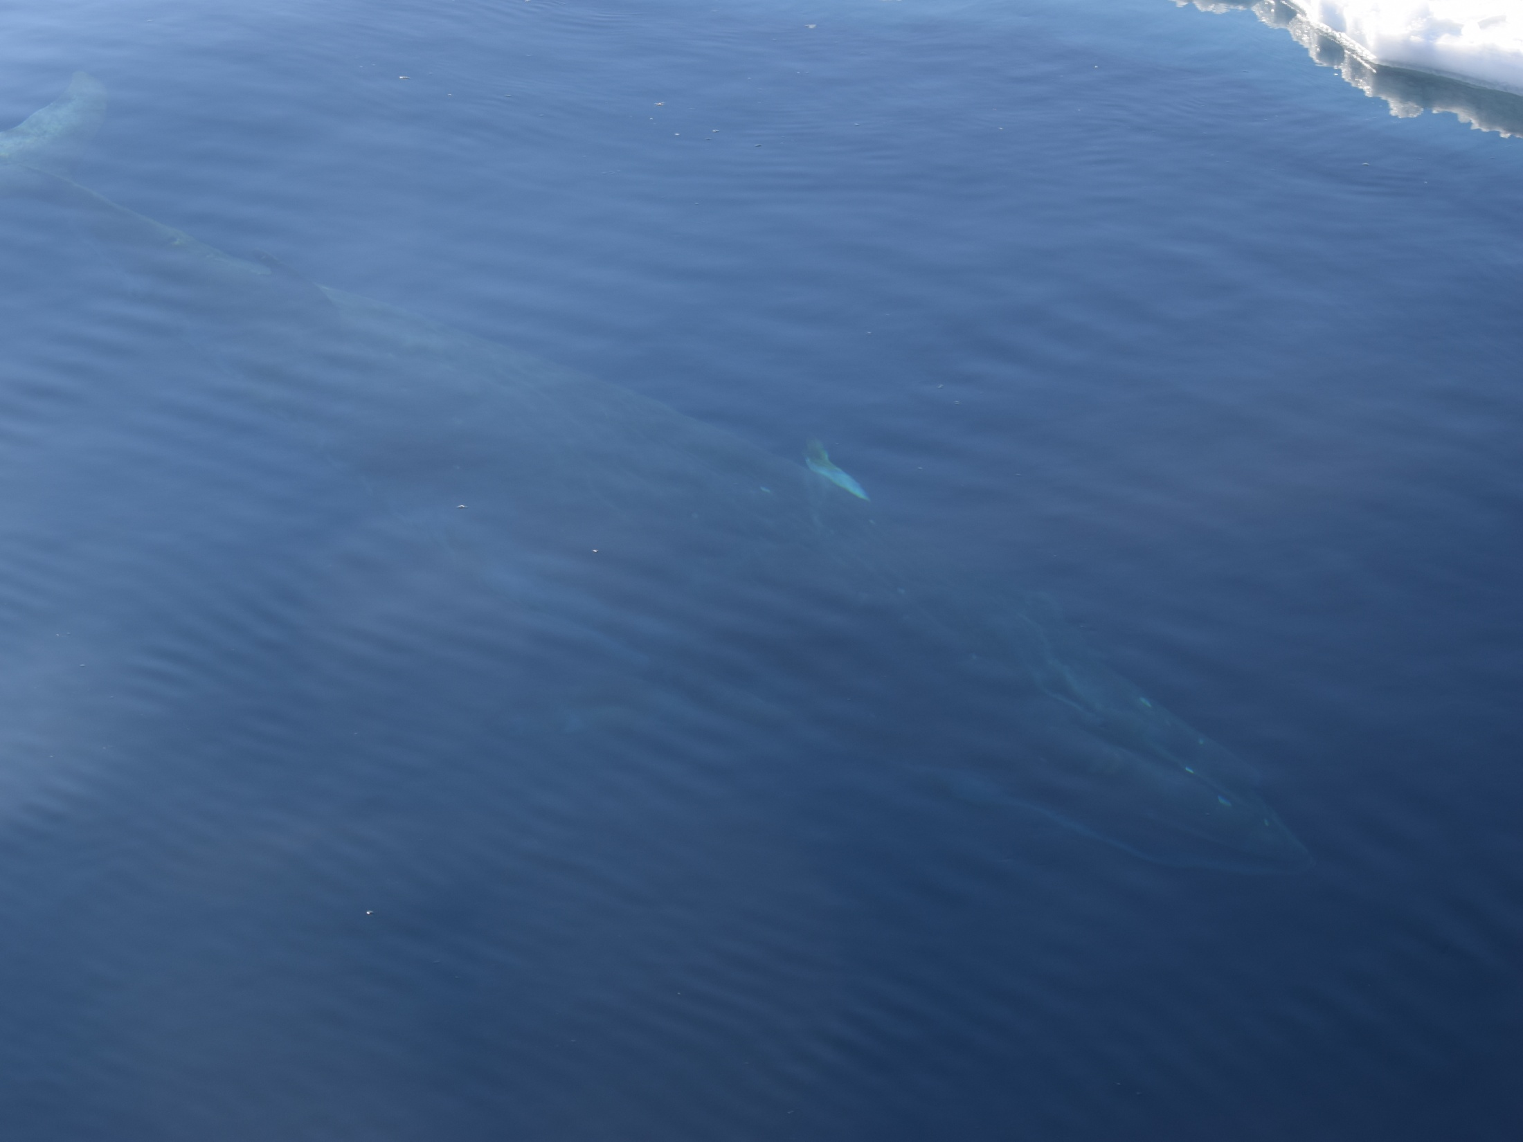
Operational Support, Lessons Learned, and Experiences
NIC participation in ODF-16 aboard USCGC Polar Star, including sea ice analysis and shipboard observations, facilitated and improved the tactical sea ice support NIC provides to the mission every year.
  Critical sea ice navigation support during the Hobart to McMurdo track including both characterization of pack ice and fast ice conditions.
  Monitoring of Marble Point fast ice conditions, influencing the final decision not to refuel the station.
  While sea ice tactical support was not as critical in the return track due to the rapid retreat and melting of the pack ice, NIC personnel continued to provide sea ice and weather and sea state information that provided general guidance for the track.
The improved sea ice support would have not being possible without dedicated Internet access to satellite, model, and NIC analyses that was afforded by the INMARSAT Broadband Global Area Network (BGAN)
Shipboard observations provided evidence of significant presence of unexpected Young ice growth within the First Year fast ice cover in the McMurdo Sound.
PUMA flights reinforced UAS potential for real-time sea ice characterization during ODF cruises but unfortunately were not able to collect the nadir imagery sought for sea ice topography analysis.
Ten buoys were deployed.
  8 buoys deployed in open water, providing pressure, temperature and drift data.
  2 Pacific Gyre SVP-B buoys were given to NSF at McMurdo for future tagging of ice pier hazards.

Slide 14
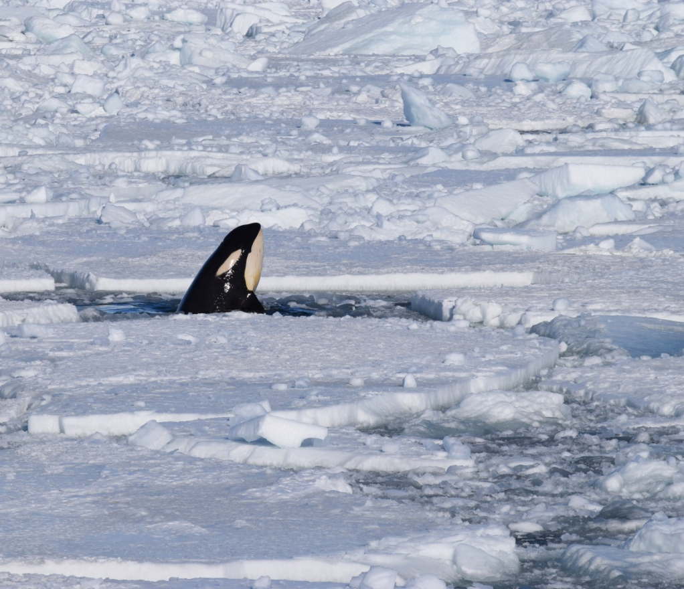
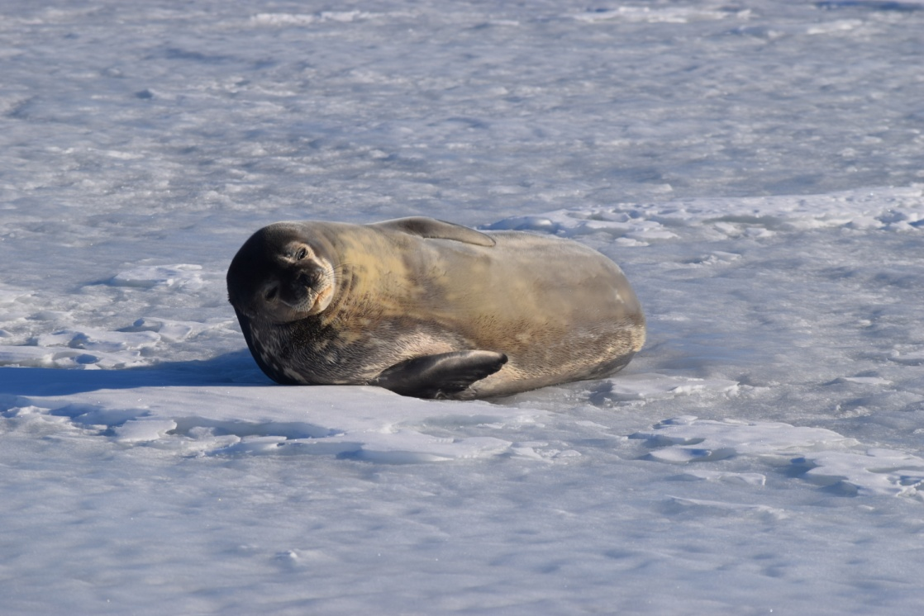
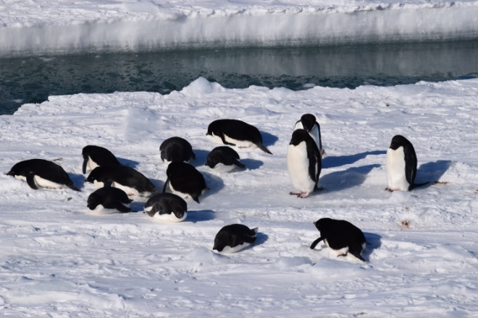
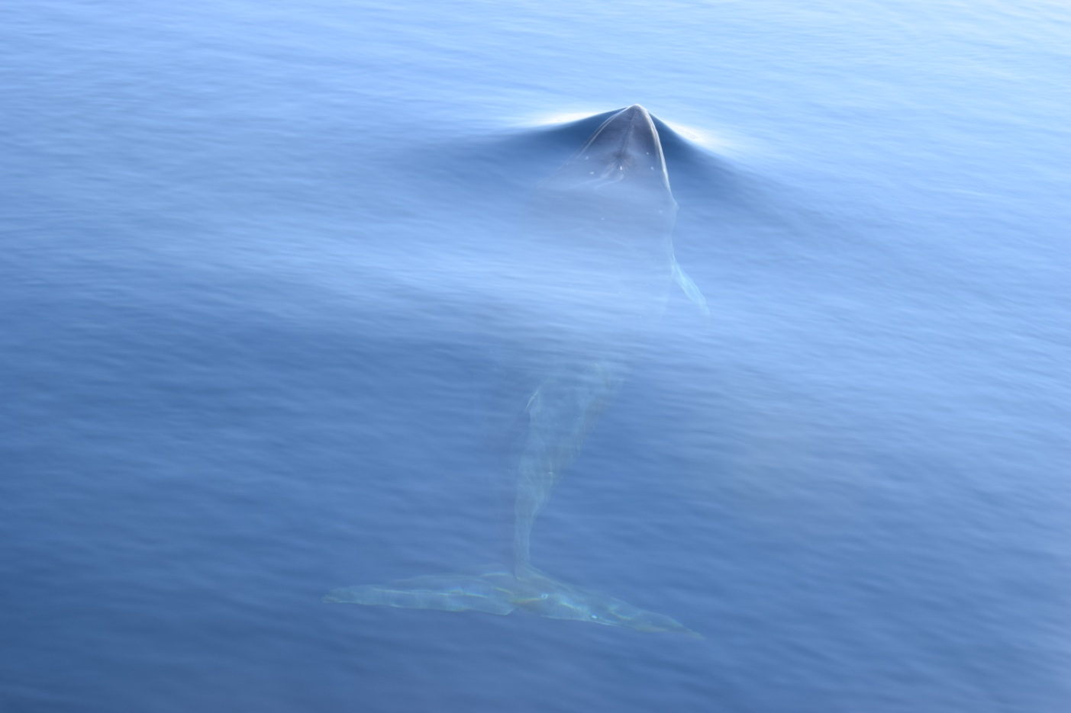
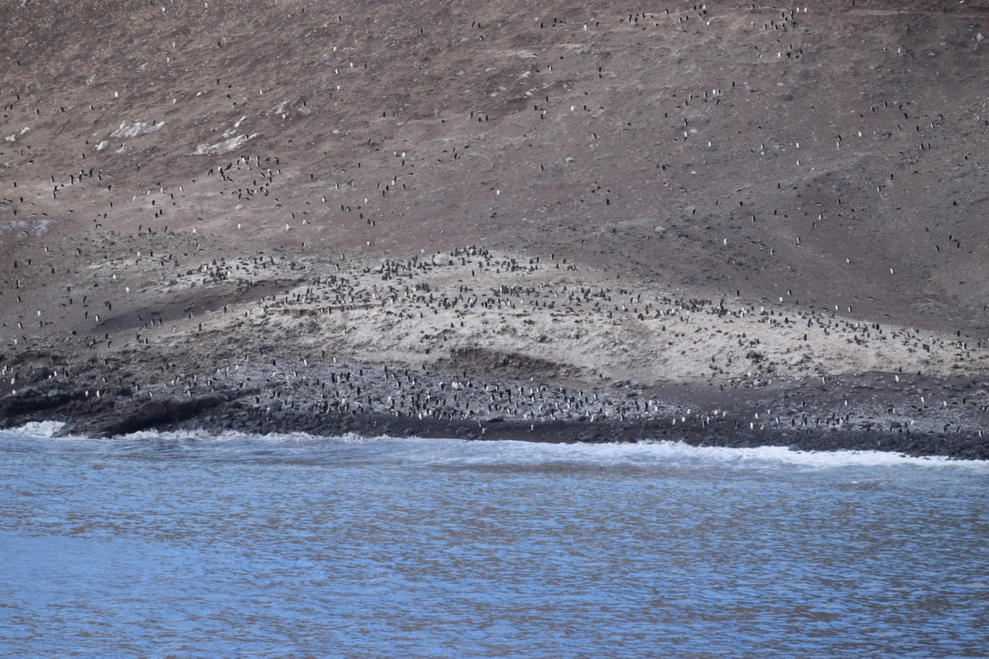
Wildlife

Slide 15
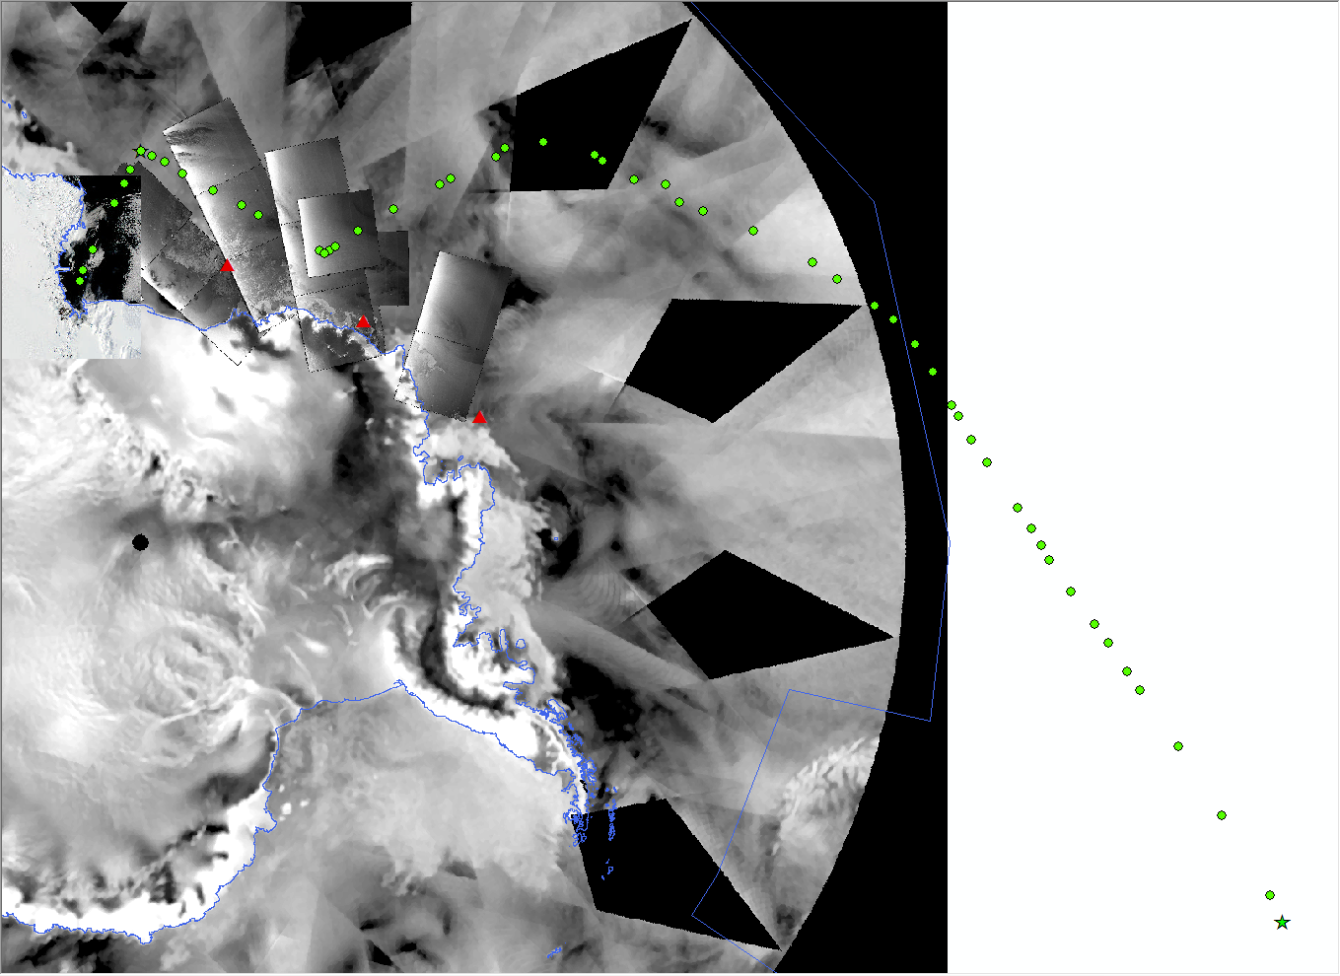
Valparaiso, Chile

Slide 16
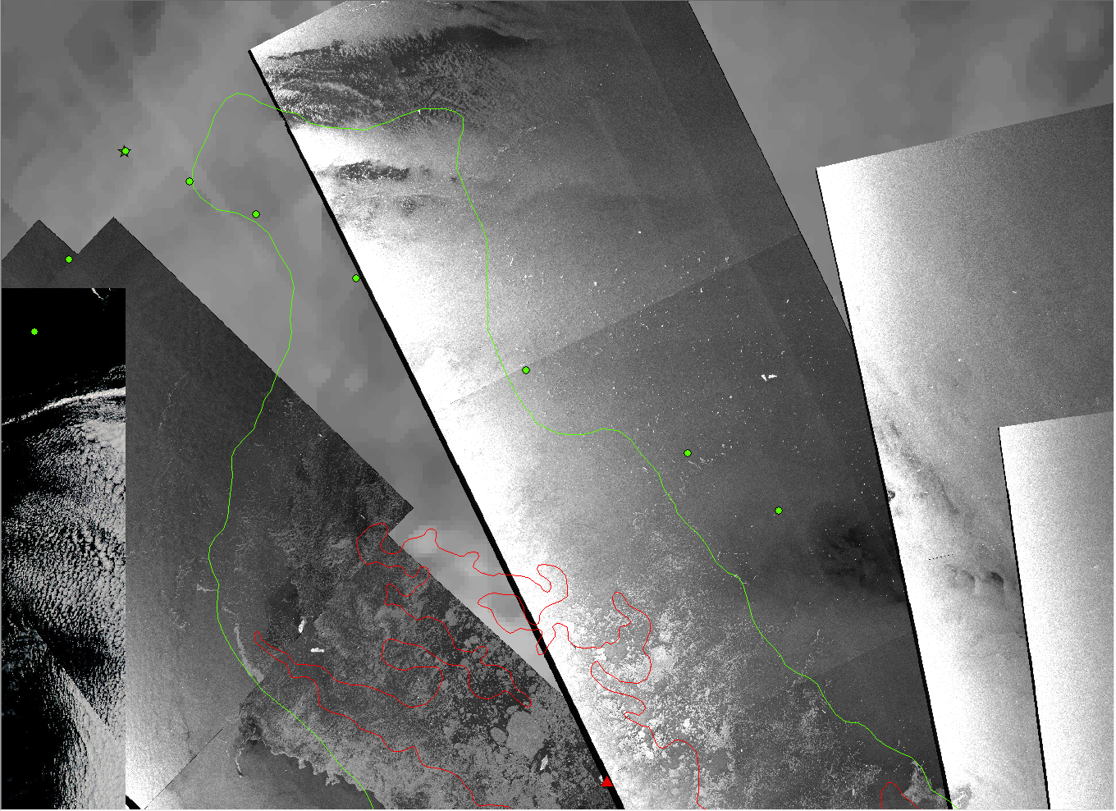
180, 70S

Slide 17
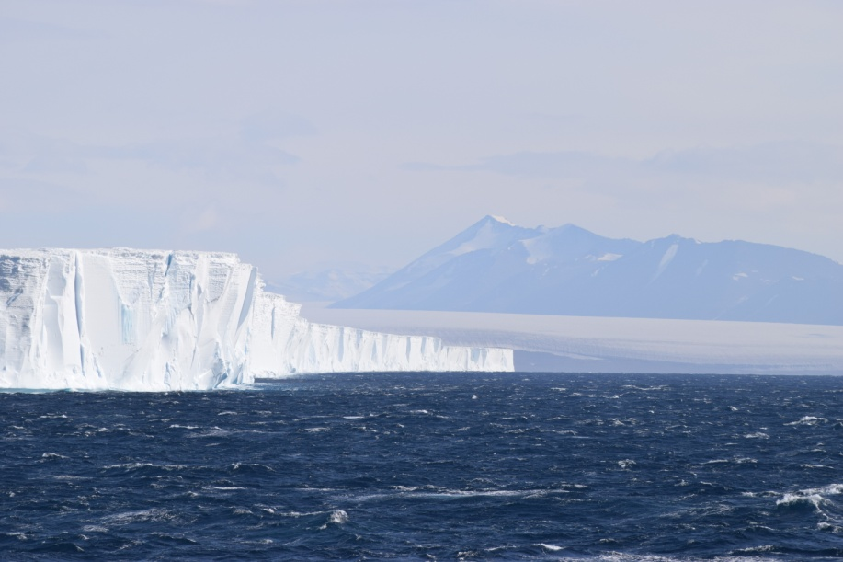
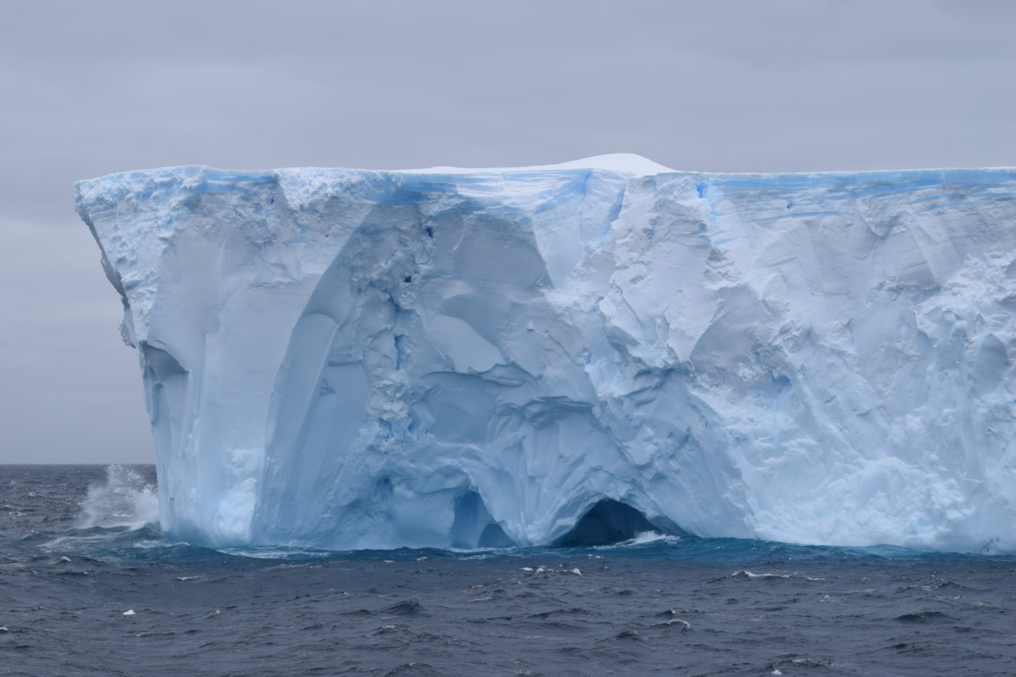
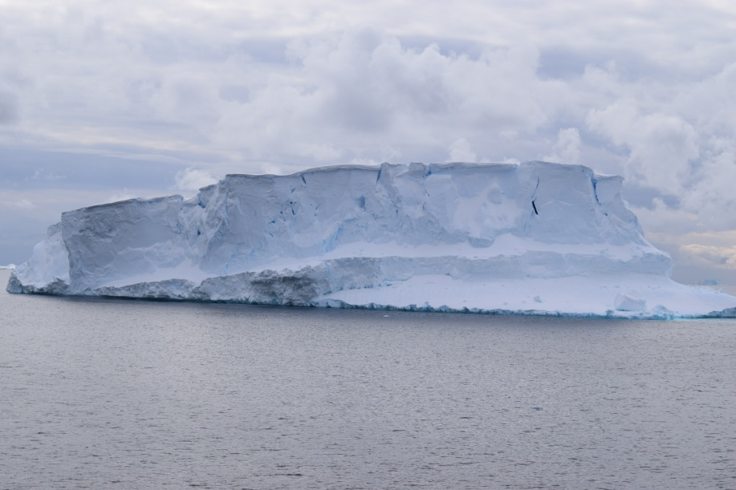
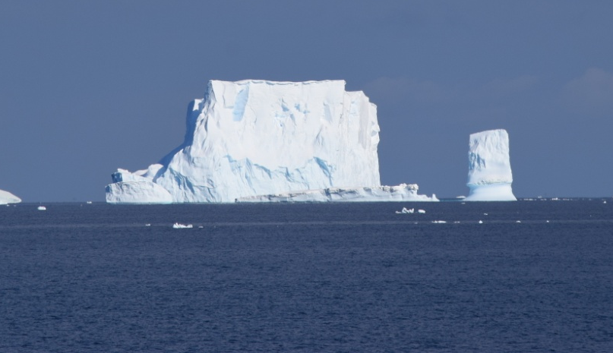
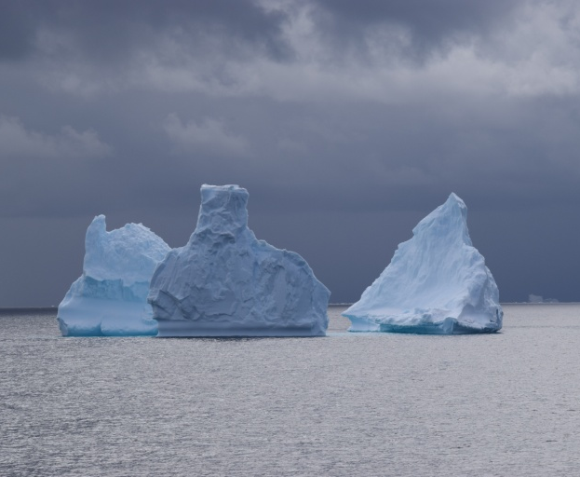
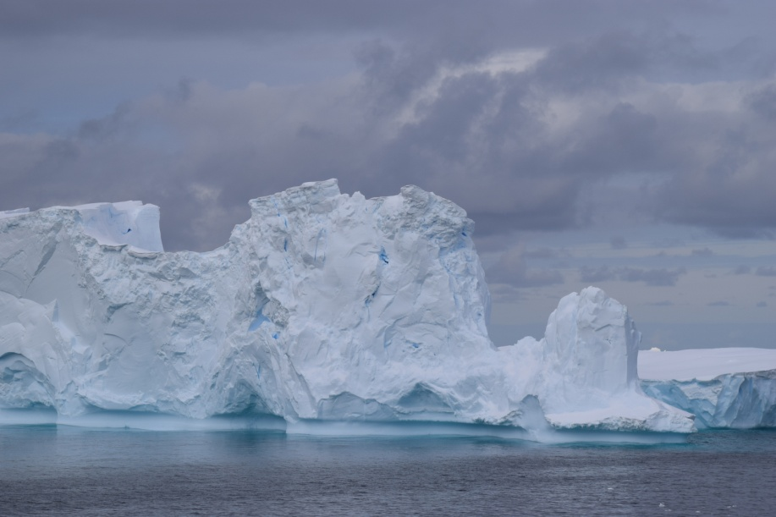
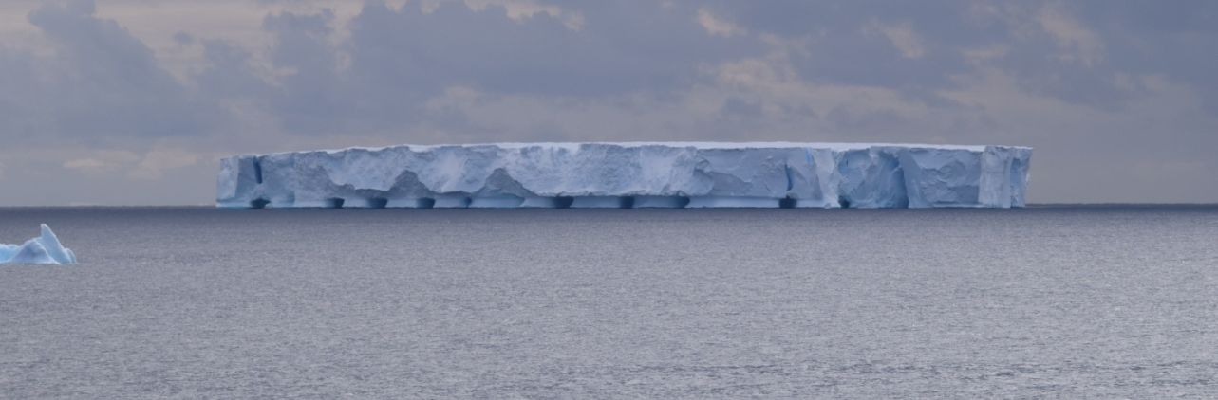
Icebergs

Slide 18

Future
Routine onboard presence of a NIC analyst during future ODF cruises should be considered. At least during the track into McMurdo.
Eventually, improved onboard tactical support could also be accomplished by USCG personnel trained at the NIC.
The availability of dedicated Internet capability for remote sensing and weather data access is a requirement.
Prior arrangements with the NSF-led USAP should be made to return NIC personnel from McMurdo if sea ice conditions do not warrant continued presence after resupply.
Arrangements and coordination with NSF must also take place before the ODF cruise start to insure that buoy platform deployments in the region are properly cleared.
https://www.youtube.com/channel/UCtWRgB8cEhbN-EAUd_a-lvw

