Slide 1

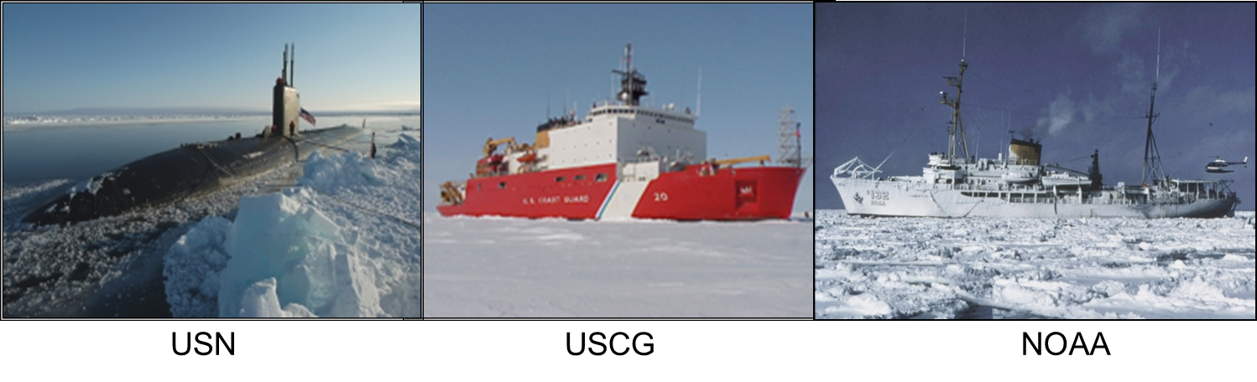
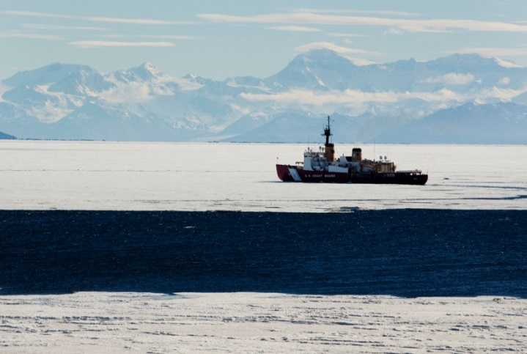
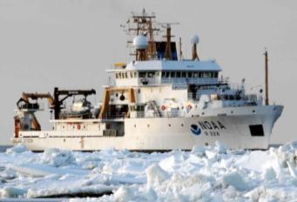
UNCLASSIFIED
Geophysical Constraints on Antarctic Sea Ice Cover
5th International Ice Analyst Workshop (IAW5)
U.S. National Ice Center (NIC)
Suitland, MD, U.S.A. – 16-20 May 2016
USN
USCG
NOAA
Dr. Pablo Clemente-Colón
Chief Scientist
U.S. National Ice Center
UNCLASSIFIED
Notes:
Geophysical Constraints on the Antarctic Sea Ice Cover
Abstract
The contrast between the slight increase of Antarctic sea ice and the drastic reduction of Arctic sea ice since the 1970s has been a conundrum to be resolved. Sea ice trajectory tracking with satellite scatterometer data in 2008 shows that ice that forms around Antarctica is pushed offshore by katabatic winds influenced by the continental topography. The ice trajectories reveal that sea ice, formed earlier in the ice growth season, drifts northward away from the Antarctic continent forming a circumpolar frontal ice zone (FIZ) behind the ice edge. The FIZ thereby consists of sea ice that becomes rougher due to a longer exposure to wind and wave actions, and thicker over time by more ice growth and greater snow accumulation.
In the Antarctic circumpolar sea ice zone adjacent to the sea ice edge, satellite data in 1999-2009 exhibit a band of strong radar backscatter, which is consistent with the signature of older, thicker, and rougher sea ice with more snow in the FIZ. This sea ice band, as wide as 1000 km, serves as a ‘Great Shield,’ encapsulating and protecting younger and thinner ice in the internal ice pack. In the young and thin ice region behind the FIZ, ice can grow rapidly as winds continue opening interior areas thereby creating effective “ice factories.” In addition, ridging can enhance ice thickness by convergence toward the circumpolar FIZ that is recirculated by westerly winds and currents. During the growth season, the FIZ advances until reaching lower-latitude warm waters at a boundary determined by the southern Antarctic Circumpolar Current front that is constrained by seafloor features. These persistent topographical and bathymetric geological factors help sustain the Antarctic sea ice cover. As such, the behavior of Antarctic sea ice is not a paradox as some have suggested, but instead is consistent with the geophysical characteristics in the southern polar region that starkly contrast to those in the Arctic.

Slide 2
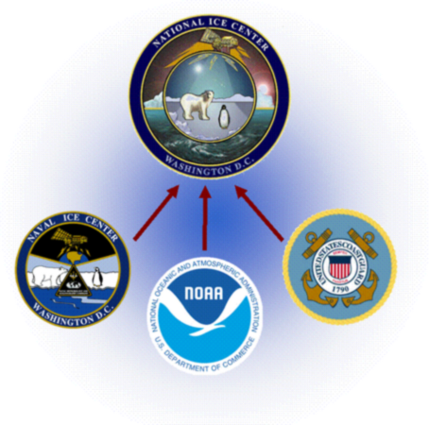
UNCLASSIFIED
Geophysical Constraints on Antarctic Sea Ice Cover
Paradox
The Arctic sea ice cover has been retreating during the last three decades while the Antarctic sea ice cover appears stable with if anything a
slight increasing trend
Conclusion
Antarctic sea ice behavior is consistent with Antarctic geophysics and thus not pose
a paradox
Outline
Geographical contrast between Arctic and Antarctic Regions
Regional Forcing Factors
Ice Extent and Location of Thermal Fronts
Tracking of Sea Ice and Distribution of “New” Ice Classes
UNCLASSIFIED

Slide 3
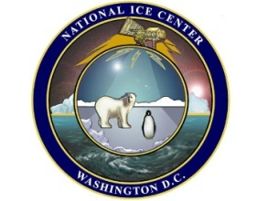
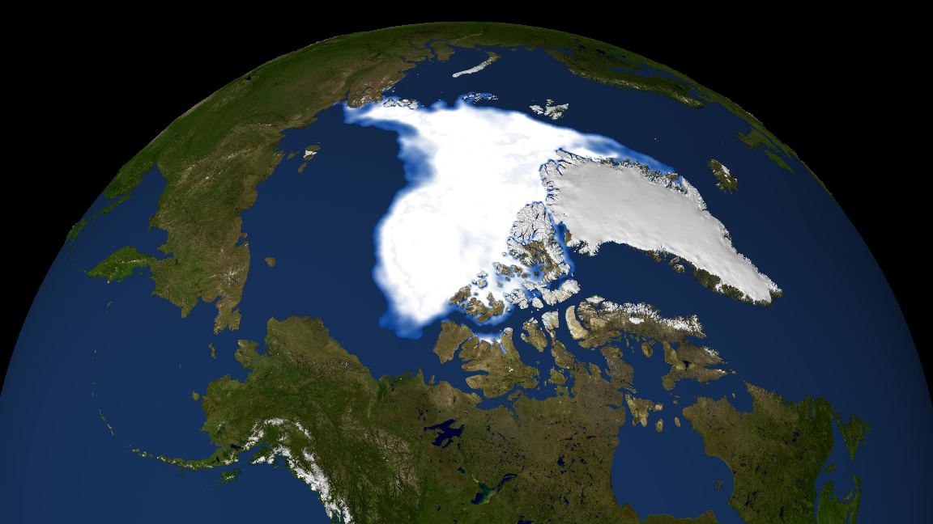
Arctic Sea Ice Loss Dominant Forcing:
Overall Increase in Arctic Temperature
Advection by Anomalous Atmospheric Forcing
Increased Ocean Insolation (solar energy input) - positive feedback
Increased Intrusion of Warmer Atlantic and Pacific Waters
L
L
Sea Ice Advection
Warmer flow
H
Increased
Sunlight
Absorption
H
Warmer flow

Slide 4
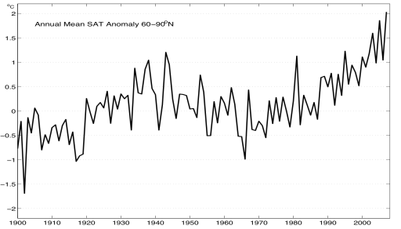
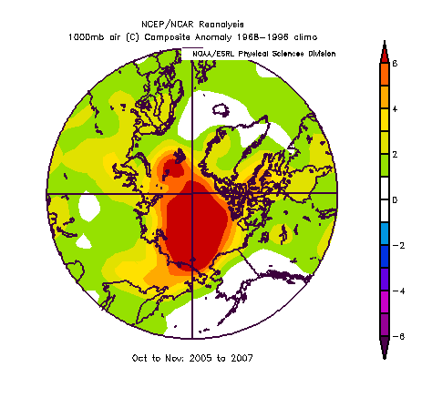
Arctic Surface Air Temperature
Warmer temperatures
result in less ice !
Arctic warming exceeds global mean warming
by roughly a factor of two

Slide 5
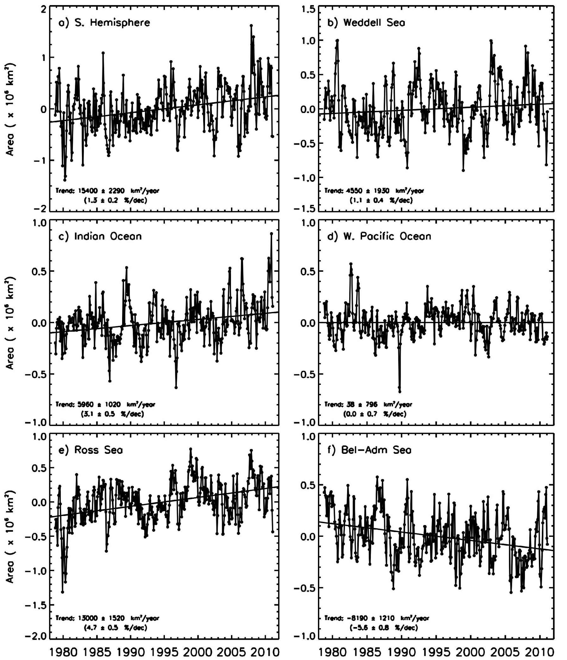
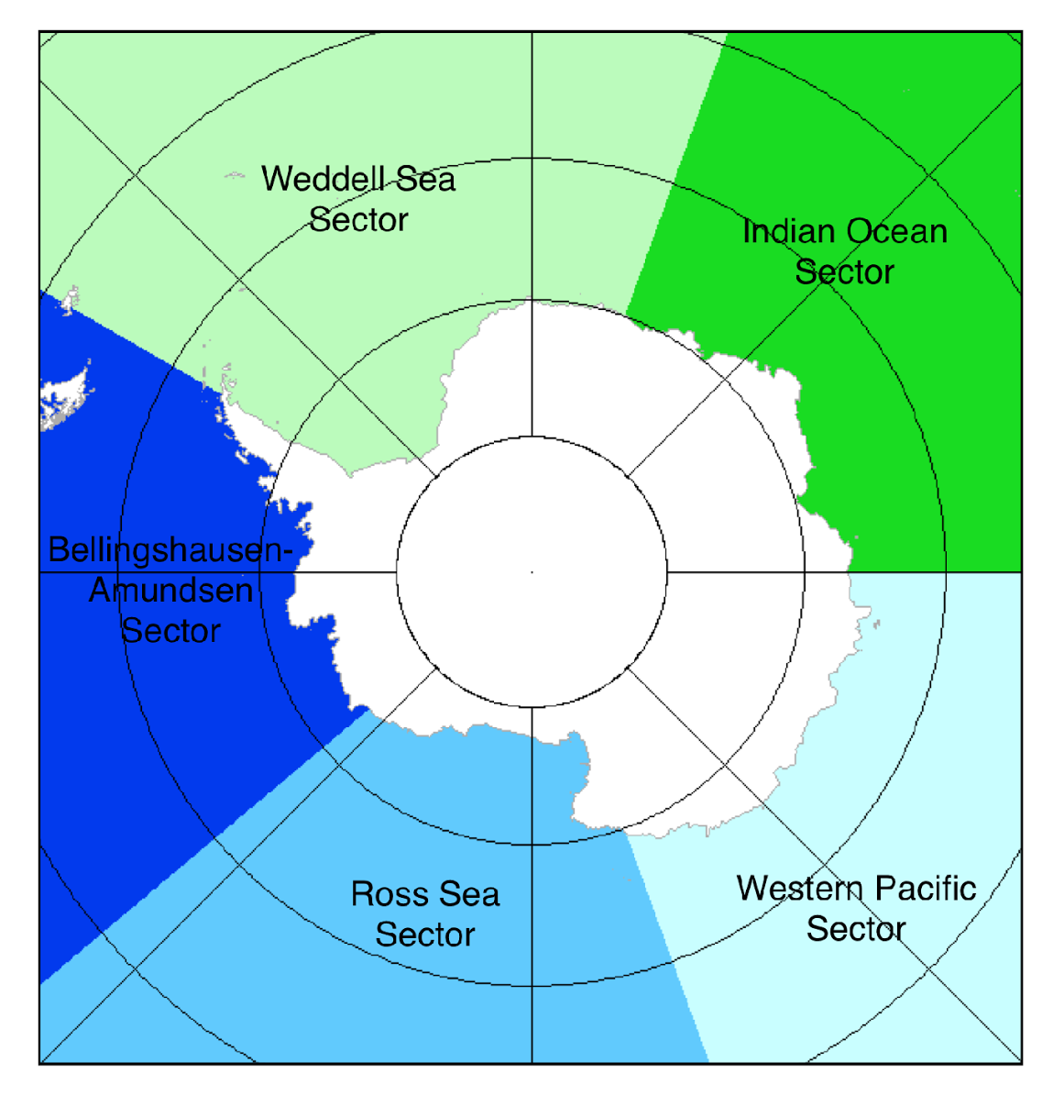
Antarctic Sea Ice
Monthly Anomalies and Trends
(After J. C. Comiso, NASA/GSFC 2011)
1.1 %/dec
3.1 %/dec
5.6%/dec
4.7 %/dec
0%/dec

Slide 6
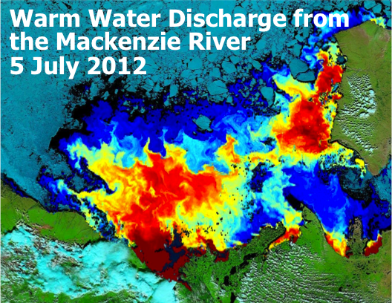
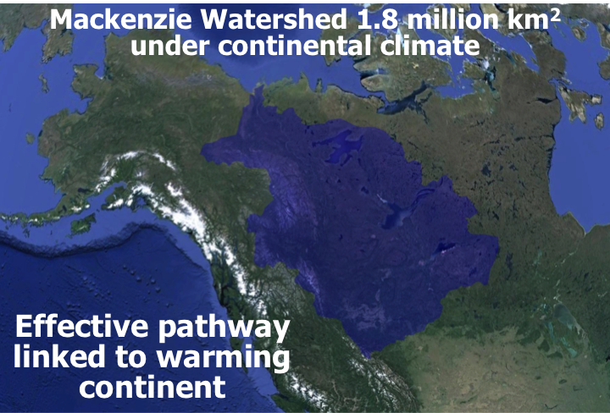
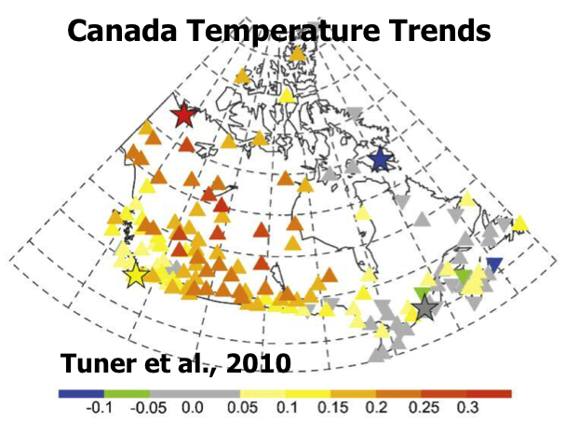
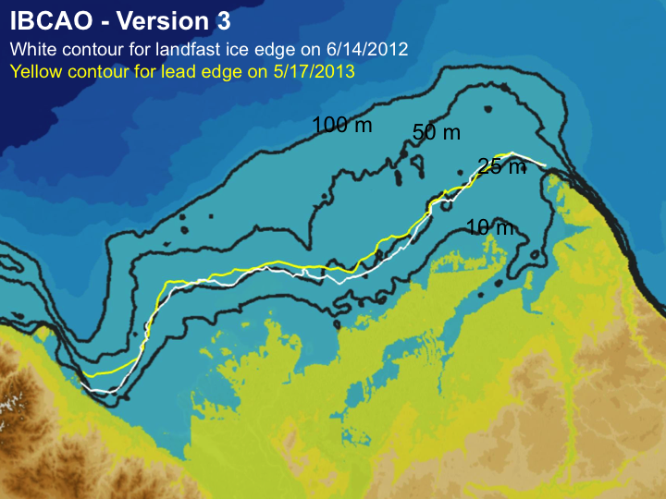
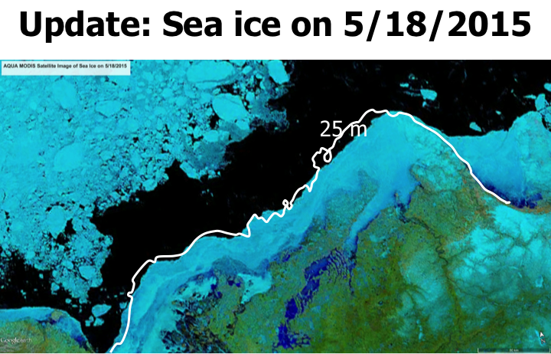
And One More Player: Arctic River Discharge
Effective Heath Pathway Linked To Warming Continents
Nghiem et al., GRL, 2014
2012 and 2013

Slide 7
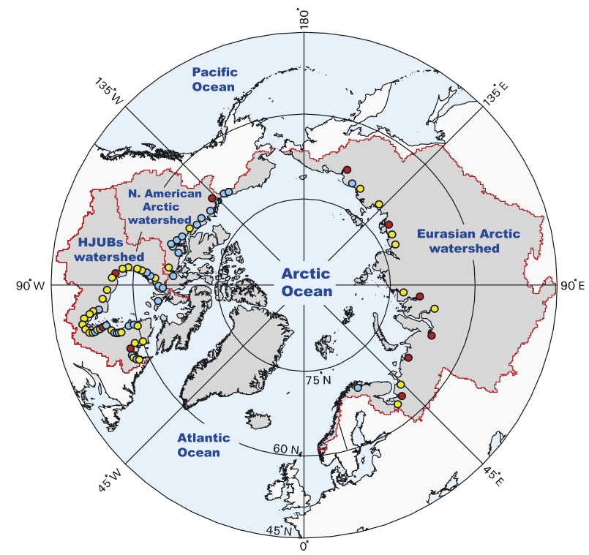
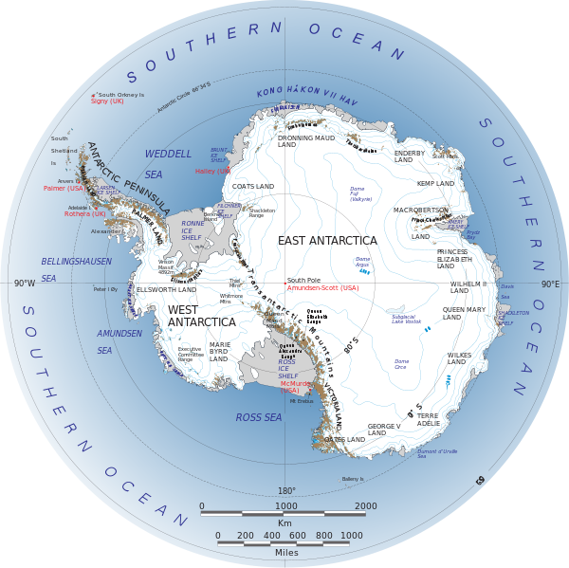
Heat Source from Rivers
Arctic sea ice: Warm river water discharge
Antarctic sea ice: Frozen continent
McClelland et al., 2006
A stark contrast between Arctic and Antarctic!
72 rivers: Blue = <6 km³/y; Yellow = 6 to <60 km³/y; Red = 60 to 600 km³/y.
No such rivers, except for ice streams!

Slide 8
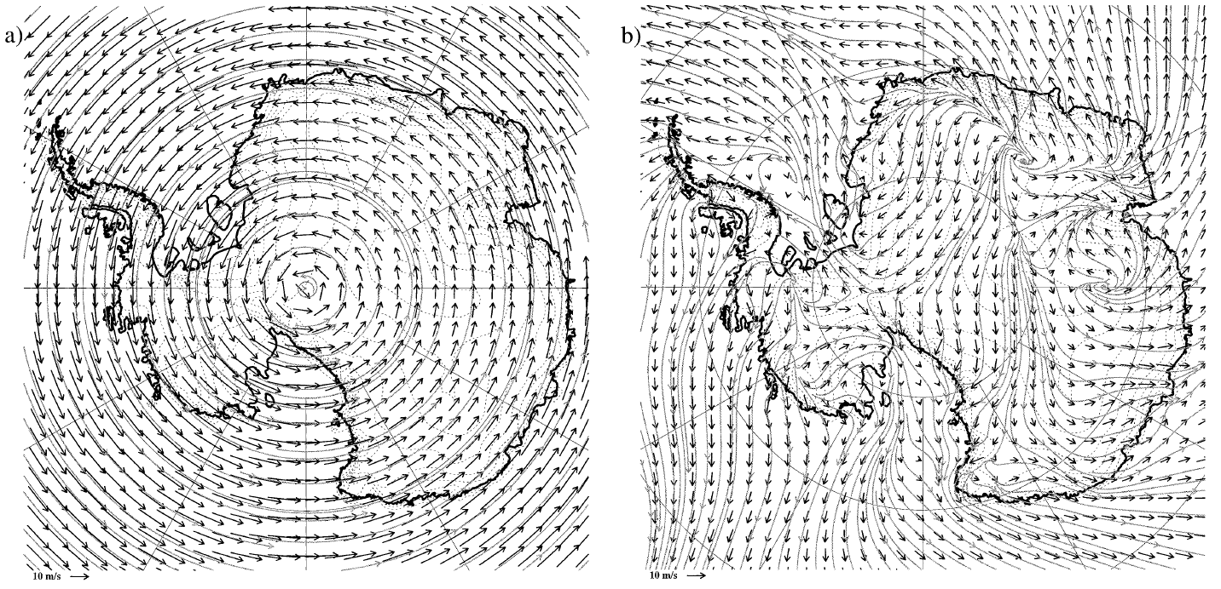
Wind Pattern Shaped by Continental Topography
Initial (0 hr)
72 hr
Parish, T. R., and J. J. Cassano, J. J. (2003). Diagnosis of the Katabatic Wind Influence on the Wintertime Antarc-tic Surface Wind Field from Numerical Simulations. Monthly Weather Rev., 131, 1128-1139.

Slide 9
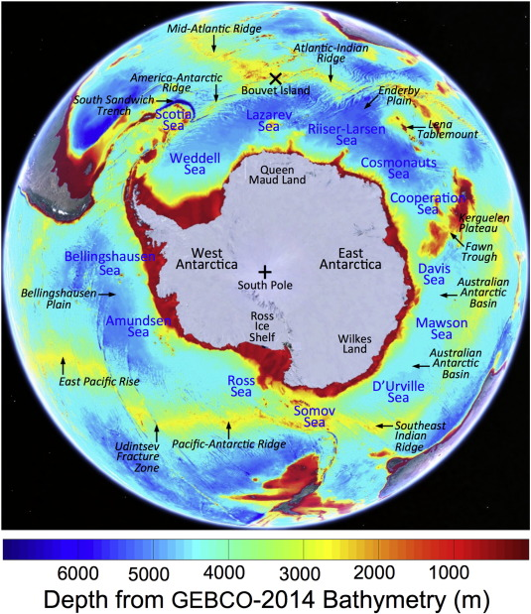
Southern Ocean Bathymetry
Notes:
Fig. 1. Names of places on a map of Antarctic land and ocean together with the GEBCO-2014 bathymetry (http://www.gebco.net/data_and_products/gridded_bathymetry_data/).
Bouvet Island (Bouvetøya) is an uninhabited subantarctic volcanic island and belongs to Norway. The island was discovered on 1 January 1739 by Jean-Baptiste Charles Bouvet de Lozier, commander of the French ships Aigle and Marie. Bouvet Island is a volcanic island constituting the top of a volcano located as the southern end of the Mid-Atlantic Ridge in the South Atlantic Ocean and is the most remote island in the world.

Slide 10

SST Isotherms (1999-2009) and GEBCO-2014 Bathymetry
Southern Antarctic Circumpolar Current (ACC) front (sACCf) delineated by Kim and Orsi (2014)
Notes:
Fig. 8. Map of the southern Antarctic Circumpolar Current (ACC) front (sACCf) delineated by the white contour (Kim & Orsi, 2014) with MUR SST − 1.0 °C isotherms represented by the black contours on 22 September in 2002–2009 plotted together with the GEBCO-2014 bathymetry. The isotherms are closely bundled close to the sACCf over pronounced seafloor features such as ridges while they tend to spread apart across smooth abyssal plains. The white cross marks the location of Bouvet Island.

Slide 11
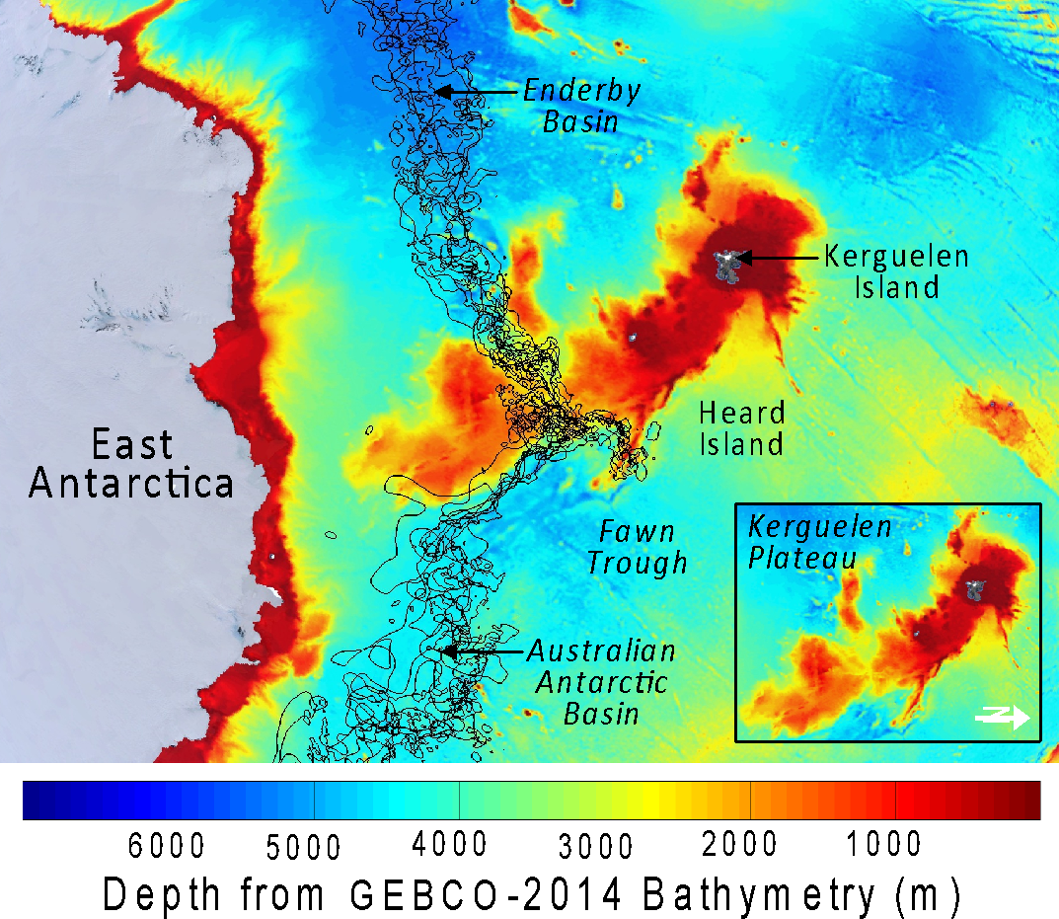
SST over Kerguelen Plateau
Notes:
Isobath conformation: depths at 1400 m along the Greenland sector and at 2300 m along the Nansen Basin south side.

Slide 12
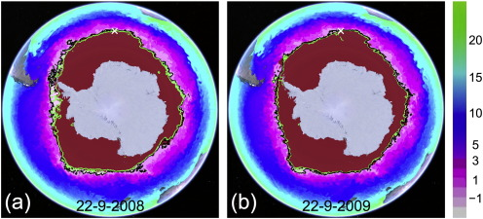
Satellite Sea Surface Temperature
Maps of Multi-sensor Ultra-high Resolution (MUR) Sea Surface Temperature (SST) represented by the color bar in degrees Celsius on the right with isotherms at − 1.0 °C (black contour) and − 1.4 °C (green contour) on National Ice Center (NIC) Sea Ice Extent.
Notes:
Fig. 7. Maps of Multi-sensor Ultra-high Resolution (MUR) Sea Surface Temperature (SST) represented by the color bar in degrees Celsius on the right with isotherms at − 1.0 °C (black contour) and − 1.4 °C (green contour) on National Ice Center (NIC) Sea Ice Ext...

Slide 13
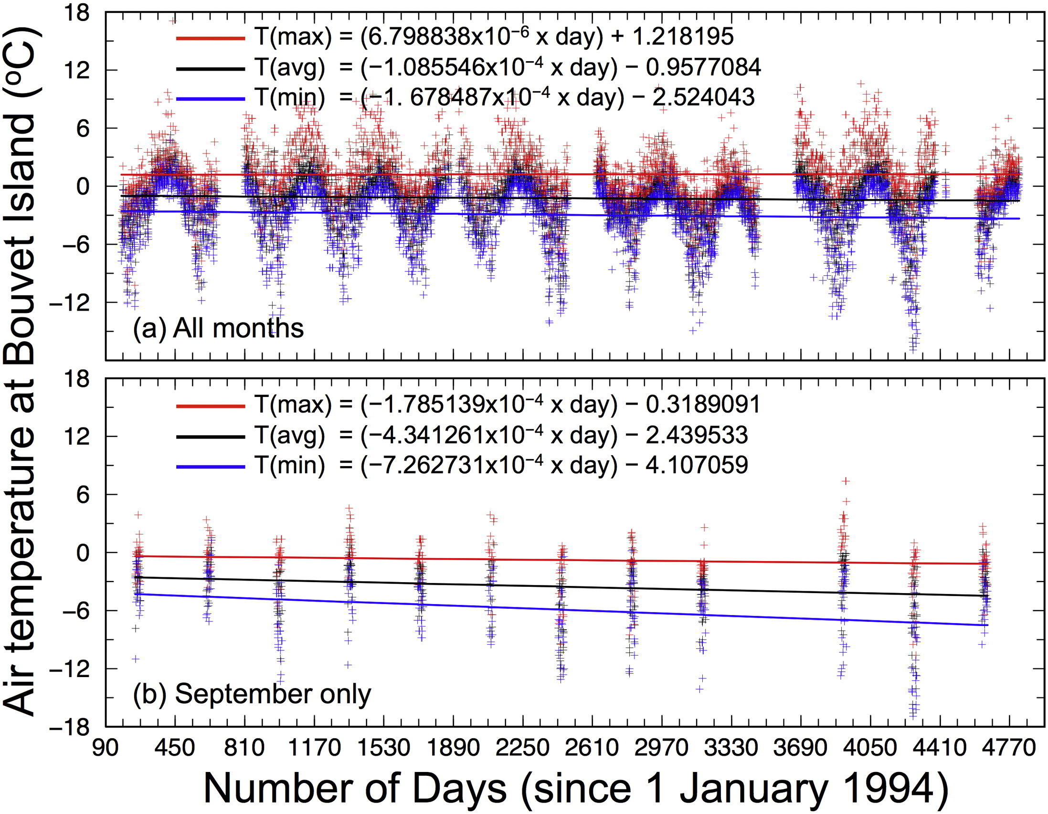
Stability of Air Temperature at Bouvet Is.
Notes:
Fig. 6. Air temperature measured at Bouvet Island, obtained from the National Oceanic and Atmospheric Administration (NOAA) Global Surface Summary of the Day (GSOD) dataset (https://data.noaa.gov/dataset/global-surface-summary-of-the-day-gsod). The horizontal ...

Slide 14
Backscatter Synoptic Sea Ice Classes
Statistical analysis of QuikSCAT scatterometer backscatter data shows a Gaussian-like distribution of Antarctic sea ice signature in contrast to the bimodal distribution found for Arctic sea ice.
Using the Gaussian mean and STD, we define ‘YI Class’ for younger ice, ‘OI Class’ for older ice, and ‘RI Class’ for rough older ice with highest backscatter.
We then use 10 years of backscatter data (1999- 2009) to map synoptic sea ice classes over the Antarctic sea ice cover.

Slide 15
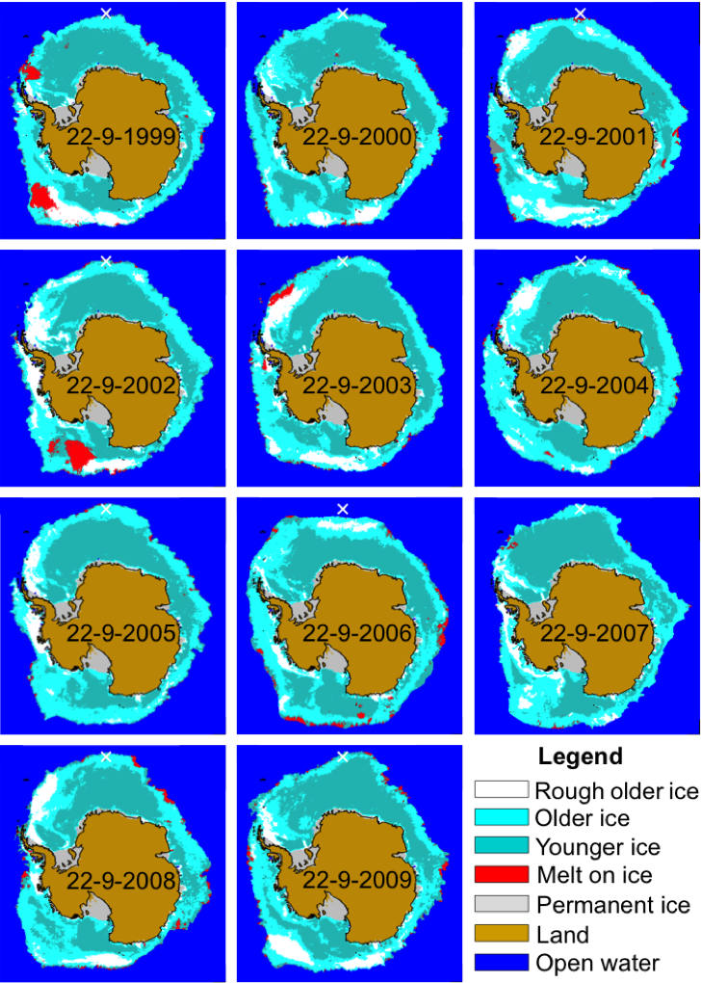
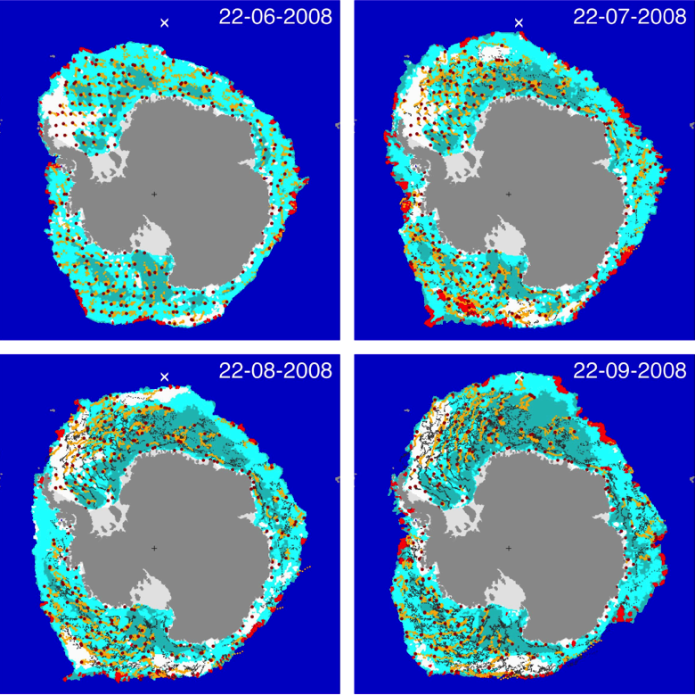
QuikSCAT Ku Backscatter Classification
and Tracking of Antarctic Sea Ice
PSC backscatter tracks validated against buoy drifts
Nghiem et al. Rem. Sens. Env., 2016
Notes:
Since the Antarctic sea ice backscatter (σ0) statistics are similar to the Gaussian distribution, the probability density function of σ0 is determined by two independent parameters: The mean value (σM) and the standard deviation (STD), which are used here as the basis to define synoptic sea ice classes. First, we identify the high backscatter range with values larger than σM as corresponding to older, rougher, and thicker sea ice with more snow in the FIZ, and the low backscatter range with values smaller than σM as pertaining to younger and thus thinner sea ice with less snow. Then, an additional synoptic sea ice class with backscatter larger than one STD above σM is identified as corresponding to the most-deformed older ice and thus likely the thickest sea ice. Based on these backscatter ranges, the following synoptic sea ice classes are defined: Rough older ice (RI) for σ0 > σM + STD, older ice (OI) for σM + STD ≥ σ0 > σM, and younger ice (YI) for σM ≥ σ0. Coincidentally, these thresholds are found to be within 0.3 dB of those used to identify different Arctic sea ice classes ( Nghiem et al., 2006 and Nghiem et al., 2007). In addition, a limited amount of ‘permanent’ ice, including ice shelves and persistent landfast ice, is routinely identified and mapped around Antarctica by the NIC (NIC, 2015).

Slide 16
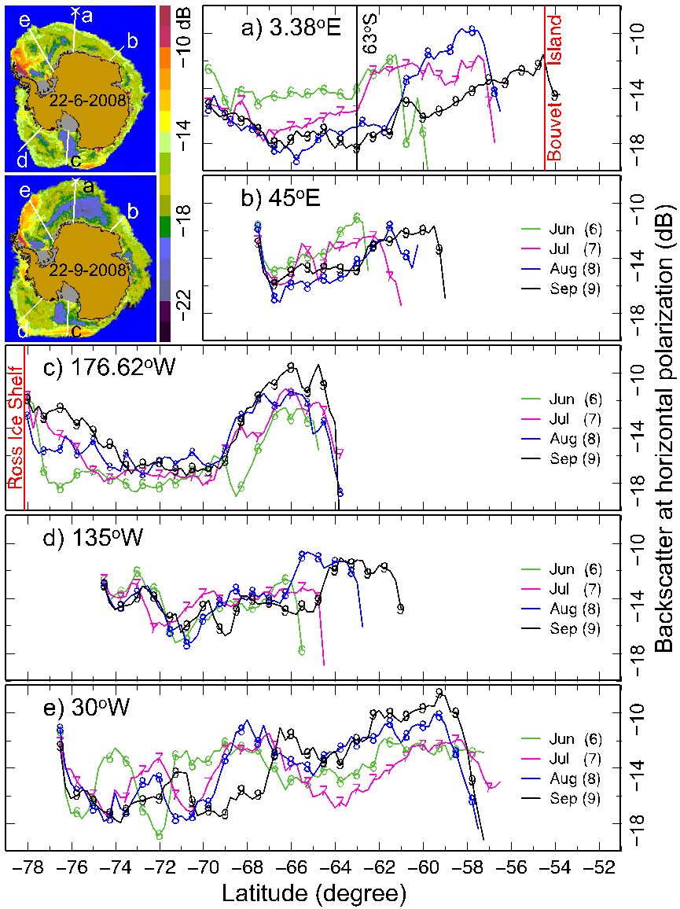
Tracks of Antarctic Sea Ice Backscatter Signatures
Indicate the Circumpolar Presence of the Frontal Ice Zone (FIZ)

Slide 17
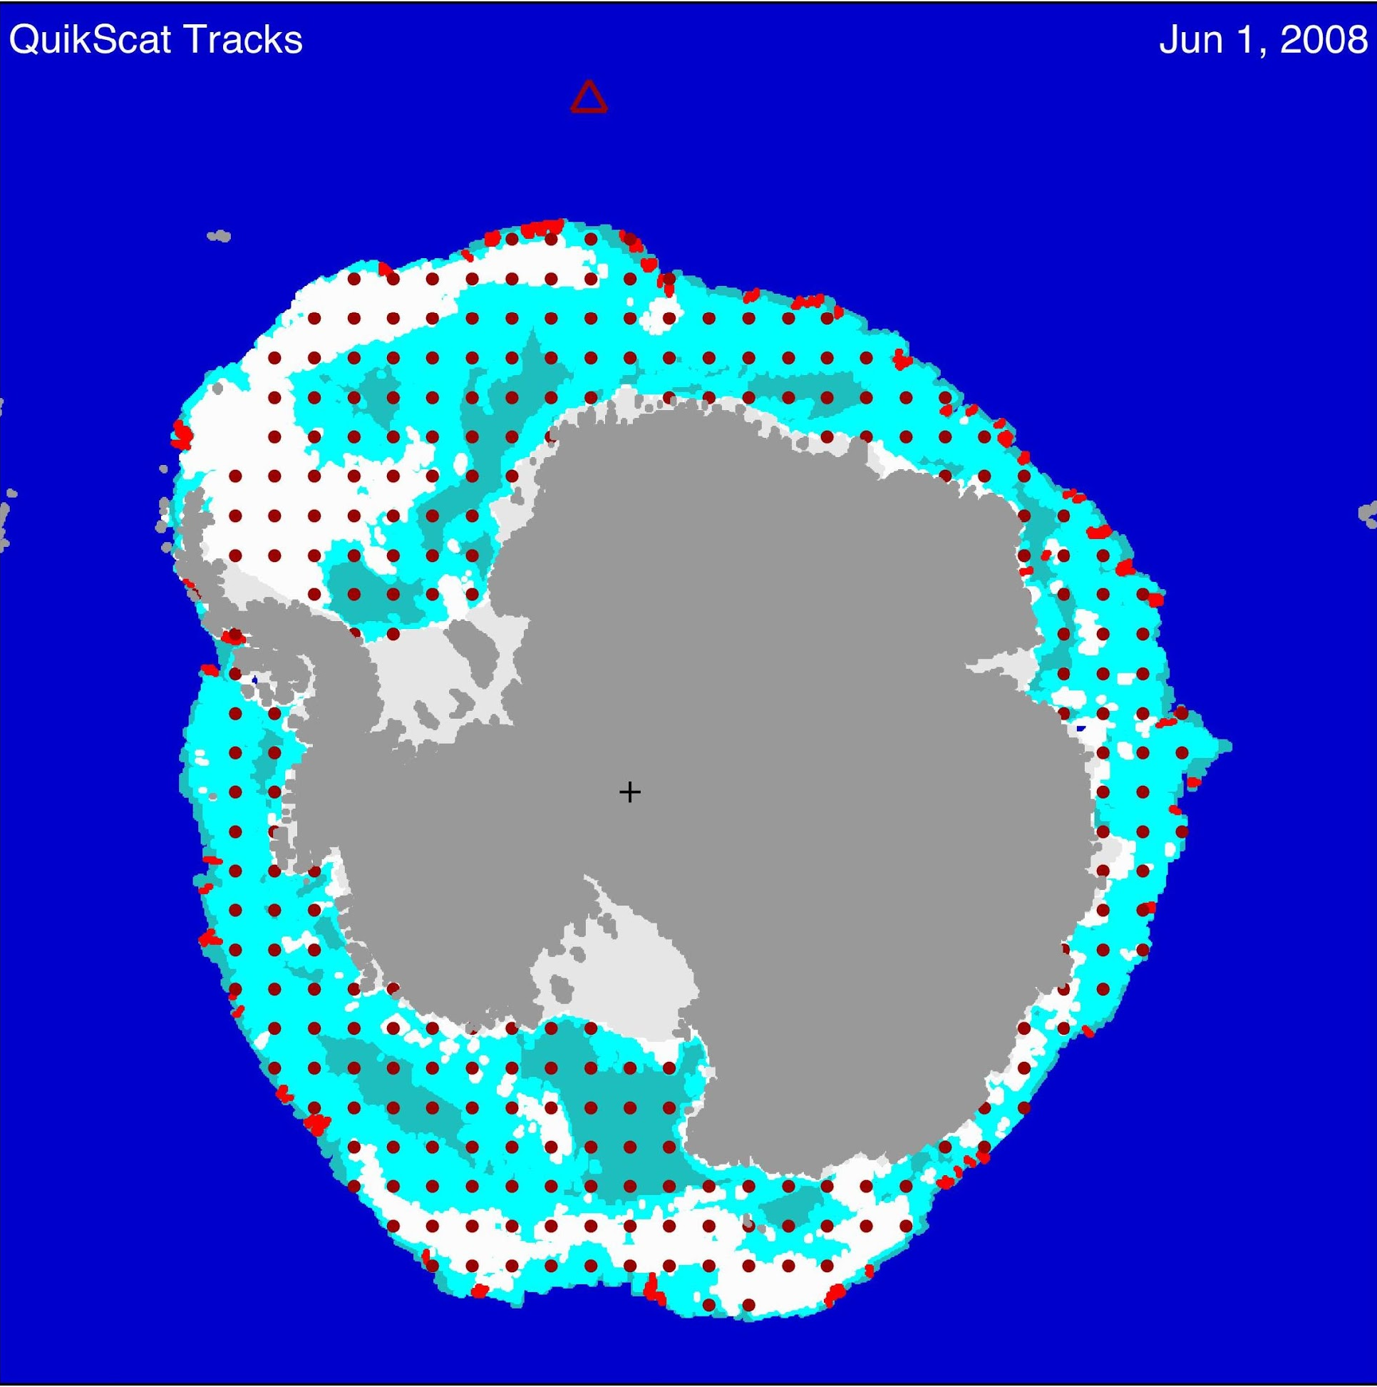
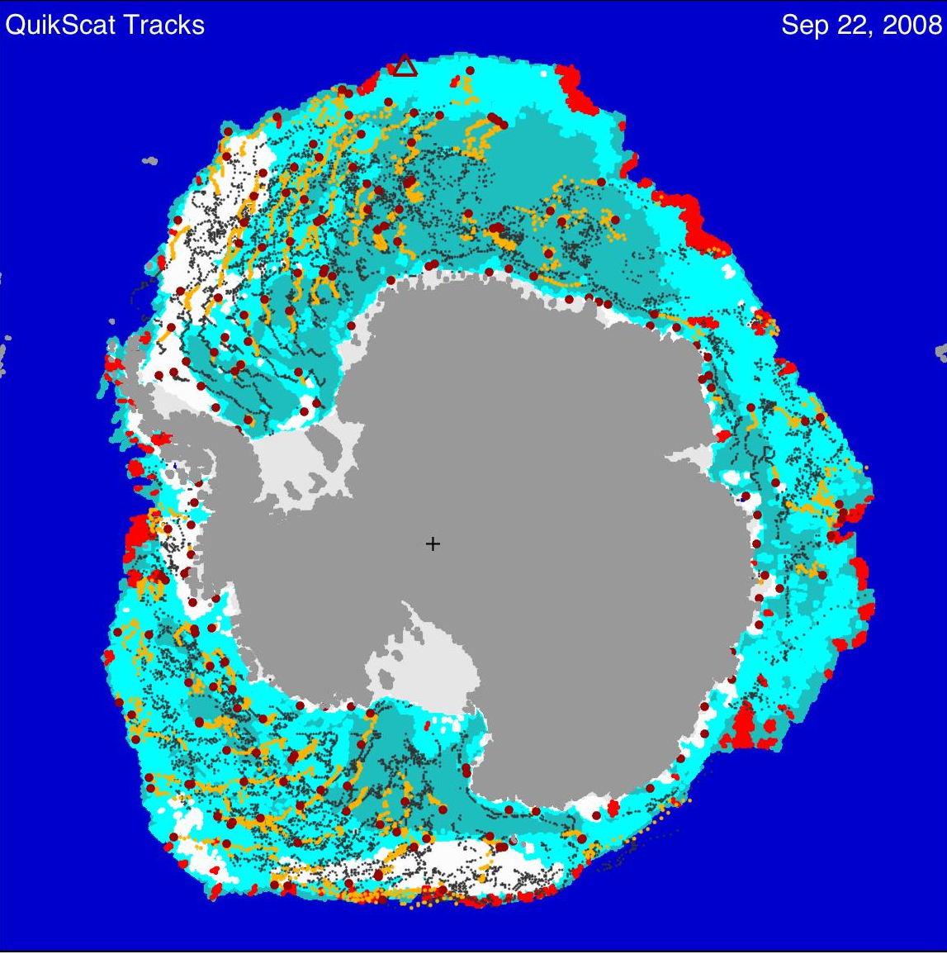
A Complementary Observation
From Sea Ice Trajectory Tracking

Slide 18
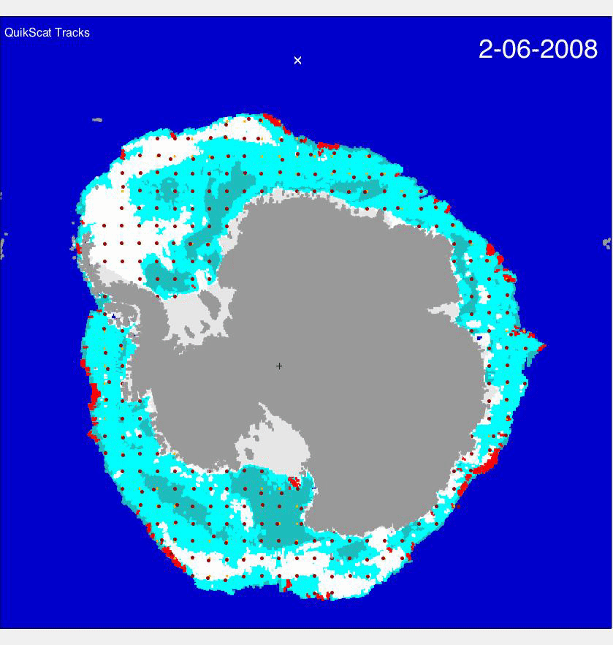
A Complementary Observation
From Sea Ice Trajectory Tracking
Notes:
Geophysical Constraints on the Antarctic Sea Ice Cover
Abstract
The contrast between the slight increase of Antarctic sea ice and the drastic reduction of Arctic sea ice since the 1970s has been a conundrum to be resolved. Sea ice trajectory tracking with satellite scatterometer data in 2008 shows that ice that forms around Antarctica is pushed offshore by katabatic winds influenced by the continental topography. The ice trajectories reveal that sea ice, formed earlier in the ice growth season, drifts northward away from the Antarctic continent forming a circumpolar frontal ice zone (FIZ) behind the ice edge. The FIZ thereby consists of sea ice that becomes rougher due to a longer exposure to wind and wave actions, and thicker over time by more ice growth and greater snow accumulation.
In the Antarctic circumpolar sea ice zone adjacent to the sea ice edge, satellite data in 1999-2009 exhibit a band of strong radar backscatter, which is consistent with the signature of older, thicker, and rougher sea ice with more snow in the FIZ. This sea ice band, as wide as 1000 km, serves as a ‘Great Shield,’ encapsulating and protecting younger and thinner ice in the internal ice pack. In the young and thin ice region behind the FIZ, ice can grow rapidly as winds continue opening interior areas thereby creating effective “ice factories.” In addition, ridging can enhance ice thickness by convergence toward the circumpolar FIZ that is recirculated by westerly winds and currents. During the growth season, the FIZ advances until reaching lower-latitude warm waters at a boundary determined by the southern Antarctic Circumpolar Current front that is constrained by seafloor features. These persistent topographical and bathymetric geological factors help sustain the Antarctic sea ice cover. As such, the behavior of Antarctic sea ice is not a paradox as some have suggested, but instead is consistent with the geophysical characteristics in the southern polar region that starkly contrast to those in the Arctic.

Slide 19
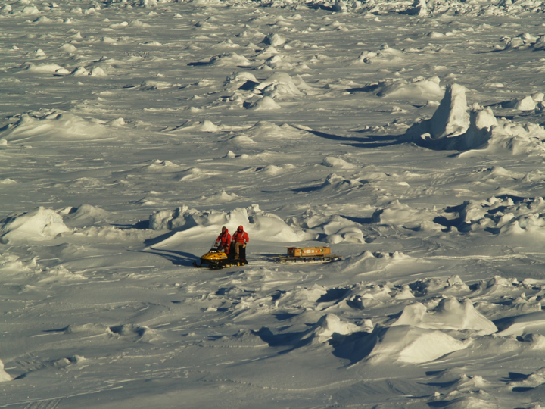
Conditions Observed Over Older Ice Class Region in the Bellingshausen Sea During SIMBA on October 2007
Photo courtesy of M. Lewis

Slide 20

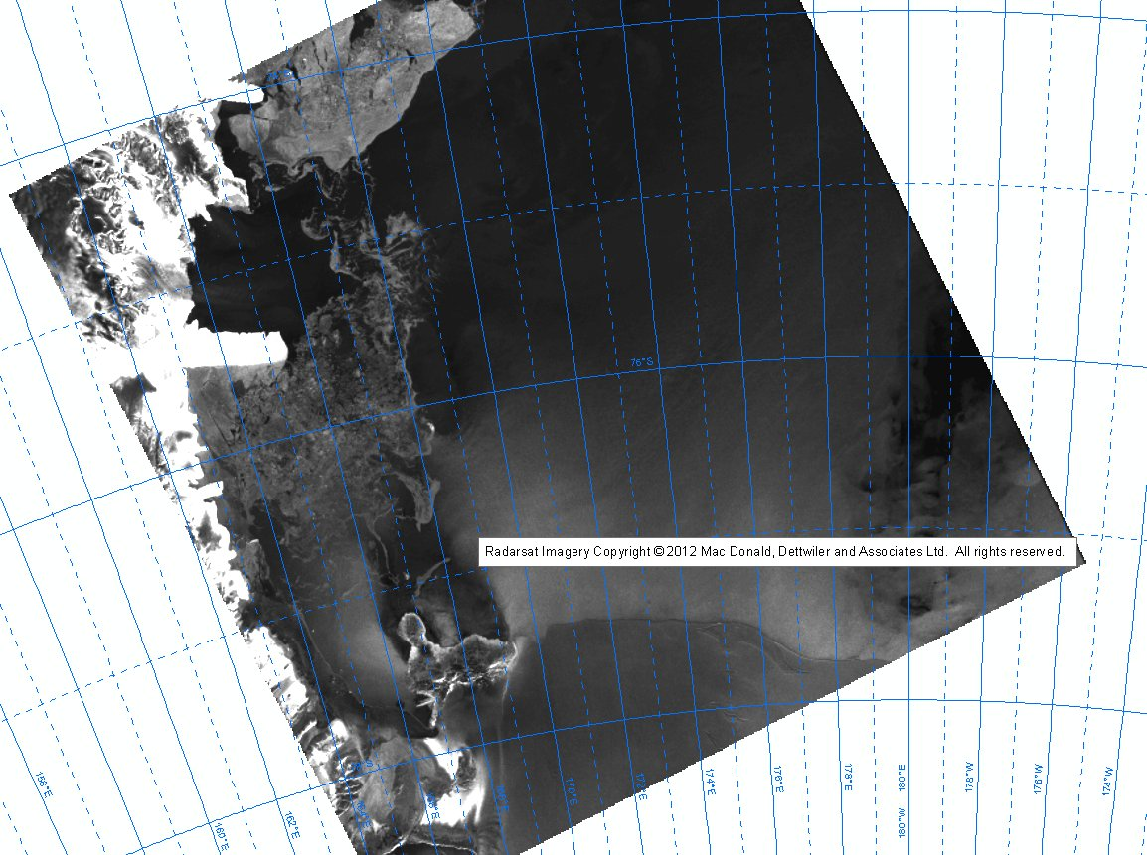
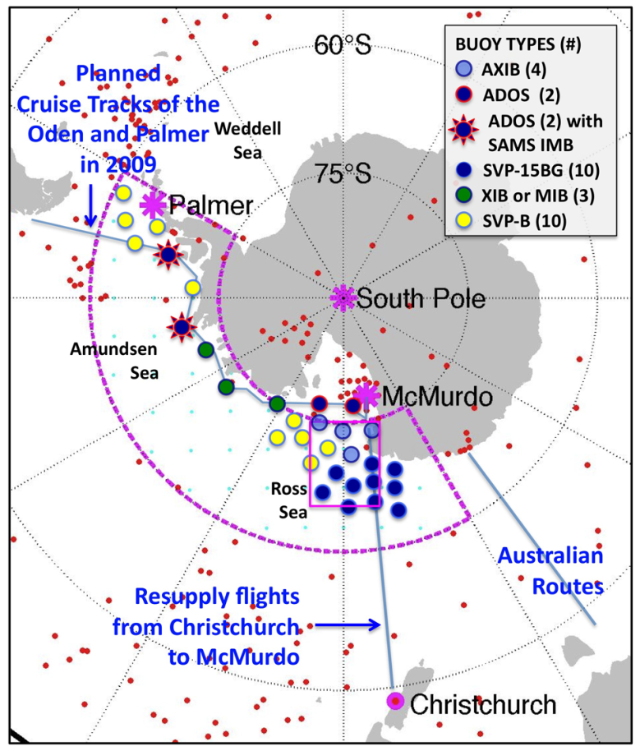
International Programme for Antarctic Buoys
UNCLASSIFIED
    Global participants working together to maintain a network
    of drifting buoys around the Antarctic continent to provide
    real-time operational requirements and research purposes.
Australia
Finland
France
Germany
Italy
Japan
New Zealand
Norway
South Africa
UK
United States
SHARED RESOURCES
Science and Research
Manpower
Platforms of Opportunity
Financial Cost Sharing
Imagery Savings
The U.S. IPAB contributions are coordinated through the U.S. Interagency Program for Antarctic Buoys (USIPAB), which is also managed by the U.S. National Ice Center and the Polar Science Center at University of Washington. To date the main effort has been funded by NSF with additional support from NOAA and limited leveraging of other USIABP resources. The goal is to establish and maintain an array of meteorological and ocean buoys on sea ice, primarily in the U.S. operational region of interest, i.e. Amundsen /Bellingshausen and Ross Seas.
UNCLASSIFIED
Proposed 2017 IABP/IPAB Meeting in Hobart
Notes:
20

Slide 21
Conclusions
Wind consistently opens internal sea ice for effective growth (ice factories in YI areas).
Formation of a FIZ with OI and RI encapsulating and thus protecting internal sea ice, bounded by the sACC front.
FIZ recirculating around by the persistent westerlies.
Geological factors, topography for winds and bathymetry for waters, persistently maintain the stability of Antarctic sea ice.
Antarctic sea ice behavior is consistent with Antarctic geophysics and thus not a paradox.

Slide 22
Geophysical Constraints on Antarctic Sea Ice Cover
http://www.sciencedirect.com/science/article/pii/S0034425716301481
S.V. Nghiem, I.G. Rigor, P. Clemente-Colón, G. Neumann, and P.P. Li. Geophysical constraints on the Antarctic sea ice cover. Remote Sensing of Environment, Volume 181, 2016, 281–292. http://dx.doi.org/10.1016/j.rse.2016.04.005

Slide 23

UNCLASSIFIED
Back-up Slides
UNCLASSIFIED
Notes:
23

Slide 24
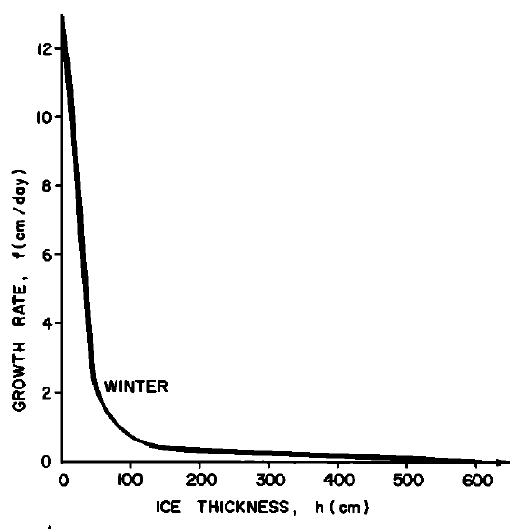
Effective Sea Ice Growth in the Regions of
YI Class behind the FIZ
Thorndike, A. S., et al. (1975), Thickness distribution of sea ice, J. Geophys. Res., 80(33), 4501-4513, doi:10.1029/JC080i033p04501

